Slide 1
EU forest area protection and different adjustments mechanism Pekka Lauri^{1,*}, Fulvio Di Fulvio ¹, Mykola Gusti¹, Andrey Lessa Derci Augustynczik¹ ¹⁾ International Institute for Applied Systems Analysis (IIASA), Schlossplatz 1, A-2361 Laxenburg, Austria ^{*)} Corresponding author, pekka.lauri@iiasa.ac.at
-The goal of EU biodiversity strategy is to protect 30% of EU’s land and sea area by 2030
=>without adjustments 30% protection target can reduce EU harvests up to 250 Mm3/yr
(=50% of EU current harvest level)
-EU bioeconomy sector can decrease up to 50% (=60 billion euro/yr loss in GDP)
-production displacement to other regions (=leakages to other regions)
-contradicts to other EU climate and environment targets
=>with adjustments (protected area management, unprotected area management, feedstock substitution)
negative impacts on EU bioeconomy can be partly avoided, but lower protection impact and/or
additional leakages to unprotected areas and other sectors
-In this study, we considers different adjustment mechanism to EU forest area protection by using global spatial explicit forest sector model (GLOBIOM-forest), which includes
1) Forestry, forest industry and bioenergy sectors
2) 58 economic regions + supply side modelled in 0.5-degree resolution
3) Different forest management and protection practices
4) Forest age-class dynamics
[5) For simplicity HWP carbon pool and carbon substitution effects not considered in this study]

Slide 2
1. EU roundwood harvests and forest carbon sink under different implementations of 30% protection target

Slide 3
2. EU netexports and harvest/carbon leakages to outside EU

Slide 4
3. EU forest management areas (leakage to unprotected area)

Slide 5
4. EU feedstock substitution (leakage to agriculture sector)

Slide 6
5. Comparison of different leakage effect

Slide 7
6. Conclusions
Protecting 30% of EU forest area can decrease EU harvests and bioeconomy considerably, which contradicts to other EU sustainability targets
This can be avoided by different adjustment mechanism but leads to lower protection impact and additional leakages to unprotected areas and other sectors
EU should consider carefully its priorities in nature conservation, climate mitigation, and bioeconomy
-option 1: protection without adjustments (bioeconomy↓,
leakages to other regions↑)
-option 2: protection with adjustments (bioeconomy↑,
leakages to other regions↓, leakages to unprotected areas ↑,leakages
to other sectors↑, protection impact↓)
Thank you !

Slide 8
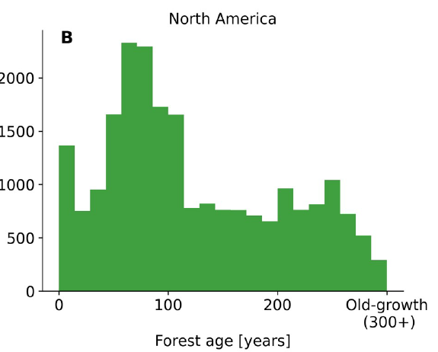
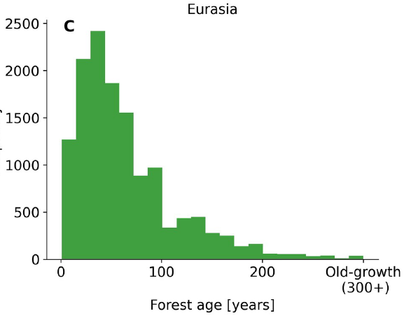
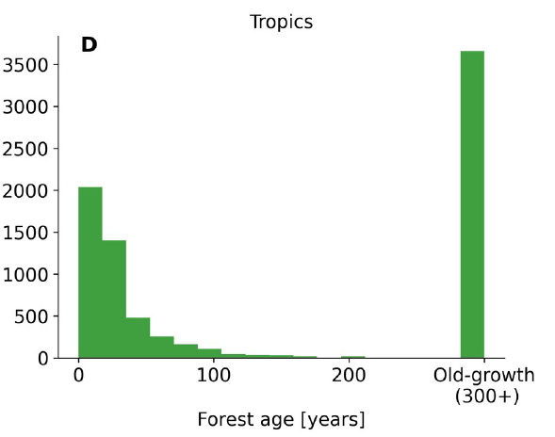
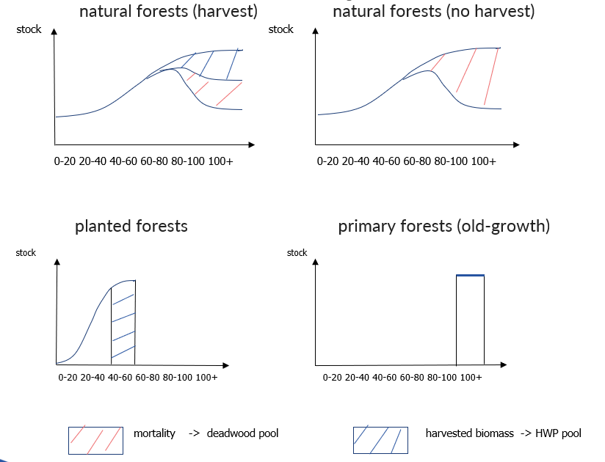
Age-class dynamics in GLOBIOM-forest
-biophysical data (biomass stocks, rotation times and growth functions) from the G4M (Kinderman et al. 2006)
-initial age-class areas on Besnard et al. (2021)
-initial age-classes calibrated to match FRA (2020) country level data on forest areas and biomass stocks
-different managements have different dynamics
-recursive dynamics:
harvest ≤ increment
harvested age-classes ≤ rotation time

Slide 9
EU age-class dynamics in baseline (harvests: 502 Mm3 in 2020 -> 670 Mm3 in 2100)

Slide 10
Different forest managements and protection practices
1) Initial management and protection areas:
EU: i) set-aside (=WDPA protected area I-III) -> natural forest
ii) close-to-nature (=WDPA protected area IV-VI) -> natural forest
iii) high intensity (=Nature Map planted forests) -> planted forest
iv) multifunctional (=residual forest area) -> seminatural forest
v) primary forests (=Sabatini map) -> natural forest
ROW: i) set-aside (=WDPA protected area I-III) -> natural forest
ii) close-to-nature (=WDPA protected area IV-VI) -> natural forest
iii) high intensity (=Nature Map planted forests) -> planted forest
iv) multifunctional (=FRA production forests-high intensity) -> seminatural forest
v) primary forests (=FRA primary forests) -> natural forest
vi) secondary forests (=residual forest area) -> natural forest
2) Management intensities (relative to maximum sustainable harvests under intensive management):
EU: close-to-nature 0-50%, multifunctional 50-75%, high intensity 75-100%
ROW: close-to-nature 0-25%, multifunctional 25-50%, high intensity 50-100%
3) Logging residues: high-intensity 50% of residues allowed to be harvested, multifunctional 25%, close-to-nature 0%

Slide 11
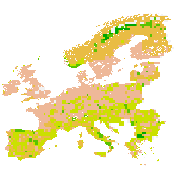
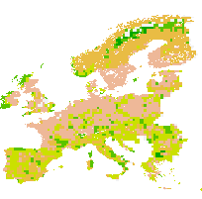
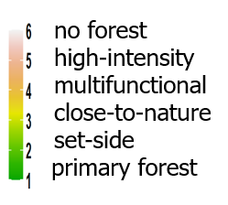
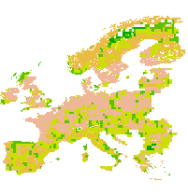
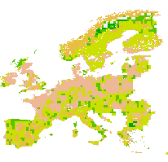
Spatial allocation of protected areas
-30% forest area protection target can be applied in EU, country or grid level
-country/grid level target: more protection in Scandinavia (otherwise protection located South/East Europe where forest land opportunity costs are lower)
No target EU level target
Country level target Grid level target

Slide 12
EU FOREST AREA PROTECTION SCENARIOS
Baseline: EU forest area protection stays in 2020 level (5% set-aside +19% close-to-nature)
Protect10/20_EU: EU level target 10% set-aside 10%+ 20% close-to-nature
Protect10/20 country: for each country 10% set-aside 10%+ 20% close-to-nature
Protect10/20 grid: for each grid 10% set-aside + 20% close-to-nature
Protect30_EU: EU level target 30% set-aside
Protect30_country: for each country 30% set-aside
Protect30_grid: for each grid level 30% set-aside
set-aside management= strict protection, no harvest or removal of trees allowed
close-to-nature management=Retention forestry which decrease availability of merchantable roundwood (=growing stock) 50% relative to intensive management.

Slide 13
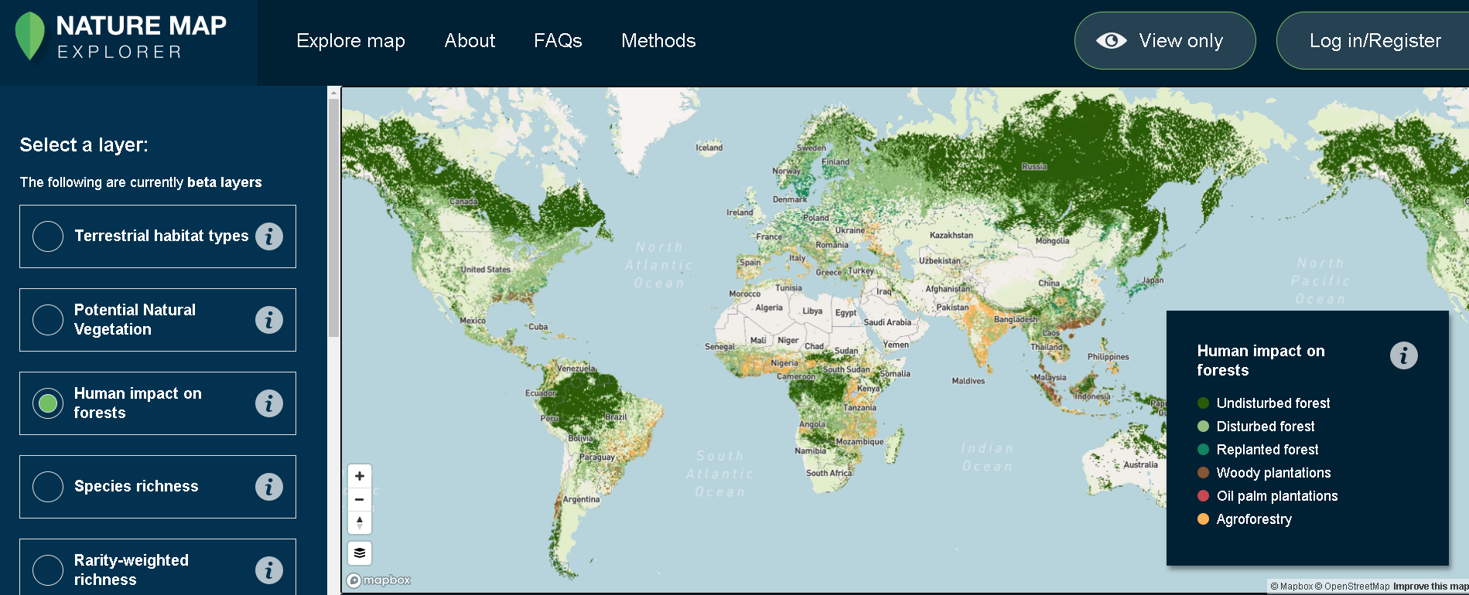
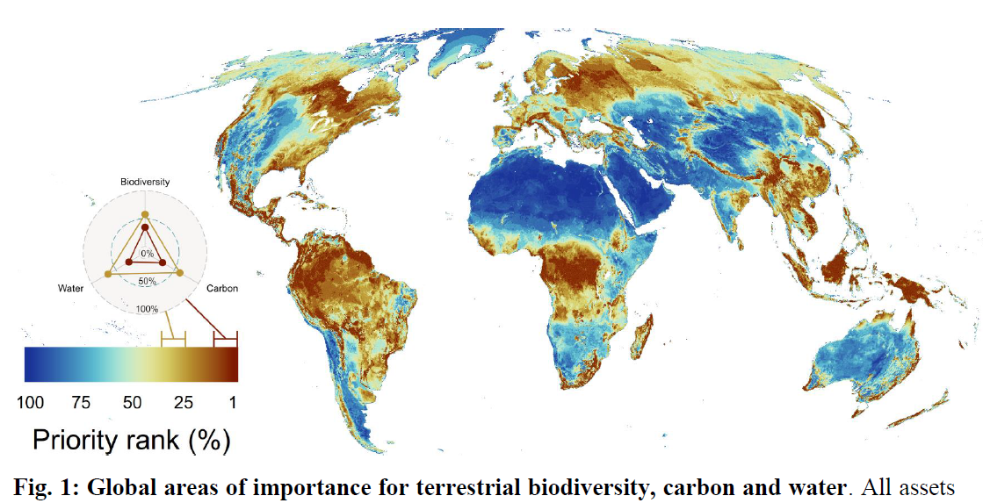
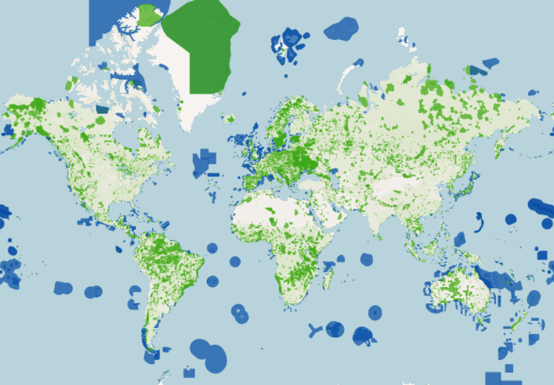
Forest management and biodiversity maps used in the model
1) Global forest management map 100x100 m resolution based on remote sensing data (Lesiv et al. 2021) (https://zenodo.org/record/4541513#.YRKilIgzaUl)
2) Global map of important biodiversity, carbon and water areas in 10x10 km resolution based on different remote sensing/ground observation data (Jung et. al 2021) (https://www.biorxiv.org/content/10.1101/2020.04.16.021444v1.full )
3) World Database of Protected Area (WDPA): global protected area map up to 100x100m resolution
(https://www.protectedplanet.net/en)

Slide 14
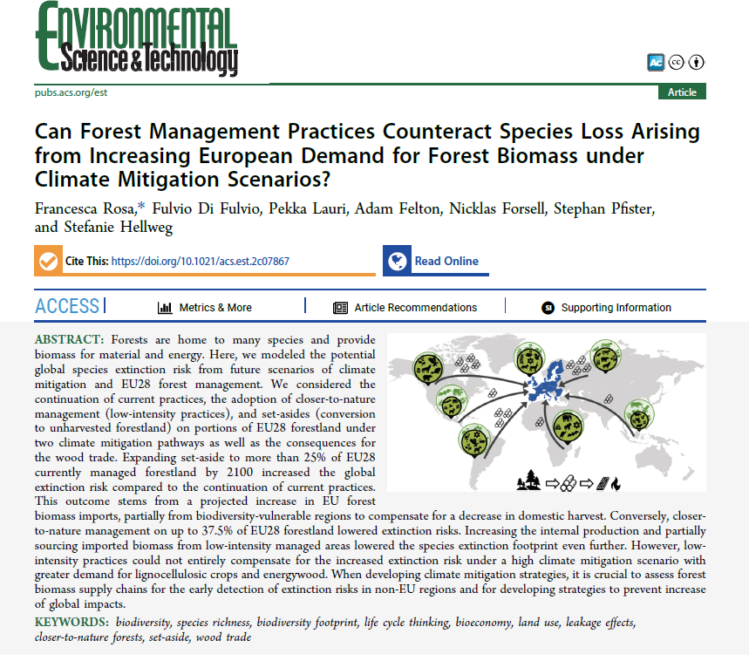
Biodiversity leakages outside EU

Slide 15
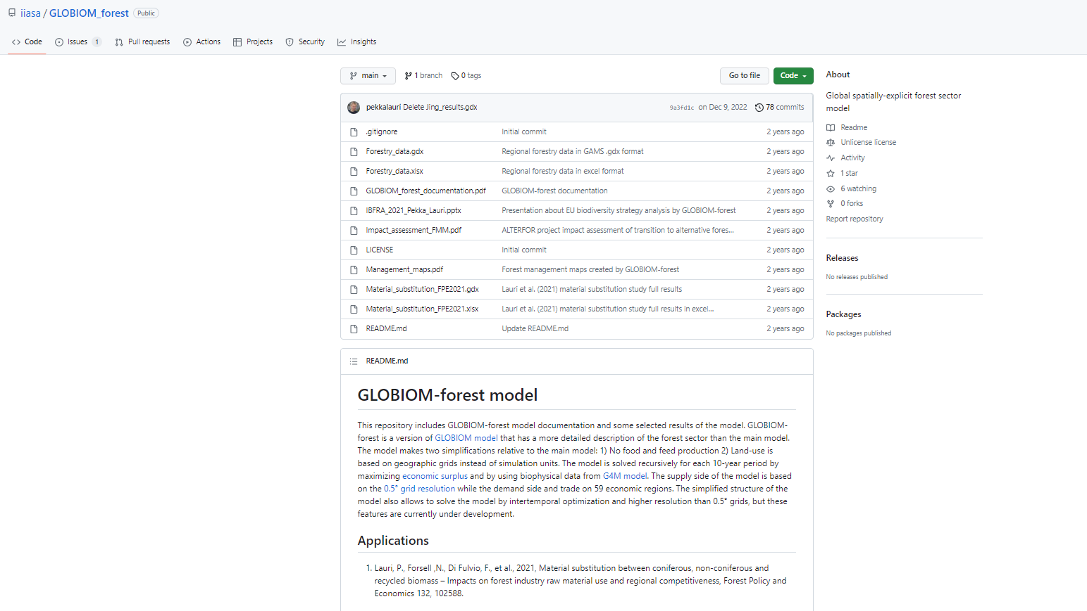
Documentation of GLOBIOM-forest
-https://github.com/iiasa/GLOBIOM_forest

