Slide 1
27/05 action items
 | Action item | Assigned to | Status:
1 | Update res SFH/MFH share for EU countries | MK | In progress
2 | Update commercial data for EU countries | SN | On hold
3 | Update res floorspace reduction for EU countries based on Mira’s survey | SN
4 | Literature search for Slow_r assumption https://www.sciencedirect.com/science/article/pii/S037877882600280X | SN & AM | In progress
5 | Update building lifetime values by EU country | AM to share data (DONE) SN to update
6 | Vacant buildings part | SN to deep dive and fix | Done (resid) IP (comm)

Slide 2
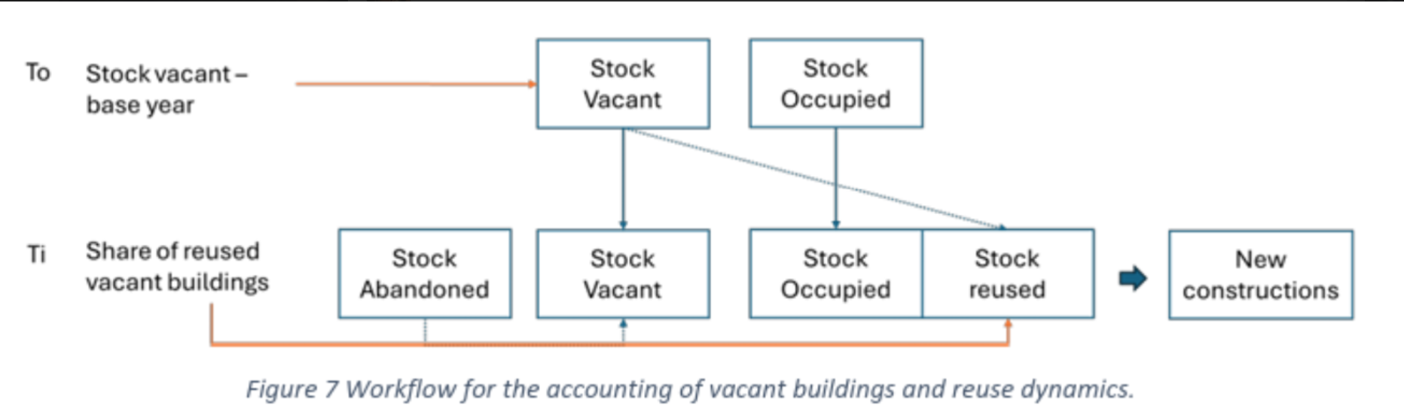
Checked whether vacancy reuse causes negative new construction. No negative floor_new_Mm2 values were found in the 2020–2030 SSP2_vacant test run.

Slide 3
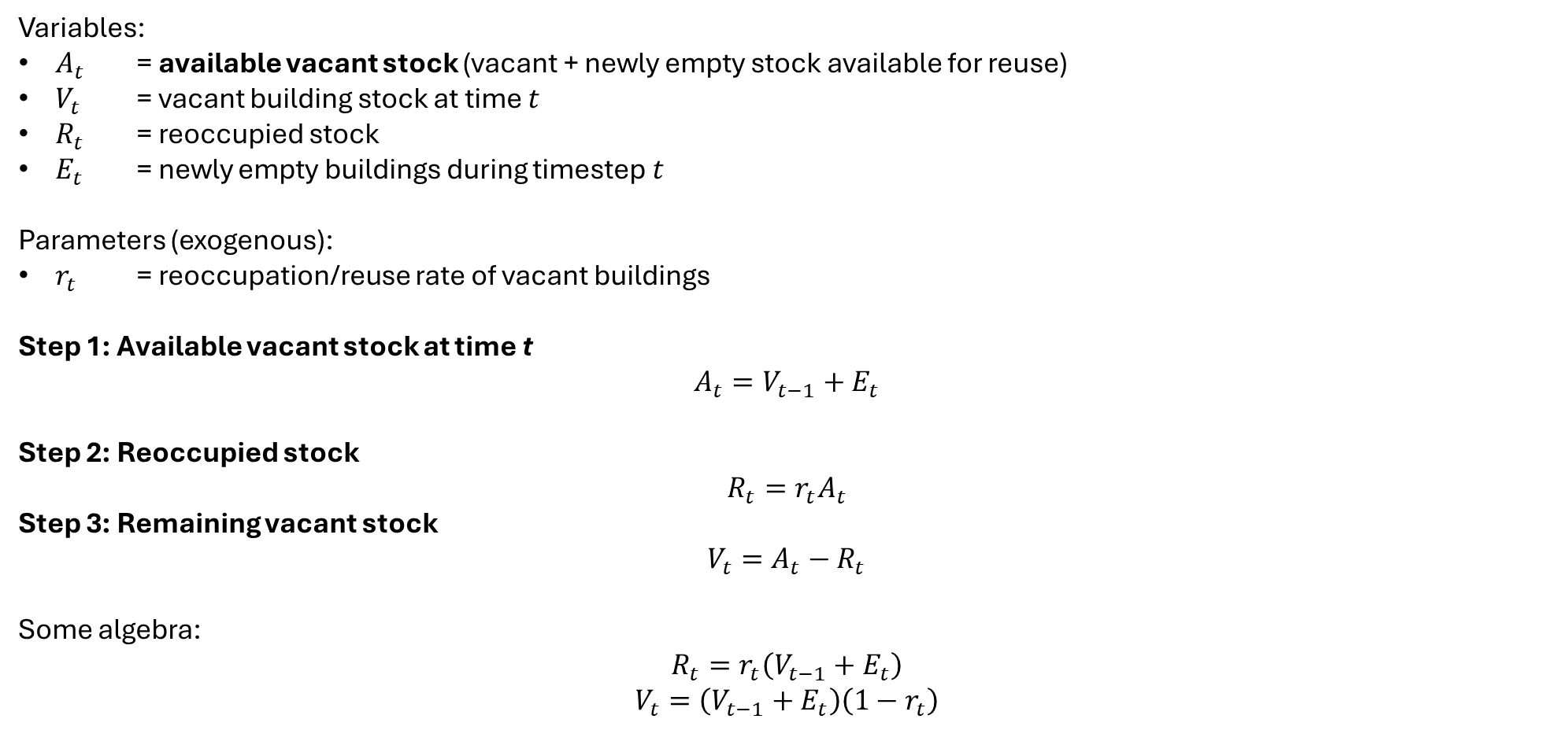
Variables:
$A_{t}$ = available vacant stock (vacant + newly empty stock available for reuse)
$V_{t}$ = vacant building stock at time $t$
$R_{t}$ = reoccupied stock
$E_{t}$ = newly empty buildings during timestep $t$
Parameters (exogenous):
$r_{t}$ = reoccupation/reuse rate of vacant buildings
Step 1: Available vacant stock at time t
$$A_{t}=V_{t−1}+E_{t}$$
Step 2: Reoccupied stock
$$R_{t}=r_{t}A_{t}$$
Step 3: Remaining vacant stock
$$V_{t}=A_{t}−R_{t}$$
Some algebra:
$$R_{t}=r_{t}\left(V_{t−1}+E_{t}\right)$$
$$V_{t}=\left(V_{t−1}+E_{t}\right)\left(1−r_{t}\right)$$
V₀ : initialized from the vacant base-stock input data
E_{t} : newly empty stock from STURM stock-balance dynamics (e.g., due to population decline, household-size change, slower demolition)
In F06: Reuse of vacant buildings cannot exceed new construction demand
n_reocc_upd = pmin(n_reocc, n_new)
So can never have –ve new construction

Slide 4
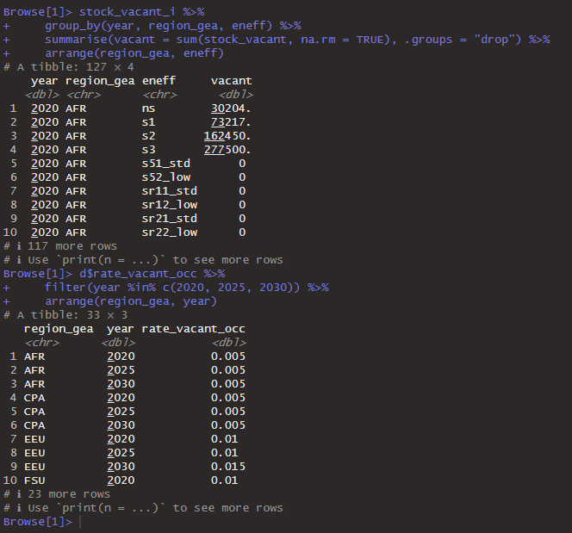
F10 debug

Slide 5
Stock abandoned -> original STURM
Sum of the occupied buildings (don’t want negative new consturciton)
F02 (initialization):
Mode vacant (yes/no)
Stock of vacant in base year (total vacant in base year)
sfh/mfh, period of construction
F06 (): the year in not include in gin building lifetime
Rate of reuse of vacant
To add check that the new construction be negative
Check if new – occupied building is positive or negative
Inputs (_vacant_):
Base_stock (units or floorspace)
Sahre_vacant_occ_eneff
Eneff
Bagging mode
F10
Letter d: List to dataframe
List2(env)

Slide 6
Key literatures on building lifetime
 | Country
Kayo, C., Sanjo, K., Tanikawa, H., Komata, H., Maekawa, Y., & Tonosaki, M. (2026). Long-term changes in the lifespan of buildings at the national level: A case study in Japan. Energy and Buildings, 117220. | Japan
Andersen, R., & Negendahl, K. (2023). Lifespan prediction of existing building typologies. Journal of Building Engineering, 65, 105696. | Denmark
Aktas, C. B., & Bilec, M. M. (2012). Impact of lifetime on US residential building LCA results. The International Journal of Life Cycle Assessment, 17(3), 337-349. | U.S.

Slide 7
Half-life: defined as the number of elapsed years at which the survival rate reaches 50%
Wooden: half-life went from 35 years (1991) → 50 years (2021) = +15 years = +43%
Non-wooden: half-life went from 36 years (1991) → 52 years (2021) = +16 years = +44%

Slide 8
Slow scenarios assumptions
Reference: All future buildings have the same lifetime as the 2020 stock (i.e, a "frozen lifetime“)
Slow_r: Future buildings progressively extend their lifetime at the historically observed rate. From literature.
Slow_tp: A much more ambitious acceleration beyond historical trends, matching Japan's unconstrained extrapolation to 2050 (~+90%).

Slide 9
Global Circular Results
26 May 2026

Slide 10
Residential

Slide 11
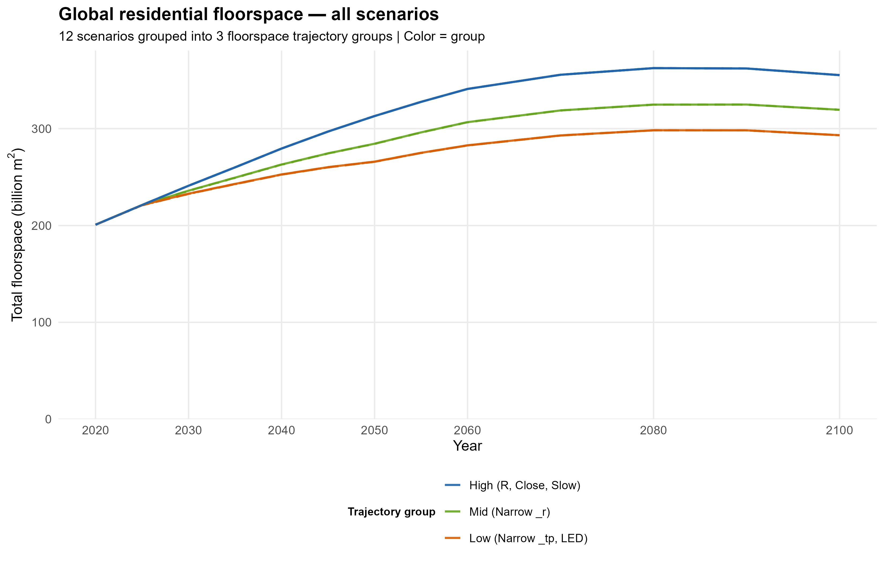
355
320
293
Floorspace trajectories are exclusively driven by demand-side strategies (Narrow), specifically lower per-capita floorspace and higher MFH share
Close and Slow strategies are decoupled from floorspace
Close strategies have no effect on floorspace stock, as they only modify end-of-life material treatment,
Slow strategies, while designed to reduce building turnover through extended lifetimes, show negligible impact on global floorspace trajectories by 2100.

Slide 12
# A tibble: 12 × 5
scenario strategy_family floor_billion_m2 diff_vs_R pct_vs_R
<fct> <chr> <dbl> <dbl> <dbl>
1 R Reference 355. 0 0
2 N_r Narrow (_r) 319. -35.8 -10.1
3 N_tp Narrow (_tp) 293. -62.1 -17.5
4 S_r Slow 355. 0.00105 0.000297
5 S_tp Slow 355. 0.00171 0.000481
6 C_r Close 355. 0 0
7 C_tp Close 355. 0 0
8 A_r Narrow (_r) 319. -35.8 -10.1
9 A_tp Narrow (_tp) 293. -62.1 -17.5
10 E_r Narrow (_r) 319. -35.8 -10.1
11 E_tp Narrow (_tp) 293. -62.1 -17.5
12 LED LED 293. -62.1 -17.5
Close: exactly 0% impact on floorspace — fully decoupled by design
Slow: <0.001% impact on floorspace — negligible
Narrow (_r): −10% reduction in global residential floorspace by 2100
Narrow (_tp): −17.5% reduction in global residential floorspace by 2100

Slide 13
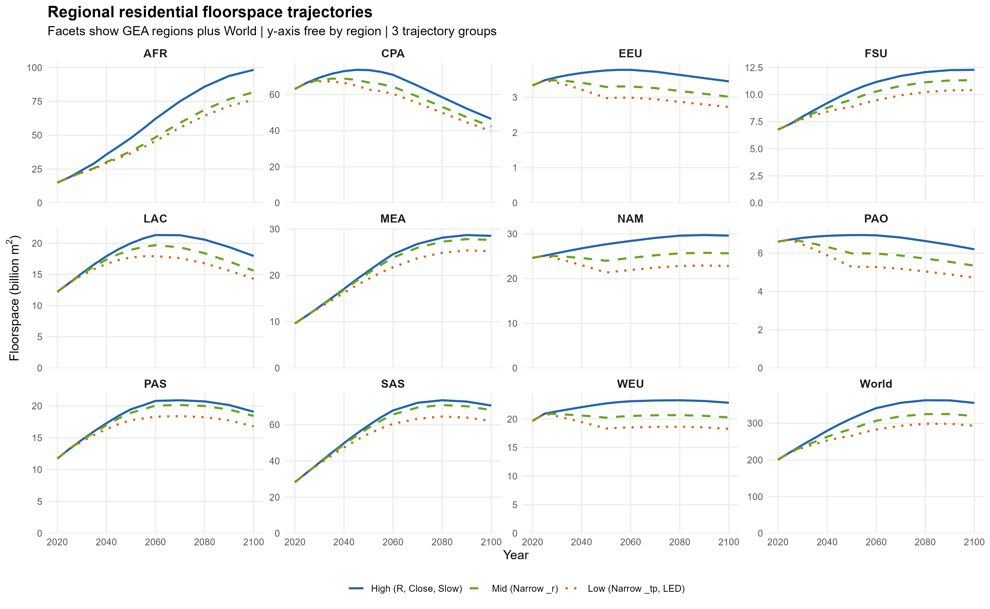

Slide 14
# A tibble: 11 × 7
# Groups: geo_group [2]
region_gea High Mid Low geo_group pct_mid_vs_high pct_low_vs_high
<chr> <dbl> <dbl> <dbl> <chr> <dbl> <dbl>
1 PAO 6.20 5.35 4.72 Global North -13.8 -24
2 NAM 29.6 25.7 22.8 Global North -13.3 -22.9
3 EEU 3.45 3.02 2.72 Global North -12.6 -21.1
4 WEU 22.8 20.3 18.3 Global North -11.2 -20
5 FSU 12.3 11.3 10.4 Global North -7.7 -15.2
6 AFR 98.3 81.8 76.2 Global South -16.8 -22.5
7 LAC 18.0 15.6 14.3 Global South -13.1 -20.3
8 CPA 46.5 42.3 39.7 Global South -9 -14.5
9 SAS 70.6 68.1 62.0 Global South -3.5 -12.1
10 PAS 19.1 18.4 16.8 Global South -3.5 -12
11 MEA 28.5 27.6 25.2 Global South -3.1 -11.6
Narrow strategies reduce floorspace by 20–24% in Global North regions and 12–23% in Global South regions by 2100.

Slide 15
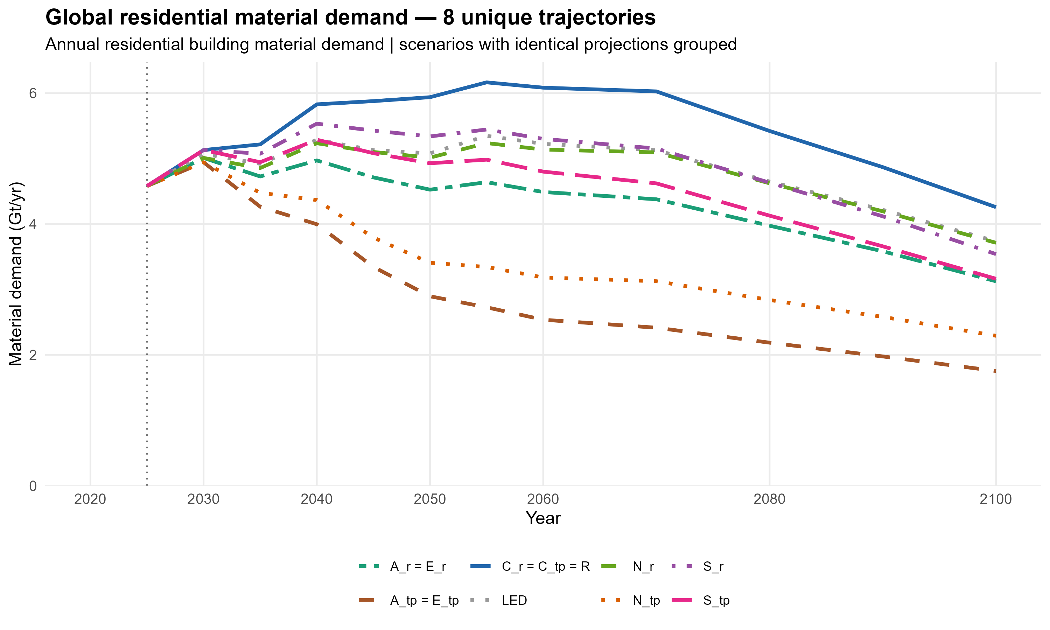
# A tibble: 3 × 6 (can see the effects of Slow scenarios here)
year scenario mat_demand_Mt mat_demand_Gt diff_vs_R pct_vs_R
<dbl> <fct> <dbl> <dbl> <dbl> <dbl>
1 2100 R 4257. 4.26 0 0
2 2100 S_r 3539. 3.54 -0.718 -16.9
3 2100 S_tp 3162. 3.16 -1.09 -25.7
Slow strategies achieve 17–26% reduction in annual material demand by 2100 relative to Reference, without reducing total floorspace stock.

Slide 16
Difference in 2100
# A tibble: 12 × 5
scenario strategy_family mat_demand_Gt diff_vs_R pct_vs_R
<chr> <chr> <dbl> <dbl> <dbl>
1 A_tp Narrow (_tp) 1.75 -2.50 -58.8
2 E_tp Narrow (_tp) 1.75 -2.50 -58.8
3 N_tp Narrow (_tp) 2.29 -1.97 -46.2
4 A_r Narrow (_r) 3.12 -1.13 -26.6
5 E_r Narrow (_r) 3.12 -1.13 -26.6
6 S_tp Slow 3.16 -1.09 -25.7
7 S_r Slow 3.54 -0.718 -16.9
8 N_r Narrow (_r) 3.71 -0.545 -12.8
9 LED LED 3.74 -0.522 -12.3
10 R Reference 4.26 0 0
11 C_r Close 4.26 0 0
12 C_tp Close 4.26 0 0
Interesting finding: Extending building lifetimes (Slow) can achieve greater reductions in annual material demand than moderate sufficiency measures (Narrow_r), despite having negligible impact on total floorspace stock.

Slide 17
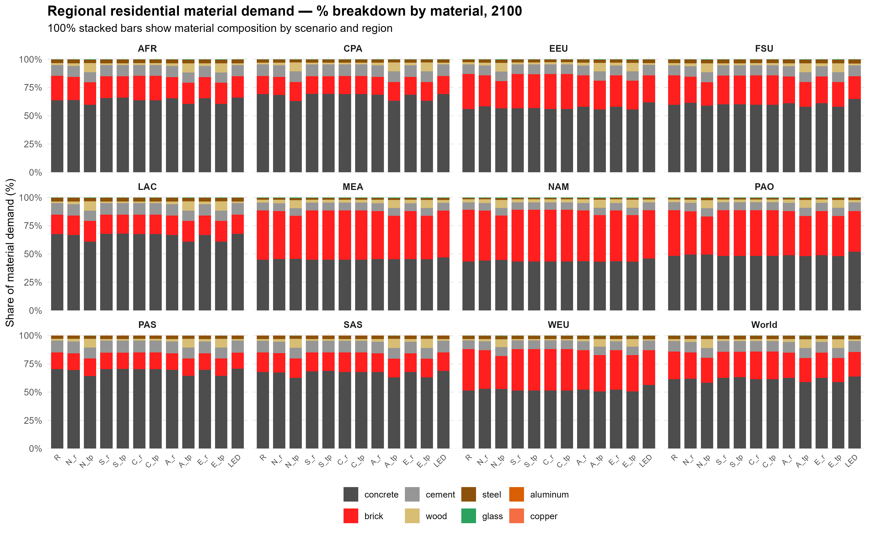

Slide 18
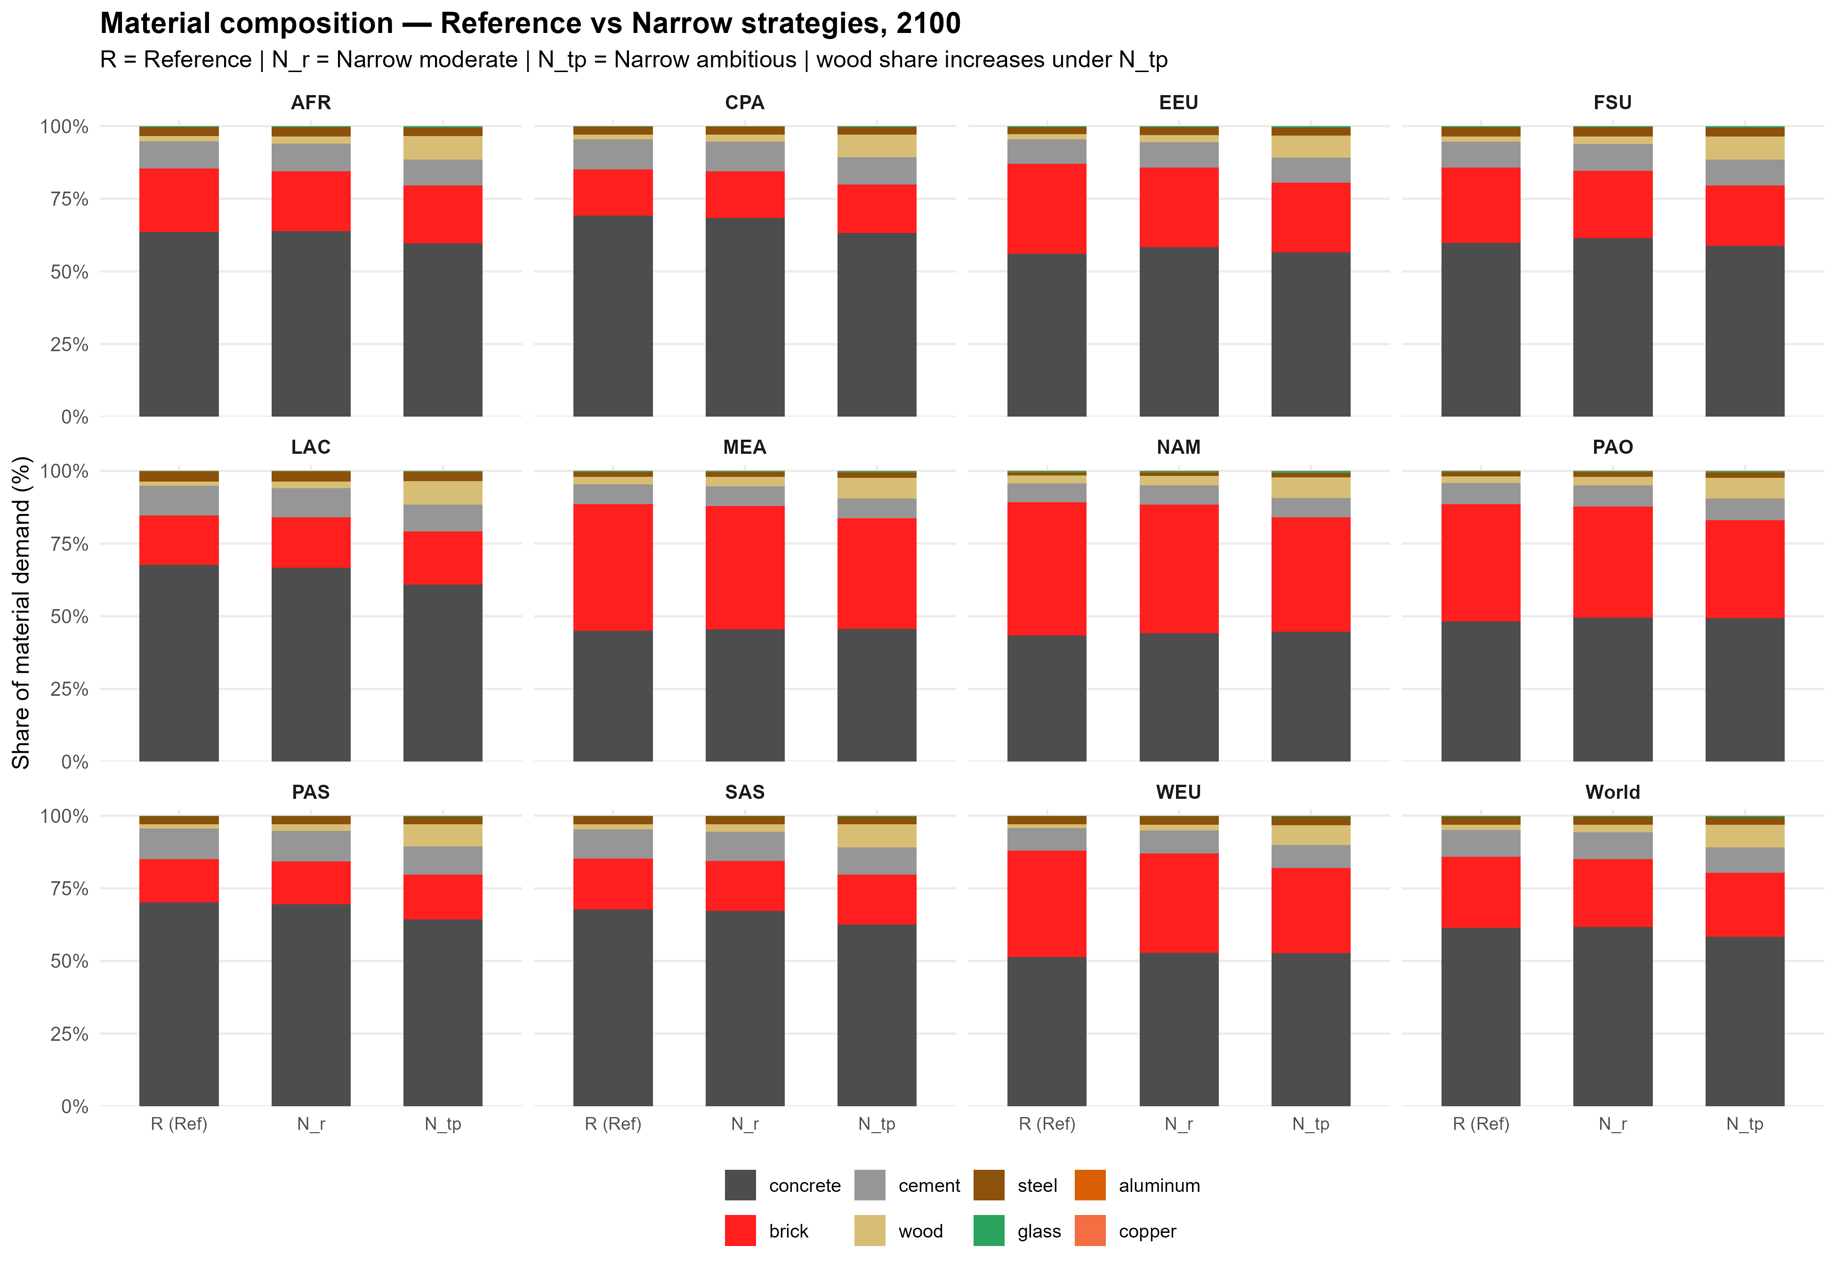

Slide 19
Commercial

Slide 20
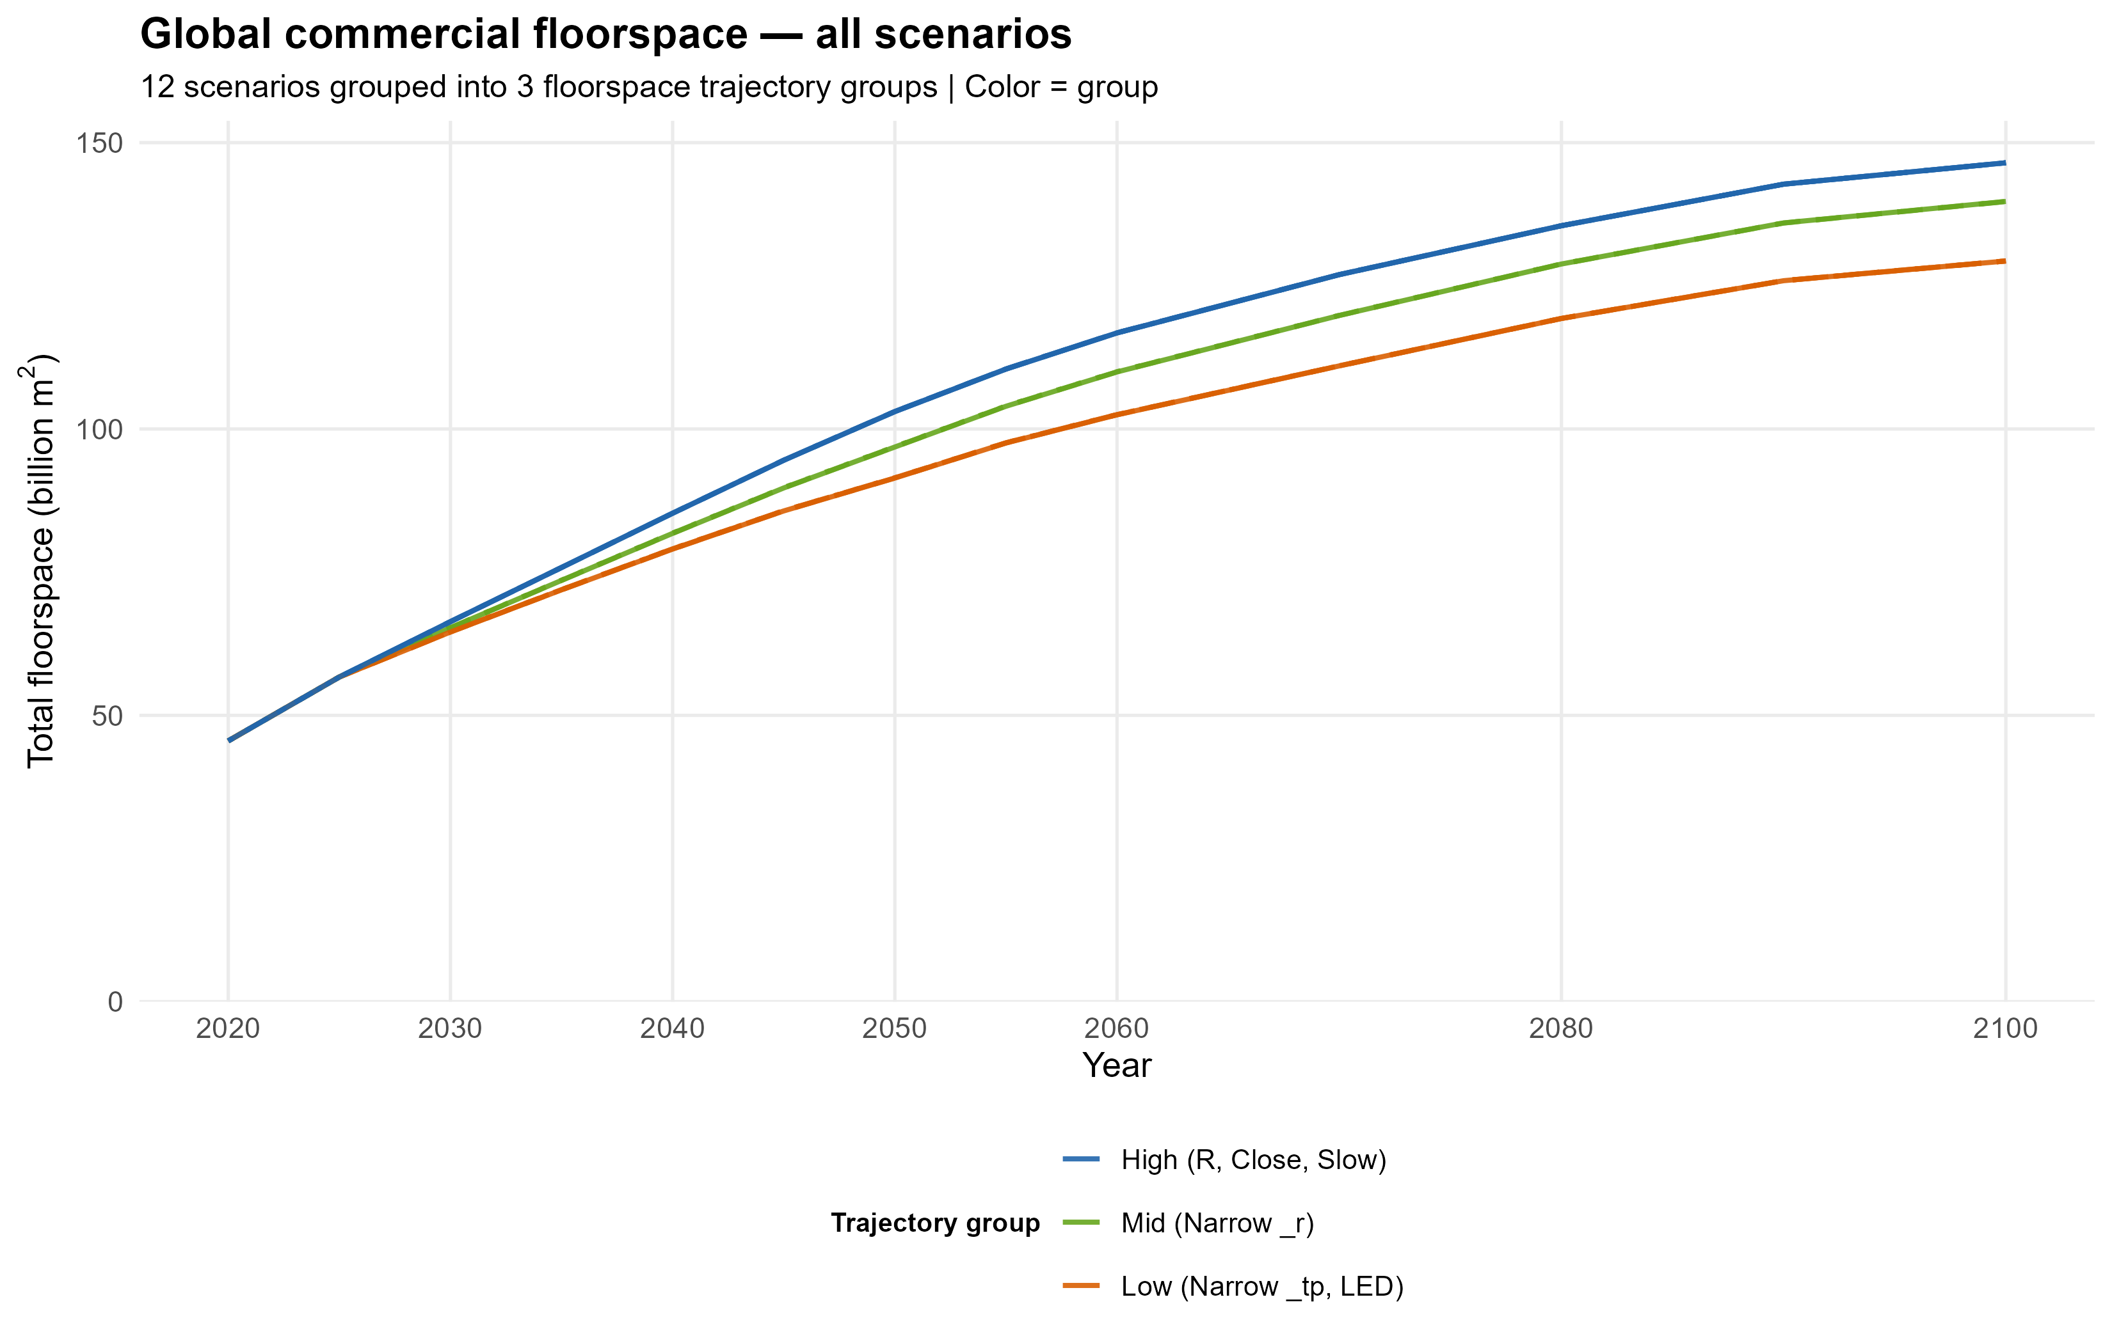

Slide 21
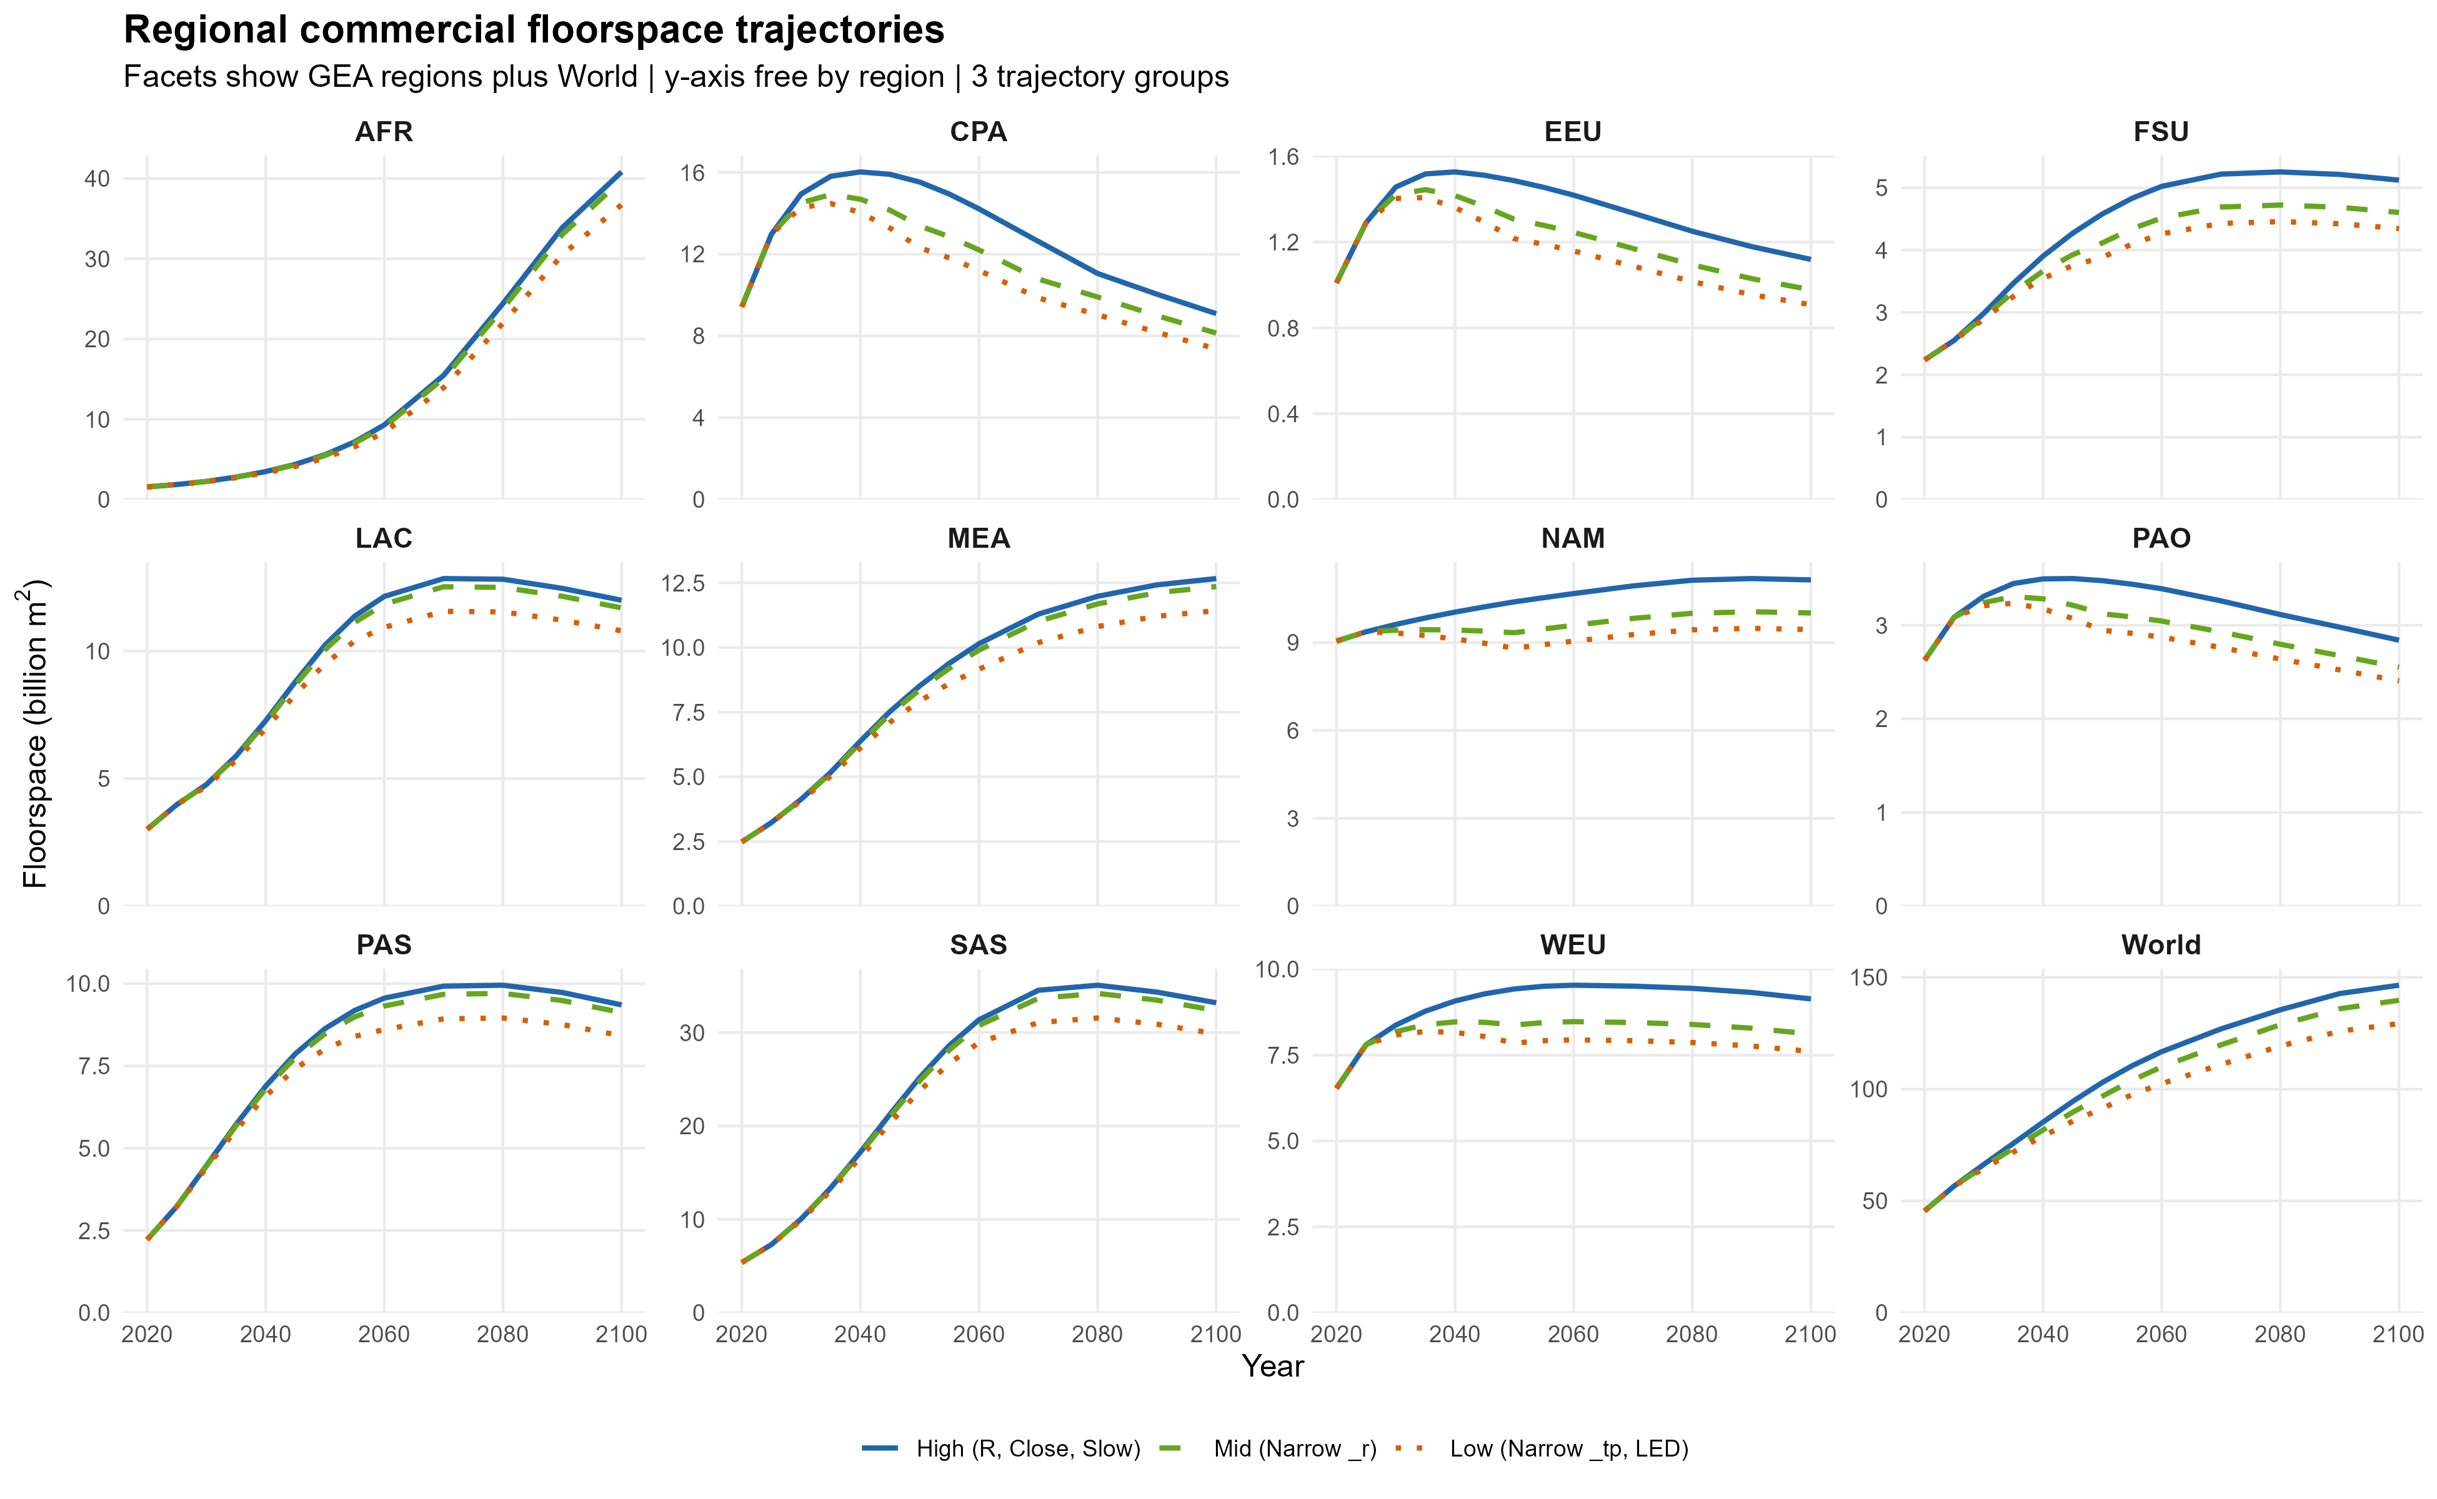

Slide 22
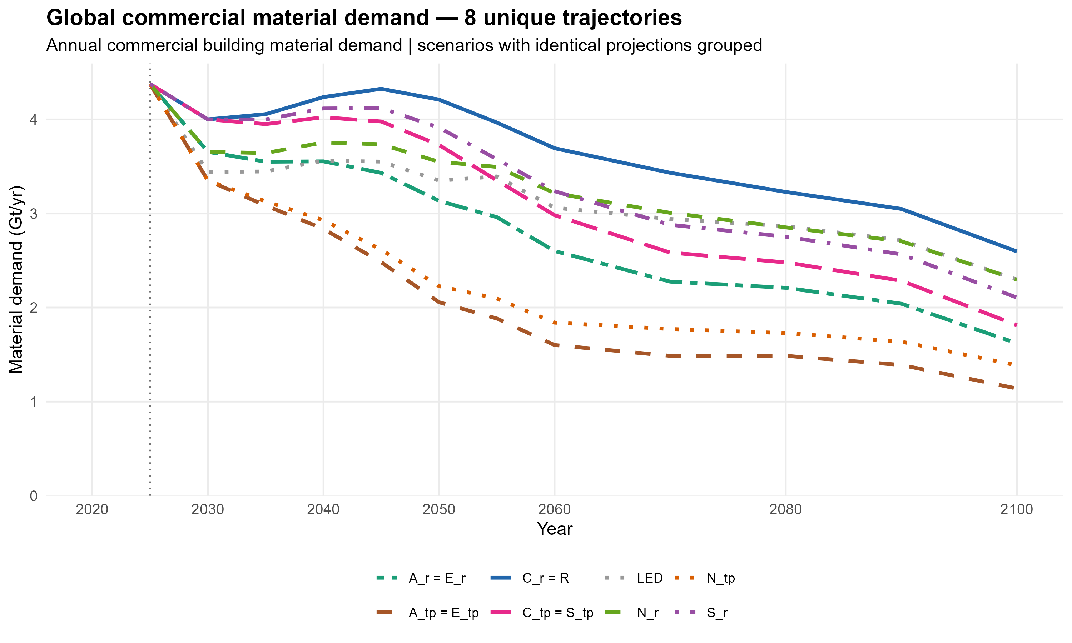

Slide 23
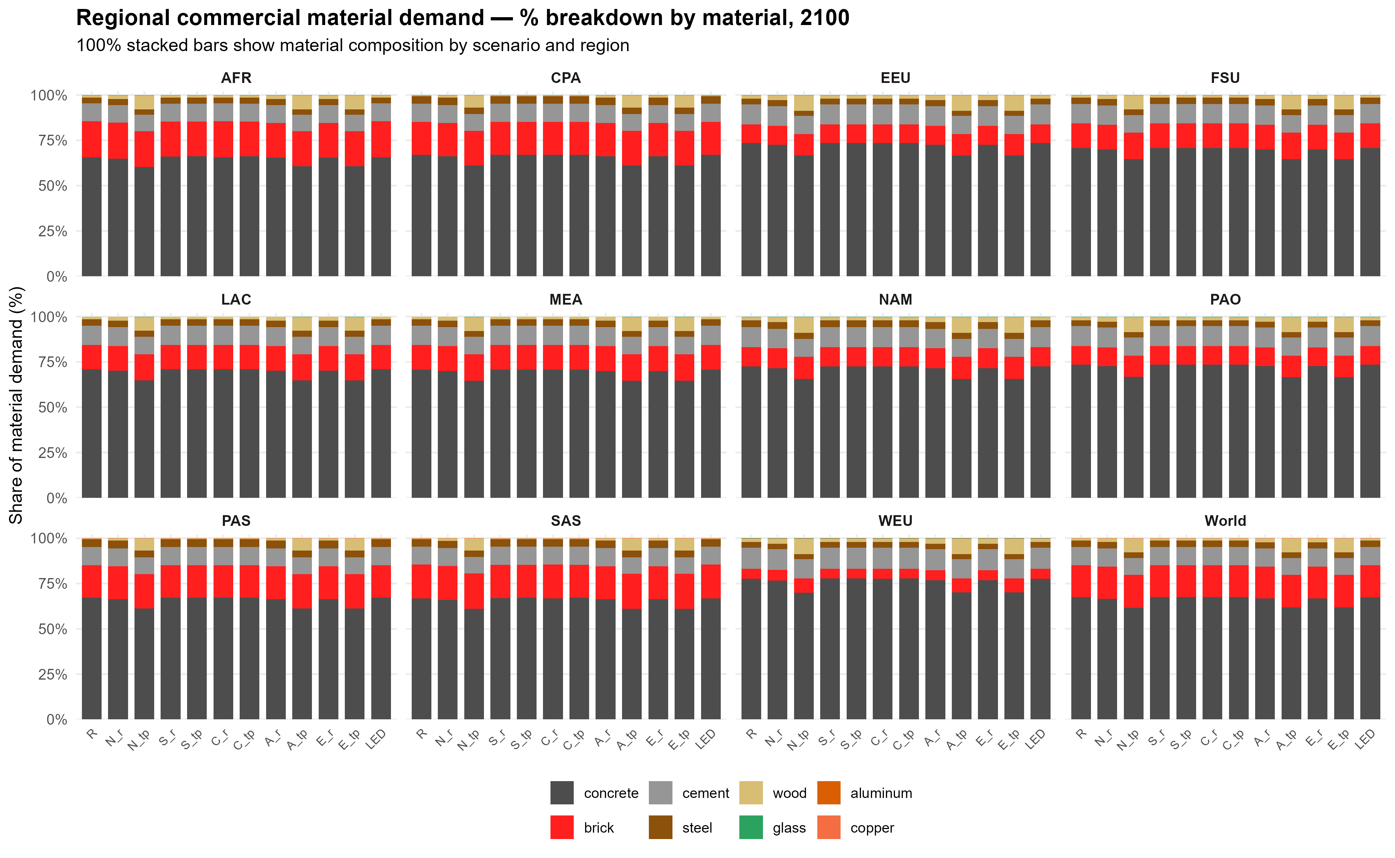

Slide 24
