Slide 1
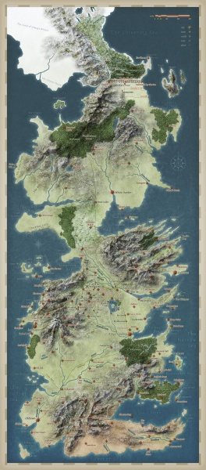
Primary Energy
(resources)
/
Renewable- potential
Primary
Energy
Secondary
Energy
Final
Energy
Useful
Energy
Coal Extraction
Coal Power plant
Electricity grid
Light bulb
Wind Power plant
Pass-out turbine
District heating grid
Heating
System
coal
coal
heat
heat
wind
electricity
electricity
heat
light
Notes:
Tutorial: FULL

Slide 2
Secondary
Energy
Final
Energy
Useful
Energy
Coal Power plant
Electricity grid
Light bulb
Wind Power plant
electricity
electricity
light
Notes:
Tutorial: westeros_baseline.ipynb (baseline_res.png)

Slide 3
Primary Energy
(resources)
Secondary
Energy
Final
Energy
Useful
Energy
Coal Power plant
Electricity grid
Light bulb
Wind Power plant
coal
electricity
electricity
light
Notes:
Tutorial: westeros_fossil_resource.ipynb (fossil_resource_res.png)

Slide 4
Resources
Primary
Energy
Secondary
Energy
Final
Energy
Useful
Energy
Coal Extraction
Coal Power plant
Electricity grid
Light bulb
Wind Power plant
coal
coal
electricity
electricity
light
Notes:
Tutorial: westeros_xxx.xxx.ipynb (xxx_xxx_res.png)

Slide 5
Renewable- potential
Secondary
Energy
Final
Energy
Useful
Energy
Coal Power plant
Electricity grid
Light bulb
Wind Power plant
wind
electricity
electricity
light
Notes:
Tutorial: westeros_renewable_resource.ipynb (renewable_resource_res.png)

Slide 6
Renewable- potential
Primary
Energy
Secondary
Energy
Final
Energy
Useful
Energy
connection_to_grid_c1
Coal Power plant
Electricity grid
Light bulb
connection_to_grid_c2
Wind Power plant
connection_to_grid_c3
connection_to_grid_c4
Wind potential “c1”
Wind potential “c4”
Wind potential “c2”
Wind potential “c3”
electricity
electricity
light
Notes:
Tutorial: westeros_renewable_resource.ipynb (renewable_resource_res_exercise.png)

Slide 7
Secondary
Energy
Final
Energy
Useful
Energy
Coal Power plant
Electricity grid
Light bulb
Wind Power plant
Pass-out turbine
District heating grid
Heating System
heat
heat
electricity
electricity
heat
light
Notes:
Tutorial: westeros_addon_technologies.ipynb (addon_technologies_res.png)

Slide 8
Secondary
Energy
Final
Energy
Useful
Energy
Coal Power plant
Electricity grid
Light bulb
Gas Power plant
electricity
electricity
light
Tutorial Part 2.
Notes:
Tutorial: westeros_historical_new_capacity.ipynb (historical_new_capacity_res.png)

