Slide 1
How IAMs represent materials
Seminar EP8900 – Nils Dittrich

Slide 2
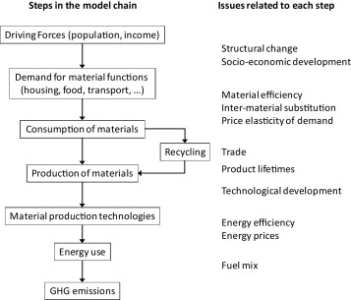
IMAGE material modeling
Function of per capita economic activity
Literature
IMAGE model
https://doi.org/10.1016/j.resconrec.2016.04.016

Slide 3
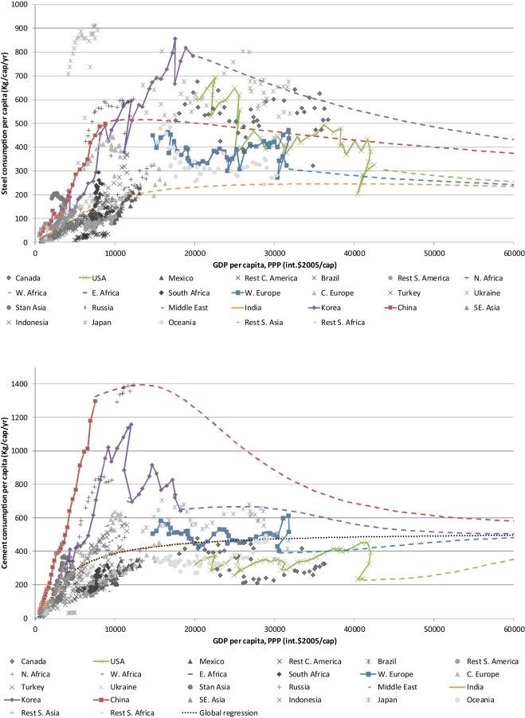
Material demand
Based on trade (comtrade model in GCAM) and production data

Slide 4
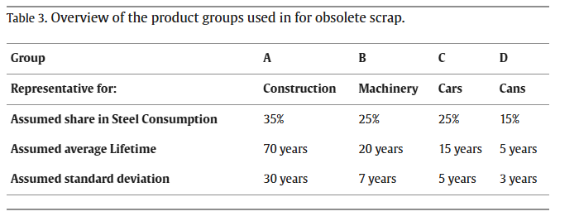
Consumption
Fully fulfilled through trade or domestic production
Trade is motivated by production costs
Recycling based on a technical report from the Netherlands environmental agency (2006) that is not available anymore
Time/cohort model for steel use

Slide 5
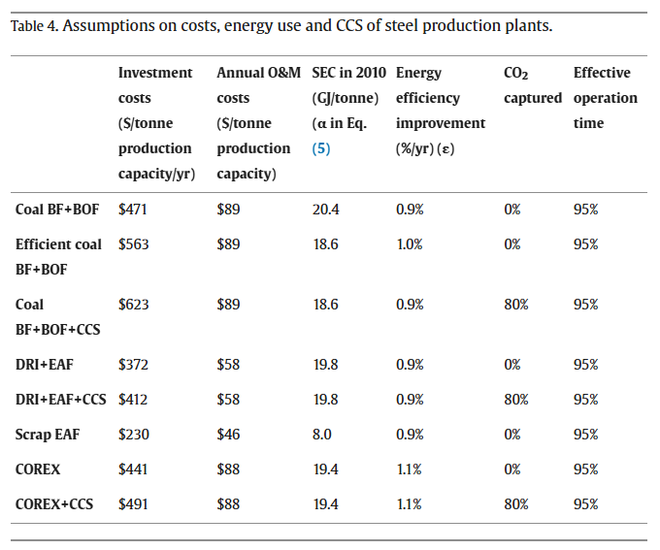
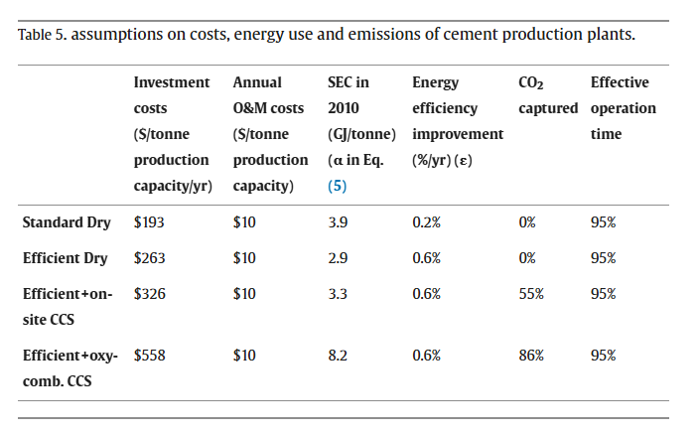
Production, energy, emissions
Costs and energy use based on MARKAL-MATTER with updates
“normal” regional model with demand for production and induced capital build-up

Slide 6
Reflection – does the IMAGE steel&cement model work?
Crux lies in the material intensity data

Slide 7
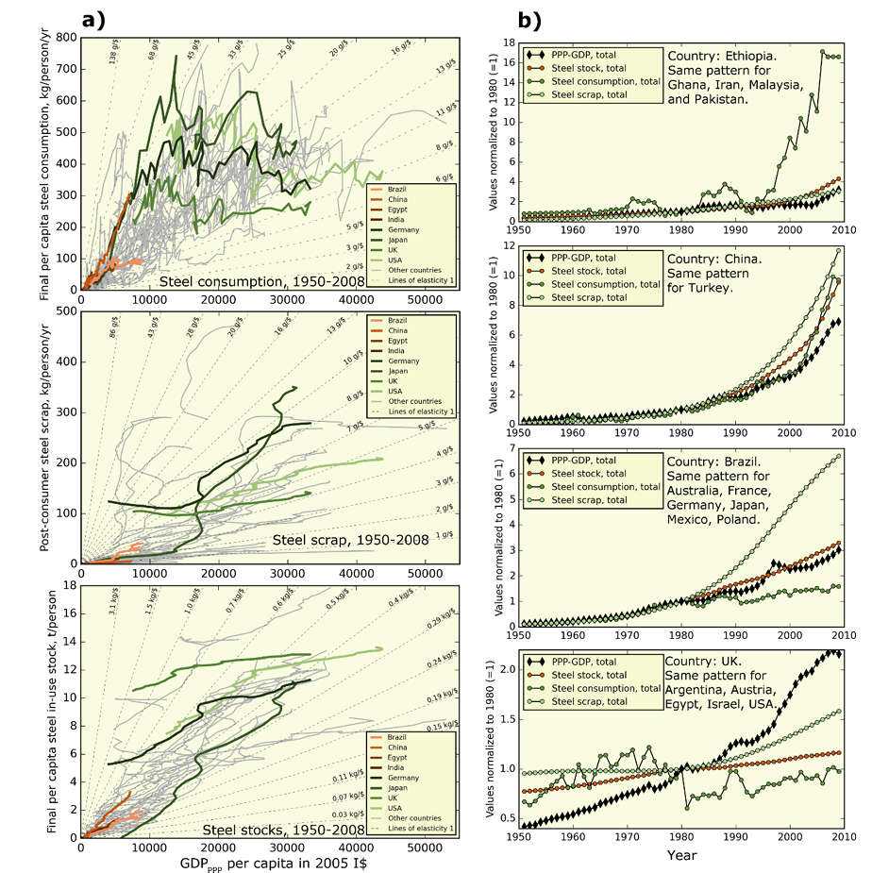
Reflection – does the IMAGE steel&cement model work?
Crux lies in the material intensity data
  Affluence is not well linked with material consumption
Good to have the physical model of production
https://www.nature.com/articles/nclimate3148

Slide 8
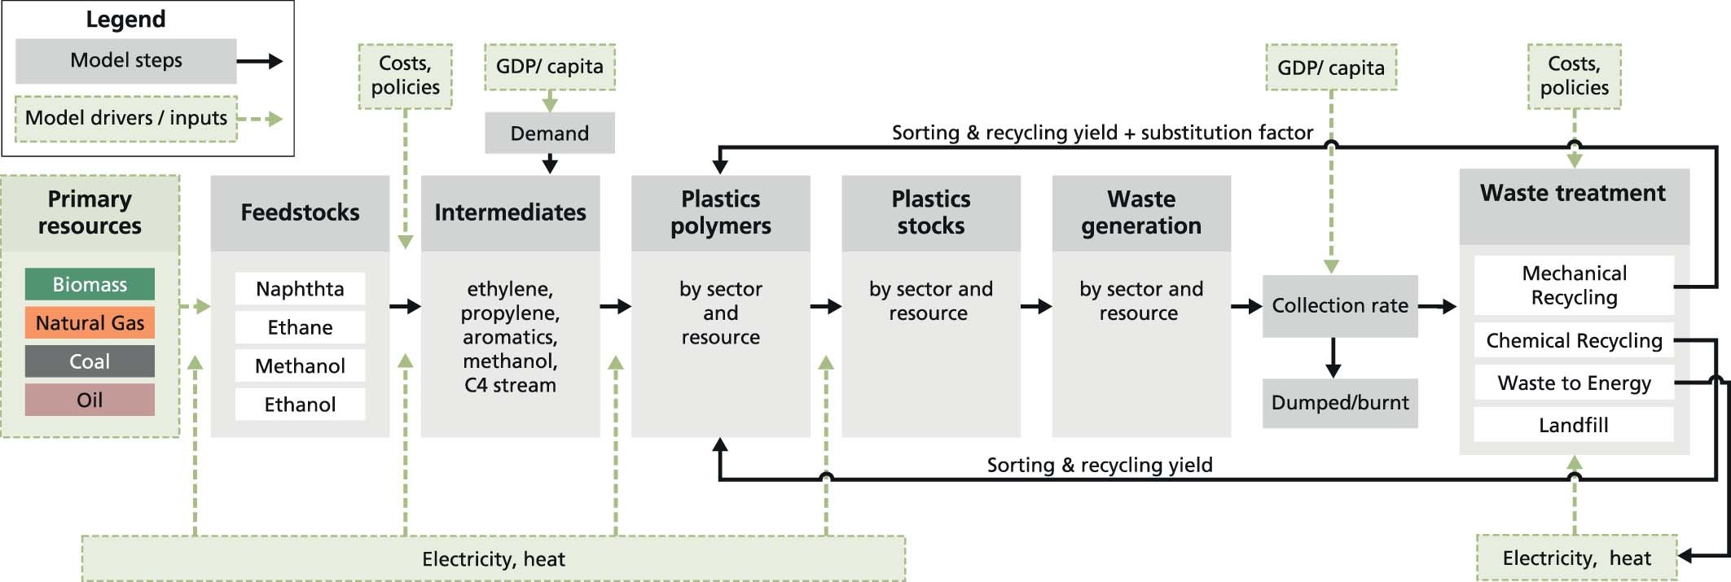
Plastics in IMAGE - PLAIA

Slide 9
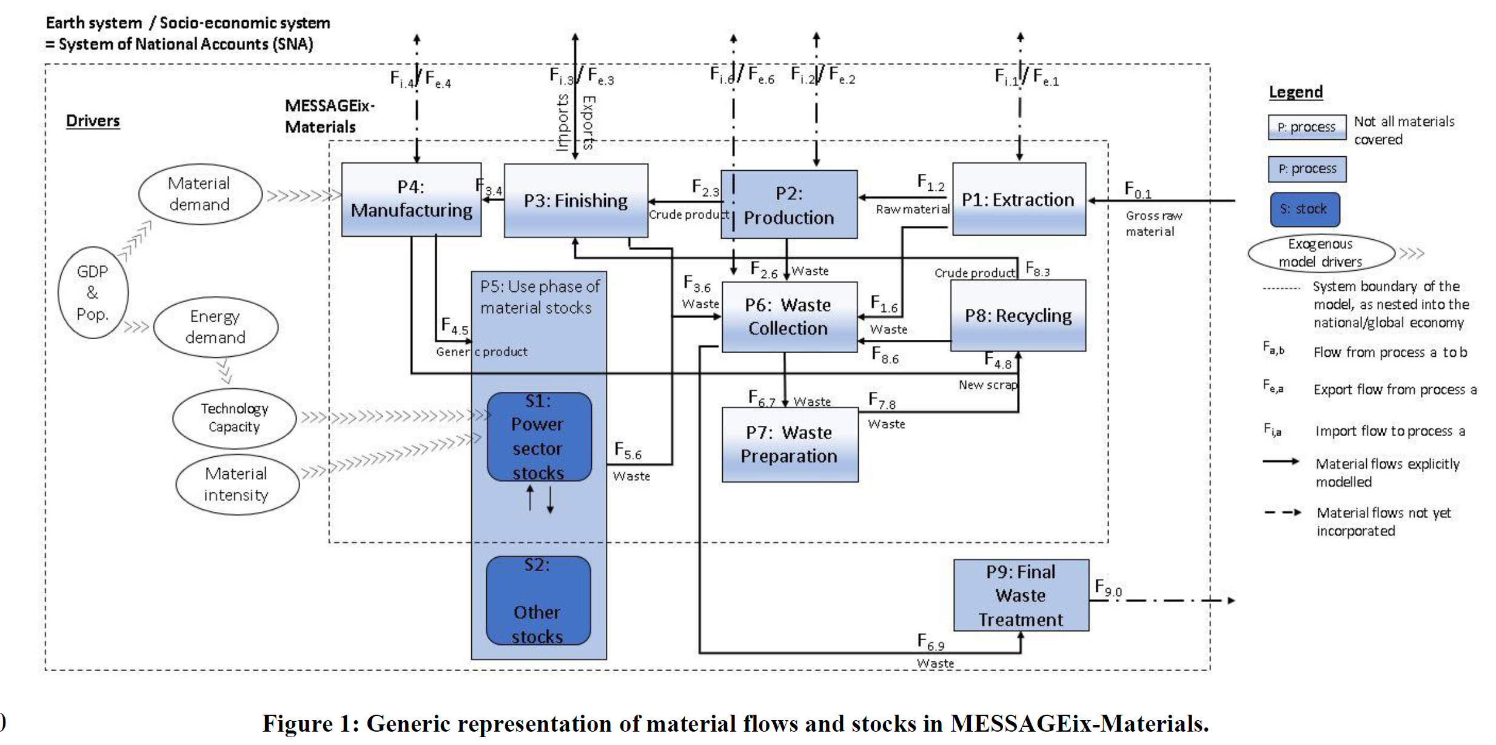
MESSAGEIX_MATERIALS

