Slide 1

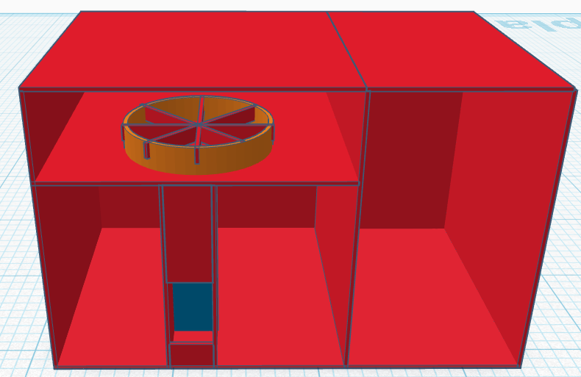
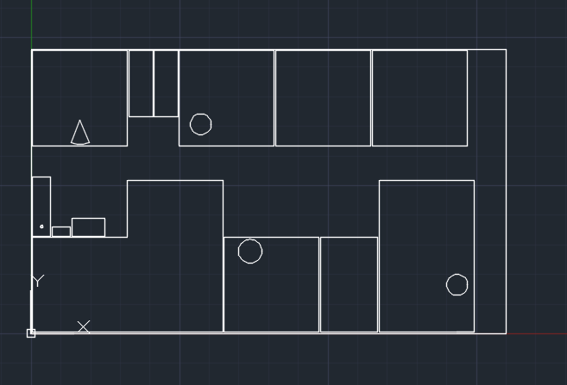
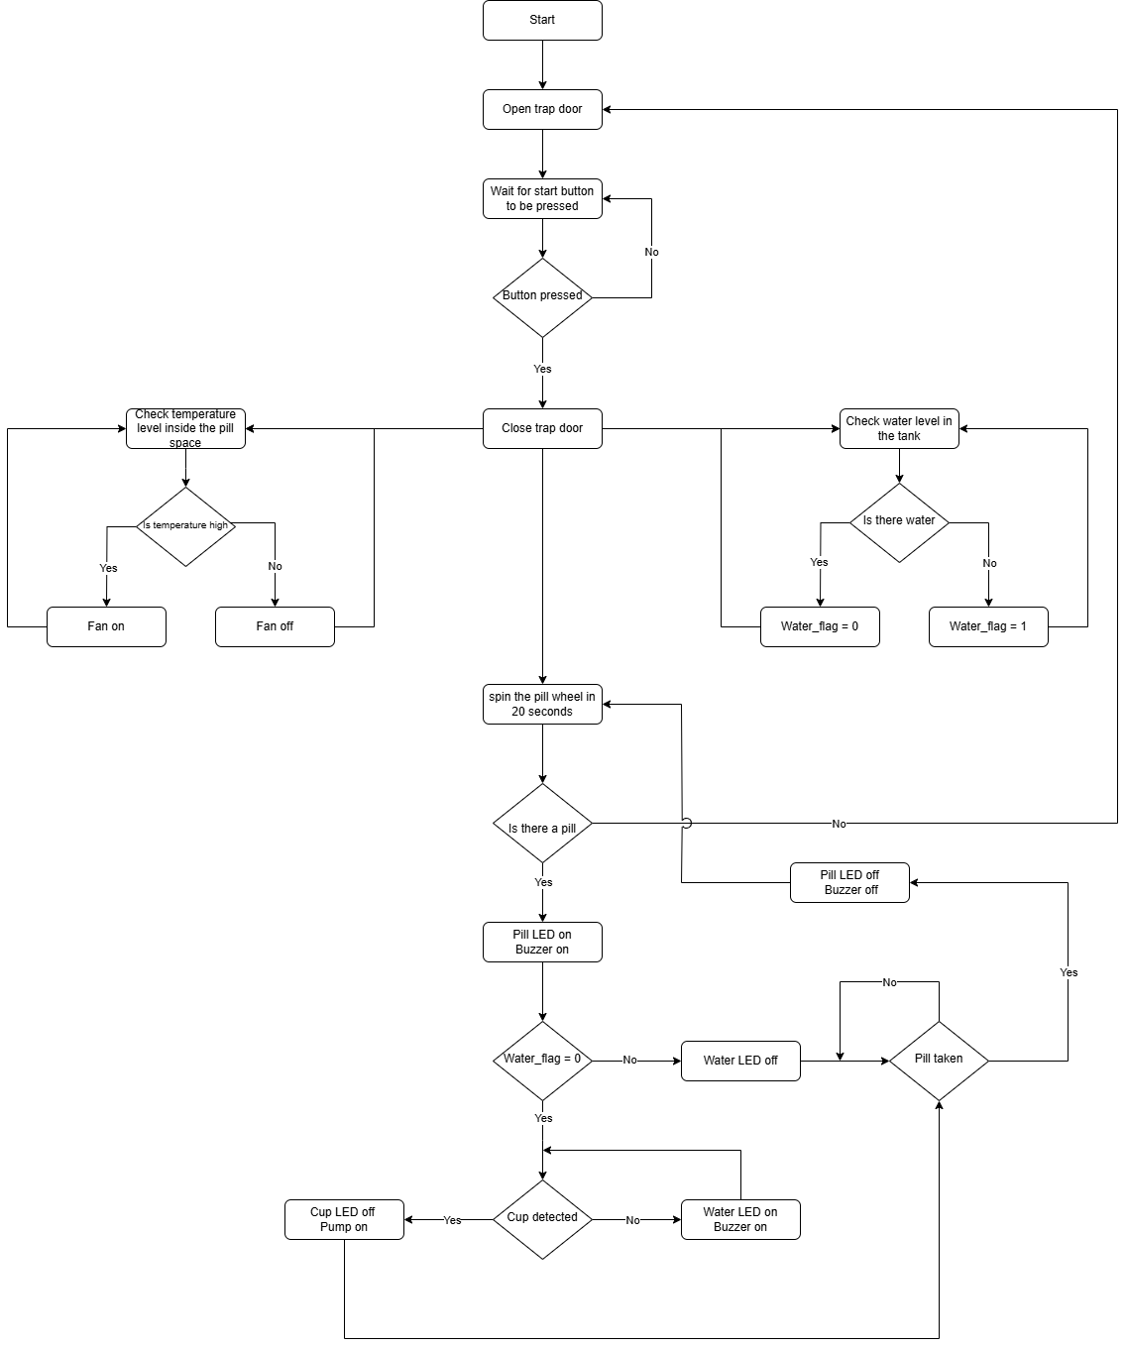
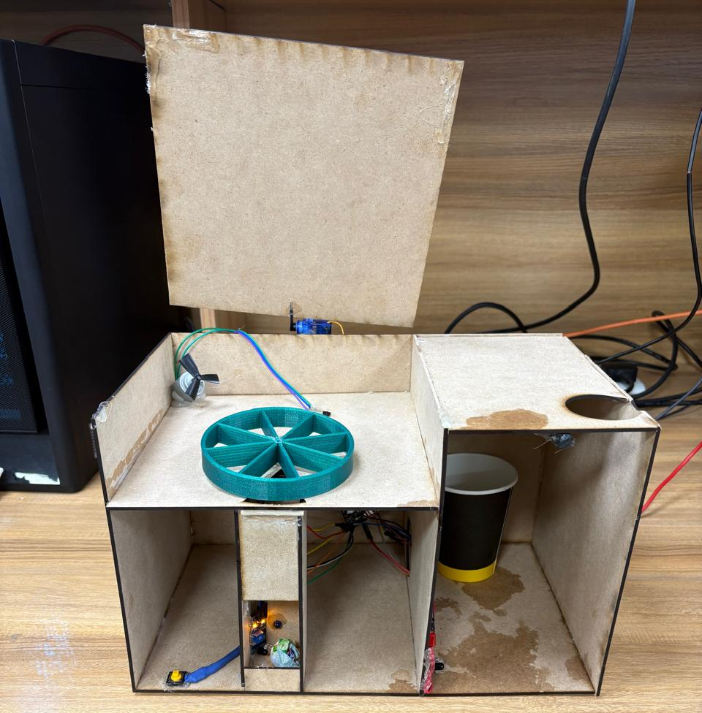
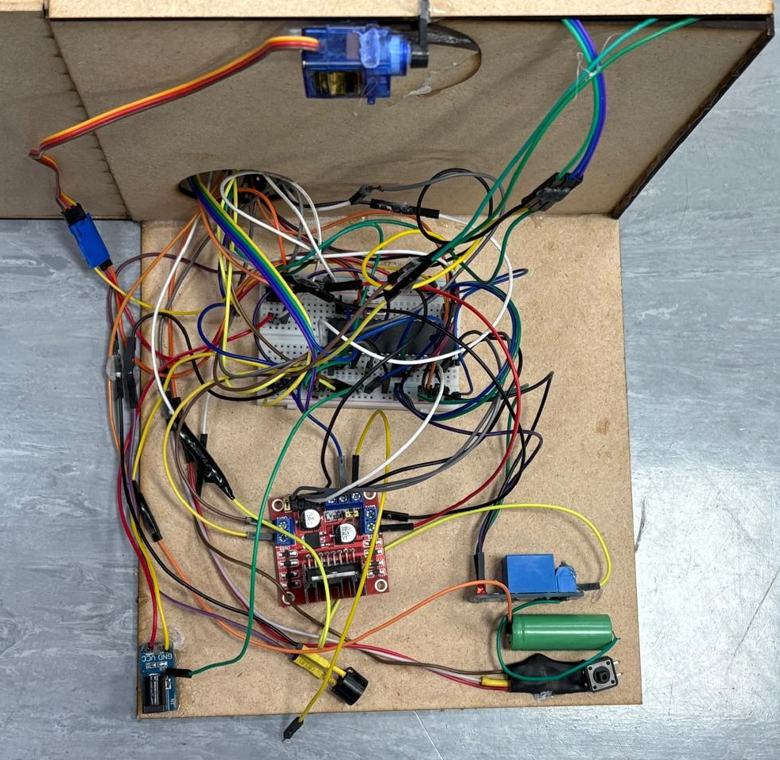
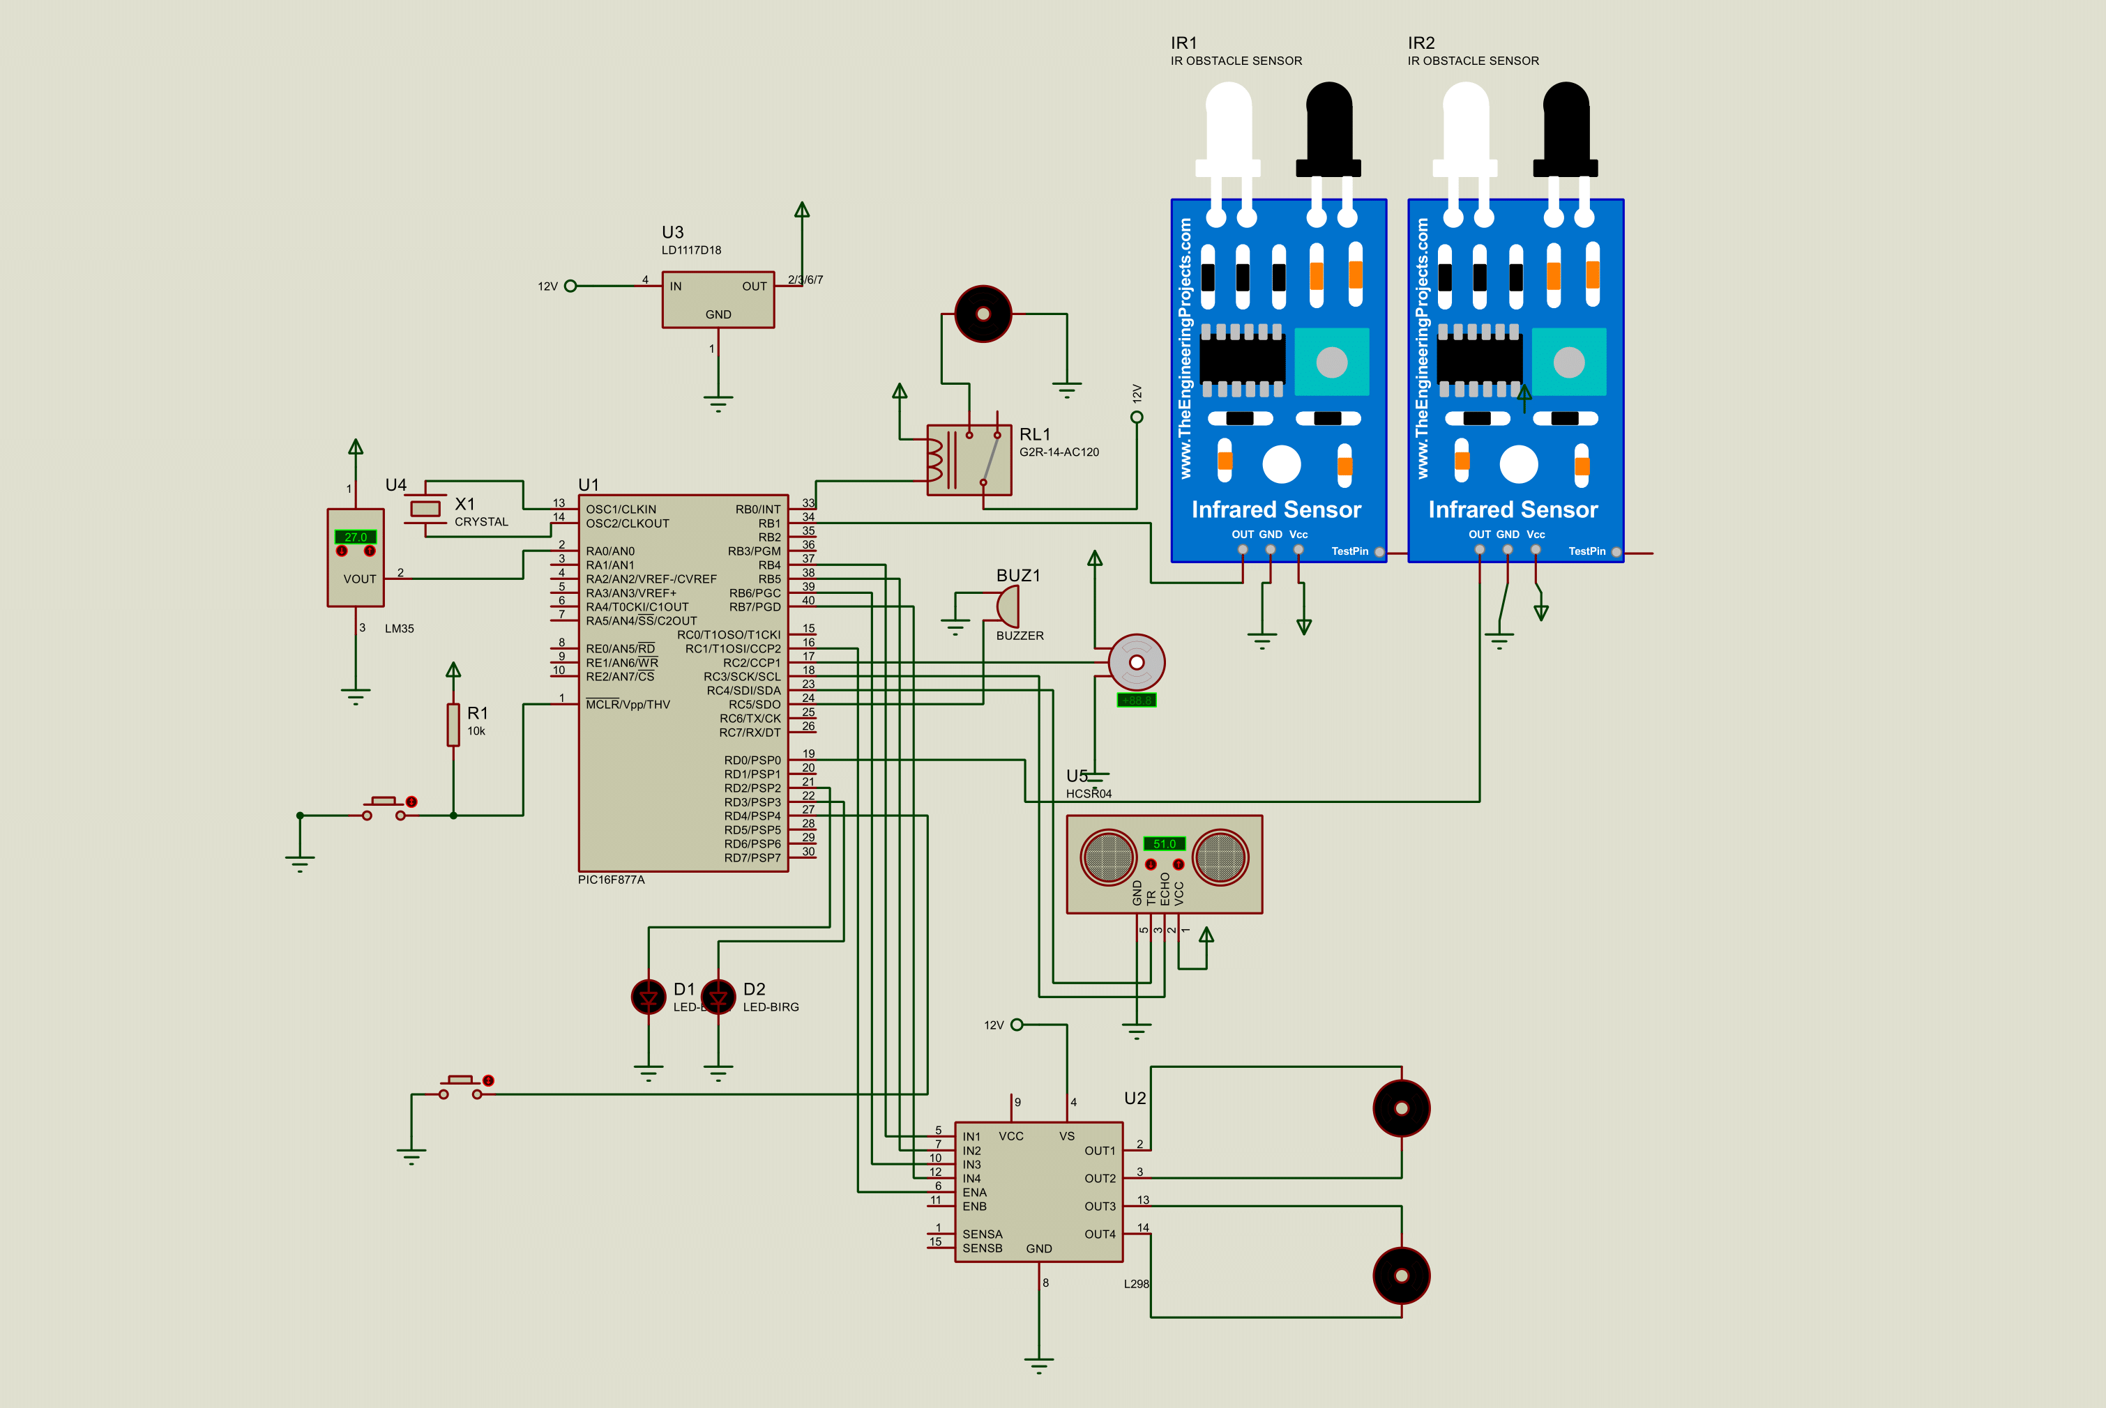
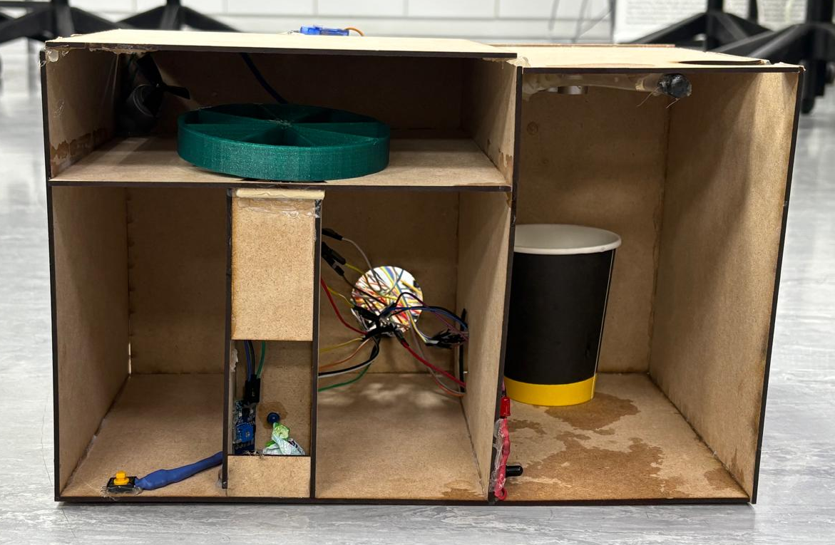
Smart Pill Dispenser with
Water System
H. Bodair, H.Abu-Sair, M. Al-Shawabkeh
Supervisor: Prof. Belal Sababha , Prof. Esam AlQaralleh
Embedded Systems Final Design Project, Spring 2025
King Abdullah II School of Engineering
Princess Sumaya University for Technology
Introduction
Medication mistakes, missing doses, or inappropriate administration might result from manual pill-taking practices. These issues are particularly prevalent with older or visually impaired users. This procedure is automated by the Smart Pill Dispenser with Water System, which lowers human error and enhances drug administration. When a pill is successfully dispensed, the system detects the presence of water and a cup, maintains the proper storage temperature, and tells users visually or audibly of any problems.
The layout design can be seen in the figure 2. and the laser cut design in figure 3. done using AutoCAD.
Figure 3: Layout Design Figure 4: Laser Cut Design
Results
The system has been successfully designed and tested with all the possible scenarios. The system can be seen in the following figures.
Figure 4:Trap door open.
Figure 5: Electric Circuit
Figure 6: Front view of the system
Figure 6: Blah blah blah blah blah.
Design
The Smart Pill Dispenser with Water System's operational logic and electrical design is depicted in figure 1, 2.
Figure 1: Software Flowchart
Figure 2: Electrical Design
Conclusion
The Smart Pill Dispenser with Water System project offers a dependable and easy-to-use way to automate the taking of medications. It makes sure that consumers only receive medicines and water when all the conditions are right by integrating sensor feedback, actuator control, and safety alerts. This invention is very helpful for busy people, elderly patients, and healthcare environments. The system worked effectively in testing, showing strong potential for real-life application.

