Slide 1


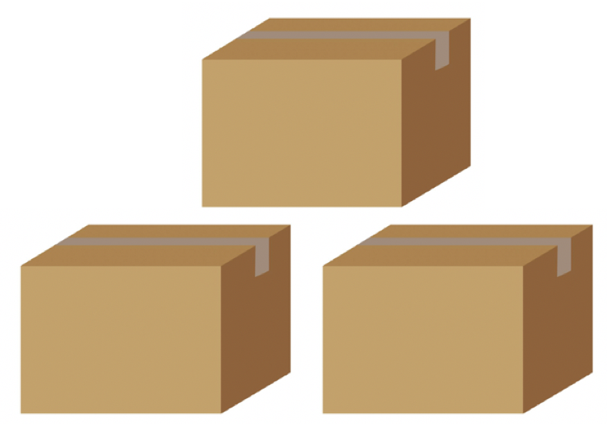
w
m
e

Slide 2
w
m
e

Slide 3
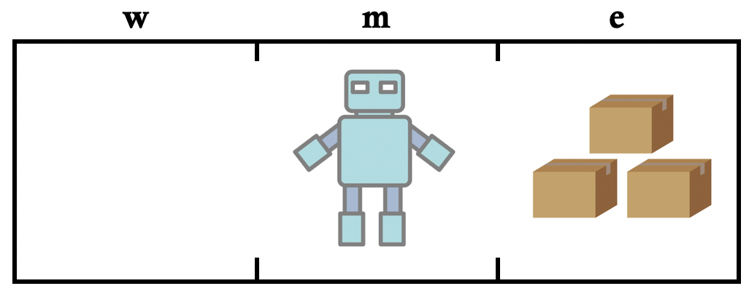
Success
1.0
2500 AS
5000 AS
Success
0.7

Slide 4
pick
Success
1.0
2500 AS
5000 AS
pick
Success
0.7

Slide 5
Success
1.0
pick
Success
1.0
2500 AS
5000 AS
Success
0.7
pick
Success
0.7

Slide 6
Success
1.0
2500 AS
7500 AS
Success
0.7
5000 AS
Success
0.4

