Slide 1
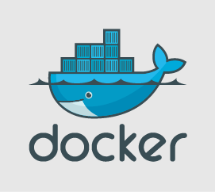
- Kaleel Ahmed A -

Slide 2
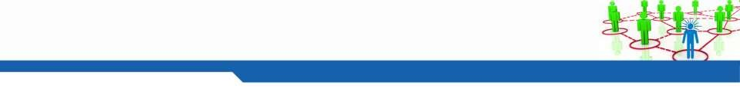
2
Agenda
▪
▪
▪
What is Docker
Container Vs Virtual machine
Docker Platform components
▪
▪
▪
▪
▪
▪
Docker Engine
Images
Containers
Registry
Repositories
Docker Hub
▪
Demo

Slide 3
What is Docker
▪
Docker containers wrap a piece of software in a complete file system that
contains everything needed to run: code, runtime, system tools, system libraries –
anything that can be installed on a server. This guarantees that the software will
always run the same, regardless of its environment.
-- Docker.com
Docker is a tool designed to make it easier to create, deploy, and run applications
by using containers. Containers allow a developer to package up an application
with all of the parts it needs, such as libraries and other dependencies, and ship it
all out as one package. By doing so, the developer can rest assured that the
application will run on any other Linux machine regardless of any customized
settings that machine might have that could differ from the machine used for
writing and testing the code.
– Opensource.com
▪

Slide 4
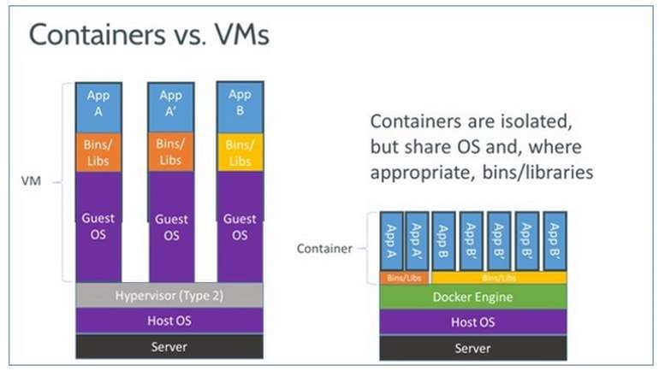
Docker Vs Virtual Machines

Slide 5
Virtual machine services
VM1
VM2
VM3
WEB SERVICE
APP SERVICE
DATABASE SERVICE

Slide 6
Docker services
DOCKER HOST VM1
.App container
Web Server container
Data base container
Network container

Slide 7
Docker Comparison
Machine
Virtual Machine
Container
Faster Deployment
Multiple VM on the same machine, Easy deployment
Very quick deployment and easy to spin – Like a process
Cost effective
Cost shared with multiple Vms
Cost optimized, Light Weight, Many containers on the machine vs VM
Effective utilization resources
Shared resource - Requires own CPU, RAM, Storage and OS
Shared - Uses kernel on the host to run multiple guest instances
Scalability
Simpler to Scale
Easy scaling - No OS required
Less CPU, RAM, Storage
High Avalability & Migration
Provision to move and upgrade
– snapshots, templates
Simple upgrade, data segregation, less in size to copy, transfer

Slide 8
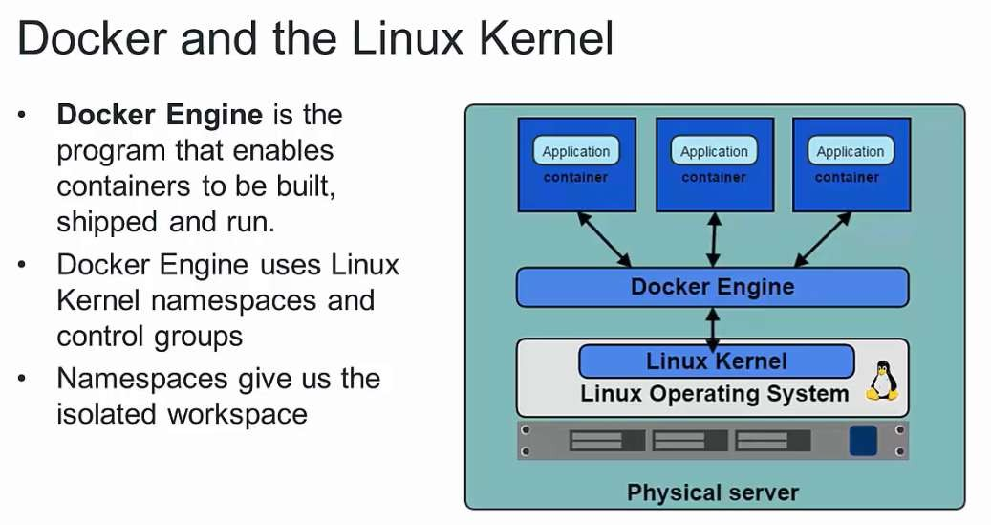
Docker Engine / Docker Daemon

Slide 9
http://proxy-ut.rd.corpintra.net:3128
DOCKER INSTALLATION
http://proxy-ut.rd.corpintra.net:3128
DOCKER FOR DESKTOP: https://hub.docker.com/editions/community/docker-ce-desktop-windows
PREREQUISITES:
1 : Laptop bios virtualization should be enabled
2 : Proxy server is required : proxy-bl3.in623.corpintra.net:3128
3 : user should be added to Docker group
4 : Raise CISM request to install : https://cism-web.es.corpintra.net/cgi-bin/bin/runTemplate?TP=web_ticket&t=GOSC_i-UHD_Incident

Slide 10
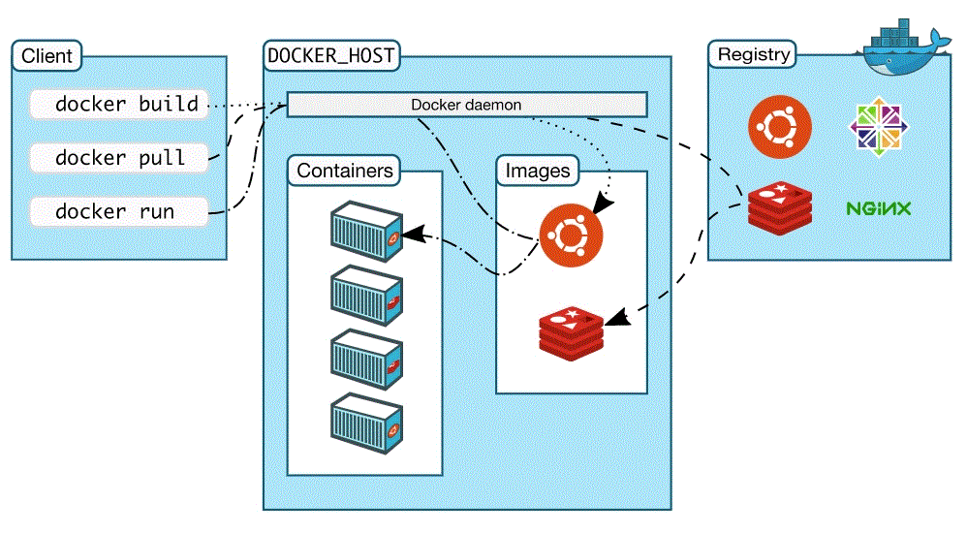
Architecture

Slide 11
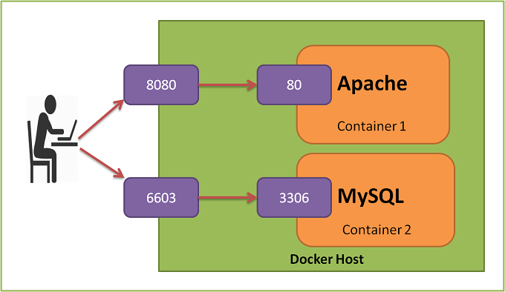
Port Binding

Slide 12
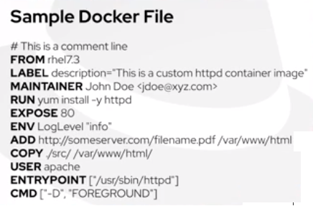
Using SuperPutty and KeePass Password Safe (Ganapathi)
Recap from Last session.
Docker in Daimler Environment (EDC & MTC)
Using GSEP Artifactory as Docker Registry.
Difference between add and copy

Slide 13
Push images to the private jfrog repository
https://www.jfrog.com/confluence/display/JFROG/Docker+Registry
https://www.jfrog.com/confluence/display/JFROG/Getting+Started+with+Artifactory+as+a+Docker+Registry
Installtion of docker on Ubuntu and suse 12.3 service pack : please refer to the documentation .

Slide 14
Installing Docker – Ubuntu / Suse
▪
install docker through binaries – Suse linux
https://gsep.daimler.com/confluence/display/GSEPSKB/Install+docker+through+binaries+-+Suse+linux
▪
Install using script Ubuntu 18+
$ curl -fsSL https://get.docker.com/ | sh
Enable and start the service
$ sudo systemctl enable docker.service
$ sudo systemctl start docker
▪

Slide 15
Installing Docker – Contd..
▪
Test the installation
$ sudo docker run hello-world
Add users to Docker group to grand
$ usermod –aG docker <user>
Docker version
$ docker version
Docker system information
$ docker info
▪
privileges
▪
▪

Slide 16
RECAP – DOCKER LIFECYCLE

Slide 17
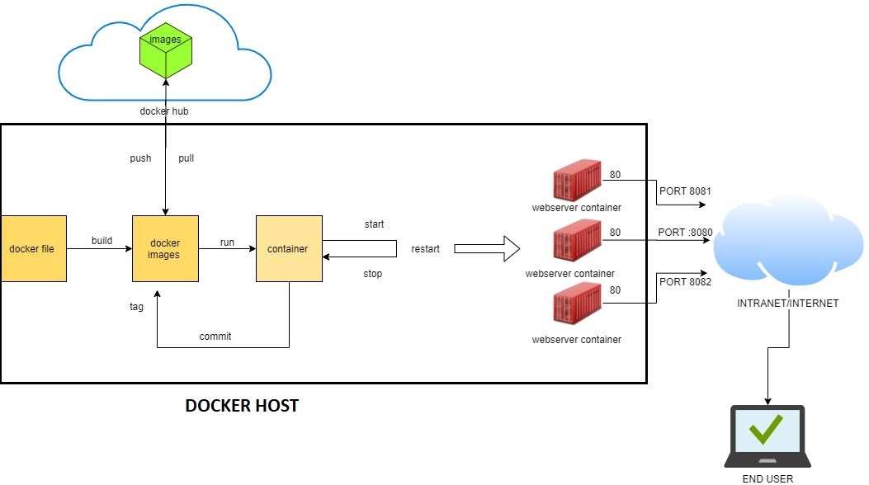
LIFECYCLE

Slide 18
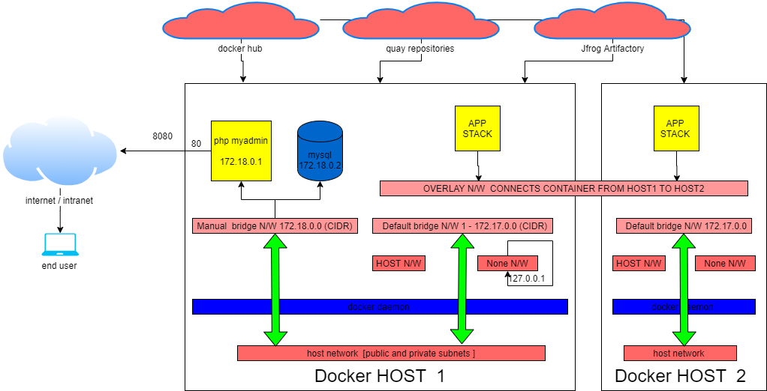
NETWORK

Slide 19
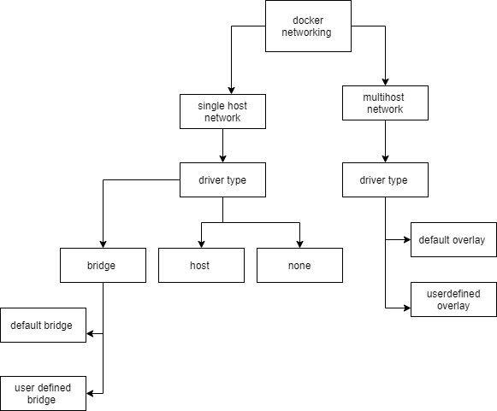

Slide 20
None
This offers a container-specific network stack that lacks a network interface. This container only has a local loopback(127.0.0.1) interface (i.e., no external network interface).
Host
This enables a container to attach to your host’s network (meaning the configuration inside the container matches the configuration outside the container).
These have specific uses for the Docker installation. Do not bind containers to these networks(Host and None).
Bridge
All Docker installations represent the docker0 network with bridge;
Bridge networks (similar to the default docker0 network) offer the easiest solution to creating your own Docker network.
Overlay network:
Docker hosts (you can use multiple hosts with overlay networks) must communicate with the service you choose. Each host needs to run Docker. You can provision the hosts with Docker Machine.

Slide 21
Sample repositories :
Jfrog :
https://gsep-int.daimler.com/artifactory/webapp/#/artifacts/browse/tree/Watch/sample2324/maven
Quay.repository:
https://reg-dhc.app.corpintra.net/repository/
https://gsep.daimler.com/confluence/display/GSEPSKB/POC+on+Jfrog+Xray+Application

Slide 22
Commands
docker images
docker ps -a
docker run --name mysql -e MYSQL_ROOT_PASSWORD=secret -d mysql/mysql-server
dokcer ps -a
docker ps -a
docker network create -d bridge my-bridge-network
docker network connect my-bridge-network mysql
docker inspect mysql | grep "IPAddress"
docker run --name phpmyadmin -d -e PMA_HOST=172.21.0.2 -p 8080:80 phpmyadmin/phpmyadmin
docker network connect my-bridge-network phpmyadmin
docker network inspect my-bridge-network
docker exec -it mysql bash

Slide 23
Database queries
mysql> CREATE USER 'dbuser'@'172.21.0.3' IDENTIFIED BY 'secret';
Query OK, 0 rows affected (0.04 sec)
mysql> GRANT ALL PRIVILEGES ON * . * TO 'dbuser'@'172.23.0.3';
Query OK, 0 rows affected (0.02 sec)
mysql> flush privileges;
Query OK, 0 rows affected (0.00 sec)
CREATE DATABASE sampledb;
CREATE TABLE example ( id smallint unsigned not null auto_increment, name varchar(20) not null, constraint pk_example primary key (id) );
INSERT INTO example ( id, name ) VALUES ( null, 'Sample data' );
mysql> exit
Bye

Slide 24
Q&A

Slide 25
Thank
You!

Slide 26
Docker
EDC
MTC
SUSE 12
With Internet
Without Internet
Ubuntu
With Internet
Without Internet
Docker Deamon

Slide 27
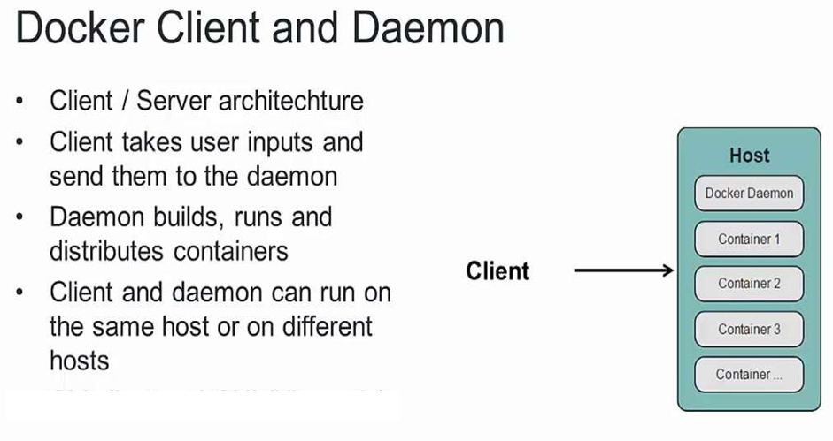
Docker CLI

Slide 28
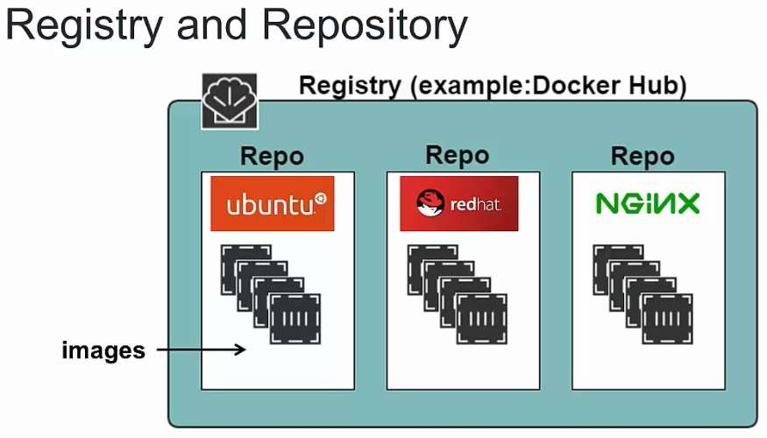
Docker Registry

Slide 29
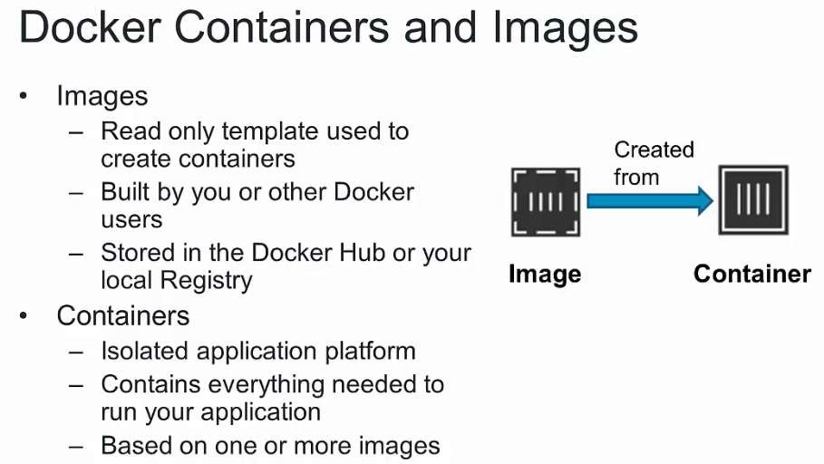
Containers and Images

Slide 30
Docker
▪
Container has
▪
▪
▪
▪
▪
Root filesystem
Process
Memory
Network
Secrets
▪
Multiple application
in the same machine
▪
Host resources can be shared across the containers

Slide 31
Docker Images
▪
▪
▪
Stored in registry under different repositories
Several images are present in the Docker hub
Public registry is “Docker hub” – hub.docker.com new place is
docker store store.docker.com
Docker registry account is free, No credit card required
▪

Slide 32
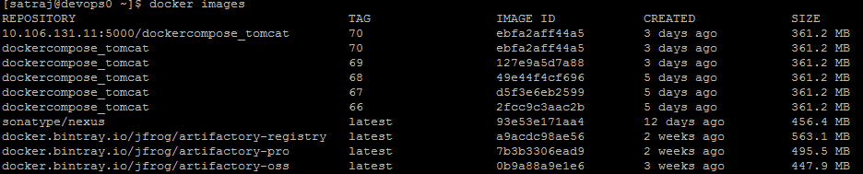
Images
▪
▪
Docker stores the images locally
When a creating the container, Local images are used by the
Docker Engine
If not found, image is downloaded from the DockerHub ( Slow) Display the available Docker images list by
▪
▪
▪
$ Docker images

Slide 33
Images Contd…
▪
Docker image
▪
▪
▪
Repository Name
Has a version / tag
Image ID
▪
Images are represented
by
▪
▪
▪
“Repositoryname:Tag”
Tag Latest is used if not specified
Tags represent the version / specific named image

Slide 34
Container
▪
Start the container by
$
$
▪
docker run tomcat
docker run centos ps eaf
Syntax “docker run [options] image [command] [args] ”
▪
Start the container with the terminal, every start
container
creates
new
▪
▪
$ docker run –it centos /bin/bash
Places the user inside the container shell
▪ -i represents standard input
▪ -t allocates pseudo-terminal

Slide 35
Container Operations
▪
Add a user inside the container
$ adduser devops
$ cat /etc/passwd
Use the characters “CTRL + P + Q” to come out of container
terminal to the main terminal
Container can be represented by container ID / name
▪
▪
▪
▪
“docker ps” lists the running containers
“docker ps –a” Lists all the containers irrespective of the state
▪
Run the containers in detached mode with the –d flag
▪
Docker run –d tomcat

Slide 36
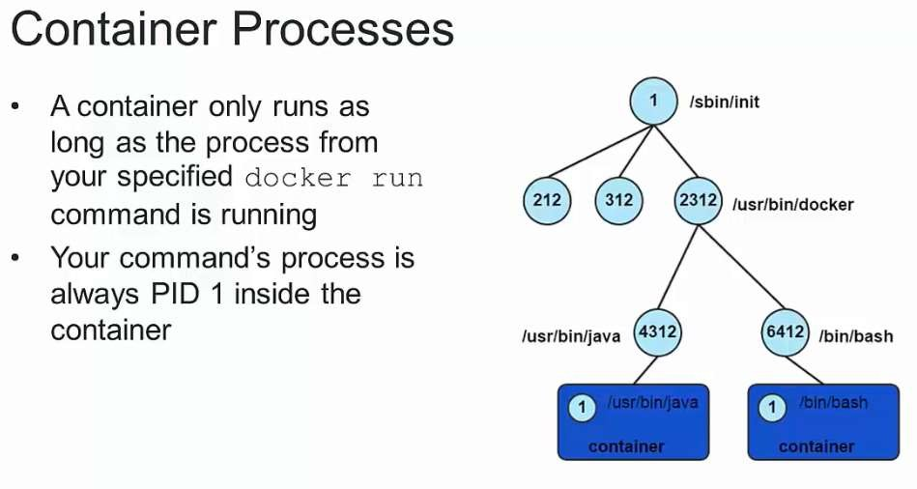
Container Process

Slide 37
Container Operations contd…
▪
Monitor the container standard output/log with
the
command
“logs”
▪
docker logs <container ID / Name>
▪
Expose the ports with the command –P /
-p
▪
▪
docker run –d –P tomcat
docker run –d –p 8080:8080 tomcat
▪
Start and stop the pre existing container
▪
▪
docker start <container ID / Name>
docker stop <container ID / Name>
▪
Save the container as image
▪
▪
docker commit 0e423cb38135 testimage:test
docker commit [OPTIONS] CONTAINER [REPOSITORY[:TAG]]

Slide 38
Container Operations contd…
▪
Attach to the running container
▪
▪
docker exec [OPTIONS] CONTAINER COMMAND
docker exec -it 0e423cb38135 /bin/bash
[ARG...]
▪
Inspect the container details
▪
docker inspect [OPTIONS] CONTAINER|IMAGE|TASK
[CONTAINER|IMAGE|TASK...]
docker inspect 0e423cb38135
▪
▪
Delete an image / container
▪
▪
▪
▪
docker
docker
docker
docker
rm [OPTIONS] CONTAINER
rm determined_meitner
[CONTAINER...]
rmi [OPTIONS] IMAGE [IMAGE...]
rmi testimage:test

Slide 39
Image Operations contd…
▪
Tagging images
▪
▪
docker tag testimage:test testtag:1
docker tag IMAGE[:TAG] IMAGE[:TAG]
▪
Save and load the images
▪
▪
docker save [OPTIONS] IMAGE [IMAGE...]
docker load –i <tarfile>
▪
Push and pull an image to repository
▪
▪
▪
docker tag testtag:1 10.106.131.11:5000/testimage
docker push 10.106.131.11:5000/testimage
docker pull 10.106.131.11:5000/dockercompose_nginx:40

Slide 40
29
Reference
▪
▪
▪
▪
https://www.docker.com/what-docker
https://docs.docker.com/engine/understanding-docker/
https://docs.docker.com/engine/installation/
https://docs.docker.com/engine/userguide/intro/

Slide 41
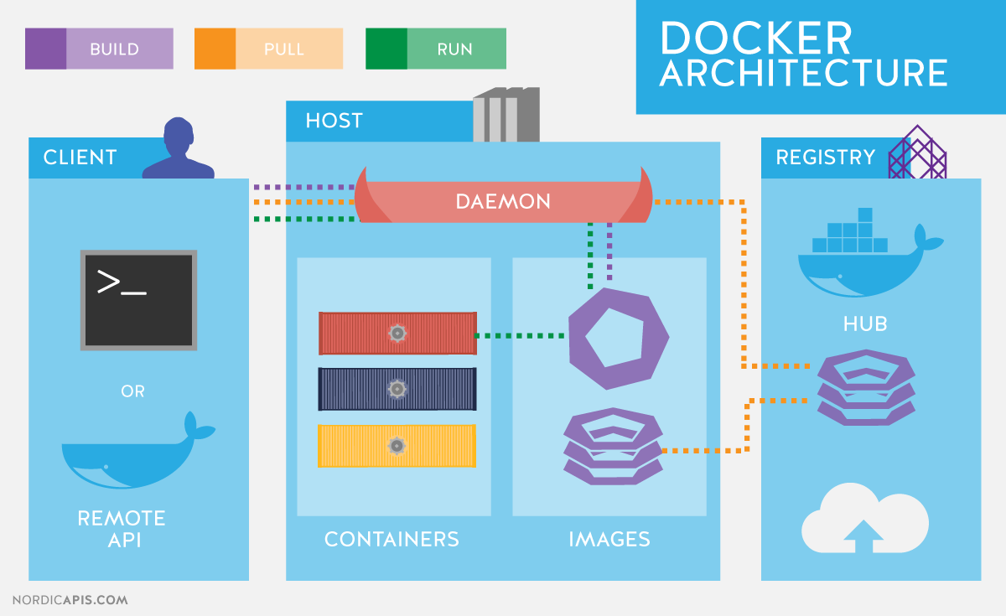
Architecture

