Slide 1
Spectron

Slide 2
Application
Below are list of Application members
Spectron uses WebdriverIO and exposes the managed client property on the created Application instances. The full client API provided by WebdriverIO can be found here http:webdriver.ioapi.html Several additional commands are provided specific to Electron.
client:SpectronClient; http://webdriver.io/api/protocol/title.html
The electron property is your gateway to accessing the full Electron API. Each Electron module is exposed as a property on the electron property so you can think of it as an alias for require('electron') from within your app.
electron:Electron.AllElectron; https://electronjs.org/docs/api
The browserWindow property is an alias for require('electron').remote.getCurrentWindow(). It provides you access to the current BrowserWindow and contains all the APIs. https://electron.atom.io/docs/api/browser-window
browserWindow:SpectronWindow;
The webContents property is an alias for require('electron').remote.getCurrentWebContents(). It provides you access to the WebContents for the current window and contains all the APIs. https:electron.atom.iodocsapiweb-contents
webContents:SpectronWebContents;
The mainProcess property is an alias for require('electron').remote.process. It provides you access to the main process's process global. https:nodejs.orgapiprocess.html mainProcess:NodeJS.Process; The rendererProcess property is an alias for global.process. It provides you access to the main process's process global. https:nodejs.orgapiprocess.html
rendererProcess:NodeJS.Process;

Slide 3
Application
How to install Spectron(give below command on windows command prompt)
npm install --save-dev spectron
Below is official Website for Spectron
https://electronjs.org/spectron
very important:
https://github.com/electron/spectron#application-api

Slide 4
WebDriver Overview - 1
As already known WebDriver can be accessed using app.client , and if you want to access API exposed by WebDriver, it can be done as below. WebDriver API(http://webdriver.io/api.html)is broadly classified into
Action
Cookie
Grid
Mobile
Property
Protocol
State
Utility
Window

Slide 5
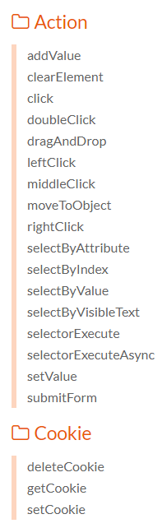
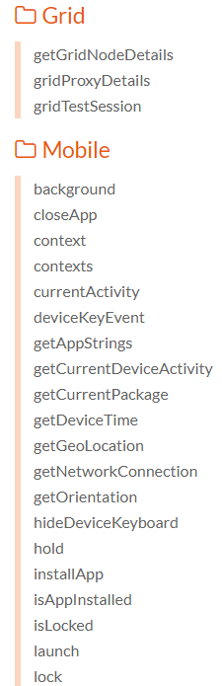
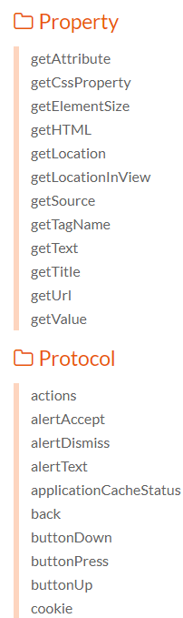
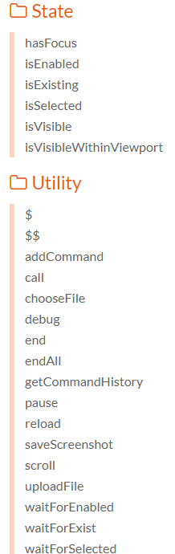
WebDriver Overview - 2

Slide 6
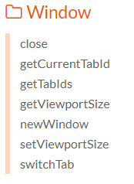
WebDriver Overview - 3

Slide 7
WebDriver Overview - 3
Example HTML
 | <button id="myButton" onclick="document.getElementById('someText').innerHTML='I was clicked'">Click me</button> <div id="someText">I was not clicked</div>
Test Code(click.js)
it('should demonstrate the click command', function () { var myButton = $('#myButton') myButton.click() // or browser.click('#myButton') var text = browser.getText('#someText'); assert(text === 'I was clicked'); // true })

Slide 8
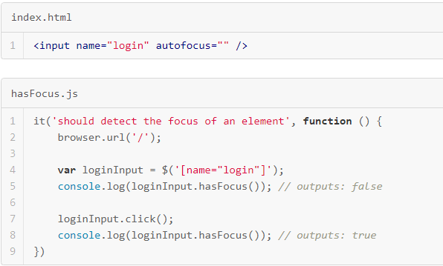
WebDriver Overview - 3
getTitle() Example
it('should get the title of the document', function () { browser.url('http://webdriver.io'); var title = browser.getTitle() console.log(title); // outputs the following: // "WebdriverIO - WebDriver bindings for Node.js" });
hasFocus() Example

Slide 9
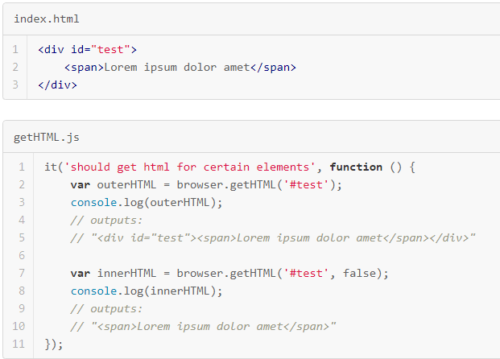
WebDriver Overview - 3
Getting HTML snippet

Slide 10
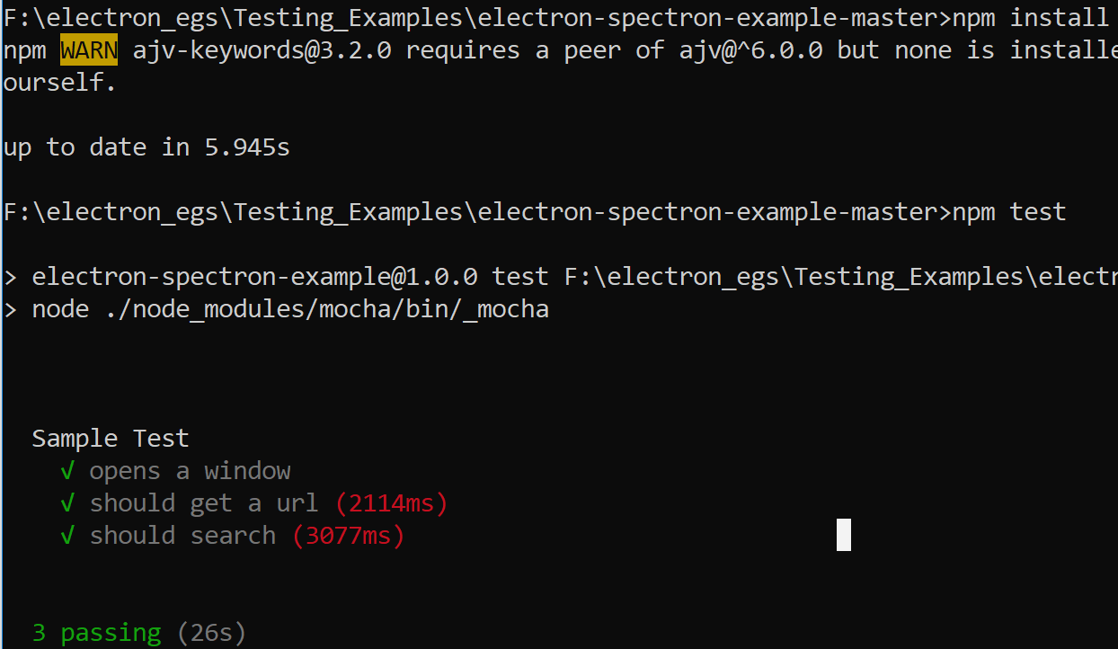
Test Example
Commands

Slide 11
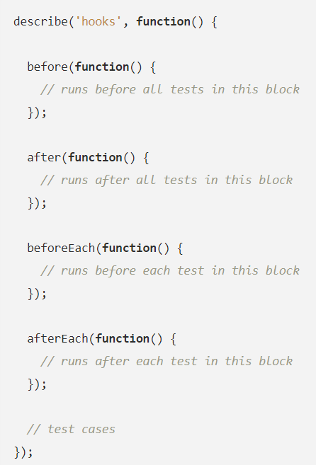
Test Hooks
Beside are the Test Hooks, we need to use specific test code inside these Hooks

Slide 12
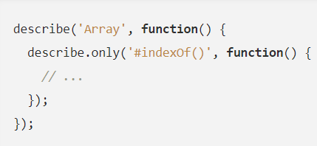
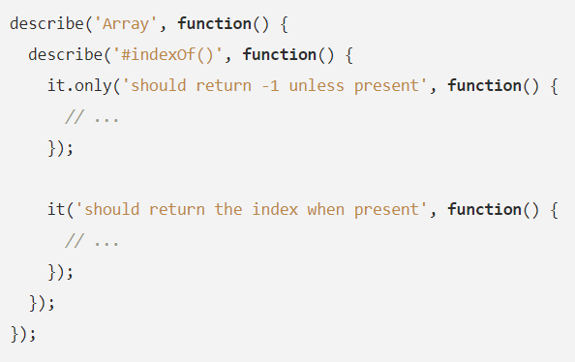
EXCLUSIVE TESTS
exclusivity feature allows you to run only the specified suite or test-case by appending .only() to the function. Here’s an example of executing only a particular suite:
Here’s an example of executing an individual test case:

Slide 13
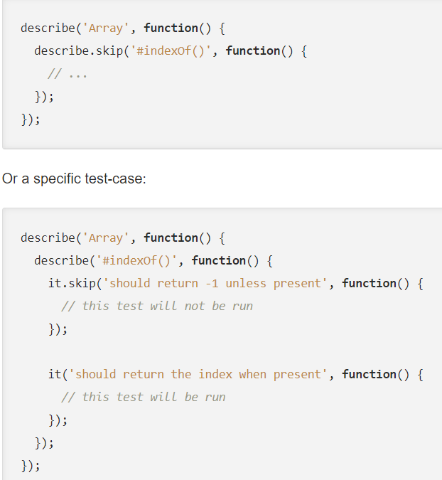
INCLUSIVE TESTS
By appending .skip(), you may tell Mocha to simply ignore these suite(s) and test case(s). Anything skipped will be marked as pending, and reported as such

Slide 14

Test Example
TEST/ DIRECTORY
By default, mocha looks for the glob ./test/*.js, so you may want to put your tests in
test/ folder. If you want to include sub directories, pass the --recursive option.
Some sample test code snippet is available below, you can use it for reference

Slide 15
app.electron
electron
The electron property is your gateway to accessing the full Electron API.
Each Electron module is exposed as a property on the electron property so you can think of it as an alias for require('electron') from within your app.
So if you wanted to access the clipboard API in your tests you would do:
app.electron.clipboard.writeText('pasta')
.electron.clipboard.readText().then(function (clipboardText) {
console.log('The clipboard text is ' + clipboardText)
})

