Slide 1

Chai
Official Website: https://www.chaijs.com/

Slide 2

Installation
Installation
Chai is available for both node.js and the browser using any test framework you like. There are also a number of other tools that include Chai.
Node.js
Package is available through npm:
Recommend adding it to package.json devDependencies using a * as the version tag. This will ensure that you always have the most recent version after running npm install, which can be especially powerful when paired with a continuous integration tool.

Slide 3

Installation
Browser
Include the chai browser build in your testing suite
This will provide chai as a global object, or define it if you are using AMD.
The latest tagged version will be available for hot-linking at http://chaijs.com/chai.js. If you prefer to host yourself, use the chai.js file from the root of the github project. We recommend that you always use a version tag as your starting point, so the tag download list is the best place to start.
.

Slide 4
Assertion styles
Assertion Styles
This section of the guide introduces you to the three different assertion styles that you may use in your testing environment. Once you have made your selection, it is recommended that you look at the API Documentation for your selected style.
Assert
View full Assert API
The assert style is exposed through assert interface. This provides the classic assert-dot notation, similar to that packaged with node.js. This assert module, however, provides several additional tests and is browser compatible.

Slide 5
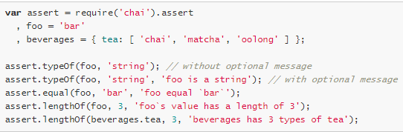
Assertion styles
In all cases, the assert style allows you to include an optional message as the last parameter in the assertstatement. These will be included in the error messages should your assertion not pass.
BDD
View full BDD API
The BDD style comes in two flavors: expect and should. Both use the same chainable language to construct assertions, but they differ in the way an assertion is initially constructed. In the case of should, there are also some caveats and additional tools to overcome the caveats.

Slide 6
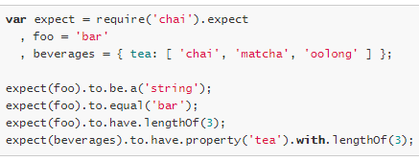
Assertion styles
Expect
The BDD style is exposed through expect or should interfaces. In both scenarios, you chain together natural language assertions.
Expect also allows you to include arbitrary messages to prepend to any failed assertions that might occur.

Slide 7
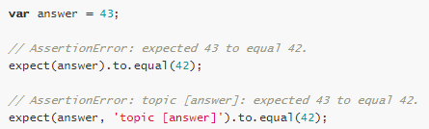
Assertion styles
This comes in handy when being used with non-descript topics such as booleans or numbers.
Should
The should style allows for the same chainable assertions as the expect interface, however it extends each object with a should property to start your chain. This style has some issues when used with Internet Explorer, so be aware of browser compatibility

Slide 8
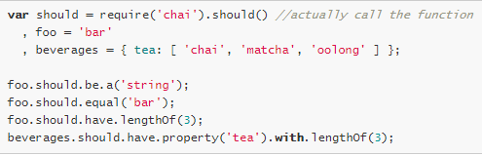

Assertion styles
Differences
First of all, notice that the expect require is just a reference to the expect function, whereas with the shouldrequire, the function is being executed.

Slide 9

Assertion styles
The expect interface provides a function as a starting point for chaining your language assertions. It works on node.js and in all browsers.
The should interface extends Object.prototype to provide a single getter as the starting point for your language assertions. It works on node.js and in all modern browsers except Internet Explorer.
Should Extras
Given that should works by extending Object.prototype, there are some scenarios where should will not work. Mainly, if you are trying to check the existence of an object. Take the following pseudocode:

Slide 10
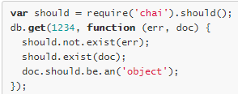
Assertion styles
Given that err should be null or undefined, err.should.not.exist is not a valid statement as undefinedand null haven’t been extended with a should chain starter. As such, the appropriate few assertions for this scenario are as follows:
Provided you assigned should to a var, you have access to several quick helpers to keep you out of trouble when using should.
should.exist
should.not.exist
should.equal
should.not.equal
should.Throw
should.not.Throw

Slide 11


Assertion styles
Using Should in ES2015
It isn’t possible to chain a function call from an ES2015 import statement – it has to go on its own line, which looks a little verbose:
For a cleaner look, you can do this instead:

Slide 12
Assertion styles
Configuration
config.includeStack
@param {Boolean}
@default false
User configurable property, influences whether stack trace is included in Assertion error message. Default of false suppresses stack trace in the error message.
config.showDiff
@param {Boolean}
@default true
User configurable property, influences whether or not the showDiff flag should be included in the thrown AssertionErrors. false will always be false; true will be true when the assertion has requested a diff be shown.

Slide 13
Assertion styles
config.truncateThreshold
@param {Number}
@default 40
User configurable property, sets length threshold for actual and expected values in assertion errors. If this threshold is exceeded, the value is truncated.
Set it to zero if you want to disable truncating altogether.

Slide 14
Chai Assertions For Promises
Chai as Promised extends Chai with a fluent language for asserting facts about promises.
Instead of manually wiring up your expectations to a promise’s fulfilled and rejected handlers:

