Slide 1

Electron JS

Slide 2
Electron - Introduction
Electron is an open source JS library/framework developed by GitHub for building cross-platform desktop applications with HTML, CSS, and JavaScript.
Electron accomplishes this by combining Chromium and Node.js into a single runtime and apps can be packaged for Mac, Windows, and Linux.
Chromium: Chromium is an open-source Web browser project started by Google, to provide the source code for the proprietary Google Chrome browser. The two browsers share the majority of code and features,
Prerequisites:
Working knowledge in the Technologies HTML5/CSS/Basic JS is essential. Knowledge in Node.js APIs such as file handling, processes, network modules, etc. is added advantage

Slide 3
Electron-Web Page diff
When normal web page executes on Browser, it cannot access the Resources(File System, etc…) of local System
But an Electron app does not have above restrictions, and can access all the resources of local system, using various modules of
Electron
NodeJS

Slide 4
Electron-overview
Many Applications such as Visual Studio Code, Git Desktop client are developed using Electron
Brief History of JavaScript:
Initially used in Web pages for Client side Validations, and to perform dynamic operations on web pages.
Due to flexibility in Javascript JSON, AJAX, etc… and due to limitations to build huge Applications in Javascript, a number of JavaScript frameworks have been mushroomed like Angular, TypeScript, etc…
ES6 are latest specifications of Javascript, Typescript is an extension to ES6 features.

Slide 5

Electron-Installation
To get started with developing using the Electron, you need to have Node and npm(Node Package Manager) installed.
However latest version of NodeJS has npm built in.
Node can be downloaded and installed from below URL
https://nodejs.org/en/download/
Installation of node can be verified by giving below commands

Slide 6
Create Electron project
Create a folder, and goto that folder from command line
Use below command
npm init
It asks for various details like author name, license type, etc.. as shown in next slide. Enter the details appropriately
Now observe that a file name package.json gets created with the details you have provided, above

Slide 7
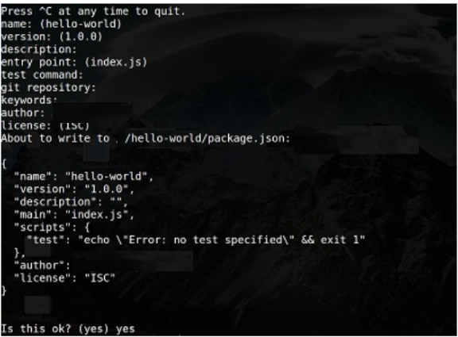
Electron-Installation
It will ask you for the following information −

Slide 8


Electron-Installation
Just keep pressing Enter, and enter your name at the “author name” field.
Create a new folder and open it using the cd command. Now run the following command to install Electron globally.
Verify installation of electron, by giving below command
You should get the output −
Now that we have set up Electron, let us move on to creating our first app using it.

Slide 9
How Electron App Works
Electron takes a main file defined in your package.json file and executes it. This main file creates main application.
As you start an application using Electron, a main process is created. This main process is responsible for interacting with the native GUI of the Operating System.
Just starting the main process does not give the users of your application any application window.
These are created by the main process in the main file by using the BrowserWindow module.

Slide 10
How Electron App Works
Each browser window then runs its own renderer process. The renderer process takes an HTML file which references the usual CSS files, JavaScript files, images, etc. and renders it in the window.
The main process can access the native GUI through modules available directly in Electron.
Above desktop applications can access all Node modules like the file system module for handling files, request to make HTTP calls, etc.

Slide 11
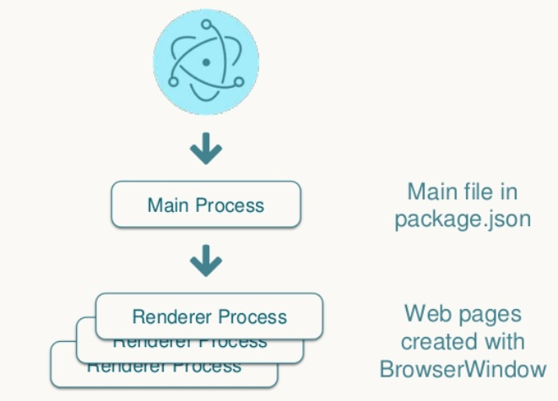
Electron-Main & Renderer Process

Slide 12
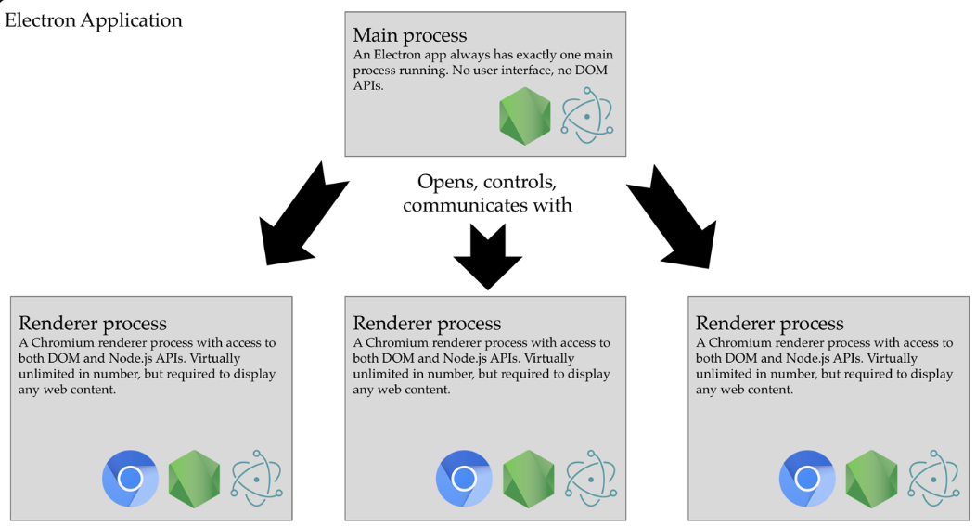
Electron-Main & Renderer Process

Slide 13
BrowserWindow
The main process creates web pages by creating the BrowserWindow instances.
Each BrowserWindow instance runs the web page in its own renderer process.
When a BrowserWindow instance is destroyed, the corresponding renderer process is also terminated.
The main process manages all web pages and their corresponding renderer processes.
Each renderer process is isolated and only cares about the web page running in it.

Slide 14
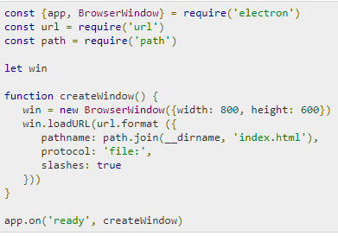
Electron-Hello World
We have created a package.json file for our project. Now we will create our first desktop app using Electron.
Create a new file called main.js. Enter the following code in it −
Electron Modules
NodeJS Modules
starts Renderer Process
current directory
JSON object
(provide examples on few JSON declarations. What is JSON)
Notes:
Official Documentation https://electronjs.org/docs

Slide 15
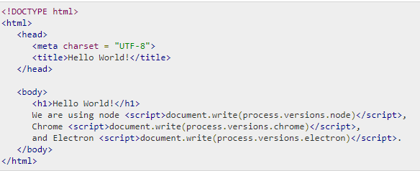

Electron-Hello World
Run this app using the following command −
Notes:
Can Main process start multiple Electron process

Slide 16
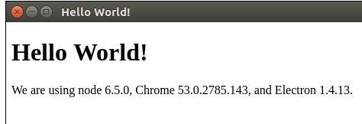
Electron-Hello World
A new window will open up. It will look like the following −
How Does This App Work?
We created a main file and an HTML file. The main file uses two modules – appand BrowserWindow. The app module is used to control your application’s event lifecycle while the BrowserWindow module is used to create and control browser windows.
We defined a createWindow function, where we are creating a new BrowserWindow and attaching a URL to this BrowserWindow. This is the HTML file that is rendered and shown to us when we run the app.
We have used a native Electron object process in our html file. This object is extended from the Node.js process object and includes all of t=itsfunctionalities while adding many more.

Slide 17
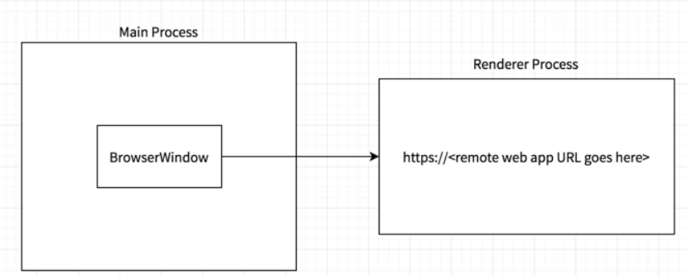
Electron
Can a Main Process launch multiple different Renderer Process?
Can one Renderer process launch another Renderer Process?
Notes:
Can one Rederer Process start another Renderer Process

Slide 18
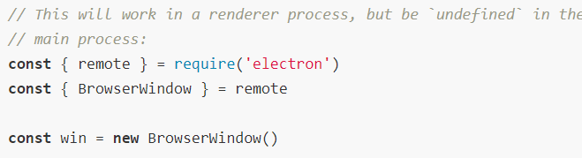
Electron-Application Architecture
An Electron app always has one main process, but never more. Since Electron uses Chromium for displaying web pages, Chromium's multi-process architecture is also used. Each web page in Electron runs in its own process, which is called the renderer process.
In normal browsers, web pages usually run in a sandboxed environment and are not allowed access to native resources. Electron users, however, have the power to use Node.js APIs in web pages allowing lower level operating system interactions.
Electron comes with a module called remote that exposes APIs usually only available on the main process. In order to create a BrowserWindow from a renderer process, we'd use the remote as a middle-man:

Slide 19
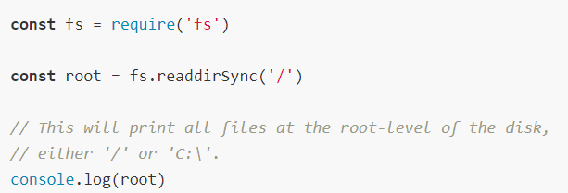
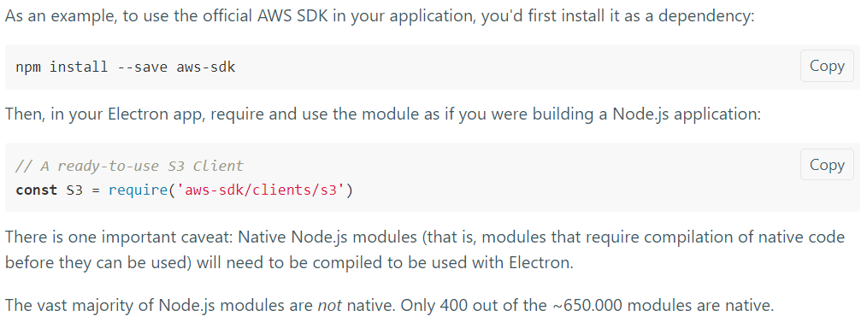
Electron-Using NodeJS APIs
Electron exposes full access to Node.js both in the main and the renderer process. This has two important implications:
1) All APIs available in Node.js are available in Electron. Calling the following code from an Electron app works:
You can use Node.js modules in your application. Pick your favorite npm module. (of any 3rd party)

Slide 20

Electron-Building Some UI’s
The User Interface of Electron apps is built using HTML, CSS and JS. So we can depend on all the available tools for front-end web development here as well.
You may also use the tools such as Angular, Backbone, React, Bootstrap, and Foundation, to build the apps.
You can use Bower to manage these front-end dependencies. Install bower using −
Bower is front end Package Manager
Now you can get all the available JS and CSS frameworks, libraries, plugins, etc. using bower. For example, to get the latest stable version of bootstrap, enter the following command −
Further, this will be required in our view.js file. We already have a main.js setup as follows −

Slide 21
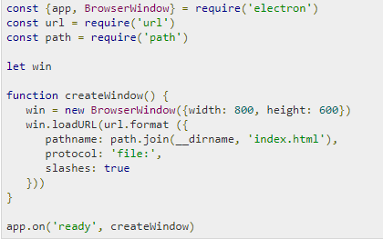
Electron-Building UI’s
Open your index.html file and enter above code in it −

Slide 22
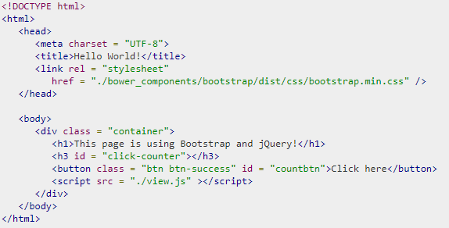
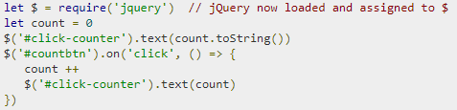
Electron-Building UI’s
including bootstrap library
include external js file
view.js
Notes:
Change above app, by adding Decrement Button as well

Slide 23

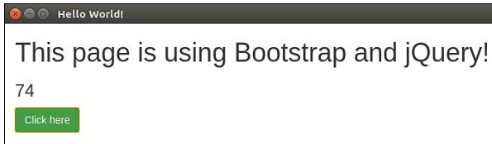
Electron-Building UI’s
Run the app using the following command −
The above command will generate the output as in the following screenshot −
You can build your native app just like you build websites.
If you do not want users to be restricted to an exact window size, you can leverage the responsive design and allow users to use your app in a flexible manner.

Slide 24
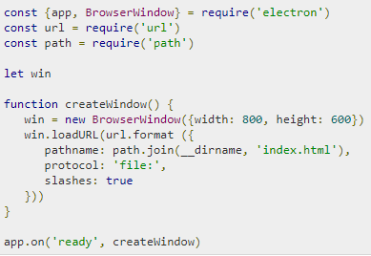
Electron-File Handling
File handling is a very important part of building a desktop application.
Almost all desktop apps interact with files.
Lets create a form in our app that takes as input, a Name and an Email address. This form will be saved to a file and a list will be created that will show this as output.
Set up your main process using the following code in the main.js file −
Notes:
alert, event and other examples

Slide 25
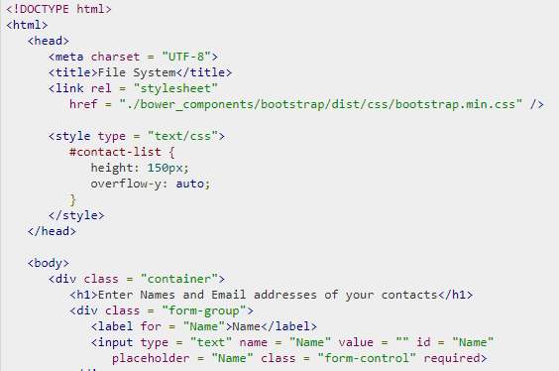
Electron-File Handling
Now open the index.html file and enter the following code in it −

Slide 26
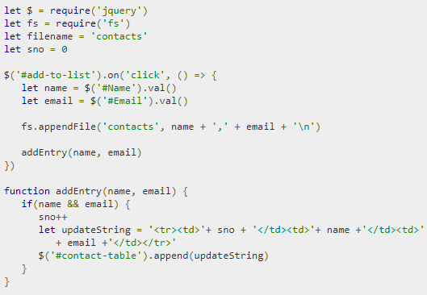
Electron-File Handling
fs is NodeJS library
jQuery is used in this example
Now run the application, using the following command −

Slide 27
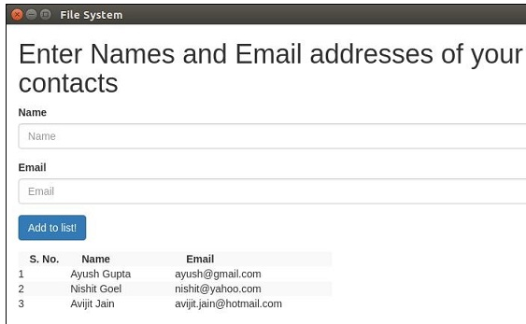
Electron-File Handling
Once you add some contacts to it, the application will look like −
For more fs module API calls, please refer to Node File reference
Now we can handle files using Electron. We will look at how to call the save and open dialog boxes(native) for files in the dialogs chapter.

Slide 28
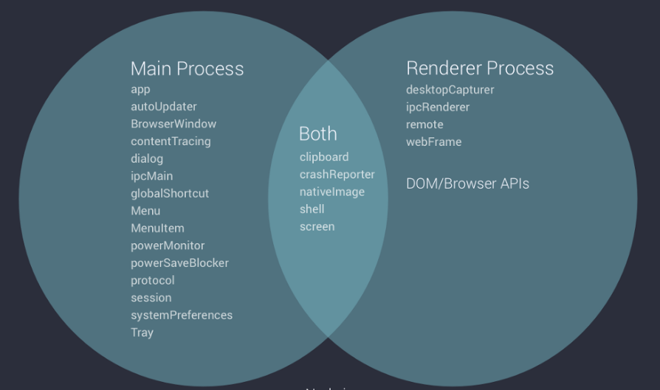
Electron-Modules Usage

Slide 29
Electron-Native Node Libraries
We used a node module, fs, in the previous chapter. Lets explore some other node modules that we can use with Electron.
OS module
Using the OS module, we can get a lot of information about the system our application is running on. Following are a few methods that help while the app is being created. These methods help us customize the apps according to the OS that they are running on.
S.No | Function & Description
1 | os.userInfo([options]) The os.userInfo() method returns information about the currently effective user. This information can be used to personalize the application for the user even without explicitly asking for information.

Slide 30
Electron-Native Node Libraries
2 | os.platform() The os.platform() method returns a string identifying the operating system platform. This can be used to customize the app according to the user OS.
3 | os.homedir() The os.homedir() method returns the home directory of the current user as a string. Generally, configs of all users reside in the home directory of the user. So this can be used for the same purpose for our app.
4 | os.arch() The os.arch() method returns a string identifying the operating system CPU architecture. This can be used when running on exotic architectures to adapt your application for that system.
5 | os.EOL A string constant defining the operating system-specific end-ofline marker. This should be used whenever ending lines in files on the host OS.
Notes:
List of Node JS Modules https://nodejs.org/api/

Slide 31
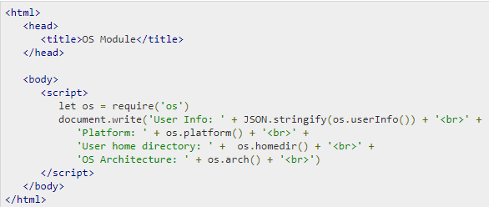

Electron-Native Node Libraries
Using the same main.js file and the following HTML file, we can print these properties on the screen −
Now run the app using the following command −

Slide 32
Electron-Native Node Libraries
S.No | Function & Description
1 | net.createServer([options][, connectionListener]) Creates a new TCP server. The connectionListener argument is automatically set as a listener for the 'connection' event.
2 | net.createConnection(options[, connectionListener]) A factory method, which returns a new 'net.Socket' and connects to the supplied address and port.
3 | net.Server.listen(port[, host][, backlog][, callback]) Begin accepting connections on the specified port and host. If the host is omitted, the server will accept connections directed to any IPv4 address.

Slide 33
Electron-Native Node Libraries
4 | net.Server.close([callback]) Finally closed when all connections are ended and the server emits a 'close' event.
5 | net.Socket.connect(port[, host][, connectListener]) Opens the connection for a given socket. If port and host are given, then the socket will be opened as a TCP socket.

Slide 34
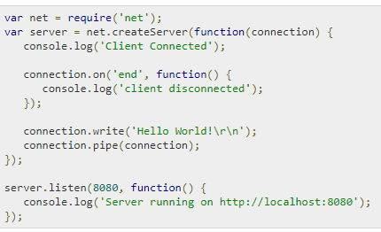
Electron-Native Node Libraries
Now, let us create an electron app that uses the net module to create connections to the server. We will need to create a new file, server.js −

Slide 35
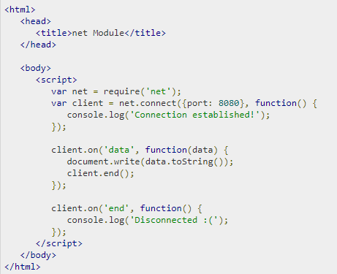
Electron-Native Node Libraries
Using the same main.js file, replace the HTML file with the following −
Run the application using the following command −

Slide 36

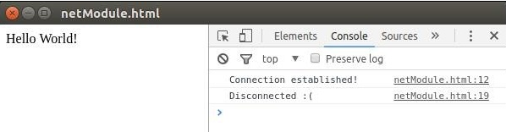
Electron-Native Node Libraries
The above command will generate the following output −
Observe that we connect to the server automatically and automatically get disconnected too.
We also have a few other node modules that we can be used directly on the front-end using Electron. The usage of these modules depends on the scenario you use them in.
url & path also are Node Modules, which we will be using in some of our code examples

Slide 37
Electron-NodeJS Modules
Below URL has list of inbuilt NodeJS Modules
https://nodejs.org/api/modules.html

Slide 38
Electron-What cannot be used
TBD
This slide briefs which Modules cannot be used from NodeJS, and any other related constraints
AJAX - TBD

Slide 39
Electron-Inter Process Communication
Electron provides us with 2 IPC (Inter Process Communication) modules called ipcMain and ipcRenderer.
ipcMain
The ipcMain module is used to communicate asynchronously from the main process to renderer processes.
When used in the main process, the module handles asynchronous and synchronous messages sent from a renderer process (web page).
The messages sent from a renderer will be emitted to this module.

Slide 40
Electron-Inter Process Communication
ipcRenderer
The ipcRenderer module is used to communicate asynchronously from a renderer process to the main process.
It provides a few methods so you can send synchronous and asynchronous messages from the renderer process (web page) to the main process.
You can also receive replies from the main process.
Lets consider an eg. which creates a main process and a renderer process that will send each other messages using the above modules.

Slide 41
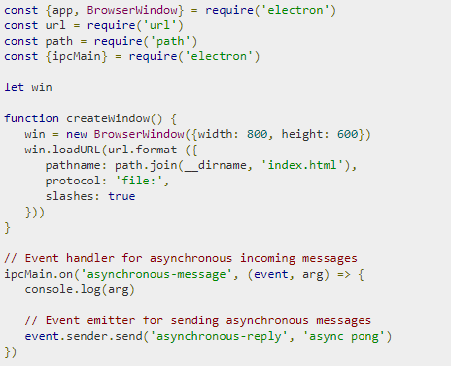
Electron-Inter Process Communication
Create a new file called main_process.js with the following contents −
Now create a new index.html file and add the following code in it.

Slide 42
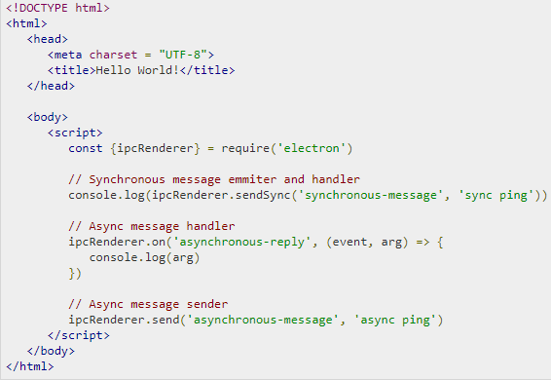

Electron-Inter Process Communication
Run the app using the following command −

Slide 43
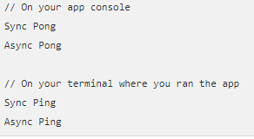
Electron-Inter Process Communication
The above command will generate the following output −
It is recommended not to perform computation of heavy/ blocking tasks on the renderer process. Always use IPC to delegate these tasks to the main process. This helps in maintaining the pace of your application.
https://electronjs.org/docs/faq#how-to-share-data-between-web-pages

Slide 44
Electron-System Dialogs
Though alert boxes can be used, those are not User friendly, instead Electron provides various System Dialogs.
Electron provides a pretty good interface to accomplish the task of creating dialog boxes. Let us have a look at it.
Electron provides a dialog module that we can use for displaying native system dialogs for opening and saving files, alerting, etc.
Let us directly jump into an example and create an app to display simple textfiles.
Create a new main.js file and enter the following code in it −

Slide 45
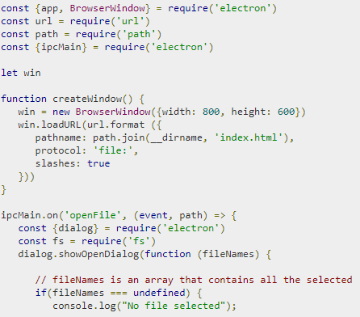
Electron-System Dialogs
This code will pop open the open dialog box whenever our main process recieves a 'openFile' message from a renderer process. This message will redirect the file content back to the renderer process. Now, we will have to print the content.
Now, create a new index.html file with the following content −

Slide 46
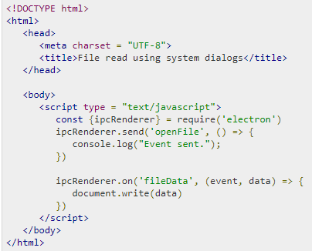
Electron-System Dialogs
Now whenever we run our app, a native open dialog box will pop up as shown in the following screenshot −

Slide 47
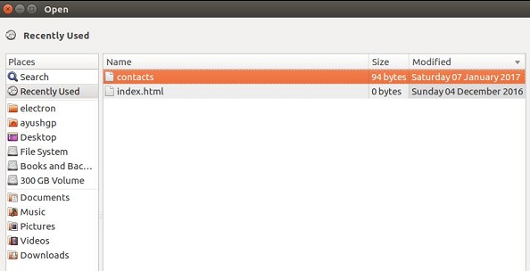

Electron-System Dialogs
Once we select a file to display, its contents will be displayed on the app window −

Slide 48
Electron-System Dialogs
This was just one of the four dialogs that Electron provides. They all have similar usage though. Once you learn how to do it using showOpenDialog, then you can use any of the other dialogs.
The dialogs having the same functionality are −
showSaveDialog([browserWindow, ]options[, callback])
showMessageDialog([browserWindow, ]options[, callback])
showErrorDialog(title, content)

Slide 49

Electron-Clipboard
Clipboard Module is used to perform copy and paste operations on the system clipboard.
Below is simple example showing how to copy to Clipboard
Below are the methods exposed by Clipboard Module
clipboard.readText([type])
type String (optional)
Returns String - The content in the clipboard as plain text.
clipboard.writeText(text[, type])
text String
type String (optional)
Writes the text into the clipboard as plain text.

Slide 50
Electron-Clipboard
clipboard.readHTML([type])
type String (optional)
Returns String - The content in the clipboard as markup.
clipboard.writeHTML(markup[, type])
markup String
type String (optional)
Writes markup to the clipboard.
clipboard.readImage([type])
type String (optional)
Returns NativeImage - The image content in the clipboard.
clipboard.writeImage(image[, type])
image NativeImage
type String (optional)
Writes image to the clipboard.
clipboard.readRTF([type])
type String (optional)
Returns String - The content in the clipboard as RTF.
clipboard.writeRTF(text[, type])
text String
type String (optional)
Writes the text into the clipboard in RTF.

Slide 51
Electron-Menus
The desktop apps come with two types of menus – the application menu(on the top bar) and a context menu(right-click menu). We will learn how to create both of these in this chapter.
We will be using two modules – the Menu and the MenuItem modules. Note that the Menu and the MenuItem modules are only available in the main process. For using these modules in the renderer process, you need the remote module. We will come across this when we create a context menu.
Now, let us create a new main.js file for the main process −

Slide 52
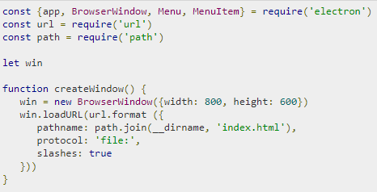

Electron-Menus
We are building a menu from a template here. This means that we provide the menu as a JSON to the function and it will take care of the rest. Now we have to set this menu as the Application menu.
Now create an empty HTML file called index.html and run this application using −

Slide 53
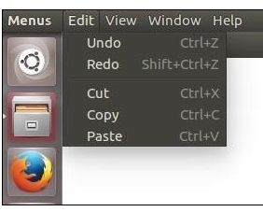
Electron-Menus
On the normal position of application menus, you will see a menu based on the above template.
We created this menu from the main process. Let us now create a context menu for our app. We will do this in our HTML file −

Slide 54
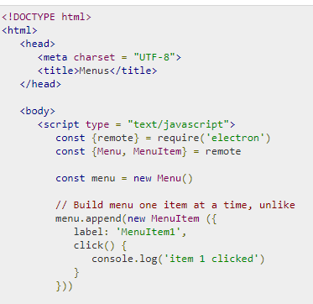
Electron-Menus
We imported the Menu and MenuItem modules using the remote module; then, we created a menu and appended our menuitems to it one by one. Further, we prevented the default action of right-click in chromium and replaced it with our menu.

Slide 55
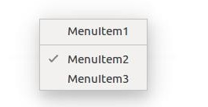
Electron-Menus
The creation of menus in Electron is a very simple task. Now you can attach your event handlers to these items and handle the events according to your needs.

Slide 56
Electron-Shell
The shell module provides functions related to desktop integration.
An example of opening a URL in the user's default browser:
const {shell} = require('electron') shell.openExternal('https://github.com')
The shell module has the following methods:
shell.showItemInFolder(fullPath)
fullPath String
Returns Boolean - Whether the item was successfully shown.
Show the given file in a file manager. If possible, select the file.
shell.openItem(fullPath)
fullPath String
Returns Boolean - Whether the item was successfully opened.
Open the given file in the desktop's default manner.
shell.openExternal(url[, options, callback])

Slide 57

Electron-System Tray
System tray is a menu outside of your application window. On MacOS and Ubuntu, it is located on the top right corner of your screen. On Windows it is on the bottom right corner. We can create menus for our application in system trays using Electron.
Create a new main.js file and add the following code to it. Have a png file ready to use for the system tray icon.

Slide 58
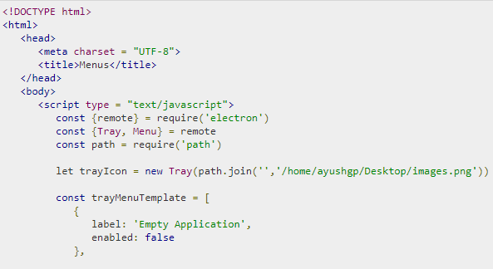
Electron-System Tray
After having set up a basic browser window, we will create a new index.htmlfile with the following content −
We created the tray using the Tray submodule. We then created a menu using a template and further attached the menu to our tray object.
Run the application using the following command −

Slide 59

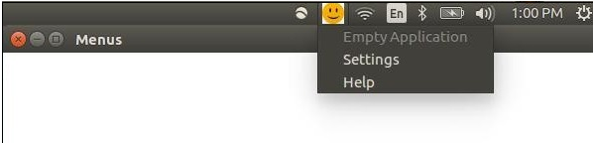
Electron-System Tray
When you run the above command, check your system tray for the icon you used. I used a smiley face for my application. The above command will generate the following output −

Slide 60

Electron-Notifications
Electron provides native notifications API only for MacOS. So we are not going to use that, instead we'll be using a npm module called node-notifier. It allows us to notify users on Windows, MacOS and Linux.
Install the node-notifier module in your app folder using the following command in that folder −
Let us now create an app that has a button which will generate a notification every time we click on this button.
Create a new main.js file and enter the following code in it −

Slide 61

Electron-Notifications
Let us now create our webpage and script that will trigger the notification. Create a new index.html file with the following code −

Slide 62
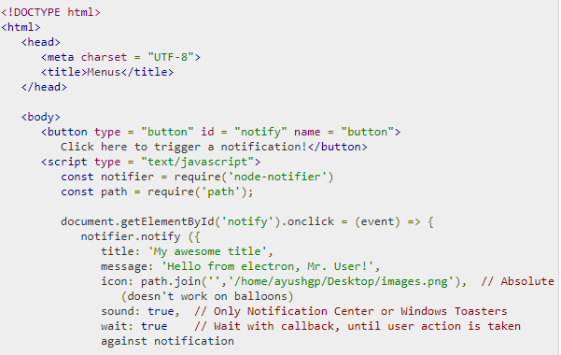
Electron-Notifications
The notify method allows us to pass it an objectwith information like the title, message, thumbnail, etc. which help us customize the notification. We can also set some event listeners on the notification.
Now, run the app using the following command −

Slide 63

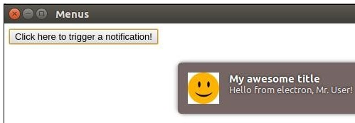
Electron-Notifications
When you click on the button that we created, you will see a native notification from your operating system as shown in the following screenshot −
We have also handled the events wherein, the user clicks the notification or the notification times out. These methods help us make the app more interactive if its running in the background.

Slide 64
Electron-WebView
The webview tag is used to embed the 'guest' content like web pages in your Electron app. This content is contained within the webview container.
The webview runs in a separate process than your app. To ensure security from malicious content, the webview doesn't have same permissions as your web page. This keeps your app safe from the embedded content. All interactions between your app and the embedded page will be asynchronous.
Let us consider an example to understand the embedding of an external webpage in our Electron app. We will embed an website in our app on the right side. Create a new main.js file with the following content −

Slide 65

Electron-WebView
Now that we have set up our main process, let us create the HTML file that will embed the tutorialspoint website. Create a file called index.html with the following content −

Slide 66
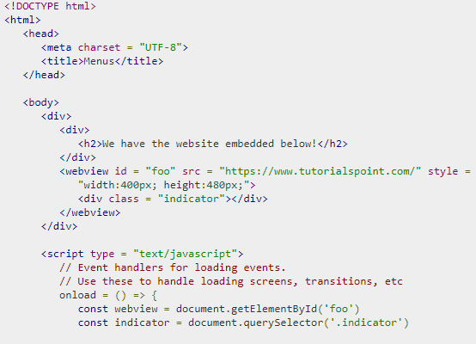
Electron-WebView

Slide 67

Electron-WebView
Run the app using the following command −
The above command will generate the following output −

Slide 68
Electron-WebView
The webview tag can be used for other resources as well. The webview element has a list of events that it emits listed on the official docs. You can use these events to improve the functionality depending on the things that take place in the webview.
Whenever you are embedding scripts or other resources from the Internet, it is advisable to use webview. This is recommended as it comes with great security benefits and does not hinder normal behaviour.

Slide 69
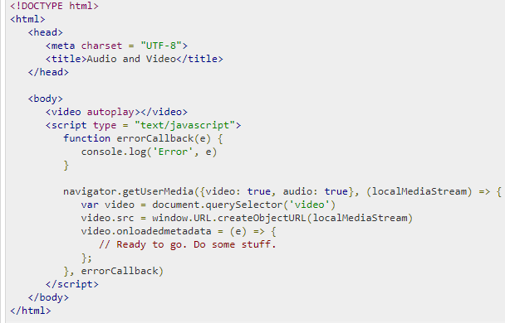
Electron-Audio And Video Capturing
Now that we have set up our main process, let us create the HTML file that will be capturing this content. Create a file called index.html with the following content −

Slide 70
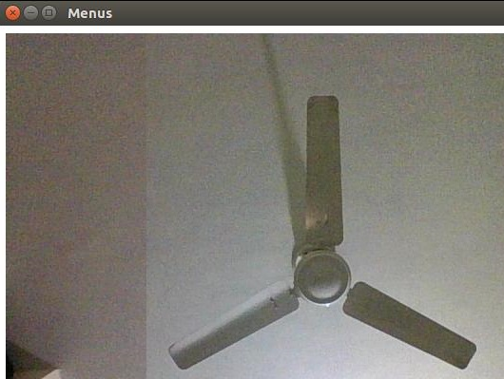
Electron-Audio And Video Capturing
The above program will generate following output

Slide 71
Electron-Audio And Video Capturing
You now have the stream from both your webcam and your microphone. You can send this stream over the network or save this in a format you like.
Have a look at the MDN Documentation for capturing images to get the images from your webcam and store them. This was done using the HTML5 getUserMedia API. You can also capture the user desktop using the desktopCapturer module that comes with Electron. Let us now see an example of how to get the screen stream.
Use the same main.js file as above and edit the index.html file to have the following content −

Slide 72
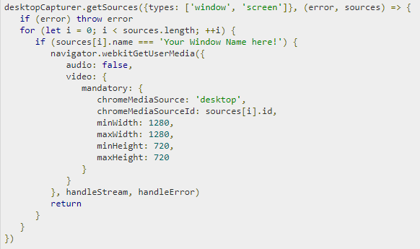
Electron-Audio And Video Capturing
We have used the desktopCapturer module to get the information about each open window. Now you can capture the events of a specific application or of the entire screen depending on the name you pass to the above if statement. This will stream only that which is happening on that screen to your app.

Slide 73
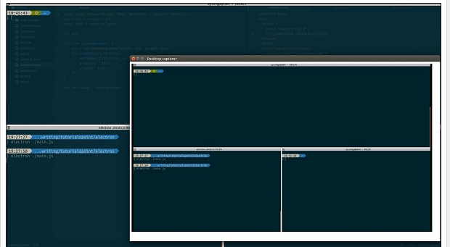
Electron-Audio And Video Capturing

Slide 74
Electron-Defining shortcuts
To make your applications feel intuitive and easily accessible to the user, you must allow the user to use shortcuts.
We will use the globalShortcut module to define shortcuts in our app. Note that Accelerators are Strings that can contain multiple modifiers and key codes, combined by the + character. These accelerators are used to define keyboard shortcuts throughout our application.
Let us consider an example and create a shortcut. For this, we will follow the dialog boxes example where we used the open dialog box for opening files. We will register a CommandOrControl+O shortcut to bring up the dialog box.
Our main.js code will remain the same as before. So create a new main.jsfile and enter the following code in it −

Slide 75
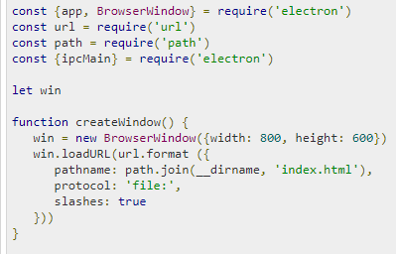
Electron-Defining shortcuts
This code will pop open the open dialog box whenever our main process receives a 'openFile' message from a renderer process. Earlier this dialog box popped up whenever the app was run. Let us now limit it to open only when we press CommandOrControl+O.
Now create a new index.html file with the following content −

Slide 76
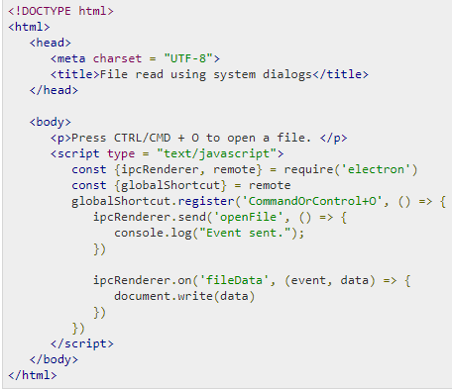
Electron-Defining shortcuts
We registered a new shortcut and passed a callback that will be executed whenever we press this shortcut. We can deregister shortcuts as and when we do not require them.
Now once the app is opened, we will get the message to open the file using the shortcut we just defined.

Slide 77
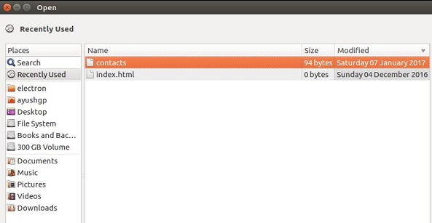
Electron-Defining shortcuts

Slide 78
Electron - Remote
What is Remote and What is purpose of it?

Slide 79
Electron-Environment Variables
Environment Variables control application configuration and behavior without changing code. Certain Electron behaviors are controlled by environment variables because they are initialized earlier than the command line flags and the app’s code.
There are two kinds of environment variables encoded in electron – Production variables and Development variables.
Production Variables
The following environment variables are intended for use at runtime in packaged Electron applications.

Slide 80
Electron-Environment Variables
S.No | Variable & Description
1 | GOOGLE_API_KEY Electron includes a hardcoded API key for making requests to Google’s geocoding webservice. Because this API key is included in every version of Electron, it often exceeds its usage quota. To work around this, you can supply your own Google API key in the environment. Place the following code in your main process file, before opening any browser windows that will make geocoding requests −
2 | ELECTRON_RUN_AS_NODE Starts the process as a normal Node.js process.
3 | ELECTRON_FORCE_WINDOW_MENU_BAR (Linux Only) Do not use the global menu bar on Linux.

Slide 81
Electron-Environment Variables
Development Variables
The following environment variables are intended primarily for development and debugging purposes.
S.No | Variable & Description
1 | ELECTRON_ENABLE_LOGGING Prints Chrome’s internal logging to the console.
2 | ELECTRON_ENABLE_STACK_DUMPING Prints the stack trace to the console when Electron crashes.
3 | ELECTRON_DEFAULT_ERROR_MODE Shows the Windows’s crash dialog when Electron crashes

Slide 82

Electron-Environment Variables
To set any of these environment variables as true, set it in your console. For example, if you want to enable logging, then use the following commands −For Windows
For Linux
Note that you will need to set these environment variables every time you restart your computer. If you want to avoid doing so, add these lines to your .bashrc files.

Slide 83
Electron-Debugging
We have two processes that run our application – the main process and the renderer process.
Since the renderer process is the one being executed in our browser window, we can use the Chrome Devtools to debug it. To open DevTools, use the shortcut "Ctrl+Shift+I" or the <F12> key. You can check out how to use devtools here.
When you open the DevTools, your app will look like as shown in the following screenshot −

Slide 84
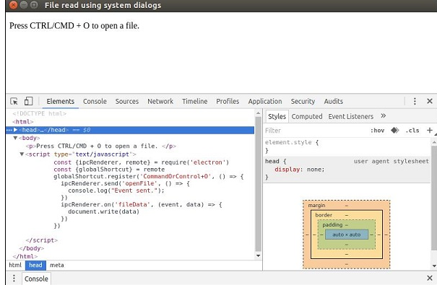
Electron-Debugging

Slide 85
Electron-Debugging
Debugging the Main Process
The DevTools in an Electron browser window can only debug JavaScript that is executed in that window (i.e., the web pages). To debug JavaScript that is executed in the main process you will need to use an external debugger and launch Electron with the --debug or the --debug-brk switch.
Electron will listen for the V8 debugger protocol messages on the specified port; an external debugger will need to connect on this port. The default port is 5858.
Run your app using the following −
Now you will need a debugger that supports the V8 debugger protocol. You can use VSCode or node-inspector for this purpose. For example, let us follow these steps and set up VSCode for this purpose. Follow these steps to set it up −
Download and install VSCode. Open your Electron project in VSCode.

Slide 86
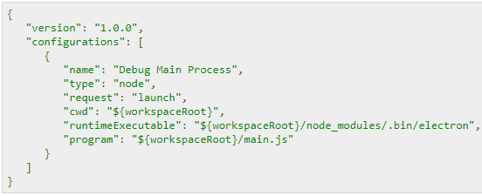
Electron-Debugging
Set some breakpoints in main.js, and start debugging in the Debug View. When you hit the breakpoints, the screen will look something like this −

Slide 87
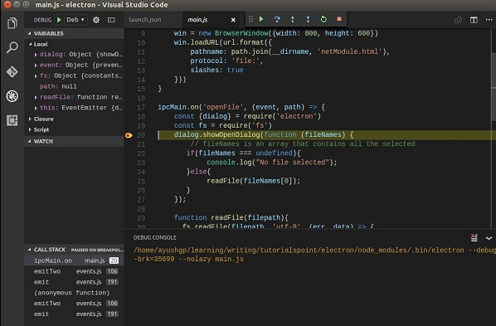
Electron-Debugging

Slide 88
Electron-Packaging Apps
Packaging and distributing apps is an integral part of the development process of a desktop application. Since Electron is a cross-platform desktop application development framework, packaging and distribution of apps for all the platforms should also be a seamless experience.
The electron community has created a project, electron-packager that takes care of the same for us. It allows us to package and distribute our Electron app with OS-specific bundles (.app, .exe etc) via JS or CLI.

Slide 89
Electron-Packaging Apps
Supported Platforms
Electron Packager runs on the following host platforms −
Windows (32/64 bit)
OS X
Linux (x86/x86_64)
It generates executables/bundles for the following target platforms −
Windows (also known as win32, for both 32/64 bit)
OS X (also known as darwin) / Mac App Store (also known as mas)
Linux (for x86, x86_64, and armv7l architectures)
Installation
Install the electron packager using −

Slide 90
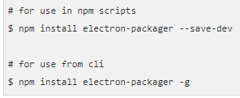
Electron-Packaging Apps
Packaging Apps
In this section, we will see how to run the packager from the command line. The basic form of the command is −
This will −
Find or download the correct release of Electron.
Use that version of Electron to create a app in <output-folder>/<appname>-<platform>-<arch>.
--platform and --arch can be omitted, in two cases. If you specify --allinstead, bundles for all valid combinations of target platforms/architectures will be created. Otherwise, a single bundle for the host platform/architecture will be created.

Slide 91
Electron Apps using MySQLDB
Installing MySQL Client for Node.js
First we need to install the mysql module for Node.js from NPM so go ahead and run:
npm install mysql –save
Bootstrapping the Module
Here are the steps we need to follow to execute SQL queries against our MySQL database using node-mysql module:
Import or require mysql module
Create a connection object
Connect to database
Query the database
Close the connection
We first start by requiring the mysql module:
var mysql = require('mysql');
Then create a connection to database, you need to enter MySQL database system credentials and your database name.
var connection = mysql.createConnection({ host : 'localhost', user : 'root', password : 'YOUR_PASSWORD', database : 'demodb' });
After creating the connection object we use the connect() method to actually connect to the database
connection.connect();

Slide 92
Electron Apps using MySQLDB
At this point, we are ready to execute SQL queries against the database. Lets take a simple example
connection.query('SELECT 1 + 1 AS result', function (error, results, fields) { if (error) throw error; console.log('1 + 1 = ', results[0].result); });
If you finish working with a connection, you need to close it, using the end() method
connection.end();
As you can see, the API is clear and self explanatory and It’s quite easy to connect to a MySQL database then execute SQL queries. For a simple and complete demo using Electron with MySQL, make sure you check this Github repository.

Slide 93
Electron Apps using TypeScript
As known using TypeScript, instead of plain JavaScript has below advantages
Lets your application to scale
Reduces number of defects, due to clarity in types
helps IDE/Editors to highlight types and other parts of programs
etc…
Since there will be ts files, tsc need to be invoked when you try to build project, hence we need to provide tsconfig.json need to be provided by us. tsconfig.json stores all the tsc transpiler configurations. Below is snapshot of the same.

