Slide 1
Java Script-Promises

Slide 2
Java Script-Promises
What is a Promise?
A promise is an object that may produce a single value some time in the future: either a resolved value, or a reason that it’s not resolved (e.g., a network error occurred).
A promise may be in one of 3 possible states:
fulfilled,
rejected,
pending.
Promise users can attach callbacks to handle the fulfilled value or the reason for rejection.

Slide 3
Java Script-Promises-Advantages
Why promises?
Generally, there are four key advantages that the promises have over simple callback handlers .
Better definition of control flow of asynchronous logic
Reduced coupling
Better error handling
Improved readability

Slide 4
Java Script-Promises
notably the WHATWG Fetch spec and the Async Functions standard (a stage 3 draft at the time of this writing).
How Promises Work
A promise is an object which can be returned synchronously from an asynchronous function. It will be in one of 3 possible states:
Fulfilled: onFulfilled() will be called (e.g., resolve() was called)
Rejected: onRejected() will be called (e.g., reject() was called)
Pending: not yet fulfilled or rejected

Slide 5
Java Script-Promises
A promise is settled if it’s not pending (it has been resolved or rejected).
Sometimes people use resolved and settled to mean the same thing: not pending.
Once settled, a promise can not be resettled. Calling resolve() or reject()again will have no effect.
The immutability of a settled promise is an important feature.
Native JavaScript promises don’t expose promise states. Instead, you’re expected to treat the promise as a black box.
Only the function responsible for creating the promise will have knowledge of the promise status, or access to resolve or reject.

Slide 6
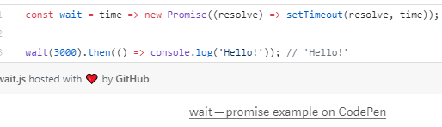
Java Script-Promises
Here is a function that returns a promise which will resolve after a specified time delay:
Is the Rejected Callback or Lambda Compulsory?

Slide 7
Java Script-Promises
The ES6 promise constructor takes a function. That function takes two parameters, resolve(), and reject(). In the example above, we’re only using resolve(), so reject() is off the parameter list. Then we call setTimeout() to create the delay, and call resolve() when it’s finished.
You can optionally resolve() or reject() with values, which will be passed to the callback functions attached with .then().
When reject() with a value, it always pass an Error object. Generally two possible resolution states: the normal happy path, or an exception — anything that stops the normal happy path from happening. Passing an Error object makes that explicit.

Slide 8
Java Script-Promises
Important Promise Rules
There are many implementations which conform to the standard, including the JavaScript standard ECMAScript promises.
Promises following the spec must follow a specific set of rules:
A promise or “thenable” is an object that supplies a standard-compliant .then() method.
A pending promise may transition into a fulfilled or rejected state.
A fulfilled or rejected promise is settled, and must not transition into any other state.
Once a promise is settled, it must have a value (which may be undefined). That value must not change.

Slide 9
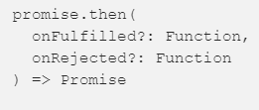
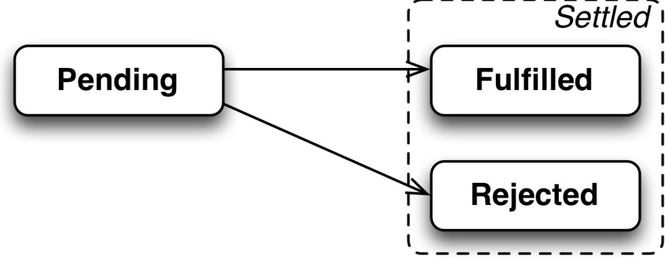
Java Script-Promises
Change in this context refers to identity (===) comparison. An object may be used as the fulfilled value, and object properties may mutate.
Every promise must supply a .then() method with the following signature:
The .then() method must comply with these rules:
Both onFulfilled() and onRejected() are optional.
If the arguments supplied are not functions, they must be ignored.

Slide 10
Java Script-Promises
onFulfilled() will be called after the promise is fulfilled, with the promise’s value as the first argument.
onRejected() will be called after the promise is rejected, with the reason for rejection as the first argument. The reason may be any valid JavaScript value, but because rejections are essentially synonymous with exceptions, I recommend using Error objects.
Neither onFulfilled() nor onRejected() may be called more than once.
.then() may be called many times on the same promise.
In other words, a promise can be used to aggregate callbacks.
.then() must return a new promise, promise2.

Slide 11
Java Script-Promises
If onFulfilled() or onRejected() return a value x, and x is a promise, promise2 will lock in with (assume the same state and value as) x. Otherwise, promise2 will be fulfilled with the value of x.
If either onFulfilled or onRejected throws an exception e, promise2must be rejected with e as the reason.
If onFulfilled is not a function and promise1 is fulfilled, promise2 must be fulfilled with the same value as promise1.
If onRejected is not a function and promise1 is rejected, promise2 must be rejected with the same reason as promise1.

Slide 12
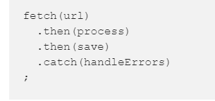
Java Script-Promise Chaining
Because .then() always returns a new promise, it’s possible to chain promises with precise control over how and where errors are handled. Promises allow you to mimic normal synchronous code’s try/catch behavior.
Like synchronous code, chaining will result in a sequence that runs in serial. In other words, you can do:
https://javascript.info/promise-chaining

Slide 13
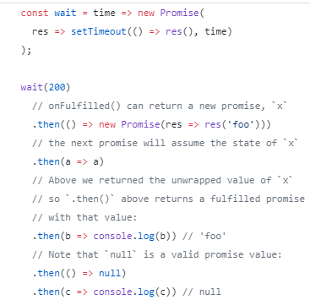
Java Script-Promise Chaining
Assuming each of the functions, fetch(), process(), and save() return promises, process() will wait for fetch() to complete before starting, and save() will wait for process() to complete before starting. handleErrors()will only run if any of the previous promises reject.
Here’s an example of a complex promise chain with multiple rejections:

Slide 14
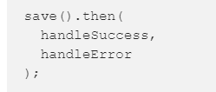
Java Script-Promises
Error Handling
Note that promises have both a success and an error handler, and it’s very common to see code that does this:
But what happens if handleSuccess() throws an error? The promise returned from .then() will be rejected, but there’s nothing there to catch the rejection — meaning that an error in your app gets swallowed. Oops!
For that reason, some people consider the code above to be an anti-pattern, and recommend the following, instead:

Slide 15
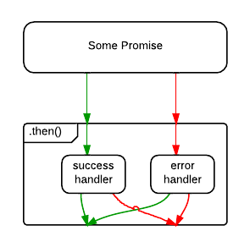
Java Script-Promises
The difference is subtle, but important. In the first example, an error originating in the save() operation will be caught, but an error originating in the handleSuccess() function will be swallowed.

Slide 16
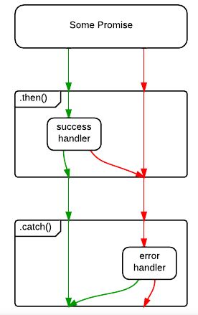
Java Script-Promises
In the second example, .catch() will handle rejections from either save(), or handleSuccess().

Slide 17
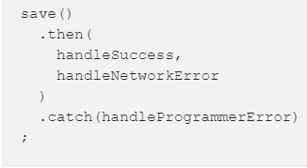
Java Script-Promises
Of course, the save() error might be a networking error, whereas the handleSuccess() error may be because the developer forgot to handle a specific status code. What if you want to handle them differently? You could opt to handle them both:

Slide 18

Promises-Error Handling
Asynchronous actions may sometimes fail: in case of an error the corresponding promise becomes rejected. For instance, fetch fails if the remote server is not available. We can use .catch to handle errors (rejections).
Promise chaining is great at that aspect. When a promise rejects, the control jumps to the closest rejection handler down the chain. That’s very convenient in practice.
For instance, in the code below the URL is wrong (no such server) and .catch handles the error:

Slide 19

Promises-Error Handling
Or, maybe, everything is all right with the server, but the response is not a valid JSON:

Slide 20
Java Script-Implicit try...catch
Explore this section in
https://javascript.info/promise-chaining

Slide 21
Java Script-Promises
Extras of the Native JS Promise
The native Promise object has some extra stuff you might be interested in:
Promise.reject() returns a rejected promise.
Promise.resolve() returns a resolved promise.
Promise.race() takes an array (or any iterable) and returns a promise that resolves with the value of the first resolved promise in the iterable, or rejects with the reason of the first promise that rejects.
Promise.all() takes an array (or any iterable) and returns a promise that resolves when all of the promises in the iterable argument have resolved, or rejects with the reason of the first passed promise that rejects.

Slide 22
Java Script-Promises
Conclusion
Promises have become an integral part of several idioms in JavaScript, including the WHATWG Fetch standard used for most modern ajax requests, and the Async Functions standard used to make asynchronous code look synchronous.
Async functions are stage 3 at the time of this writing, but I predict that they will soon become a very popular, very commonly used solution for asynchronous programming in JavaScript — which means that learning to appreciate promises is going to be even more important to JavaScript developers in the near future.

