Slide 1
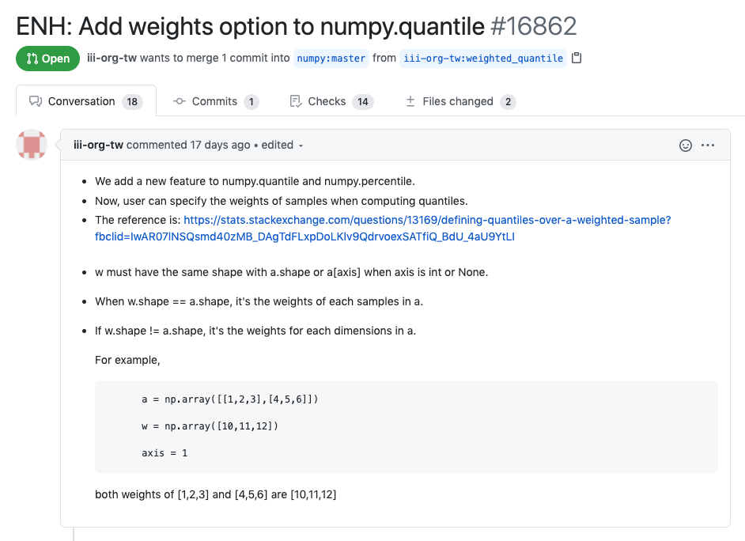
Python - Numpy
PR Link: https://github.com/numpy/numpy/pull/16862
Begin Date: 7/14
End Date: ?
Status: In Review

Slide 2
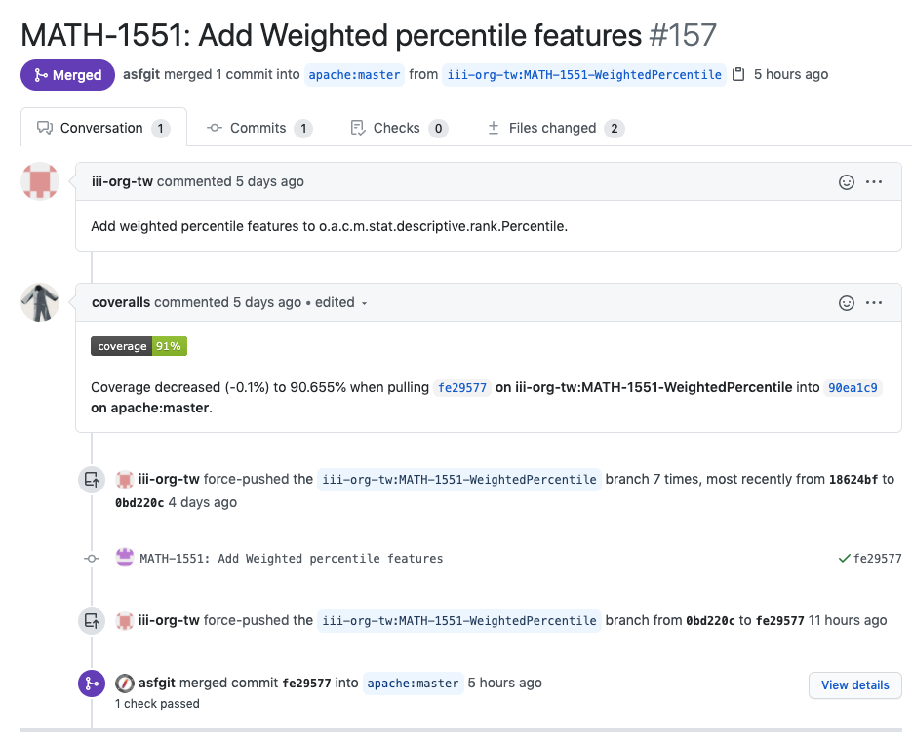
Java - Apache Common Math
PR Link: https://github.com/apache/commons-math/pull/157
Begin Date: 7/26
End Date: 7/31
Status: Merged

Slide 3
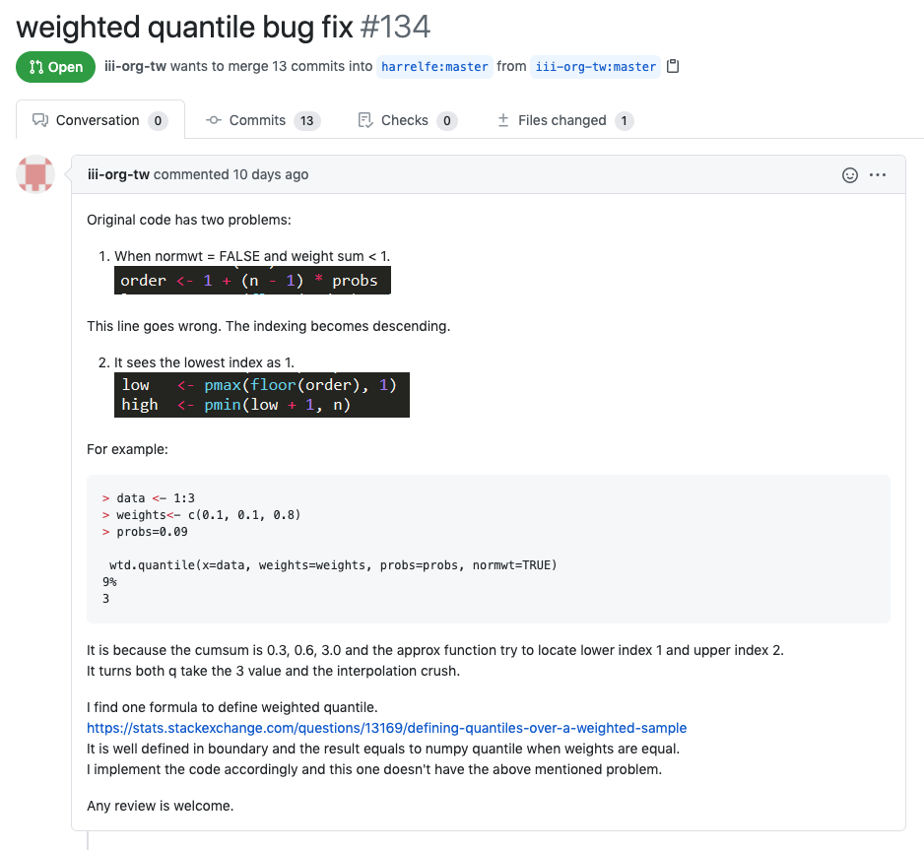
R - Hmisc
PR Link: https://github.com/harrelfe/Hmisc/pull/134
Begin Date: 7/21
End Date: ?
Status: In Review

