Slide 1
Open nlp project
Ekaterina Nikitina
Ekaterina Akhmetshina
Ramil fatkiev
Oleksii Ariasov

Slide 2
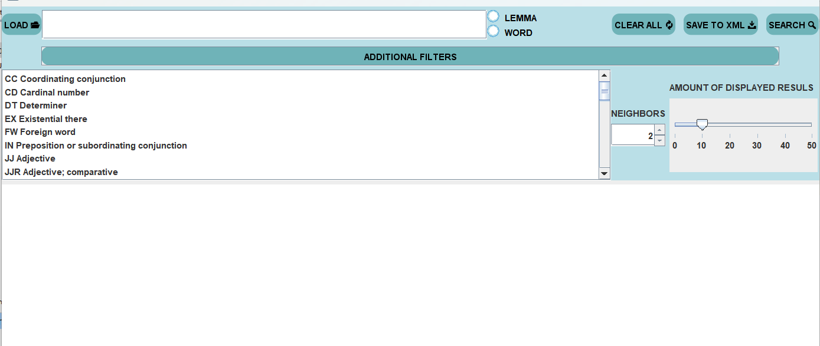
interface
Upper part:
All basic funcitons
Lower part:
Is hidable under spoiler
POS choice in list form (it is possible to choose couple of POS using Ctrl + Left Mouse Button)
Choice of word’s neighbors displayed
Choice of displayed results

Slide 3
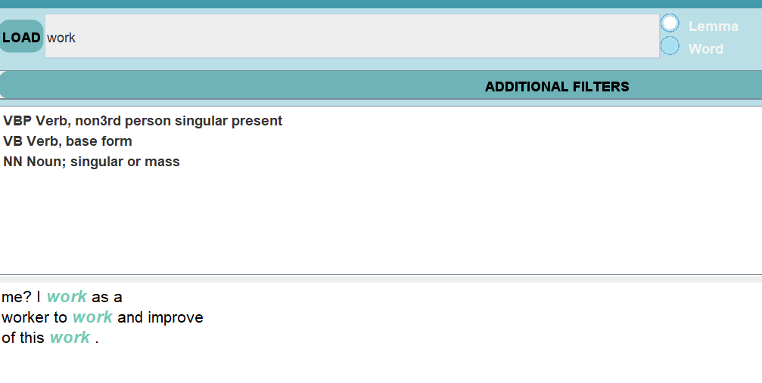
Algorithm of usage
Load text
- From file
- Using URL link
Search:
Input word
by Lemma
By Word
Leave Text Field empty
By POS
Clear to Search again
Save to XML
МЕСТО ДЛЯ ФОТО

Slide 4
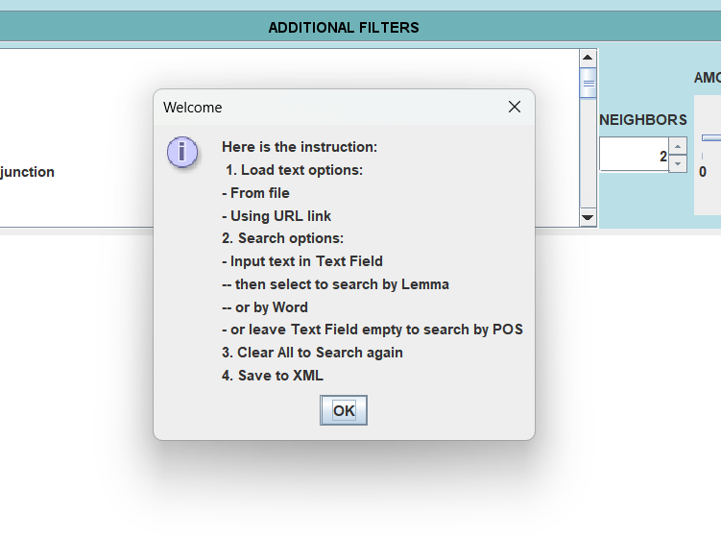
Examples instructions page

Slide 5
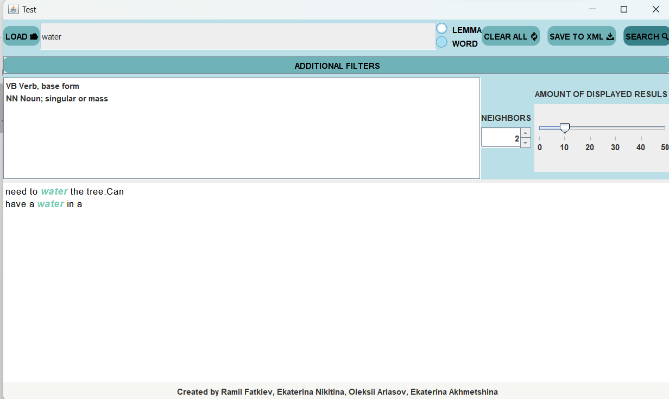
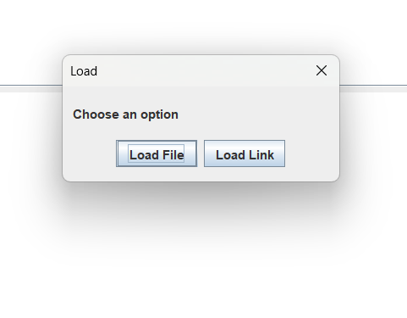
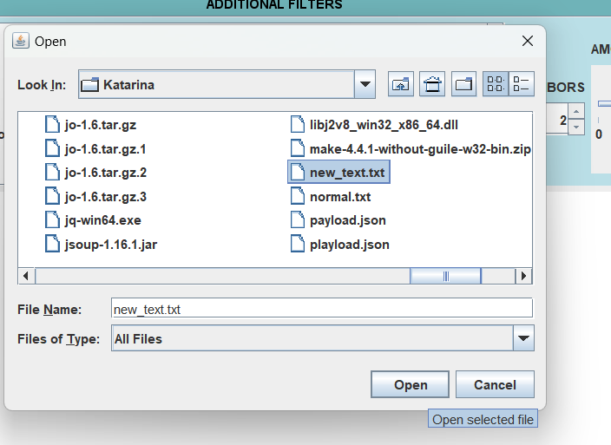
Examples file loading
Choose Load File option
Choose a file you want to process
Enter the word, choose “Word” or “Lemma”, press Search

Slide 6
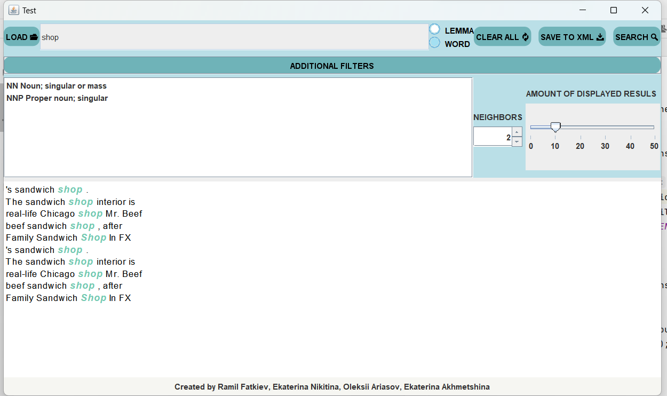
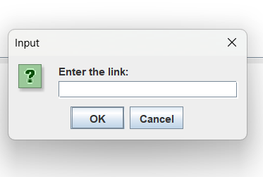
Examples Link loading
Choose Load Link option
Enter your link
Enter the word, choose “Word” or “Lemma”, press Search

Slide 7
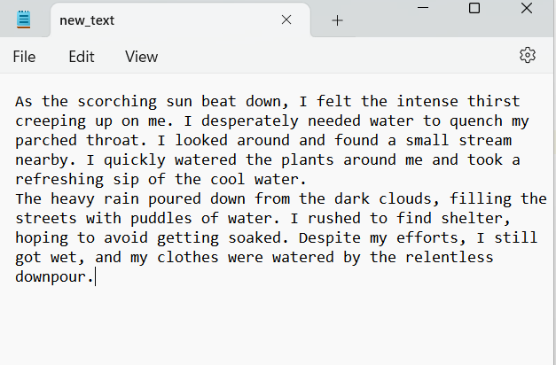
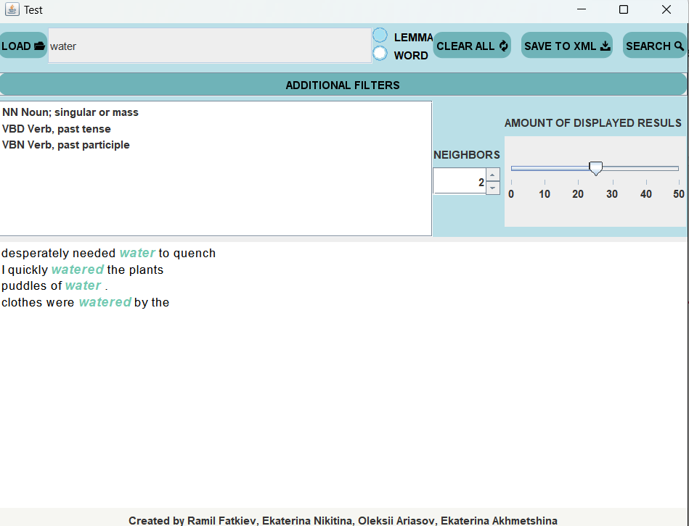
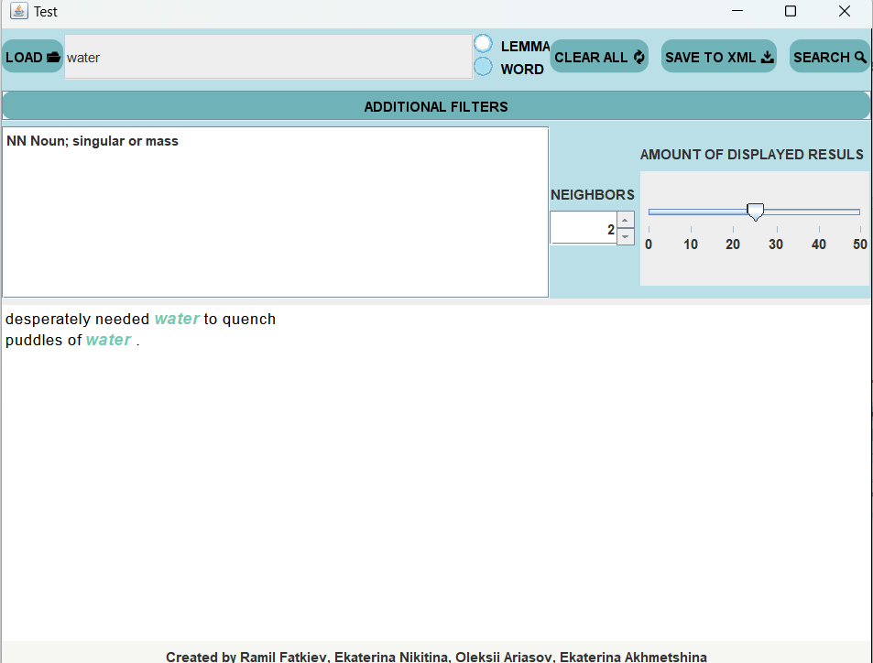
Examples search by lemma/Word
If the file contains a word, both in its original form and in a modified one , we can limit the search using this feature.

Slide 8
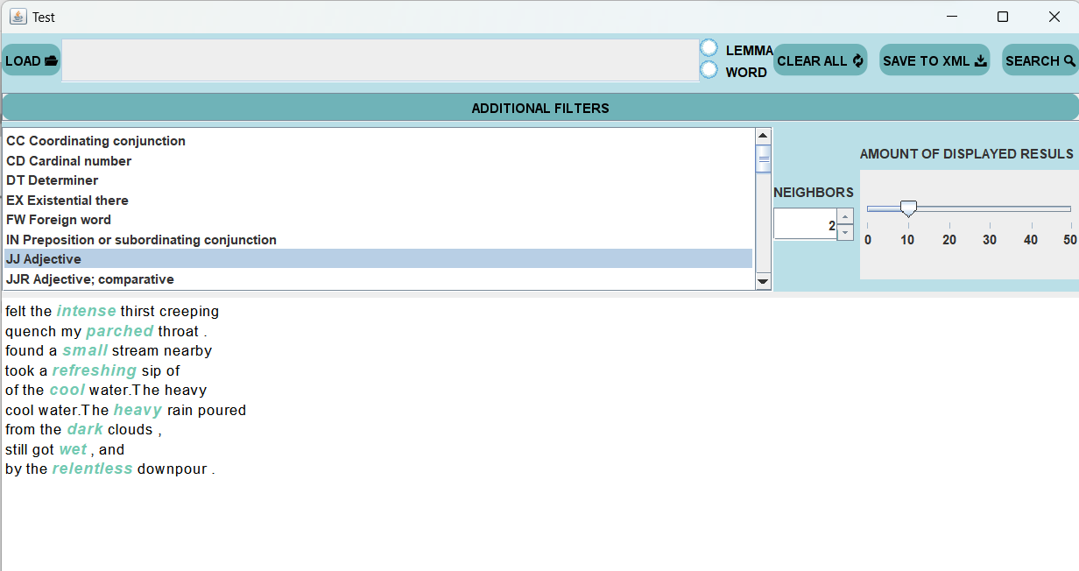
Examples search by POS
To search by POS, leave the text field empty and select Part Of Speech tag from the list in the advanced filters.

Slide 9
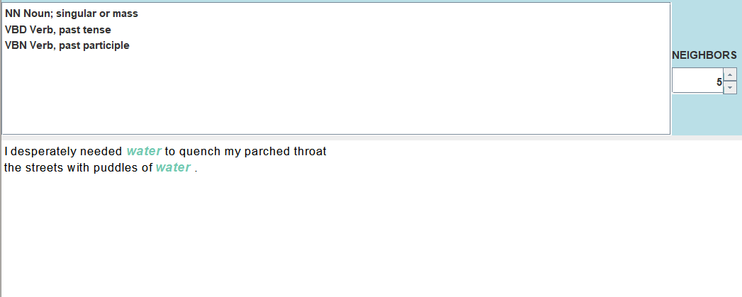
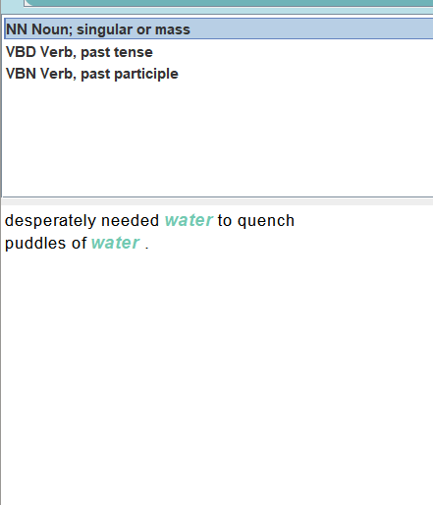
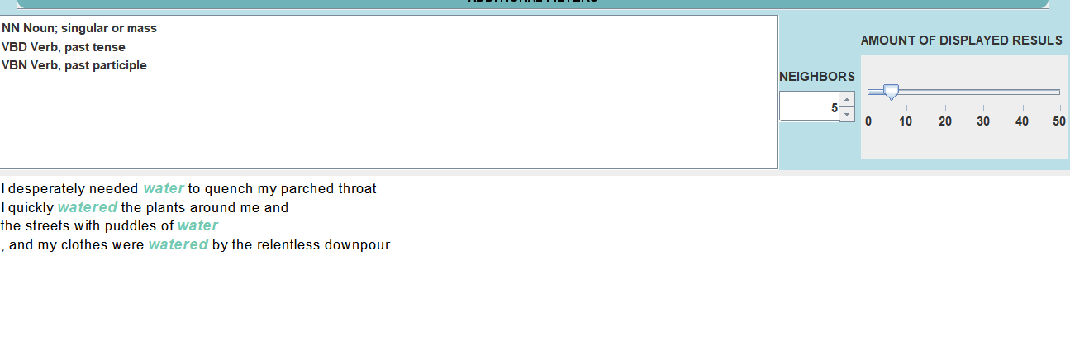
Example Additional Filters
We have 3 additional filters:
POS filter-user can filter which parts of speech of the word he wants to see
The neighbors filter- user can change the number of neighbor word
You can specify the number of matching results that you want to see in the output

Slide 10
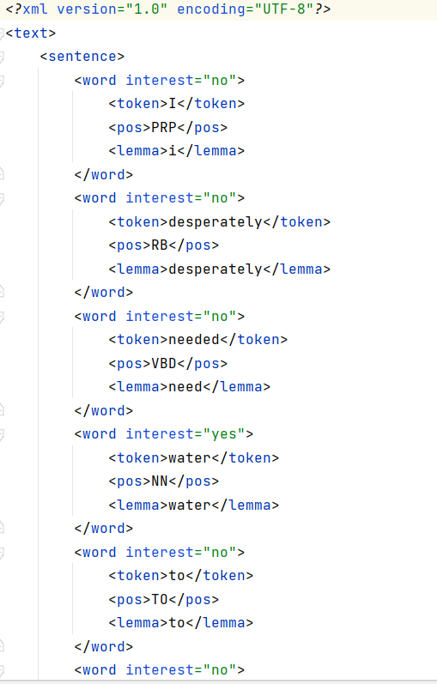
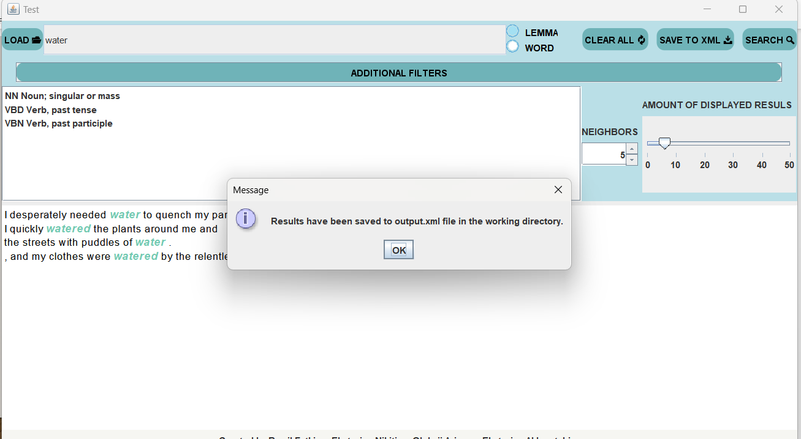
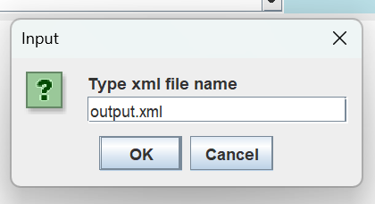
Examples save to xml
After you finished processing the file, the results can be saved as XML file

Slide 11
Used resources:
Eclipse Adoptium OpenJDK 11
The Apache OpenNLP toolkit with English models for Sentences, Tokens and POS tags, version 1.9.4
Apache Maven comprehension tool, version 3
Jsoup Java HTML Parser 1.10.2
Jar with dependencies

