Slide 1
Student performance analysis using Excel
STUDENT NAME : AARTHI.M
REGISTER No : 312204072
USERNAME : 0CB0E25D13732DEBB7A4F7B71C598F11
DEPARTMENT : BACHELOR OF COMMERCE
COLLEGE : SRI RAM COLLEGE OF ARTS AND SCIENCE

Slide 2
Student performance analysis using Excel
Agenda :
Introduction
Features
Tools
Language Used
Objective
Background
Scope
System implementation
Conclusion

Slide 3
Student performance analysis using Excel
Introduction:
Student Result Management System is based on the concept to generate the Student result records and to add their records and update it. Here User can add their Student's details safely and it's not time consuming. This System makes easy to store records of each and every Student. The whole project is designed in Result and different variables and strings have been used for the development of this project. We have also use excel to keep all record saved. This project is easy to operate and understand by the users.

Slide 4
Student performance analysis using Excel
FEATURES:
• Proper Log- in system
• Easy To Add, List, Modify And View result.
• Password Protected.

Slide 5
Student performance analysis using Excel
Tools :
• NetBeans
• MySQL
Language Used :
• Excel
Objective :
In this world of growing technologies everything has been computerized. With large number of work opportunities the Human workforce has increased. Thus there is a need of a system which can handle the data of such a large number of student results in an educational organization. This project simplifies the task of maintain records because of its user friendly nature.

Slide 6
Student performance analysis using Excel
Background :
In this world of growing technologies everything has been computerized. With large number of work opportunities the Human workforce has increased. Some of the office use Microsoft Excel to track their students result data. Due to increasing population, the excel data base becomes a slow medium to keep and track data. So we realize that there is a need for a better system.

Slide 7
Student performance analysis using Excel
Scope:
The system will keep information about a student's personal details like name, id, results. Storing updating and retrieving in a fast and accurate way.

Slide 8
Student performance analysis using Excel
Phase 1 Problem and data understanding
Phase 2 System analysis and design
Phase 3 Implementation and Testing
Phase 4 Evaluation of Results

Slide 9


Student performance analysis using Excel

Slide 10
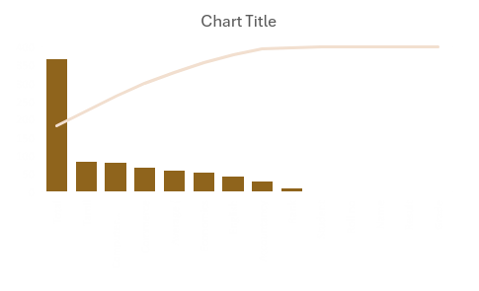
Student performance analysis using Excel

Slide 11
Student performance analysis using Excel
Conclusion :
Great skills have been achieved during the development of this project, time management being one of them, research in various areas of java programming and at the end of the day it can be said that the task has been a great success incorporated with extraordinary challenges. All in all the sleepless nights, stressful days and hard work have paid off and besides some good moments were also experienced. These experiences will be used for ever.

