Slide 1
Word2Vec
Jiawei 2014-06-30

Slide 2
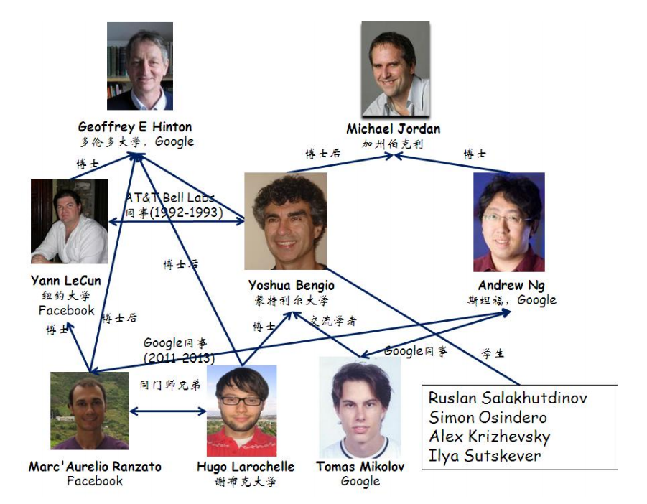
來源：
http://techblog.youdao.com/?p=915

Slide 3
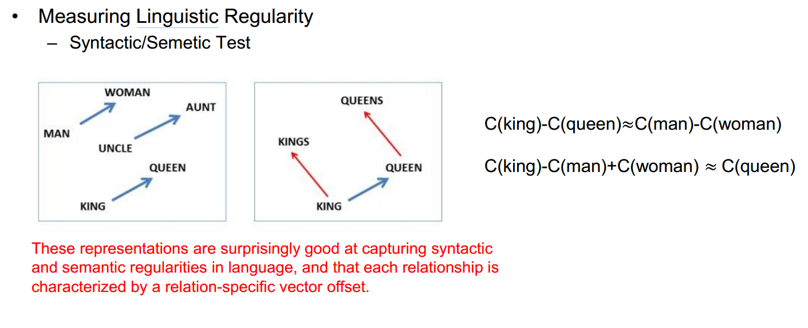
word2vec

Slide 4
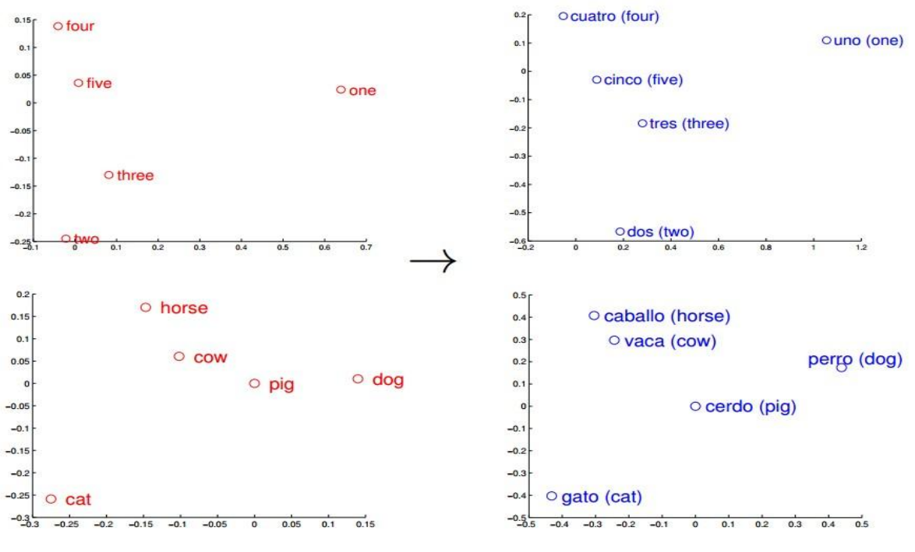
應用
機器翻譯
古文翻譯
找同義字

Slide 5
Reference - Word2Vec
[1] Tomas Mikolov, Kai Chen, Greg Corrado, and Jeffrey Dean. Efficient Estimation of Word Representations in Vector Space. In Proceedings of Workshop at ICLR, 2013.
[2] Tomas Mikolov, Ilya Sutskever, Kai Chen, Greg Corrado, and Jeffrey Dean. Distributed Representations of Words and Phrases and their Compositionality. In Proceedings of NIPS, 2013.
[3] Tomas Mikolov, Wen-tau Yih, and Geoffrey Zweig. Linguistic Regularities in Continuous Space Word Representations. In Proceedings of NAACL HLT, 2013.

Slide 6
太神奇了 ...
文章 => 單字 => vector …
HOW ????

Slide 7
Shonnon game
“large green ___________”
tree? mountain? frog? car?
“swallowed the large green ________”
pill? broccoli?

Slide 8
常看到的術語
word , sentence, document
Context (上下文, 前後關係, 語境)
Semantic (語義 )

Slide 9
Context
句子1 : ＊＊＊ 蘋果＊＊＊＊
句子2 : ＊＊＊＊ 蘋果 ＊＊＊＊

Slide 10
Context
樹上 的 蘋果 又 大 又 紅
ipad, iphone 是 蘋果 公司 的 電子產品
(word 搭配不同 上下語句關係 , 有不同意思)

Slide 11
Semantic
如果用 banana 搜尋這三份文件 ...
1. Yellow banana peels.
2. A banana is a long yellow fruit.
3. This mystery fruit is long and yellow and has a peel.

Slide 12
Semantic
只能搜尋到 1, 2 號文件, 可是 3號文件也是 banana ...
1. Yellow banana peels.
2. A banana is a long yellow fruit.
3. This mystery fruit is long and yellow and has a peel.

Slide 13
Semantic
善用 context 資訊, 能改善搜尋結果 (或尋找同義字)
1. Yellow banana peels.
2. A banana is a long yellow fruit.
3. This mystery fruit is long and yellow and has a peel.

Slide 14
如何對一堆文章建立數學模型？
Goalkeeper Keylor Navas knocking away a penalty kick of Greece’s Theofanis Gekas to open the door for Costa Rica’s victory in a shootout Sunday at the Arena Pernambuco in Recife, Brazil. Credit Yuri Kochetkov/European Pressphoto Agency
RECIFE, Brazil — Not every team can conjure attacks out of thin air with grace and panache. Not every goal is a firecracker that enchants the neutral fan. Not every game can be an instant classic, even if this rollicking World Cup has thus far made it seem so.See if Costa Rica cares one bit about it.Costa Rica gets to continue its dreamlike run at the World Cup after defeating Greece in a somnolent 1-1 game that had a penalty shootout tacked on as an exclamation point. Hailing from a country with a population roughly equal to that of Brooklyn and Queens combined, the Ticos have outlasted soccer titans and traditional powers to advance to their first World Cup quarterfinal.
“To the people in Costa Rica, those at home and on the streets, this is for you,” Coach Jorge Luis Pinto said.
The team’s next game, its next huge challenge, comes Saturday in Salvador against the Netherlands, which rallied Sunday afternoon to secure a thrilling late win over Mexico in Fortaleza. Little of that excitement carried over into the game here.
It is the New York City driver’s public shame — a sentence of solitary front-seat confinement levied against those for whom subways, buses and taxis are insufficient.For at least 90 minutes each week, residents move their vehicles from their curbside berths, slide into formation behind a row of double-parked neighbors and moor together in a singular urban traffic jam, beholden to a hulking contraption whose distinguishing feature appears to be this: It swirls plastic bags and cigarette stubs briefly before returning them to the earth.But the ignominy of alternate-side-of-the-street parking, which allows city workers to clean roadways without the obstruction of parked cars, could soon be eased. A bill that will have a hearing before the City Council on Monday would allow drivers to return to parking spaces once the street sweepers pass, causing a potentially significant reduction in wait times for those doomed to mornings in their cars.Councilman Ydanis Rodriguez, a Democrat from Manhattan and the bill’s sponsor, said the legislation would prevent accidents by reducing the duration of double-parking; help the environment, with fewer cars idling or driving in search of spaces; and save New Yorkers “millions of dollars” in lost time.
Photo

Slide 15
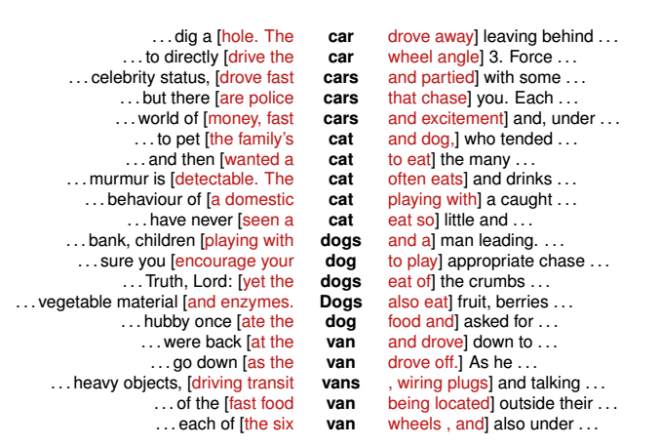
n=2, context

Slide 16
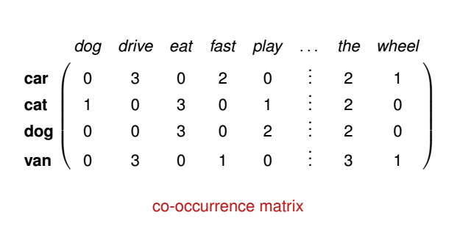
共同出現次數

Slide 17
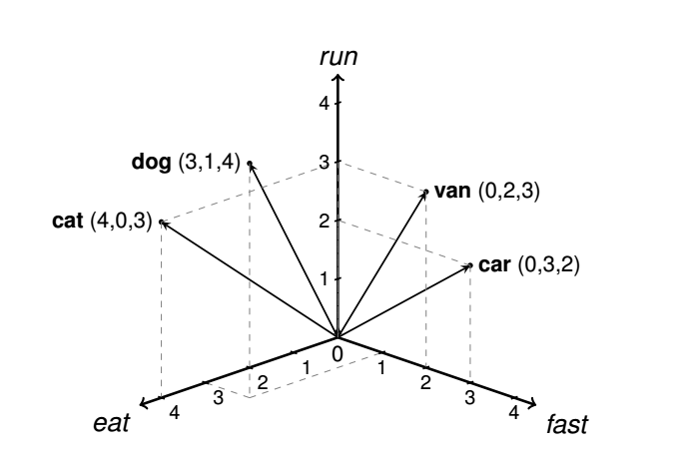

Slide 18
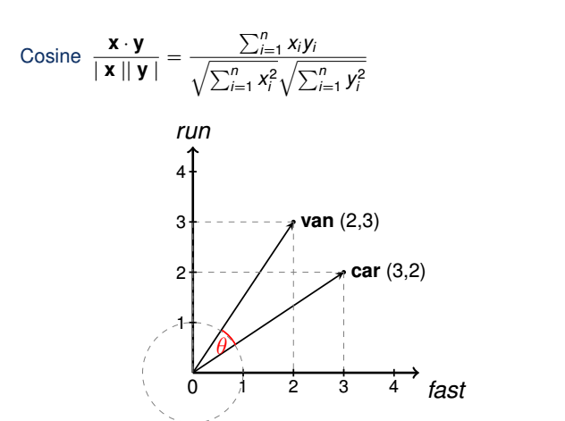
計算 相似度

Slide 19
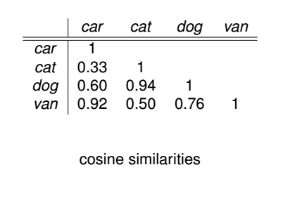

Slide 20
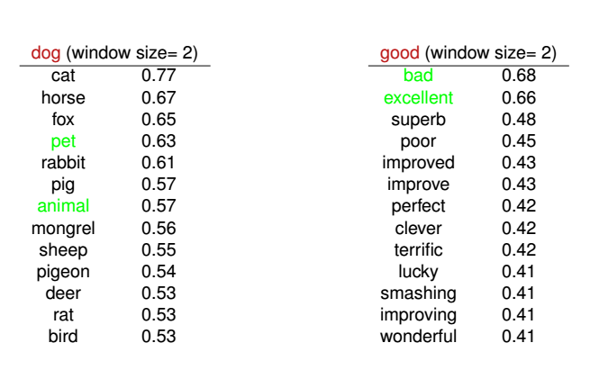

Slide 21
搭配使用工具
jieba
https://github.com/fxsjy/jieba
ansj
https://github.com/ansjsun/ansj_seg
stanford parser
http://nlp.stanford.edu/software/lex-parser.shtml
fudannlp
https://code.google.com/p/fudannlp/

Slide 22


Slide 23
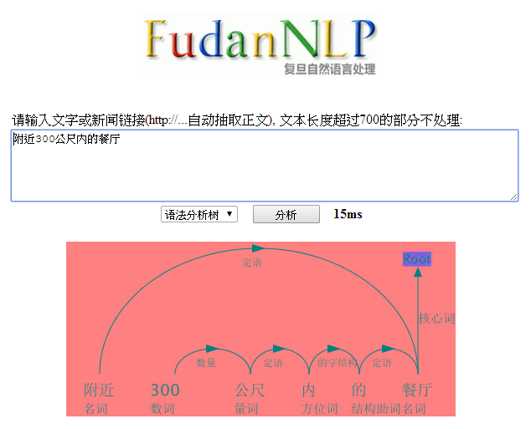

Slide 24
介紹了很多基本概念
該來看看 Word2Vec長怎樣了 !

Slide 25
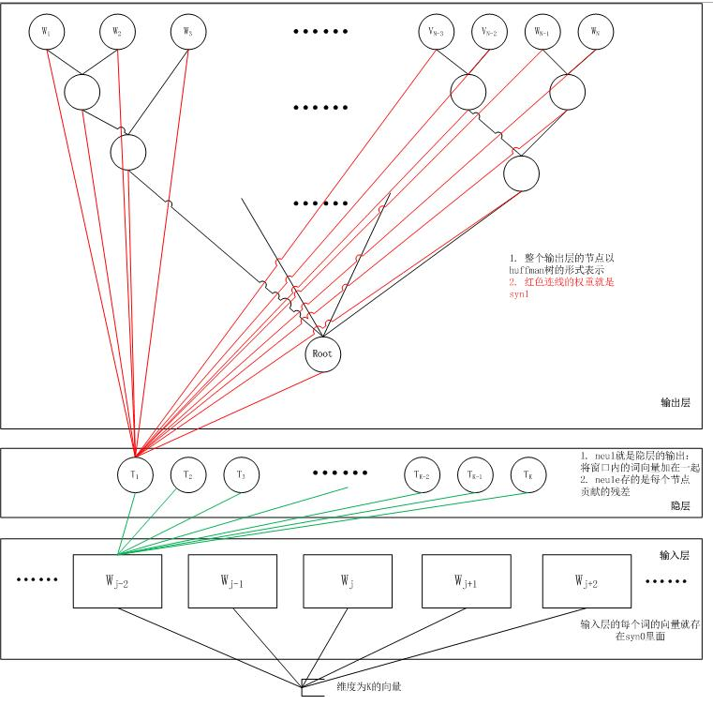
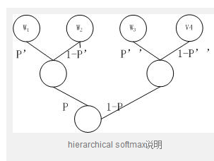
來源：
http://xiaoquanzi.net/?p=156

Slide 26
Neural Network
顏色 | 大小 | 種類
1 (red) | 11 | 蘋果
0 (green) | 25 | 西瓜
1 (red) | 9 | 蘋果
h1
5
2
r1
顏色
3
6
7
h1 = 1 / exp( 1*2 + 11*3 )
h2
r2
大小
r1 = 1 / exp( 5*h1 + 6*h2 + 7*h3 )
h3
if r1 > r2 then 為 西瓜

Slide 27
目的 和 Shannon game 是一樣的
已知 context
出現
ipad
iphone
蘋果
機率最高
電子產品

Slide 28
句子 : ipad, iphone 是 蘋果 公司 的 電子產品
紅
樹上
蘋果
富士康 ..
(total words)
分數 :
讓 蘋果 > 富士康 > 樹上
ipad ..
iphone ..
電子產品
+ 蘋果

Slide 29
1 / exp(3*9 + 4*12 + 9*2)
.. 樹上
(2,1,1)
蘋果
(3,4,2)
富士康
(total words)
分數 :
讓 蘋果 > 富士康 > 樹上
(13, 14, 12)
蘋果
(4,2,3)
ipad
(2,6,3)
iphone
(3,1,4)
電子產品
(4,5,2)

Slide 30
再將誤差 反向傳遞 做修正
.. 樹上
(2,1,1)
蘋果
(3,4,2)
富士康 ...
(13, 14, 12)
ipad +e
iphone +e
電子產品+e
富士康+e 蘋果 +e

Slide 31
賈伯斯
(3, 1, 2)
.. 樹上
(2,1,1)
蘋果
(3,4,2)
分數 :
賈伯斯 > 蘋果 > 富士康 ..
(3, 14, 10)
ipad
(2,6,3)
iphone
(3,1,4)
電子產品
(4,5,2)
賈伯斯
(4,2,1)

Slide 32
再將誤差 反向傳遞 做修正
.. 樹上
(2,1,1)
蘋果
(3,4,2)
賈伯斯 ...
(3, 14, 10)
ipad+e
iphone+e
電子產品+e
賈伯斯+e 蘋果 +e

Slide 33
.. 樹上
蘋果
富士康
(total words)
根據單字出現頻率
建立 Huffman Tree
只需更新父節點
(9, 12, 9)
分數 :
讓 蘋果 > 富士康 > 樹上
ipad
iphone
電子產品
蘋果

Slide 34
Reference
code
https://github.com/sk413025/misc
Word2Vec + paper
https://code.google.com/p/word2vec/
gensim tutorial
http://radimrehurek.com/2014/02/word2vec-tutorial/

Slide 35
