Slide 1
Technology-Aware Logic Synthesis
R14921060歐信泓
R14943065李昀儒

Slide 2
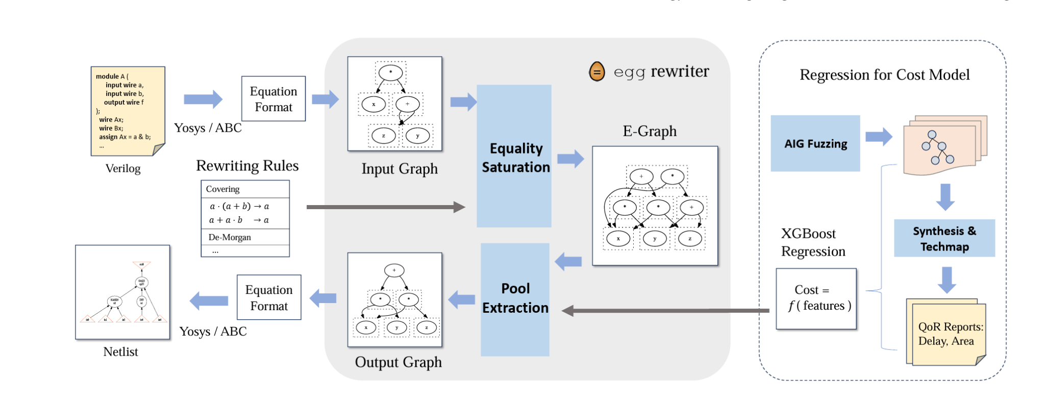
Previous Work
E-Syn: E-Graph Rewriting with Technology-Aware Cost Functions for Logic Synthesis
Use equivalent graph and rewriting rules to search for the optimal form
Use a regression model to estimate the cost instead of abc mapping

Slide 3
Feature Permutation
parameter | meaning
+ | num of OR
* | num of AND
! | num of NOT
& | num of CONCAT
ASTSize | size of AST
ASTDepth | depth of AST
SUMnode | sum of node num
SUM_LIB | sum of all node times their liberty
AVE_LIB | SUM_LIB / SUM_NODE
area | area after mapping
input
XGBoost use regression to estimate the cost (area, delay…)
The original area estimater exhibited a 39.49% MAPE（Mean Absolute Percentage Error）
output

Slide 4
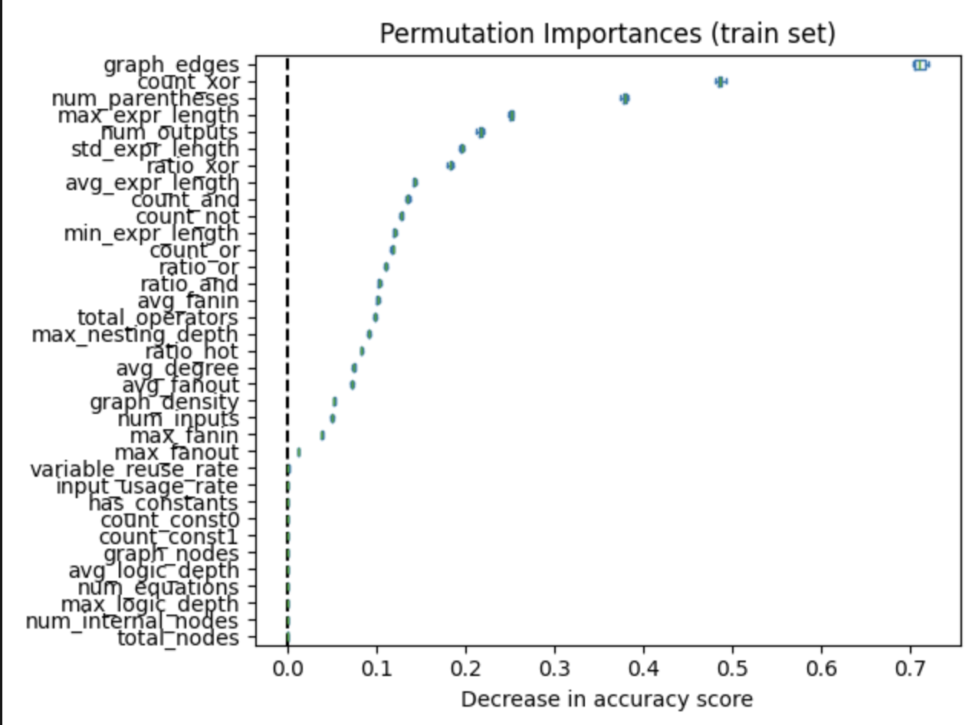
Feature Permutation
Collect features from eqn and AIGs, build a regression model, and apply feature permutation to identify the determining features.

Slide 5
Feature Permutation - Comparisom
add graph_edges, graph_density, graph_nodes, avg_degree as new features parameter
4.99% improvement in MAPE
train : 40000 data
validate : 10000 data
test : 5000 data
model | MAE | MAPE (%) | RRSE | R² | RMSE
old_xgboost | 26.63 | 39.49 | 0.6516 | 0.5754 | 40.27
new_xgboost | 25.07 | 35.50 | 0.6169 | 0.6195 | 37.84

Slide 6
Model Comparison
train : 40000 data
validate : 10000 data
test : 5000 data
model | MAE | MAPE(%) | RRSE | R² | RMSE
XGBoost | 25.07 | 35.50 | 0.6169 | 0.6195 | 37.84
MLP | 22.93 | 35.54 | 0.5548 | 0.6922 | 34.03
CatBoost | 24.38 | 38.01 | 0.5932 | 0.6481 | 36.39
LightGBM | 24.66 | 38.46 | 0.5996 | 0.6405 | 36.78
Random Forest | 25.47 | 39.68 | 0.6144 | 0.6225 | 37.69

Slide 7
Refinement on Feature Extracted
parameter | meaning
+ | num of OR
* | num of AND
! | num of NOT
& | num of CONCAT
ASTSize | size of AST
ASTDepth | depth of AST
SUMnode | sum of node num
SUM_LIB | sum of all node times their liberty
AVE_LIB | SUM_LIB / SUM_NODE
area | area after mapping
Some of the features in the training process are less important.
number of “+”, “&”, “*” , as the circuit is generated with aigfuzz
Introduced new features to get better training results.
density of the graph, average number of fanout…

Slide 8
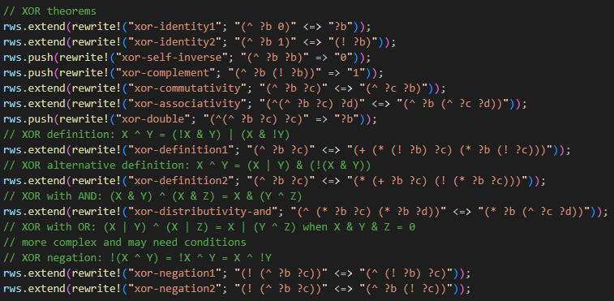
Expansion on the E-Graph Rewrite Rule
Expanded the rewrite rule to cover the XOR operator.
Used python to generate random circuit with XOR operator instead of aigfuzz.
Add features that is related to XOR in the training process.

Slide 9
Experiment Results
Compared the area between abc and out refinement.
circuit | calvc | frg2 | simple1 | adder
ABC | 465.86 | 654.82 | 116.87
our implement | 453.96 | 674.65 | 121.07

Slide 10
Possible Improvement Directions
Increase the scale of the circuit used for training.
The paper used 50000 circuit with an average logic level of 234 as training dataset.
Our only dataset only have an average logic level of 40 as for now.
Optimize the features selected for training the model.

Slide 11
END

