Slide 1



Introduction to
Git and GitHub
PRIT
CS-CLUB

Slide 2
How Was Life Before Version Control System?

Slide 3
Life Before Version Control System?
📁Manual Versioning
📤Collaboration
❌No Easy Recovery
Developers renamed files
or folders to save versions.
Code was shared via email, USB drives, or network folders.
Changes were logged manually
in text files.
No structured way to track changes.
Team members avoided
editing the same file at once.
Rolling back was unreliable and
error-prone.

Slide 4
What is a Version Control System?
📝Track Changes
🤝Collaborate Seamlessly
↩️Revert Mistakes
Record every modification to files.
Multiple developers work on same project.
Go back to previous versions.
See who changed what and when.
Integrate changes without conflicts.
Undo unwanted changes easily.

Slide 5
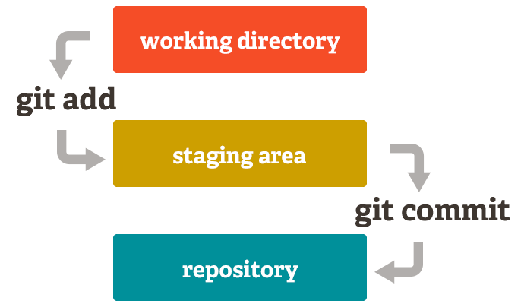



File Update Stages in Git
Working Directory
Your current project files.
Uncommitted changes.
Staging Area
Changes prepared for commit.
Select files to include.
Local Repository
Committed snapshots.
Version history stored locally.

Slide 6
Basic Git Commands
git init
Initializes a new Git repository.
git status
Shows current repository status.
git add
Adds file changes to staging area.
git commit
Saves staged changes to repository.
git show
Displays object types and contents.
git restore
Discards changes in working directory.

Slide 7
Quick Quiz?
Which git command is used to untrack a file?
git rm -r --cached file_name

Slide 8
Remote Repositories
What is a Remote Repository?
A remote repository is a version of your project hosted on the internet or network.
Used for collaborating with others by sharing code and updates.
Common default name for remote is origin.

Slide 9
Exists on your personal machine and contains your working directory, staging area, and local Git history.
Local vs Remote
Repositories
Local Repository
Remote Repository
Exists on your machine with the working directory,
staging area, and local Git history.
Allows you to make commits, check logs, create
branches, and test changes offline.
Work offline, commit often.
Remote repositories are stored on servers,
enabling collaboration and access from anywhere.
Receives updates through git push.
Repository can be shared and updated through
pull requests

Slide 10
What is GitHub?
GitHub is a leading cloud-based platform for hosting Git repositories and enabling collaborative software development.
Code Hosting
Collaboration Tools
Community
Store and manage Git repositories.
Pull requests, issues, code review.
Largest developer community.
Accessible from anywhere.

Slide 11



Cloning a GitHub Repository
Find Repository URL
Locate the HTTPS or SSH link on GitHub.
Run git clone <URL>
Execute command in your terminal.
Local Copy Created
Repository now on your machine.

Slide 12



Pushing Your Code to GitHub
Stage Changes
Select files for commit.
Commit Code
Save changes locally with a message.
Push to Remote
Upload committed code to GitHub.

Slide 13




Branching Workflow
Main Branch
1
Create Feature Branch
Stable, code.
2
Start new work from main.
4
Develop & Commit
Merge Back to Main
3
Make changes on feature branch.
Integrate completed feature.

Slide 14
What is a Pull Request?
A Pull Request (PR) is a request to merge changes from one branch into another in a remote Git repository.
Why?
Facilitate code review before merging.
Enable collaboration in teams and open-source projects.
Maintain code quality and avoid conflicts.

Slide 15
Merging
What is Merging?
Merging is combining changes from different branches into one.
Helps bring features or fixes developed in separate branches back into main branch.
How is Merging Done?
Switch to the branch you want to merge into (e.g., main): git checkout main
Merge the other branch: git merge <branch-name>
Git tries to combine changes automatically.

Slide 16
Merge Conflicts
What are Merge Conflicts?
Occur when two branches change the same part of a file differently.
Git cannot decide automatically which change to keep.
How to Resolve Merge Conflicts:
Git marks conflicts in files using <<<<<<<, =======, >>>>>>>.
Manually edit the file to keep desired changes.
Mark as resolved by adding the file: git add <file>
Complete the merge with: git commit

Slide 17
Git Collaboration and Branching Commands
git clone
Creates a local copy of a remote repository.
Fetches and merges changes from the
remote repository into your current branch.
git pull
Uploads local commits to the remote repository.
git push
Lists, creates, or deletes branches.
git branch
git checkout
Switches between branches.
Lists the names of remote repositories.
git remote

Slide 18



GitHub Features Overview
Code
Stores source files and version history.
Issues
Track bugs and enhancements.
Codespaces
Cloud-based development environment.

Slide 19
Roadmap to Learning
Introduction to Version Control
Installing & Configuring Git
Initializing Local Repository
Basic Commands
Viewing Commit Logs
Rollback to Previous Versions
Git Workflow
Remote Repositories
Cloning Remote Repositories
Branching & Switching Branches
Merging Branches
Handling Merge Conflicts
Pushing Code to Remote Repositories
Pulling Updates from Remote
Forking & Pull Requests
Collaborating with Teams
Tagging Versions & Releases
Undoing Mistakes (reset, revert, stash)
References: Pro Git
Book by Ben Straub and Scott Chacon( free online version)
https://git-scm.com/book/en/v2
Git Reference Manual https://git-scm.com/docs

Slide 20
QnA

Slide 21
Connect with us
Instagram – cs.club.iiitdm
LinkedIn – CS Club IIITDM Kancheepuram
Email – csclub@iiitdm.ac.in

Slide 22
Thank You

