Slide 1


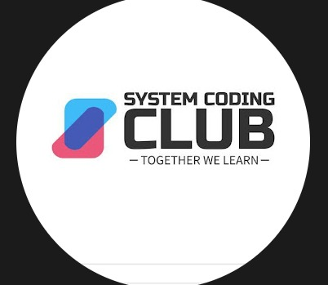
Microcontroller & Sensor Integration
PID
Your
logo
here
SYSTEM CODING CLUB

Slide 2
Your
logo
here
Motivation?
"What makes a pacemaker keep a heart beating or a drone balance in mid-air?"

Slide 3
Your
logo
here
Introduction
An embedded system is a small, specialized computer built into a device to perform specific tasks. Sensor integration involves connecting sensors to the embedded system so it can collect data from the environment (like temperature, light, or motion) and respond accordingly.

Slide 4
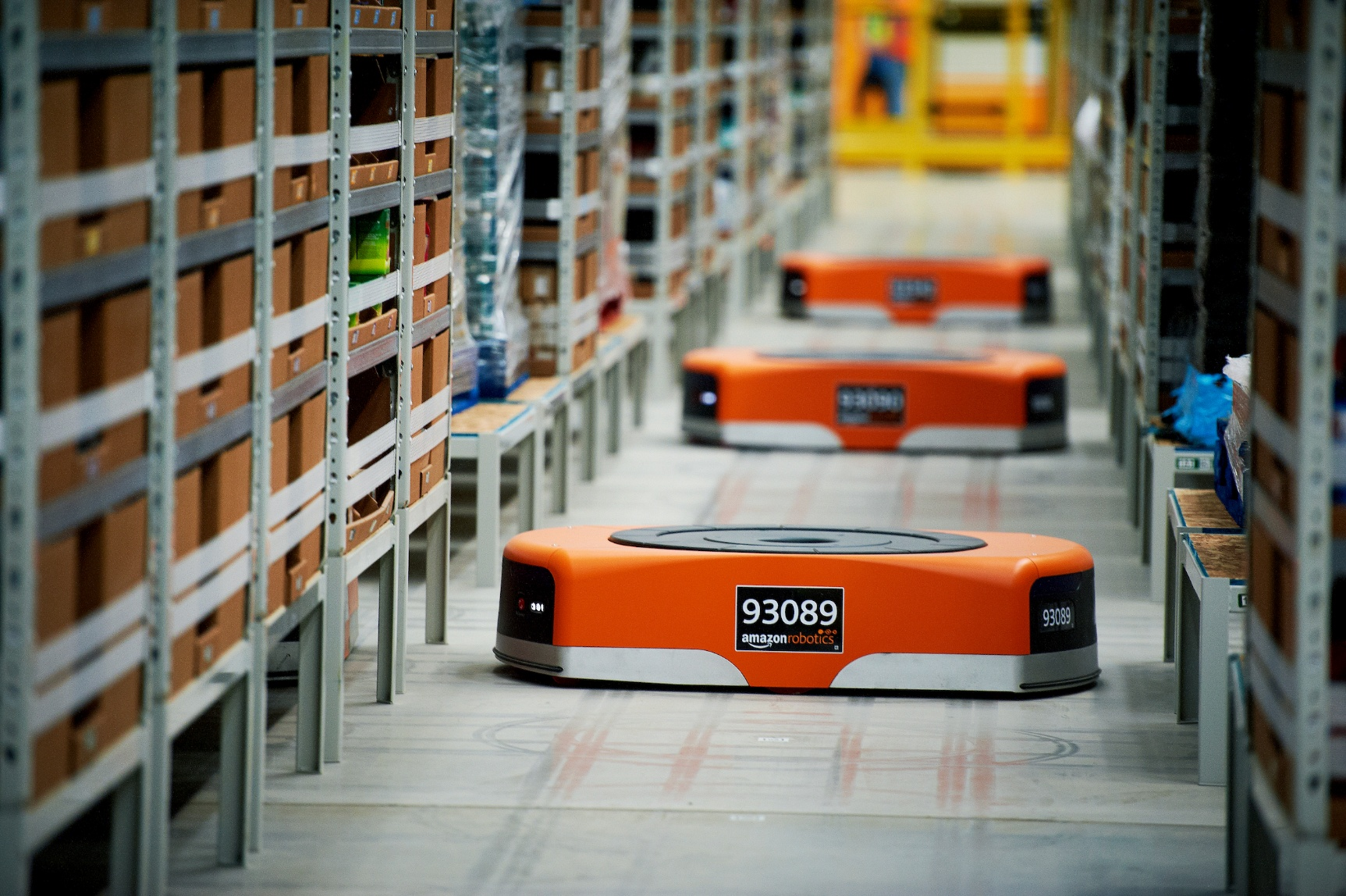
Your
logo
here
Example : line following bot
Why do we need this type of bot?

Slide 5
Your
logo
here
Prerequisites
This project is beginner-friendly
Resources:
https://github.com/theTechnowright/PID-Line-Follower-Robot
https://github.com/Pranjal-R-Agrawal/Techfest_Meshmerize_2021_Arduino_Maze_Solver

Slide 6
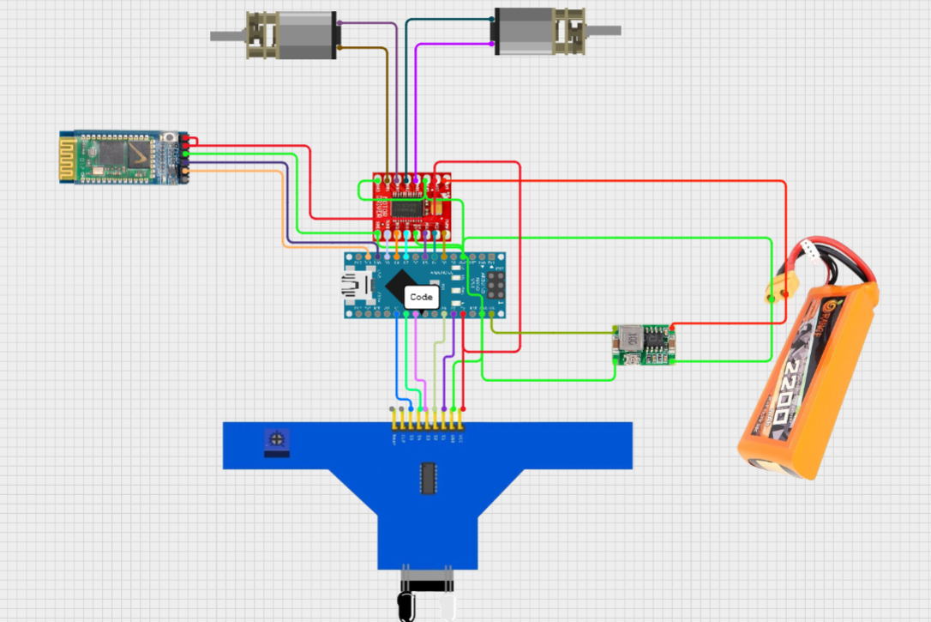
Your
logo
here
CIRCUIT DIAGRAM

Slide 7
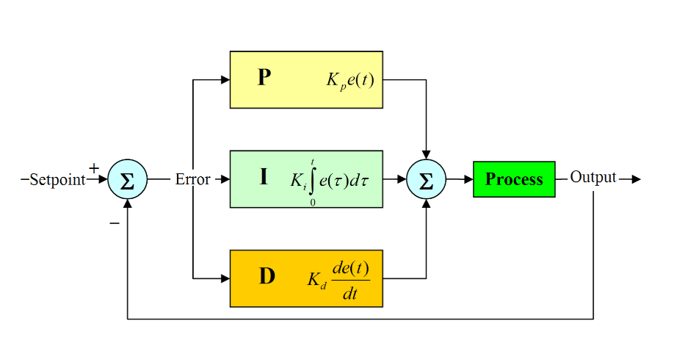
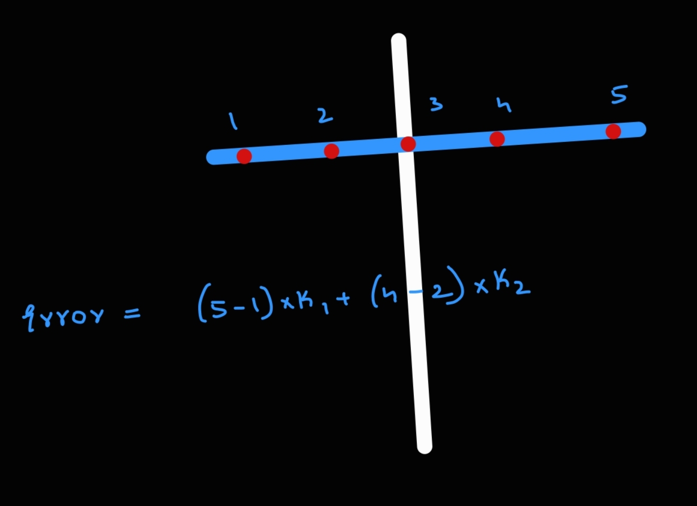
Your
logo
here
PID

Slide 8
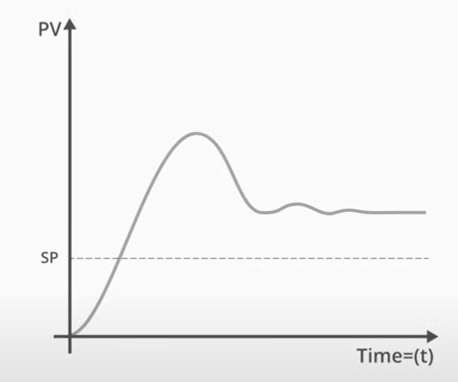
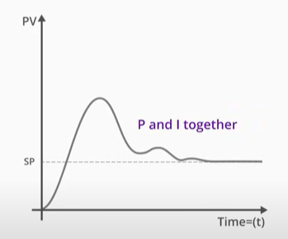
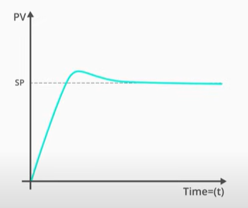
Your
logo
here

Slide 9
Your
logo
here
Quick Quiz?
What is the main function of the Integral (I) term?

Slide 10
Your
logo
here
What is the main function of the Integral (I) term?
A) React to future error B) Eliminate steady-state error over time C) Increase speed only D) Reduce noise

Slide 11
Your
logo
here
What does the Derivative (D) term respond to?

Slide 12
Your
logo
here
What does the Derivative (D) term respond to?
A) Current error B) Accumulated error C) Rate of change of error D) Noise only

Slide 13
Your
logo
here
Which of the following is a disadvantage of using only Proportional control?

Slide 14
Your
logo
here
Which of the following is a disadvantage of using only Proportional control?
A) Too slow B) Oscillates forever C) Cannot eliminate steady-state error D) Very expensive

Slide 15
Your
logo
here
CODE

Slide 16
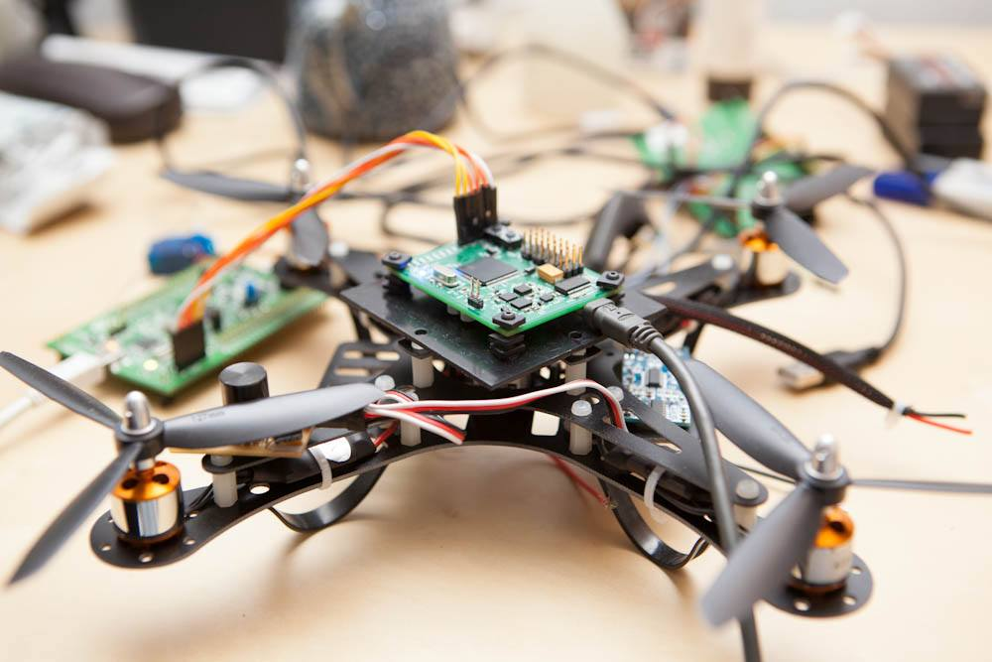
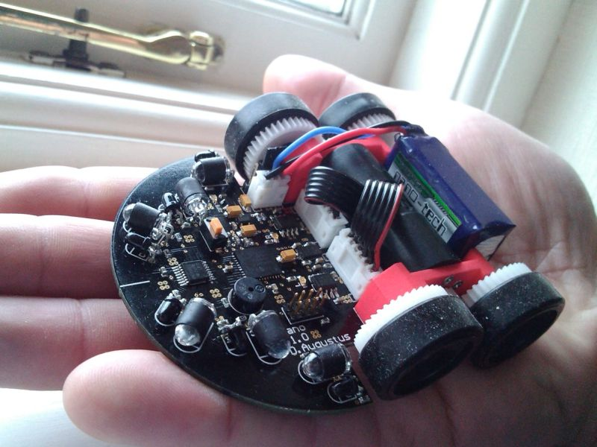
Your
logo
here
Project Ideas
drones , robotic arms , line following bot , micromouse

Slide 17
Your
logo
here
Career Prospects in Embedded Systems
Embedded Software Developer: Writing firmware for devices.
Hardware Engineer: Designing embedded circuits.
IoT Engineer: Building smart connected devices.
Robotics Engineer: Creating autonomous robots.
Automotive Engineer: Working on vehicle control systems.
Medical Device Developer: Developing healthcare gadgets.

Slide 18
Your
logo
here
Roadmap to Learning
C programing
RTOS
Digital electronics
Computer architecture
Projects
https://youtu.be/D7L1SmjQ3fo?si=UPlyELQ3NC0j2PZP

Slide 19
Your
logo
here
QnA

Slide 20


Your
logo
here
Connect with us
paparazzi time (System coding club)

Slide 21

Thank You
Share your feedback about this session

