Slide 1
Crime in SF
Iva Ivanova

Slide 2
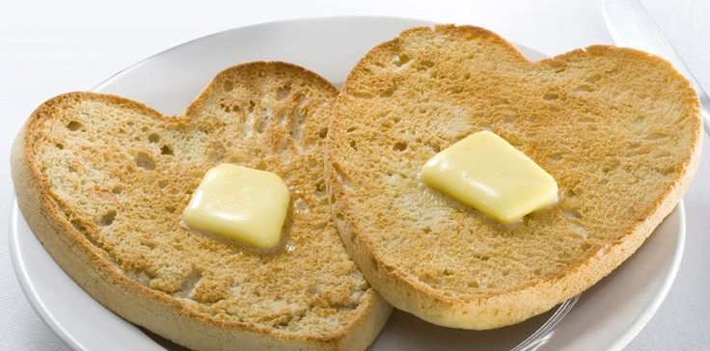
Intro What melts my butter?

Slide 3
The daTa Set
18 months back
Columns used: Category, Descript, DayOfWeek, Resolution
Issues with the data set – not continuous; had to map and create dummy variable to understand and analyze the data
137,467 rows
13 columns

Slide 4
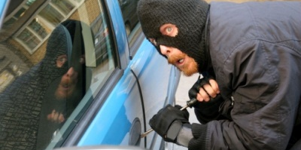
Number 1 Crime in SF – ThefT

Slide 5
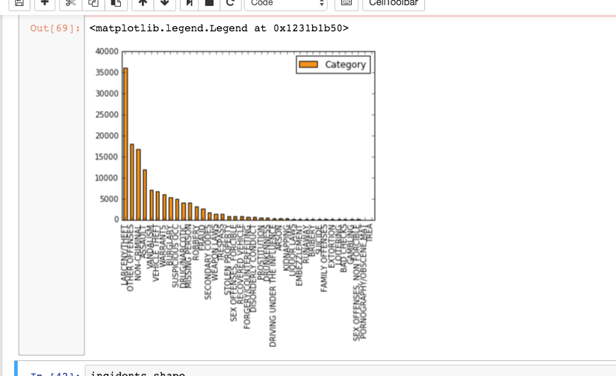
Crime Categories
Larceny/Theft
Other Offenses
Non-Criminal
Assault
Vandalism
Vehicle Theft
Warrants
Burglary
Suspicious OCC
Drugs/Narcotics

Slide 6
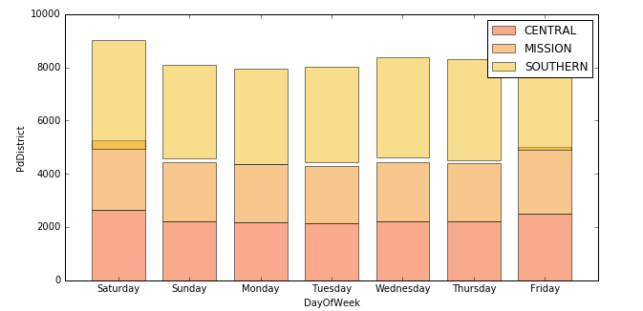
DisTricts with the highest number of crime

Slide 7
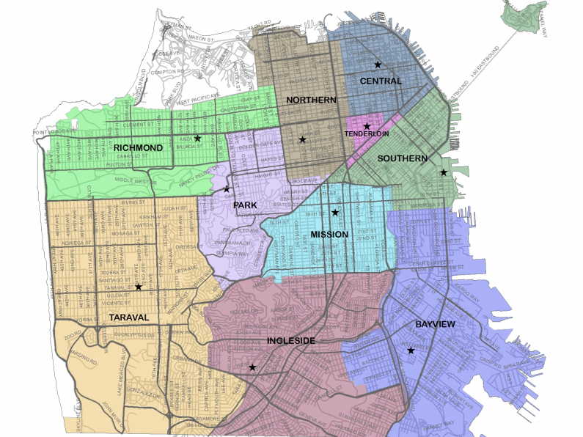

Slide 8
Machine Learning Models
I adopted two machine learning models:
1.Logistic Regression
2.Random Forest

Slide 9
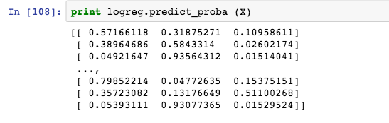
Logistic Regression
Null Accuracy =. 70
Accuracy rate = .87
Would a crime get resolved, given when and where the crime happened and the kind of crime that was committed?

Slide 10
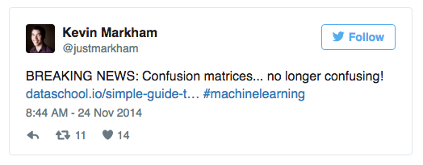
Random Forest
I used random forest classifier to train and test my data set so I can predict if a crime is going to get resolved based on when and where it occurred in San Francisco.
My accuracy_score = .8618
Confusion Matrix
0-No Resolution, 1-Arrested, 2-All else
 | Predicted 0 | Predicted 1 | Predicted 2
Actual 0 | 22551 | 1423 | 113
Actual 1 | 2320 | 6969 | 69
Actual 2 | 533 | 293 | 96

Slide 11
Conclusion
Closing Remarks And Next Steps

Slide 12

The end

