Slide 1
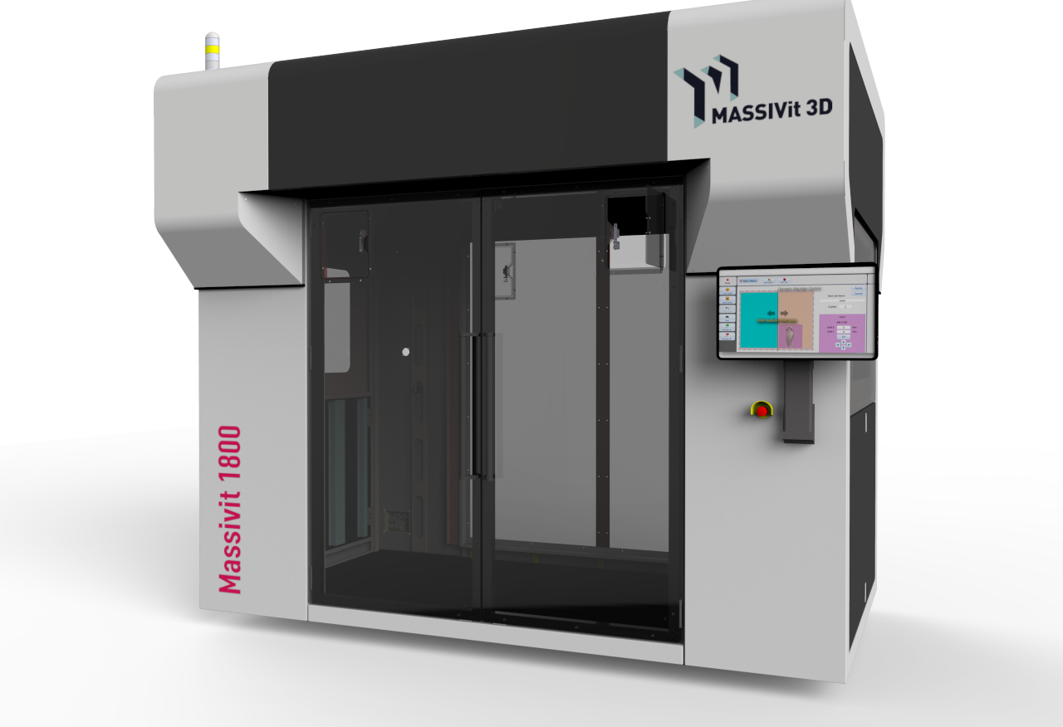

0

Slide 2
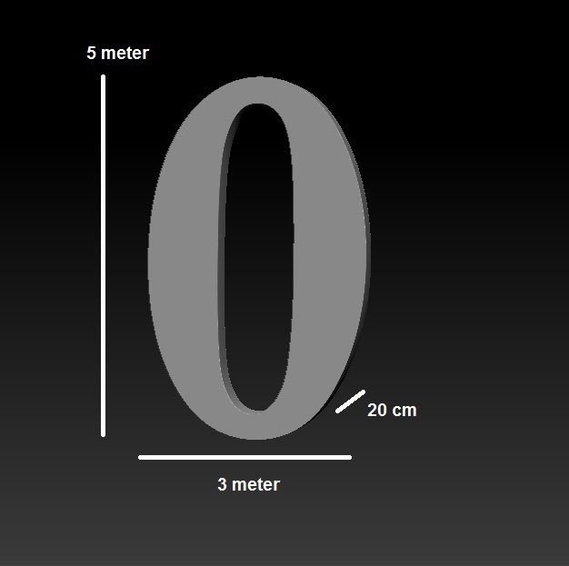
Dimensions

Slide 3
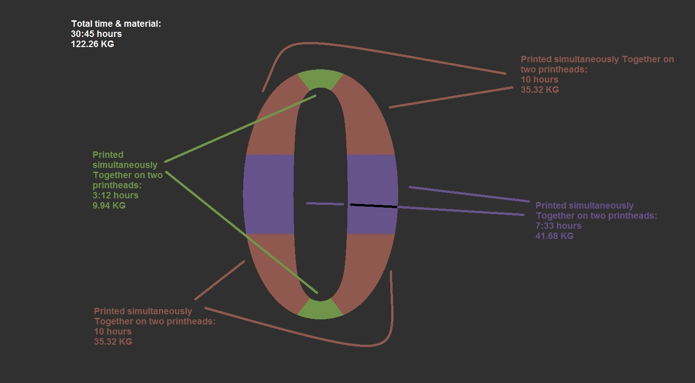
Closed shape (with front and back panels)

Slide 4
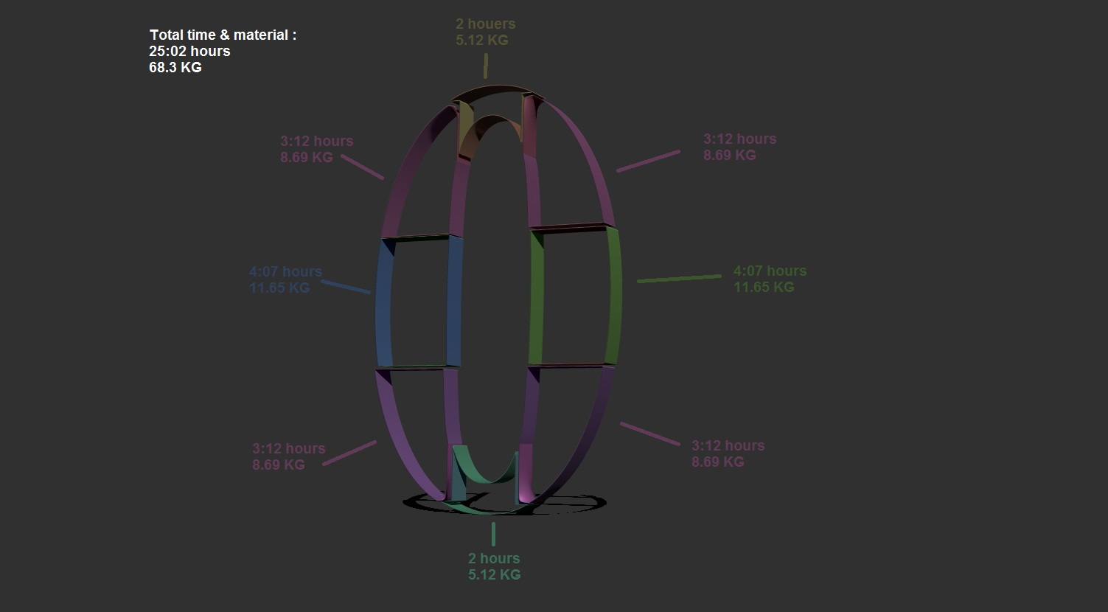
Open shape (Shell only - without front and back panels)

