Slide 1
Hershey
In MASSIVit 1800

Slide 2
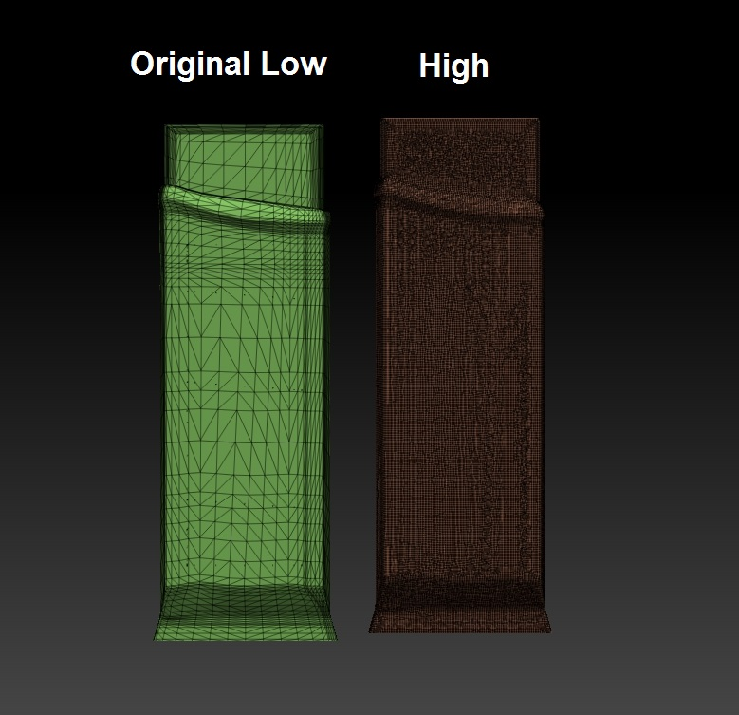
Hershey- file correction
The file was completely fine, We Only intensified its polygonal resolution, When you print in very large Scale, it is important that the resolution will be higher- otherwise, it might be possible to notice the triangles in the printed model. This was done in Zbrush: import stl – DynaMesh- export stl.
As we discussed “the Click of a button”

Slide 3
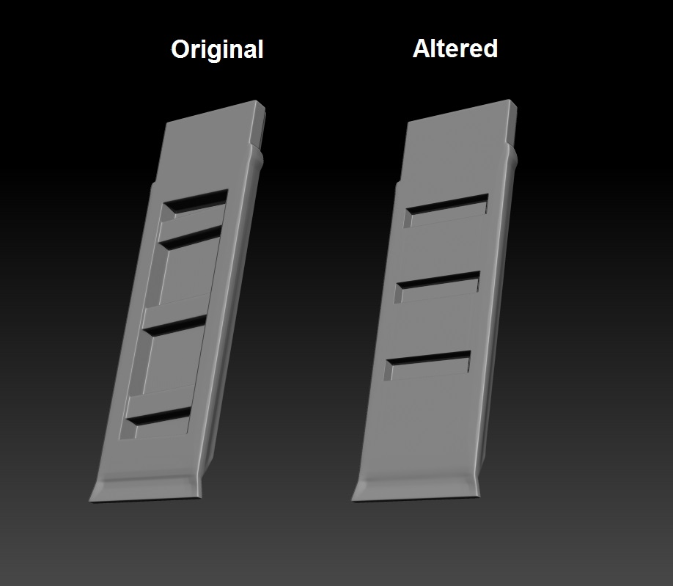
Hershey- Design change
Another change we have implemented, was to change the sockets for the screws, in a way that will consume less support material & printing time

Slide 4
Model info
The print is best preformed in “normal” mode
It will take 7:14 hours & 9.34 Kg

Slide 5
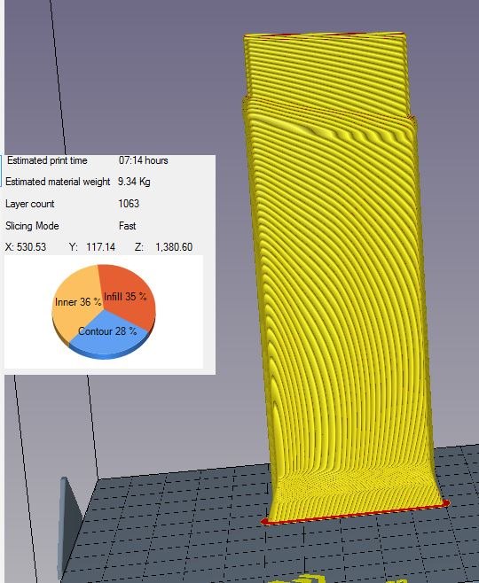
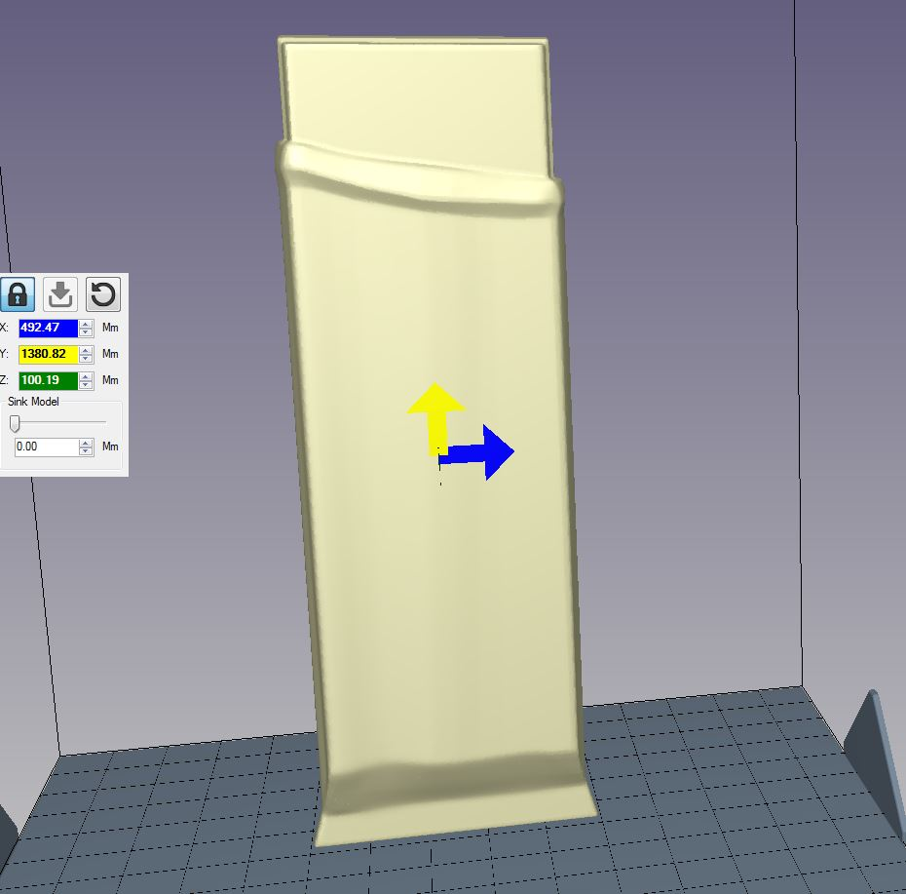
Model info

Slide 6
Post Print
The model comes out of the printer completely rigid but under severe pressure (hammer blow or a toll fall) it might break, In order to get a really strong structural strength- it is possible to fill the model in polyurethane foam, which is cheap and fast to implement

Slide 7
Post Print
https://www.dropbox.com/s/7as37apkjo932f0/Octopus.MOV?dl=0
https://www.dropbox.com/s/7as37apkjo932f0/Octopus.MOV?dl=0
Another option is to use the model as a toll (template) for Thermoforming- in this way, one can produce a large number of copies from the same print, In addition Integration of graphics can be applied already in the Thermoforming process itself, as can be seen this link:
https://www.dropbox.com/s/7as37apkjo932f0/Octopus.MOV?dl=0
https://www.dropbox.com/s/oqo59s72ianjcl0/Thermoforming%20with%20Massivit.wmv?dl=0

