Slide 1
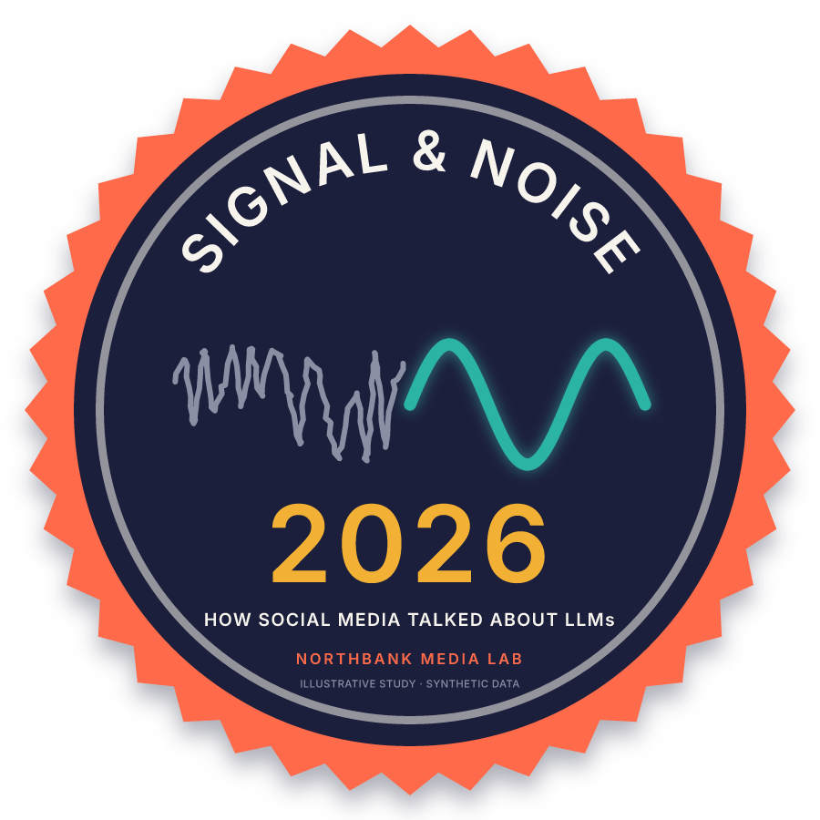
NORTHBANK MEDIA LAB · 2026 STUDY
Signal & Noise 2026
How social media talked about LLMs, Jan–Sep 2026
Hand-coded sample: 387 posts · 6 platforms · 10 themes
Illustrative study. The data is synthetic. Authors are fictional. There are no real quotes or release claims.
Notes:
This deck is illustrative. All data is synthetic. We report shares, not counts.

Slide 2
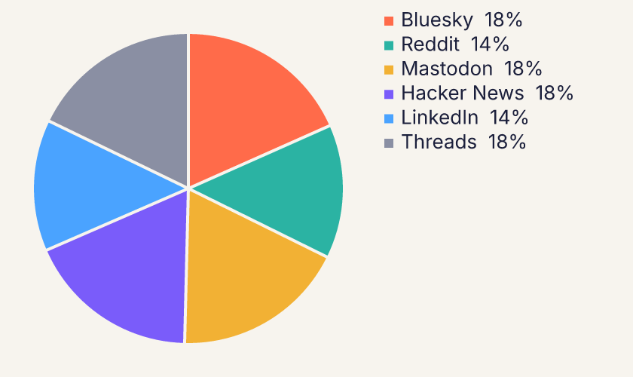
METHOD
A hand-coded sample, reported as shares
We hand-coded 387 synthetic posts from Jan–Sep 2026.
The sample represents a much larger stream of posts.
Each post has 1 of 10 themes and 1 sentiment: positive, neutral or negative.
We report shares, not counts: a theme's share of the conversation in a month.
We also report the share of each theme's posts that are negative.
Sample by platform (chart: VectorCraft)
Signal & Noise 2026 · Northbank Media Lab · illustrative, synthetic data · 2/7

Slide 3
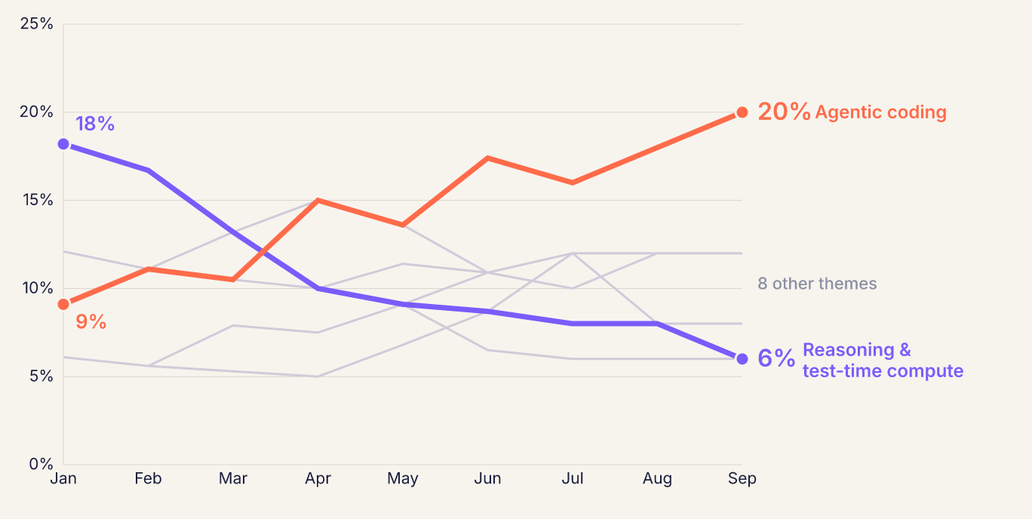
FINDING 1
Agentic coding doubled its share of the conversation
9% → 20%
Agentic coding's share of the conversation, Jan to Sep. It is the largest theme overall, with 15% of all posts.
Signal & Noise 2026 · Northbank Media Lab · illustrative, synthetic data · 3/7

Slide 4
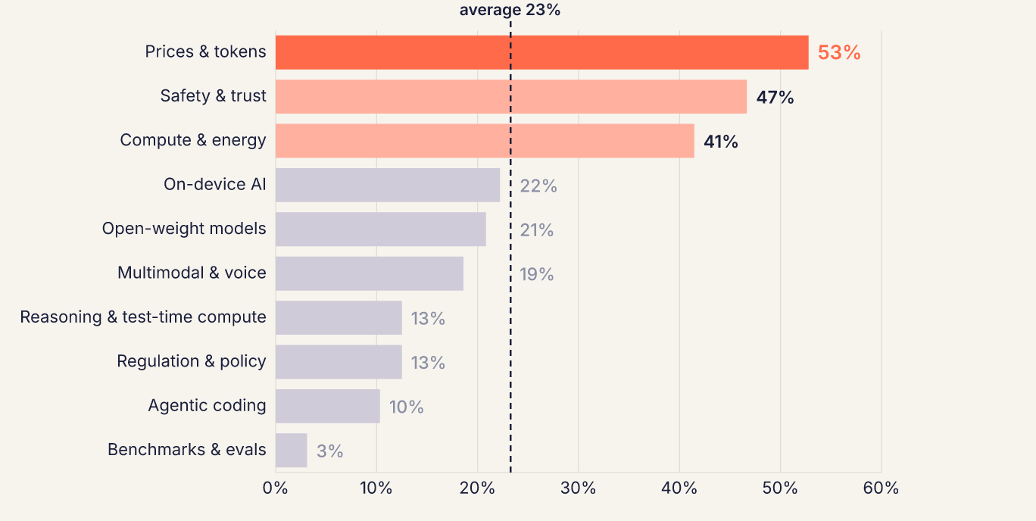
FINDING 2
Prices & tokens is the most negative theme
53%
of Prices & tokens posts were negative. The average for all themes is 23%. A frequent complaint: “price per token down, bill up.”
Signal & Noise 2026 · Northbank Media Lab · illustrative, synthetic data · 4/7

Slide 5
FINDING 3
What grew and what fell
18% → 6%
Reasoning & test-time compute fell from the largest theme to one of the smallest. Benchmarks & evals fell from 12% to 6%.
Share of the conversation (%), Jan vs Sep 2026. Reasoning = Reasoning & test-time compute. Native DeckCraft chart.
Signal & Noise 2026 · Northbank Media Lab · illustrative, synthetic data · 5/7

Slide 6
TAKEAWAY
The conversation moved from what models can think to what they can do, and to what they cost.
BUILD
BUDGET
GROUND
Agentic coding's share of the conversation grew from 9% to 20%.
53% of price posts were negative. Posters said bills increased as token prices fell.
Compute & energy grew from 9% to 12%. On-device AI grew from 6% to 8%.
Signal & Noise 2026 · Northbank Media Lab · illustrative, synthetic data · 6/7

Slide 7
ABOUT THE DATA
Synthetic by design
All 387 posts are synthetic. The fictional Northbank Media Lab made them for this example.
Authors are fictional handles (@researcher_NNN). No quote comes from a real person.
The deck makes no claims about real models or companies.
We show shares because the sample is small. The shares describe the sample only.
VectorCraft drew the charts and badge. DesignCraft made the poster. DeckCraft made this deck.
Signal & Noise 2026 · Northbank Media Lab · illustrative, synthetic data · 7/7

