Slide 1

The Embedding Layer
(Process PDF)
ChromaDB
The Search Layer
(Retrieve and Rank results)
User Query
The Generation Layer
Top 3 results from Search Layer
LLM
Response
Prompt Engineering

Slide 2
Complete AI System
The Embedding Layer
(Process PDF)
Chat conversation
ChromaDB
The Search Layer
(Retrieve and Rank results)
User Query
Moderation check -Pass?
The Generation Layer
Top 3 results from Search Layer
Moderation failure Response
LLM
Response
Prompt Engineering

Slide 3
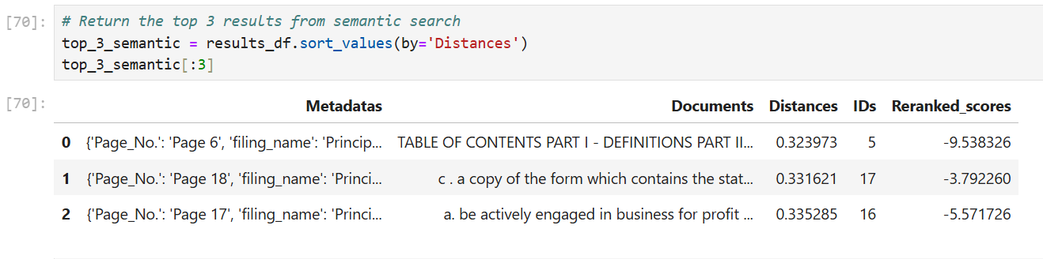
TOP 3 Results

Slide 4
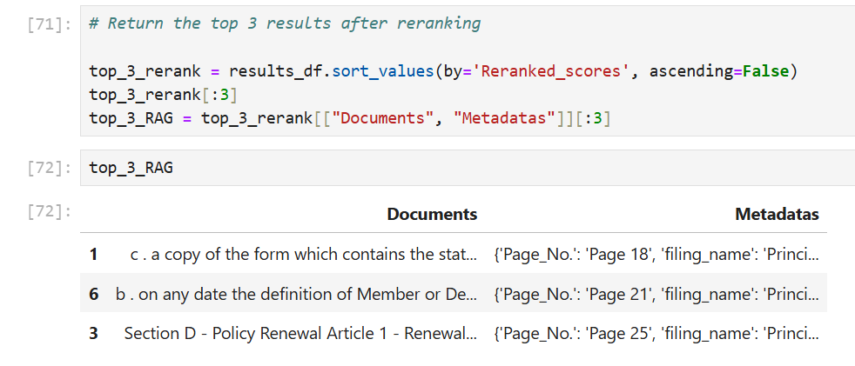
TOP 3 Results

Slide 5
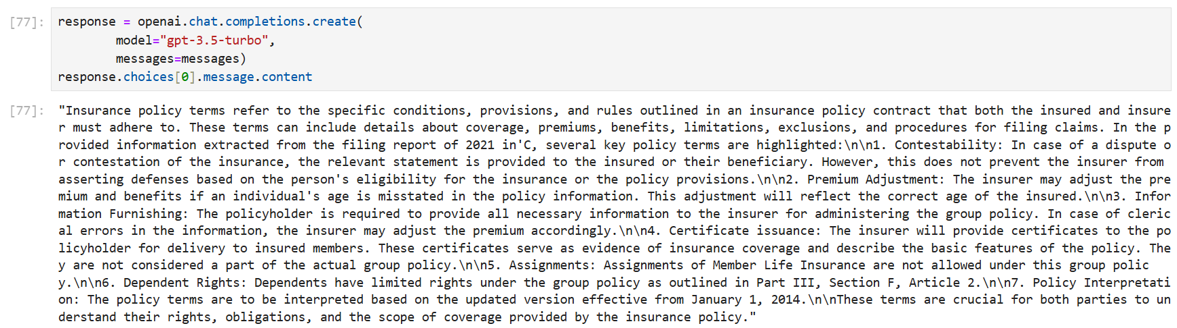
LLM Response with RAG

Slide 6
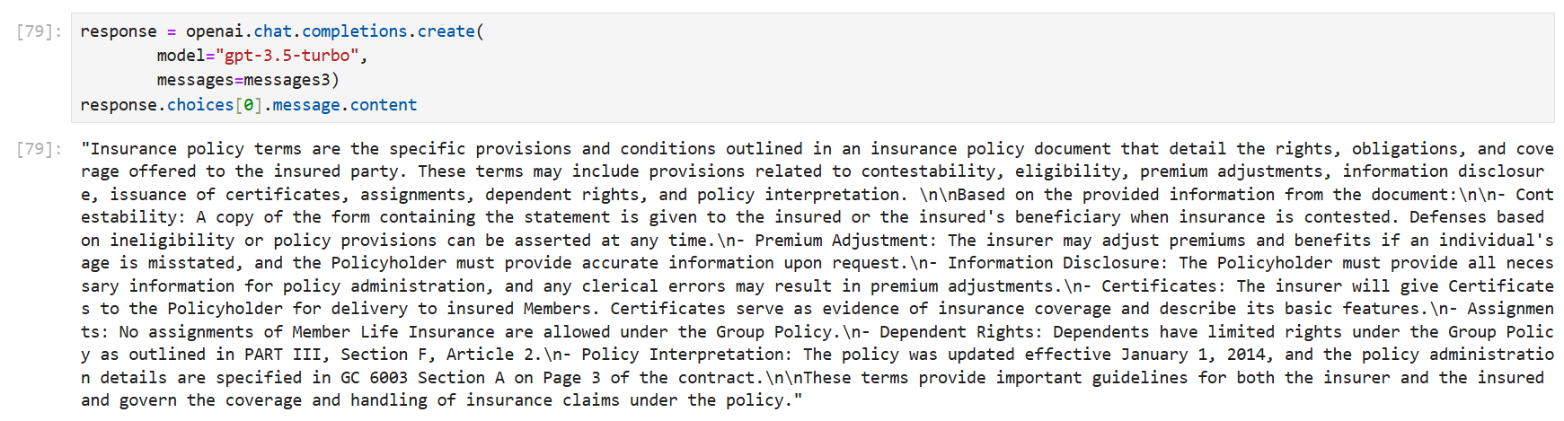
LLM Response with RAG

