Slide 1
Automatic temperature
Adiel Ramos
Alex Kolobutin
Marc Schneider
Markus Kring
Tamara Hejny
Theresa Lichtenberger

Slide 2
Problem solved by the application
People complain about the temperature of the room
Too hot
Too cold
Solution
Collect body temperature and change the room temperature to a comfortable level

Slide 3
Idea
Rooms with automatic adjusting temperature
The comfort temperature will be around 36-37.5
Skin temperature will be measured by smart watches and smartphones
The average temperature of everyone in the room will impact the amount of change

Slide 4
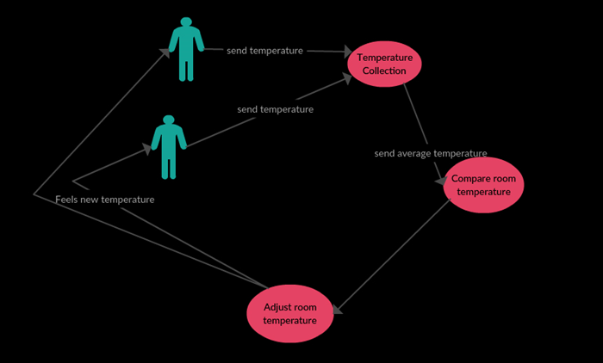
Visual representation

Slide 5



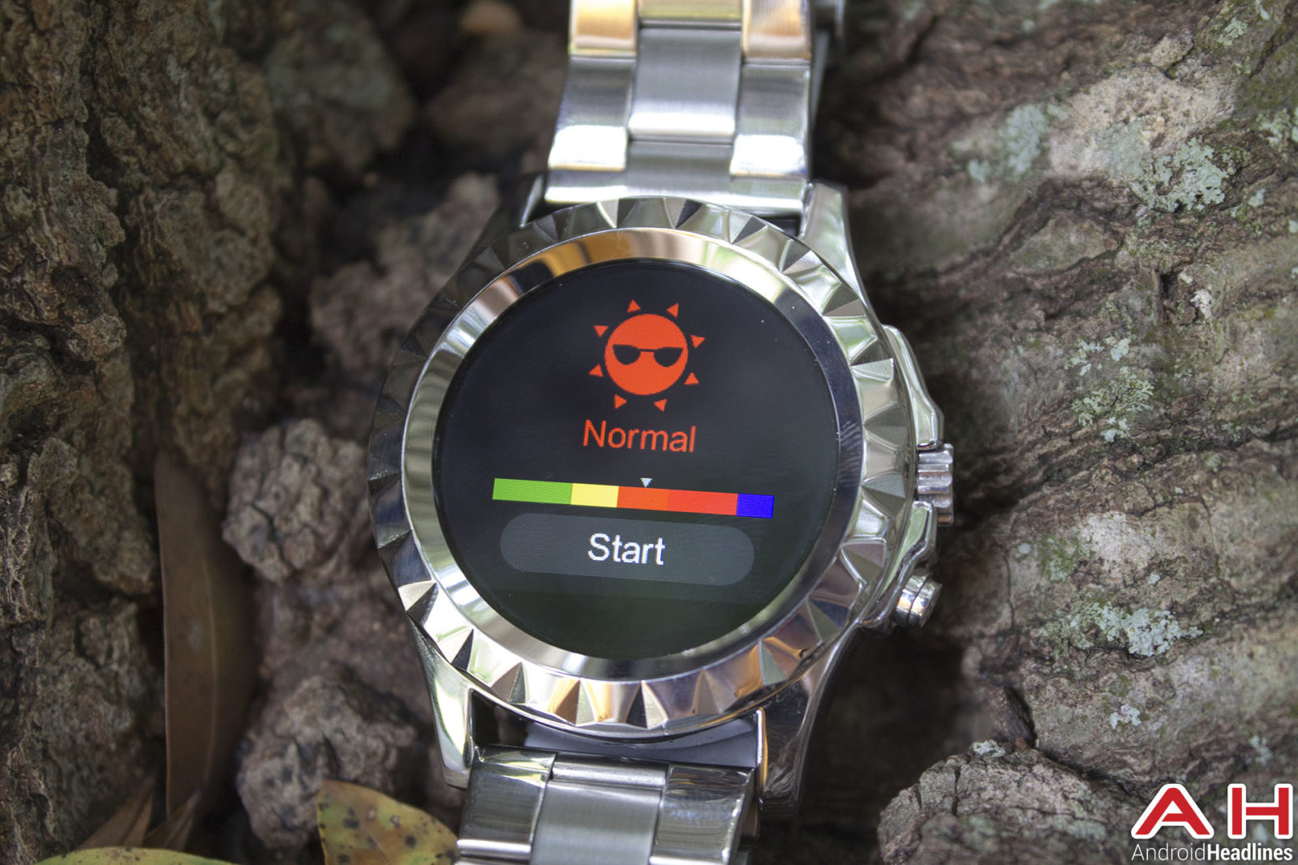
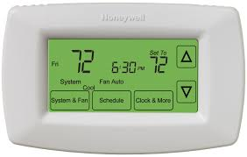
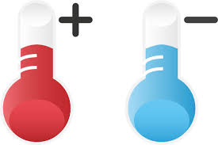
How it works

Slide 6
Benefits
Adjusting the temperature to create a comfortable room temperature for everyone
Reduces cost
Saving energy when there is no need to change the temperature
Allows for automation rather than manually adjusting
Saving time for employees
Greater population opposed to the individual
Focusing on everyone and not the deviations

Slide 7
Future developments
Develop two heat maps (grids)
Visualizes the room temperature and body temperature
First grid
X-axis
Time
Y-axis
Various rooms
Gradient colors
Second grid
Same principle as the first but shows current average body temperature

Slide 8
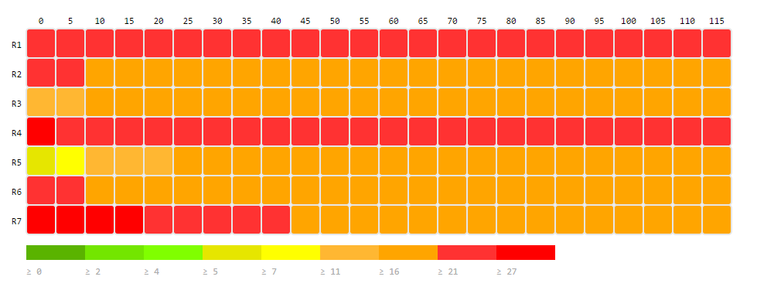
Future implementation grids

Slide 9
Future developments pt.2
Energy Saver
When no one is in the room the climate stays the same
Open streetmaps.
Extract the different buildings representing the rooms from the map.
People represented by dots
Different colors represent body temperature of the person
GPS Sensors of mobile phones to get the current position of the persons and use the already existing data from smart watches to get the body temperature of the people.

Slide 10
Technical overview
List of user objects
Functions to adjust room and body temperatures
Iteration cycle to export data to Spark (userid, location, body temp, room temp)
Localhost listening socket used
Data stream is split and paired with location as a key
Average body temperature used to complete closed loop and provide feedback for room temperature adjustment.

Slide 11
demonstration

Slide 12
reference
http://www.clipartpanda.com/clipart_images/people-and-white-clipart-57691153
http://www.steyr-tractoren.com/how-to-utilize-wifi-routers/
http://www.blogshared.com/article/featured-review-no-1-sun-s2-smartwatch-39182.aspx
https://forwardthinking.honeywell.com/products/thermostats/thermostat_products.html
http://www.clipartpanda.com/categories/hot-and-cold-thermometer-clip-art

Slide 13
Thank you
This work is licensed under a Creative Commons Attribution 4.0 International License.

