Slide 1



Introduction to CTF
Prepared by : KHALED MOHAMED

Slide 2

What is CTF?

Slide 3

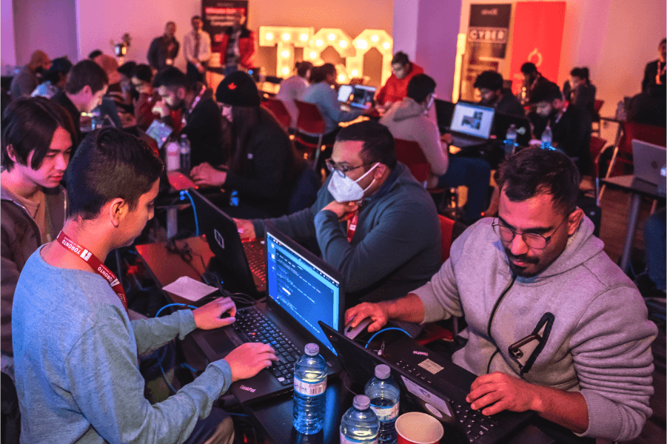
Online CTF
Offline CTF

Slide 4
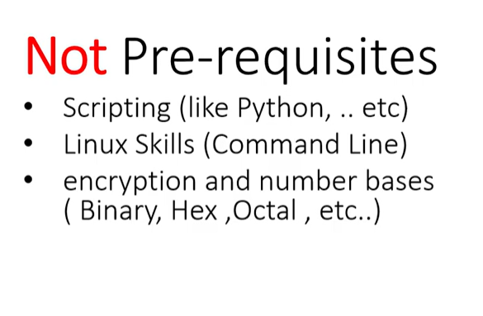


Slide 5

CTF Categories :
Web exploitation
Forensics
Cryptography
OSINT
Network
Binary – Reverse engineering
etc..

Slide 6




Where and how play in Competitions?

Slide 7
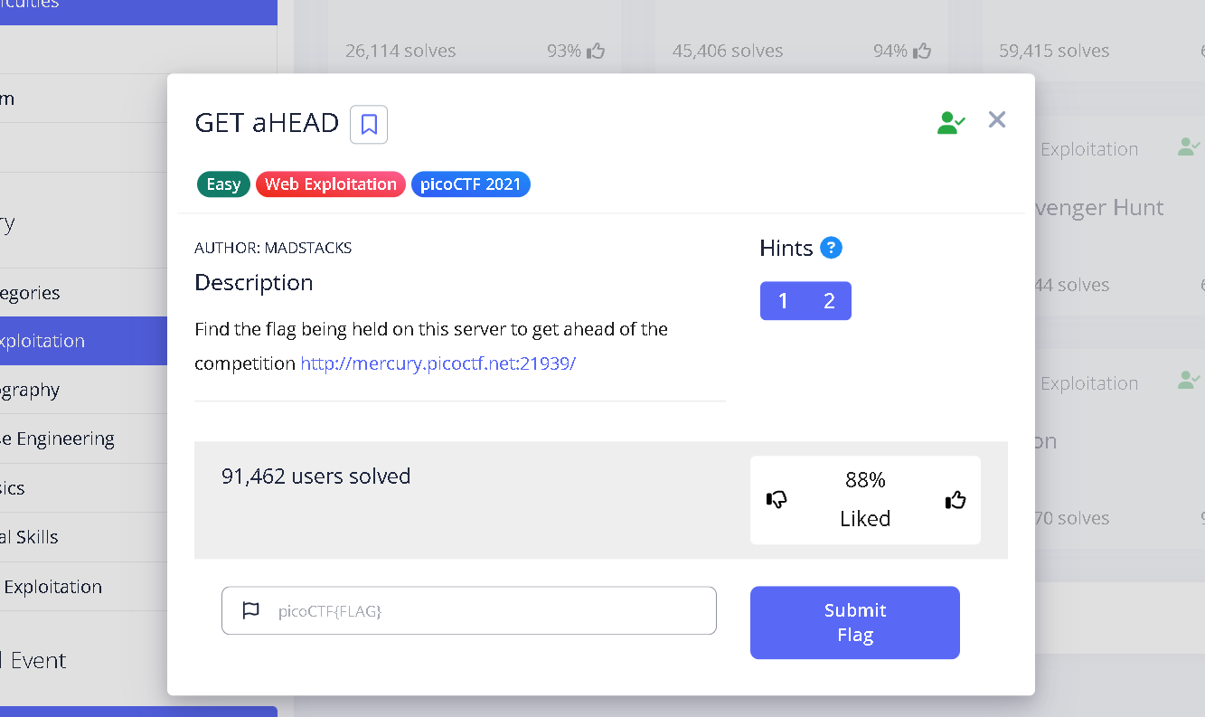

Slide 8





Common tools use in CTF

Slide 9
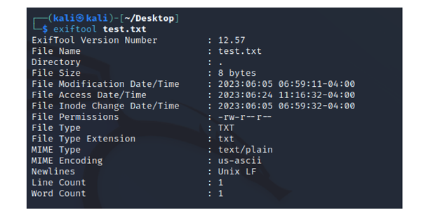
ExifTool

Slide 10
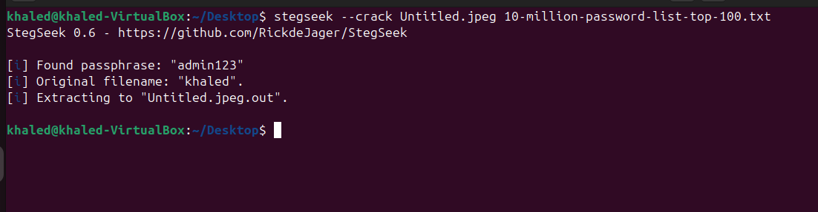
Stegseek

Slide 11


Slide 12
Challenge Time

Slide 13
Thank you

