Slide 1
WEEK 12 · SOC FINAL CAPSTONE
Threat Detection & Incident Response
1
Reconnaissance
ICMP probing · Snort
2
Authentication
Failed SSH, then success · Wazuh
A multi-stage incident detected, correlated and handled with Wazuh and Snort in an authorised lab
3
System / file
Session, sudo, FIM · Wazuh
Md Mohtasim
DG/JULY/CYBER/017 · DG Interns Hub ·
Notes:
Final capstone of the four-week SOC module. Scenario D combines three authorised lab activities on a private host-only network: reconnaissance, authentication events and system/file activity.

Slide 2
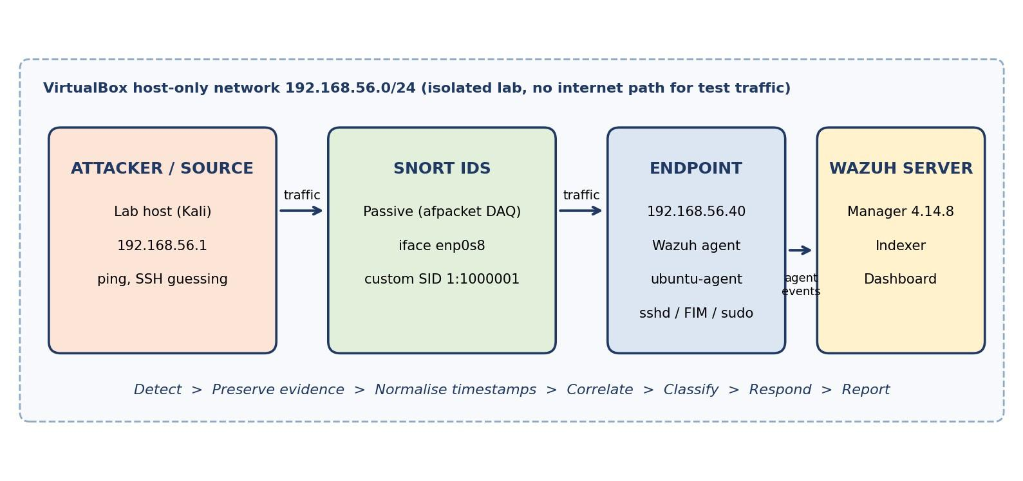
Lab and Scenario
1
Reconnaissance
ICMP ping, seen by Snort
2
Authentication
Failed SSH logins, then success
3
System / file
Session, sudo to root, FIM change
Figure 1 · Snort passive on enp0s8, agent events to Wazuh
Host-only 192.168.56.0/24
Endpoint 192.168.56.40
Wazuh manager 4.14.8
Snort on interface enp0s8
Notes:
Everything stays inside the isolated VirtualBox host-only network 192.168.56.0/24. Snort is a passive sensor on enp0s8; Wazuh agent ubuntu-agent ships auth.log, sudo, PAM and FIM events.

Slide 3
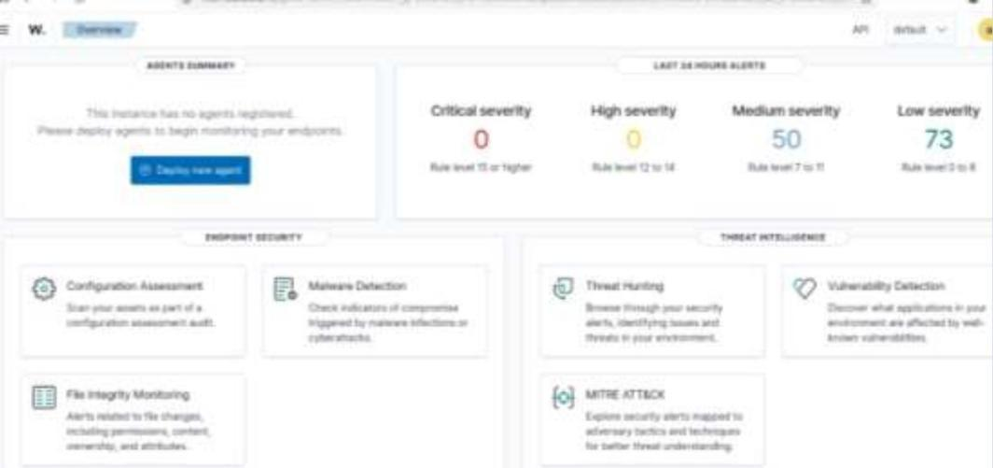
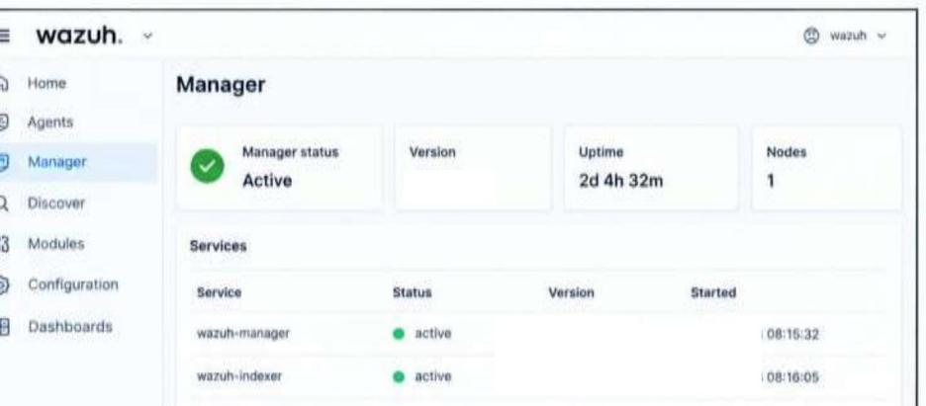
Lab Validation
Figure 2 · Alerts by severity, last 24 h
Figure 3 · Manager and indexer services active
0 / 0
50
73
Active
critical / high
medium alerts
low alerts
manager 4.14.8
Open item: capture the Agents page showing ubuntu-agent Active (dashboard tile reads “no agents registered”).
Notes:
Dashboard shows 0 critical, 0 high, 50 medium, 73 low in the last 24 hours. Manager is Active on 4.14.8 with wazuh-manager and wazuh-indexer running. Open item: the Agents Summary tile says no agents registered although alerts come from ubuntu-agent, so a fresh Agents page screenshot is still to be captured.

Slide 4
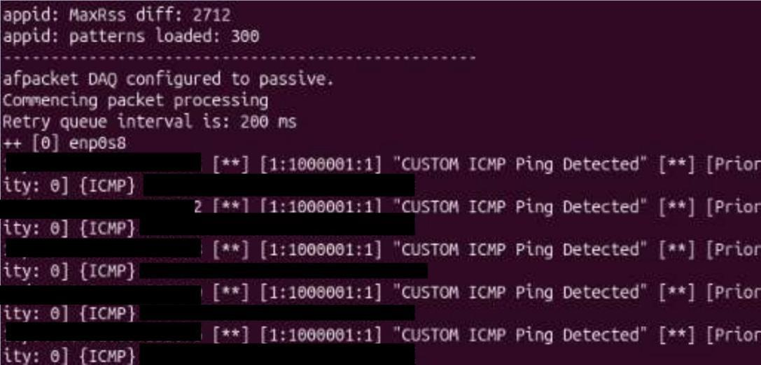
Snort: Network View
Passive afpacket DAQ on enp0s8
300 appid patterns loaded
SID 1:1000001, priority 0, protocol ICMP
Figure 5 · Repeated ICMP alerts, SID 1:1000001
Detection gap: rules cover ICMP and HTTP only, so SSH guessing raised no Snort alert and its encrypted payload cannot be read anyway.
Notes:
Snort is passive on enp0s8 with 300 appid patterns loaded. The custom rule SID 1:1000001 fires on every ICMP echo. The Week 9 rule set covers ICMP and HTTP only, so SSH password guessing produced no Snort alert. That is a detection gap, not a sensor failure.

Slide 5
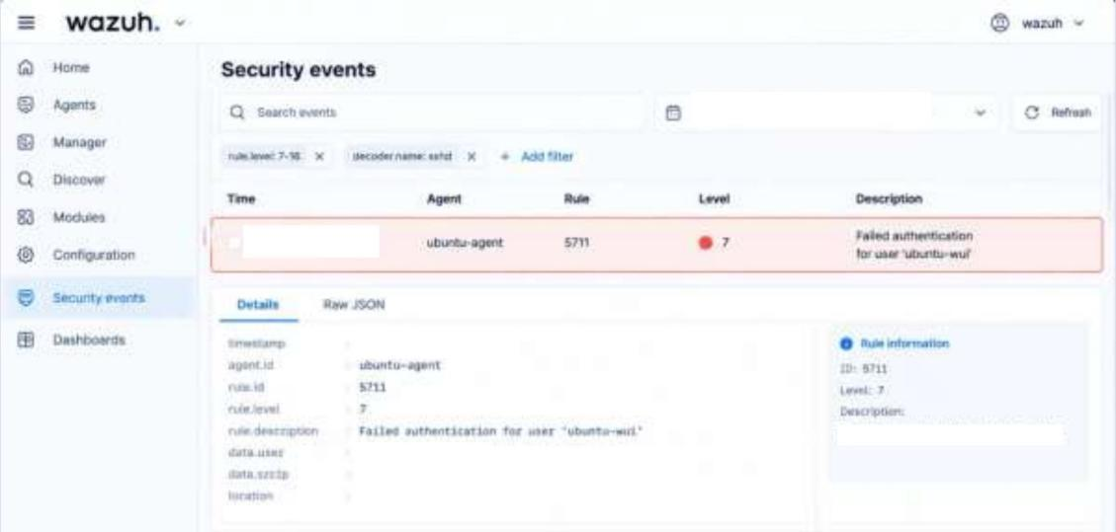
Wazuh: Host Evidence
Failed logins climb from level 5 to 7 to 10
Success (5715) follows the 5763 burst from one source
Sudo to root and FIM changes follow login
Figure 6 · Rule 5711, level 7, ubuntu-agent
Rule chain, tool level shown · colour is analyst severity
5710
5760
5711
5763
5715
5501
5402
554
550
Level 5
Level 5
Level 7
Level 10
Level 3
Level 3
Level 3
Level 5
Level 7
High
Medium
Low
Notes:
Failed logins climb from level 5 to 7, the frequency rule 5763 fires at level 10, and rule 5715 records the success. After login the host logs the PAM session, sudo to root and the FIM events. Tool level and analyst severity are separate scales: 5715 is level 3 but High in sequence.

Slide 6
Incident Timeline
Snort ICMP ping
SID 1:1000001
Brute-force threshold
5763, level 10
Session + sudo root
5501 / 5402
Analyst decision
Benign TP, ticket opened
T0
T1
T2
T3
T4
T5
T6
Failed SSH logins
5710 / 5760 / 5711
SSH success
5715
File created, modified
FIM 554 / 550
Timestamps [hh:mm:ss TZ] to be copied from the raw alerts after normalising all sources to one timezone.
Notes:
Seven steps from T0 to T6. Exact hh:mm:ss values and the timezone are still to be copied from the raw alert JSON and Snort alert log after normalising all sources to one timezone and checking VM clock drift.

Slide 7
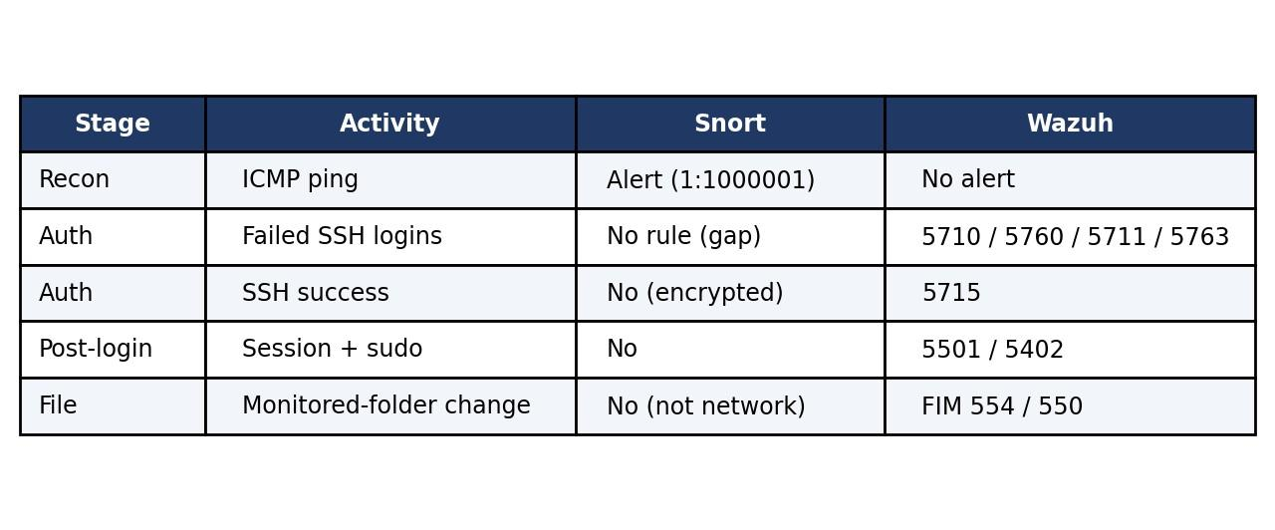
Snort + Wazuh Correlation
Snort
Sees the wire. Blind to encrypted SSH and host activity.
Wazuh
Sees logins, sudo, files. Blind to network recon.
Figure 8 · Which tool saw which stage
Same source and target, one actor: Low and Medium alerts become one High-severity attack path.
Notes:
Each tool has blind spots the other covers. Snort saw the ping on the wire but cannot read encrypted SSH or host activity. Wazuh saw the authentication result, sudo and file change but not the network recon. Correlated, the Low and Medium alerts describe a successful attack path.

Slide 8
Investigation and IOCs
VERDICT
Source IP
Target
Accounts
192.168.56.1
192.168.56.40
root, ubuntu-wui
Benign true positive
confirm in data.srcip
ubuntu-agent
lab accounts
Service
File
Detections
10 alert types, 0 false positives. Authorised lab test.
22/TCP and ICMP
/tmp/soc-lab-demo/ evidence.txt
SID 1:1000001
SSH + ping
FIM 554 / 550
Wazuh 5710 to 550
Key IOC: 192.168.56.1 + root + rule 5715 after 5763, a success following a brute-force burst (MITRE T1110).
Notes:
Classification is benign true positive: every rule detected the behaviour it was written for, and the source, timing and account match the planned lab test. In production the same pattern would be escalated as a likely compromise because success followed failures. The source address 192.168.56.1 should be confirmed in data.srcip, since .1 is normally the host-side adapter in VirtualBox.

Slide 9
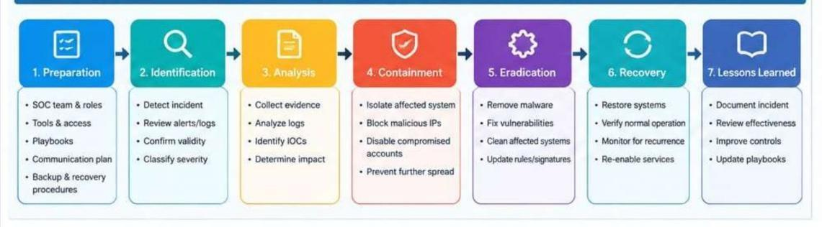
Incident Response
Ticket DG-SOC-2026-001
High during triage, benign true positive, closed after monitoring.
If unauthorised
Block source IP, lock account, end sessions, isolate host.
Notes:
The plan follows preparation, identification, analysis, containment, eradication, recovery and lessons learned. In the lab, containment means stopping the test and confirming isolation. Production actions are documented but not executed. Wazuh active response was left disabled, so blocking is manual.

Slide 10
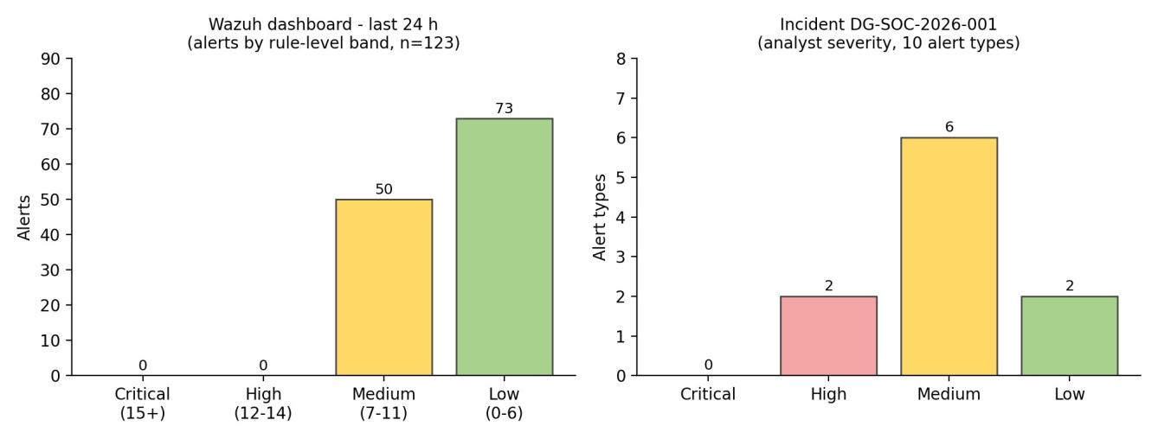
Metrics and Lessons
123
alerts in 24 h
10 / 0
alert types / false positives
2·6·2
High · Medium · Low
Figure 12 · Dashboard bands (left) and analyst severity (right)
How I would improve the SOC
Thresholded Snort rule for port 22
Key-only SSH, no root login, MFA
Enforce NTP on all VMs
Test Wazuh active response
Notes:
Dataset A is the dashboard overview (123 alerts in 24 hours). Dataset B is the 10 alert types reviewed for this incident: 2 High (5763, 5715), 6 Medium, 2 Low (Snort 1:1000001 and 5501), none Critical. Improvements: thresholded Snort rule for port 22, key-only SSH with no root login and MFA, enforced NTP, and testing Wazuh active response.

