Slide 1
WEEK 7 // VAPT PRACTICAL ASSESSMENT
Web Application Testing
with Burp Suite
VAPT Project Report — Phase 2
Proxy Interception
App Mapping
Manual Exploitation
Directory Discovery
Formal Reporting
Prepared by Md Mohtasim DG/JULY/CYBER/017 • Cyber Security Intern
Deadline: 21 September
#DGInternsHub

Slide 2
01 · INTRODUCTION
Objectives & Scope
Phase 2 builds on Week 6's OWASP Top 10 theory with a structured, Burp Suite-centred workflow: proxy interception, application mapping, manual exploitation, endpoint discovery, and professional VAPT reporting.
SCOPE & AUTHORISATION
Testing performed exclusively on intentionally vulnerable, legally testable targets:
1
Configure Burp as an intercepting proxy and trust its CA certificate for HTTPS
DVWA
2
Map the attack surface — pages, forms, parameters — via Target & Proxy tabs
Damn Vulnerable Web App — local instance
3
Manually confirm SQL Injection, XSS, weak auth & parameter tampering
Juice Shop
OWASP intentionally-vulnerable app
4
Perform hidden-endpoint discovery with Burp, Dirsearch & Gobuster
testphp.vulnweb.com
Document 3+ vulnerabilities in real-world VAPT report format
Acunetix public demo target
5
No production system or unauthorised target was accessed at any point.
Md Mohtasim (DG/JULY/CYBER/017) • VAPT Phase 2 • Week 7 • Burp Suite
2

Slide 3
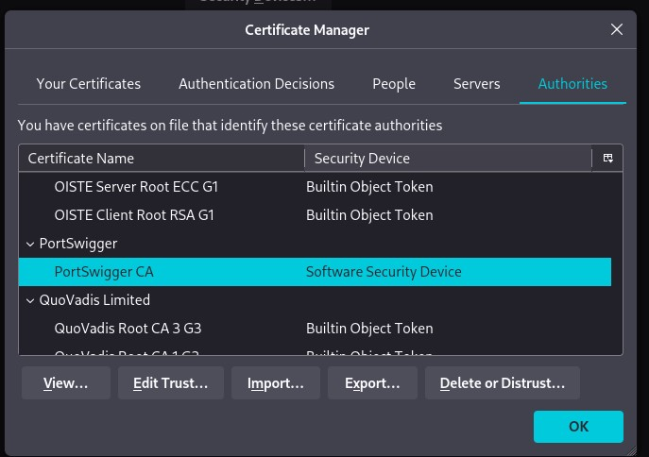
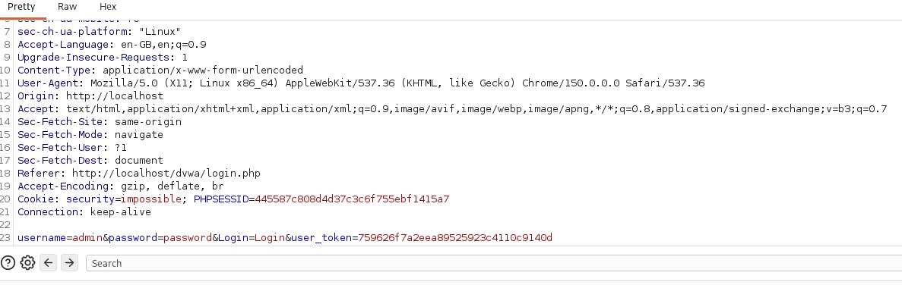
TASK 22 · SETUP & INTERCEPTION
Burp Suite Setup & Interception
Install
Burp Suite Community Edition installed from the official PortSwigger site.
Fig 1 — PortSwigger CA trusted in
Firefox Certificate Manager
Proxy Config
Firefox routed through Burp's listener via the FoxyProxy extension (per-tab toggle).
Trust CA
Burp's self-signed CA certificate imported into Firefox's trust store for HTTPS interception.
Capture Login
DVWA login POST intercepted — credentials confirmed sent as plaintext body params.
Fig 2 — Intercepted DVWA login POST request (Burp Proxy)
Md Mohtasim (DG/JULY/CYBER/017) • VAPT Phase 2 • Week 7 • Burp Suite
3

Slide 4
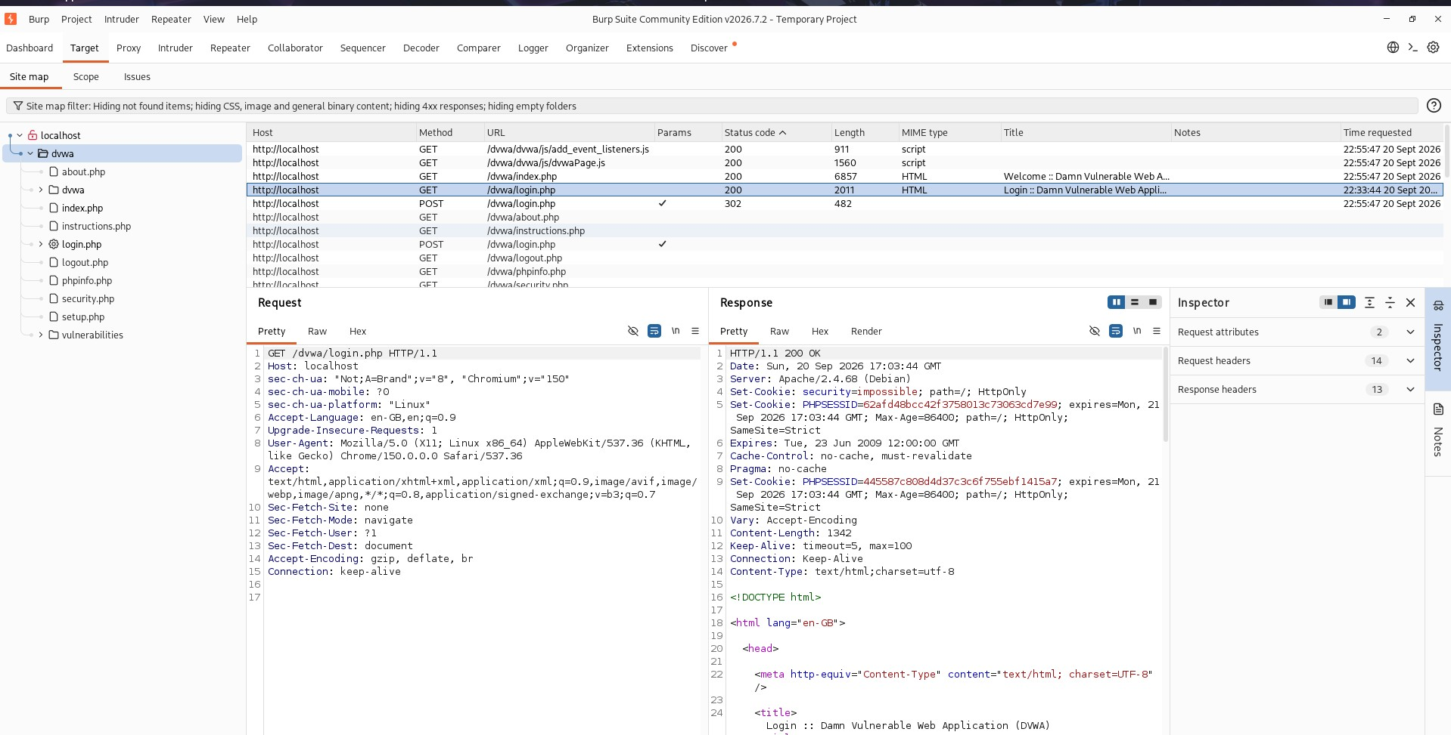
TASK 23 · RECON & MAPPING
Mapping the Web Application
With Intercept off, the app was browsed end-to-end so Proxy → HTTP History and Target → Site map captured the full application tree and every user-input point.
LOGIN FORMS & INPUT FIELDS IDENTIFIED
DVWA
Login form + per-module security-level selector
Juice Shop
Login, registration, search, basket qty, feedback
testphp.vulnweb.com
Fig 3 — Burp Target → Site map of the crawled DVWA application tree
Login, guestbook, product search field
Md Mohtasim (DG/JULY/CYBER/017) • VAPT Phase 2 • Week 7 • Burp Suite
4

Slide 5
TASK 24 · VULNERABILITY TESTING
Manual Exploitation with Repeater & Intruder
SQLi
SQL Injection
XSS
Cross-Site Scripting
' OR 1=1 -- bypassed the WHERE clause on the id parameter, returning every row via Repeater.
<script>alert(1)</script> reflected unescaped in the response — confirmed persistent in Juice Shop's guestbook.
AUTH
Authentication Testing
PARAM
Parameter Tampering
Intruder Sniper attack on the password field found no lockout, delay, or CAPTCHA after repeated failures.
Client-controlled price / security-level values edited in Repeater to test server-side re-validation.
Md Mohtasim (DG/JULY/CYBER/017) • VAPT Phase 2 • Week 7 • Burp Suite
5

Slide 6
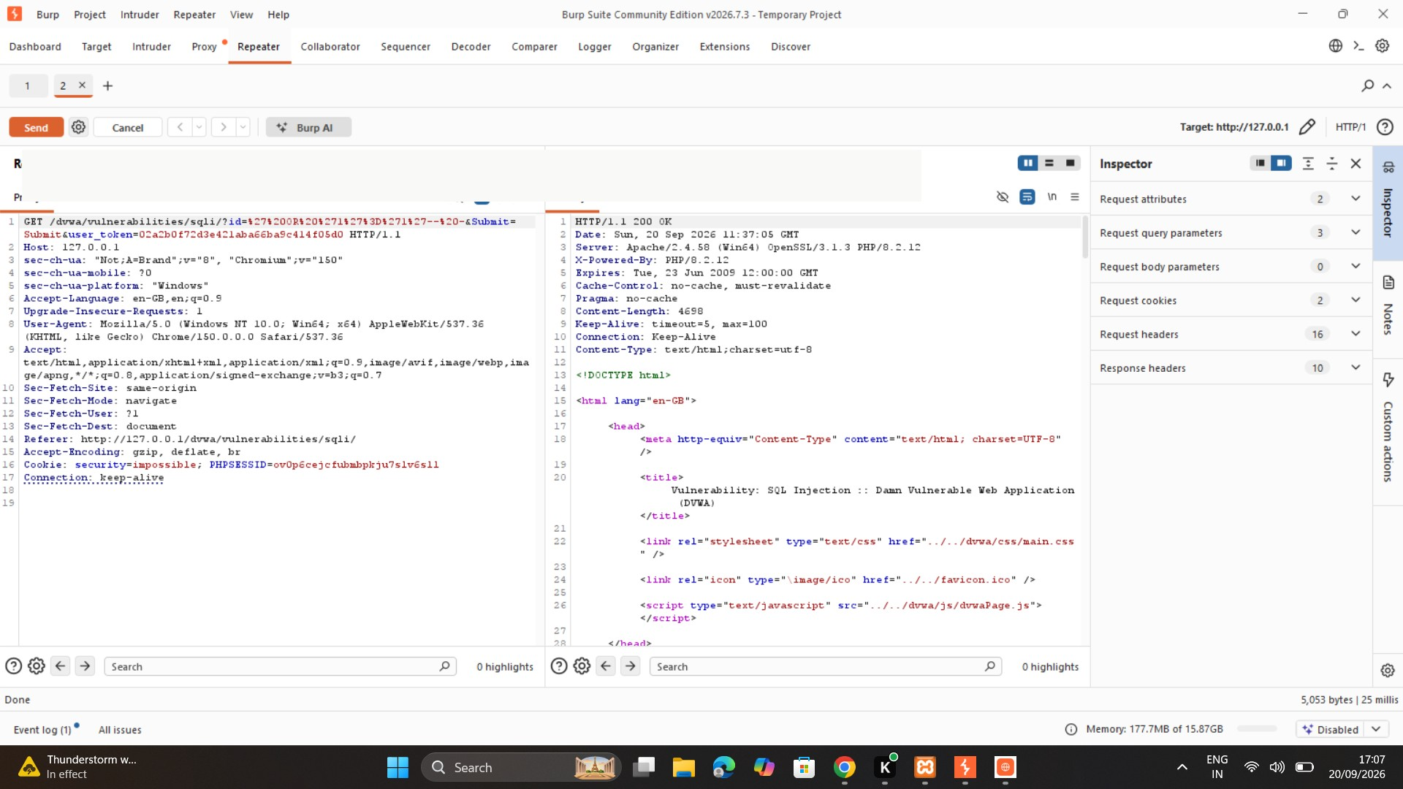
TASK 24.1 · PROOF OF CONCEPT
HIGH RISK
SQL Injection — DVWA Module
PAYLOAD
' OR 1=1 -- -
The id parameter is concatenated directly into the SQL query with no parameterisation, letting the injected clause always evaluate true.
IMPACT
Enumerate the entire users table, bypass similar auth queries, and potentially modify/delete data.
REMEDIATION
Parameterised queries, least-privilege DB accounts, and server-side input validation.
Fig 4 — Burp Repeater: SQLi payload returning every DB row
Md Mohtasim (DG/JULY/CYBER/017) • VAPT Phase 2 • Week 7 • Burp Suite
6

Slide 7
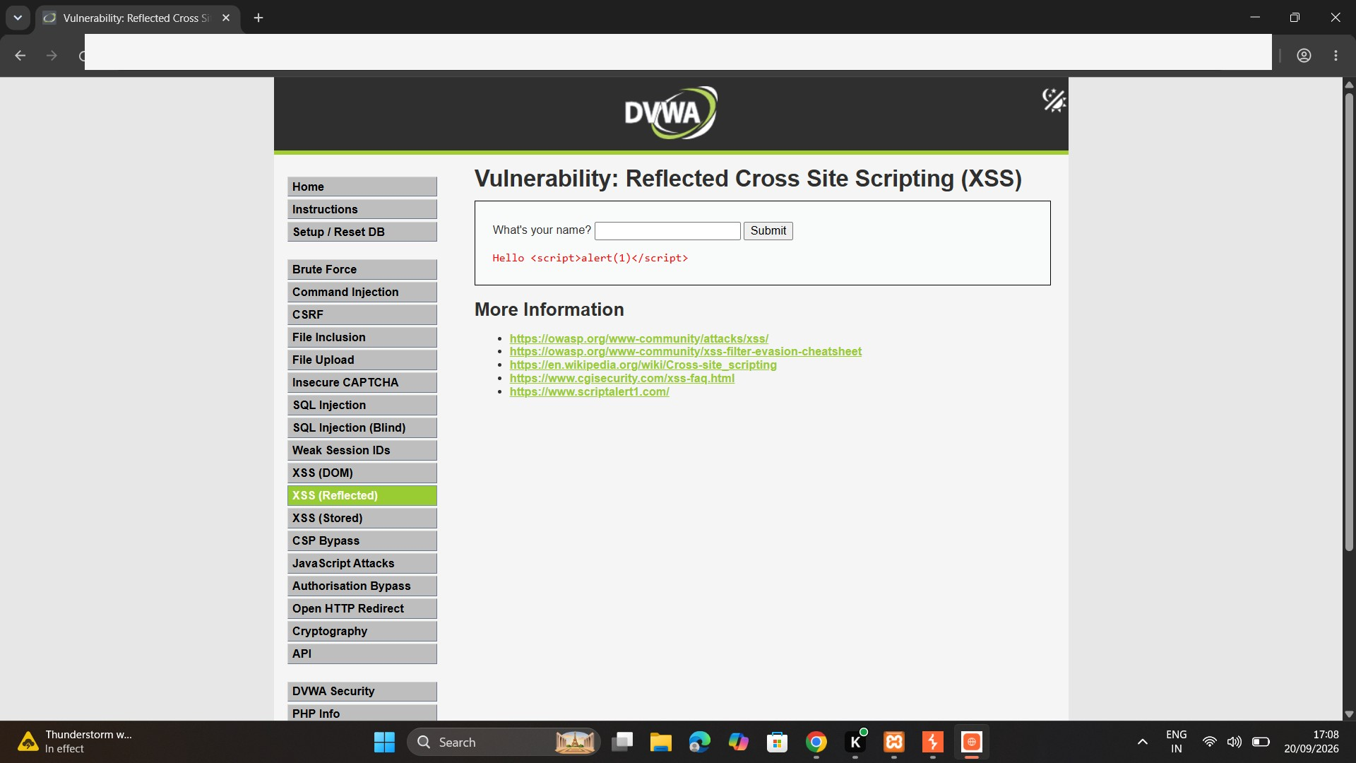
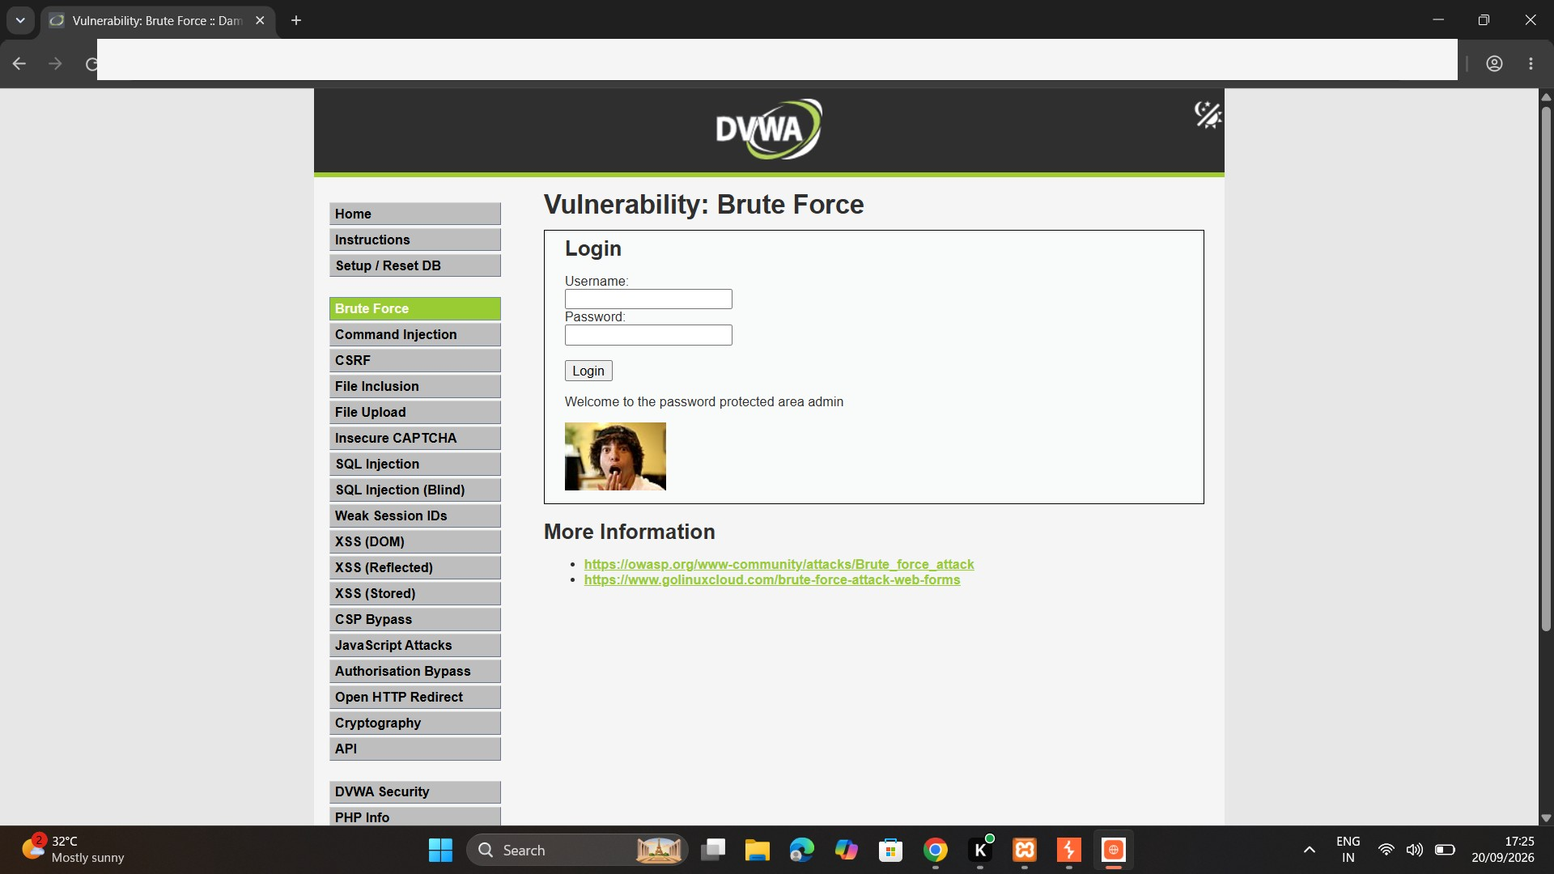
TASK 24.2 / 24.3 · PROOF OF CONCEPT
Reflected XSS & Broken Authentication
HIGH
Fig 5 — Payload reflected unescaped in DVWA XSS module
MEDIUM
Fig 6 — DVWA Brute Force login target for Intruder attack
<script>alert(1)</script> returned unescaped in both reflected and stored (guestbook) contexts — proving server-side persistence, not just a one-off render.
Intruder Sniper attack on the password field, common weak-password list, username fixed at admin — no CAPTCHA, delay, or lockout triggered after repeated failures.
Md Mohtasim (DG/JULY/CYBER/017) • VAPT Phase 2 • Week 7 • Burp Suite
7

Slide 8
TASK 25 · DISCOVERY
Directory & Endpoint Discovery
Automated discovery surfaced endpoints not linked from the visible UI — admin panels, backup files, API routes, and setup scripts.
Manual — Burp
Automated — Dirsearch / Gobuster
Cross-Validation
Target → Site map → "Engagement tools → Discover content" passively/actively probed each target's root using robots.txt, sitemap.xml, JS files, and HTML comments.
Brute-force content scan against local DVWA with a medium wordlist; php / html / txt extensions enabled since DVWA is PHP-based.
Automated results cross-checked against the manual Burp site map to remove false positives before recording confirmed endpoints.
Path | Status | Risk note
/config/ | 200 | Config directory publicly listed
/setup.php | 200 | DB setup script reachable without auth
/admin/ | 403 / 404 | Present but access-controlled
/api/ (Juice Shop) | 200 | REST API surface — needs own parameter review
/backup/, /.git/ | Not found | Checked as known-risk paths; none exposed
Md Mohtasim (DG/JULY/CYBER/017) • VAPT Phase 2 • Week 7 • Burp Suite
8

Slide 9
TASK 26 · VAPT REPORT
Consolidated Findings
Vulnerability | Location | Risk | Remediation Priority
SQL Injection | DVWA — SQL Injection module (id param) | High | Immediate — parameterised queries
Reflected / Stored XSS | DVWA XSS module + Juice Shop guestbook | High | Immediate — output encoding + CSP
Broken Authentication | Login endpoint (no lockout / rate limit) | Medium | Short-term — lockout + MFA
Parameter Tampering | Juice Shop basket price / DVWA security level | Medium | Short-term — server-side re-validation
RISK RATING METHODOLOGY (Likelihood × Impact, aligned to OWASP)
HIGH
MEDIUM
LOW
Easily exploitable, no auth required, high confidentiality/integrity impact (SQLi, XSS).
Needs a precondition or repeated interaction; moderate impact (weak auth, tampering).
Difficult to exploit directly or informational, but weakens overall posture.
Md Mohtasim (DG/JULY/CYBER/017) • VAPT Phase 2 • Week 7 • Burp Suite
9

Slide 10
CONCLUSION · SUBMISSION
From Findings to Deliverables
Phase 2 moved from vulnerability theory (Week 6) to a complete Burp-centred workflow: intercept, map, manually confirm exploits, discover hidden endpoints, and report to a professional VAPT standard. Manual, tool-assisted testing remains essential for confirming true positives and business-logic flaws that automated scanners alone can't provide.
SUBMISSION REQUIREMENTS
✓
Report — 12 to 15 pages (PDF)
✓
PPT — 8 to 10 slides
✓
Screenshots — Proxy, Repeater, Intruder
3
Vulnerabilities manually reproduced, documented and remediated: SQL Injection, Reflected XSS, and Broken Authentication.
✓
3+ working vulnerabilities demonstrated
✓
LinkedIn post tagging DG Interns Hub
Deadline: 21 September
Form shared: 19 September
Md Mohtasim (DG/JULY/CYBER/017) • VAPT Phase 2 • Week 7 • Burp Suite
10

