Slide 1
WEEK 8 — ADVANCED VAPT
Attack-Chain & Full Exploitation
Assessment of a Web Application
DVWA (Medium) • Burp Suite Community Edition • Localhost Training Lab
CANDIDATE
TARGET
SUBMISSION
Md Mohtasim (DG/JULY/CYBER/017)
DVWA — Damn Vulnerable Web App
30-09-2026

Slide 2
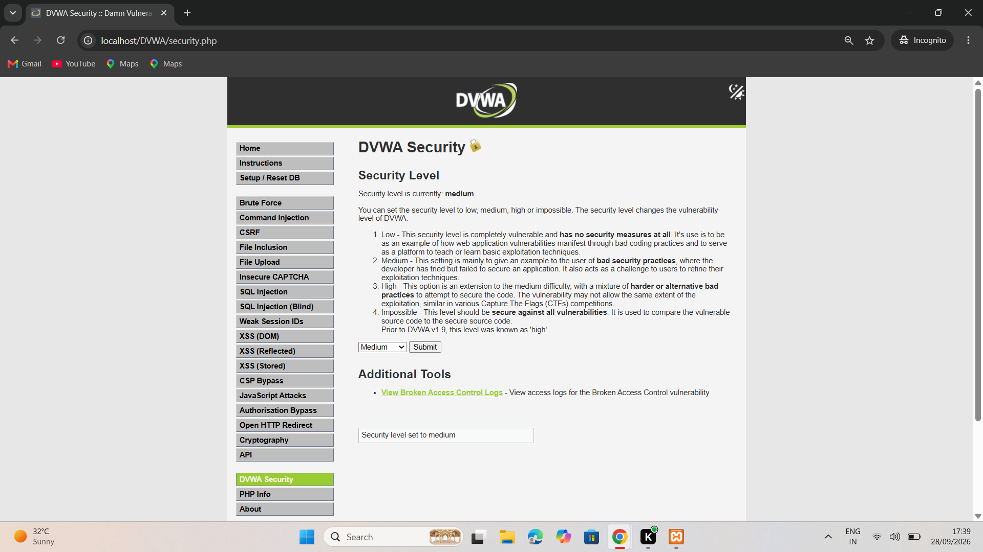
Not a Vulnerability List — an Attack Chain
A vulnerability list answers ‘what is broken.’ An attack chain answers ‘what can someone do with it, in what order.’
1
Authentication layer
Login + Brute Force page — no visible lockout
2
Data / input layer
SQL Injection — client-editable ID parameter
3
Session layer
Weak Session IDs — replay-tested
4
Access-control layer
Authorization Bypass — client-supplied object ID
DVWA security page — Medium level, full vulnerability menu
Selected as the spine of the chain: together they mirror a real breach path — past the login, through a manipulated identifier, into weak session and access controls.
Section 3 — Attack Surface Mapping
DG Interns Hub — Week 8 Advanced VAPT

Slide 3
Attack Chain — Step by Step
Each stage depends on the one before it — written as the attacker would experience it.
1
2
3
4
5
6
Get past
authentication
Editable
request
Tamper the
identifier
Test session
layer
Reach auth-
sensitive endpoint
Prove
compromise
→
→
→
→
→
Brute Force page reachable,
no visible lockout
SQL Injection page traffic
captured in Burp Proxy
id changed 1 → 2 in Repeater,
server returns 200 OK
Weak Session ID endpoint
replayed successfully
JSON body with client-
supplied id + profile fields
Needs 2nd identity +
cross-account confirmation
Validated up to Step 5 with captured evidence — Step 6 is the defined next action, not yet performed.
Section 6 — Attack Chain
DG Interns Hub — Week 8 Advanced VAPT

Slide 4
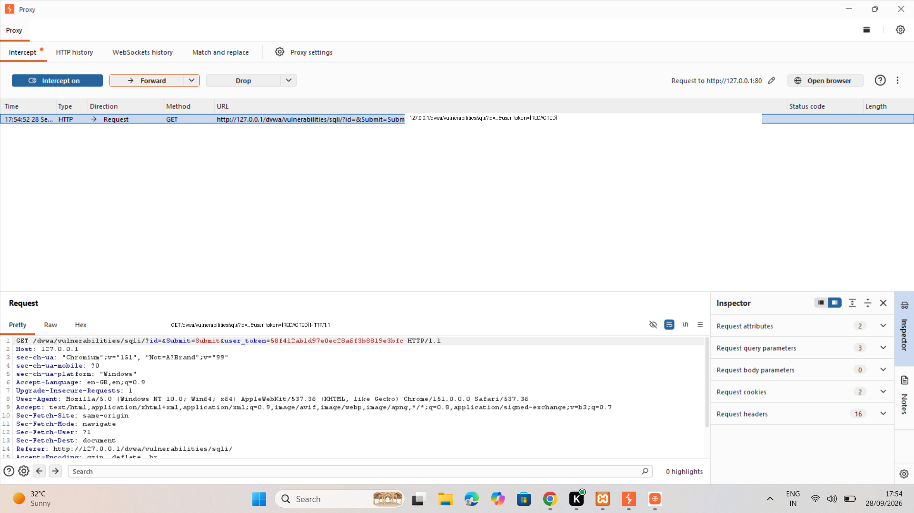
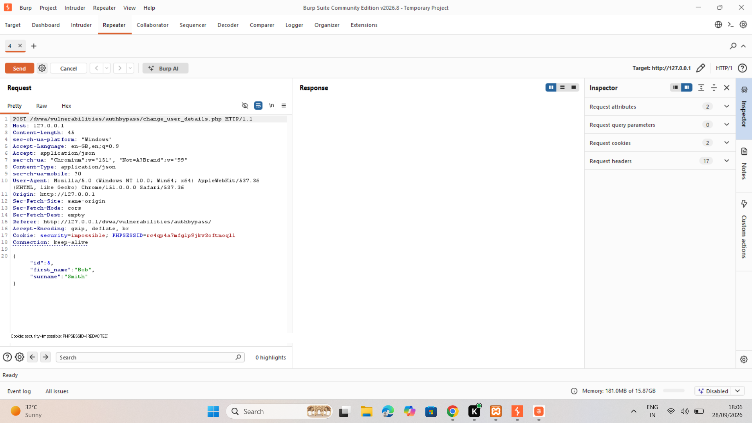
Exploitation Evidence — Burp Suite
Fig. 5 — Intercepted SQLi request in Burp Proxy (tokens redacted)
Fig. 8 — Authorization-bypass request: client-supplied id + profile JSON
Mechanical half confirmed: the server accepts a client-controlled id it was never issued through the UI. Security half open: no evidence yet ties id=2 or the profile update to a second, unauthorized identity.
Sections 5–6 — Proxy Interception & Parameter Tampering
DG Interns Hub — Week 8 Advanced VAPT

Slide 5
Risk & Business Impact
Test Area
Potential Impact if Confirmed
Severity
Parameter tampering (ID)
Access to another user's record
High
Weak session handling
Session fixation / takeover
High
Authorization endpoint
Unauthorized profile modification
Critical
Authentication surface
Credential stuffing compromise
Medium
IF THE CHAIN IS FULLY CONFIRMED
Data integrity — profile fields altered without consent
Privacy exposure — personal data read/written without authorization
Trust & support cost — unexplained account changes erode confidence
Sections 7, 9, 10 — Evidence Summary & Risk Positioning
DG Interns Hub — Week 8 Advanced VAPT

Slide 6
Remediation & Closing Reflection
Re-check ownership server-side on every request carrying an identifier
REFLECTION
Replace direct object references with indirect, per-session tokens
“Real breaches are rarely one dramatic exploit — they're a handful of individually minor gaps that happen to line up.”
Issue high-entropy session IDs; rotate on login, invalidate on logout
Add authentication throttling and account lockout
Next validation: repeat Steps 3–5 with two lab identities to convert the authorization-bypass hypothesis into a demonstrated cross-account result.
Validate every client-controlled parameter, including JSON body fields
Md Mohtasim
DG Interns Hub — Cyber Security Intern
Sections 9, 11 — Remediation & Conclusion
DG Interns Hub — Week 8 Advanced VAPT

