Slide 1
Linux Platform Installation Guide Service Workshop
Ahmad Alamoush (UHi)
IIP-Ecosphere Platform Documentation

Slide 2
Introduction
These slides are used to do the Service Workshop setup in Linux OS.
The slides are divided into:
Using pre-defined Docker image.
Install Docker.
Running the container.
Using the pre-defined development environment.
Full manual Installation of the platform
Install the required setup (Prerequisites).
Download and install the IDE Eclipse development environment.
Install the IIP-Ecosphere platform.
Start the IIP-Ecosphere platform.
Stop the IIP-Ecosphere platform.

Slide 3
Introduction
For the sake of the Service Workshop you might use the pre-defined Docker image OR you should follow this order to manually prepared your machine:
Install prerequisites that should be use by the IIP-Ecosphere platform and IDE development environment.
Download the IDE Eclipse + Workspace for the Workshop.
Install the IIP-Ecosphere platform to test the App developed in the Workshop.
Start and Stop the IIP-Ecosphere platform to validate the installation, and use it in the Workshop (more details in the Workshop).

Slide 4
The pre-defined Docker image
Install Docker

Slide 5
Docker Engine Installation - step (1)
If Docker Engine v20.10.7 is not installed, then Install Docker Engine v20.10.7, may be needed
- sudo apt-get update -y
- sudo apt-get install \
ca-certificates \
curl \
gnupg \
lsb-release -y

Slide 6
Docker Engine Installation - step (2)
If Docker Engine v20.10.7 is not installed, then Install Docker Engine v20.10.7, may be needed
- sudo mkdir -p /etc/apt/keyrings
curl -fsSL https://download.docker.com/linux/ubuntu/gpg | sudo gpg --dearmor -o /etc/apt/keyrings/docker.gpg
- echo \
"deb [arch=$(dpkg --print-architecture) signed-by=/etc/apt/keyrings/docker.gpg] https://download.docker.com/linux/ubuntu \
$(lsb_release -cs) stable" | sudo tee /etc/apt/sources.list.d/docker.list > /dev/null

Slide 7
Docker Engine Installation - step (3)
If Docker Engine v20.10.7 is not installed, then Install Docker Engine v20.10.7, may be needed
- sudo apt-get update -y
- sudo apt-get install docker-ce=5:20.10.7~3-0~ubuntu-focal docker-ce-cli=5:20.10.7~3-0~ubuntu-focal containerd.io docker-compose-plugin -y

Slide 8
The pre-defined Docker image
Running the container

Slide 9
Running The Container
Use the following command to pull the image and run it on your machine
docker run -p 6080:80 -v /dev/shm:/dev/shm iipecosphere/dev-container:0.1
You should have the following screen.

Slide 10
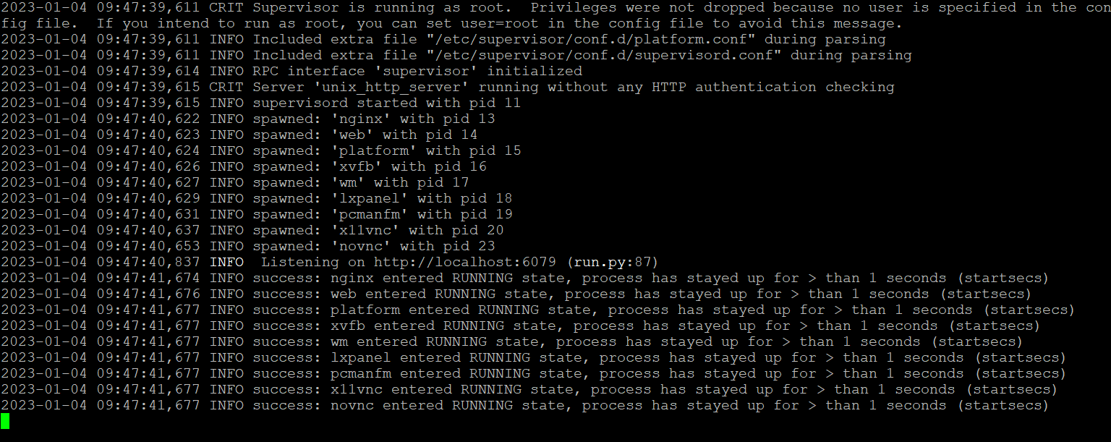
Running The Container

Slide 11
The pre-defined Docker image
Using the pre-defined development environment

Slide 12
Development Environment
To access the pre-defined working environment use any browser with the URL: localhost:6080 OR replace the localhost with the IP address of the machine that run the container.
You have IDE Eclipse environment install and ready to use with a workspace (eclipse-workspace) that has Impl.model project.
You have the platform install and running (the logs are in /root/platform/logs)
You should have the following screen.

Slide 13
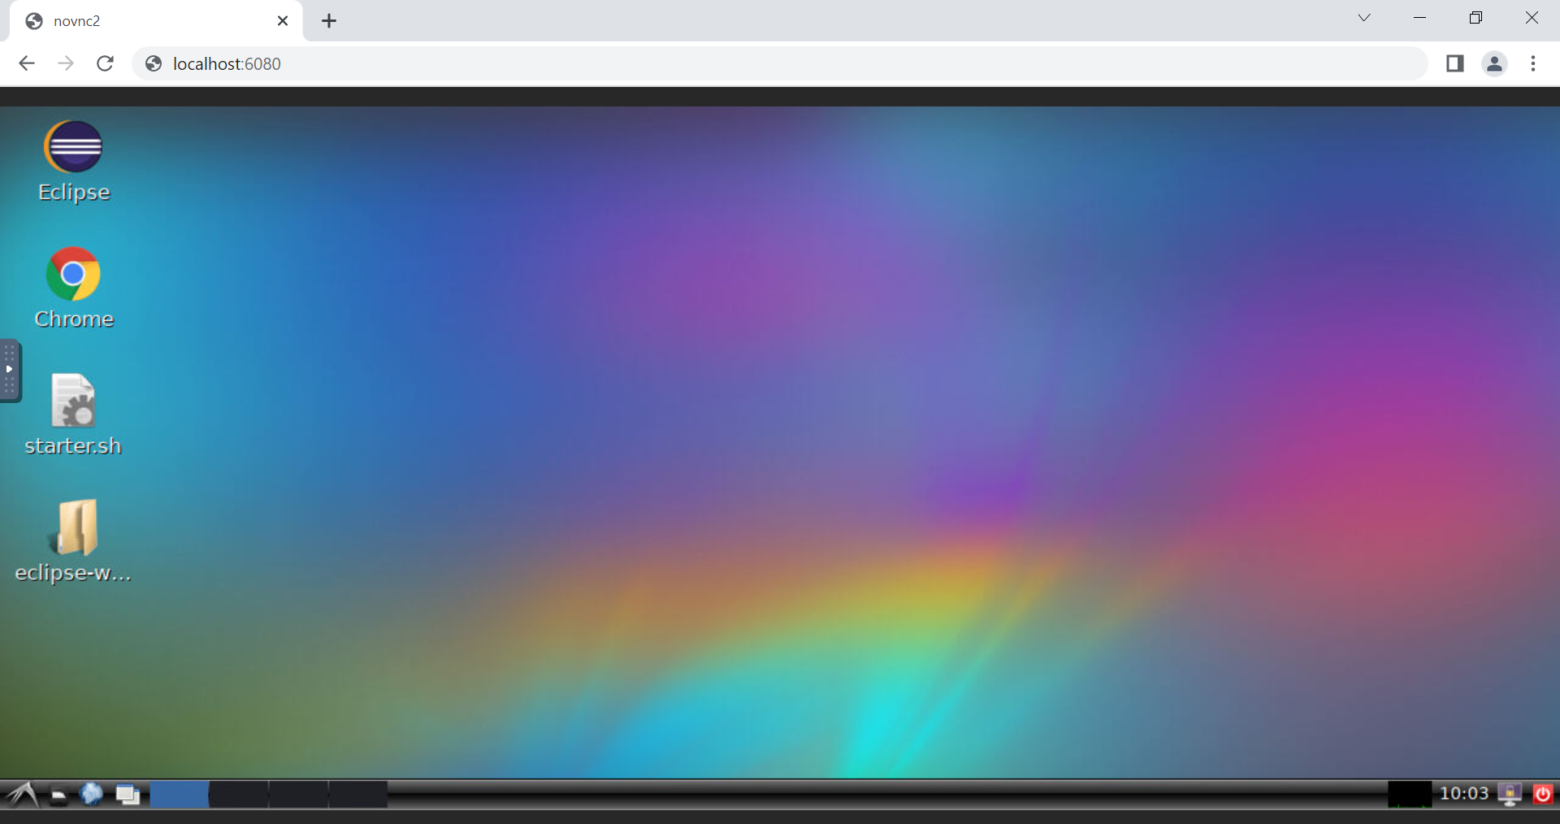
Development Environment

Slide 14
Full manual Installation of the platform
Install the required setup (Prerequisites)

Slide 15
Required Setup
Notes:
Please ensure that you use the exact version numbers given for every software in this guide.
Please do not use ”the latest” version of a given software, as these later versions maybe incompatible with the current IIP/Ecosphere platform build.

Slide 16
Required Setup - step (1)
Please note that you should run the commands in root.
Update all of your packages for Linux
- sudo apt-get update
Install unzip
sudo apt install unzip –y
Please note that the current IIP-Ecosphere platform required Java JDK 8, 11 or 13, no other. In this guide we are installing JDK 13.
If Java JDK 13 is not installed, then install Java JDK 13
- sudo apt install openjdk-13-jdk-headless -y
If Maven 3.6.3 is not installed, then install Maven 3.6.3
- sudo apt install maven -y

Slide 17
Required Setup - step (2)
If Python v3.9 is not installed, then Install Python v3.9
- sudo apt update -y
- sudo apt install software-properties-common -y
- sudo echo | add-apt-repository ppa:deadsnakes/ppa
- sudo apt update -y
sudo apt install python3.9 -y
If you want to use a UI (User Interface), there are several applications like Angular, JavaScript… etc. Please check the handbook for more information.

Slide 18
Required Setup - step (3)
If Python v3.9 is installed add the requirements by running:
python3 –m pip install scikit-learn==0.23.2
python3 –m pip install numpy==1.20.1
python3 –m pip install pickle==4.0
python3 –m pip install pyflakes

Slide 19
Setup the IDE Eclipse environment

Slide 20
Setup the IDE Eclipse environment
For the purpose of the Service Workshop, we have prepared the projects and the examples for Eclipse IDE - with exact Eclipse version (Eclipse 2021-03, version 4.19.0) provided by the link in next slide.
Any other Java-enabled IDE like Netbeans may do, but this requires manual work.
The Eclipse provided by the link in next slide is compiled one with the required plugins (like checkstyle) fitting the required JDK for the platform.

Slide 21
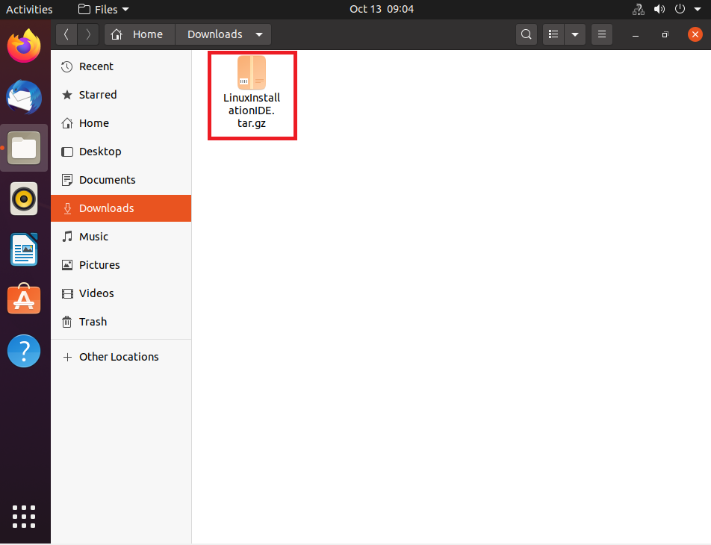
Setup the IDE Eclipse environment
Click the following link to download a tar file (LinuxInstallationIDE.tar.gz) that contains the IDE Eclipse with the workspace to use:
https://sync.academiccloud.de/index.php/s/RWNxvXnELhTJNoc
Extract the tar file.

Slide 22
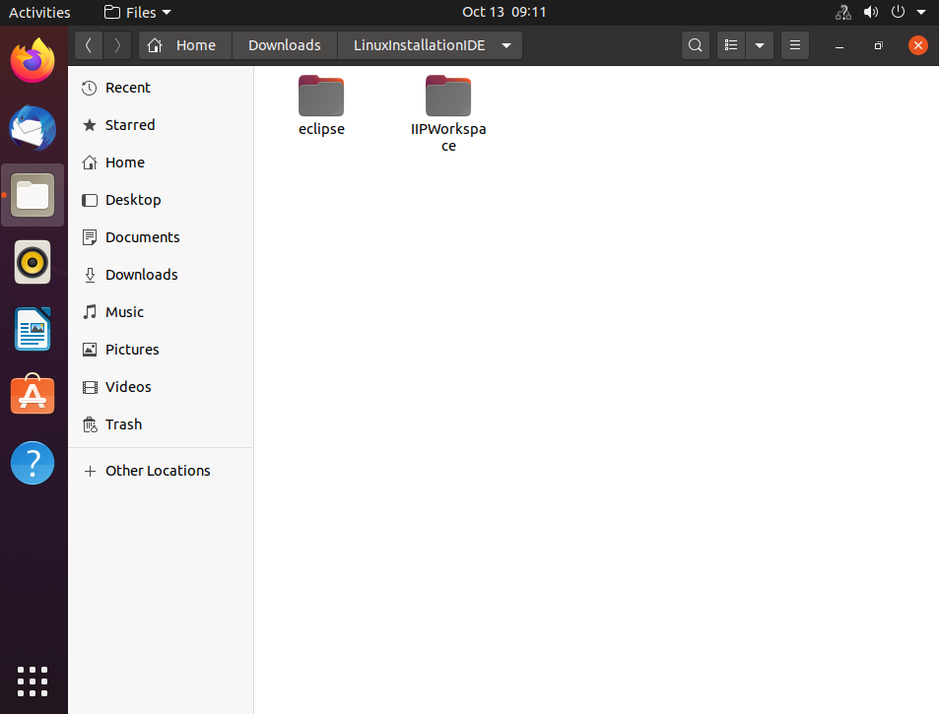
Setup the IDE Eclipse environment
There are two folders.
Eclipse (folder)
IIPWorkspace (folder)

Slide 23
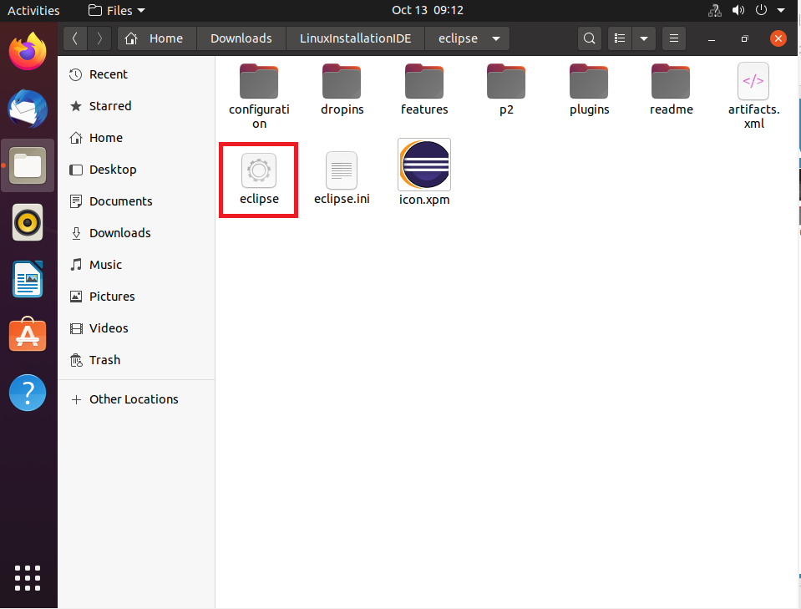
Setup the IDE Eclipse environment
Inside eclipse folder, open eclipse application.

Slide 24
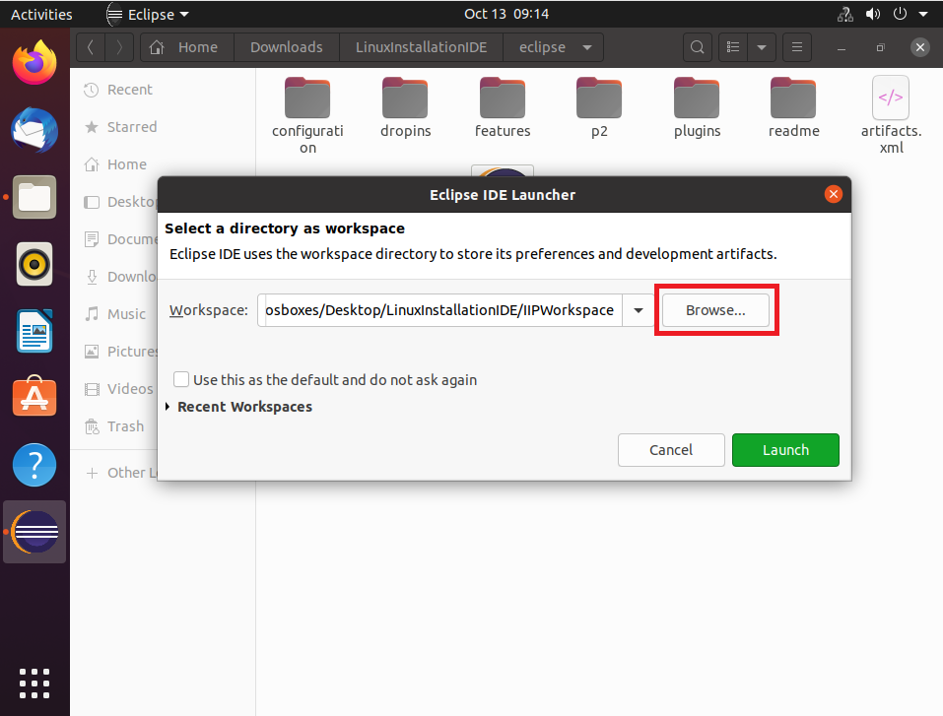
Setup the IDE Eclipse environment
Browse to IIPWorkspace in downloaded folder.

Slide 25
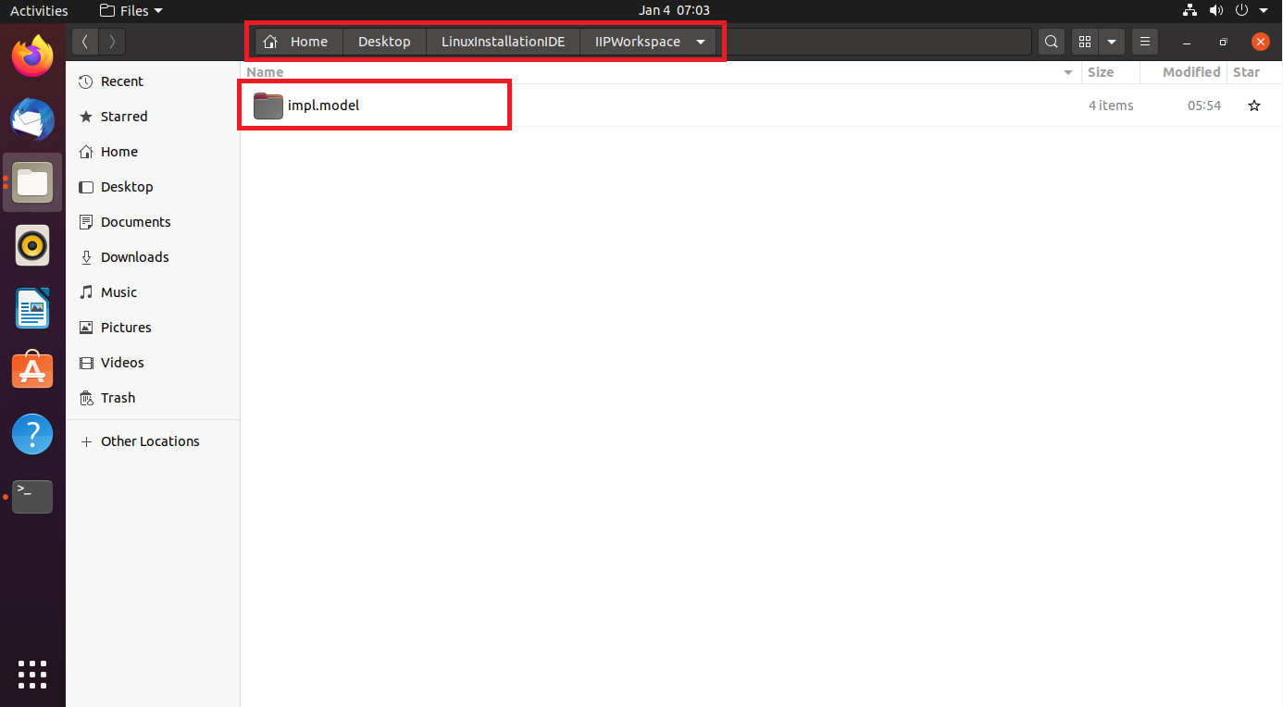
Setup the IDE Eclipse environment
You should see the following projects in that directory.
Click open.

Slide 26
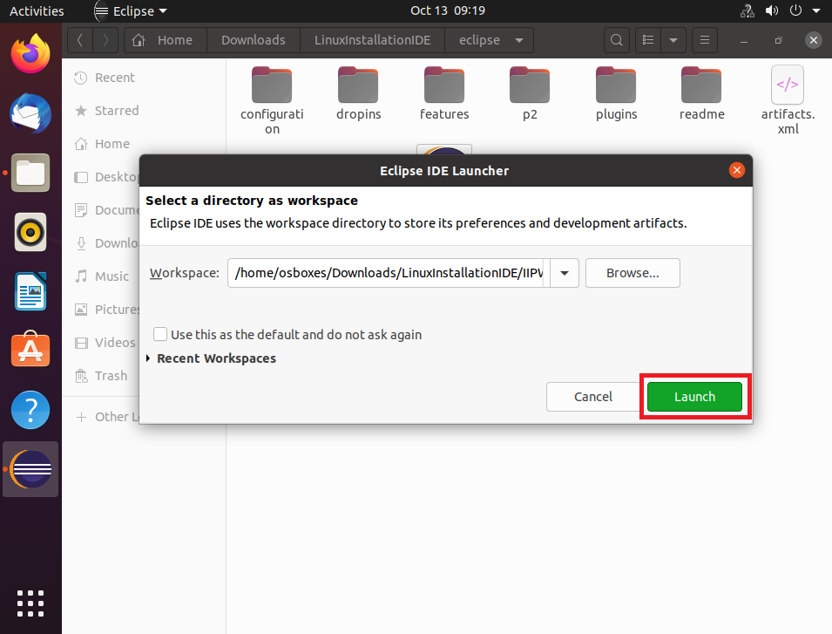
Setup the IDE Eclipse environment
Click Launch.

Slide 27
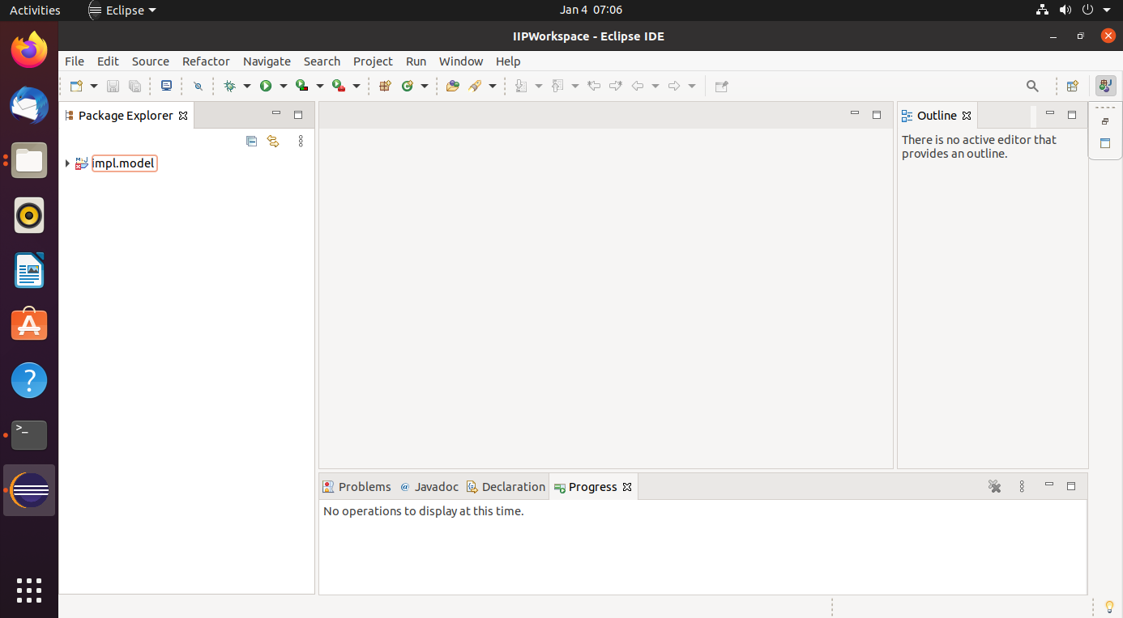
Setup the IDE Eclipse environment
Wait until all projects are build and ready to use.

Slide 28
Install the platform

Slide 29
Platform Installation - step (1)
Create an empty folder and it (for example “Install”)
- mkdir Install
- cd Install
Download Install-Package and unpack it
- wget https://jenkins-2.sse.uni-hildesheim.de/view/IIP-Ecosphere/job/IIP_Install/lastSuccessfulBuild/artifact/platform/tools/Install/install.tar.gz
- tar xzpvf install.tar.gz

Slide 30
Platform Installation - step (2)
Modify the IP address for the platform in the configuration file (src/main/easy/InstallTest.ivml) or use the following two commands to do so
- export localIP=$(hostname -I | cut -d ' ' -f1)
- sed -i 's/147.172.178.145/'$localIP'/g' src/main/easy/InstallTest.ivml
Instantiate platform: Execute in “install folder”
mvn install
Now the platform is installed, the script files are create and ready to start.

Slide 31
Start The Platform

Slide 32
Start The Platform
There are two possible aways to the run the platform:
Local: One machine working as platfrom and device at the same time.
Distributed: One machine working as platform, another machine(s) working as device(s)

Slide 33
Start The Platform Local - Step (1)
The broker scripts and files in “Install/gen/broker” folder, run the following script in separate terminal to start it
- broker.sh
The platform scripts and files in “Install/gen” folder, run the following script separate terminal to start it
- platform.sh

Slide 34
Start The Platform Local - Step (2)
To make the platform machine working as resources run the following scripts, each one in separate terminal
- ecs.sh
- serviceMgr.sh
Or just run the following script in separate terminal (share the same memory)
- ecsServiceMgr.sh
To start the command line interface for the platform run the following script in separate terminal
- cli.sh
The above scripts are exists in “Install/gen” folder

Slide 35
Start The Platform Distributed - Step (1)
Copy the following files and folders from the platform server (the PC you installed the platform on) to the PC/Device that should be added to the platform as a resource:
gen\ecsJars (folder)
gen\ecsSVCJars(folder)
gen\broker (folder)
gen\svcJars (folder)
gen\ecs.bat (file)
gen\serviceMgr.bat (file)
gen\ecsServiceMgr.bat (file)

Slide 36
Start The Platform Distributed - Step (2)
To add the new PC/Device as resource in the platform run the following scripts on the new PC/Device, each one in separate terminal
- ecs.sh
- serviceMgr.sh
Or just run the following script in separate terminal (share the same memory)
- ecsServiceMgr.sh
If everything worked fine, then PC/Device should be listed as a platform resource.

Slide 37
Add a Linux Edge device to the platform
The difference between a device and an Edge devices is (in case that Edge device only supports Java 8)
- Copy the following files (not the files from slide 26) from the platform server to the Edge device and run it.
gen\ecs8.sh instead of gen\ecs.sh
gen\serviceMgr8.sh instead of gen\serviceMgr.sh
gen\ecsServiceMgr8.sh instead of gen\ ecsServiceMgr.sh

Slide 38
Stop The Platform

Slide 39
Stop The Platform
Stopping the platform:
Type Crtl-C on all the open Termials to stop them and clean the resources in the reverse order we opened (started) them.
If asked to quit (Y/N), type Y

Slide 40
Ahmad Alamoush
alamoush@sse.uni-hildesheim.de

