Slide 1

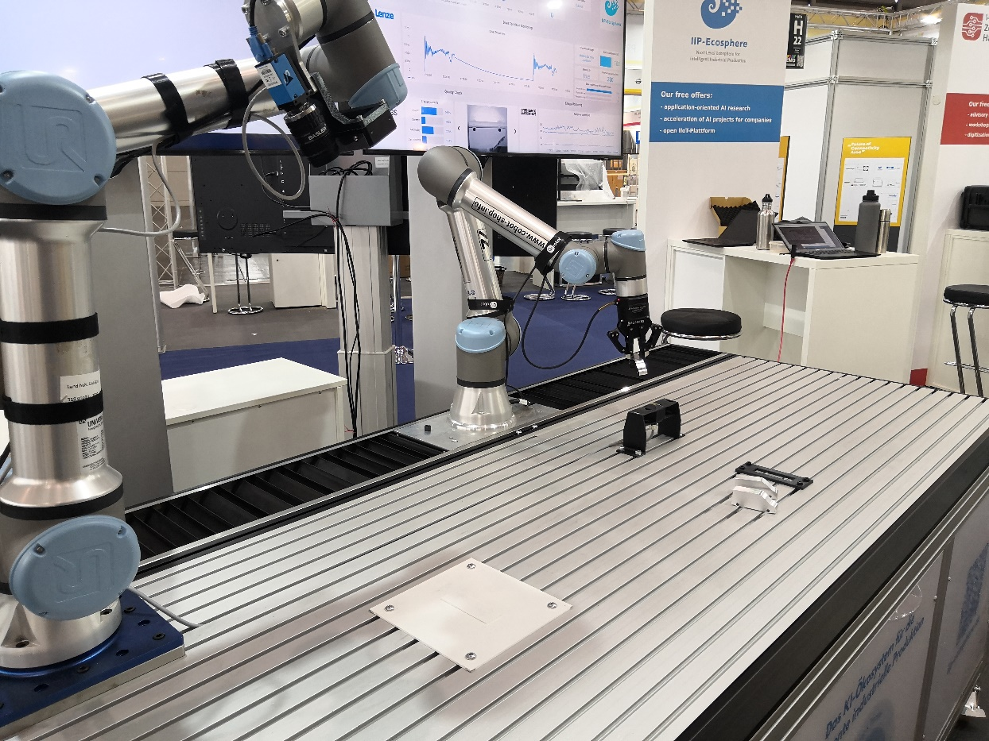
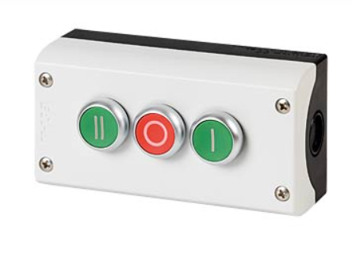
EMO‘23/HM‘23 demonstrator setup
Cobot 1 (gripping)
Cobot 1 (visual quality inspection)
MIP magnetic sensor
Lenze linear drive (condition monitoring on forward path)
Control buttons

Slide 2
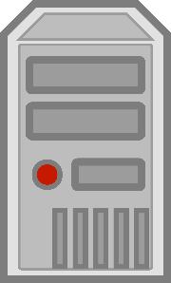
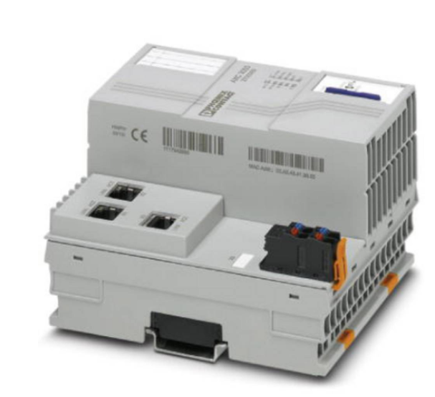
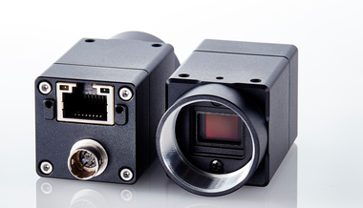
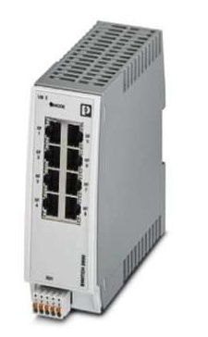
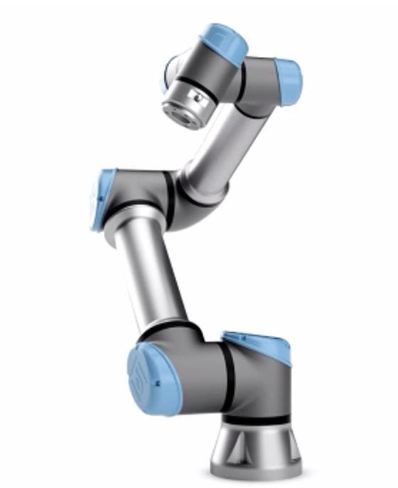
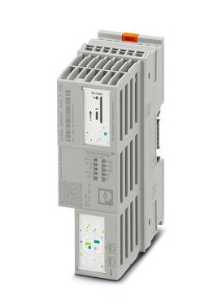
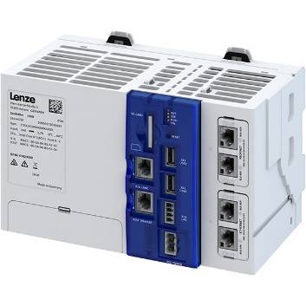
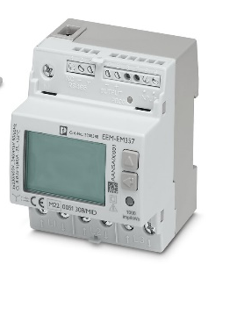
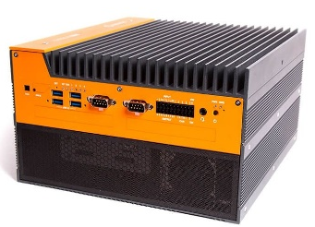
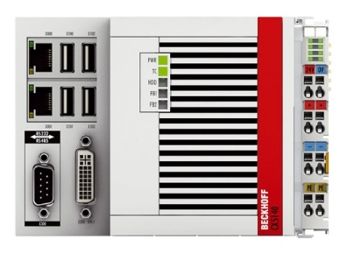
Cobot Control
AI Application
Lenovo Server
2 Schalter
Platform core
PLCnext AXC f3152
Elektr.
IP: 192.168.2.10
IP: 192.168.2.1
9001: Platform AAS server
9902: Platform AAS registry
9003: Platform VAB server
8883: Central AMQP Broker
9989: MDZH AAS server/registry
9090: Prometheus server
9091: Prometheus alert mgr
*: Exporter
*: APP AAS VAB server
4000: BaSyx UI
4200: Mgt UI
4201: Tablet UI
5001: Local Docker Registry
Container:
*: AAS VAB server
Port X2
4840: OPC UA server
Container:
*: AAS VAB server
U2x Cam
LAN
LAN
IP: -> Beckhoff
LAN
Managed Switches
IP: 192.168.2.30 (li)
IP: 192.168.2.31 (re)
LAN/Profinet
QR Code Reading
Photo Taking
Reaction to AI Result
IP: 192.168.2.21
IP: 192.168.2.23
2x UR5 Cobots
Proxmox: 192.168.2.11 (Eth1)
GPU-VM: 192.168.2.13
Bitmotec: 192.168.2.12
1883: MQTT -> Grafana
IP: 192.168.2.80
4840: OPC UA
IP: 192.168.2.40
IP: 192.168.2.81
MQTT: 1883
IP: 192.168.2.82
MODBUS TCP

Slide 3
Hardware connections at AXC F 3152
HM’23
Pin | PLC Global | After Trigger | Meaning
dio-1/IN01 | HW_IN_1 | HW_Button1 | Start Cobot 1
dio-1/IN02 | HW_IN_2 | HW_Button2 | Start Cobot 2
dio-1/IN03 | HW_IN_3 | HW_Button0 | Quit
EMO’23
Pin | PLC Global | After Trigger | Meaning
dio-1/IN01 | HW_IN_1 | HW_Button1 | Start Cobot 1
dio-1/IN02 | HW_IN_2 | HW_Button2 | (Start Cobot 2)
dio-1/IN03 | HW_IN_3 | HW_Button0 | Drive to start

Slide 4


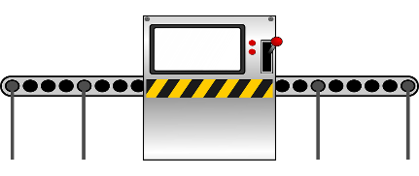
Federated Learning Path

Slide 5


PlcNext → Decider
HW_Btn0: Boolean
HW_Btn1: Boolean
HW_Btn2: Boolean
PC_ReadyForRequest: Boolean
PC_RobotBusyOperating: Boolean
PC_RobotBusyOperatingAddInfo: short
Path 2
Decider -> AppAAS
io: Boolean
ioReason: Integer
error: String []
img1Error: String[]
img2Error: String[]
img3Error: String[]
errorConfidence: Double []
imageUri: String[]
robotId: Integer
aiId: String
PlcNextOpcConn
Decider-> PlcNext
PC_StartOperation: Boolean
PC_Command01: Int16
PC_Quit: Boolean
status: String [red, green, off]
Beckhoff → Decider
bPicCounter: Short
bPicScene: Short
bPicTrigger: Short
Decider → Beckhoff
bPicCounter: Short
bPicScene: Short
bPicTrigger: Short
AAS
PlcBeckhoffOpcConn
ActionDecider
AppAAS (2x)
errorThreshold: Double
Decider → CamSource
command: String
stringParam: String
AppAas → MdzhAasConn
command=QUERY_CAR_AAS
param=<productId>
AI → Decider
error: String [Shatter, Scratch
,Geometry, Car missing, Normal]
errorConfidence: Double []
imageUri: String base64
robotId: Integer
aiId: String
FL-Client
CamSource
AppAAS → AI
command=SEND_FEEDBACK_TO_AI
param=<feedback>
MdzhAasConn
CamSource → AI
image: String base64
imageUri: String
side: String
robotId: Integer
Static AI
Forward Flow
Backward Flow
Param
commented out
AppAAS → AI
command=SEND_MODEL_CHANGE_TO_AI
param=<modelId>

Slide 6
REQUEST_DRIVE
DRIVE_DONE,
DRIVE_INTERRUPTED
DRIVE_DONE
STOP
DRIVE_ACTIVE
DRIVE_INTERRUPTED
done
REQUEST_START_QUALITY_DETECTION
RUNNING
Left, top, right, *NEXT and !busy
WAIT_FOR_ROBOT_BUSY
busy
WAIT_FOR_ROBOT_DONE

Slide 7
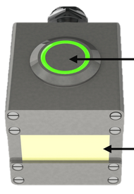
Drive Path

Slide 8

PLCNext -> Aggregator
channel: String
value: String
timestamp: IEC61131_3DateTime
Path 1
Decider → StateController
command: String
stringParam: String
driveMqttEnergyConn
(MQTT v3)
PlcNextOpcConn

driveChannelToTimeSeriesAggregator
(values to channels to time series)
DriveAppAas -> Aggregator, OpcConn
iFriction_set: int
iTension_set: int
iFriction_actual: Integer (ro)
iTension_actual: Integer (ro)
bExecute: Boolean
rPosition: Double
rVelocity: Double
driveAppAas
AAS

Aggregator -> AI
Channels: PhoenixChannel[]
channel: String
values[]: String
timestamp: IEC61131_3DateTime
samplerate: Double
MdzhAasConn
MiPAiService
Opc -> DriveAppAas
Done : Boolean
Busy : Boolean
Active : Boolean
CommandAborted : Boolean
Error : Boolean
ErrorID : UInt32
iFriction_actual: Integer (ro)
iTension_actual: Integer (ro)
MiPMqttConn
(Mqtt v3)
driveBeckhoffOpcUaConn
Drive data.hub
Lenze -> AI
channelcount: Integer
channels: LenzeChannel[]
channelNo: Integer
timestamp: String
timebase: Double
samplerate: Double
connection: String
name: String
unit: String
data: String
AI -> Grafana
io: Boolean
String[Tension_is_good, Tension_to_low,
Tension_to_high]: error
double[]: errorConfidence
aiId: String
energy: Aggregator -> AI
drive: Lenze -> AI
DriveLenzePythonAi
DriveIsmllPythonAi
DriveRapidMinerAi
Forward Flow
Backward Flow
Param
Commented out
driveLenzeMqttConn
(Mqtt v3)

Slide 9
RESPONSE_DRIVE_NACK
STOP
DRIVE_INTERRUPTED
REQUEST_ID_SCAN (next ID_SCAN) and !busy
fail
Place car (next WAIT_FOR_DRIVE_BWD) and !busy
WAIT_FOR_ROBOT_BUSY
REQUEST_ID_SCAN (next ID_SCAN) and !busy
busy
WAIT_FOR_ROBOT_DONE
!busy, next: ID_SCAN
!busy, next: WAIT_FOR_DRIVE_BWD
ID_SCAN
RESPONSE_NACK
ok
busy
REQUEST_DRIVE
WAIT_FOR_APP_ACK
WAIT_FOR_DRIVE_BWD_STARTED
RESPONSE_ACK
!busy
busy
WAIT_FOR_DRIVE_FWD_STARTED
WAIT_FOR_DRIVE_BWD_COMPLETED
!busy
DRIVE_DONE
WAIT_FOR_DRIVE_FWD_COMPLETED

Slide 10
Cobot movements
(x) case in UR cobot-program
PLC auto-advance
PLC explicit next
BASE (21)
Safe for driving back, may be base
BWD_DRIVE (36)
Safe for driving with car
GRIP_CAR (30)
wherever the car is
FWD_DRIVE (34)
Switch on Sensor,
wait for time signal
PLACE_CAR (35)
SAFE_RESCAN (33)
Place car below 2nd cobot
Switch off Sensor
DO_ID_SCAN (32)
ID_SCAN_POS (31)
May be base, or safe over sensor for re-scan or driving
move over sensor
Left or right of sensor

