Slide 1
Windows Platform Installation Guide Service Workshop
Ahmad Alamoush (UHi)
IIP-Ecosphere Platform Documentation

Slide 2
Introduction
These slides are used to do the Service Workshop setup in Windows OS.
The slides are divided into:
Install the required setup (Prerequisites).
Download and install IDE Eclipse development environment.
Install the IIP-Ecosphere platform.
Start the IIP-Ecosphere platform.
Stop the IIP-Ecosphere platform.

Slide 3
Introduction
For the sake of the Service Workshop you should follow this order:
Install prerequisites that should be use by the IIP-Ecosphere platform and IDE development environment.
Download the IDE Eclipse + Workspace for the Workshop.
Install the IIP-Ecosphere platform to test the App developed in the Workshop.
Start and Stop the IIP-Ecosphere platform to validate the installation, and use it in the Workshop (more details in the Workshop).

Slide 4
Install the required setup (Prerequisites)

Slide 5
Required Setup
Notes:
Please ensure that you use the exact version numbers given for every software in this guide.
Please do not use ”the latest” version of a given software, as these later versions maybe incompatible with the current IIP-Ecosphere platform build.

Slide 6
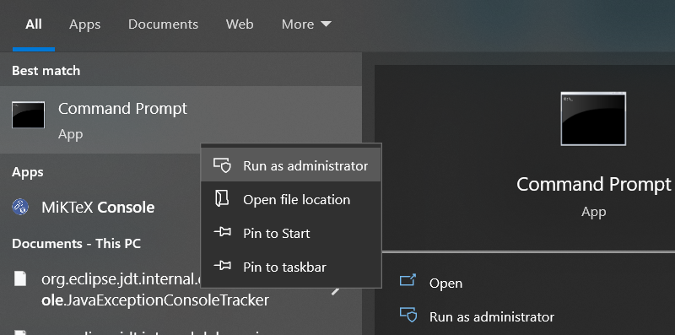
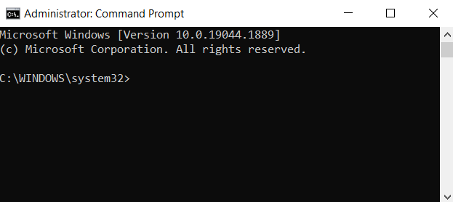
Required Setup - step (1)
For the installation we will use the command line interface (CLI) or console.
To open the console search for @Console@ in the Start menu.
Please ensure that you run the console with Administrator rights (right/click and select ”Run as administrator”)

Slide 7
Required Setup - step (2)
Please note that the current IIP-Ecosphere platform required Java JDK 8, 11 or 13, no other. In this guide we are installing JDK 13.
If Java JDK 13 is not installed, then install Java JDK 13, using the following CLI commands (enter the following lines in the console and after each press return):

Slide 8
Required Setup - step (3)
curl https://download.java.net/openjdk/jdk13/ri/openjdk-13+33_windows-x64_bin.zip –O openjdk-13+33_windows-x64_bin.zip
- tar xzpvf openjdk-13+33_windows-x64_bin.zip
- setx /M JAVA_HOME "%cd%\jdk-13"
- SET JAVA_HOME=%cd%\jdk-13
- setx /M Path "%Path%;%JAVA_HOME%\bin"
- SET Path=%Path%;%JAVA_HOME%\bin

Slide 9
Required Setup - step (4)
If Maven 3.6.3 is not installed, then install Maven 3.6.3 by entering the following comands in your console:
curl https://archive.apache.org/dist/maven/maven-3/3.6.3/binaries/apache-maven-3.6.3-bin.zip -O apache-maven-3.6.3-bin.zip
- tar xzpvf apache-maven-3.6.3-bin.zip
- setx /M MAVEN_HOME "%cd%\apache-maven-3.6.3“
- SET MAVEN_HOME=%cd%\apache-maven-3.6.3
- setx /M Path "%Path%;%MAVEN_HOME%\bin“
- SET Path=%Path%;%MAVEN_HOME%\bin

Slide 10
Required Setup - step (5)
If Python v3.9 is not installed, then Install Python v3.9 by entering the following comand into your console:
- curl https://www.python.org/ftp/python/3.9.6/python-3.9.6-amd64.exe -O python-3.9.6-amd64.exe
- start /w "" "python-3.9.6-amd64.exe" install
If you want to use a UI (User Interface), there are several applications like Angular, JavaScript… etc. Please check the handbook for more information.

Slide 11
Required Setup - step (6)
If Python v3.9 is installed add the requirements by running:
python –m pip install scikit-learn==0.23.2
python –m pip install numpy==1.20.1
python –m pip install pickle==4.0

Slide 12
Setup the IDE Eclipse environment

Slide 13
Setup the IDE Eclipse environment
For the purpose of the Service Workshop, we have prepared the projects and the examples for Eclipse IDE - with exact Eclipse version (Eclipse 2021-03, version 4.19.0) provided by the link in next slide.
Any other Java-enabled IDE like Netbeans may do, but this requires manual work.
The Eclipse provided by the link in next slide is compiled one with the required plugins (like checkstyle) fitting the required JDK for the platform.

Slide 14
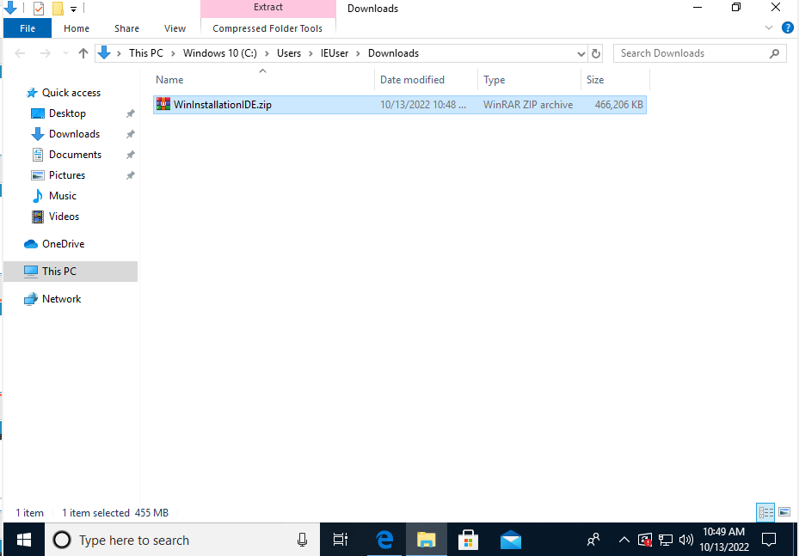
Setup the IDE Eclipse environment
Click the following link to download a tar file (WinInstallationIDE.tar.gz) that contains the IDE Eclipse with the workspace to use:
https://sync.academiccloud.de/index.php/s/WNC2iHNX2cMs2lm
Extract the Zip file.

Slide 15
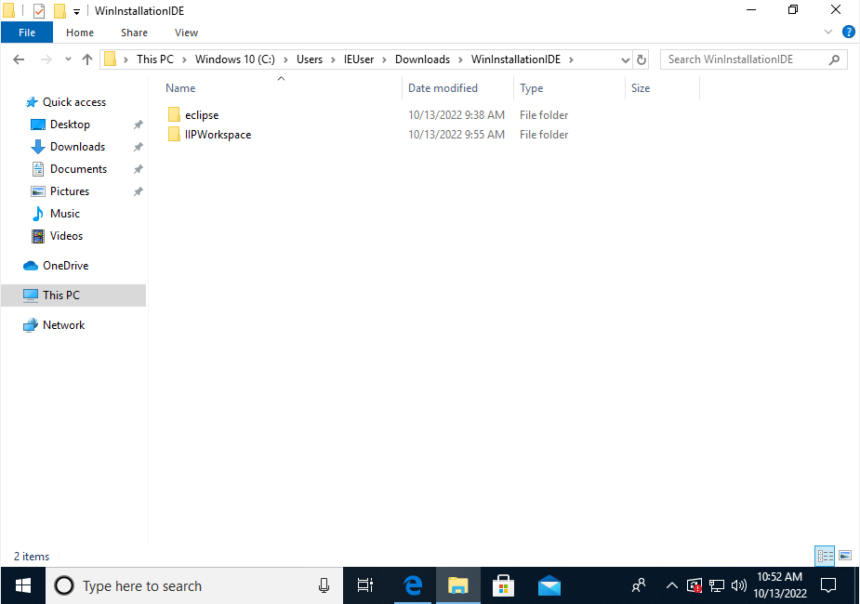
Setup the IDE Eclipse environment
There are two folders.
Eclipse (folder)
IIPWorkspace (folder)

Slide 16
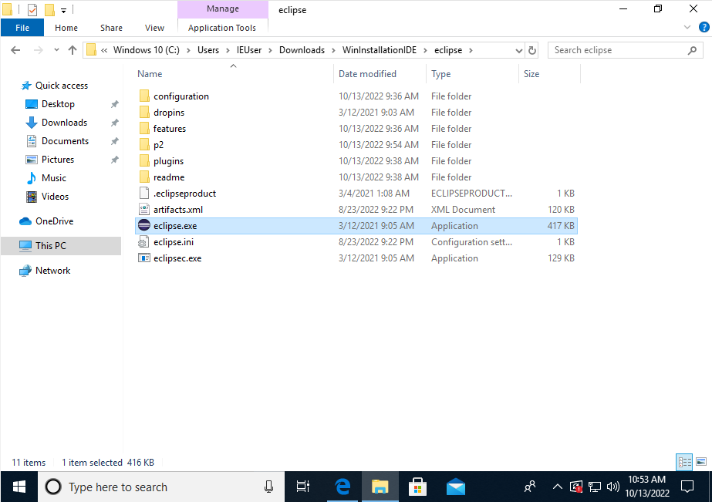
Setup the IDE Eclipse environment
Inside eclipse folder, open eclipse application.

Slide 17
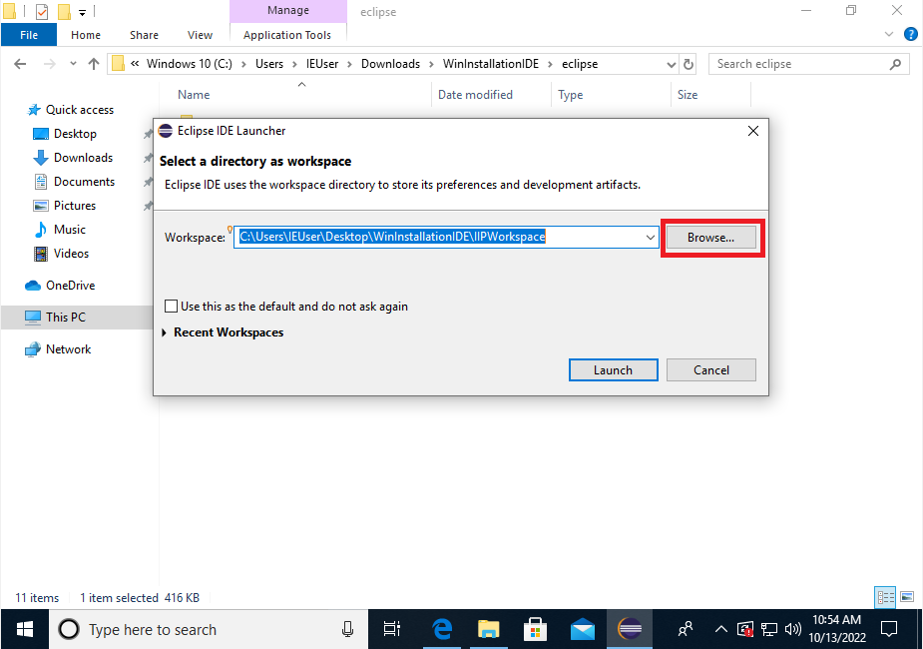
Setup the IDE Eclipse environment
Browse to IIPWorkspace in downloaded folder.

Slide 18
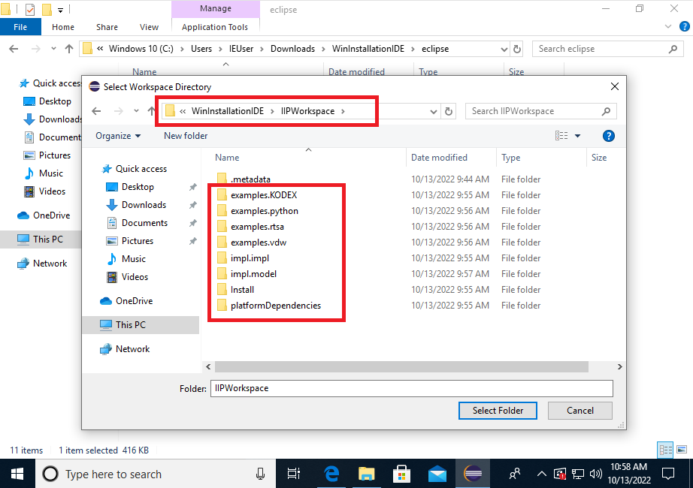
Setup the IDE Eclipse environment
You should see the following projects in that directory.
Click open.

Slide 19
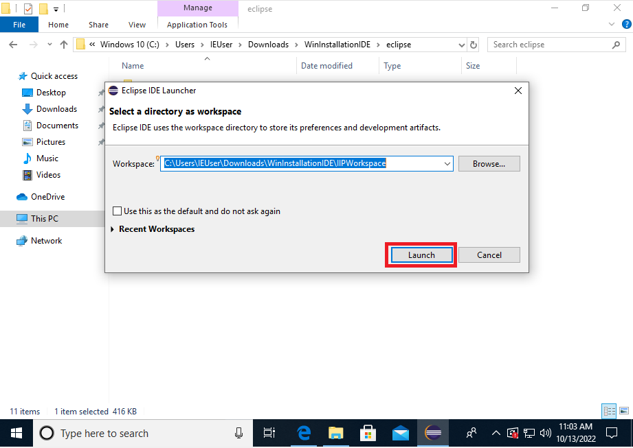
Setup the IDE Eclipse environment
Click Launch.

Slide 20
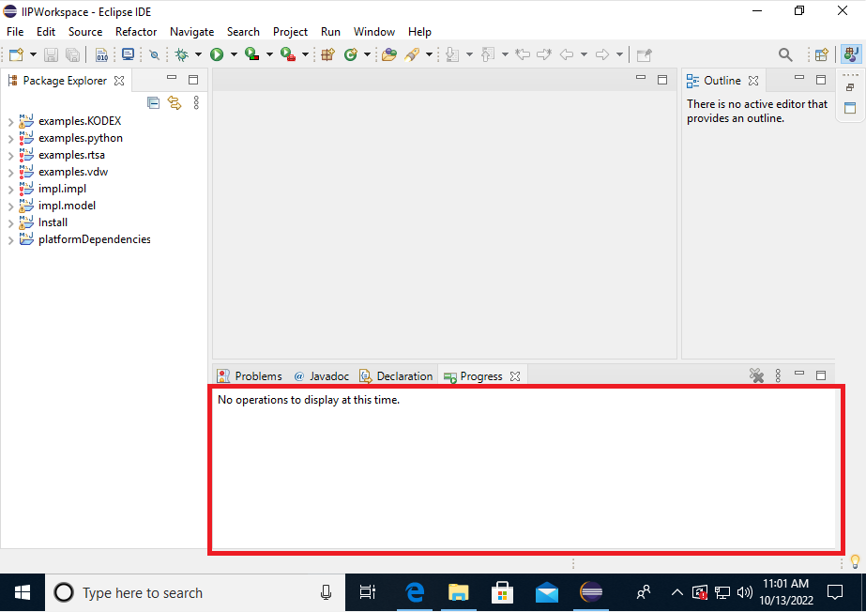
Setup the IDE Eclipse environment
Wait until all projects are build and ready to use.

Slide 21
Install the platform

Slide 22
Docker Engine Installation - step (1)
Please note that you should install Docker Engine in case to want to run the container version of the platform, else Skip Docker Installation. Please check the handbook for more information.
If Docker Engine v20.10.7 is not installed, then Install Docker Desktop 3.4.0 which uses Docker Engine v20.10.7 and all the prerequisites it may needs. Please enter the following comands into zour console:
- curl https://desktop.docker.com/win/main/amd64/65384/Docker%%20Desktop%%20Installer.exe -O DockerDesktopInstaller.exe
- rename "Docker%%20Desktop%%20Installer.exe" DockerDesktopInstaller.exe
- start /w "" "DockerDesktopInstaller.exe" install

Slide 23
Docker Engine Installation - step (2)
You should install Windows Sub system for Linux (WSL), which is required for Docker in Windows, please see the Instructions to install WSL in Windows:
https://ubuntu.com/tutorials/install-ubuntu-on-wsl2-on-windows-10#1-overview

Slide 24
Platform Installation - step (1)
Create an empty folder and name it (for example) “Install”, as usual via entering the following comands into your console:
- mkdir Install
- cd Install
Download the Install-Package and unpack it (again, via Console)
curl https://jenkins-2.sse.uni-hildesheim.de/view/IIP-Ecosphere/job/IIP_Install/lastSuccessfulBuild/artifact/install.tar.gz -O install.tar.gz
- tar xzpvf install.tar.gz

Slide 25
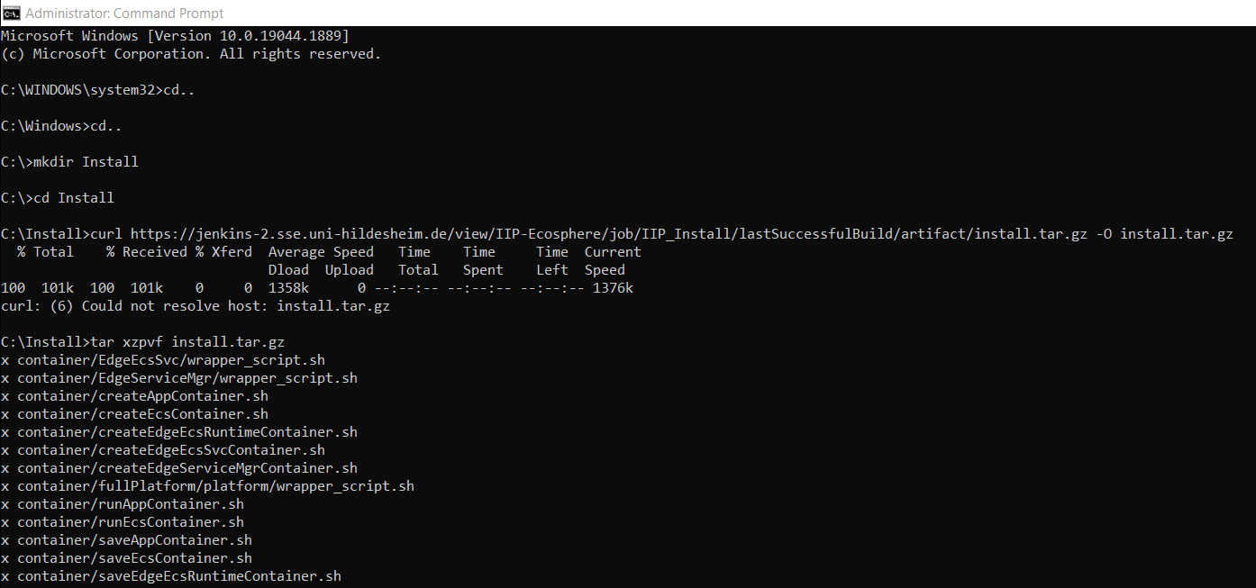
Platform Installation - step (2)

Slide 26
Platform Installation - step (3)
Install platform dependencies
- cd platformDependencies
- mvn install
cd ..
Obtain platform bootstrap packages
- mvn package -DskipTests

Slide 27
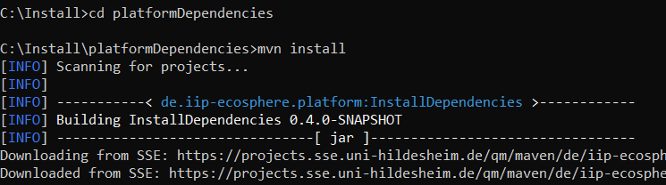
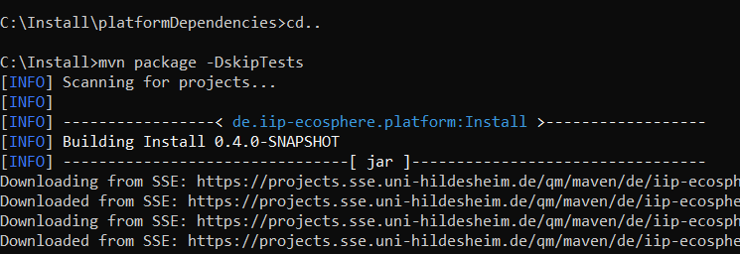
Platform Installation - step (4)

Slide 28
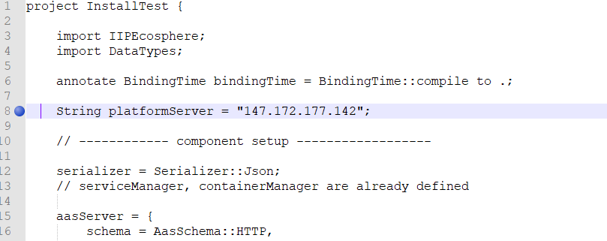
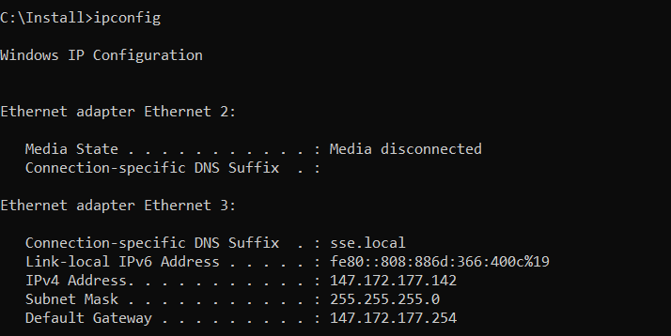
Platform Installation - step (5)
Modify the IP address for the platform in the configuration file (src/main/easy/InstallTest.ivml) to the IP address of your PC (where you have installed the Platform)
You can type“ipconfig” in the console to see you PC’s IP address

Slide 29

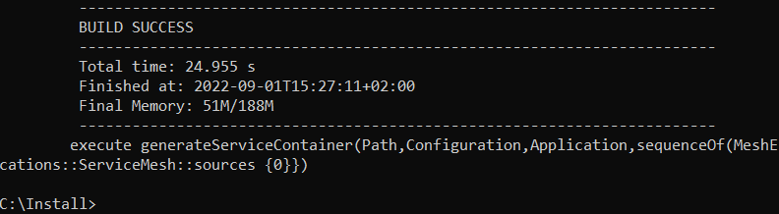
Platform Installation - step (6)
Instantiate the platform: Execute these comands in the “Install” folder (the folder you installed the platform in)
mvn exec:java
This will take a while, once finished it looks like this:
Now the platform is installed, the script files are created and ready to start.

Slide 30
Start The Platform

Slide 31
Start The Platform
There are two possible aways to the run the platform:
Local: One machine working as platfrom and device at the same time.
Distributed: One machine working as platform, another mahine(s) working as device(s)

Slide 32
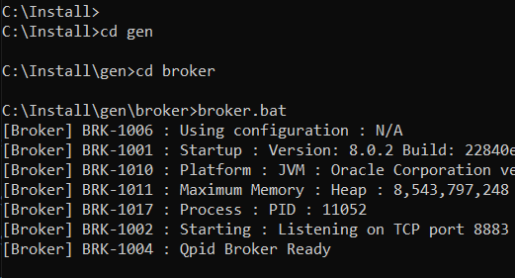
Start The Platform Local - Step (1)
Open a new console
You can do so by holding shift and clicking on your console icon in the windows task bar
The broker scripts and files are in “Install/gen/broker” folder, change to this path and run the following batch script to start it>
- broker.bat

Slide 33
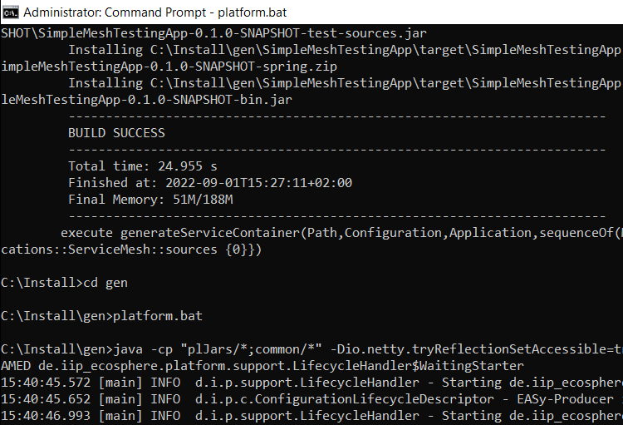
Start The Platform Local - Step (2)
Now return to your previous console and start the actual platform.
The platform scripts and files are in the “Install/gen/” folder, run the following script to start it:
- platform.bat

Slide 34
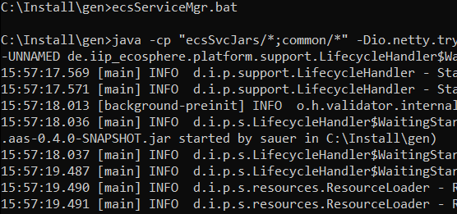
Start The Platform Local - Step (3)
To make the platform machine working as resource run the following scripts in zet another new console:
- ecs.bat
- serviceMgr.bat
Or just run the following script (share the same memory)
ecsServiceMgr.bat

Slide 35
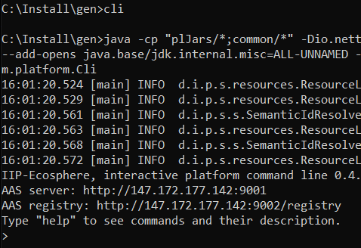
Start The Platform Local - Step (4)
To start the command line interface for the platform run the following script
cli.bat
Again, the above scripts are in the “Install/gen” folder

Slide 36
Start The Platform Distributed - Step (1)
Please note that you should execute all the steps in “Required setup (Prerequisites)” and the first 3 steps in “Platform Installation” on each device.
Copy the following files and folders from the platform server (the PC you installed the platform on) to the PC/Device that is to be added to the platform as a resource:
gen\ecsJars (folder)
gen\ecsSVCJars(folder)
gen\broker (folder)
gen\svcJars (folder)
gen\ecs.bat (file)
gen\serviceMgr.bat (file)
gen\ecsServiceMgr.bat (file)

Slide 37
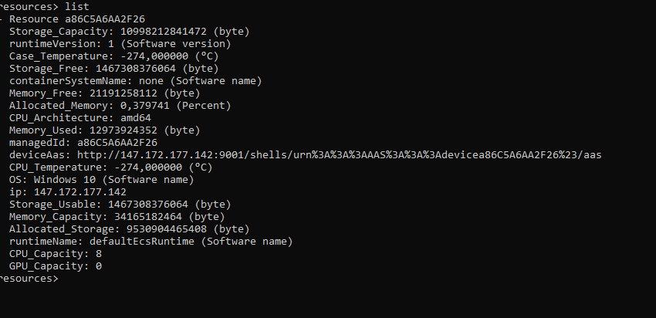
Start The Platform Distributed - Step (2)
To add the new device/pc as resource in the platform run the following scripts on the new device/pc
- ecs.bat
- serviceMgr.bat
Or just run the following script (share the same memory)
ecsServiceMgr.bat
If everything worked fine, then PC/device should be listed as a platform resource

Slide 38
Add a Windows Edge device to the platform
The difference between a PC/ pc like device and an Edge devices is (in case that Edge device only supports Java 8)
- Copy the following files (not the files from slide 31) from the platform server to the Edge device and run them
gen\ecs8.bat instead of gen\ecs.bat
gen\serviceMgr8.bat instead of gen\serviceMgr.bat
gen\ecsServiceMgr8.bat instead of gen\ ecsServiceMgr.bat

Slide 39
Stop The Platform

Slide 40
Stop The Platform
Stopping the platform:
Type Crtl-C on all the open shells (CLIs) to stop them and clean the resources in the reverse order we opened (started) them.
If asked to quit (Y/N), type Y

Slide 41
Ahmad Alamoush
alamoush@sse.uni-hildesheim.de

