Slide 1
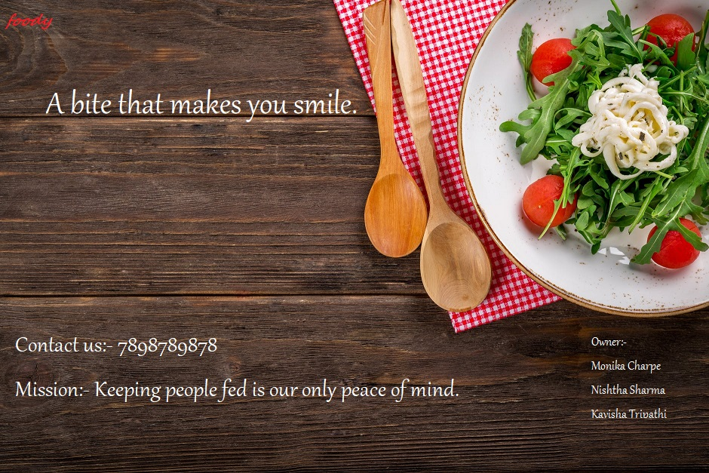

Slide 2
Food Ordering System

Slide 3
Introduction
Interaction between customer and organization.
Easy process for the customers.
The system deals with ordering, processing and delivering food products.
Ordering is done by valid customer with appropriate customer ids.
It typically deals with Ordering food item.

Slide 4
Functionalities
Online Food Ordering System manages the customer details, order detail, food.
It tracks all the information of Item category, customer etc.
Shows the information and description of the food item, food quantity, and total amount.
To increase efficiency of managing the food, Item Category.
Manage the information of food.
Editing, adding and updating of Records is improved which results in proper resource management of Food data.
Manage the information of Customer.
Integration of all records of order.
Allow customer to give feedback.

Slide 5
Existing System
The Existing system is manual system or in the existing system the product information was shown in the hard copy or in the PDF, PPT.
Inefficient and manual keeping of records and data storage.
Bill books are having bill number and the name of the customers.
Separate registers are maintained for keeping written records of Bill, Stock, Services and Customers.
System is not dynamic and it is difficult to be shown to the clients.
Customer’s interaction is not structured.

Slide 6
Disadvantages
Time consuming process.
Unusual disturbance through fake ordering.
Less flexible.
Lack of security of data.
More man power.
Needs manual calculation.

Slide 7
Proposed System
It will make the system more dynamic and flexible.
It will be an entirely integrate work flow of the organization.
It will structure the storage of data and information.
It will provide the effective communication channel with customer by showing the different type of meals in menu.
Allows valid customer to book his or her order and make them delivered.

Slide 8
Advantages
Ease in process.
Only valid customer is allow to make orders.
Consumes limited time.
Ensure data accuracy’s.
Greater efficiency.
Better service.
Allow user to give feedback.

Slide 9
Different Module
Login Module
Signup Module
Order Module
Menu Module
Bill Module
Feedback Module

Slide 10
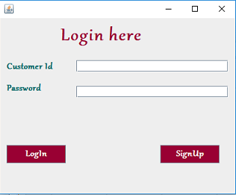
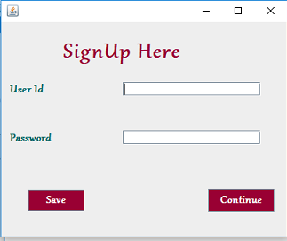
Login/Signup Module
Login Module
Signup Module

Slide 11
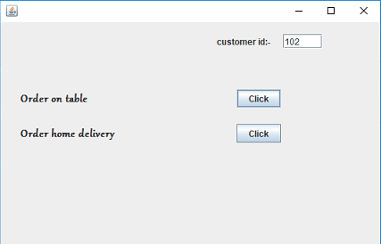
Order Module

Slide 12
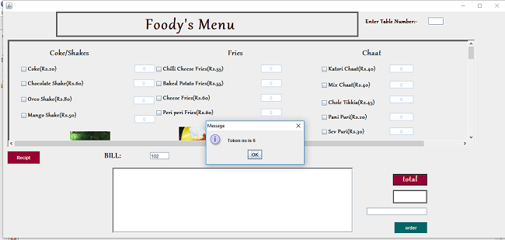
Menu Module

Slide 13
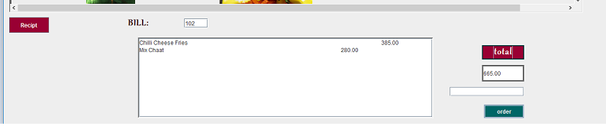
Bill Module

Slide 14
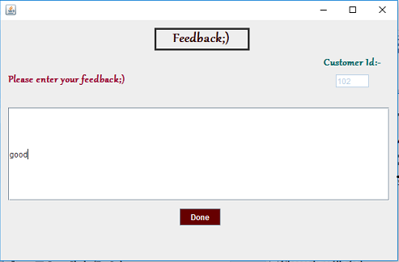
Feedback Module

Slide 15
Future Enhancement
We can make it as Android app so that it can available to everyone.
We can add online payment mode.
We can give more advance software for online food ordering System including more facilities.
We will host the platform on online servers to make it accessible worldwide.

Slide 16
Software Requirements
Operating System (Windows 10).
Front End Java.
Back End MySQL.
A java based platform (NetBeans).

