Slide 1
Intro to Unix/Bash
Maria Eleonora Rossi and Iker Irisarri

Slide 2
Unix/Linux is the operating system
Bash is a specific command-language interpreter (the shell) that runs on Unix-like systems
Bash is one of the most common shells used in bioinformatics

Slide 3
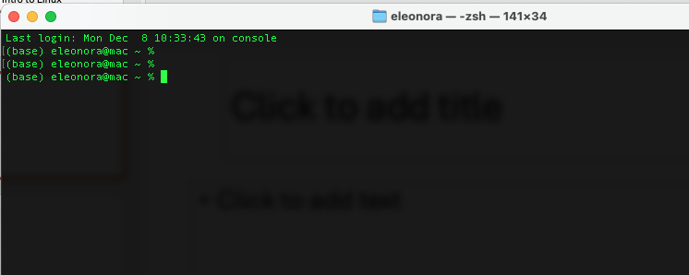
The terminal

Slide 4
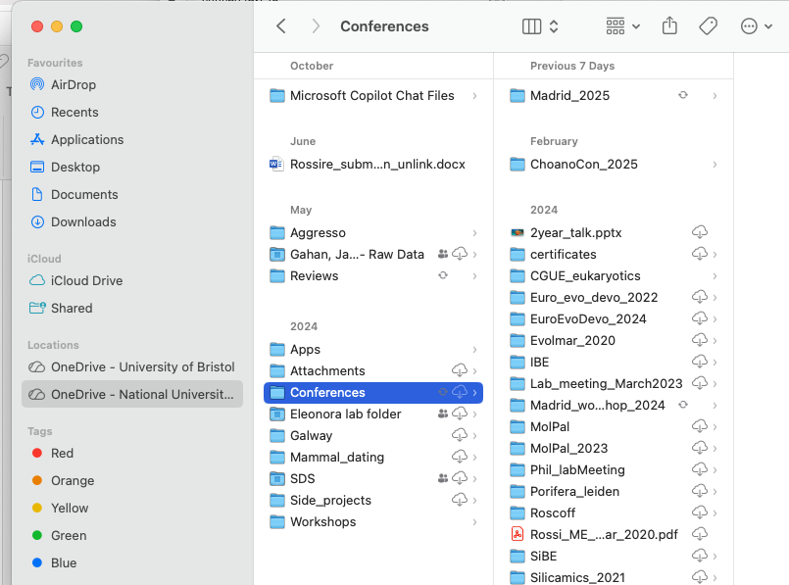
Navigating the file system

Slide 5
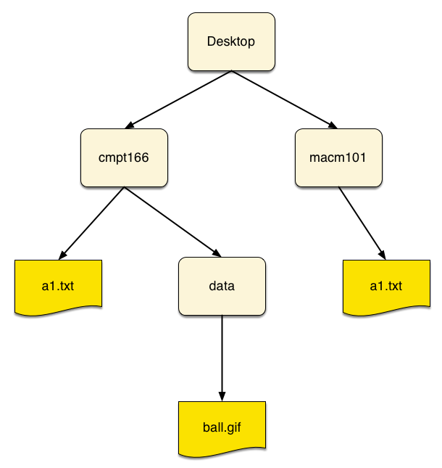
Navigating the file system
Useful commands to navigate the file system
pwd ( print working directory)
ls (list)
cd (change directory)
cd .. (change directory moving up)
cd ~ (change directory and go to home directory)
mkdir <name directory> (make a new directory)
Example of path: /Users/Eleonora/Documents/data.txt/
Notes:
The path is a list of directory names separated by slashes

Slide 6
Working with files
Copying files
cp original.txt. duplicate.txt
cp <path to file you want to copy/filename> <path where you want to copy the file>
cp Phylogenomics/data/fasta.txt /results/fasta.txt
cp Phylogenomics/data/fasta.txt .
Shortcuts
Up arrow key = moves back from your previous command history
Tab key = auto-completion button

Slide 7
Working with files
Viewing files
less <file-name> allow to visualize the file , very useful if you need to take a quick look at a huge file
head <file-name> visualize the start of the file, using the –n flag we can specify the number of lines we want to see e.g. head –n file.txt it will show us the first 10 lines of file.txt
tail <file-name> visualize the end of the file

Slide 8
Let’s start with the practical!!

