Slide 1
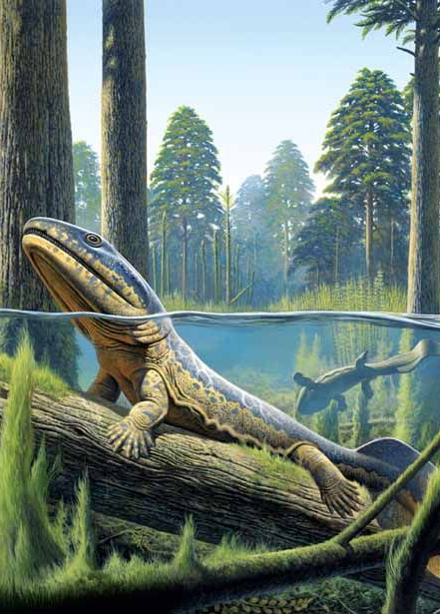
Our case study: a jawed vertebrate phylogeny

Slide 2
lizards & snakes
turtles
birds
crocodiles
mammals
amphibians
lobe-finned fish
ray-finned fish
cartilaginous fish
Irisarri et al. 2017 Nat Ecol Evol

Slide 3
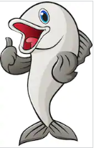
Lungfishes: closest living relatives of tetrapods
Systematic error:
Among-lineage rate variation (LBA)
Compositional heterogeneity
Morphology
Limited data
Irisarri & Meyer 2016 Syst Biol
Notes:
Important part of my research has involved inferring robust phylogenies with genomic data. For example,

Slide 4
Systematic error: precision vs. accuracy
Site-homogeneous model (LG)
Removal of fast-evolving positions
Complex mixture models (CAT-GTR)
Remove fast-evolving lineage (actinopterygians)
Break-up long branch (add slow-evolving gar)
Reduce compositional heterogeneity (SymTest)
Notes:
Site-homogeneous models (LG), which assume evolutionary process to be the same along the gene, support T2 in both ML and BI, even with maximum support.
We also show models like LG4X that aim to account for site-heterogeneities have a worse performance than CAT. Using Bayesian posterior predictive tests we show that the superiority of CAT is due to its ability to more accurately modelling the observed site-specific amino acid diversity, which allows CAT to more easier identify true homoplasy.

Slide 5
Our results
ML
Bayesian

Slide 6
Our results
Coalescence method

Slide 7
