Slide 1


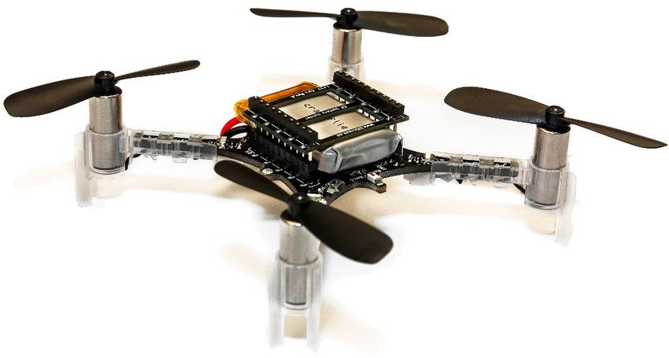
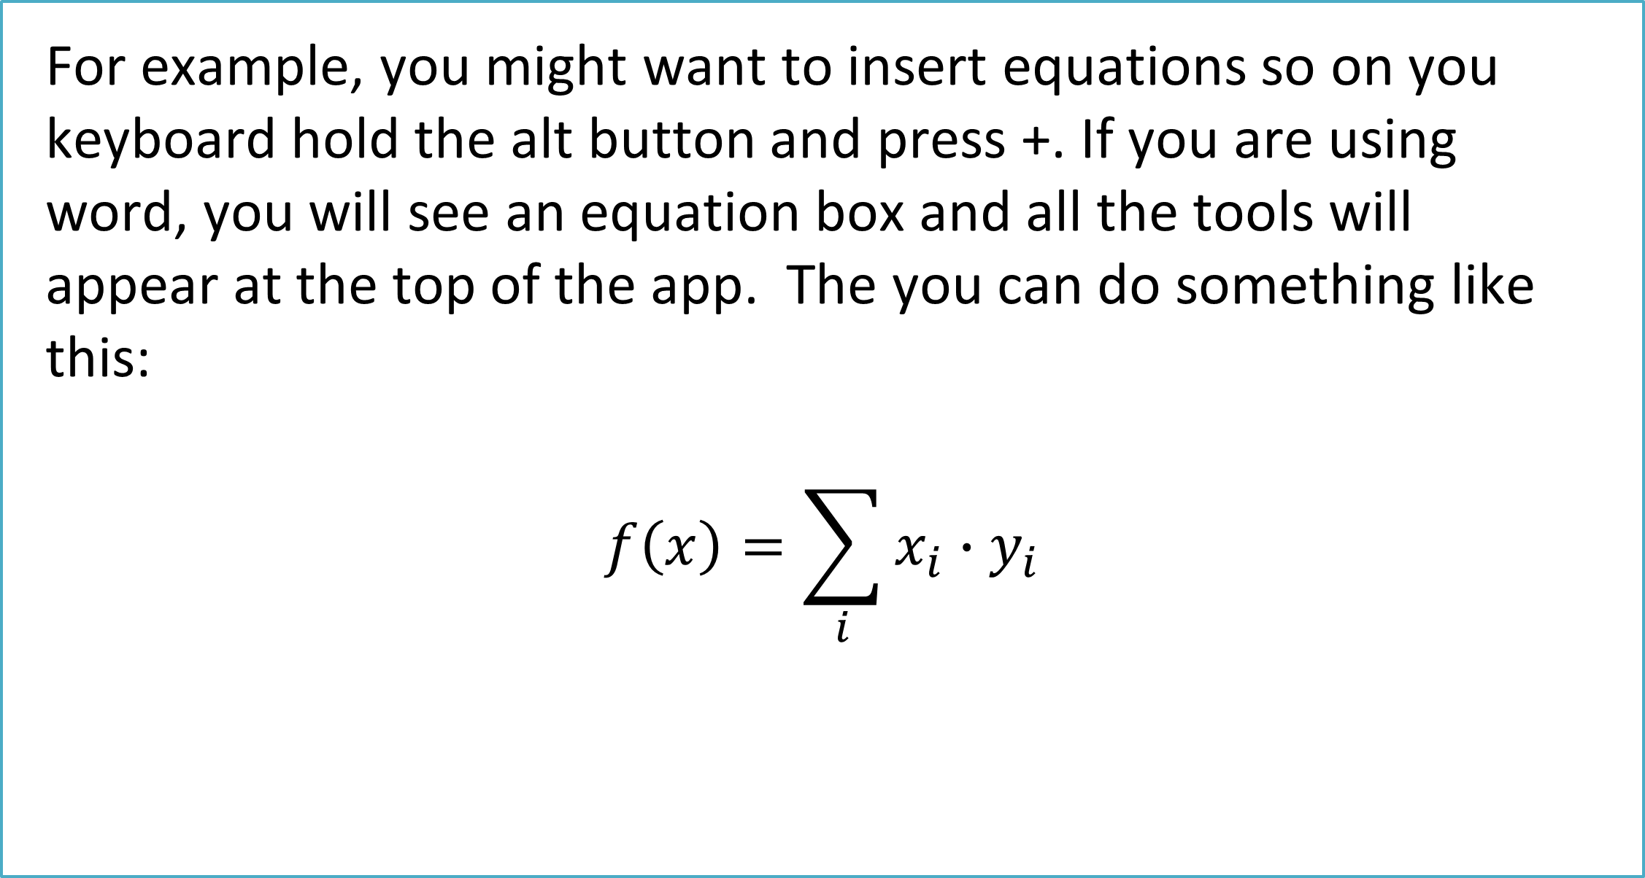
What is Your Title
Your Name or Names
Department of Physics, California State University San Bernardino
Introduction outline problem
More pics or diagrams or explanation
Results
With crowded cities and transportation pathways becoming an increasing problem a movement toward urban air mobility is necessary. To meet these needs in the inner-city areas or low access areas the need for aerodynamic innovations in electric vertical takeoff and landing aircraft (eVTOL) and associated new technologies are required. The CSUSB eVTOL group uses a fleet of quadcopters and hexacopter drones in conjunction with a dedicated multi-axis test stand to explore many aspects of flight dynamics. This work focuses on the efficiency of the electromechanical power delivery system for the hexa-copter configuration. We seek to identify the system efficiency under a spectrum of flight conditions.
With crowded cities a
With crowded cities a
What you did
Your Approach to the Problem
With crowded cities a
Main focus:
Supporting images, documents, etc
Future work
Pictures to outline your approach
For example, you might want to insert equations so on you keyboard hold the alt button and press +. If you are using word, you will see an equation box and all the tools will appear at the top of the app. The you can do something like this:
$$f\left(x\right)=\sum_{i}{x_{i}∙y_{i}}$$
Acknowledgments: we wish to thank …; Supported by NSF Grant #1914777.

