Slide 1

Bias Detection in News Media
Understanding and identifying bias in news reporting

Slide 2

Project Topic: Bias Detection in News Media
Team Name: The Geeks Behind Scaling Algorithms (GBSA)
Team Members:
Girish S N (girishsn@iisc.ac.in)
Bharath Karanth A (bharathk@iisc.ac.in)
Saravanakumar R (saravanakum1@iisc.ac.in)
Anmol Gupta (anmolg@iisc.ac.in)

Slide 3
Problem Introduction

Slide 4

Problem Definition
News outlets are often accused of biased reporting across dimensions - political, gender, religious, caste, regional, socioeconomic, and others.
With increasing polarization and misinformation, unbiased reporting is critical.
With the rapid growth of digital news, readers are exposed to vast and diverse information, often with subtle or overt biases.
Biased reporting can influence public opinion and societal harmony.

Slide 5
Motivation
There is a need for an automated, scalable solution that can analyze news articles for bias, offering transparent, multi-dimensional, and interpretable results.
This project seeks to provide researchers, fact-checkers, and the public with actionable insights into media bias in Indian journalism.
A bias detection system can help everyone identify and understand media bias, promoting transparency and informed decision-making.

Slide 6
Architecture and DESIGN

Slide 7
Design Goals
Multi-Dimensional Detection: Support six bias dimensions.
Scalability: Process large datasets both in batch and streaming modes.
Robustness: Use an ensemble approach for accurate and interpretable results.
Extensibility: Enable easy addition of new data sources, languages, and bias dimensions.
Monitoring & Usability: Simplified deployment, monitoring, and result querying.

Slide 8
Key Features
Automated web scraping from Indian news sources.
Real-time and batch data processing pipelines.
Storage and retrieval from a scalable database.
Configurable ensemble bias detection.
Monitoring UI, logs, error handling.

Slide 9
Data Collection
Data was collected through the web scraping of the online news articles.
To give an idea, we scraped articles from the “The Indian Express” from 1998 to 2025.
Took around 80 hours,
Using 4 Threads, where
Size per article was 4,000 to 8,000 words.
Articles also collected from “The Economic Times” and “The Times of India”.
Total number of samples that we eventually worked on was 303,518.

Slide 10
Data Flow
Ingestion: Scrapers collect articles, push to Kafka.
Processing: Spark jobs process data in batch (daily analysis) or stream (real-time analysis).
ML Pipeline: Topic classification and bias detection using ensemble models.
Storage: Results stored in MongoDB, logs/errors tracked for analysis and troubleshooting.

Slide 11
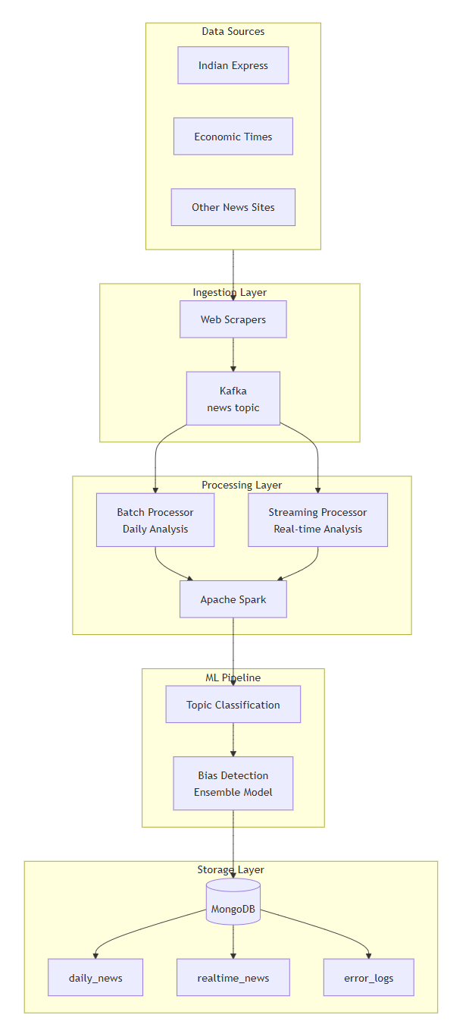
Data Flow Diagram
(continued in next slide)

Slide 12
Data Flow Diagram

Slide 13
Methodology

Slide 14
Technologies
Big Data Platforms Used:
Apache Spark for scalable distributed processing.
Apache Kafka for message queuing and streaming.
MongoDB for document-based storage and analytics.
Orchestration: Docker, Docker-Compose for environment setup and deployment.
Languages Used: Shell Scripting and Python.

Slide 15
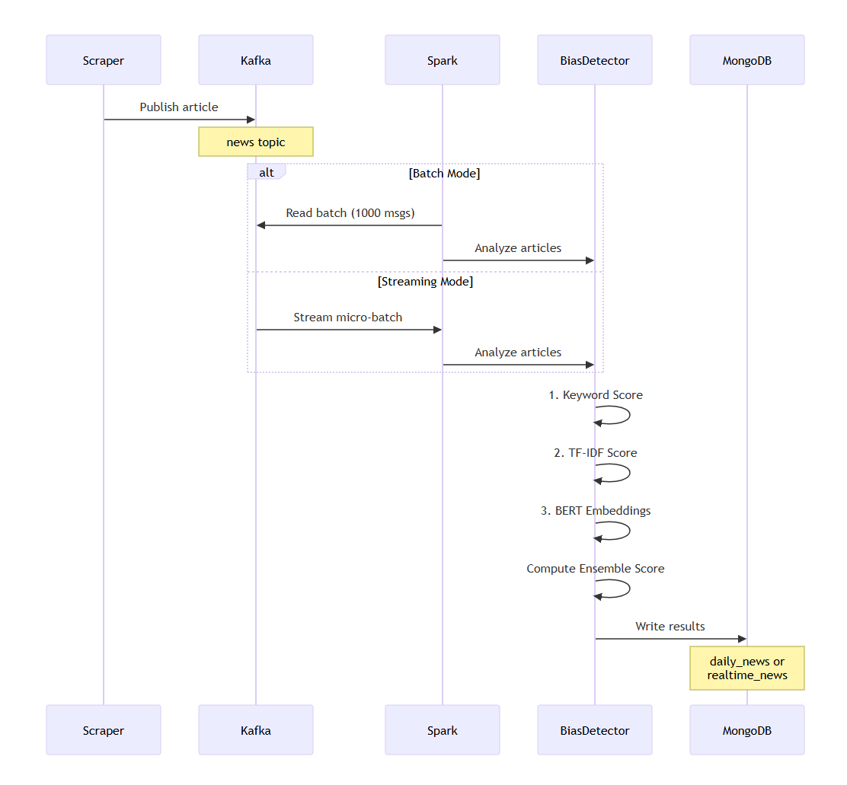
Sequence Diagram

Slide 16
Machine Learning Methods
Ensemble Approach (Bias Detection):
Keyword Matching (30% weight): Rule-based, interpretable
TF-IDF Analysis (30% weight): Statistical term importance
BERT Embeddings (40% weight): Semantic understanding (Sentence-Transformers)

Slide 17
Machine Learning Methods
Topic Modeling & Classification:
Zero-shot classification
LDA topic modeling
TF-IDF clustering
Ensemble topic consensus

Slide 18
Scalability and Performance Metrics
End-to-End Latency: For the streaming pipeline, the time taken from when an article is published to Kafka until its analysis is stored in MongoDB.
Throughput: The number of articles processed per second or minute.
Resource Utilization: CPU and memory usage of the Spark cluster, which can be monitored via the Spark UI.

Slide 19
Visualizations of Key Results

Slide 20
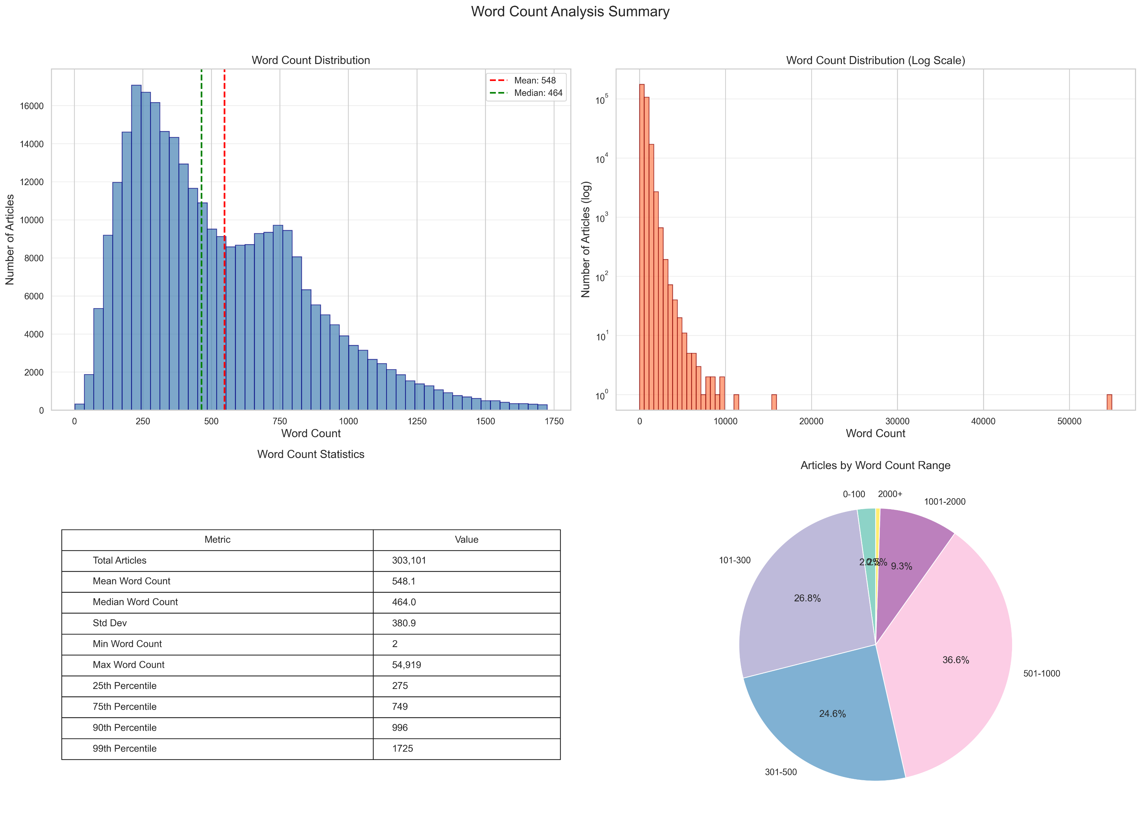
Word Count Analysis Summary Dashboard

Slide 21
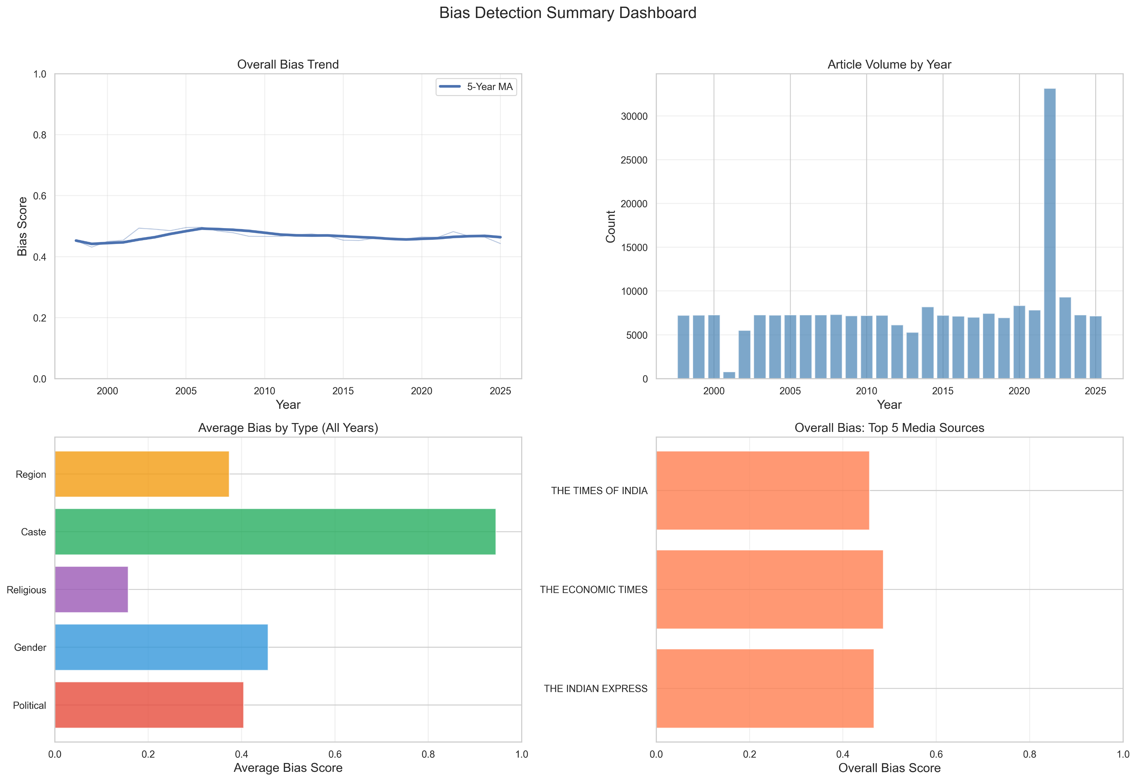
Bias Detection Summary Dashboard

Slide 22
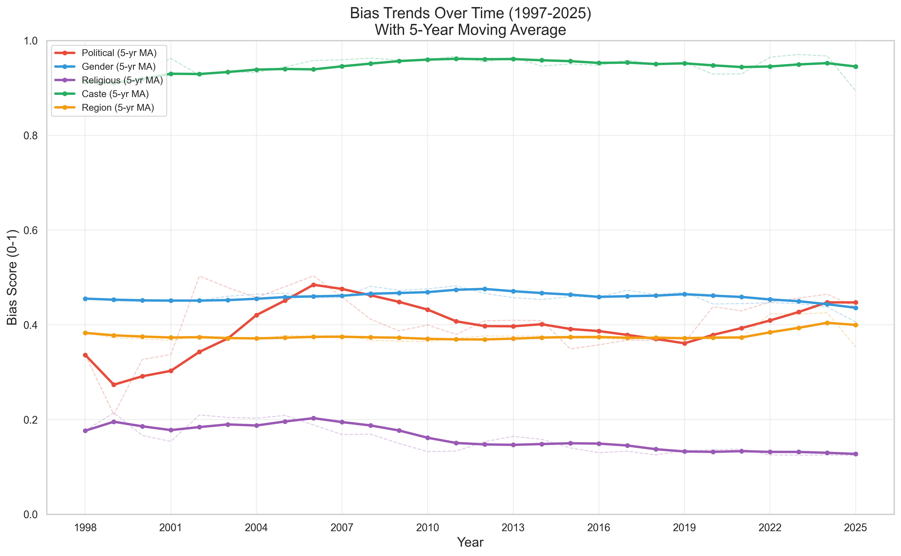

Slide 23
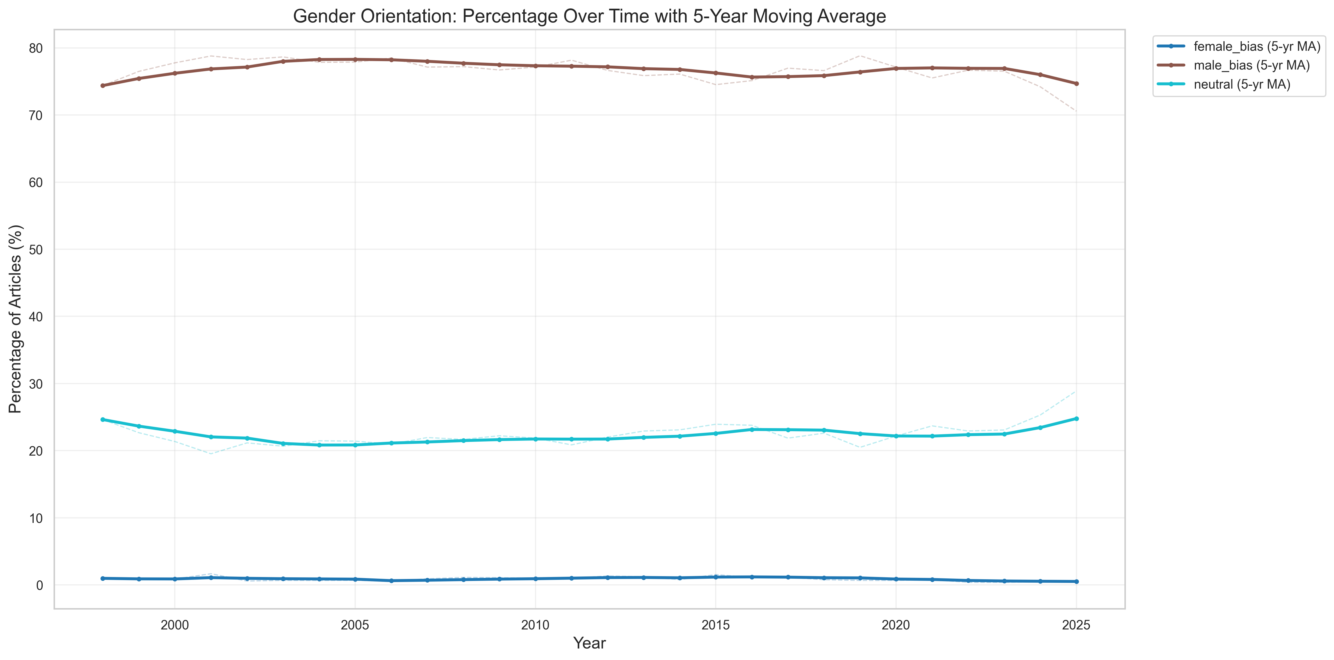
Gender Bias

Slide 24
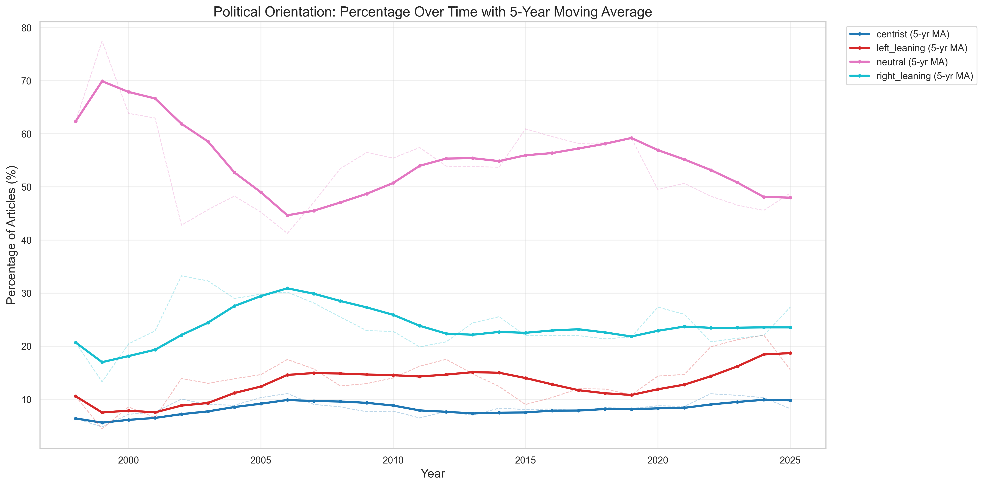
Political Bias

Slide 25
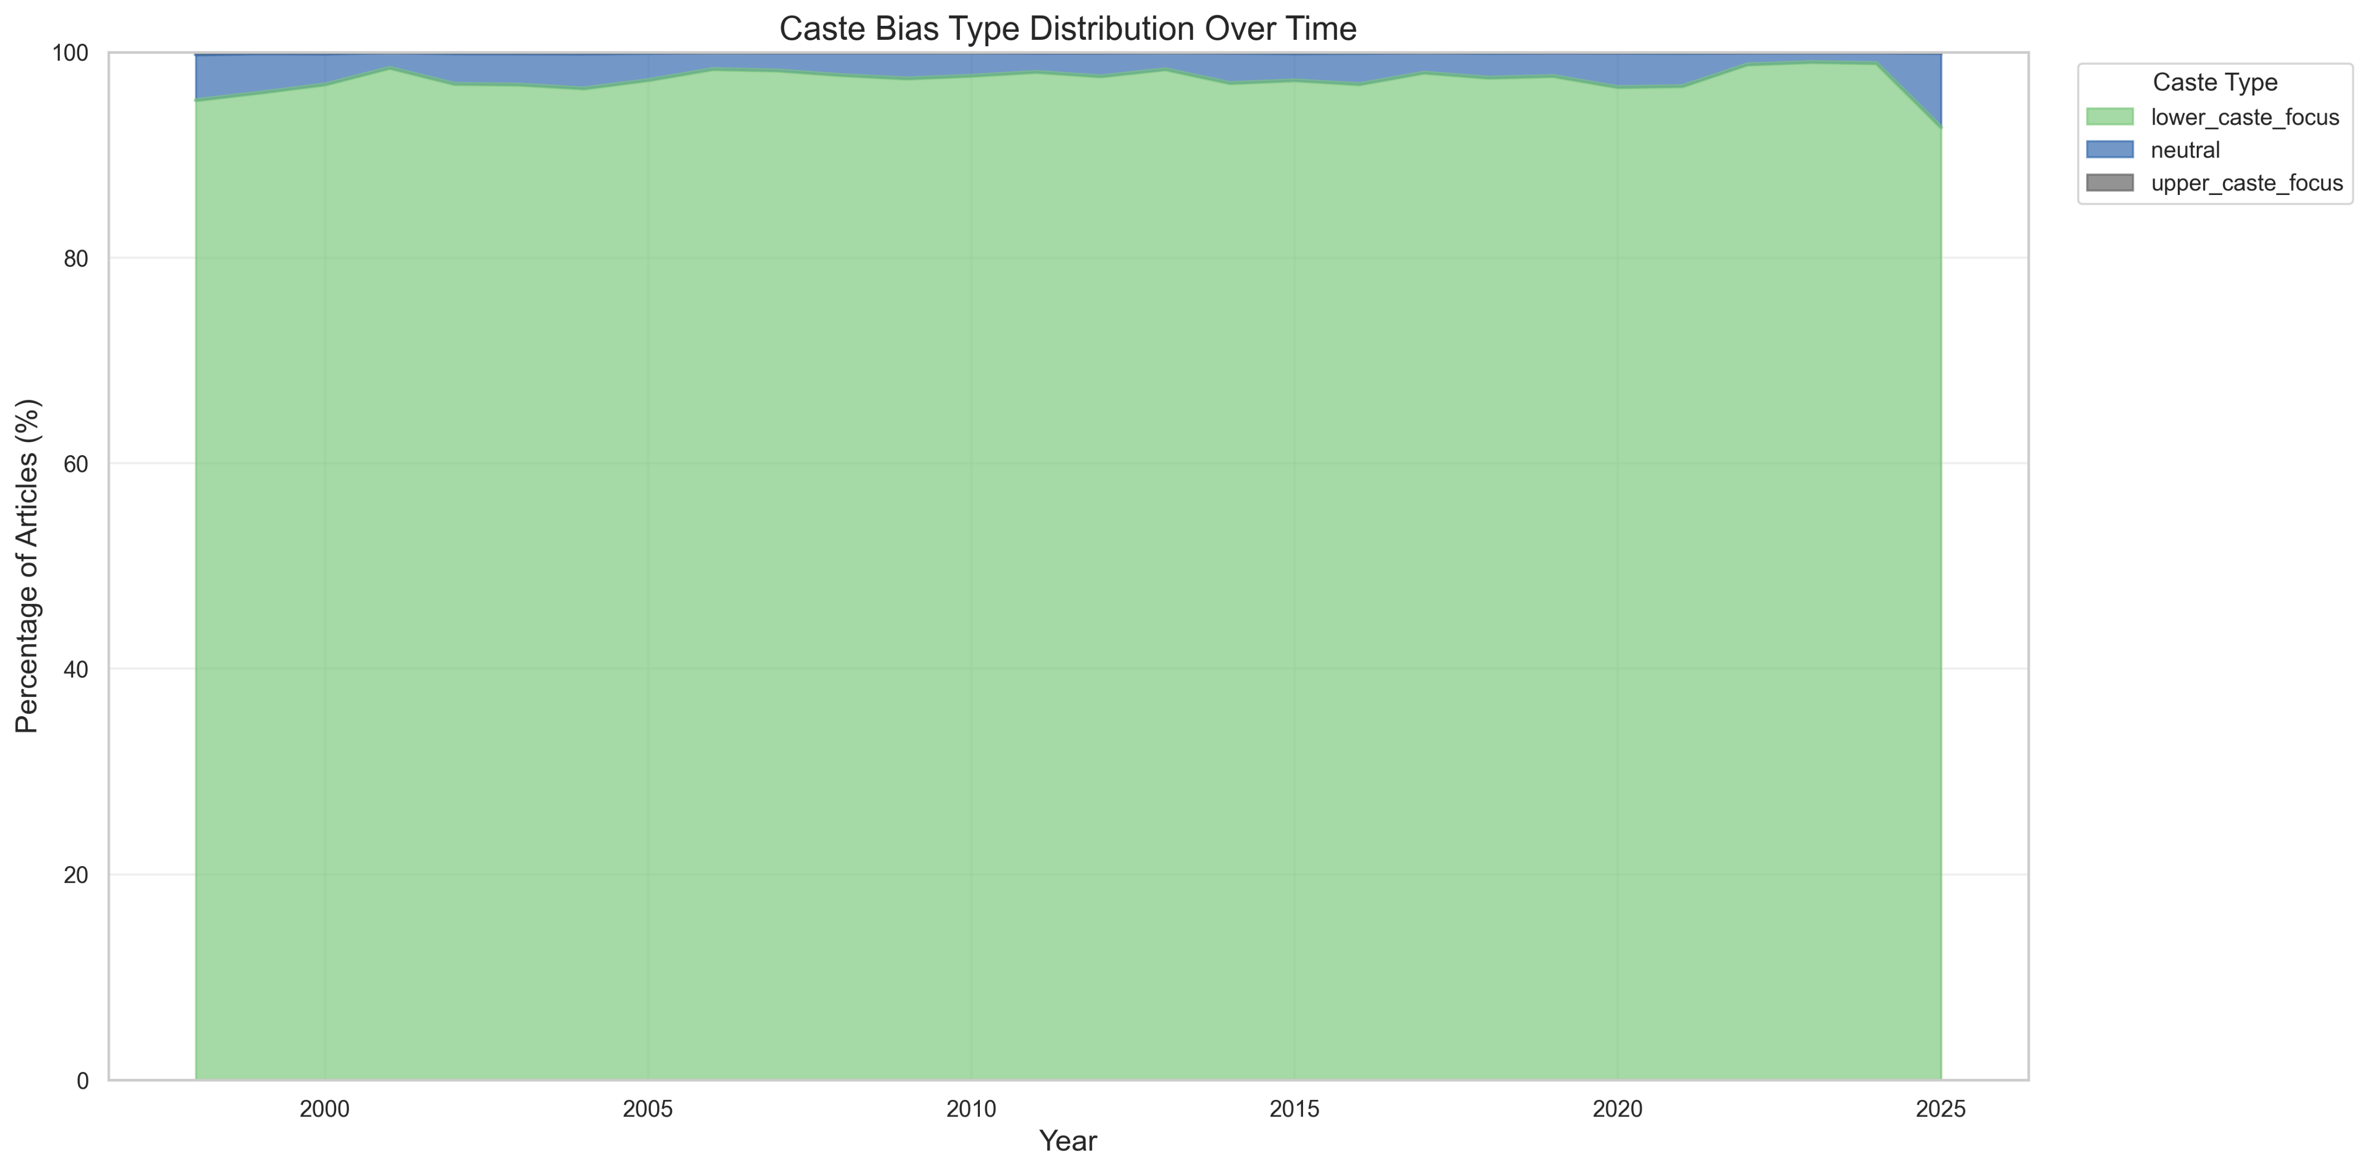
Caste Based Bias

Slide 26
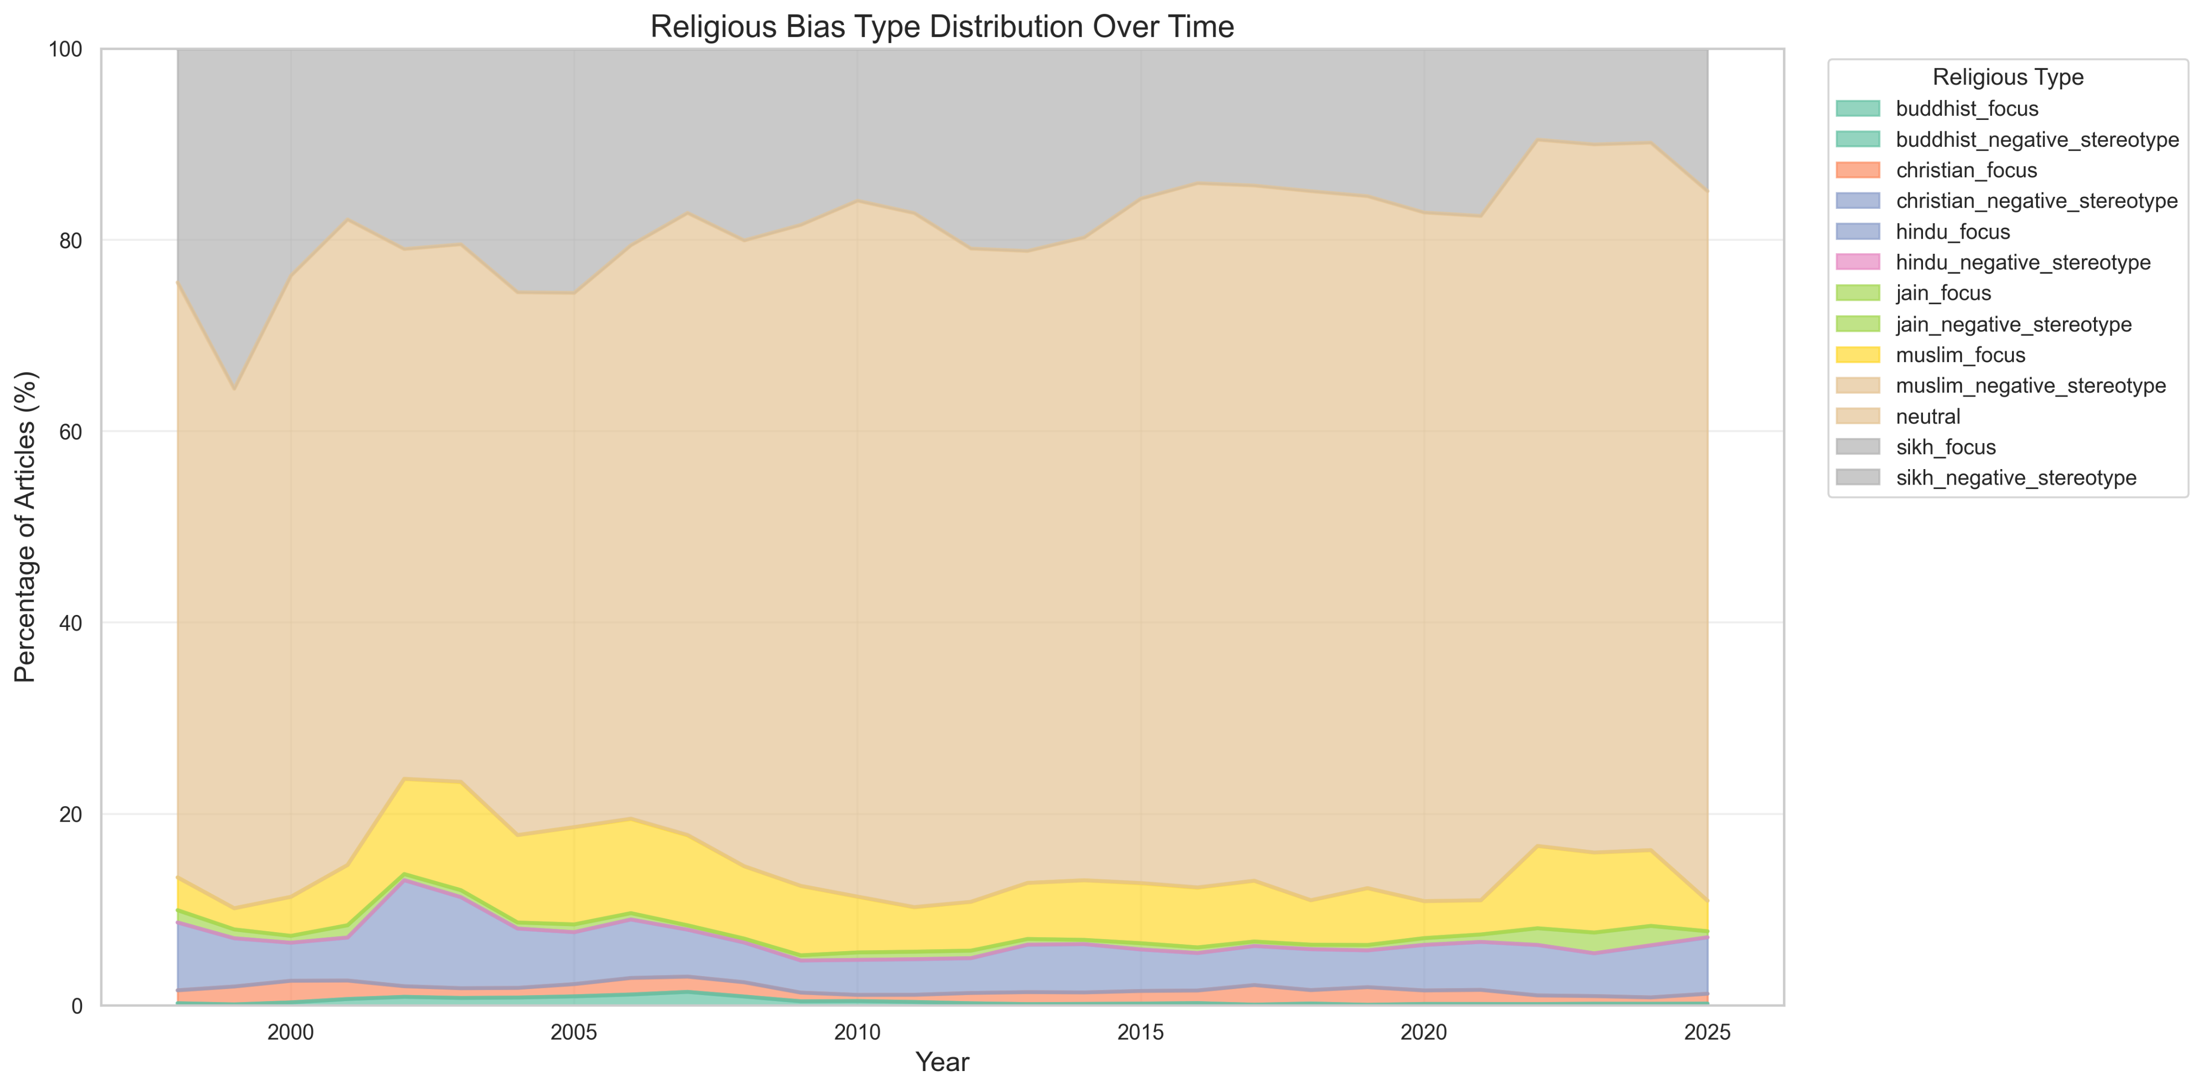
Religion Based Bias

Slide 27
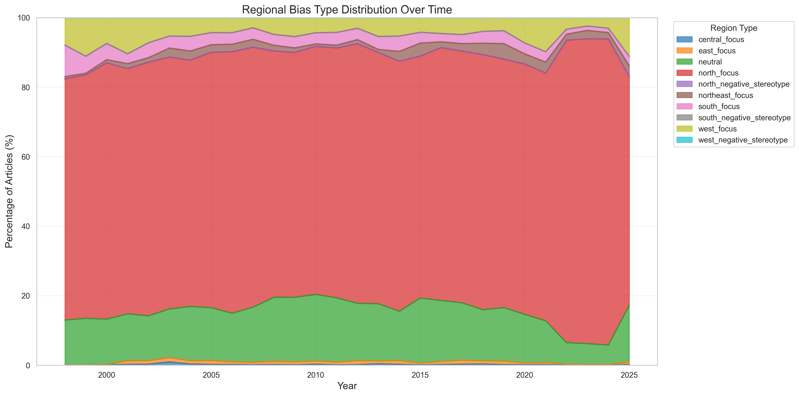
Region Based Bias

Slide 28
Key Performance Benchmarks

Slide 29
Batch Size = 1,000 | Topic Partition = 3
Data Set Size | Topic Partition | Producer Batch Size | Consumer Batch Size | Records Processed | Total Duration of Produce and Consume | Throughput | Average Batch Processing | Spark Cores and Memory
1 % | 3 | 1000 | 1000 | 3035 | 58s | 51 records/second | 1238ms | 2 Cores and 4 GB Memory
5 % | 3 | 1000 | 1000 | 15175 | 178s | 84 records/second | 659ms | 2 Cores and 4 GB Memory
10 % | 3 | 1000 | 1000 | 30351 | 333s | 91 records/second | 663ms | 2 Cores and 4 GB Memory
20 % | 3 | 1000 | 1000 | 60703 | 629s | 96 records/second | 686ms | 2 Cores and 4 GB Memory
50 % | 3 | 1000 | 1000 | 151759 | 1539s | 98 records/second | 615ms | 2 Cores and 4 GB Memory
100 % | 3 | 1000 | 1000 | 303518 | 3065s | 98 records/second | 678ms | 2 Cores and 4 GB Memory
Note: Total Data Size was 300,000 rows.

Slide 30
Batch Size = 10,000 | Topic Partition = 3
Data Set Size | Topic Partition | Producer Batch Size | Consumer Batch Size | Records Processed | Total Duration of Produce and Consume | Throughput | Average Batch Processing | Spark Cores and Memory
1 % | 3 | 10000 | 10000 | 3035 | 44s | 68 records/second | 7187ms | 2 Cores and 4 GB Memory
5 % | 3 | 10000 | 10000 | 15175 | 48s | 313 records/second | 4195ms | 2 Cores and 4 GB Memory
10 % | 3 | 10000 | 10000 | 30351 | 59s | 513 records/second | 3788ms | 2 Cores and 4 GB Memory
20 % | 3 | 10000 | 10000 | 60703 | 88s | 686 records/second | 3554ms | 2 Cores and 4 GB Memory
50 % | 3 | 10000 | 10000 | 151759 | 183s | 824 records/second | 4563ms | 2 Cores and 4 GB Memory
100 % | 3 | 10000 | 10000 | 303518 | 339s | 895 records/second | 5152ms | 2 Cores and 4 GB Memory
Note: Total Data Size was 300,000 rows.

Slide 31
Batch Size = 10,000 | Topic Partition = 6
Data Set Size | Topic Partition | Producer Batch Size | Consumer Batch Size | Records Processed | Total Duration of Produce and Consume | Throughput | Average Batch Processing | Spark Cores and Memory
1 % | 6 | 10000 | 10000 | 3035 | 43s | 69 records/second | 3996ms | 2 Cores and 4 GB Memory
5 % | 6 | 10000 | 10000 | 15175 | 48s | 310 records/second | 4670ms | 2 Cores and 4 GB Memory
10 % | 6 | 10000 | 10000 | 30351 | 63s | 477 records/second | 3295ms | 2 Cores and 4 GB Memory
20 % | 6 | 10000 | 10000 | 60703 | 93s | 650 records/second | 3141ms | 2 Cores and 4 GB Memory
50 % | 6 | 10000 | 10000 | 151759 | 188s | 804 records/second | 2767ms | 2 Cores and 4 GB Memory
100 % | 6 | 10000 | 10000 | 303518 | 338s | 896 records/second | 3019ms | 2 Cores and 4 GB Memory
Note: Total Data Size was 300,000 rows.

Slide 32
Varying the Spark Cores and Memory
Batch Size = 10,000 | Topic Partition = 6
Data Set Size | Topic Partition | Producer Batch Size | Consumer Batch Size | Records Processed | Total Duration of Produce and Consume | Throughput | Average Batch Processing | Spark Cores and Memory
100 % | 6 | 10000 | 10000 | 303518 | 338s | 896 records/second | 3019ms | 2 Cores and 4 GB Memory
100 % | 6 | 10000 | 10000 | 303518 | 334s | 908 records/second | 3682ms | 4 Cores and 4 GB Memory
100 % | 6 | 10000 | 10000 | 303518 | 328s | 923 records/second | 3051ms | 6 Cores and 4 GB Memory
Note: Total Data Size was 300,000 rows.

Slide 33
Summary

Slide 34
What We Achieved
The system meets its design goals:
multi-dimensional bias detection,
scalable batch/streaming pipelines,
robust ensemble methodologies, and
modular/extensible architecture.
Provides actionable insights and analytics on Indian news media bias, aligning with original motivation and proposal.

Slide 35
Envisioned Scale of Data
A conservative, evidence-based estimate:
Large/global publishers (top ~1,000): average ~50–200 articles/day → 50,000–200,000/day.
Mid/small publishers and local outlets (tens of thousands): if 20,000 sites average 5–20/day → 100,000–400,000/day.
Automated and niche feeds, blogs, and micro-sites (many thousands): likely add another 100,000–500,000/day.

Slide 36
Envisioned Scale of Data
More aggressive estimate (including broad blogosphere, social-news posts, and automated micro-updates):
1 million to 3+ million per day is plausible depending on inclusion of short automated items and social-origin reporting.

Slide 37
Roadmap and Future Work
Source Expansion: More Indian news outlets and support for regional languages.
Cloud Deployment: Migrate to AWS (EMR, MSK, DynamoDB).
Real-time Alerting: Automated notifications for high-bias content.
Dashboard Visualization: Web-based dashboards for broader user outreach.
Community Feedback and Further Research: Incorporate impact measurements and retrain models.

Slide 38
Thank you!

