Slide 1
Retrofitting Legacy Code for
Authorization Policy Enforcement
Vinod Ganapathy Ph.D. Thesis Defense Thursday, July 12th, 2007

Slide 2
Principle of Design for Security
Historic example:
  MULTICS [Corbato et al. ‘65]
More recent examples:
  Operating systems
  Database servers
To create a secure system, design
it to be secure from the ground up

Slide 3
Relevance of the Principle today
Deadline-driven software development
  Design.Build.(Patch)* is here to stay
Diverse/Evolving security requirements
  MULTICS security study [Karger and Schell, ‘72]
Most deployed software is
not designed for security
Notes:
“Much of the common software that we use day to day is not designed for security”
Give examples of software that has not been designed for security or was designed with insufficient security mechanisms.
Mention that entire security subsystems have shipped using Design.Build.(Patch)*. For example, the LSM framework shipped this way.
Mention that we can take advantage of the Design.Build.(Patch)* paradigm to add extra security.

Slide 4
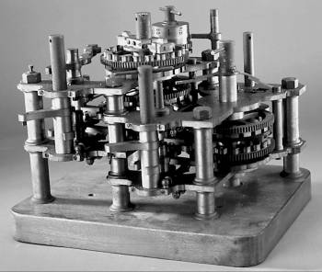
Retrofitting legacy code
Need systematic techniques to
retrofit legacy code for security
Legacy
code
Retrofitted
code
INSECURE
SECURE
Notes:
Legacy code won’t go away, and their security problems won’t go away. We need systematic techniques to retrofit legacy code with security mechanisms.

Slide 5
Retrofitting legacy code
Enforcing type safety
  CCured [Necula et al. ’02]
Partitioning for privilege separation
  PrivTrans [Brumley and Song, ’04]
Enforcing authorization policies
Need systematic techniques to
retrofit legacy code for security

Slide 6

Enforcing authorization policies
Resource user
Operation request
Response
Resource manager
Reference monitor
Allowed?
YES/NO
‹Alice, /etc/passwd, File_Read›
Authorization policy
Notes:
We would like to enhance the resource manager so that it checks the authorization policy before granting the resource request. This is achieved by consulting an authorization policy. The mechanism used to achieve this is called a reference monitor. Give examples of real resource users and resource managers here. For example, the operating system is a resource manager, and processes are resources. A server is a resource manager and its clients are resource users.

Slide 7
Retrofitting for authorization
Mandatory access control for Linux
  Linux Security Modules [Wright et al.,’02]
  SELinux [Loscocco and Smalley,’01]
Secure windowing systems
  Trusted X, Compartmented-mode workstation, X11/SELinux [Epstein et al.,’90][Berger et al.,’90][Kilpatrick et al.,’03]
Java Virtual Machine/SELinux [Fletcher,‘06]
IBM Websphere/SELinux [Hocking et al.,‘06]
Painstaking, manual procedure
Notes:
There are now several efforts to integrate authorization policy enforcement, not only into operating systems, but also into general purpose applcaitons. The integration of mandatory access control in Linux has spurred the integration of authorization policy enforcement frameworks in applications as well.

Slide 8
Thesis statement
Program analysis and transformation techniques
offer a principled and automated way to
retrofit legacy code with reference monitors
Notes:
Describe informally security-sensitive operations as operations on resources.

Slide 9
Contributions
Analyses and transformations for
authorization policy enforcement
Fingerprints: A new representation for security-sensitive operations
Two algorithms to mine fingerprints
Result: Reduced effort to retrofit legacy code for authorization policy enforcement
  Manual effort needed reduces to a few hours
  Applied to X server, Linux kernel, PennMUSH
Notes:
Describe informally security-sensitive operations as operations on resources. Mention that the algorithms to mine fingerprints may be of independent interest.

Slide 10
Outline
Motivation
Problem
  Example
  Retrofitting legacy code: Lifecycle
Solution

Slide 11
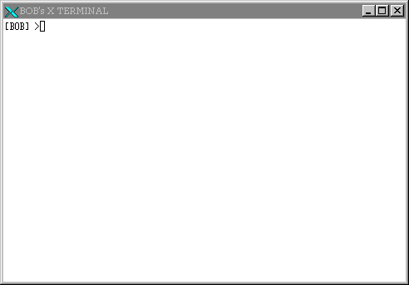
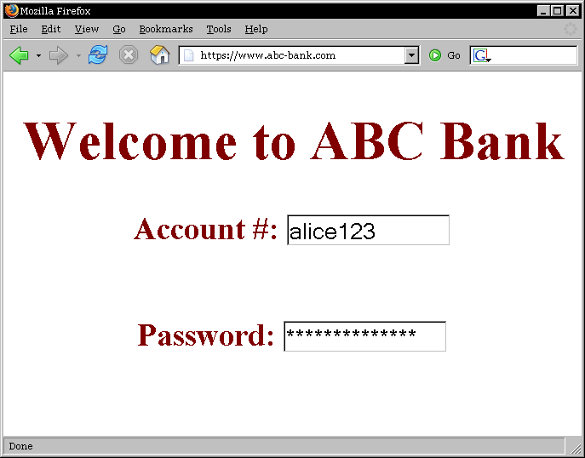
X server with multiple X clients
REMOTE
LOCAL

Slide 12

Malicious remote X client
REMOTE
LOCAL

Slide 13
Undesirable information flow
REMOTE
LOCAL
Notes:
“The keyboard input events meant for the browser window must not be sent to the X terminal window, which could potentially be compromised”
Can’t we prevent this attack by simply disallowing all information flows between a local client and a remote client? No, as the next slide will show.

Slide 14
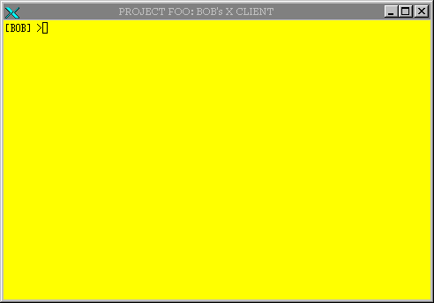
Desirable information flow
REMOTE
LOCAL
Notes:
Example of desirable information flow: cut from local client and paste to remote client, or vice versa. You would like to allow copy and paste

Slide 15
Other policies to enforce
Prevent unauthorized
  Copy and paste
  Modification of inputs meant for other clients
  Changes to window settings of other clients
  Retrieval of bitmaps: Screenshots
[Berger et al., ’90]
[Epstein et al., ‘90]
[Kilpatrick et al., ‘03]

Slide 16
X server with authorization
X client
Operation request
Response
X server
Reference monitor
Allowed?
YES/NO
Authorization policy

Slide 17
Outline
Motivation
Problem
  Example
  Retrofitting legacy code: Lifecycle
Solution

Slide 18
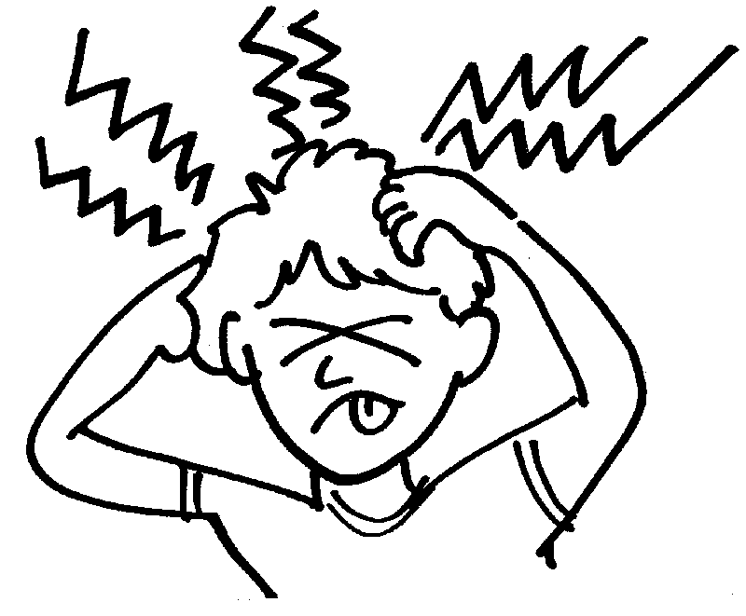
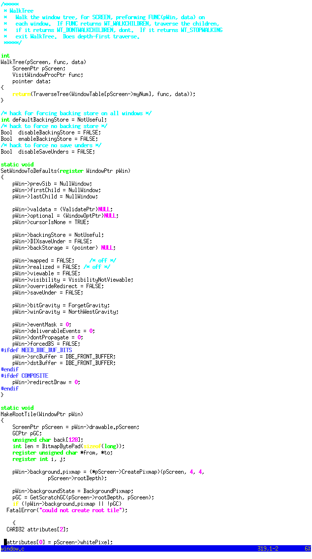
Retrofitting lifecycle
Identify security-sensitive operations
Locate where they are performed in code
Instrument these locations
Security-sensitive
operations
Source Code
Policy checks
Input_Event
Create
Destroy
Copy
Paste
Map
Can the client
receive this
Input_Event?
Notes:
What are security-sensitive operations? These are fundamental operations on resources, in this case Window resource, that we would like to mediate access to. That is, when an X client requests that these operations be performed on a Window, we would like to consult an authorization policy to check that this request can be allowed. Mention that the state of the art is manual.

Slide 19
Problems
Manual
X11/SELinux ~ 2 years [Kilpatrick et al., ‘03]
Linux Security Modules ~ 2 years [Wright et al., ‘02]
Violation of complete mediation
Time-of-check to Time-of-use bugs [Zhang et al., ‘02][Jaeger et al., ‘04]
Ad hoc
Notes:
Say that these points make it clear that we need automated techniques to retrofit legacy code

Slide 20

Our approach
Principled
Fingerprints: A new representation of security-sensitive operations
Legacy code retrofitted using fingerprints
  Use of static and dynamic program analysis
Automated
Notes:
Emphasize the impact of your approach: mention that you applied it to real code and your experimental results demonstrate that manual effort is drastically reduced and that it provides a basis to prove security. Mention also that the net result of your approach is that we can now secure more legacy code faster.

Slide 21
Approach overview
Legacy code
Miner
Fingerprints
Matcher
Retrofitted code
Notes:
“A central concept in our approach is the notion of a fingerprint. While I will introduce fingerprints next. informally, you can think of each fingerprint as a code-template. Our approach then proceeds in two stages. We first mine fingerprints by analyzing legacy code. That stage is called fingerprint mining. In this talk, I will describe two algorithms that we have developed for fingerprint mining. The second stage is fingerprint matching, which uses the mined fingerprints to retrofit legacy code. As you will see, each of these stages is largely automated, but there will still be some manual effort involved. For example, an analyst must manually examine and refine the output produced by the fingerprint miner. I will next describe fingerprints and the fingerprint matcher.”

Slide 22
Outline
Motivation
Problem
Solution
  Fingerprints [CCS’05]
  Dynamic fingerprint mining
  Static fingerprint mining

Slide 23

What are fingerprints?
Resource accesses that are unique to a security-sensitive operation
Denote key steps needed to perform the security-sensitive operation on a resource
Code-level signatures of
security-sensitive operations
Notes:
“Serve to distinguish one security-sensitive operation from another”
“Each security-sensitive operation has at least one fingerprint, possibly multiple, if it can be performed in multiple ways”
What is a security-sensitive operation? It is a primitive operation on a shared resource.
Fingerprints are code-level descriptions of these security-sensitive operations

Slide 24
Examples of fingerprints
Input_Event :-
Cmp xEvent->type == KeyPress
Security-sensitive
operations
Source Code
Input_Event
Create
Destroy
Copy
Paste
Map
Notes:
“Let me illustrate what a fingerprint is by taking an example. Let’s look at Input_Event, which denotes input being sent to a window from an I/O device. The fingerprint for this security-sensitive operation is shown here. This line here says that Input_Event is characterized by this code-template shown here. In this code-template, xEvent is a data type, i.e., a C struct, that it uses in the management of Windows. This code template says that the field called “type” of the xEvent data structure is being compared against a constant, called KeyPress, which internally denotes pressing a Key. This code-template denotes an essential action that happens in the X server when input from the keyboard is delivered to a client window. As you can see, this is a code-template, and can thus be matched directly against code. All lines of code that compare the value of field “type” of the xEvent data structure with KeyPress will match this fingerprint.

Slide 25
Examples of fingerprints
Input_Event :-
  Cmp xEvent->type == KeyPress
Input_Event :-
Cmp xEvent->type == MouseMove
Map :-
  Set Window->mapped to True &
  Set xEvent->type to MapNotify
Enumerate :-
  Read Window->firstChild &
  Read Window->nextSib &
  Cmp Window ≠ 0
Notes:
(1) Explain in detail what each of these fingerprints means.
(2) Explain that the code-patterns are expressed using abstract syntax trees.
(3) Explain that WINDOW actually corresponds to the type-name of the Window, and need not refer to a specific window variable
We have developed a fingerprint language to represent several such code templates. Aside from Read, Set and Cmp, we also can also have Calls in the language. Currently, the language expresses fingerprints using a conjunction of several resource accesses. It does not consider how these resource accesses are ordered. We did so to keep our analysis techniques simple and scalable. However, it is also possible to have more sophisticated fingerprints.

Slide 26
Fingerprint matching
  Enumerate :- Read Window->firstChild &
  Read Window->nextSib &
  Cmp Window ≠ 0
X server function MapSubWindows
MapSubWindows(Window *pParent, Client *pClient) {
Window *pWin;
…
// Run through linked list of child windows
pWin = pParent->firstChild; …
for (;pWin != 0; pWin=pWin->nextSib) {
...
// Code that maps each child window
...
}
}
Performs Enumerate

Slide 27
Placing authorization checks
X server function MapSubWindows
MapSubWindows(Window *pParent, Client *pClient) {
Window *pWin;
…
// Run through linked list of child windows
if CHECK(pClient,pParent,Enumerate) == ALLOWED {
pWin = pParent->firstChild; …
for (;pWin != 0; pWin=pWin->nextSib) {
...
// Code that maps each child window
...
}
} else { HANDLE_FAILURE }
}
Notes:
We place authorization checks guarding the statements that match the fingerprint. In this case, we ensure that the pClient is indeed authorized to Enumerate the child windows of the pParent pointer. If the authorization check fails, we must notify the client that the requested operation failed. This is represented by the else part, which handles failure. We currently implement handle_failure on a case-by-case basis. It may be possible to use the server’s error handling functionality to implement handle failure: e.g., throw an exception that is caught by the error handler.
We placed such checks in the X server and used these to enforce several authorization policies. These authorization policies prevented attacks that were otherwise possible.

Slide 28
Fingerprint matching
Currently employ simple pattern matching
More sophisticated matching possible
  Metacompilation [Engler et al., ‘01]
  MOPS [Chen and Wagner, ‘02]
Inserting authorization checks is akin to static aspect-weaving [Kiczales et al., ’97]
Other aspect-weaving techniques possible
  Runtime aspect-weaving
Notes:
(1) Explain in detail what each of these fingerprints means.
(2) Explain that the code-patterns are expressed using abstract syntax trees.
(3) Explain that WINDOW actually corresponds to the type-name of the Window, and need not refer to a specific window variable

Slide 29
Outline
Motivation
Problem
Solution
  Fingerprints
  Dynamic fingerprint mining [Oakland’06]
  Static fingerprint mining

Slide 30
Dynamic fingerprint mining
Security-sensitive
operations
Source Code
Input_Event
Create
Destroy
Copy
Paste
Map
Output: Fingerprints
Input_Event :-
Cmp xEvent->type == KeyPress
Notes:
In this slide, explain that
Manually identified security-sensitive operations were obtained from the NSA study
Explain, at least informally what fingerprints are
Explain that we use both static and dynamic program analysis

Slide 31
Dynamic fingerprint mining
Security-sensitive operations [NSA’03]
Use this information to induce the program to perform security-sensitive operations
Input_Event | Input to window from device
Create | Create new window
Destroy | Destroy existing window
Map | Map window to console
Notes:
When you say output are fingerprints, be sure to mention that these fingerprints characterize the code fragments that perform these operations

Slide 32
Problem definition
S: Set of security-sensitive operations
D: Descriptions of operations in S
R: Set of resource accesses
  Read/Set/Cmp of Window/xEvent
Each s є S has a fingerprint
  A fingerprint is a subset of R
  Contains a resource access unique to s
Problem: Find fingerprints for each security-sensitive operation in S using D
Notes:
Note that the set of resource data types implicitly define our fingerprint language: Reads, Writes, Comparisons to fields of these data structures define the alphabet over which we will search for fingerprints. Each security-sensitive operation has a fingerprint. The goal of the dynamic analysis is to find fingerprints for each of the security-sensitive operations.

Slide 33

Traces contain fingerprints
Security-sensitive
operations
Source Code
Runtime trace
Induce security-sensitive operation
  Typing to window will induce Input_Event
Fingerprint must be in runtime trace
  Cmp xEvent->type == KeyPress
Input_Event
Create
Destroy
Copy
Paste
Map
Notes:
What is the problem: Each trace can perform multiple security-sensitive operations, and so will contain the fingerprints for multiple security-sensitive operations. How do we find the fingerprint for one security-sensitive operation in the trace?

Slide 34
Compare traces to localize
Security-sensitive
operations
Source Code
Runtime trace
Localize fingerprint in trace
  Trace difference and intersection
Input_Event
Create
Destroy
Copy
Paste
Map

Slide 35
Runtime traces
Trace the program and record reads/writes to resource data structures
  Window and xEvent in our experiments
Example: from X server startup
(In function SetWindowtoDefaults)
Set Window->prevSib to 0
Set Window->firstChild to 0
Set Window->lastChild to 0
  …
  about 1400 such resource accesses
Notes:
“During X server startup, a function called SetWindowDefaults is called that results in all these initializations happening to Window”

Slide 36
Using traces for fingerprinting
Obtain traces for each security-sensitive operation
  Series of controlled tracing experiments
Examples
  Typing to keyboard generates Input_Event
  Creating new window generates Create
  Creating window also generates Map
  Closing existing window generates Destroy

Slide 37
Comparison with “diff” and “∩”
Annotation is a manual step
 | Open xterm | Close xterm | Move xterm | Open browser | Switch windows
Create
Destroy
Map
Unmap
Input_Event

Slide 38
Comparison with “diff” and “∩”
Perform same set operations on resource accesses
 | Open xterm | Close xterm | Move xterm | Open browser | Switch windows
Create
Destroy
Map
Unmap
Input_Event
Create = Open xterm ∩ Open browser
- Move xterm
Notes:
Mention that even after we perform these set operations, fingerprints need to be identified manually. Thus, trace analysis reduces, but does not completely eliminate the effort needed to find fingerprints. Then ask the question “by how much does trace analysis reduce the manual effort needed to identify fingerprints?” This will provide a smooth transition to the next slide, which contains exactly these numbers

Slide 39
Set equations
Each trace has a set of labels
  Open xterm: {Create, Map}
  Browser: {Create, Destroy, Map, Unmap}
  Move xterm: {Map, Input_Event}
Need set equation for {Create}
  Compute an exact cover for this set
  Open xterm ∩ Open browser – Move xterm
Perform the same set operations on the set of resource accesses in each trace

Slide 40
Experimental methodology
Source code
gcc –-enable-logging
Server with logging enabled
Run experiments and collect traces
Raw traces
Localize security-sensitive operation
Relevant portions of traces
Compare traces with “diff” and “∩”
Pruned traces

Slide 41
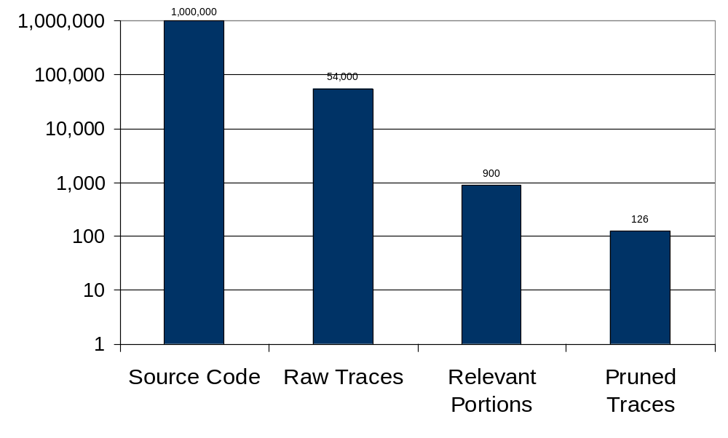
Dynamic mining: Results
Each fingerprint localized to
within 126 resource accesses
Size
Notes:
This graph shows number of (distinct resource accesses x the location they are accessed in): e.g.,
Window->field accessed in different functions is counted twice. So the actual work for the software engineer is even smaller than studying 126 resource accesses.

Slide 42
Limitations of dynamic mining
Security-sensitive
operations
Incomplete: False negatives
High-level description needed
Operations are manually induced
Source Code
Runtime trace
Input_Event
Create
Destroy
Copy
Paste
Map

Slide 43
Outline
Motivation
Problem
Solution
  Fingerprints
  Dynamic fingerprint mining
  Static fingerprint mining [ICSE’07]

Slide 44
Static fingerprint mining
Security-sensitive
operations
Source Code
Resources
Window
xEvent
Input_Event
Create
Destroy
Copy
Paste
Map
Output: Candidate Fingerprints
Cmp xEvent->type == KeyPress
Notes:
Mention that the key thing to keep in mind here is that fingerprints are resource accesses unique to a security-sensitive operation

Slide 45
Problem definition
R: Set of resource accesses
  Read/Set/Cmp of Window/xEvent
E: Set of entry points into the server
Goal: Find fingerprints using R and E
Not given an a priori description
of security-sensitive operations
Notes:
We would also like elements of the partition to be as large as possible. This is because we would like to find maximal sets of resource accesses that correspond to a security-sensitive operation

Slide 46
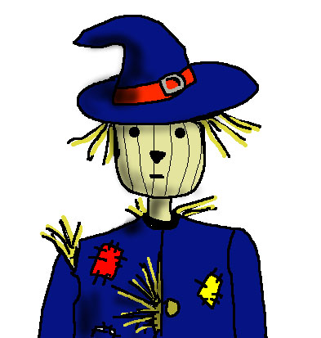
Straw-man proposal I
Finest level of granularity
Cmp xEvent->type == KeyPress
Read Window->firstChild
Read Window->nextSib
Cmp Window ≠ 0
Each resource access
in R is a fingerprint

Slide 47
Problem with this proposal
Cmp xEvent->type == KeyPress
Read Window->firstChild
Read Window->nextSib
Cmp Window ≠ 0
Difficult to write and maintain
policies at this level of granularity
Notes:
The problem with this solution is that these fingerprints are at too fine a level of granularity, and do not really correspond to any higher-level operations on the resource. As a result, if we were to use these as fingerprints, and therefore as enforcement points, the resulting policies will be difficult to write and maintain. As an analogy, when you write a policy to determine who can access what files on a file system, you do not write policies at the granularity of individual inodes, but rather at a higher-level of granularity, e.g., read, write, append, and so on.

Slide 48
Straw-man proposal II
Coarsest level of granularity
Call MapSubWindows
Call MapWindow
Write policies allowing/disallowing the use of an API call
Each API in E is a fingerprint

Slide 49
Problem with this proposal
Call MapSubWindows
  Enumerates child windows and maps them to the screen
Call MapWindows
  Maps a window onto the screen
Does not reflect actual resource
accesses performed by API call
Notes:
Policies written at this level of granularity do not reflect the actual resource accesses performed. What we would really like is to seek the middle ground between the finest level of granularity and the coarsest level of granularity

Slide 50
Our approach
Each API entry point implicitly defines a set of resource accesses
Cluster resource accesses based upon the API entry points that perform them
Cluster resource accesses
that always happen together

Slide 51
Static analysis
Extract resource accesses potentially possible via each entry point
Example from the X server
  Entry point: MapSubWindows(…)
  Resource accesses:
  Set xEvent->type To MapNotify
  Set Window->mapped To True
Read Window->firstChild
  Read Window->nextSib
  Cmp Window ≠ 0

Slide 52
Resource accesses
 | MapSub Windows | Map Window | KeyboardInput
Set xEvent->type To MapNotify
Set Window->mapped To True
Read Window->firstChild
Read Window->nextSib
Cmp Window ≠ 0
Cmp xEvent->type==KeyPress
Identify candidate fingerprints by
clustering resource accesses
270 API functions
430 distinct resource accesses
Notes:
Here are the resource accesses being performed. Intuitively, we would like to think of the following as defining a fingerprint (resource accesses unique to a security-sensitive operation)
We would like to combine traces like this. However, we have a problem: Large number of APIs. Large number of resource manipulations. Table is of size 100,000 for the X server (hundred thousand). We need an efficient way to combine these traces.

Slide 53
Concept analysis
 | MapSub Windows | Map Window | KeyboardInput
Set xEvent->type To MapNotify
Set Window->mapped To True
Read Window->firstChild
Read Window->nextSib
Cmp Window ≠ 0
Cmp xEvent->type==KeyPress
Instances
Features
Comparison via
hierarchical clustering
Notes:
Concept analysis clusters instances based upon the features that they share. The output of concept analysis is a lattice.

Slide 54
Hierarchical clustering
A
B
C
MapSub
Windows
Map
Window
Keyboard
Input
1
2
3
4
5
6
Set xEvent->type To MapNotify
Set Window->mapped To True
Read Window->firstChild
Read Window->nextSib
Cmp Window ≠ 0
Cmp xEvent->type==KeyPress
{A,B,C}, Ф
{A,B}, {1,2}
{C}, {6}
{A}, {1,2,3,4,5}
Ф, {1,2,3,4,5,6}
Notes:
Concept analysis clusters instances based upon the features that they share. The output of concept analysis is a lattice. Explain the lattice

Slide 55
Mining candidate fingerprints
A
B
C
MapSub
Windows
Map
Window
Keyboard
Input
Cand. Fing. 1
1
2
3
4
5
6
Set xEvent->type To MapNotify
Set Window->mapped To True
Read Window->firstChild
Cand. Fing. 2
Read Window->nextSib
Cmp Window ≠ 0
Cand. Fing. 3
Cmp xEvent->type==KeyPress
{A,B,C}, Ф
{A,B}, {1,2}
{C}, {6}
{A}, {1,2,3,4,5}
Ф, {1,2,3,4,5,6}
Notes:
We traverse the lattice from top to bottom, searching for new resource accesses. That is, we search for resource accesses in a node that do not appear in any ancestral node.

Slide 56
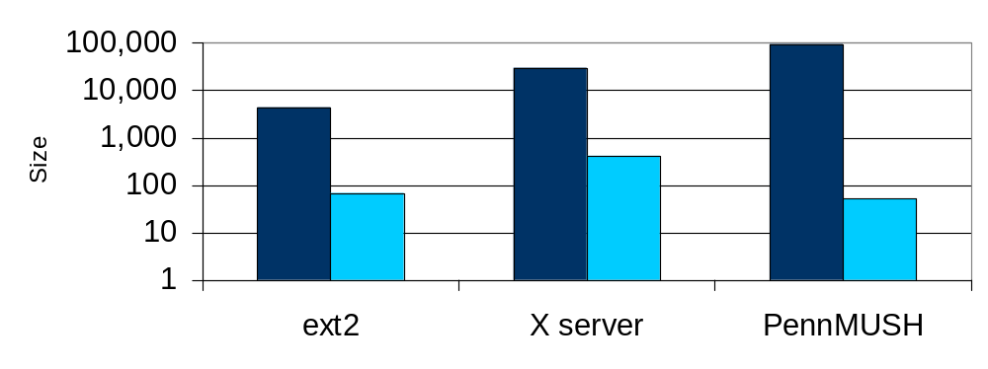
Static mining: Results
Benchmark
LOC
Cand. Fing.
Avg. Size
ext2
4,476
18
3.7
X Server/dix
30,096
115
3.7
PennMUSH
94,014
38
1.4
Notes:
Mention that you only analyzed a subset of the X server. This was because the traces that we gathered in dynamic analysis showed that it suffices to focus on just this subset of the X server to find fingerprints. We could have done the whole thing, but that would have taken more time, without significantly changing the results.

Slide 57
Static mining: Results
Manually identified
Security-sensitive ops
Candidate
fingerprints
Benchmark
ext2
11
18
X Server/dix
22
115
Able to find at least one fingerprint
for each security-sensitive operation

Slide 58
Static mining: Results
Manually identified
Security-sensitive ops
Candidate
fingerprints
Benchmark
ext2
11
18
X Server/dix
22
115
Identified automatically in a few minutes
Interpretation takes just a few hours
Identified as part of
multi-year efforts

Slide 59
Static mining: Results
Associated 59 candidate fingerprints with security-sensitive operations
Remaining are likely security-sensitive too
Manually identified
Security-sensitive ops
Candidate
fingerprints
Benchmark
ext2
11
18
X Server/dix
22
115
  Read Window->DrawableRec->width & Read Window->DrawableRec->height
Notes:
It was unclear whether the remaining were security-sensitive. We could not find SSOs corresponding to these resource accesses in X server dix

Slide 60
Summary of contributions
Fingerprints
Mining
Matching
Input_Event
Create
Destroy
Copy
Paste
Map
Can the client
receive this
Input_Event?
Notes:
Give a very high-level description of each of these steps and what each paper achieved

Slide 61
Lessons for the future
Modifications may break software
Modifying executables is challenging
Modifying legacy code is non-trivial
Low-overhead runtime system for policy
enforcement on unmodified code

Slide 62
Lessons for the future
Type-safety violations the main problem
Soundness/completeness
hard to achieve for C
Provable guarantees with
additional runtime checks?

Slide 63
Lessons for the future
Difficult to automate failure handling
Failure handling is a crosscutting-concern
Handling failure gracefully is the main challenge
Aspect-oriented solution?
Checkpoint and rollback?

Slide 64


Slide 65
Errors in labeling traces (I)
 | Open xterm | Close xterm | Move xterm | Open browser | Switch windows
CREATE
DESTROY
MAP
UNMAP
INPUTEVENT

Slide 66
Errors in labeling traces (I)
 | Open xterm | Close xterm | Move xterm | Open browser | Switch windows
CREATE
DESTROY
MAP
UNMAP
INPUTEVENT
CREATE = Trace1 – Trace3

Slide 67
Errors in labeling traces (II)
 | Open xterm | Close xterm | Move xterm | Open browser | Switch windows
CREATE
DESTROY
MAP
UNMAP
INPUTEVENT

Slide 68
Dealing with errors in labeling
Missing labels from traces:
  “∩” operation will not discard fingerprint
  “diff” operation may erroneously eliminate a fingerprint
Extra labels on traces:
  May erroneously eliminate a fingerprint
Trial-and-error
  Relabel and recompute set-equations
Empirically: tolerance of about 15% errors

