Slide 1

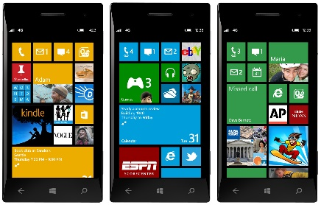

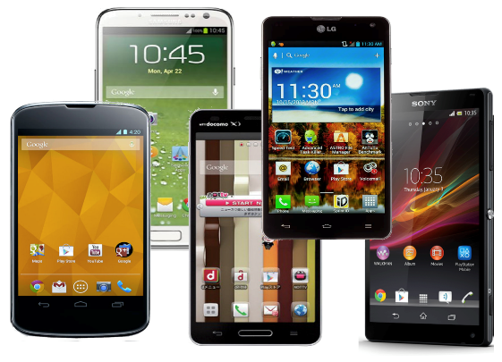
App
Native Windows App
Windows SDK
App source code
Runtime
Compilation
App
Written in C#
with calls to
Windows API
Native Android App
Android SDK
Compatibility
library

Slide 2
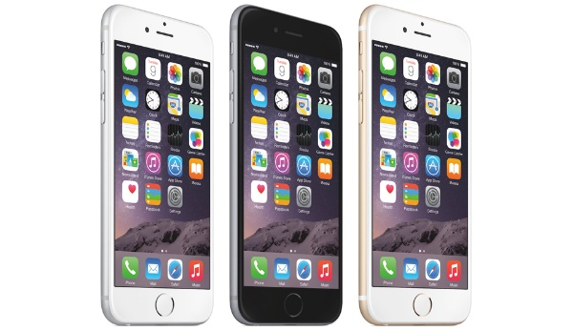
Windows App
Native Windows App
Windows SDK
App source code
Native iOS App
iOS App
Compatibility
library
iOS SDK
Written in C#
with calls to
Windows API
Native Android App
Android App
Compatibility
library
Android SDK
Compilation
Runtime

Slide 3
Platform
specific
UI code
Application Core
Shared Asset
Project
Platform-independent business logic
#ifdef WINDOWS
...
#elsif ANDROID
...
#elsif IOS
...
PCL interface

Slide 4
Application Core
Platform-independent business logic
UI code
Compatibility Library
(called Portable Class Library (PCL)
on Xamarin)
Platform-specific code
Target platform SDK (Windows Phone)

