Slide 1
Retrofitting Legacy Code for Authorization Policy Enforcement
Vinod Ganapathy vg@cs.wisc.edu | Trent Jaeger tjaeger@cse.psu.edu | Somesh Jha jha@cs.wisc.edu
2006 IEEE Symposium on Security and Privacy
Oakland, California

Slide 2

Motivating example
Client: Alice
Client: Bob
Alice
Bob
X Server

Slide 3
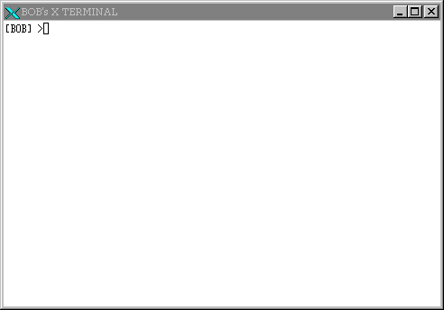
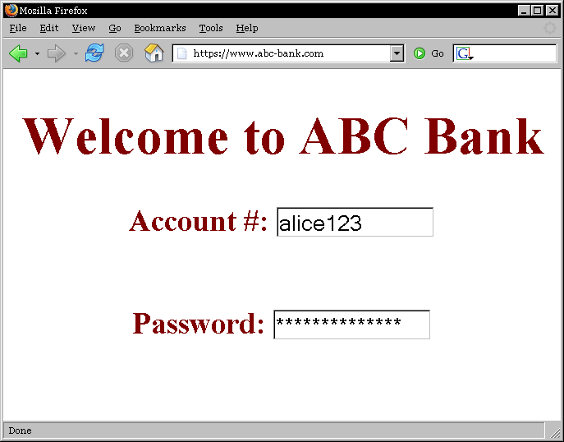
X server with multiple X clients
BOB
ALICE

Slide 4

Bob’s malicious X client
BOB
ALICE

Slide 5
Bob stealing Alice’s password
BOB
ALICE
Notes:
This information flow is clearly undesirable. Mention that the techniques that we develop can prevent such information flows. However, there are other techniques to do so as well. For example, simply prevent Bob from connecting to the X server. Them mention that there are scenarios where Bob connecting to the X server may be useful. Then transition to the next slide.

Slide 6
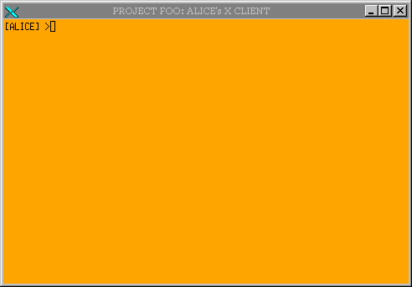
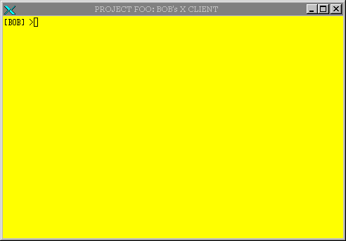
Collaboration
ALICE
BOB
PROJECT FOO
PROJECT FOO

Slide 7
Desirable information flow
ALICE
BOB
PROJECT FOO
PROJECT FOO

Slide 8
Undesirable information flow
ALICE
BOB
PROJECT FOO
PROJECT FOO
ALICE

Slide 9
Many more examples
Prevent unauthorized
  copy-and-paste [Epstein et al., 1991]
  modification of inputs meant for other clients
  changing window settings of other clients
  retrieval of bitmaps: screenshots
  …several more examples…
  Source: [Kilpatrick et al., 2003]

Slide 10
Fine-grained enforcement
Fine-grained, server-level enforcement of authorization policies
Server offers shared resources to clients
Manages multiple clients simultaneously
Request
Allowed?
Client
Server
Policy
Reply
Yes/No
X Client → X Server: Give me input keystrokes
X Server → Policy Engine: Is this allowed?
X Server → X Client: Here are the keystrokes
Notes:
Mention that our main goal is to develop automated techniques to retrofit legacy servers for authorization policy enforcement

Slide 11
Problem statement
Provide server-level mechanisms for enforcement of authorization policies
Make server code security-policy-aware

Slide 12
Contributions
Analyses for legacy code retrofits
  Enforcing authorization policies
Fingerprints
  Code-patterns of security-sensitive operations
Two prototype tools
  AID: automates fingerprint-finding
  ARM: uses fingerprints to retrofit code
Real-world case study
  Retrofitting the X server

Slide 13
Talk outline
Motivation and contributions
Retrofitting legacy code: Lifecycle
Our techniques
  Fingerprints
  Finding fingerprints: AID
  Using fingerprints: ARM
Conclusion

Slide 14
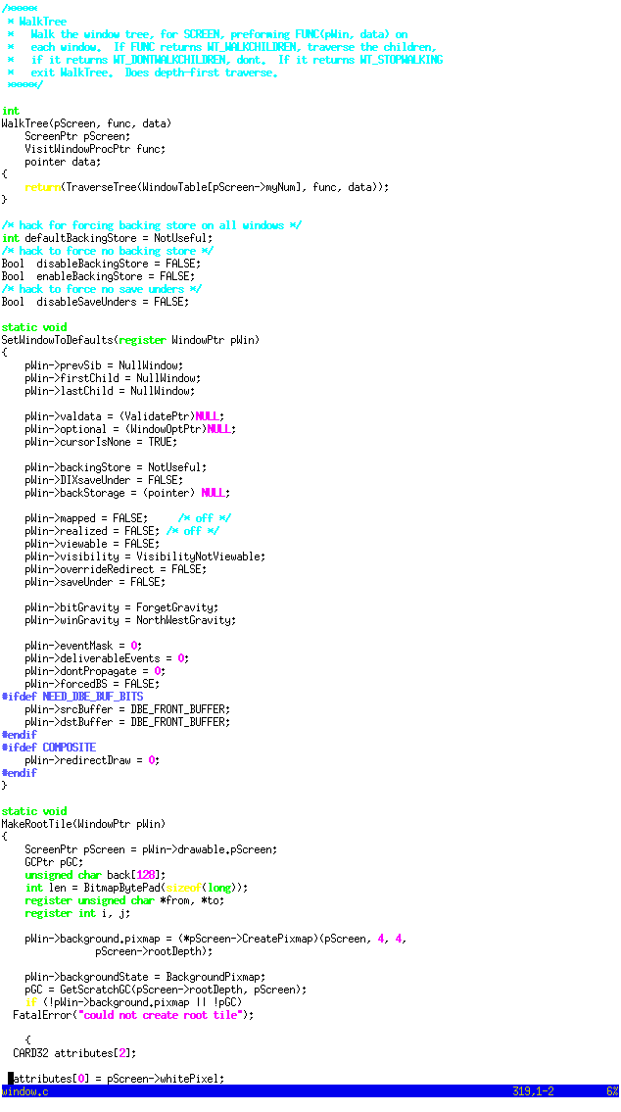
Retrofitting legacy code: Lifecycle
Identify security-sensitive operations
Locate where they are performed in code
Retrofit these locations
Security-sensitive
operations
Source Code
Policy checks
INPUT_EVENT
CREATE
DESTROY
COPY
PASTE
MAP
...
Can the client
receive this
INPUT_EVENT?

Slide 15
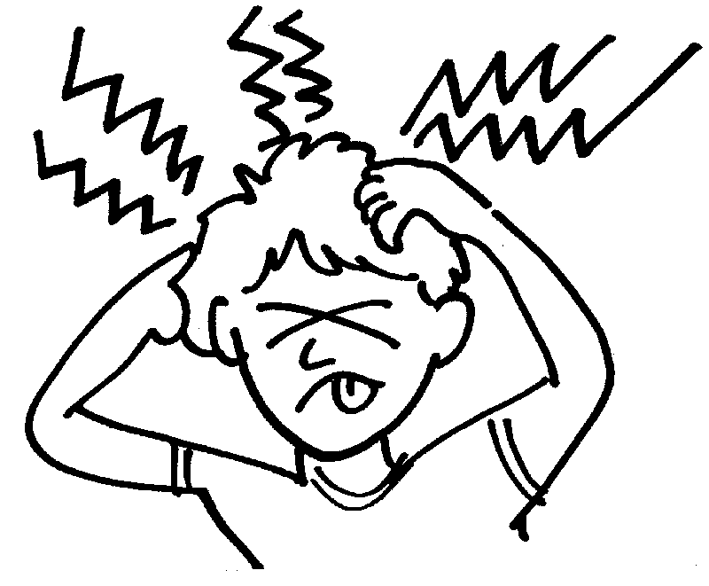
Lifecycle: State-of-the-art
Security-sensitive
operations
Source Code
Policy checks
INPUT_EVENT
CREATE
DESTROY
COPY
PASTE
MAP
...
Can the client
receive this
INPUT_EVENT?

Slide 16
State-of-the-art: Consequences
Tedious
  Linux Security Modules ~ 2 years [Wright et al., 2002]
  X11/SELinux ~ 2 years [Kilpatrick et al., 2003]
Error-prone
  Violation of complete mediation [Jaeger et al. 2002]
Notes:
Say that these points make it clear that we need automated techniques to retrofit legacy code

Slide 17
Talk outline
Motivation and contributions
Retrofitting legacy code: Lifecycle
Our techniques
  Fingerprints
  Finding fingerprints: AID
  Using fingerprints: ARM
Conclusion

Slide 18

Lifecycle: Our contributions
AID
ARM
Security-sensitive
operations
Source Code
Policy checks
INPUT_EVENT
CREATE
DESTROY
COPY
PASTE
MAP
...
Can the client
receive this
INPUT_EVENT?

Slide 19
Overview of our work
Operations on shared resources
Manually identified list
  For X server, used NSA study [Kilpatrick et al., 2003]
Security-sensitive
operations
Source Code
Policy checks
INPUT_EVENT
CREATE
DESTROY
COPY
PASTE
MAP
...
Can the client
receive this
INPUT_EVENT?
Notes:
In this slide, explain that
Manually identified security-sensitive operations were obtained from the NSA study
Explain, at least informally what fingerprints are
Explain that we use both static and dynamic program analysis

Slide 20
Overview of our work
Main concept: fingerprints
Approach: analysis of runtime traces
Security-sensitive
operations
Source Code
Policy checks
INPUT_EVENT
CREATE
DESTROY
COPY
PASTE
MAP
...
Can the client
receive this
INPUT_EVENT?
Notes:
In this slide, explain that
Manually identified security-sensitive operations were obtained from the NSA study
Explain, at least informally what fingerprints are
Explain that we use both static and dynamic program analysis

Slide 21
Overview of our work
Main concept: reference monitoring
Approach: static matching of fingerprints [Ganapathy/Jaeger/Jha, CCS’05]
Security-sensitive
operations
Source Code
Policy checks
INPUT_EVENT
CREATE
DESTROY
COPY
PASTE
MAP
...
Can the client
receive this
INPUT_EVENT?
Notes:
In this slide, explain that
Manually identified security-sensitive operations were obtained from the NSA study
Explain, at least informally what fingerprints are
Explain that we use both static and dynamic program analysis

Slide 22
Talk outline
Motivation
Case study: X window system
Retrofitting legacy code: Lifecycle
Our techniques
  Fingerprints
  Finding fingerprints: AID
  Using fingerprints: ARM
Conclusion

Slide 23
What are fingerprints?
Code-level description of security-sensitive operations
Each operation has at least one fingerprint
Security-sensitive
operations
Source Code
INPUT_EVENT
CREATE
DESTROY
COPY
PASTE
MAP
...
Notes:
What is a security-sensitive operation? It is a primitive operation on a shared resource.
Fingerprints are code-level descriptions of these security-sensitive operations

Slide 24
Examples of Fingerprints
Code-patterns
INPUT_EVENT :-
Call ProcessKeybdEvent
INPUT_EVENT :-
Call ProcessPointerEvent
ENUMERATE:-
  Read Window->firstChild &
  Read Window->nextSib &
  Compare Window ≠ 0
Notes:
(1) Explain in detail what each of these fingerprints means.
(2) Explain that the code-patterns are expressed using abstract syntax trees.
(3) Explain that WINDOW actually corresponds to the type-name of the Window, and need not refer to a specific window variable

Slide 25

Finding and using fingerprints
Legacy Code
Retrofitted
Code
AID
ARM
Security-sensitive
operations

Slide 26
AID: A fingerprint finder
Legacy Code
AID
Security-sensitive
operations

Slide 27
Main problem solved by AID
Inputs:
  1. Source code of legacy server
  2. Security-sensitive operations
Security-sensitive operations [NSA’03]
Output: Fingerprints
INPUT_EVENT | Input to window from device
CREATE | Create new window
DESTROY | Destroy existing window
MAP | Map window to console
Notes:
When you say output are fingerprints, be sure to mention that these fingerprints characterize the code fragments that perform these operations

Slide 28
Key insight used by AID
Induce server to perform a security-sensitive operation
  typing to window will induce INPUT_EVENT
Code-patterns in its fingerprint must be exercised by the server
  Call ProcessKeybdEvent must be in trace
Analyze runtime traces to find fingerprints!

Slide 29
Runtime traces
Trace the server and record
  function calls and returns
  reads/writes to critical data structures
    Data structures used to represent resources
Example: from X server startup
  CALL SetWindowToDefaults
  SET Window->prevSib TO 0
  SET Window->firstChild TO 0
  SET Window->lastChild TO 0
  … about 1400 such code-patterns

Slide 30
Using traces for fingerprinting
Obtain traces for each security-sensitive operation
  Series of controlled tracing experiments
Examples
  Typing to keyboard generates INPUT_EVENT
  Creating new window generates CREATE
  Creating window also generates MAP
  Closing existing window generates DESTROY

Slide 31
Analyzing traces
Input:
  Traces annotated with the security-sensitive operations they perform
Output:
  Fingerprint for each security-sensitive operation
Notes:
Mention here that these are raw traces that are processed by the trace analysis technique

Slide 32
Analyzing traces: “diff” and “∩”
Annotation is currently a manual step
 | Open xterm | Close xterm | Move xterm | Open browser | Switch windows
CREATE
DESTROY
MAP
UNMAP
INPUTEVENT

Slide 33
Analyzing traces: “diff” and “∩”
Perform same set operations on code-patterns in traces
 | Open xterm | Close xterm | Move xterm | Open browser | Switch Windows
CREATE
DESTROY
MAP
UNMAP
INPUTEVENT
CREATE = Trace1 ∩ Trace4
- Trace 3
Notes:
Mention that even after we perform these set operations, fingerprints need to be identified manually. Thus, trace analysis reduces, but does not completely eliminate the effort needed to find fingerprints. Then ask the question “by how much does trace analysis reduce the manual effort needed to identify fingerprints?” This will provide a smooth transition to the next slide, which contains exactly these numbers

Slide 34
How effective is trace analysis?
Source code: 1,000,000 lines of C code
Raw traces: 54,000 code-patterns
Pre-analysis: Relevant portion of trace
  Average of 900 distinct code-patterns
  Average of 140 distinct functions
Post-analysis: Each result
  Average of 126 distinct code-patterns
  Average of 15 distinct functions
18x
~60x
~7x
~9x
Notes:
Also mention that because you have the runtime trace, you know the EXACT path that was traced through the function!!!

Slide 35
Examples of fingerprints
Operation | Fingerprint
CREATE | Call CreateWindow
DESTROY | Call DeleteWindow
UNMAP | Set xEvent->type To UnmapNotify
CHSTACK | Call MoveWindowInStack
INPUT_EVENT | Call ProcessPointerEvent, Call ProcessKeybdEvent

Slide 36
ARM: Static code retrofitter
Legacy Code
Retrofitted
Code
AID
ARM
Security-sensitive
operations

Slide 37
Fingerprints from AID
Operation | Fingerprint
CREATE | Call CreateWindow
DESTROY | Call DeleteWindow
UNMAP | Set xEvent->type To UnmapNotify
CHSTACK | Call MoveWindowInStack
INPUT_EVENT | Call ProcessPointerEvent, Call ProcessKeybdEvent

Slide 38
Using fingerprints: simple example
CreateWindow(Client *pClient) {
Window *pWin;
…
// Create new window here
pWin = newly-created window;
}
CreateWindow(Client *pClient) {
Window *pWin;
if (CHECK(pClient, CREATE) == FAIL) { return; }
// Create new window here
pWin = newly-created window;
}

Slide 39
More complex example
ENUMERATE:-
  Read Window->firstChild &
  Read Window->nextSib &
  Compare Window ≠ 0
Paper has details on how we match these
Notes:
Use these fingerprints to explain how you place authorization hooks.
Mention that placing authorization hooks in the case of CALL fingerprints is relatively easy. Just place the authorization check within this function, or at calls to the function.

Slide 40
Talk outline
Motivation
Case study: X window system
Retrofitting legacy code: Lifecycle
Our techniques
  Fingerprints
  Finding fingerprints: AID
  Using fingerprints: ARM
Conclusion

Slide 41
X server case study
Applied AID and ARM to the X server
Added policy checks for window operations
  Policy lookups at 24 locations

Slide 42
Similar example in the paper
ALICE
BOB
PROJECT FOO
PROJECT FOO
ALICE

Slide 43
Limitations
AID uses analysis of runtime traces
  no guarantees of finding all fingerprints
  Possible remedies
    coverage metrics to augment runtime tracing
    static fingerprint-finding technique
Identification of security-sensitive operations is still manual

Slide 44
Summary of important ideas
Analysis techniques to retrofit servers for policy enforcement
Fingerprints
  Code-patterns of security-sensitive operations
Two prototype tools
  AID: automates fingerprint-finding
  ARM: uses fingerprints to retrofit code
Case study on X server

Slide 45
Questions?
Retrofitting Legacy Code for Authorization Policy Enforcement
Vinod Ganapathy vg@cs.wisc.edu | Trent Jaeger tjaeger@cse.psu.edu | Somesh Jha jha@cs.wisc.edu
http://www.cs.wisc.edu/~vg/papers/ieee-sp2006

Slide 46
Backup slides

Slide 47
Why server-level enforcement?
Main goal of server-level enforcement
  Mediate operations on shared resources
  Example: stop INPUT_EVENT to unauthorized client windows
Enforcement within the OS?
  INPUT_EVENT, Windows: X server primitives
  pollutes OS with application-specific information
Notes:
Talk about what it would take to enforce policy within the operating system: You will have to track the kernel footprint of each of the application’s operations, interpret them and enforce them at the OS. This is very hard to do, and sometimes impossible. Conclude that it is best to enforce policies at the server level

Slide 48
Solution space
Make server code security-policy-aware
Proactive approach: design for security
  High development cost
  Hard to anticipate all security requirements
  Useless if you want to modify legacy code
Retroactive approach: retrofit legacy code
  Time-consuming and error-prone
  Lack of systematic techniques to retrofit code
Notes:
Talk about LSM here, and say that retroactive approach helps here as well!

Slide 49
More complex example
ENUMERATE:-
  Read Window->firstChild &
  Read Window->nextSib &
  Compare Window ≠ 0
Notes:
Use these fingerprints to explain how you place authorization hooks.
Mention that placing authorization hooks in the case of CALL fingerprints is relatively easy. Just place the authorization check within this function, or at calls to the function.

Slide 50
Using fingerprints: Example
X server function MapSubWindows
MapSubWindows(Window *pParent, Client *pClient) {
Window *pWin;
…
// Run through linked list of child windows
pWin = pParent->firstChild; …
for (;pWin != 0; pWin=pWin->nextSib) {
...
// Code that maps each child window
...
}
}

Slide 51
Using fingerprints: Example
  Read Window->firstChild &
  Read Window->nextSib &
  Compare Window ≠ 0
X server function MapSubWindows
MapSubWindows(Window *pParent, Client *pClient) {
Window *pWin;
…
// Run through linked list of child windows
pWin = pParent->firstChild; …
for (;pWin != 0; pWin=pWin->nextSib) {
...
// Code that maps each child window
...
}
}
Performs
ENUMERATE

Slide 52
Placing authorization checks
X server function MapSubWindows
MapSubWindows(Window *pParent, Client *pClient) {
Window *pWin;
…
// Run through linked list of child windows
if CHECK(pClient,pParent,ENUMERATE) == ALLOWED {
pWin = pParent->firstChild; …
for (;pWin != 0; pWin=pWin->nextSib) {
...
// Code that maps each child window
...
}
} else { HANDLE_FAILURE }
}

Slide 53
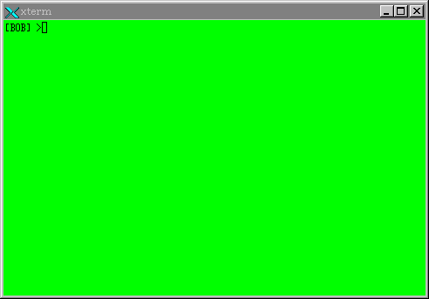
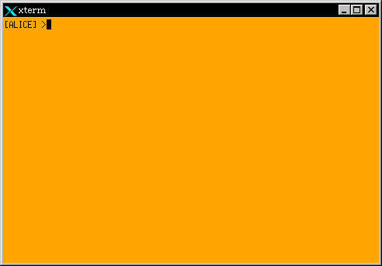
X server with multiple X clients
BOB
ALICE

Slide 54

Bob’s malicious X client
BOB
ALICE

Slide 55
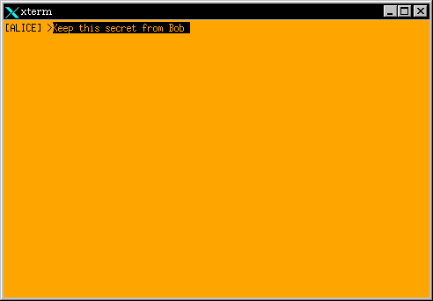
Compromising confidentiality
BOB
ALICE

Slide 56
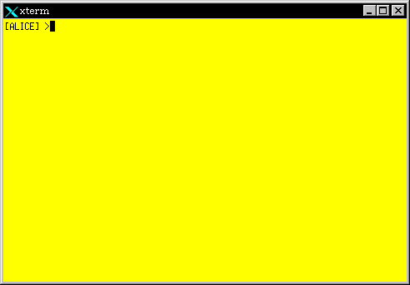
More complex example
ALICE
PROJECT Y
BOB
PROJECT X
ALICE
PROJECT X

