Slide 1


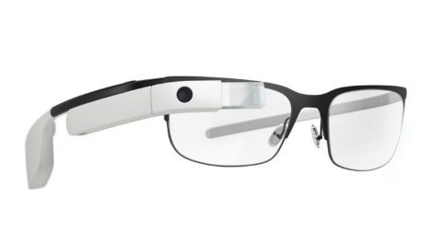
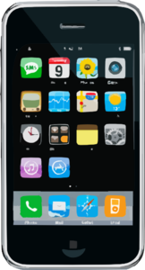

4G
Device
check-in
Device
check-out
4G
4G
Public Space
Unrestricted use of
peripherals on smart devices
Restricted Space
Policies enforced on the use
of certain peripherals on devices
Public Space
Configuration of peripherals
restored on device check-out

Slide 2
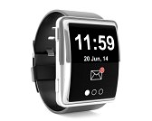
Device
check-in
4G
4G
Public Space
Unrestricted use of
peripherals on smart devices
Restricted Space
Policies enforced on the use
of certain peripherals on devices
Device
check-out

Slide 3


Guest device
Normal world
(Untrusted)
Secure world
(Trusted)
Vetting
service
2
Authentication
UI App: Check-in & Check-out
Other user apps
Remote Memory Operation Support
1
Verification
Token Support
3
Host’s
policy
server
OS
Kernel
REM Suspend Support
Kernel
Module
5
4
Normal-world
memory
Secure-world
memory
ARM TrustZone

Slide 4
Vetting
service
SW
NW
Host’s policy
server
ARM TZ
SW
NW
ARM TZ
Remote memory
read & write operations
SW
NW
ARM TZ

Slide 5
OS Kernel
Peripheral interface
Device driver

Slide 6
OS Kernel
Peripheral interface
Dummy driver
Original driver

Slide 7
OS Kernel
Peripheral interface
NULL
Original driver

