Slide 1

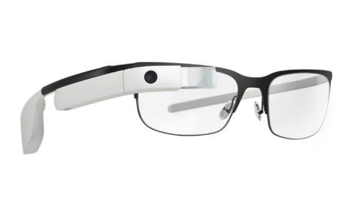



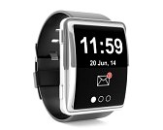
Check-in: Host inspects and modifies
guest devices’ configuration
4G
4G
Check-out: Host restores
guest devices’ configuration
Public Space
Unrestricted use of
smart personal devices
Restricted Space
Policies enforced on the use of
peripherals on smart devices

Slide 2
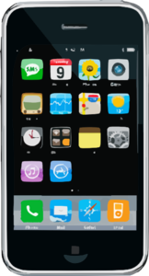

4G
Device
check-in
Device
check-out
4G
4G
Public Space
Unrestricted use of
peripherals on smart devices
Restricted Space
Policies enforced on the use
of certain peripherals on devices
Public Space
Configuration of peripherals
restored on device check-out

Slide 3
4G
Device Check-in
Device Check-out
Public Space
Restricted Space

Slide 4

Guest device
Normal world
(Untrusted)
Secure world
(Trusted)
Host’s
policy
server
Authentication
UI App: Check-in & Check-out
1
Other user apps
Remote Memory Operation Support
2
Verification
Token Support
OS
Kernel
Kernel
Module
4
3
Normal-world
memory
Secure-world
memory
ARM TrustZone

Slide 5
SW
NW
Host’s policy
server
ARM TZ
SW
NW
ARM TZ
Remote memory
read & write operations
SW
NW
ARM TZ

Slide 6
OS Kernel
Peripheral interface
Device driver

Slide 7
OS Kernel
Peripheral interface
Dummy
device driver
Original
device driver

Slide 8
OS Kernel
Peripheral interface
NULL
Original
device driver

