Slide 1
Signal Analysis Using Autoregressive Models of Amplitude Modulation
Sriram Ganapathy
Advisor - Hynek Hermansky
11-18-2011

Slide 2
Overview
Introduction
AR Model of Hilbert Envelopes
FDLP and its Properties
Applications
Summary

Slide 3
Overview
Introduction
AR Model of Hilbert Envelopes
FDLP and its Properties
Applications
Summary

Slide 4
Introduction
Sub-band speech and audio signals - product of smooth modulation with a fine carrier.

Slide 5
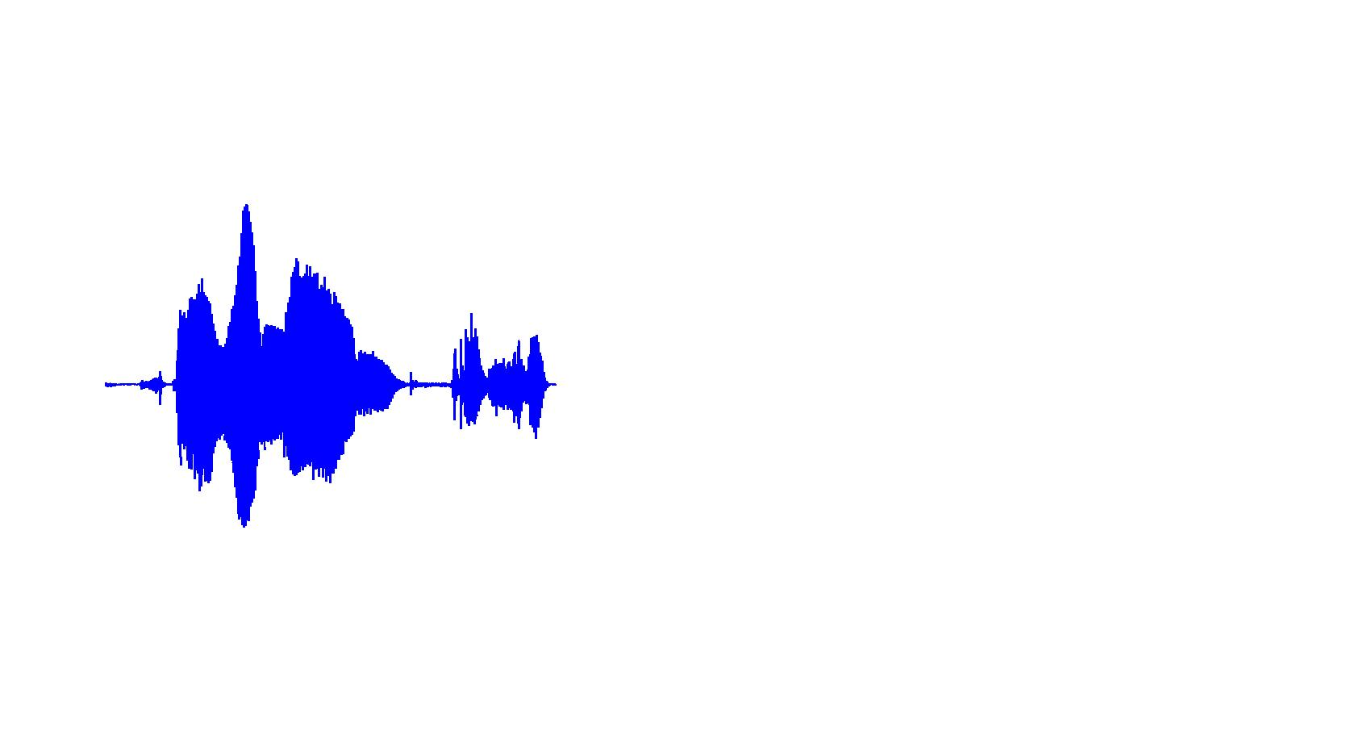
Introduction
Sub-band speech and audio signals - product of smooth modulation with a fine carrier.

Slide 6
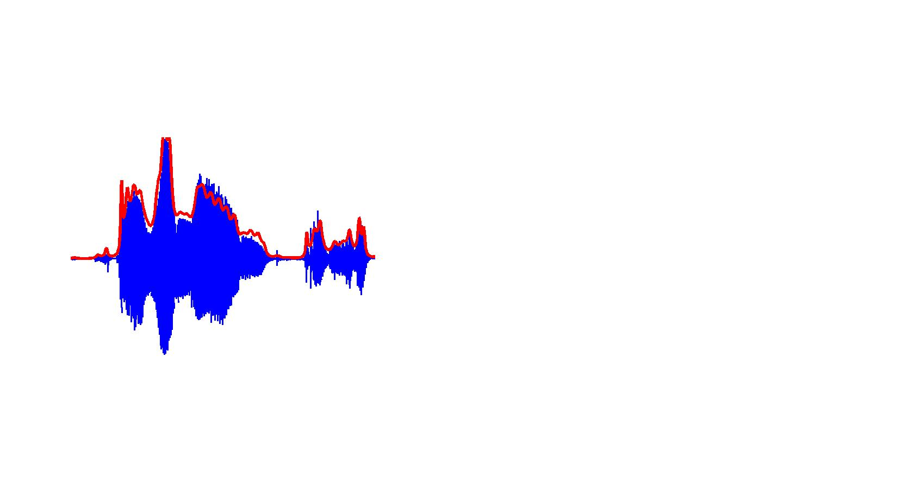
Introduction
Sub-band speech and audio signals - product of smooth modulation with a fine carrier.

Slide 7
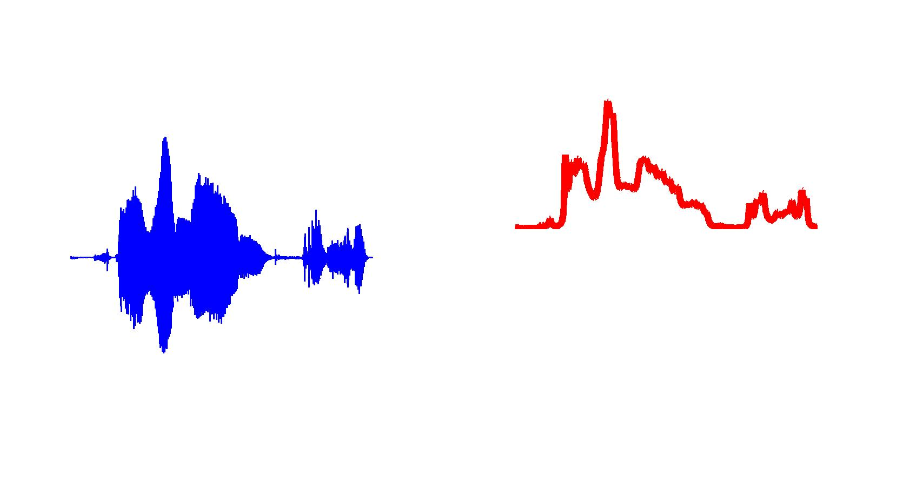
Introduction
Sub-band speech and audio signals - product of smooth modulation with a fine carrier.

Slide 8
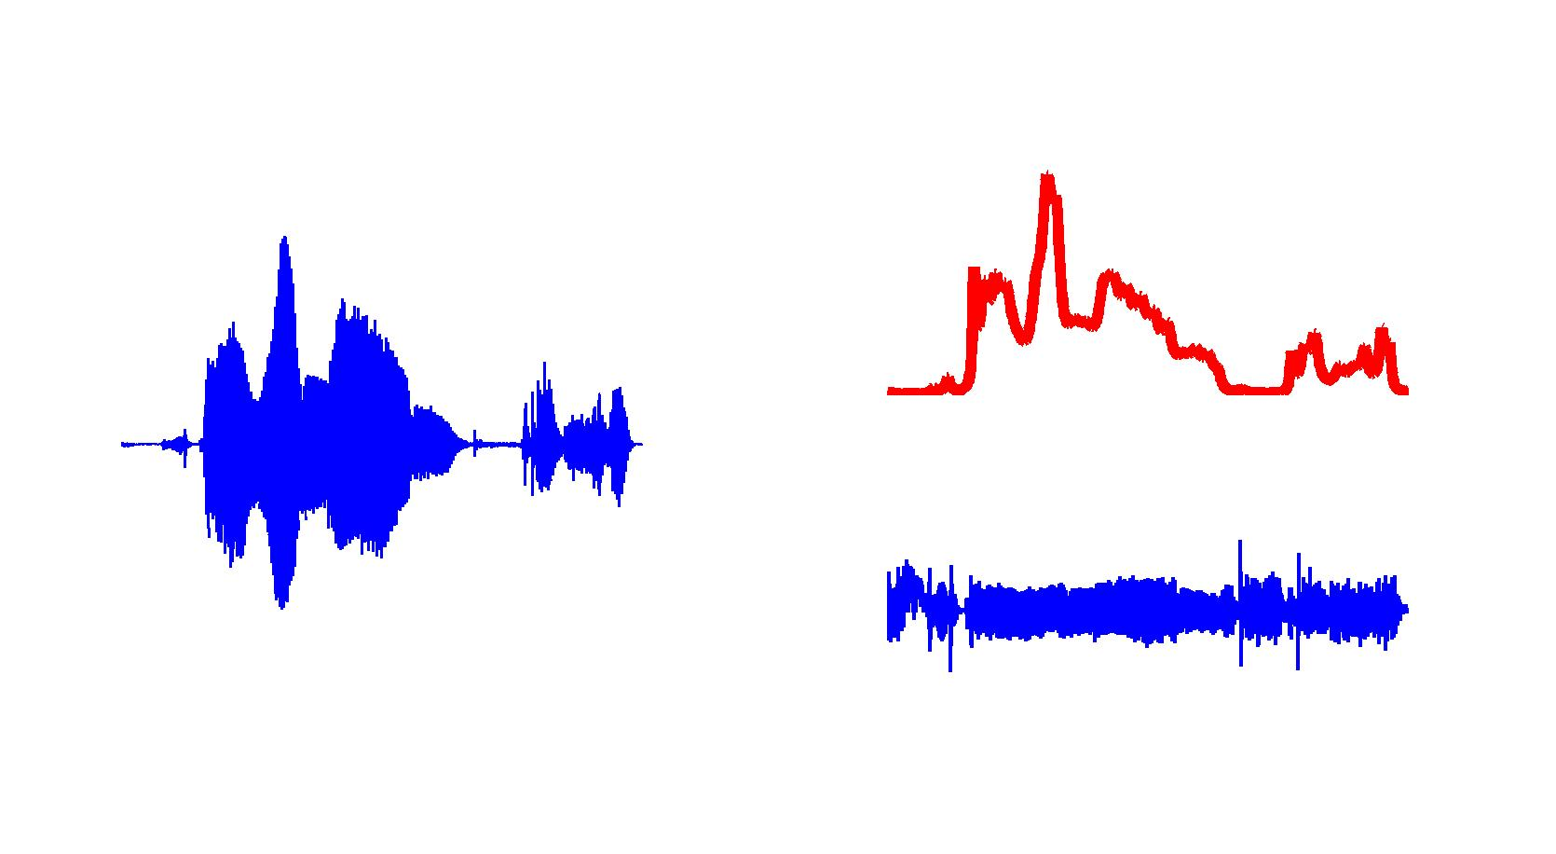
Introduction
Sub-band speech and audio signals - product of smooth modulation with a fine carrier.
=

Slide 9

Introduction
Sub-band speech and audio signals - product of smooth modulation with a fine carrier.
=

Slide 10
Introduction
Sub-band speech and audio signals - product of smooth modulation with a fine carrier.
?
AM
Non-Unique
FM

Slide 11
Introduction
Sub-band speech and audio signals - product of smooth modulation with a fine carrier.
?
AM
Non-Unique
FM
$$x\left(t\right) = m\left(t\right)∗cos⁡\{ωot+φ\left(t\right)\}$$

Slide 12
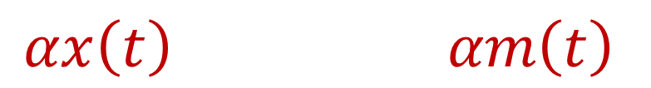

Desired Properties of AM
Linearity
Continuity
Harmonicity
$$αx\left(t\right) αm\left(t\right)$$
$$x\left(t\right)+δx\left(t\right) m\left(t\right)+δm\left(t\right)$$
$$cos⁡(ωot) 1$$

Slide 13




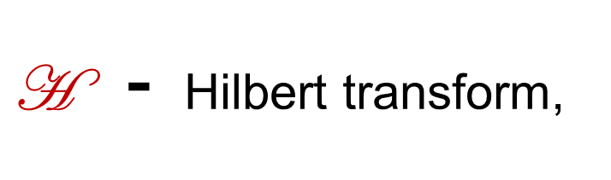



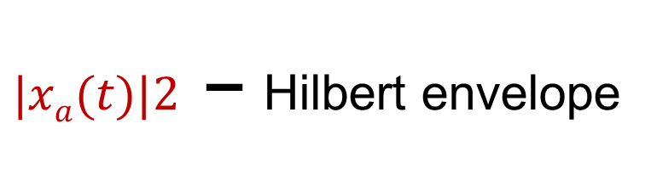
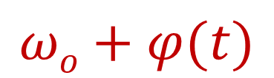


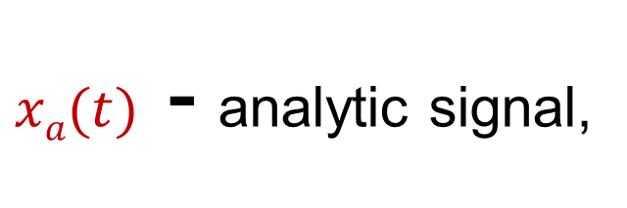
Desired Properties of AM
Uniquely satisfied by the analytic signal
$$xa⁡(t)$$
$$| |$$
$$m(t)$$
$$+$$
$$\frac{d}{dt}$$
$$x⁡(t)$$
$$ω(t)$$
$$\text{H}$$
$$j$$
$$ωo+φ(t)$$
$xa⁡(t)$ - analytic signal,
$\text{H}$ - Hilbert transform,
$|xa⁡(t)|2$ – Hilbert envelope

Slide 14
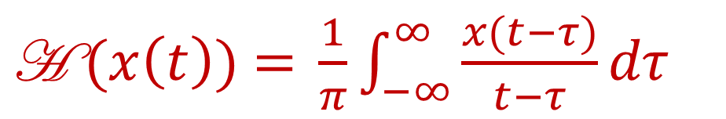
Desired Properties of AM
However, the Hilbert transform filter is infinitely long and can cause artifacts for finite length signals.
Need for modeling the Hilbert envelope without explicit computation of the Hilbert transform.
$\text{H} \text{(}x\left(t\right)\text{)}\text{ = }\frac{1}{π}\int_{−∞}^{∞}{\frac{x(t−τ)}{t−τ}dτ}$

Slide 15
Overview
Introduction
AR Model of Hilbert Envelopes
FDLP and its Properties
Applications
Summary

Slide 16
Overview
Introduction
AR Model of Hilbert Envelopes
FDLP and its Properties
Applications
Summary

Slide 17



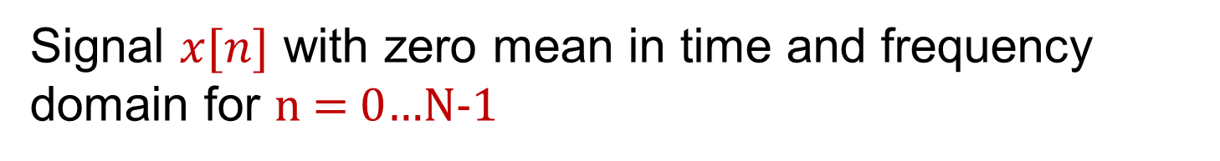
AR Model of Hilbert Envelopes
Signal $x[n]$ with zero mean in time and frequency domain for n = 0…N-1
Discrete-time analytic signal
$$2X[k] \text{for} \text{k}\text{<}\text{N}\text{/2}$$
$$Xa[k]\text{ =}$$
$$0 for k≥N/2$$

Slide 18


AR Model of Hilbert Envelopes
Signal $x[n]$ with zero mean in time and frequency domain for n = 0…N-1
Discrete-time analytic signal
$$2X[k] \text{for} \text{k}\text{<}\text{N}\text{/2}$$
$$Xa[k]\text{ =}$$
$$0 for k≥N/2$$
$$X[k]$$
$$Xa[k]$$

Slide 19




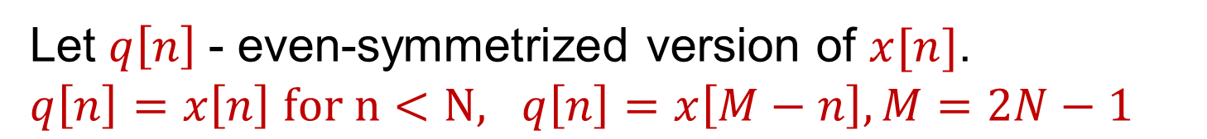
AR Model of Hilbert Envelopes
Let $q\left[n\right]$- even-symmetrized version of $x[n]$.
$q\left[n\right]=x\left[n\right] for n<N, q\left[n\right]=x\left[M−n\right], M=2N−1$
Discrete-time analytic signal
$$Q\left[k\right]=2Re\{X[k]\}$$
$$2Q[k]\text{, }\text{k}\text{<}\text{N}$$
$$Qa[k]\text{ =}$$
$$0 k≥N$$

Slide 20


AR Model of Hilbert Envelopes
Let $q\left[n\right]$- even-symmetrized version of $x[n]$.
$q\left[n\right]=x\left[n\right] for n<N, q\left[n\right]=x\left[M−n\right], M=2N−1$
Discrete-time analytic signal
N-point DCT
$$Q\left[k\right]=2Re\{X[k]\}$$
$$2Q[k]\text{, }\text{k}\text{<}\text{N}$$
$$y[k]\text{ =}$$
$$4Re\{X\left[k\right]\}\text{, }\text{k}\text{<}\text{N}$$
$$Qa[k]\text{ =}$$
$$0 k≥N$$

Slide 21



AR Model of Hilbert Envelopes
Let $q\left[n\right]$- even-symmetrized version of $x[n]$.
$q\left[n\right]=x\left[n\right] for n<N, q\left[n\right]=x\left[M−n\right], M=2N−1$
Discrete-time analytic signal
DCT zero-padded with N-zeros
$$Q\left[k\right]=2Re\{X[k]\}$$
$$2Q[k]\text{, }\text{k}\text{<}\text{N}$$
$$4Re\{X\left[k\right]\} \text{k}\text{<}\text{N}$$
$$\hat{y[k]} \text{=}$$
$$Qa[k]\text{ =}$$
$$0 k≥N$$
$$0 k≥N$$

Slide 22

AR Model of Hilbert Envelopes
Let $q\left[n\right]$- even-symmetrized version of $x[n]$.
$q\left[n\right]=x\left[n\right] for n<N, q\left[n\right]=x\left[M−n\right], M=2N−1$
Discrete-time analytic signal
Zero-padded DCT
$$Q\left[k\right]=2Re\{X[k]\}$$
$$2Q[k]\text{, }\text{k}\text{<}\text{N}$$
$$4Re\{X\left[k\right]\} \text{k}\text{<}\text{N}$$
$$\hat{y[k]} \text{=}$$
$$Qa[k]\text{ =}$$
$$0 k≥N$$
$$0 k≥N$$
$$Qa[k]\text{ = }\text{F} \left\{qa\left[n\right]\right\}=\hat{y[k]}$$

Slide 23

AR Model of Hilbert Envelopes
We have shown -
$$Qa[k]\text{ = }\text{F} \left\{qa\left[n\right]\right\}=\hat{y[k]}$$
Spectrum of
even-sym.
analytic signal
Zero-padded DCT sequence

Slide 24
AR Model of Hilbert Envelopes
We have shown -
$$Qa[k]\text{ = }\text{F} \left\{qa\left[n\right]\right\}=\hat{y[k]}$$
Spectrum
Signal

Slide 25

AR Model of Hilbert Envelopes
We have shown -
$$Qa[k]\text{ = }\text{F} \left\{qa\left[n\right]\right\}=\hat{y[k]}$$
Spectrum
Signal
$$\text{F}$$
Power
Spectrum
Auto-corr.

Slide 26
AR Model of Hilbert Envelopes
We have shown -
$$Qa[k]\text{ = }\text{F} \left\{qa\left[n\right]\right\}=\hat{y[k]}$$
Spectrum of
even-sym.
Analytic Signal
Zero-padded DCT sequence

Slide 27
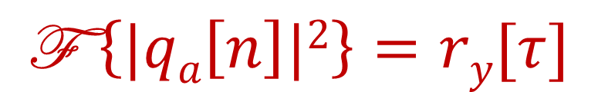
AR Model of Hilbert Envelopes
We have shown -
$$Qa[k]\text{ = }\text{F} \left\{qa\left[n\right]\right\}=\hat{y[k]}$$
$$\text{F} \left\{|qa\left[n\right]|2\right\}=ry[τ]$$
Spectrum of
Hilbert env. for
even-sym. signal
Auto-correlation of DCT sequence

Slide 28

AR Model of Hilbert Envelopes
We have shown -
$$Qa[k]\text{ = }\text{F} \left\{qa\left[n\right]\right\}=\hat{y[k]}$$
$$\text{F} \left\{|qa\left[n\right]|2\right\}=ry[τ]$$
Hilb. env. of
even-symm.
signal
$$\text{F}$$
Auto-corr. of
DCT

Slide 29

AR Model of Hilbert Envelopes
We have shown -
$$Qa[k]\text{ = }\text{F} \left\{qa\left[n\right]\right\}=\hat{y[k]}$$
$$\text{F} \left\{|qa\left[n\right]|2\right\}=ry[τ]$$
AR model of
Hilb. env.
$$\text{LP}$$
Auto-corr. of
DCT

Slide 30
LP in Time and Frequency
LP
Time
Power
Spec.
"F"
Duality

Slide 31
LP in Time and Frequency
LP
Time
Power
Spec.
"F"
Duality
DCT
Hilb.
Env.
"F"
Duality
LP

Slide 32
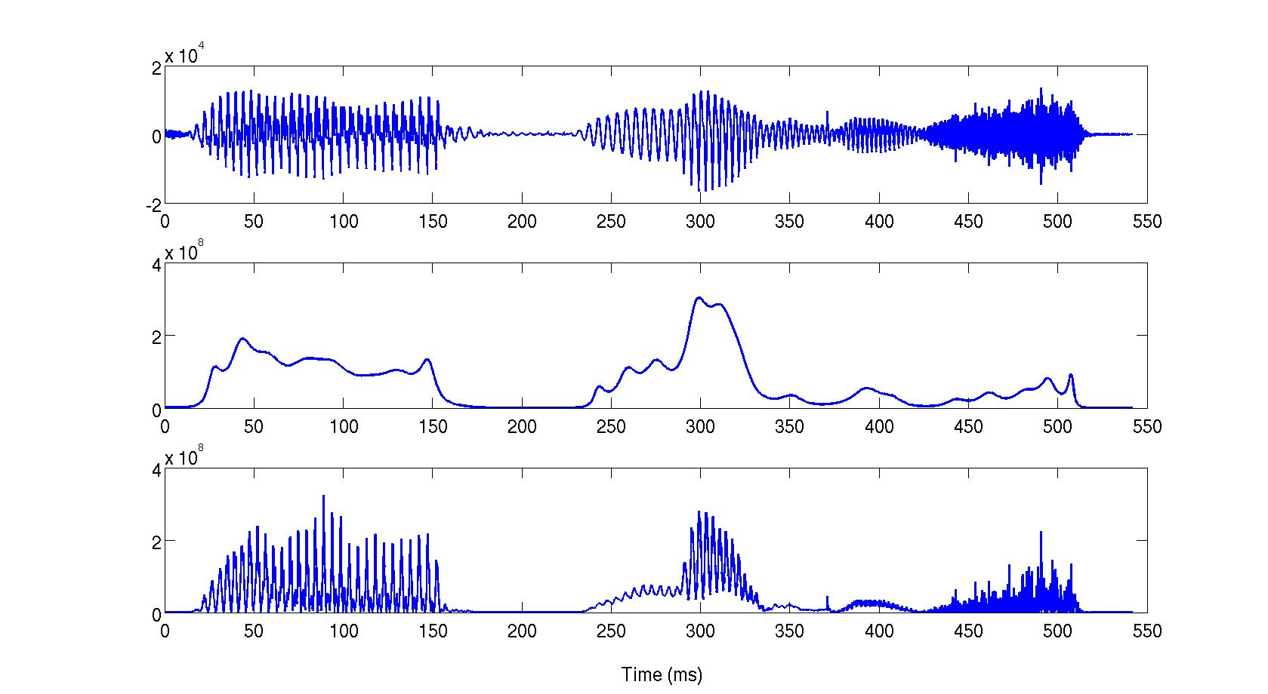
FDLP
Linear prediction on the cosine transform of the signal
Speech
FDLP Env.
Hilb. Env.

Slide 33
FDLP
Linear prediction on the cosine transform of the signal
DCT
LP
FDLP Env.
Hilb. Env.

Slide 34
FDLP
Linear prediction on the cosine transform of the signal
DCT
LP
Hilb. Env.

Slide 35
FDLP
Linear prediction on the cosine transform of the signal
Speech
FDLP Env.
Hilb. Env.

Slide 36
FDLP for Speech Representation
DCT

Slide 37
FDLP for Speech Representation
DCT

Slide 38
FDLP for Speech Representation
LP
DCT

Slide 39
FDLP for Speech Representation
LP
DCT

Slide 40
FDLP for Speech Representation
LP
DCT

Slide 41
FDLP for Speech Representation
FDLP
Spectrogram
Freq.
Time

Slide 42
FDLP for Speech Representation
FDLP
Spectrogram
Conventional
Approaches
Freq.
Time
Freq.
Time

Slide 43
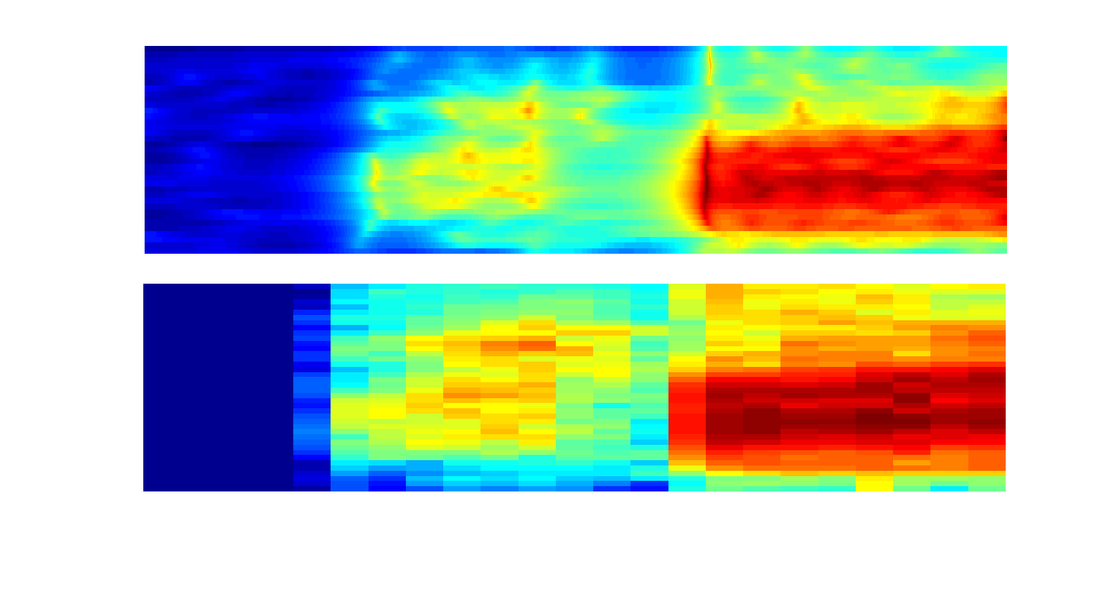
FDLP versus Mel Spectrogram
FDLP
Mel
Sriram Ganapathy, Samuel Thomas and H. Hermansky, “Comparison of Modulation Frequency Features for Speech Recognition", ICASSP, 2010.

Slide 44
Overview
Introduction
AR Model of Hilbert Envelopes
FDLP and its Properties
Applications
Summary

Slide 45
Overview
Introduction
AR Model of Hilbert Envelopes
FDLP and its Properties
Applications
Summary

Slide 46
Resolution of FDLP Analysis
FDLP
Sig.
FDLP Env.
Mel

Slide 47
Resolution of FDLP Analysis
FDLP
Sig.
Sig.
FDLP Env.
FDLP Env.
Mel
Res. = (Critical Width)⁻¹

Slide 48
Resolution of FDLP Analysis
FDLP
Mel

Slide 49
Properties of FDLP Analysis
Summarizing the gross temporal variation with a few parameters
Model order of FDLP controls the degree of smoothness.
AR model captures perceptually important high energy regions of the signal.
Suppressing reverberation artifacts
Reverberation is a long-term convolutive distortion.
Analysis in long-term windows and narrow sub-bands.
FDLP
Mel

Slide 50
Properties of FDLP Analysis
Summarizing the gross temporal variation with a few parameters
Model order of FDLP controls the degree of smoothness.
AR model captures perceptually important high energy regions of the signal.
Suppressing reverberation artifacts
Reverberation is a long-term convolutive distortion.
Analysis in long-term windows and narrow sub-bands.
FDLP
Mel

Slide 51
Reverberation
When speech is corrupted with convolutive distortion like room reverberation
Clean
Speech
Room
Response
Revb.
Speech
*
=

Slide 52
Reverberation
When speech is corrupted with convolutive distortion like room reverberation
In the long-term DFT domain, this translates
Clean
Speech
Room
Response
Revb.
Speech
*
=
Clean
DFT
x
Response
DFT
Revb.
DFT
=

Slide 53
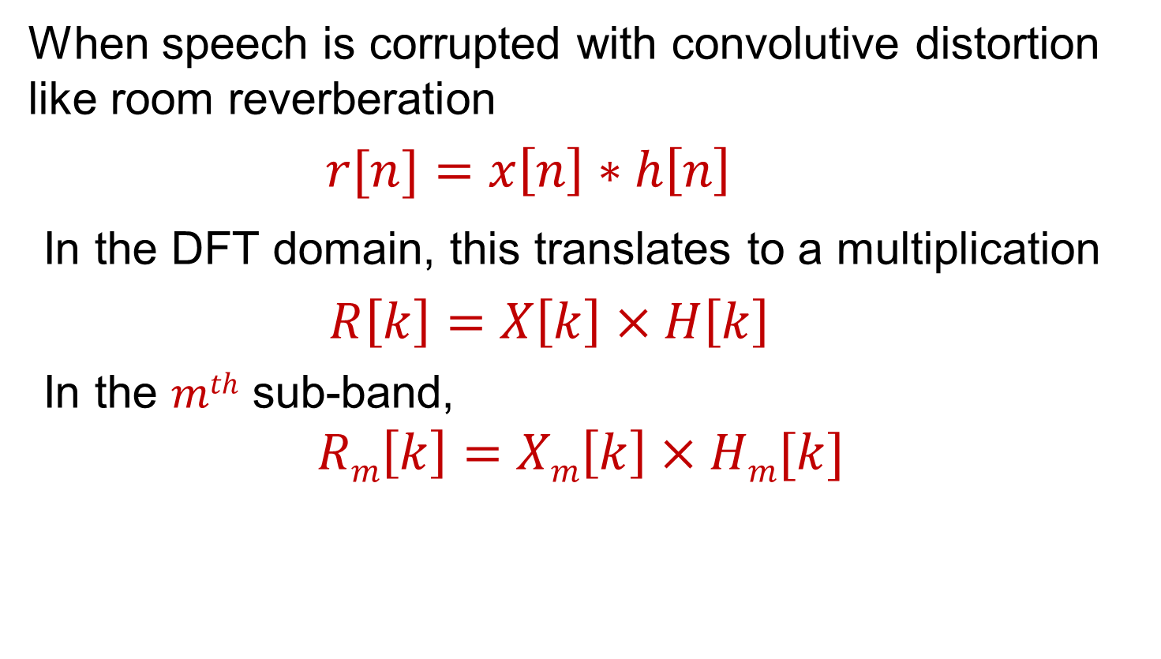
Reverberation
When speech is corrupted with convolutive distortion like room reverberation
$r[n]=x\left[n\right]∗h\left[n\right]$
In the DFT domain, this translates to a multiplication
$R\left[k\right]=X\left[k\right]×H\left[k\right]$
In the $mth$ sub-band,
$$Rm\left[k\right]=Xm\left[k\right]×Hm[k]$$

Slide 54
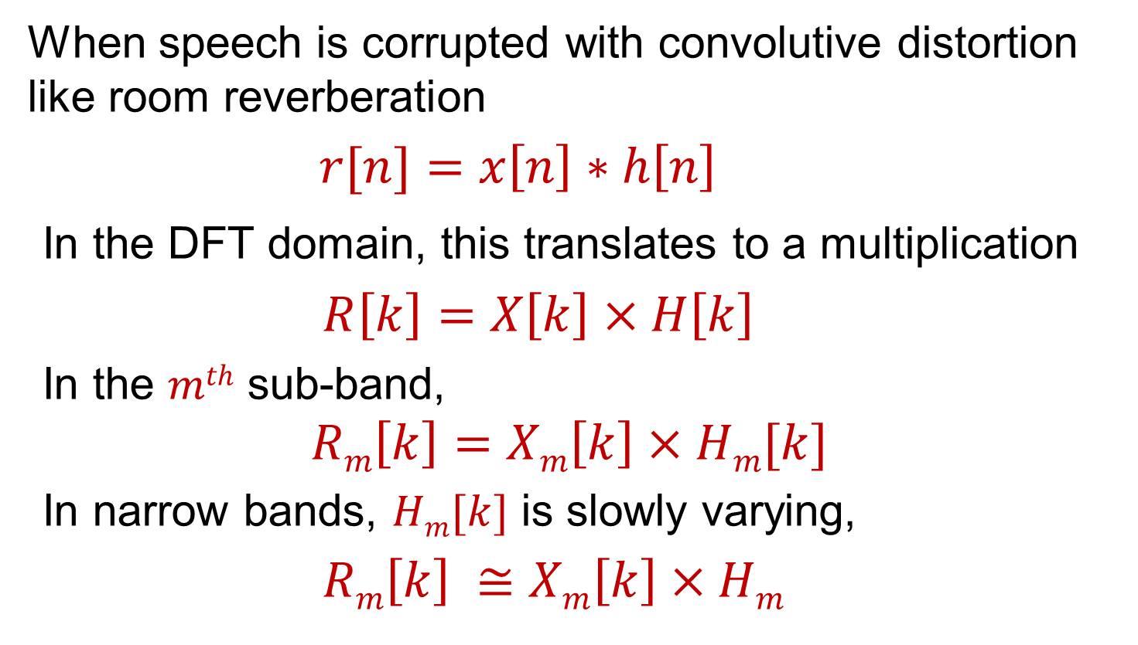
Reverberation
When speech is corrupted with convolutive distortion like room reverberation
$r[n]=x\left[n\right]∗h\left[n\right]$
In the DFT domain, this translates to a multiplication
$R\left[k\right]=X\left[k\right]×H\left[k\right]$
In the $mth$ sub-band,
$$Rm\left[k\right]=Xm\left[k\right]×Hm[k]$$
In narrow bands, $Hm[k]$ is slowly varying,
$Rm\left[k\right] ≅Xm\left[k\right]×Hm$

Slide 55
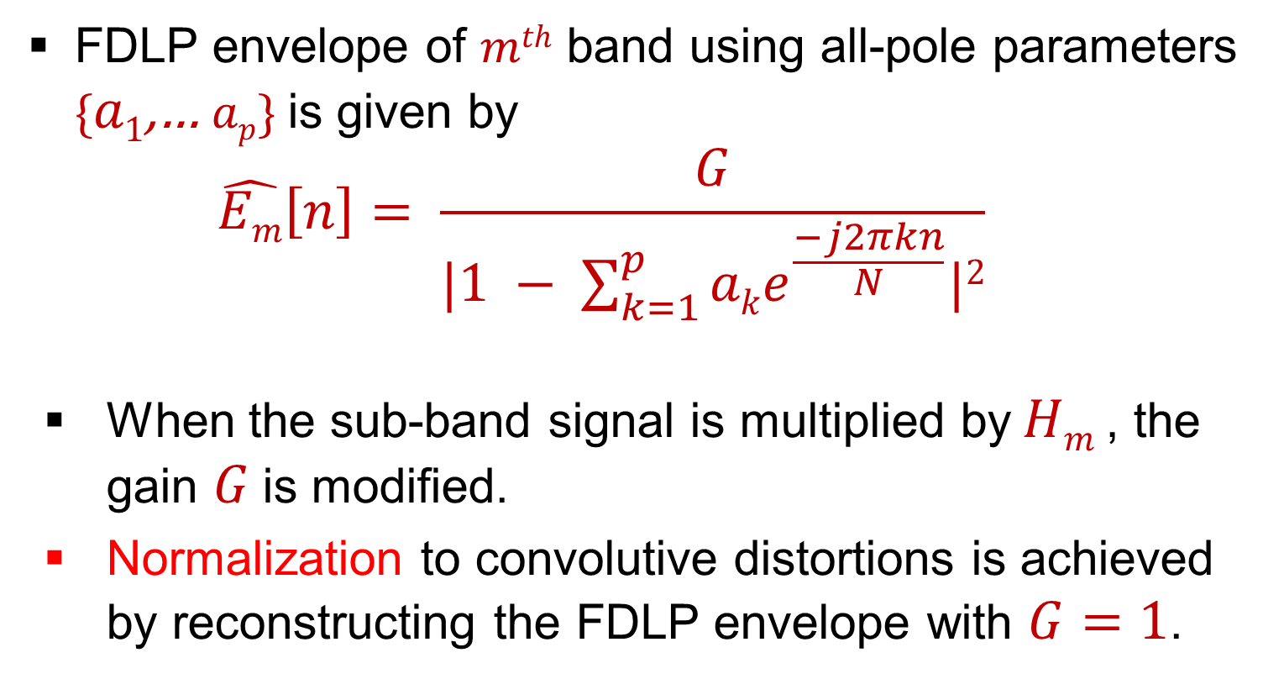
Gain Normalization in FDLP
FDLP envelope of $mth$ band using all-pole parameters {$a1$,… $ap$} is given by
$$\hat{Em}\left[n\right]= \frac{G}{|1 − \sum_{k=1}^{p}{ake^{\frac{−j2πkn}{N}}|2}}$$
When the sub-band signal is multiplied by$Hm$ , the gain $G$is modified.
Normalization to convolutive distortions is achieved by reconstructing the FDLP envelope with $G=1$.

Slide 56
Gain Normalization in FDLP
Without gain norm.
With gain norm.
S. Thomas, S. Ganapathy and H. Hermansky, “Recognition of Reverberant Speech Using FDLP", IEEE Signal Proc. Letters, 2008.

Slide 57
Overview
Introduction
AR Model of Hilbert Envelopes
FDLP and its Properties
Applications
Summary

Slide 58
Overview
Introduction
AR Model of Hilbert Envelopes
FDLP and its Properties
Applications
Summary

Slide 59
Outline of Applications
Short-term Features for Speaker & Speech Recog.
Sub-band
Decomposition
Gain
Norm.
AM
Input
FDLP
Modulation Features for Phoneme Recog.
Signal
Quant.
Wide-band Speech & Audio Coding
FM
S. Ganapathy, S. Thomas, P. Motlicek and H. Hermansky, “Applications of Signal Analysis Using Autoregressive Models of Amplitude Modulation", IEEE WASPAA, Oct. 2009.

Slide 60
Short-term Features
Short-term Features for Speaker & Speech Recog.
Sub-band
Decomposition
Gain
Norm.
AM
Input
FDLP
Modulation Features for Phoneme Recog.
Signal
Quant.
Wide-band Speech & Audio Coding
FM

Slide 61
Short-term Features
Sub-band
Window
Energy
Int.
Input
DCT
FDLP
Gain
Norm.
Log+
DCT
Feat.

Slide 62
Short-term Features
Sub-band
Window
Energy
Int.
Input
DCT
FDLP
Gain
Norm.
Log+
DCT
Feat.
Envelopes in each band are integrated along time (25 ms with a shift of 10 ms).
Integration in frequency axis to convert to mel scale.

Slide 63
Short-term Features
Sub-band
Window
Energy
Int.
Input
DCT
FDLP
Gain
Norm.
Log+
DCT
Feat.
Sub-band energies are converted to cepstral coefficients by applying log and DCT along frequency axis.
Delta and acceleration coefficients are appended to obtain 39 dim. feat similar to conventional MFCC feat.

Slide 64
Speech Recognition
TIDIGITS Database (8 kHz)
Clean training data, test data can be clean or naturally reverberated.
HMM-GMM system
Whole-word HMM models trained on clean speech.
Performance in terms of word error rate (WER).
Features
PLP features with cepstral mean subtraction (CMS).
Long term log spectral subtraction (LTLSS) [Gelbart, 2002]
FDLP short-term (FDLP-S) features – 39 dim.

Slide 65
Speech Recognition
S. Thomas, S. Ganapathy and H. Hermansky, “Recognition of Reverberant Speech Using FDLP", IEEE, Signal Proc. Letters, 2008.

Slide 66
Speaker Verification
NIST 2008 Speaker recognition evaluation (SRE)
Has telephone speech and far-field speech.
GMM-UBM system
Trained on a large set of development speakers.
Adapted on the enrollment data from the target speaker.
Nuisance attribute projection (NAP) on supervectors.
Detection cost function (DCF) = 0.99 P_{fa} + 0.1 P_{miss}
Features with warping [Pelecanos, 2001].
Mel Frequency Cepstral Coefficients (MFCCs)
FDLP short-term (FDLP-S) features.

Slide 67
Speaker Verification
S. Ganapathy, J. Pelecanos and M. Omar, “Feature Normalization for Speaker Verification in Room Reverberation", ICASSP, 2011.

Slide 68
Outline of Applications
Short-term Features for Speaker & Speech Recog.
Sub-band
Decomposition
Gain
Norm.
AM
Input
FDLP
Modulation Features for Phoneme Recog.
Signal
Quant.
Wide-band Speech & Audio Coding
FM

Slide 69
Modulation Features
Short-term Features for Speaker & Speech Recog.
Sub-band
Decomposition
Gain
Norm.
AM
Input
FDLP
Modulation Features for Phoneme Recog.
Signal
Quant.
Wide-band Speech & Audio Coding
FM

Slide 70
Modulation Feature Extraction
Critical-band
Window
DCT
Static
Input
DCT
FDLP
Sub-
band
Feat.
DCT
Dynamic
200ms

Slide 71
Modulation Feature Extraction
Critical-band
Window
DCT
Static
Input
DCT
FDLP
Sub-
band
Feat.
DCT
Dynamic
200ms
Static compression is a logarithm – reduce the huge dynamic range in the in the sub-band envelope.

Slide 72
Modulation Feature Extraction
Critical-band
Window
DCT
Static
Input
DCT
FDLP
Sub-
band
Feat.
DCT
Dynamic
200ms
Dynamic compression is implemented by dynamic compression loops consisting of dividers and low pass filters [Kollmeier, 1999].
.

Slide 73
Modulation Feature Extraction
Critical-band
Window
DCT
Static
Input
DCT
FDLP
Sub-
band
Feat.
DCT
Dynamic
200ms
Compressed sub-band envelopes are DCT transformed to obtain modulation frequency components
14 static and dynamic modulation spectra (0-35 Hz) with 17 sub-bands, gets a feature of 476 dim.

Slide 74
Phoneme Recognition
TIMIT Database (8 kHz)
Clean training data, test data can be clean, additive noise, reverberated or telephone channel.
Multi-layer perceptron (MLP) based system
MLPs estimate phoneme posteriors
Hidden Markov model (HMM) – MLP hybrid model.
Performance in phoneme error rate (PER).
Features
Perceptual linear prediction (PLP) - 9 frame context.
Advanced ETSI standard [ETSI,2002] – 9 frame context.
FDLP modulation (FDLP-M) features – 476 dim.

Slide 75
Phoneme Recognition
S. Ganapathy, S. Thomas and H. Hermansky, “Temporal Envelope Compensation for Robust Phoneme Recognition Using Modulation Spectrum", JASA, 2010..

Slide 76
Outline of Applications
Short-term Features for Speaker & Speech Recog.
Sub-band
Decomposition
Gain
Norm.
AM
Input
FDLP
Modulation Features for Phoneme Recog.
Signal
Quant.
Wide-band Speech & Audio Coding
FM

Slide 77
Audio Coding
Short-term Features for Speaker & Speech Recog.
Sub-band
Decomposition
Gain
Norm.
AM
Input
FDLP
Modulation Features for Phoneme Recog.
Signal
Quant.
Wide-band Speech & Audio Coding
FM

Slide 78
Audio Coding
1
1
QMF
Analysis
QMF
Synthesis
Env.
Input
FDLP
Q
Q⁻¹
Mul.
Output
Carr.
MDCT
Q
Q⁻¹
IMDCT
32
32
Sriram Ganapathy, Petr Motlicek and H. Hermansky, “Autoregressive Modeling of Hilbert Envelopes for Wide-band Audio Coding", AES 124th Convention, Audio Engineering Society, May 2008.

Slide 79
Subjective Evaluations
S. Ganapathy, P. Motlicek, and H. Hermansky, “AR Models of Amplitude Modulation in Audio Compression", IEEE Transactions on Audio, Speech and Language Proc., 2010..

Slide 80
Overview
Introduction
AR Model of Hilbert Envelopes
FDLP and its Properties
Applications
Summary

Slide 81
Overview
Introduction
AR Model of Hilbert Envelopes
FDLP and its Properties
Applications
Summary

Slide 82
Summary
Employing AR modeling for estimating amplitude modulations.
Long-term temporal analysis of signals forms an efficient alternative to conventional short-term spectrum.
Provides AM-FM decomposition in sub-bands and acts as unified model for speech and audio signals.

Slide 83
Summary
Employing AR modeling for estimating amplitude modulations.
Long-term temporal analysis of signals forms an efficient alternative to conventional short-term spectrum.
Provides AM-FM decomposition in sub-bands and acts as unified model for speech and audio signals.

Slide 84
Summary
Employing AR modeling for estimating amplitude modulations.
Long-term temporal analysis of signals forms an efficient alternative to conventional short-term spectrum.
Provides AM-FM decomposition in sub-bands and acts as unified model for speech and audio signals.

Slide 85
Our Contributions
Simple mathematical analysis for AR model of Hilbert envelopes.
Investigating the resolution properties of FDLP.
Gain normalization of FDLP Envelopes

Slide 86
Our Contributions
Simple mathematical analysis for AR model of Hilbert envelopes.
Investigating the resolution properties of FDLP.
Gain normalization of FDLP Envelopes

Slide 87
Our Contributions
Simple mathematical analysis for AR model of Hilbert envelopes.
Investigating the resolution properties of FDLP.
Gain normalization of FDLP Envelopes

Slide 88
Our Contributions
Short-term feature extraction using FDLP –Improvements in reverb speech recog.
Modulation feature extraction – Phoneme recognition in noisy speech.
Speech and audio codec development using AM-FM signals from FDLP.

Slide 89
Our Contributions
Short-term feature extraction using FDLP –Improvements in reverb speech recog.
Modulation feature extraction – Phoneme recognition in noisy speech.
Speech and audio codec development using AM-FM signals from FDLP.

Slide 90
Our Contributions
Short-term feature extraction using FDLP –Improvements in reverb speech recog.
Modulation feature extraction – Phoneme recognition in noisy speech.
Speech and audio codec development using AM-FM signals from FDLP.

Slide 91
Acknowledgements
Lab Buddies – Samuel Thomas, Sivaram Garimella, Padmanbhan Rajan, Harish Mallidi, Vijay Peddinti, Thomas Janu, Aren Jansen.
Idiap personnel – Petr Motlicek, Joel Pinto, Mathew Doss.
IBM personnel – Jason Pelecanos, Mohamed Omar
Others – Xinhui Zhou, Daniel Romero, Marios Athineos, David Gelbart, Harinath Garudadri.

Slide 92
Thank You

Slide 93
Evidences
Physiological evidences -
Spectro-temporal receptive fields [Shamma et.al. 2001]
Psycho-physical evidences -
Perceptual importance of modulation frequencies [Drullman et al. 1994].
Syllable recognition from temporal modulations with minimal spectral cues [Shannon et al., 1995].

Slide 94
Evidences
Physiological evidences -
Spectro-temporal receptive fields [Shamma et.al. 2001].
Psycho-physical evidences -
Perceptual importance of modulation frequencies [Drullman et al. 1994].
Syllable recognition from temporal modulations with minimal spectral cues [Shannon et al., 1995].

Slide 95
Applications
Modulation spectra has been used in the past
Speech intelligibility [Houtgast et al, 1980].
RASTA processing [Hermansky et al, 1994].
Speech recognition [Kingsbury et al, 1998].
AM-FM decomposition [Kumaresan et al, 1999].
Sound texture modeling [Athineos et al, 2003].
Sound source separation [King et al, 2010].

Slide 96
Linear Prediction – Time Domain
Current sample expressed as a linear combination of past samples
n-3
n-2
n-1
n
a₁
a₂
a₃

Slide 97
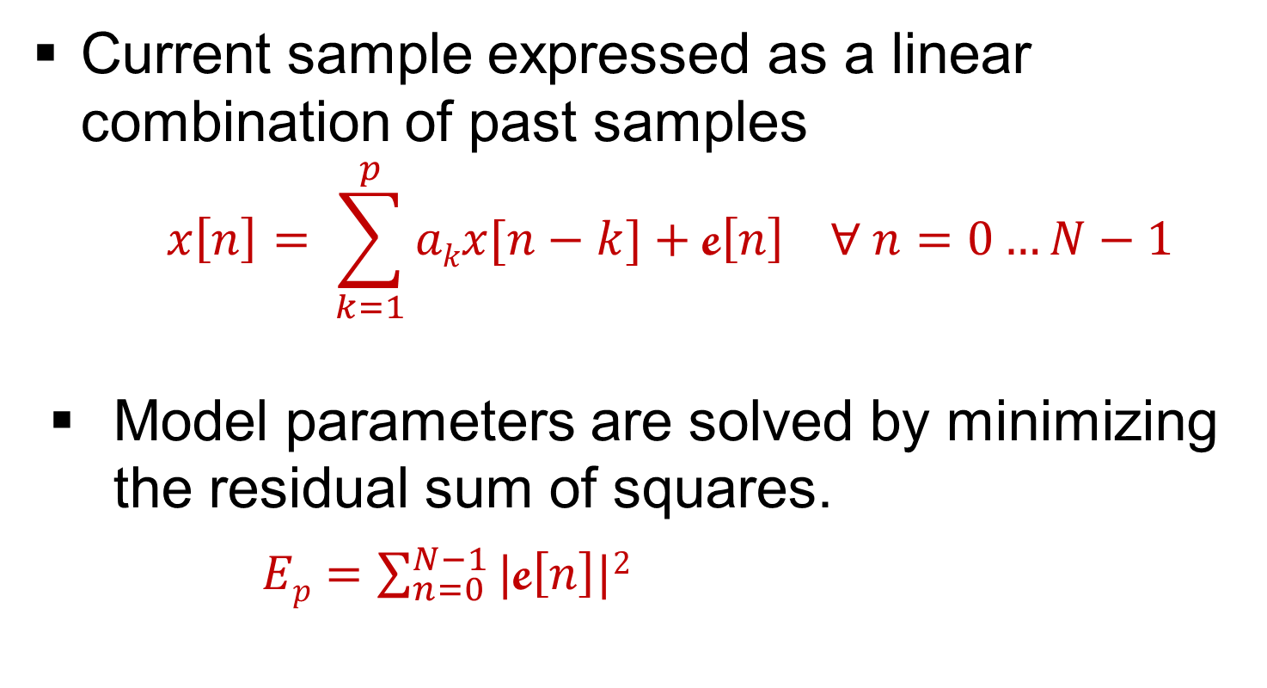
Linear Prediction – Time Domain
Current sample expressed as a linear combination of past samples
$$x\left[n\right]= \sum_{k=1}^{p}{akx[n−k]}+\text{e}\left[n\right] ∀ n=0…N−1$$
Model parameters are solved by minimizing the residual sum of squares.
$Ep=\sum_{n=0}^{N−1}{|\text{e}\left[n\right]|2}$

Slide 98
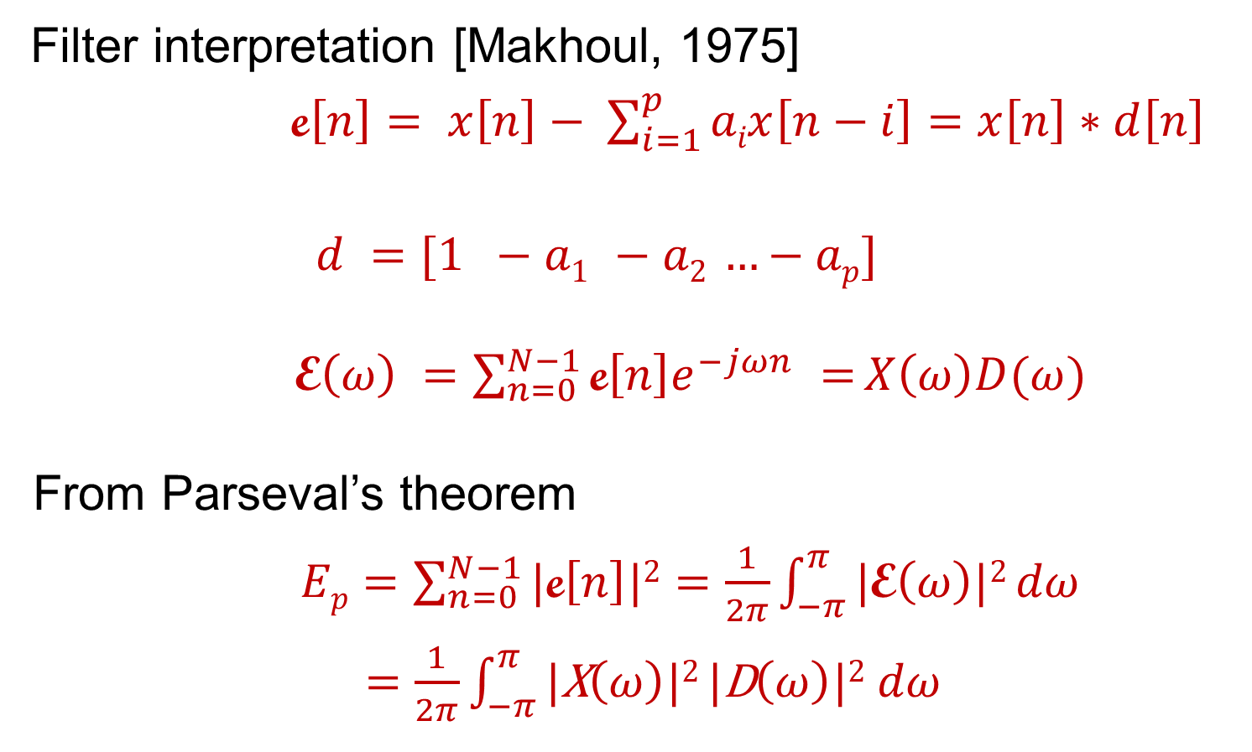
AR model of Power Spectrum
Filter interpretation [Makhoul, 1975]
$\text{e}\left[n\right]= x\left[n\right]− \sum_{i=1}^{p}{aix\left[n−i\right]}=$ $x\left[n\right]∗d\left[n\right]$
$$d =[1 −a1 −a2 …−ap]$$
$\text{E}\left(ω\right) =\sum_{n=0}^{N−1}{\text{e}\left[n\right]e^{−jωn} =}X\left(ω\right)D(ω)$
From Parseval’s theorem
$Ep=\sum_{n=0}^{N−1}{|\text{e}\left[n\right]|2}=\frac{1}{2π}\int_{−π}^{π}{\text{|}\text{E}\left(ω\right)|2}dω$
$=\frac{1}{2π}\int_{−π}^{π}{\text{|}\text{X}\left(ω\right)|2 |\text{D}\left(ω\right)|2}$ $dω$

Slide 99
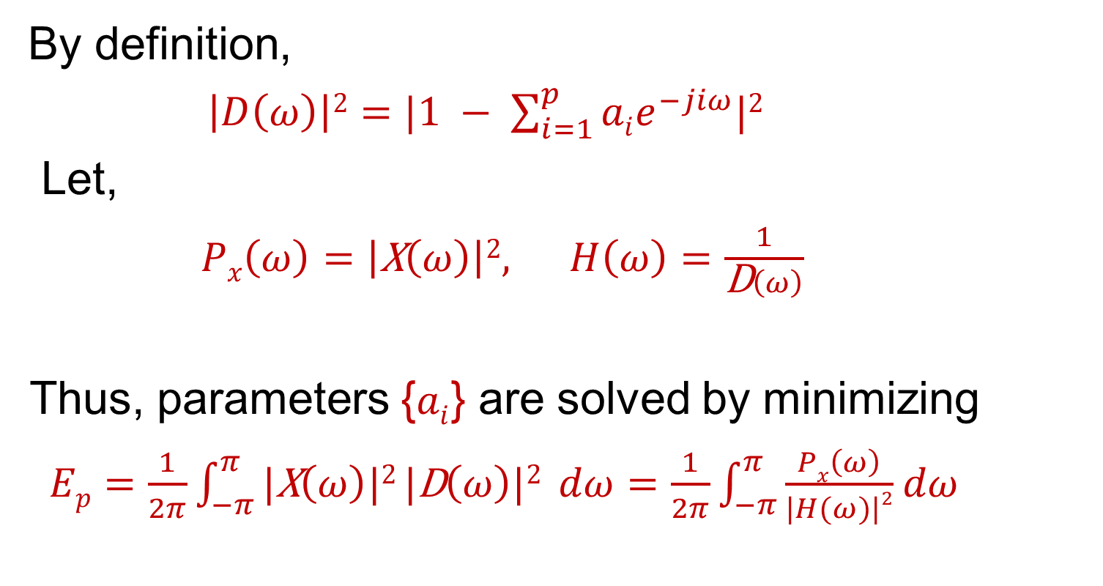
AR model of Power Spectrum
By definition,
$\left|D\left(ω\right)\right|2=|1 − \sum_{i=1}^{p}{aie^{−jiω}|2}$
Let,
$Px\left(ω\right)=\left|\text{X}\left(ω\right)\right|2, H\left(ω\right)=\frac{1}{\text{D}\left(ω\right)}$
Thus, parameters {$ai$} are solved by minimizing
$Ep=\frac{1}{2π}\int_{−π}^{π}{\text{|}\text{X}\left(ω\right)|2 |\text{D}\left(ω\right)|2} dω=\frac{1}{2π}\int_{−π}^{π}{\frac{Px\left(ω\right)}{|H(ω)|2}}$ $dω$

Slide 100
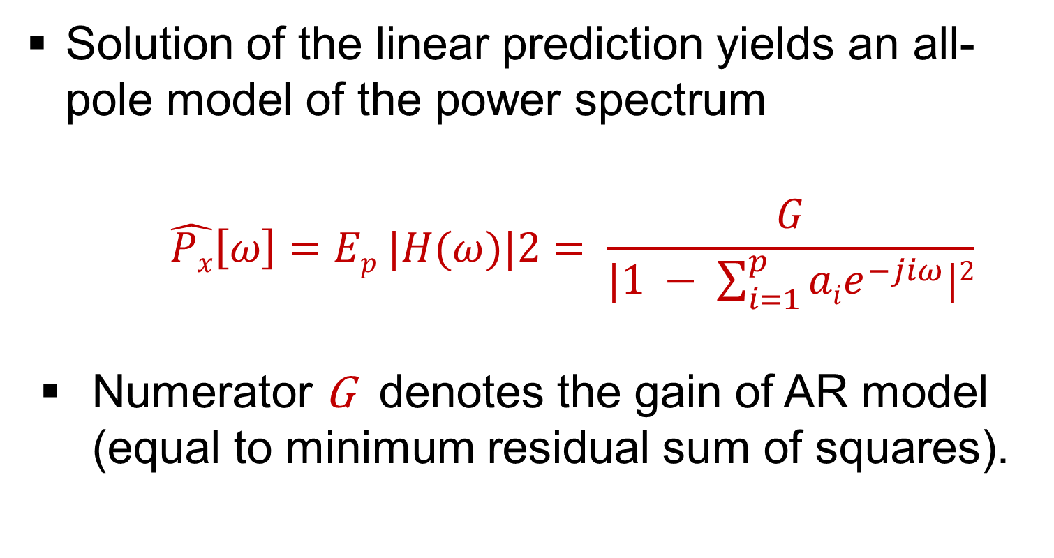
AR model of Power Spectrum
Solution of the linear prediction yields an all-pole model of the power spectrum
$$\hat{Px}\left[ω\right]=Ep |H(ω)|2= \frac{G}{|1 − \sum_{i=1}^{p}{aie^{−jiω}|2}}$$
Numerator G denotes the gain of AR model (equal to minimum residual sum of squares).

Slide 101
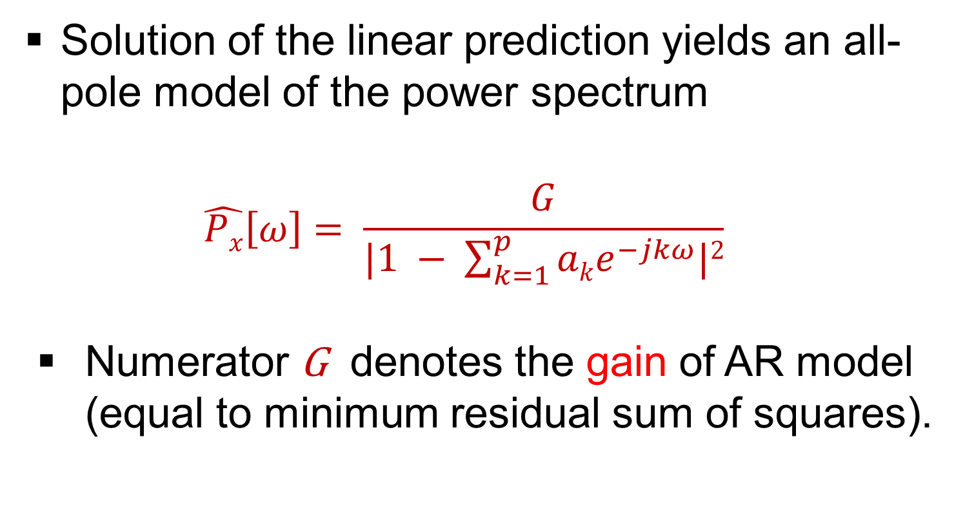
AR model of Power Spectrum
Solution of the linear prediction yields an all-pole model of the power spectrum
$$\hat{Px}\left[ω\right]= \frac{G}{|1 − \sum_{k=1}^{p}{ake^{−jkω}|2}}$$
Numerator G denotes the gain of AR model (equal to minimum residual sum of squares).

Slide 102
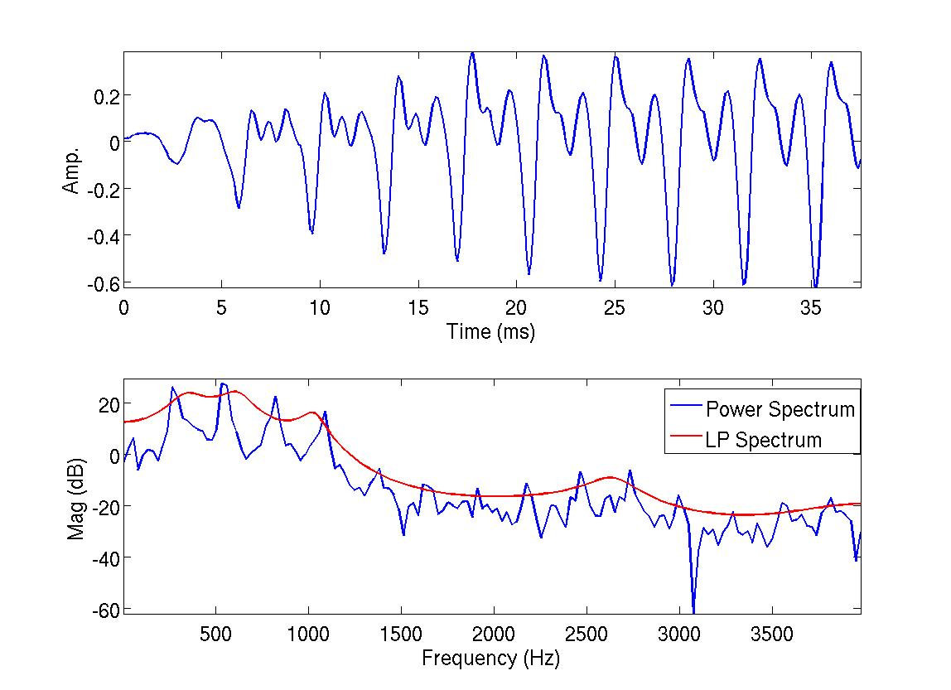
AR model of power spectrum

Slide 103
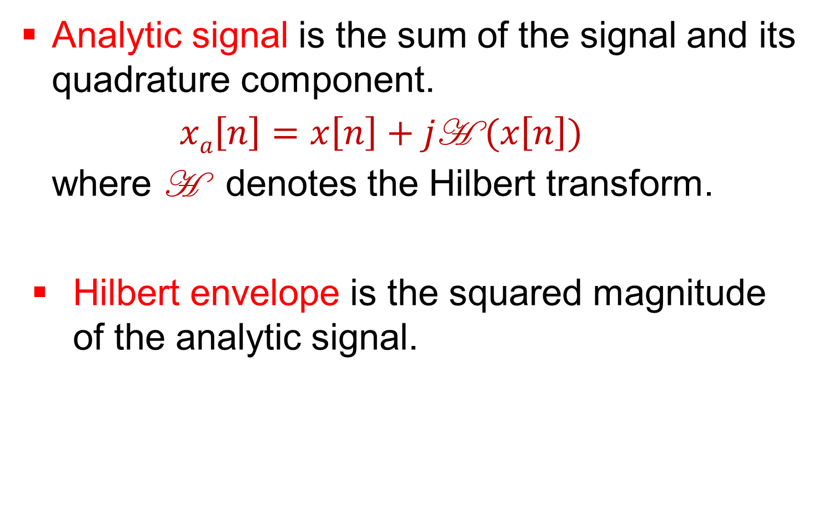
Hilbert Envelope - Definition
Analytic signal is the sum of the signal and its quadrature component.
$xa\left[n\right]=x\left[n\right]+j\text{H} (x\left[n\right])$
where H denotes the Hilbert transform.
Hilbert envelope is the squared magnitude of the analytic signal.

Slide 104
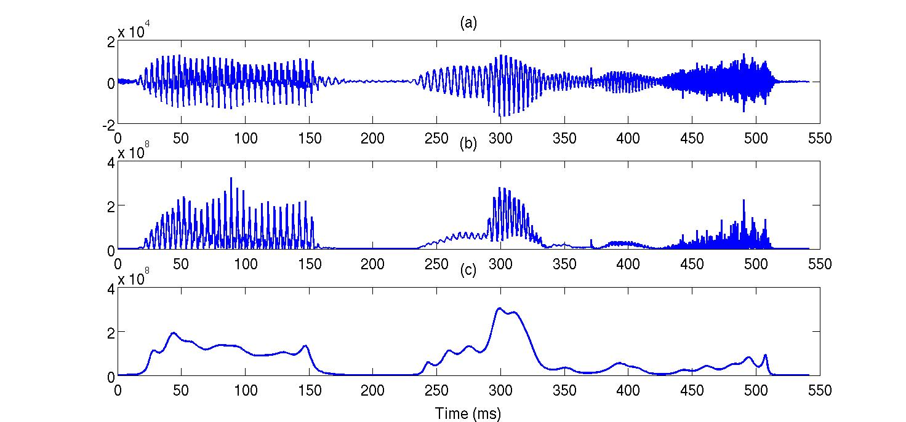
Hilbert Envelope
a. Speech
b. Hilb. Env.
c. FDLP Env.

Slide 105
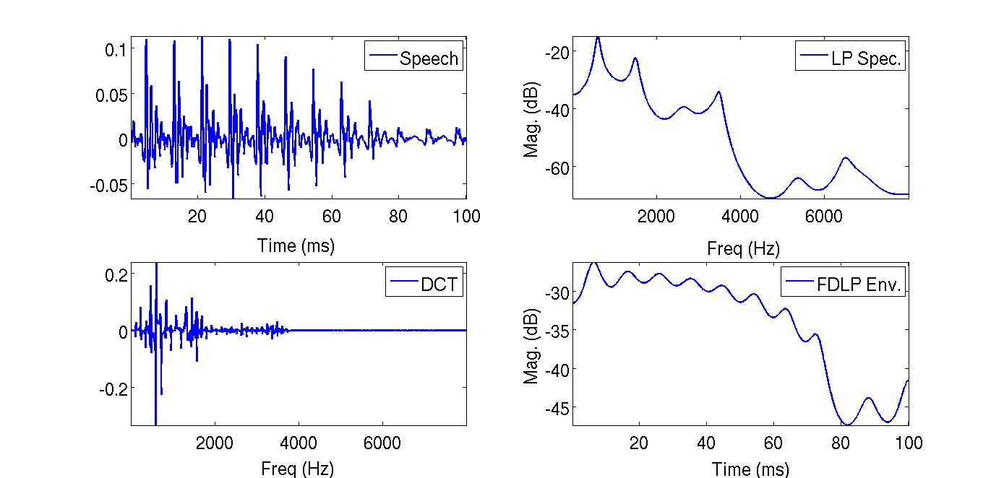
Duality
LP
FDLP

Slide 106
LP in Time and Frequency

Slide 107
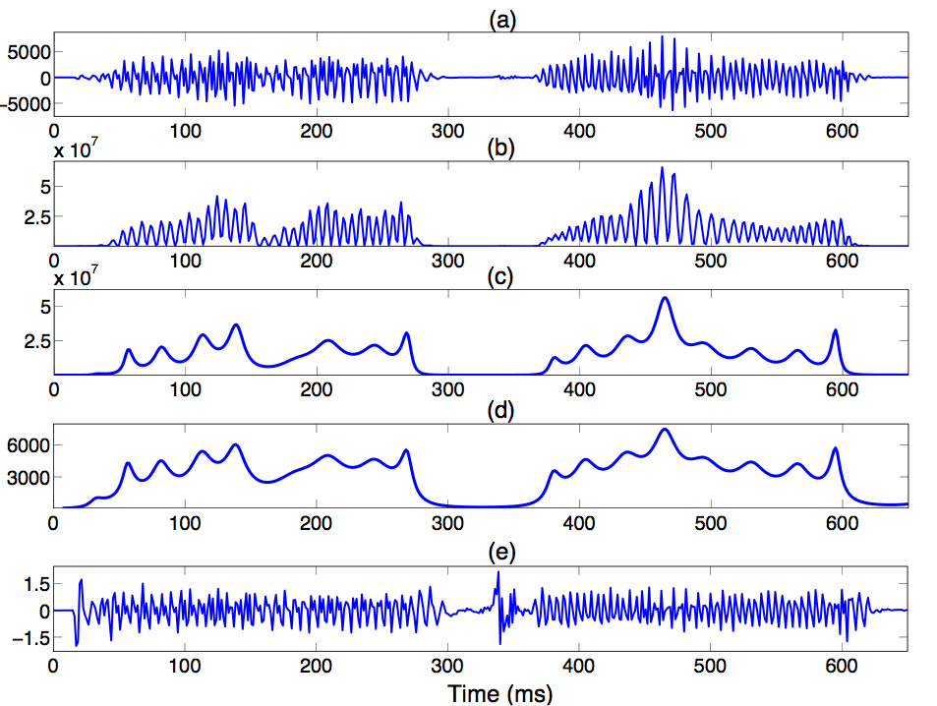
AM-FM Decomposition
Signal
Hilb. Env.
FDLP Env.
AM comp.
FM comp.

Slide 108
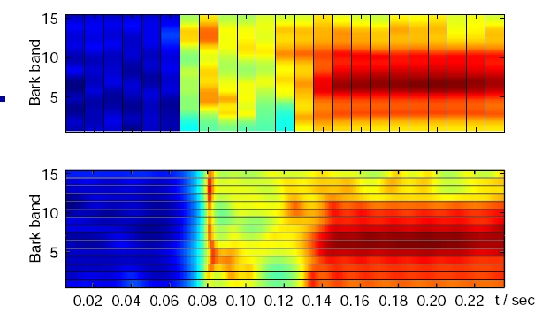
Spectrogram Comparison
PLP
FDLP
Sriram Ganapathy, Samuel Thomas and H. Hermansky, “Comparison of Modulation Frequency Features for Speech Recognition", ICASSP, 2010.

Slide 109
Dealing with Convolutive Distortions
Cepstral mean subtraction (CMS), long-term log spectral subtraction (LTLSS) & gain normalization
CMS assumes distortion in neighboring frames to be similar – suppresses short-term artifacts.
Long-term subtraction deals with reverberation assuming over the same response over a window of long-term frames [Gelbart, 2002].
Gain normalization deals with short and long term distortions within a single long-term frame.

Slide 110
Dealing with Convolutive Distortions
Cepstral mean subtraction (CMS), long-term log spectral subtraction (LTLSS) & gain normalization
CMS assumes distortion in neighboring frames to be similar – suppresses short-term artifacts.
Long-term subtraction deals with reverberation assuming over the same response over a window of long-term frames [Gelbart, 2002].
Gain normalization deals with short and long term distortions within a single long-term frame.

Slide 111
Dealing with Convolutive Distortions
Cepstral mean subtraction (CMS), long-term log spectral subtraction (LTLSS) & gain normalization
CMS assumes distortion in neighboring frames to be similar – suppresses short-term artifacts.
Long-term subtraction deals with reverberation assuming over the same response over a window of long-term frames [Gelbart, 2002].
Gain normalization deals with short and long term distortions within a single long-term frame.

Slide 112
Dealing with Convolutive Distortions
Cepstral mean subtraction (CMS), long-term log spectral subtraction (LTLSS) & gain normalization
CMS assumes distortion in neighboring frames to be similar – suppresses short-term artifacts.
Long-term subtraction deals with reverberation assuming over the same response over a window of long-term frames [Gelbart, 2002].
Gain normalization deals with short and long term distortions within a single long-term frame.

Slide 113
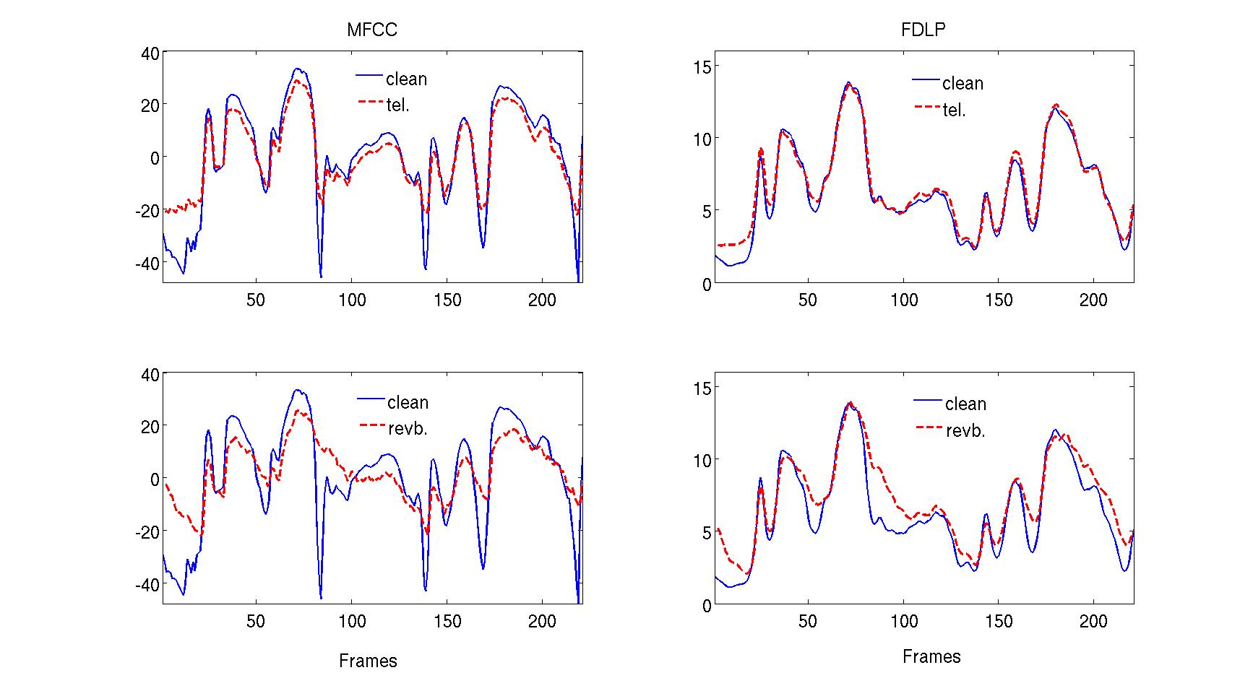
Feature Comparison

Slide 114
Modulation Feature Extraction
Critical-band
Window
DCT
Static
Input
DCT
FDLP
Sub-
band
Feat.
DCT
Dynamic
200ms

Slide 115
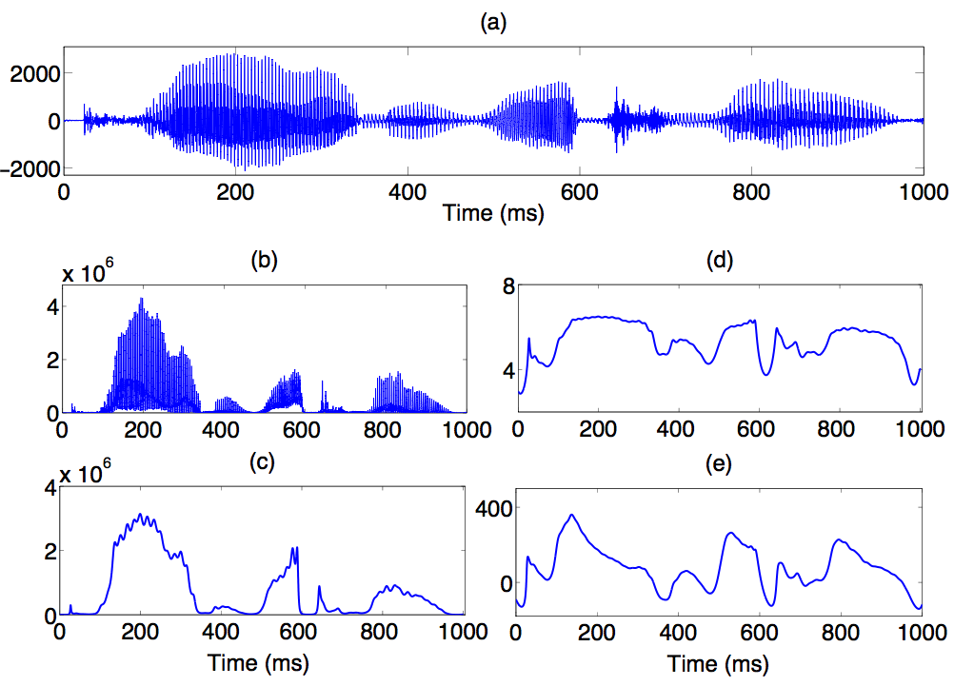
Modulation Features
Signal
Hilb. Env.
FDLP Env.
Log comp.
Dyn. comp.
Sriram Ganapathy, Samuel Thomas and H. Hermansky, “Modulation Frequency Features for Phoneme Recognition in Noisy Speech", JASA, Express Letters, 2009.

Slide 116
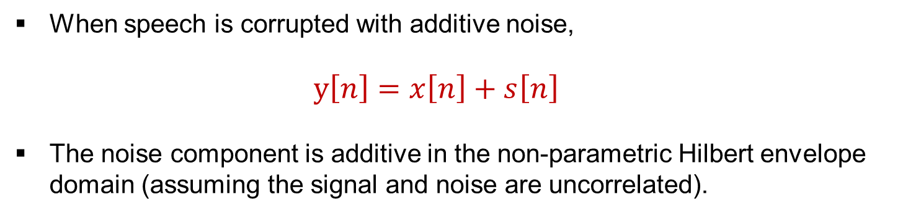
Noise Compensation in FDLP
Critical-band
Window
Signal
+
Noise
IDFT
| |²
DFT
Linear
Pred..
FDLP
DCT
Env.
When speech is corrupted with additive noise,
y$\left[n\right]=x\left[n\right]+s\left[n\right]$
The noise component is additive in the non-parametric Hilbert envelope domain (assuming the signal and noise are uncorrelated).

Slide 117
Noise Compensation in FDLP
Critical-band
Window
Input
DCT
IDFT
| |²
Wiener
Filtering
DFT
VAD
Voice activity detector (VAD) provides information about the non-speech regions which are used for estimating the temporal envelope of the noise.
Noise subtraction tries to subtract the estimate the noise envelope from the noisy speech envelope.

Slide 118
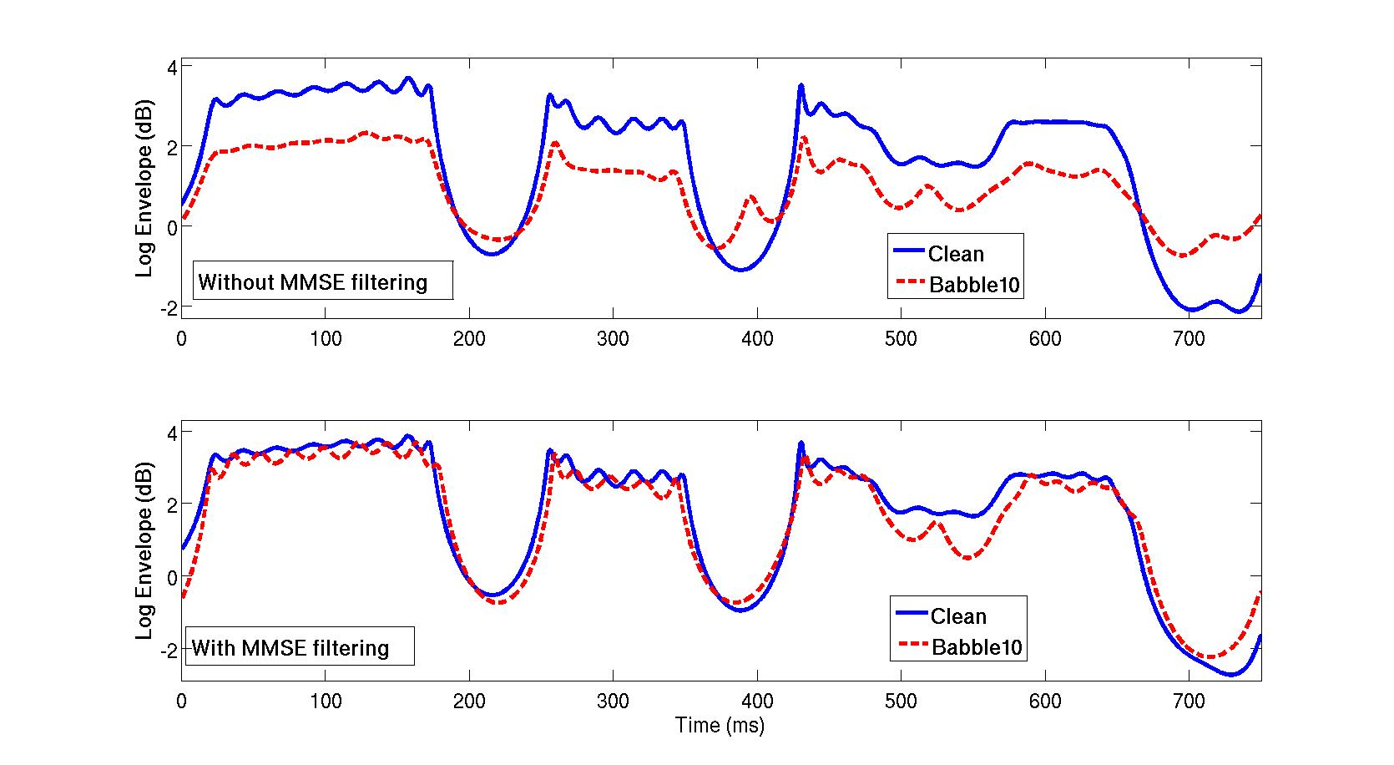
Noise Compensation in FDLP
S. Ganapathy, S. Thomas, and H. Hermansky, “Temporal Envelope Subtraction for Robust Speech Recognition using Modulation Spectrum", IEEE ASRU, 2009.

Slide 119
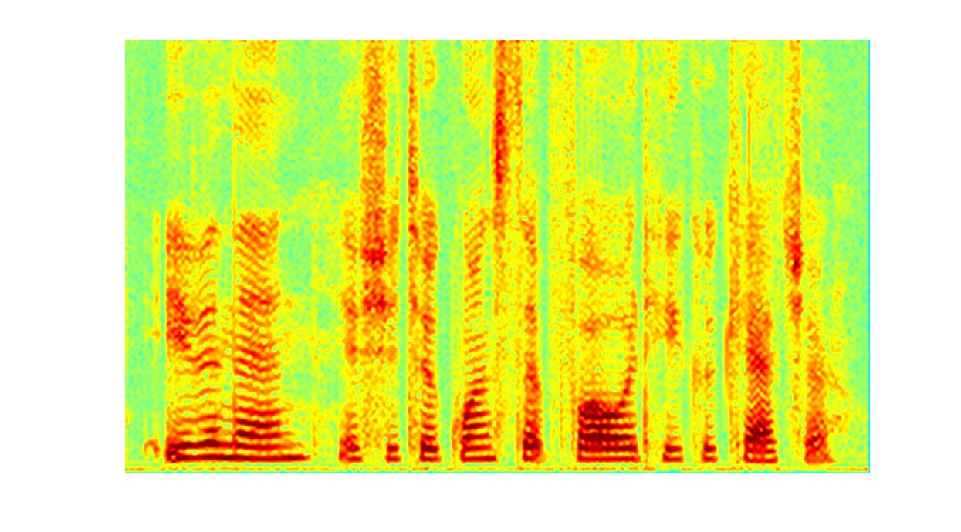
Introduction
Conventional signal analysis – starts with the estimation of short-term spectrum (10-40 ms).
Frequency
Time

Slide 120
Introduction
Conventional signal analysis – starts with the estimation of short-term spectrum (10-40 ms).
Spectrum is sampled at a preset rate before further modeling/processing stages.
Contextual information is typically processed with time-series models such as HMM.

Slide 121
Introduction
Conventional signal analysis – starts with the estimation of short-term spectrum (10-40 ms).
Spectrum is sampled at a preset rate before further modeling/processing stages.
Contextual information is typically processed with time-series models such as HMM.

