Slide 1
Understand the health indicators of human body and design a Diabetes Prediction Model (DPM)

Slide 2
Motivation
Diabetes is among the most prevalent chronic diseases In United states
Diabetes is a metabolic disease characterized by elevated levels of blood glucose
Over time, Diabetes leads serious damage to human body
Neuropathy
Diabetic Retinopathy
Cardiovascular Disease
Kidney Failure
Early diagnosis can lead to lifestyle changes and more effective treatment
Notes:
Explain each type of disease : I didn’t write detail here so u could speak

Slide 3
Food ~ Blood Glucose
Human body breaks down most of the food, we eat into sugar and releases in into your bloodstream
When our blood sugar goes up, it signals our pancreas to release insulin
Insulin acts like a key to let the blood sugar into our body’s cells for use as energy
When our blood sugar goes down, it signals our pancreas to release glucagon
Glucagon breaks down into glucose to maintain blood glucose level in our body

Slide 4
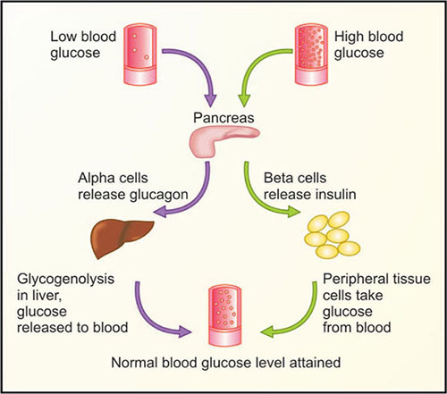
Blood Glucose Regulation
Notes:
Explain each type of disease : I didn’t write detail here so u could speak

Slide 5
Diabetes
Diabetes is a chronic health condition that affects how human body turns food into energy
If our pancreas isn’t functioning well, our body can’t use the insulin it makes, and our blood sugar levels get to high, which makes us Diabetic
There are three types of diabetes :
Type 1 diabetes
Type 2 diabetes
Gestational diabetes

Slide 6
Type 1 Diabetes
It is caused by an Autoimmune reaction which stops your body from making insulin
Approximately 5-10% of the people who have diabetes have type 1.
Signs and Symptoms :
Extreme thirst, Dry mouth, Frequent urination, Increased hunger (especially after eating) etc.

Slide 7
Type 2 diabetes
Type 2 diabetes is a disease in which your body doesn’t make enough of insulin
Insulin helps to carry glucose to your cells
When there’s problem with the insulin, glucose builds up in your blood and is called “high blood sugar”
Signs and Symptoms :
More thirst, More hunger, Dehydration, Hypoglycemia, Hyperglycemia etc.
Notes:
More thirst
More hunger
Dehydration
Hypoglycemia (if your blood sugar falls below 70 milligrams per deciliter).
Hyperglycemia (Blood sugar that goes above 180 to 200 mg/dl)
diabetic neuropathy

Slide 8
Gestational diabetes
Gestational diabetes is diabetes diagnosed for the first - time during pregnancy.
Gestational diabetes affects how your cells use glucose.
Gestational diabetes causes high blood sugar that can affect your pregnancy and your baby's health.
Signs and Symptoms :
Fatigue, Blurred vision, Nausea and vomiting, and Dry mouth etc.
Notes:
More thirst
More hunger
Dehydration
Hypoglycemia (if your blood sugar falls below 70 milligrams per deciliter).
Hyperglycemia (Blood sugar that goes above 180 to 200 mg/dl)
diabetic neuropathy

Slide 9
Prevalence
CDC estimates that 1 in 5 diabetics, and roughly 8 in 10 prediabetics are unaware of their risk
There are different types of diabetes:
Type I diabetes is mostly known as Juvenile diabetes or insulin diabetes, is known to be a chronic condition.
Type II diabetes is the most common form, and its prevalence varies by age, education, income, location, race, and other social determinants of health
The economic cost of diabetes is enormous;
Diagnosed diabetes costs around $327 billion yearly
The total cost of prediabetes and undiagnosed diabetes is close to $400 billion.
Notes:
Read : What is Type 1 and why known as Juvenile diabetes , why Type II is common

Slide 10
Diabetes Health Indicators dataset
This dataset contains 3 files:
diabetes_012_health_indicators_BRFSS2015.csv :
253,680 survey responses
This dataset has 21 feature variables and is imbalanced
3 classes :
0 is for no diabetes or only during pregnancy
1 is for prediabetes
2 is for diabetes.
Notes:
This Dataset was collected from females at the age of 21 year old from National Institute of Diabetes and Digestive and Kidney Disease.

Slide 11
Diabetes Health Indicators dataset
2. diabetes_binary_5050split_health_indicators_BRFSS2015.csv:
70,692 survey responses
50-50 split of respondents with no diabetes and with either prediabetes or diabetes
This dataset has 21 feature variables and is balanced (Perfect for Analysis => FileID2)
Notes:
This Dataset was collected from females at the age of 21 year old from National Institute of Diabetes and Digestive and Kidney Disease.

Slide 12
Diabetes Health Indicators dataset
3. diabetes _ binary _ health _ indicators _ BRFSS2015.csv:
253,680 survey responses
This dataset has 21 feature variables and is not balanced. (May Produce Biased Results :FileID3)
2 classes :
0 is for no diabetes
1 is for prediabetes or diabetes.
Notes:
This Dataset was collected from females at the age of 21 year old from National Institute of Diabetes and Digestive and Kidney Disease.

Slide 13
Health Indicators
Binary Health Markers :
* Diabetes * PhysActivity
* HighBP * HighChol
* CholCheck * Smoker
* Stroke * HeartDiseaseorAttack
* Fruits * Vegetables
* AnyHealthCare * DiffWalk
* Sex
Notes:
This Dataset was collected from females at the age of 21 year old from National Institute of Diabetes and Digestive and Kidney Disease.

Slide 14
Health Indicators
Non-binary Health Markers :
* BMI * GenHealth
* MentHealth * PhyHealth
* Age * Education
* Income
Notes:
This Dataset was collected from females at the age of 21 year old from National Institute of Diabetes and Digestive and Kidney Disease.

Slide 15
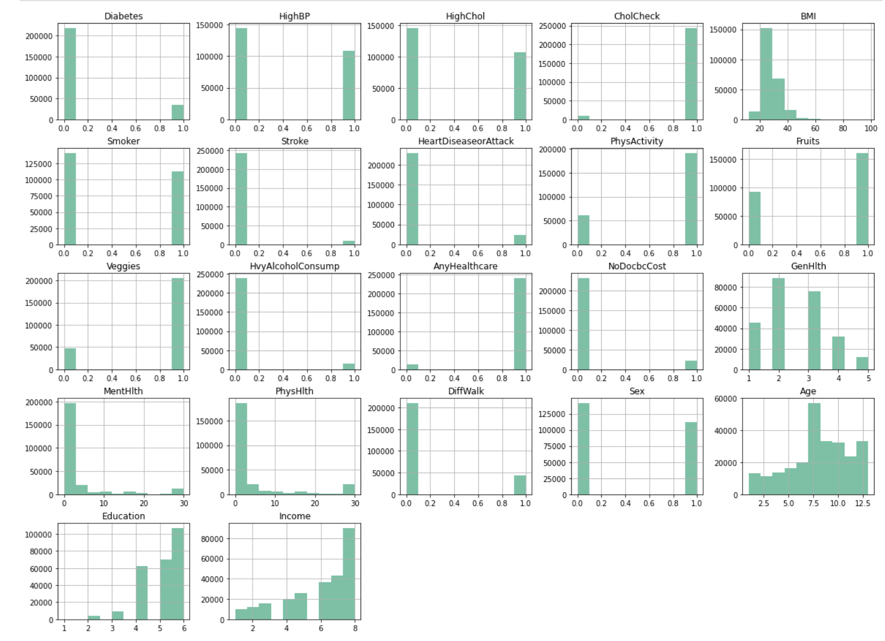
Histogram of Health Indicators
Notes:
Histogram, makes us understand the each markers the frquencey of it as it appears to divide the datasets by each marker if we want to observe.

Slide 16
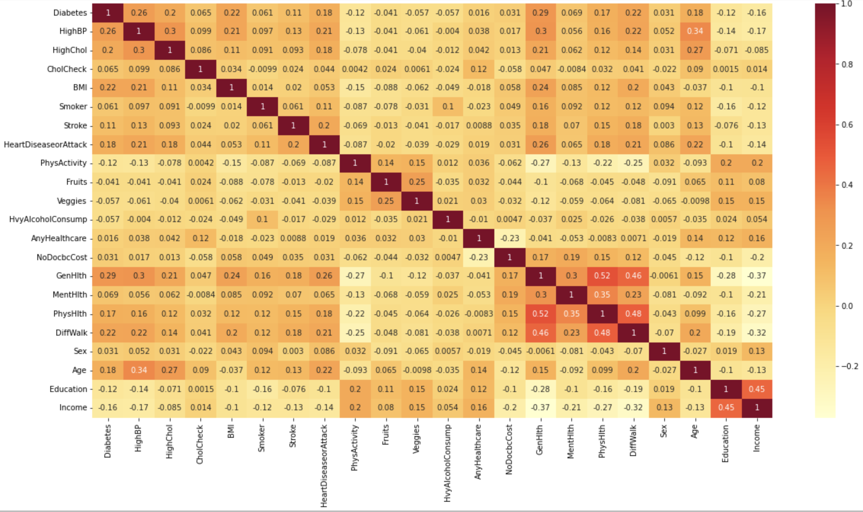
Correlation among Health Indicator
Notes:
From these correlation, we can understand the how Diabetes is correlated with each health markers :
Most Significant Health Markers, we can analyze are which is beyond 0.20 and above
- HighBP
- HighChol
- BMI
- GenHlth
- PhyHlth
- Diff Walk
But there were many more non-binary health markers which we can’t ignore because due to outliers, their co-relation are less than 0.2, but we can’t ignore them. After removing outlier, we can check the correlation later.

Slide 17
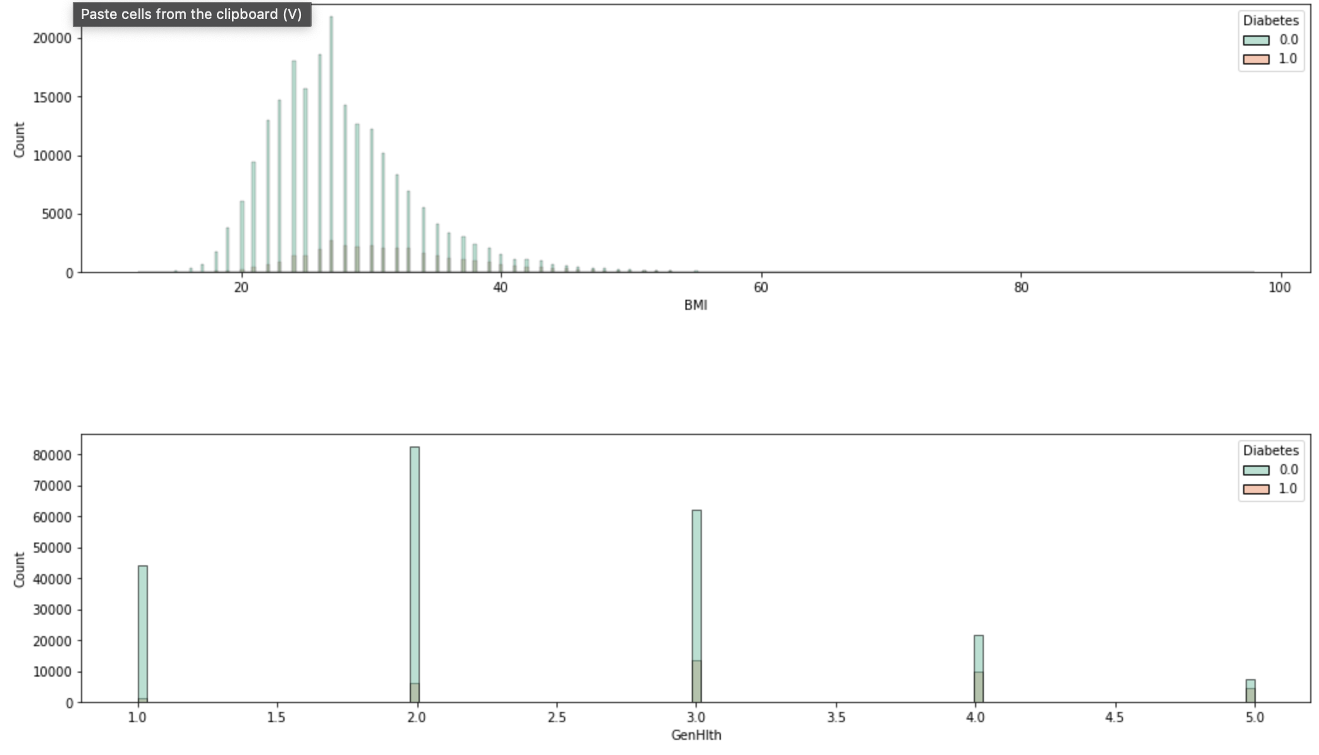
Correlation of BMI Vs Diabetes

Slide 18
Correlation of GenHlth Vs Diabetes

Slide 19
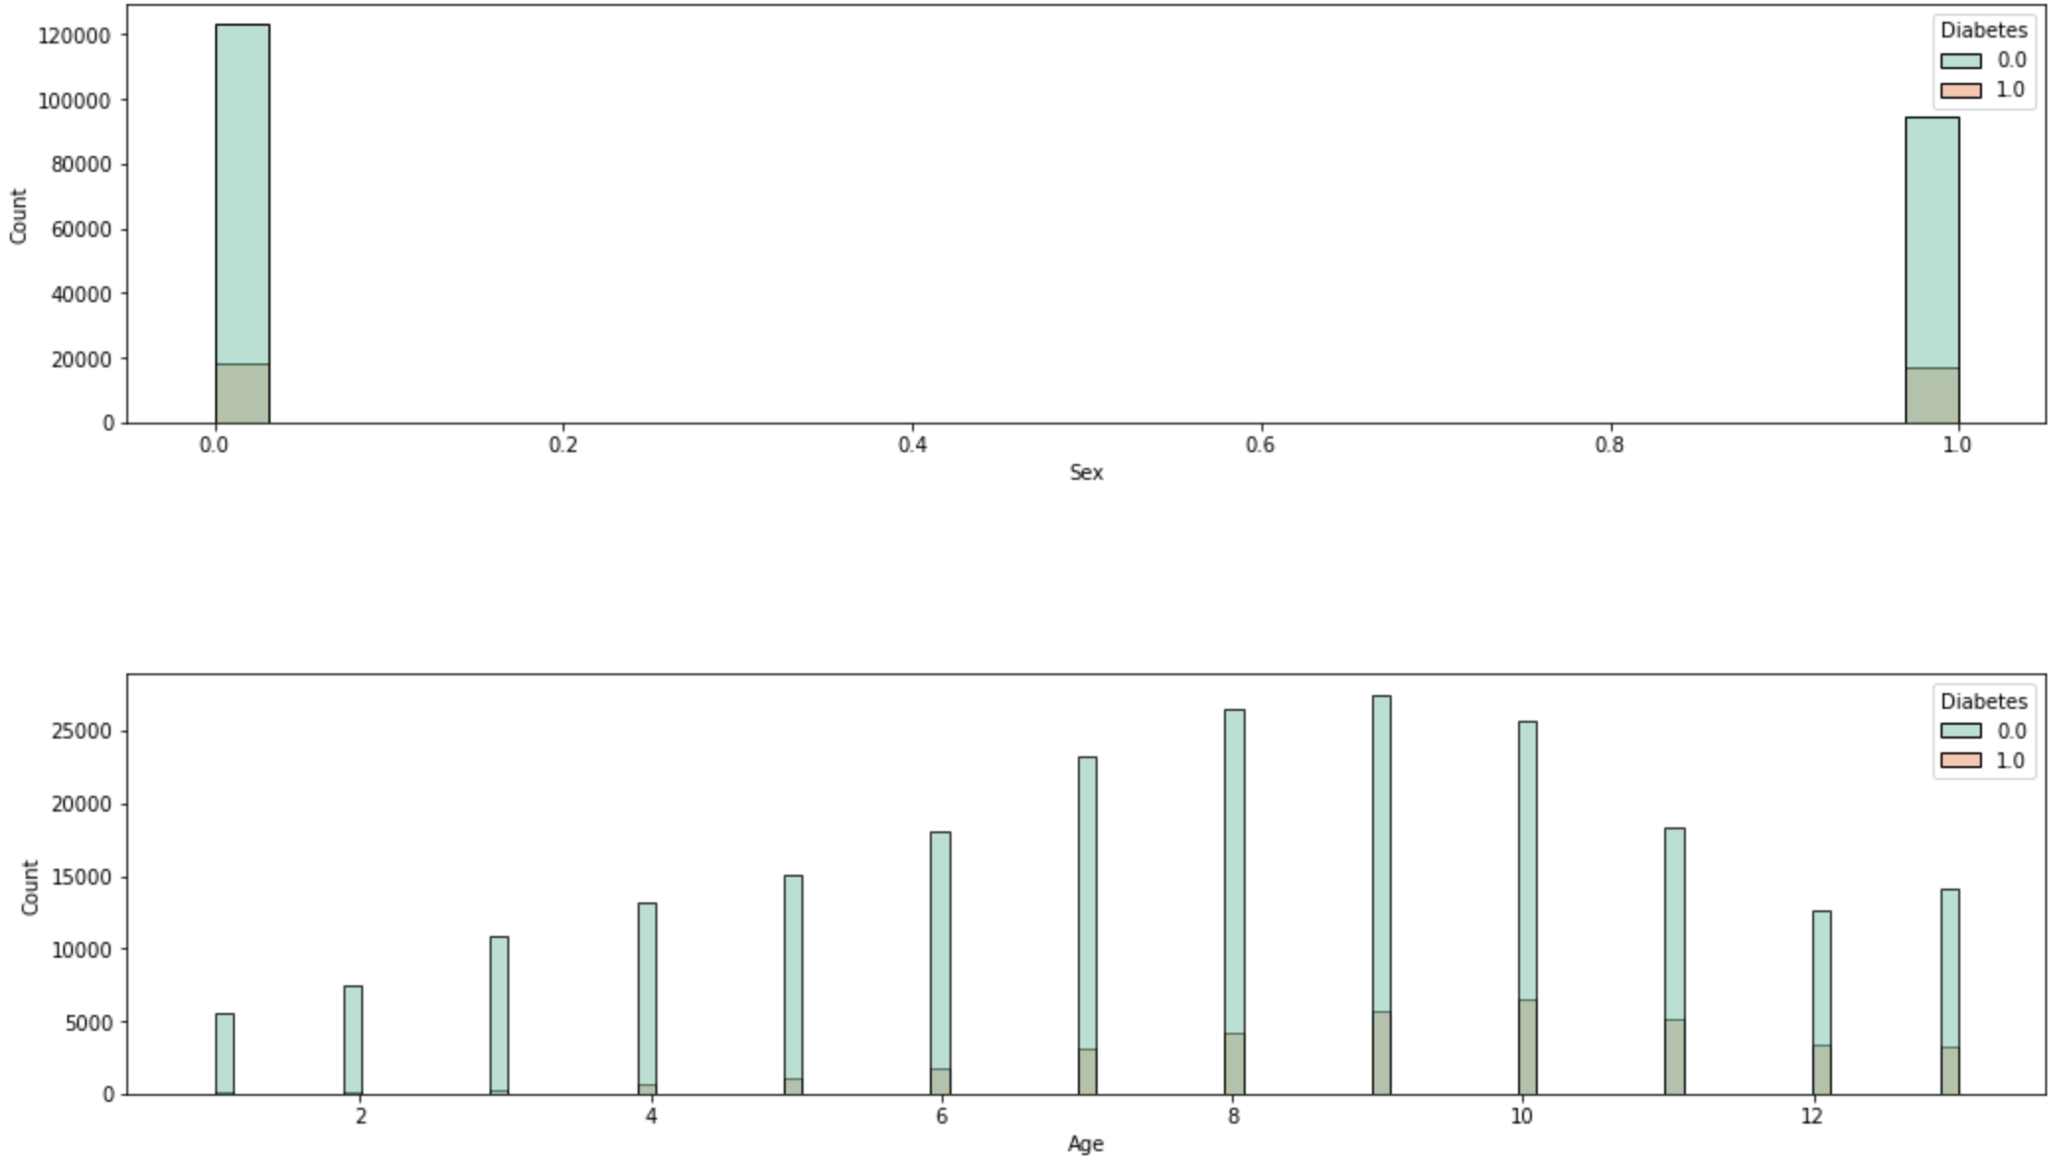
Correlation of Age Vs Diabetes

Slide 20
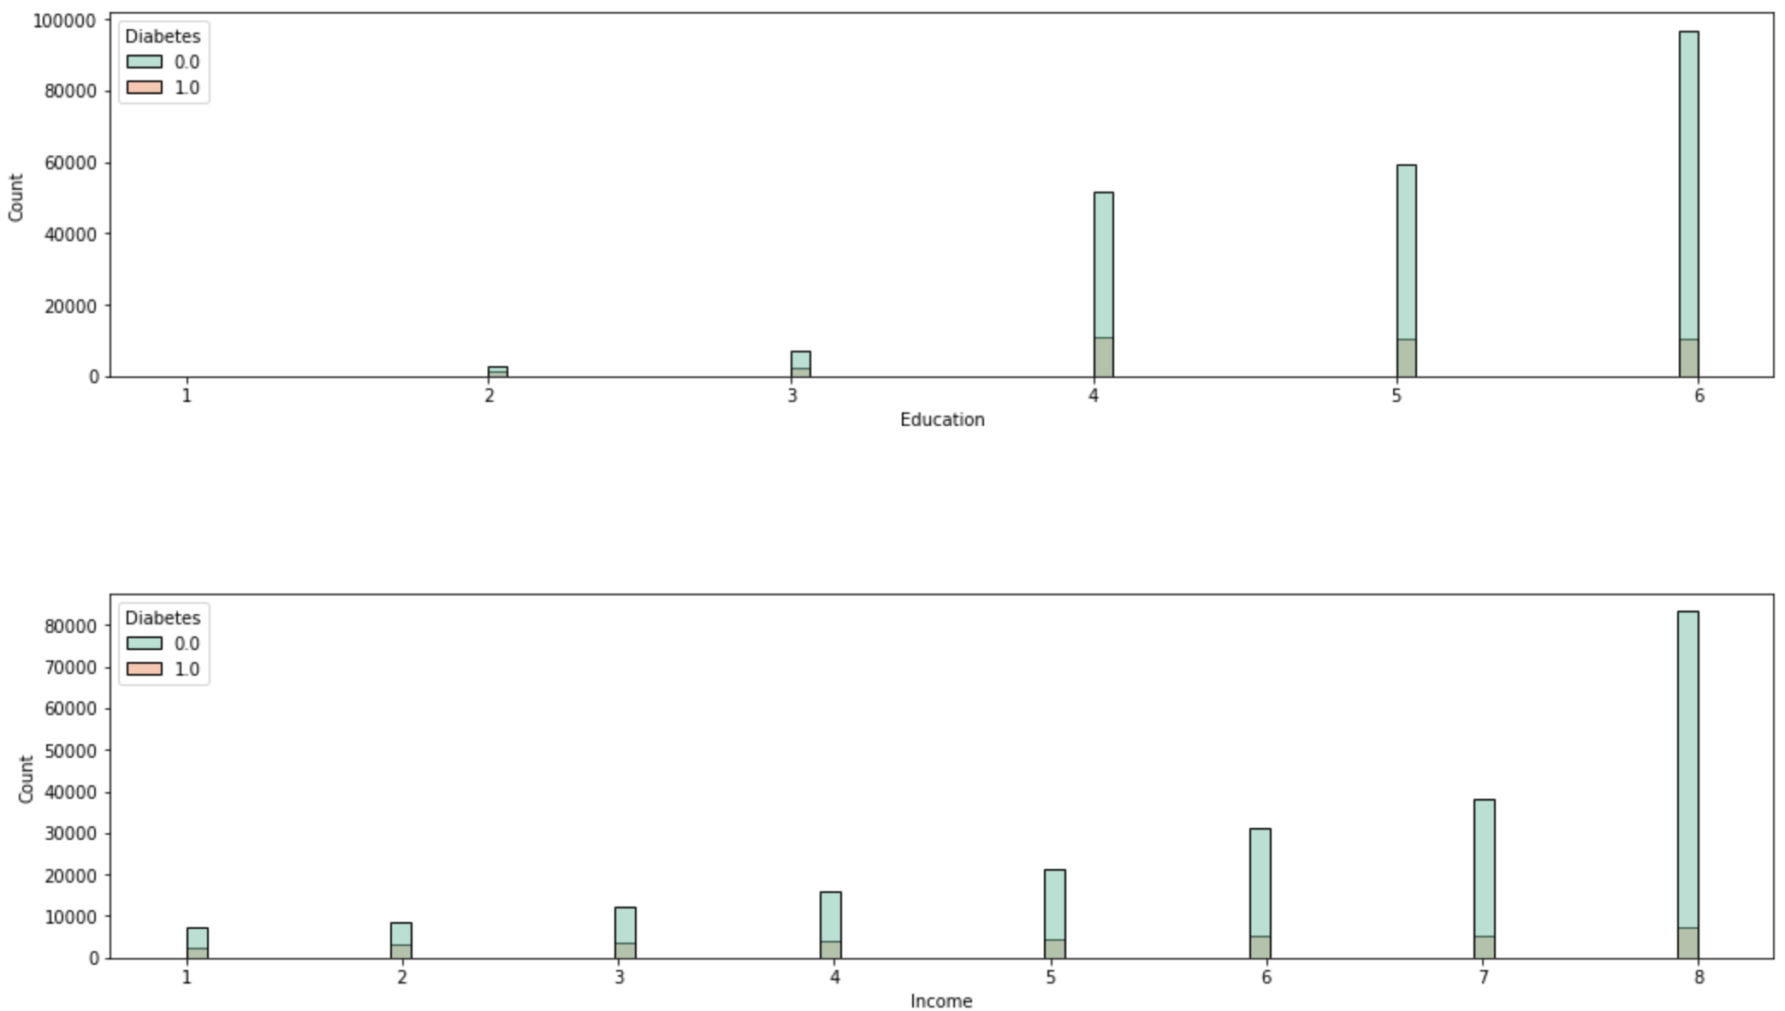
Correlation of Income Vs Diabetes

Slide 21
Correlation of Education V Diabetes

Slide 22
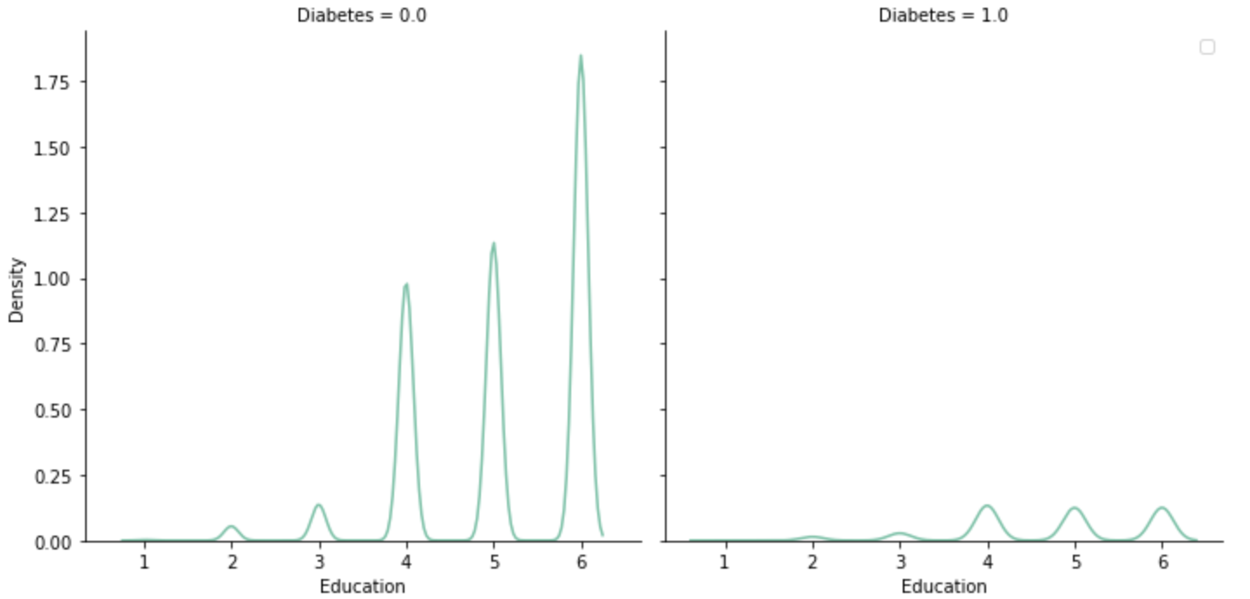
Correlation of Education V Diabetes

Slide 23
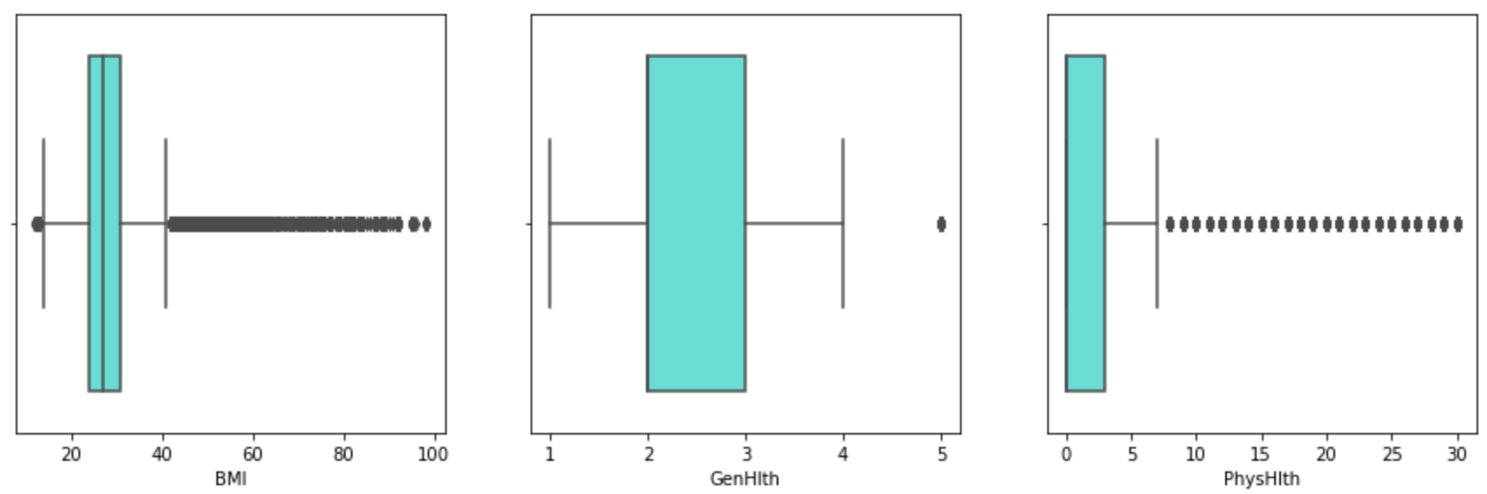
Outliers in Non-Binary Markers
Notes:
As we can see from IQR , In case of BMI many samples are there after Q3 ranges, all are the outliers. Before Building the model, these samples were removed.
In GenHlth : there is only one sample, which is beyond our IQR (Inter-Quartile Range )
In PhyHlth : There were also many sample which lies after Q3 IQR …those were also removed before modelling

Slide 24
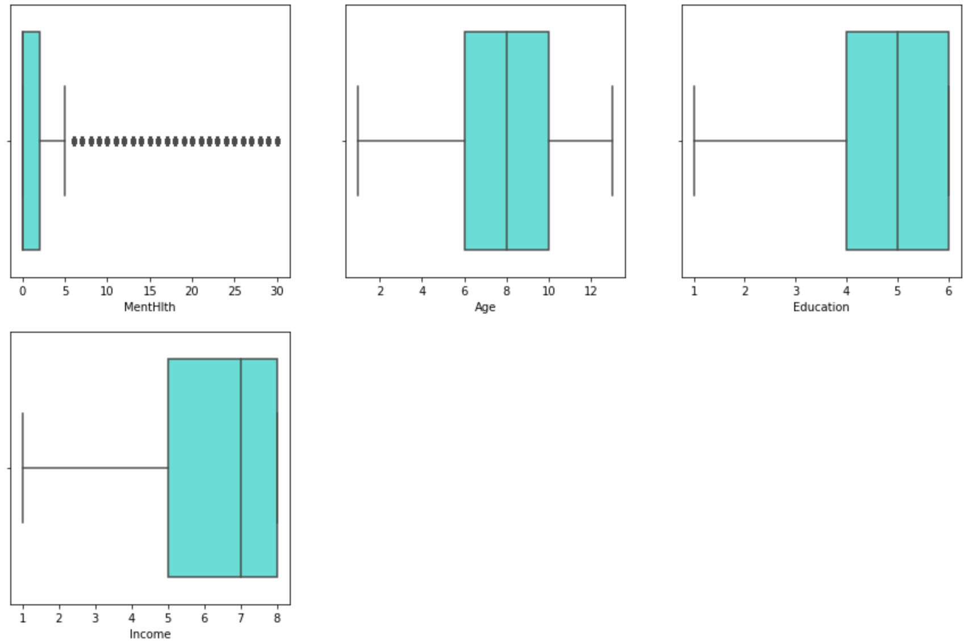
Outliers in Non-Binary Markers
Notes:
As we can see from IQR , In case of Menhlth many samples are there after Q3 ranges, all are the outliers. Before Building the model, these samples were removed

Slide 25
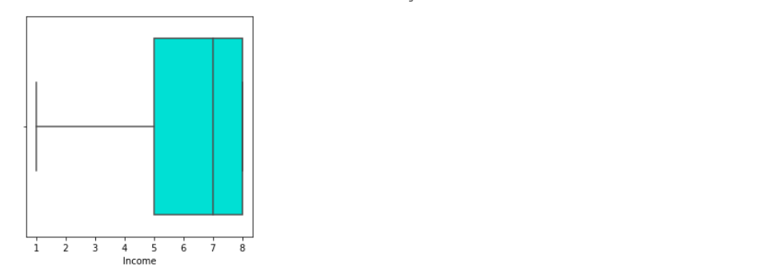
Outliers in Non-Binary Markers
Notes:
There are no outlier samples in Income column.

Slide 26
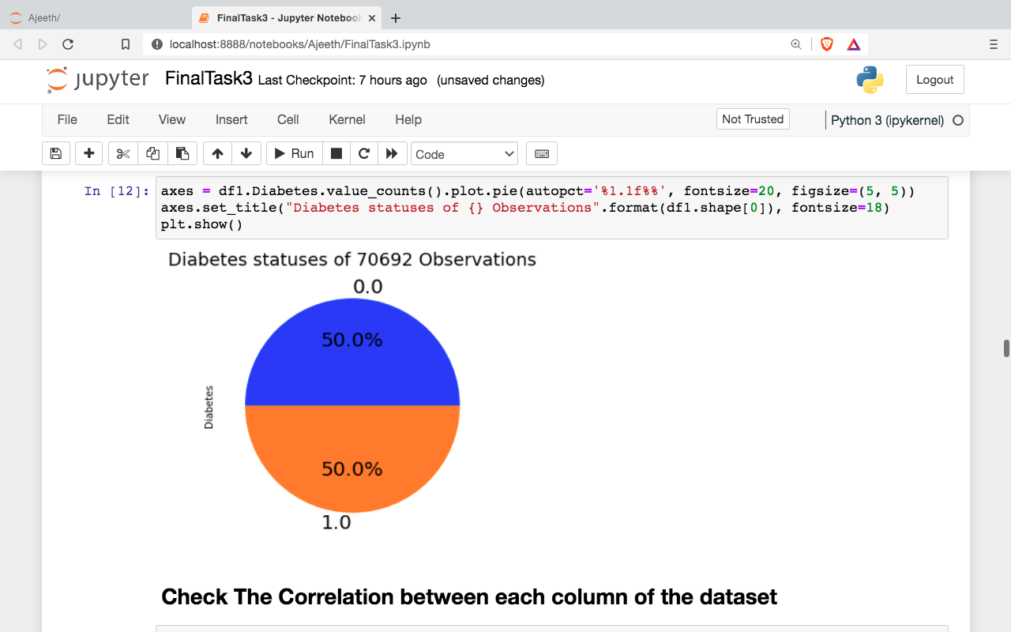
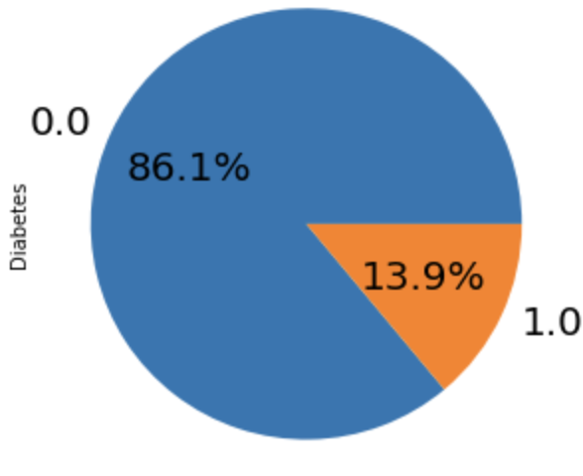
Dataset Samples Percentage
Diabetes
Non-Diabetes
From Pie-Chart, we can understand that left dataset is imbalanced (FileID3) and right dataset is balanced (FileID2).

Slide 27
Preparation for Building Model
Datasets cleaning for missing values
Remove the outliers from the samples by using IQR, Box Plot
Find the sampling method which able to given samples of using the equal number of samples from both the (Diabetes, Non-Diabetes) to balance the train model
Split the samples in training (75%) and testing (25%)
Identify the kernel which performs well in our dataset
Build the Machine Learning Classifier from different Supervised-Learning

Slide 28
Logistic Regression
Logistic Regression is a statistical Machine Learning algorithm that is used for classification problems
It is based on the concept of probability
It is used when the dependent variable (target) is categorical
It is widely used when the classification problem at hand is binary; true or false, yes or no, etc.
Logistics regression uses the sigmoid function to return the probability of a label.
Notes:
Logistic Regression comes under Supervised Learning

Slide 29
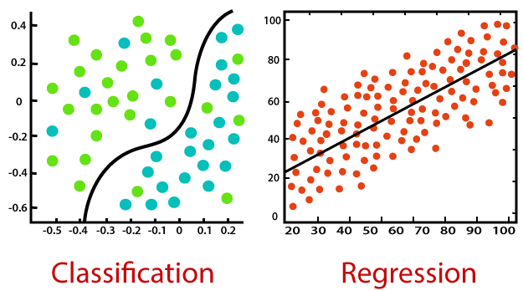
Logistic Regression
Notes:
Logistic Regression comes under Supervised Learning

Slide 30

Gaussian Naïve Bayes
Naïve Bayes classifier used the Bayes Theorem for prediction of sample
P(c|x) - Posterior Probability of the response (target) variable given the training data inputs
P(c) - Prior probability of the class (target)
P(x|c) - Probability of the predictor (x) given the class/target (c)
P(x) - Prior probability of the predictor (x).
Notes:
Logistic Regression comes under Supervised Learning

Slide 31
Decision Tree Classifier
Decision trees are a type of flowchart which assist in the decision making process
Internal nodes represent tests on particular attributes, while branches exiting nodes represent a single test outcome, and leaf nodes represent class labels
The tree building aspect of decision tree classification are composed of 2 main tasks:
Tree Induction
Tree Pruning
Notes:
Tree induction is method of taking a set of pre-classified instances as input, deciding which attributes are best to split on, splitting the dataset, and recusing on the resulting split datasets until all training instances are categorized
Tree pruning is method to split samples on the attributes which create the purest child nodes possible, which would keep to a minimum the number of splits that would need to be made in order to classify all instances in our dataset

Slide 32
Random Forest Classifier
Random Forest is an Ensemble Learning method for classification, regression, that contain multiple Decision Trees
A multitude of trees builds a forest, also known as Random Forest
Ensembling Learning in the most simplest explanation is stacking together a lot of classifiers to improve performance
Decision Trees infers data features to predict target variable
Random forest output is the average or mean of the output from the various Decision Trees
As number of trees increases, the precision of the outcome increases - better accuracy, and overfitting is reduced
Notes:
Logistic Regression comes under Supervised Learning

Slide 33
XGBoost Classifier
XGBoost stands for Extreme Gradient Boosting and is a supervised learning algorithm that falls under the gradient-boosted decision tree (GBDT) family of machine learning algorithms
They make their predictions based on combining a set of weaker models and evaluate other decision trees through if-then-else true/false feature questions
They are created in sequential form to assess and estimate the probability of producing a correct decision
Gradient Tree Boosting
Regularized Learning
Shrinkage and Feature Subsampling
Notes:
https://www.kdnuggets.com/2022/08/tuning-xgboost-hyperparameters.html

Slide 34
Report Analysis
Experiment 1 : Keeping all health markers, and outliers and perform the model building and prediction analysis
Experiment 2 : Keeping only the selected features and Remove the outliers and perform the model building and prediction analysis
Notes:
https://www.kdnuggets.com/2022/08/tuning-xgboost-hyperparameters.html

Slide 35
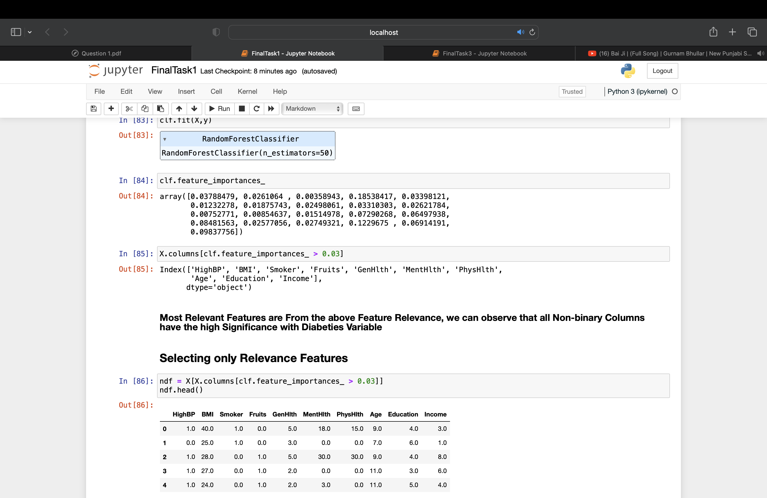
Feature Importance (FileID3)
Notes:
https://www.kdnuggets.com/2022/08/tuning-xgboost-hyperparameters.html

Slide 36
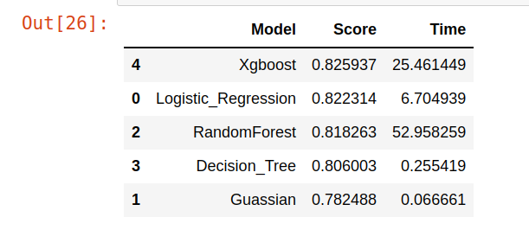
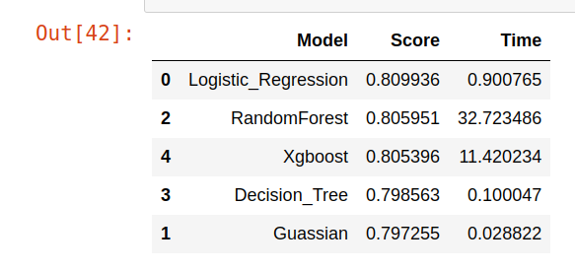
Reports : FileID3 (Imbalanced)
Keeping all features, built model and perform predictions
Total Samples : 253680 ,
Training (70%) : 177576
Testing (30%) : 76104
Keeping only relevant features, after removing outlier, built model and perform predictions
Total Samples : 185762 ,
Training (70%) : 130033
Testing (30%) : 55729
Notes:
https://www.kdnuggets.com/2022/08/tuning-xgboost-hyperparameters.html

Slide 37
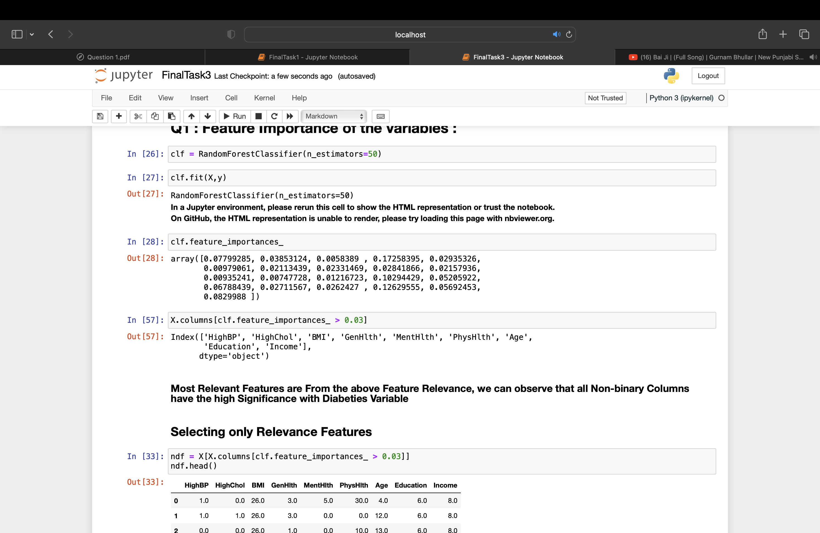
Reports : FileID2 (Balanced)
Notes:
https://www.kdnuggets.com/2022/08/tuning-xgboost-hyperparameters.html

Slide 38
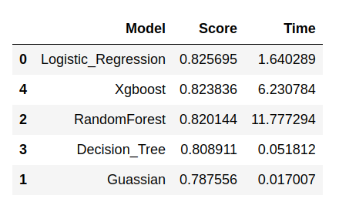
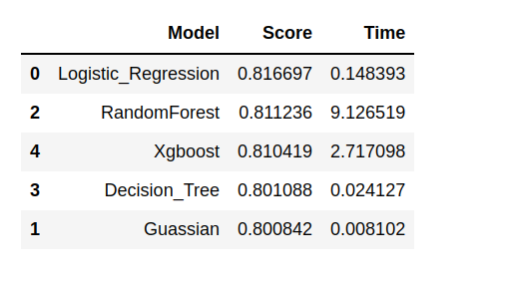
Reports : FileID2 (Balanced)
Keeping all features, built model and perform predictions
Total Samples : 70692
Training (70%) : 49484
Testing (30%) : 21208
Keeping only relevant features, after removing outlier, built model and perform predictions
Total Samples : 51793
Training (70%) : 36255
Testing (30%) : 15538
Notes:
https://www.kdnuggets.com/2022/08/tuning-xgboost-hyperparameters.html

Slide 39
Thank you

