Slide 1
Diabetes Machine Learning Prediction Model by Utilizing the Health Diabetes Indicator Datasets
Student Name
Supervised by
Dr. XXXXXX

Slide 2
Motivation
Diabetes is among the most prevalent chronic diseases In United states
Diabetes is a metabolic disease characterized by elevated levels of blood glucose
Over time, Diabetes leads serious damage to human body
Neuropathy
Diabetic Retinopathy
Cardiovascular Disease
Kidney Failure
Early diagnosis can lead to lifestyle changes and more effective treatment
Notes:
Explain each type of disease : I didn’t write detail here so u could speak

Slide 3
Prevalence
CDC estimates that 1 in 5 diabetics, and roughly 8 in 10 prediabetics are unaware of their risk
There are different types of diabetes:
Type I diabetes is mostly known as Juvenile diabetes or insulin diabetes, is known to be a chronic condition.
Type II diabetes is the most common form, and its prevalence varies by age, education, income, location, race, and other social determinants of health
The economic cost of diabetes is enormous;
Diagnosed diabetes costs around $327 billion yearly
The total cost of prediabetes and undiagnosed diabetes is close to $400 billion.
Notes:
Explain each type of disease : I didn’t write detail here so u could speak

Slide 4
Diabetes Health Indicators dataset
Diabetes Health Indicators dataset
This datasets is collected by telephone survey by CDC from The Behavioral Risk Factor Surveillance System (BRFSS).
It was collected in 2015, from 441,455 Individuals by responding 330 Questions.
From these questions, they have form the 21 health markers

Slide 5
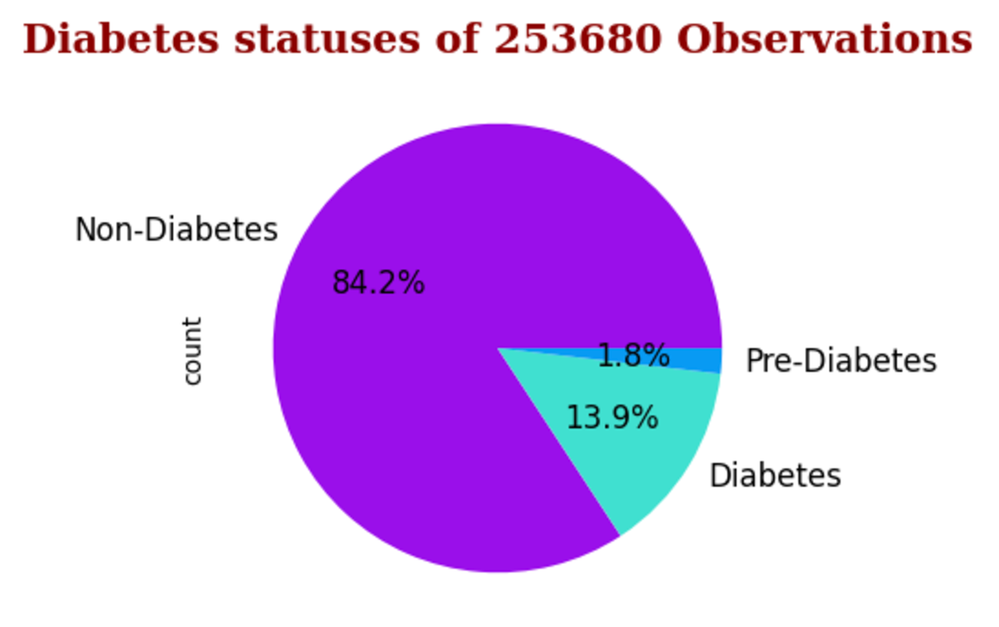
Diabetes Health Indicators dataset
This dataset contains 3 files:
diabetes_012_health_indicators_BRFSS2015.csv
253,680 survey responses
This dataset has 21 feature variables and is imbalanced
3 classes :
0 is for no diabetes or only during pregnancy
1 is for prediabetes
2 is for diabetes.
Notes:
This Dataset was collected from females at the age of 21 year old from National Institute of Diabetes and Digestive and Kidney Disease.

Slide 6
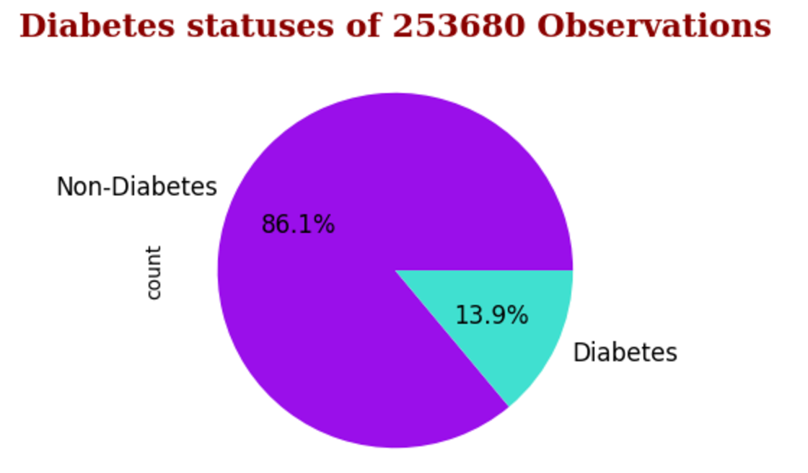
Diabetes Health Indicators dataset
2. diabetes _ binary _ health _ indicators _ BRFSS2015.csv
253,680 survey responses
This dataset has 21 feature variables and is not balanced.
2 classes :
0 is for no diabetes
1 is for prediabetes or diabetes.
Notes:
This Dataset was collected from females at the age of 21 year old from National Institute of Diabetes and Digestive and Kidney Disease.

Slide 7
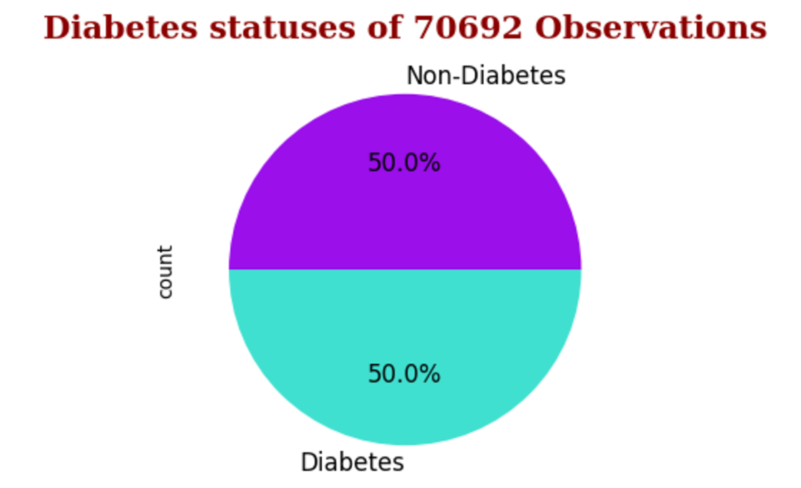
Diabetes Health Indicators dataset
3. diabetes_binary_5050split_health_indicators_BRFSS2015.csv
70,692 survey responses
50-50 split of respondents with no diabetes and with either prediabetes or diabetes
This dataset has 21 feature variables and is balanced

Slide 8
Health Indicators
Binary Health Markers :
* Diabetes * PhysActivity
* HighBP * HighChol
* CholCheck * Smoker
* Stroke * HeartDiseaseorAttack
* Fruits * Vegetables
* AnyHealthCare * DiffWalk
* Sex
Notes:
This Dataset was collected from females at the age of 21 year old from National Institute of Diabetes and Digestive and Kidney Disease.

Slide 9
Health Indicators
Non-binary Health Markers :
* BMI * GenHealth
* MentHealth * PhyHealth
* Age * Education
* Income
Notes:
This Dataset was collected from females at the age of 21 year old from National Institute of Diabetes and Digestive and Kidney Disease.

Slide 10
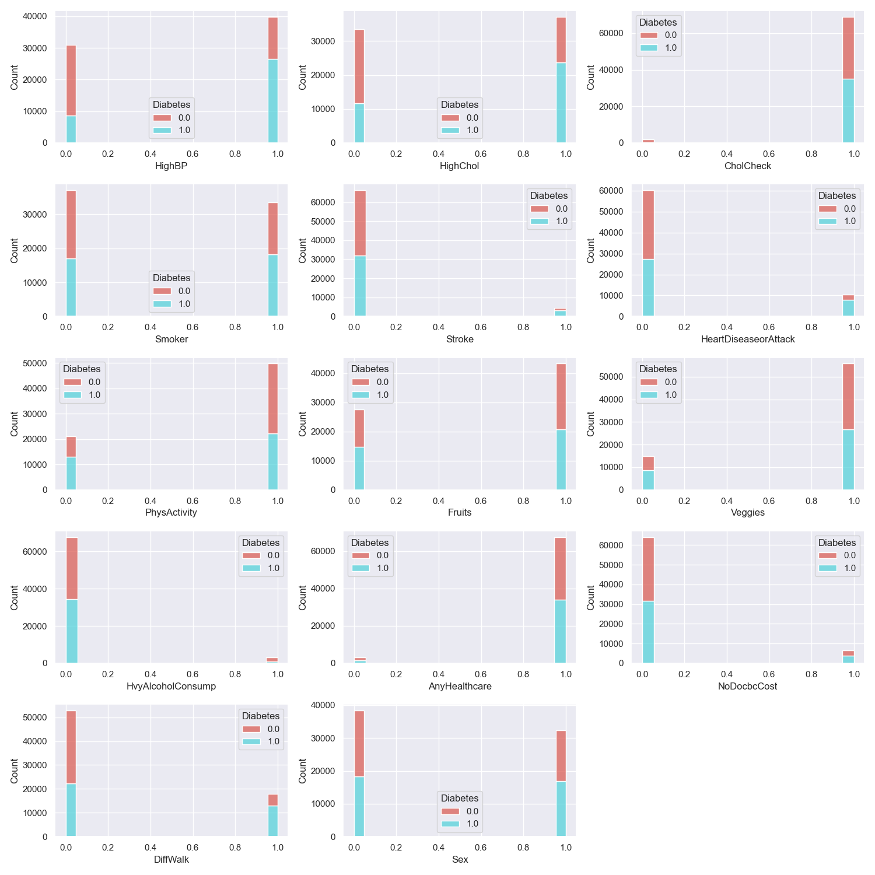
Histogram of Health Indicators
Notes:
Histogram, makes us understand the each markers the frquencey of it as it appears to divide the datasets by each marker if we want to observe.

Slide 11
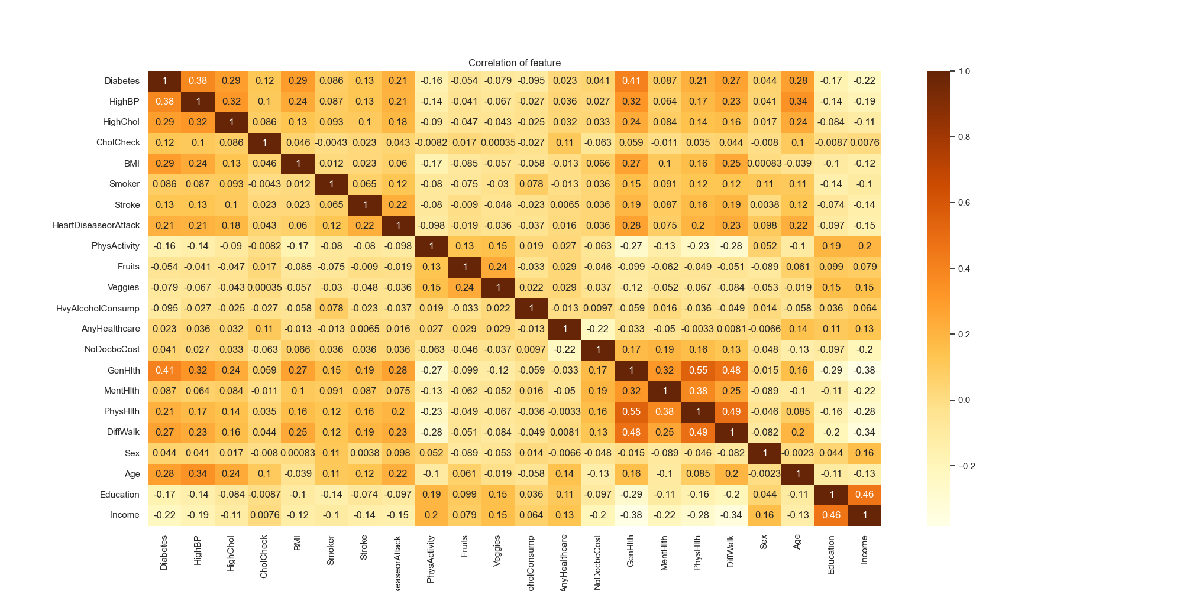
Correlation among Health Indicators
Notes:
From these correlation, we can understand the how Diabetes is correlated with each health markers :
Most Significant Health Markers, we can analyze are which is beyond 0.20 and above
- HighBP
- HighChol
- BMI
- GenHlth
- PhyHlth
- Diff Walk
But there were many more non-binary health markers which we can’t ignore because due to outliers, their co-relation are less than 0.2, but we can’t ignore them. After removing outlier, we can check the correlation later.

Slide 12
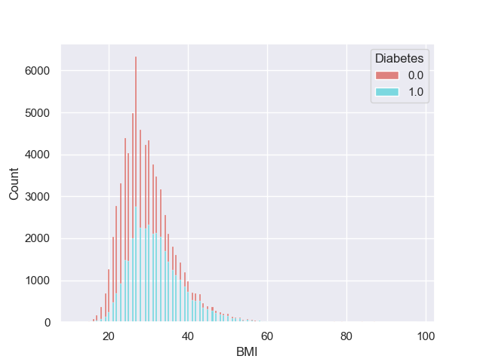
Correlation of BMI Vs Diabetes
Notes:
From these correlation, we can understand the how Diabetes is correlated with each health markers :
Most Significant Health Markers, we can analyze are which is beyond 0.20 and above
- HighBP
- HighChol
- BMI
- GenHlth
- PhyHlth
- Diff Walk
But there were many more non-binary health markers which we can’t ignore because due to outliers, their co-relation are less than 0.2, but we can’t ignore them. After removing outlier, we can check the correlation later.

Slide 13
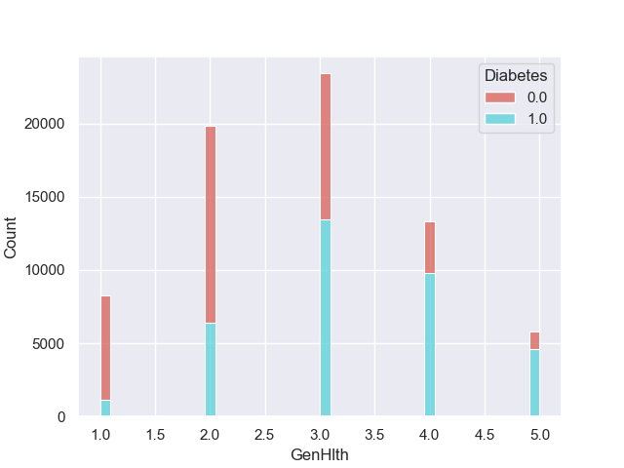
Correlation of GenHlth Vs Diabetes

Slide 14
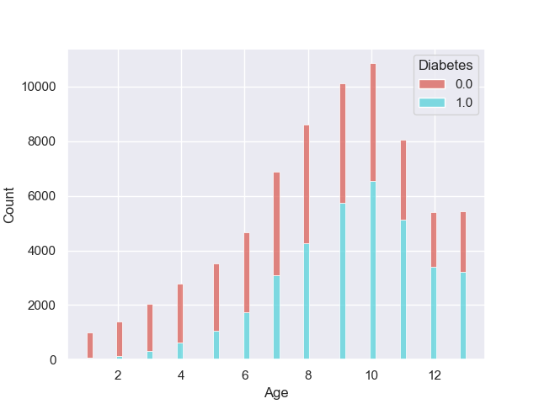
Correlation of Age Vs Diabetes

Slide 15
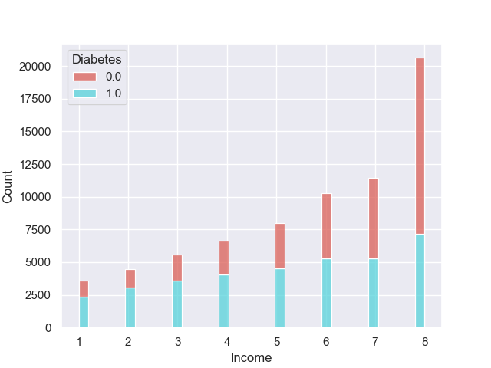
Correlation of Income Vs Diabetes

Slide 16
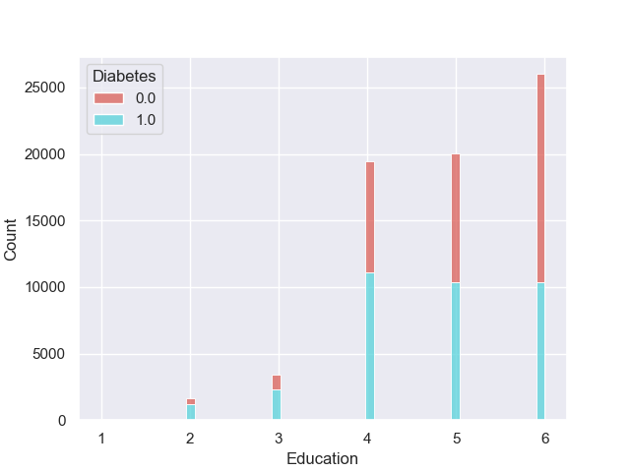
Correlation of Education V Diabetes

Slide 17
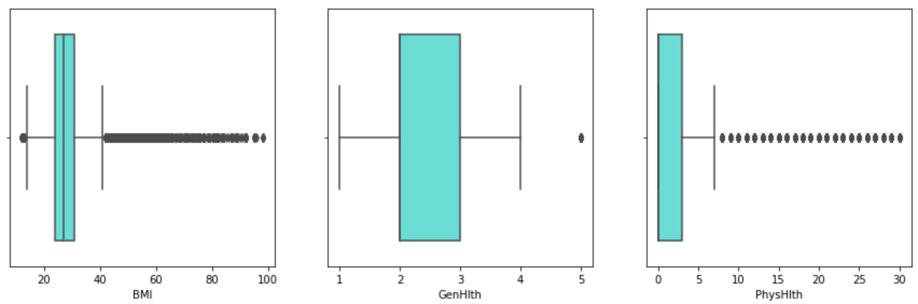
Outliers in Non-Binary Markers
Notes:
There are no outlier samples in Income column.

Slide 18
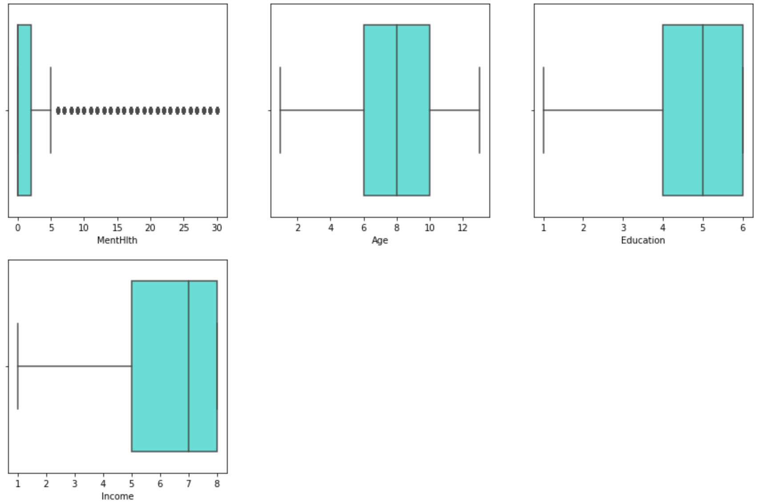
Outliers in Non-Binary Markers
Notes:
There are no outlier samples in Income column.

Slide 19
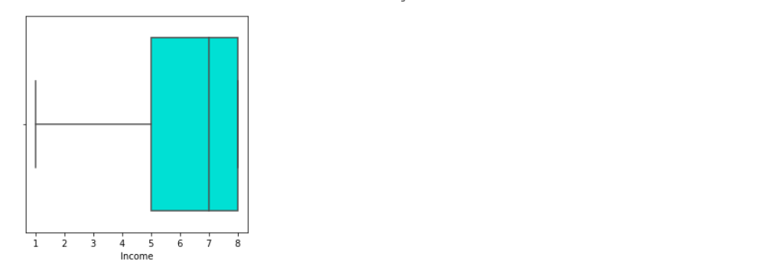
Outliers in Non-Binary Markers
Notes:
There are no outlier samples in Income column.

Slide 20
Preparation for Building Model
Datasets cleaning for missing values
Remove the outliers from the samples by using IQR, Box Plot
Find the sampling method which able to given samples of using the equal number of samples from both the (Diabetes, Non-Diabetes) to balance the train model
Split the samples in training (70%) and testing (30%)
Identify the kernel which performs well in our dataset
Build the Machine Learning Classifier from different Supervised-Learning
Notes:
Logistic Regression comes under Supervised Learning

Slide 21
Logistic Regression
Logistic Regression is a statistical Machine Learning algorithm that is used for classification problems
It is based on the concept of probability
It is used when the dependent variable (target) is categorical
It is widely used when the classification problem at hand is binary; true or false, yes or no, etc.
Logistics regression uses the sigmoid function to return the probability of a label.
Notes:
Logistic Regression comes under Supervised Learning

Slide 22
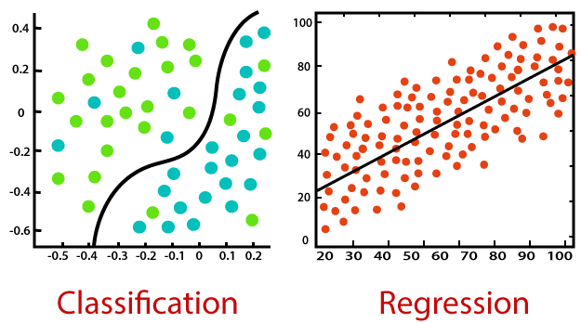
Logistic Regression
Notes:
Logistic Regression comes under Supervised Learning

Slide 23
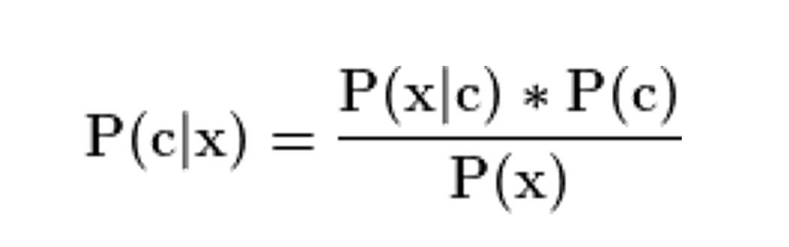
Gaussian Naïve Bayes
Naïve Bayes classifier used the Bayes Theorem for prediction of sample
P(c|x) - Posterior Probability of the response (target) variable given the training data inputs
P(c) - Prior probability of the class (target)
P(x|c) - Probability of the predictor (x) given the class/target (c)
P(x) - Prior probability of the predictor (x).
Notes:
Logistic Regression comes under Supervised Learning

Slide 24
Decision Tree Classifier
Decision trees are a type of flowchart which assist in the decision making process
Internal nodes represent tests on particular attributes, while branches exiting nodes represent a single test outcome, and leaf nodes represent class labels
The tree building aspect of decision tree classification are composed of 2 main tasks:
Tree Induction
Tree Pruning
Notes:
Tree induction is method of taking a set of pre-classified instances as input, deciding which attributes are best to split on, splitting the dataset, and recusing on the resulting split datasets until all training instances are categorized
Tree pruning is method to split samples on the attributes which create the purest child nodes possible, which would keep to a minimum the number of splits that would need to be made in order to classify all instances in our dataset

Slide 25
Random Forest Classifier
Random Forest is an Ensemble Learning method for classification, regression, that contain multiple Decision Trees
A multitude of trees builds a forest, also known as Random Forest
Ensembling Learning in the most simplest explanation is stacking together a lot of classifiers to improve performance
Decision Trees infers data features to predict target variable
Random forest output is the average or mean of the output from the various Decision Trees
As number of trees increases, the precision of the outcome increases - better accuracy, and overfitting is reduced
Notes:
Logistic Regression comes under Supervised Learning

Slide 26
XGBoost Classifier
XGBoost stands for Extreme Gradient Boosting and is a supervised learning algorithm that falls under the gradient-boosted decision tree (GBDT) family of machine learning algorithms
They make their predictions based on combining a set of weaker models and evaluate other decision trees through if-then-else true/false feature questions
They are created in sequential form to assess and estimate the probability of producing a correct decision
Gradient Tree Boosting
Regularized Learning
Shrinkage and Feature Subsampling
Notes:
https://www.kdnuggets.com/2022/08/tuning-xgboost-hyperparameters.html

Slide 27
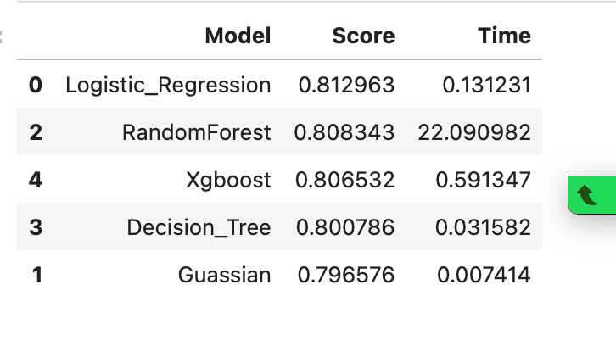
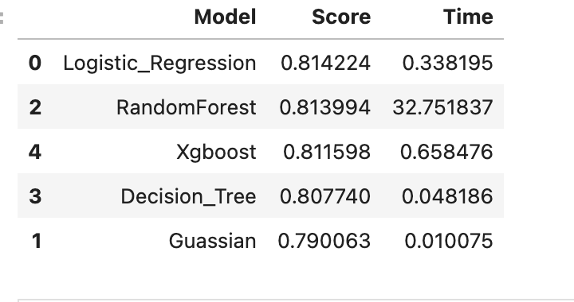
Reports
Each Classifier has performed well over 70% accuracy in prediction
Logistic Regression was able to achieve the the highest accuracy of 81.42 %
Second Best Classifier is Random Forest which was able to achieve 81.39% accuracy
Notes:
https://www.kdnuggets.com/2022/08/tuning-xgboost-hyperparameters.html

Slide 28
Thank you

