Slide 1
A Warm Welcome To Careerera Family

Slide 2
DATABASE MANAGEMENT SYSTEM USING MY SQL

Slide 3

TABLE OF CONTENT
Introduction to DBMS
An Introduction to Relational Database
Concepts and SQL Accessing
Data Servers MYSQL/RDBMS Concepts
Extraction, Transformation and Loading (“ETL”) Processes
Retrieve data from Single Tables-(use of SELECT Statement) and the power of WHERE and ORDER by Clause. Retrieve and Transform data from multiple Tables using JOINS and Unions
Introduction to Views Working with Aggregate functions, grouping and summarizing Records Writing Sub queries

Slide 4

WHAT IS DATABASE MANAGEMENT SYSTEM?

Slide 5
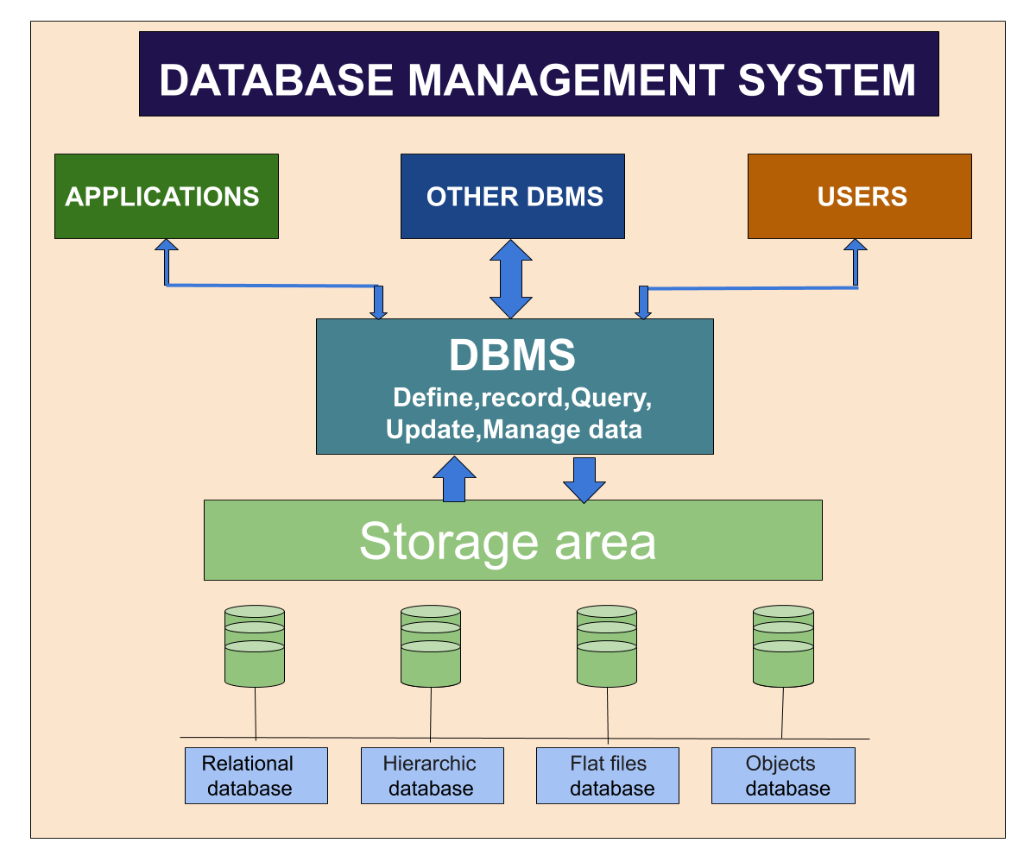

Slide 6
INTRODUCTION TO DBMS
A database management system (DBMS) refers to the technology for creating and managing databases.
A DBMS is a database program. It is a software system that uses a standard method of cataloging, retrieving, and running queries on data.
The DBMS manages incoming data, organizes it, and provides ways for the data to be modified or extracted by users or other programs.
DBMS Examples:- MySQL, Microsoft Access, SQL Server, FileMaker, Oracle, RDBMS.

Slide 7
WHY USES DBMS?
To develop software applications In less time.
Data independence and efficient use of data.
For uniform data administration.
For data integrity and security.
For concurrent access to data, and data recovery from crashes.
To use user-friendly declarative query language.

Slide 8
WHERE IS A DATABASE MANAGEMENT SYSTEM (DBMS) BEING USED?
Airlines: reservations, schedules, etc
Telecom: calls made, customer details, network usage, etc
Universities: registration, results, grades, etc
Sales: products, purchases, customers, etc
Banking: all transactions etc

Slide 9
ADVANTAGES OF THE DBMS
Data independence: Application programs should be as free or independent as possible from details of data representation and storage. DBMS can supply an abstract view of the data for insulating application code from such facts.
Efficient data access: DBMS utilizes a mixture of sophisticated concepts and techniques for storing and retrieving data competently. This feature becomes important in cases where the data is stored on external storage devices.
Data integrity and security: If data is accessed through the DBMS, the DBMS can enforce integrity constraints on the data.

Slide 10
ADVANTAGES OF THE DBMS(Cont..)
Data administration: When several users share the data, integrating the administration of data can offer significant improvements. Experienced professionals understand the nature of the data being managed and can be responsible for organizing the data representation to reduce redundancy and make the data to retrieve efficiently.
Improve decision making:- We can mind the data and get useful results from the data. these results help us to improve our business.
Data inconsistency reduction:- Data inconsistency is minimized with the help of database management systems.

Slide 11
DISADVANTAGES OF THE DBMS
Expensive technical staff:- you want to maintain a DBMS for office our organization, you need to hire a well educated and Technical database administrator for maintaining the database management system.
Cost:-We need to buy expensive hardware, software and highly paid technical database administrator.
Complexity:-DBMS are not very easy, DBMS are complex. there are many Complex relationships among tables. Physical schema of the databases are not very easy to understandable.

Slide 12
DISADVANTAGES OF THE DBMS(Cont..)
The extra cost of hardware:- We need to buy expensive, Reliable, and efficient storage devices to store the data.
Database failure:- chances of database failure can be very high.
Cost of data conversion:-The cost of data conversion is very high. Train staff and train database administrators required for converting the data smoothly.

Slide 13
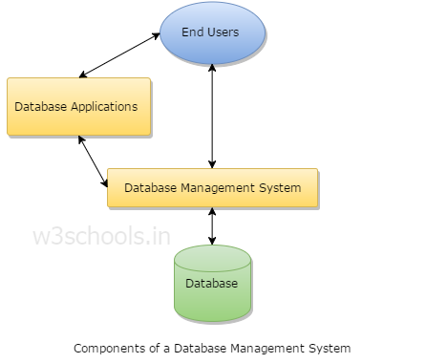
COMPONENT OF DBMS

Slide 14
COMPONENT OF DBMS(Cont..)
Users: Users may be of any kind such as DB administrator, System developer, or database users.
Database application: Database application may be Departmental, Personal, organization's and / or Internal.
DBMS: Software that allows users to create and manipulate database access,
Database: Collection of logical data as a single unit.

Slide 15
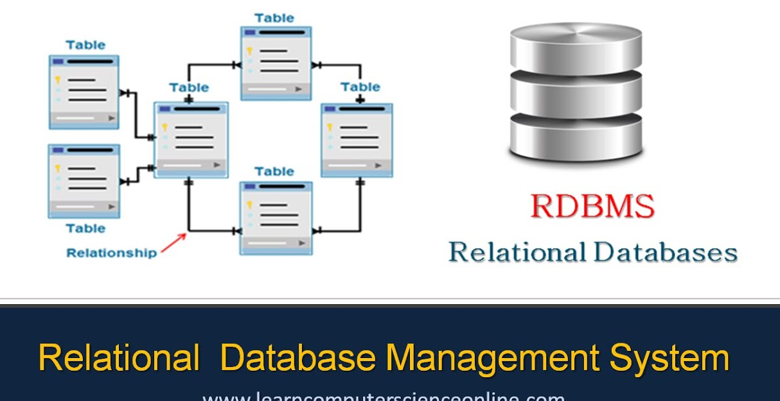
WHAT IS A RELATIONAL DATABASE?

Slide 16
INTRODUCTION TO RELATIONAL DATABASE
A relational database is a type of database that stores and provides access to data points that are related to one another.
Relational databases are based on the relational model, an intuitive, straightforward way of representing data in tables.
In a relational database, each row in the table is a record with a unique ID called the key.
The columns of the table hold attributes of the data, and each record usually has a value for each attribute, making it easy to establish the relationships among data points.

Slide 17
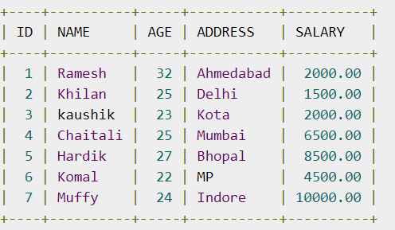
WHAT IS A TABLE?
The data in an RDBMS is stored in database objects which are called as tables. This table is basically a collection of related data entries and it consists of numerous columns and rows.
A table is the most common and simplest form of data storage in a relational database.

Slide 18
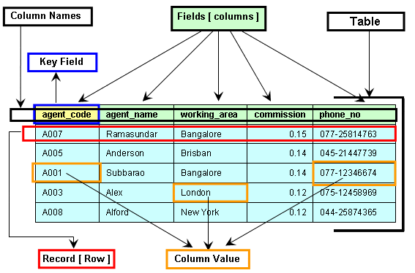
WHAT IS A FIELD?
Every table is broken up into smaller entities called fields.
A field is a column in a table that is designed to maintain specific information about every record in the table.

Slide 19

WHAT IS A RECORD OR A ROW?
A record is also called as a row of data is each individual entry that exists in a table.

Slide 20
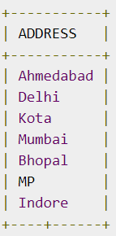
WHAT IS A COLUMN ?
A column is a vertical entity in a table that contains all information associated with a specific field in a table.

Slide 21
WHAT IS A NULL VALUE?
A NULL value in a table is a value in a field that appears to be blank, which means a field with a NULL value is a field with no value.
It is very important to understand that a NULL value is different than a zero value or a field that contains spaces. A field with a NULL value is the one that has been left blank during a record creation.

Slide 22
WHAT IS SQL?
SQL is a programming language for Relational Databases. It is designed over relational algebra and tuple relational calculus. SQL comes as a package with all major distributions of RDBMS.
SQL comprises both data definition and data manipulation languages. Using the data definition properties of SQL, one can design and modify database schema, whereas data manipulation properties allows SQL to store and retrieve data from database.

Slide 23
MYSQL FEATURES
High Performance.
High Availability.
Scalability and Flexibility Run anything.
Robust Transactional Support.
Web and Data Warehouse Strengths.
Strong Data Protection.
Comprehensive Application Development.
Management Ease.
Open Source Freedom and 24 x 7 Support.
Lowest Total Cost of Ownership.

Slide 24
SEMICOLON AFTER SQL STATEMENTS?
Some database systems require a semicolon at the end of each SQL statement.
Semicolon is the standard way to separate each SQL statement in database systems that allow more than one SQL statement to be executed in the same call to the server.
In this tutorial, we will use semicolon at the end of each SQL statement.

Slide 25
ADVANTAGES OF SQL
High speed:- Using the SQL queries, the user can quickly and efficiently retrieve a large amount of records from a database.
No coding needed:- In the standard SQL, it is very easy to manage the database system. It doesn't require a substantial amount of code to manage the database system.
Well defined standards:- Long established are used by the SQL databases that are being used by ISO and ANSI.
Portability:- SQL can be used in laptop, PCs, server and even some mobile phones.
Interactive language:- SQL is a domain language used to communicate with the database. It is also used to receive answers to the complex questions in seconds.
Multiple data view:- Using the SQL language, the users can make different views of the database structure.

Slide 26
TYPES OF SQL STATEMENTS
Data Definition Language (DDL)
Data Control Language(DCL)
Data Query Language (DQL)
Data Manipulation Language (DML)
Transaction Control Language(TCL)

Slide 27

WHAT IS DATA DEFINITION LANGUAGE?
Data Definition Language helps you to define the database structure or schema.
Here are some important DDL commands in SQL are:
CREATE
CREATE statements is used to define the database structure schema:
Syntax:
CREATE TABLE TABLE_NAME (COLUMN_NAME DATATYPES[,....]);
For example :-

Slide 28

DDL COMMANDS IN SQL (Cont..)
3. ALTER
Alters command allows you to alter the structure of the database.
Syntax:
To add a new column in the table
ALTER TABLE table_name ADD column_name COLUMN-definition;
To modify an existing column in the table:
ALTER TABLE MODIFY(COLUMN DEFINITION....);
For example:-

Slide 29

DDL COMMANDS IN SQL (Cont..)
2. DROP
Drops commands remove tables and databases from RDBMS.
Syntax:
DROP TABLE ;
For example:-

Slide 30

DDL COMMANDS IN SQL (Cont..)
3. TRUNCATE:
This command used to delete all the rows from the table and free the space
containing the table.
Syntax:
TRUNCATE TABLE table_name;
For example:-

Slide 31
WHAT IS DATA MANIPULATION LANGUAGE?
Data Manipulation Language (DML) allows you to modify the database instance by inserting, modifying, and deleting its data. It is responsible for performing all types of data modification in a database.
Here are some important DML commands in SQL:
INSERT
UPDATE
DELETE

Slide 32
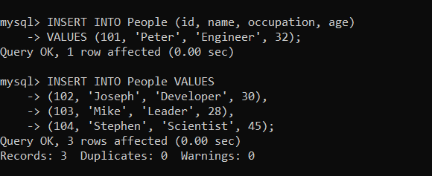
DML COMMANDS IN SQL (Cont..)
1.INSERT:
This is a statement is a SQL query. This command is used to insert data into
the row of a table.
Syntax:
INSERT INTO TABLE_NAME (col1, col2, col3,.... col N)
VALUES (value1, value2, value3, .... valueN);
Or
INSERT INTO TABLE_NAME VALUES (value1, value2, value3, .... valueN);
For example:-

Slide 33
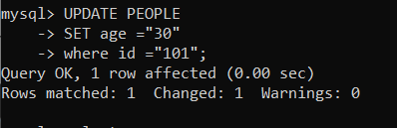
DML COMMANDS IN SQL (Cont..)
2. UPDATE:
This command is used to update or modify the value of a column in the table.
Syntax:
UPDATE table_name SET [column_name1= value1,...column_nameN = valueN]
[WHERE CONDITION]
For example:-

Slide 34

DML COMMANDS IN SQL (Cont..)
3. DELETE:
This command is used to remove one or more rows from a table.
Syntax:
DELETE FROM table_name [WHERE condition];
For example:-

Slide 35
WHAT IS DATA CONTROL LANGUAGE?
DCL (Data Control Language) includes commands like GRANT and REVOKE, which are useful to give "rights & permissions." Other permission controls parameters of the database system.
Commands that come under DCL:
Grant
Revoke

Slide 36
DCL COMMANDS IN SQL (CONT..)
1. Grant:
This command is use to give user access privileges to a database.
Syntax:
GRANT SELECT, UPDATE ON MY_TABLE TO SOME_USER, ANOTHER_USER;
2. Revoke:
It is useful to back permissions from the user.
Syntax:
REVOKE privilege_nameON object_nameFROM {user_name |PUBLIC |role_name}

Slide 37
WHAT IS TRANSACTION CONTROL LANGUAGE?
TCL commands can only use with DML commands like INSERT, DELETE and UPDATE only.
These operations are automatically committed in the database that's why they cannot be used while creating tables or dropping them.
Here are some commands that come under TCL:
COMMIT
ROLLBACK
SAVEPOINT

Slide 38
TCL COMMANDS IN SQL (CONT..)
1. Commit
This command is used to save all the transactions to the database.
Syntax:
Commit;
2. Rollback
Rollback command allows you to undo transactions that have not already been
saved to the database.
Syntax:
ROLLBACK;
3. SAVEPOINT
This command helps you to sets a savepoint within a transaction.
Syntax:
SAVEPOINT SAVEPOINT_NAME;

Slide 39
WHAT IS DATA QUERY LANGUAGE?
Data Query Language (DQL) is used to fetch the data from the database.
It uses only one command:
SELECT:
This command helps you to select the attribute based on the condition described
by the WHERE clause.
Syntax:
SELECT expressions FROM TABLES WHERE conditions;

Slide 40
MYSQL CREATE USER
The MySQL user is a record in the USER table of the MySQL server that contains the login information, account privileges, and the host information for MySQL account. It is essential to create a user in MySQL for accessing and managing the databases.
Create User statement allows us to create a new user account in the database server. It provides authentication, SSL/TLS, resource-limit, role, and password management properties for the new accounts. It also enables us to control the accounts that should be initially locked or unlocked.

Slide 41
WHY DID USERS REQUIRE IN MYSQL SERVER?
When the MySQL server installation completes, it has a ROOT user account only to access and manage the databases. But, sometimes, you want to give the database access to others without granting them full control. In that case, you will create a non-root user and grant them specific privileges to access and modify the database.
Syntax
The following syntax is used to create a user in the database server.
CREATE USER [IF NOT EXISTS] account_name IDENTIFIED BY 'password';

Slide 42
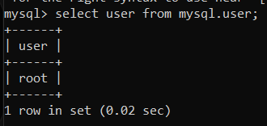
CREATE USER EXAMPLE
Step 1: Open the MySQL server by using the mysql client tool.
Step 2: Enter the password for the account and press Enter.
Enter Password: ****
Step 3: Execute the following command to show all users in the current MySQL server.
MySQL> select user from MySQL. User;

Slide 43
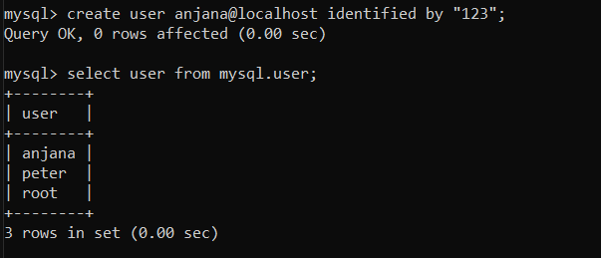
CREATE USER EXAMPLE
Step 4: Create a new user with the following command.
mysql> create user anjana@localhost identified by ’123';
Now, run the command to show all users again.

Slide 44
GRANT PRIVILEGES TO THE MYSQL NEW USER
MySQL server provides multiple types of privileges to a new user account. Some of the most commonly used privileges are given below:
ALL PRIVILEGES: It permits all privileges to a new user account.
CREATE: It enables the user account to create databases and tables.
DROP: It enables the user account to drop databases and tables.
DELETE: It enables the user account to delete rows from a specific table.
INSERT: It enables the user account to insert rows into a specific table.
SELECT: It enables the user account to read a database.
UPDATE: It enables the user account to update table rows.

Slide 45
GRANT PRIVILEGES TO THE MYSQL NEW USER
If you want to give all privileges to a newly created user, execute the following command.
mysql> GRANT ALL PRIVILEGES ON * . * TO anjana@localhost;
If you want to give specific privileges to a newly created user, execute the following command.
mysql> GRANT CREATE, SELECT, INSERT ON * . * TO anjana@localhost;
Sometimes, you want to flush all the privileges of a user account for changes occurs immediately, type the following command.
FLUSH PRIVILEGES;
If you want to see the existing privileges for the user, execute the following command.
mysql> SHOW GRANTS for username;

Slide 46
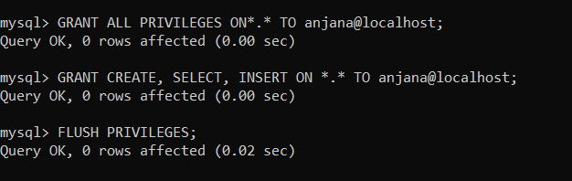
GRANT PRIVILEGES TO THE MYSQL NEW USER

Slide 47
DROP USER
The Drop User statement allows us to remove one or more user accounts and their privileges from the database server. If the account does not exist in the database server, it gives an error.
If you want to use the Drop User statement, it is required to have a global privilege of Create User statement or the DELETE privilege for the MySQL system schema.
Syntax
The following syntax is used to delete the user accounts from the database server completely.
DROP USER 'account_name';

Slide 48
DROP USER EXAMPLE
The following are the step required to delete an existing user from the MySQL server database.
Step 1: Open the MySQL server by using the mysql client tool.
Step 2: Enter the password for the account and press Enter.
Enter Password: ********
Step 3: Execute the following command to show all users in the current MySQL server.
mysql> select user from MySQL.User;

Slide 49
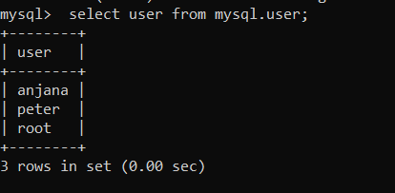
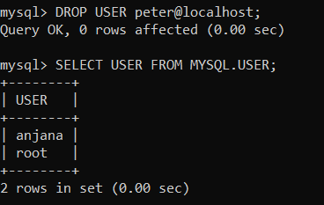
DROP USER EXAMPLE
Step 4: To drop a user account, you need to execute the following statement.
DROP USER peter@localhost;

Slide 50
SHOW USERS/LIST ALL USERS
Sometimes we want to manage a database in MySQL. In that case, we need to see the list of all user's accounts in a database. Most times, we assume that there is a SHOW USERS command similar to SHOW DATABASES, SHOW TABLES, etc. for displaying the list of all users available in the database server. Unfortunately, MySQL database does not have a SHOW USERS command to display the list of all users in the MySQL server. We can use the following query to see the list of all user in the database server:
- Select user from mysql.user;

Slide 51
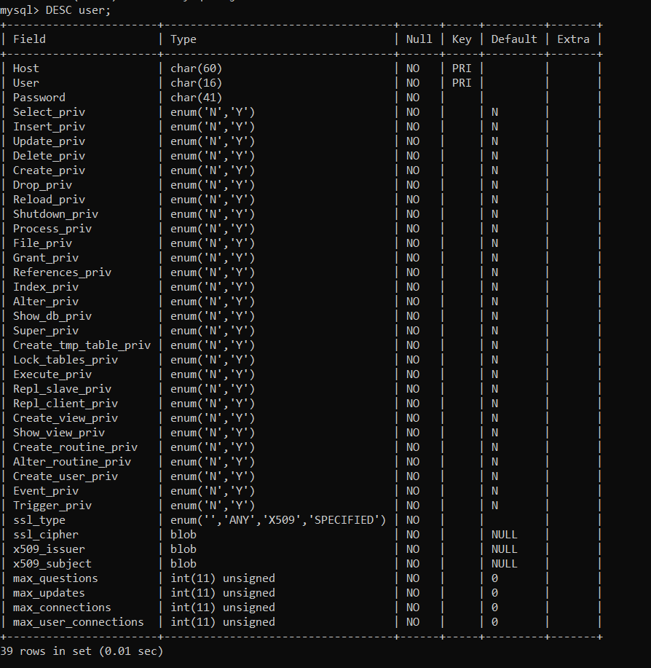
SHOW USERS/LIST ALL USERS
we want to see more information on the user table,

Slide 52
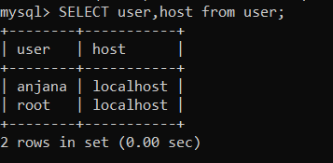
SHOW USERS/LIST ALL USERS
To get the selected information like as hostname, password expiration status, and account locking, execute the query as below:
-SELECT user, host FROM user;

Slide 53
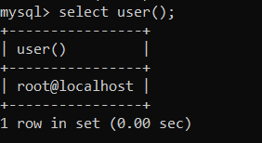
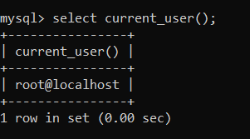
SHOW CURRENT USER
We can get information of the current user by using the user() or current_user() function

Slide 54
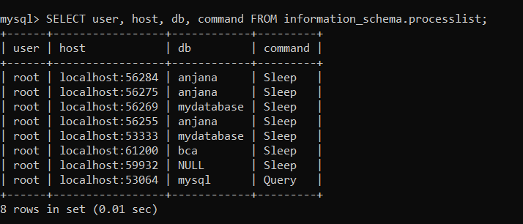
SHOW CURRENT LOGGED USER
-mysql> SELECT user, host, db, command FROM information_schema.processlist;

Slide 55
CHANGE USER PASSWORD
To change the password of any user account, you must have to keep this information in your mind:
-The details of the user account that you want to change.
-An application used by the user whose password you want to change. If you reset the user account password without changing an application connection string, then the application cannot connect with the database server.
MySQL allows us to change the user account password in three different ways, which are given below:
UPDATE Statement
SET PASSWORD Statement

Slide 56

CHANGE USER ACCOUNT PASSWORD USING THE UPDATE STATEMENT
mysql> USE mysql;
mysql> UPDATE user SET password = PASSWORD('jtp12345') WHERE user = 'peter' AND host = 'localhost';
mysql> FLUSH PRIVILEGES;

Slide 57
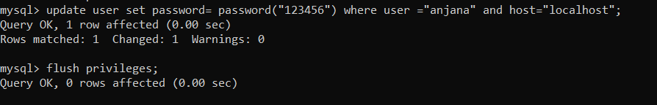
CHANGE USER ACCOUNT PASSWORD USING SET PASSWORD STATEMENT
USE mysql;
mysql> UPDATE user SET password = PASSWORD('jtp12345') WHERE user = 'peter' AND host = 'localhost';
mysql> FLUSH PRIVILEGES;

Slide 58
CREATE DATABASE
MySQL implements a database as a directory that stores all files in the form of a table.
MySQL Command Line Client.
We can create a new database in MySQL by using the CREATE DATABASE statement with the below syntax:
CREATE DATABASE [IF NOT EXISTS] database_name
[CHARACTER SET charset_name]
[COLLATE collation_name];

Slide 59
PARAMETER EXPLANATION
The parameter descriptions of the above syntax are as follows:
Parameter | Description
database_name | It is the name of a new database that should be unique in the MySQL server instance. The IF NOT EXIST clause avoids an error when we create a database that already exists.
charset_name | It is optional. It is the name of the character set to store every character in a string. MySQL database server supports many character sets. If we do not provide this in the statement, MySQL takes the default character set.
collation_name | It is optional that compares characters in a particular character set.

Slide 60
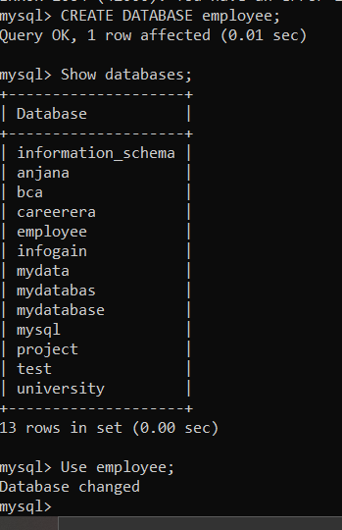
CREATE DATABASE
CREATE DATABASE employee;
Show databases;

Slide 61
SELECT DATABASE
SELECT Database is used in MySQL to select a particular database to work with. This query is used when multiple databases are available with MySQL Server.
You can use SQL command USE to select a particular database.
Syntax:
USE database_name;
For example;

Slide 62
DROP DATABASE
We can drop/delete/remove a MySQL database quickly with the MySQL DROP DATABASE command. It will delete the database along with all the tables, indexes, and constraints permanently.
Therefore, we should have to be very careful while removing the database in MySQL because we will lose all the data available in the database.
If the database is not available in the MySQL server, the DROP DATABASE statement throws an error.

Slide 63
DROP DATABASE
We can drop an existing database in MySQL by using the DROP DATABASE statement with the below syntax:
DROP DATABASE [IF EXISTS] database_name;
In MySQL, we can also use the below syntax for deleting the database. It is because the schema is the synonym for the database, so we can use them interchangeably.
DROP SCHEMA [IF EXISTS] database_name;

Slide 64
DROP DATABASE
Parameter Explanation
The parameter descriptions of the above syntax are as follows:
Parameter | Description
database_name | It is the name of an existing database that we want to delete from the server. It should be unique in the MySQL server instance.
IF EXISTS | It is optional. It is used to prevent from getting an error while removing a database that does not exist.

Slide 65
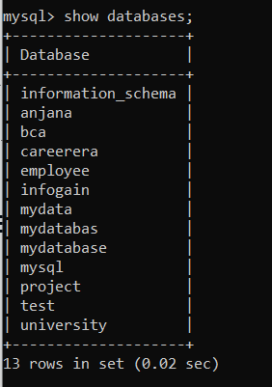

DROP DATABASE
SHOW DATABASES;
DROP DATABASE careerera;
For example:

Slide 66
CREATE TABLE
A table is used to organize data in the form of rows and columns and used for both storing and displaying records in the structure format. It is similar to worksheets in the spreadsheet application. A table creation command requires three things:
Name of the table
Names of fields
Definitions for each field

Slide 67
CREATE TABLE
MySQL allows us to create a table into the database by using the CREATE TABLE command.
SYNTAX:
CREATE TABLE [IF NOT EXISTS] table_name(
column_definition1,
column_definition2,
........,
table_constraints
);

Slide 68
CREATE TABLE
Parameter Explanation
The parameter descriptions of the above syntax are as follows:
Parameter | Description
database_name | It is the name of a new table. It should be unique in the MySQL database that we have selected. The IF NOT EXIST clause avoids an error when we create a table into the selected database that already exists.
column_definition | It specifies the name of the column along with data types for each column. The columns in table definition are separated by the comma operator. The syntax of column definition is as follows: column_name1 data_type(size) [NULL | NOT NULL]
table_constraints | It specifies the table constraints such as PRIMARY KEY, UNIQUE KEY, FOREIGN KEY, CHECK, etc.

Slide 69
CREATE TABLE
CREATE TABLE employees (
NAME VARCHAR (20),
ID VARCHAR(15),
ADDRESS VARCHAR(50)
);
For example:

Slide 70
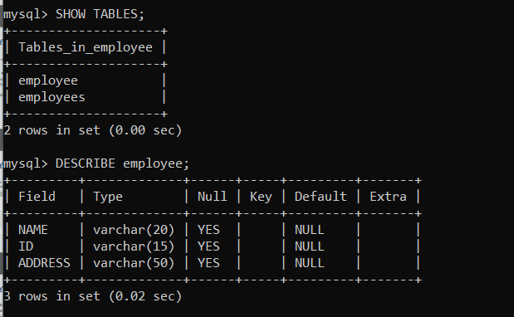
CREATE TABLE
SHOW TABLES;
DESCRIBE employee;

Slide 71
ALTER TABLE
ALTER statement is used when you want to change the name of your table or any table field. It is also used to add or delete an existing column in a table.
The ALTER statement is always used with "ADD", "DROP" and "MODIFY" commands according to the situation.

Slide 72
ADD A COLUMN IN THE TABLE
SYNTAX:
ALTER TABLE table_name
ADD new_column_name column_definition
[ FIRST | AFTER column_name ];
Parameters
table_name: It specifies the name of the table that you want to modify.
new_column_name: It specifies the name of the new column that you want to add to the table.
column_definition: It specifies the data type and definition of the column (NULL or NOT NULL, etc).
FIRST | AFTER column_name: It is optional. It tells MySQL where in the table to create the column. If this parameter is not specified, the new column will be added to the end of the table.

Slide 73
ADD A COLUMN IN THE TABLE
FOR EXAMPLE:
CREATE TABLE employee(NAME VARCHAR(20),ID VARCHAR(15),ADDRESS VARCHAR(50));

Slide 74
ADD MULTIPLE COLUMNS IN THE TABLE
SYNTAX:
ALTER TABLE table_name
ADD new_column_name column_definition
[ FIRST | AFTER column_name ],
ADD new_column_name column_definition
[ FIRST | AFTER column_name ], ... ;
For example:

Slide 75
MODIFY COLUMN IN THE TABLE
The MODIFY command is used to change the column definition of the table.
SYNTAX:
ALTER TABLE table_name
MODIFY column_name column_definition
[ FIRST | AFTER column_name ];
For example:-

Slide 76

DROP COLUMN IN TABLE
SYNTAX:
ALTER TABLE table_name
DROP COLUMN column_name;
For example:-

Slide 77

RENAME COLUMN IN TABLE
SYNTAX:
ALTER TABLE table_name
CHANGE COLUMN old_name new_name
column_definition
[ FIRST | AFTER column_name ]
For Example:-

Slide 78
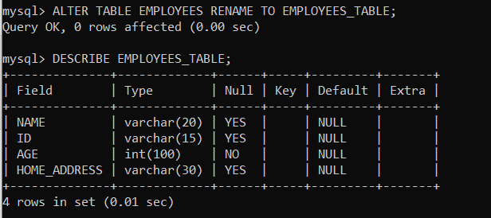
RENAME TABLE
SYNTAX:
ALTER TABLE table_name
RENAME TO new_table_name;
For example:-

Slide 79
TRUNCATE TABLE
The TRUNCATE statement in MySQL removes the complete data without removing its structure.
The following points must be considered while using the TRUNCATE command:
We cannot use the WHERE clause with this command so that filtering of records is not possible.
We cannot rollback the deleted data after executing this command because the log is not maintained while performing this operation.
We cannot use the truncate statement when a table is referenced by a foreign key or participates in an indexed view.
The TRUNCATE command doesn't fire DELETE triggers associated with the table that is being truncated because it does not operate on individual rows.

Slide 80
TRUNCATE TABLE
SYNTAX:-
TRUNCATE [TABLE] table_name;
For example:-

Slide 81
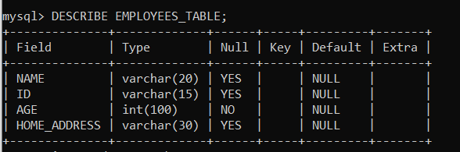
DESCRIBE TABLE
DESCRIBE means to show the information in detail. Since we have tables in MySQL, so we will use the DESCRIBE command to show the structure of our table, such as column names, constraints on column names, etc. The DESC command is a short form of the DESCRIBE command. Both DESCRIBE and DESC command are equivalent and case sensitive.
Syntax
{DESCRIBE | DESC} table_name;
For example:-

Slide 82

DROP TABLE
MYSQL uses a Drop Table statement to delete the existing table. This statement removes the complete data of a table along with the whole structure or definition permanently from the database.
Syntax
mysql> DROP TABLE table_name;
OR,
mysql> DROP TABLE schema_name.table_name;
For example:-

Slide 83
DROP TABLE
SYNTAX:-
DROP [ TEMPORARY ] TABLE [ IF EXISTS ] table_name [ RESTRICT | CASCADE ];
Parameter Name | Description
TEMPORARY | It is an optional parameter that specifies to delete the temporary tables only.
table_name | It specifies the name of the table which we are going to remove from the database.
IF EXISTS | It is optional, which is used with the DROP TABLE statement to remove the tables only if it exists in the database.
RESTRICT and CASCADE | Both are optional parameters that do not have any impact or effect on this statement. They are included in the syntax for future versions of MySQL.

Slide 84
CONSTRAINTS
SQL constraints are used to specify rules for the data in a table.
Constraints are used to limit the type of data that can go into a table. This ensures the accuracy and reliability of the data in the table. If there is any violation between the constraint and the data action, the action is aborted.
Constraints can be column level or table level. Column level constraints apply to a column, and table level constraints apply to the whole table.

Slide 85
CONSTRAINTS
The following constraints are commonly used in SQL:
NOT NULL - Ensures that a column cannot have a NULL value
UNIQUE - Ensures that all values in a column are different
PRIMARY KEY - A combination of a NOT NULL and UNIQUE. Uniquely identifies each row in a table
FOREIGN KEY - Prevents actions that would destroy links between tables
CHECK - Ensures that the values in a column satisfies a specific condition
DEFAULT - Sets a default value for a column if no value is specified
CREATE INDEX - Used to create and retrieve data from the database very quickly

Slide 86
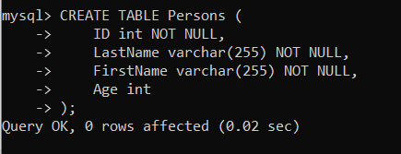
NOT NULL CONSTRAINT
By default, a column can hold NULL values.
The NOT NULL constraint enforces a column to NOT accept NULL values.
This enforces a field to always contain a value, which means that you cannot insert a new record, or update a record without adding a value to this field.
NOT NULL on CREATE TABLE

Slide 87
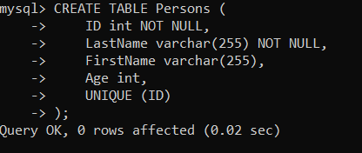
UNIQUE CONSTRAINT
The UNIQUE constraint ensures that all values in a column are different.
Both the UNIQUE and PRIMARY KEY constraints provide a guarantee for uniqueness for a column or set of columns.
A PRIMARY KEY constraint automatically has a UNIQUE constraint.
However, you can have many UNIQUE constraints per table, but only one PRIMARY KEY constraint per table.
UNIQUE CONSTRAINT ON CREATE TABLE

Slide 88
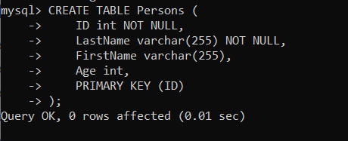
PRIMARY KEY CONSTRAINT
The PRIMARY KEY constraint uniquely identifies each record in a table.
Primary keys must contain UNIQUE values, and cannot contain NULL values.
A table can have only ONE primary key; and in the table, this primary key can consist of single or multiple columns (fields).
PRIMARY KEY of CREATE TABLE

Slide 89


PRIMARY KEY CONSTRAINT
PRIMARY KEY on ALTER TABLE
To create a PRIMARY KEY constraint on the "ID" column when the table is already created ;
DROP A PRIMARY KEY CONSTRAINT
To drop a PRIMARY KEY constraint, use the following SQL:

Slide 90
FOREIGN KEY CONSTRAINT
The FOREIGN KEY constraint is used to prevent actions that would destroy links between tables.
A FOREIGN KEY is a field (or collection of fields) in one table, that refers to the PRIMARY KEY in another table.
The table with the foreign key is called the child table, and the table with the primary key is called the referenced or parent table.

Slide 91
CHECK CONSTRAINT
The CHECK constraint is used to limit the value range that can be placed in a column.
If you define CHECK constraint on a column it will allow only certain values for this column.
If you define a CHECK constraint on aa table it can limit the values in certain columns based on values in other columns in the row.

Slide 92
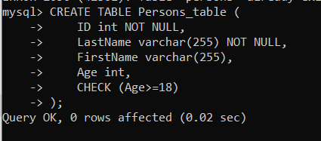
CHECK CONSTRAINT
The following SQL creates a CHECK constraint on the "Age" column when the "Persons" table is created. The CHECK constraint ensures that the age of a person must be 18, or older:

Slide 93
CHECK CONSTRAINT
CHECK ON ALTER TABLE
To create a CHECK constraint on the "Age" column when the table is already created, use the following SQL:
ALTER TABLE Persons ADD CHECK (Age>=18);

Slide 94
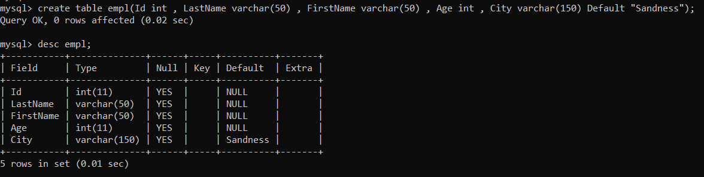
DEFAULT CONSTRAINT
The DEFAULT constraint is used to set a default value for a column.
The default value will be added to all new records, if no other value is specified
DEFAULT ON CREATE TABLE
The following SQL sets a DEFAULT value for the "City" column when the "Persons" table is created:

Slide 95
CREATE INDEX STATEMENT
The CREATE INDEX statement is used to create indexes in tables.
Indexes are used to retrieve data from the database more quickly than otherwise. The users cannot see the indexes, they are just used to speed up searches/queries.
CREATE INDEX Syntax
Creates an index on a table. Duplicate values are allowed:
CREATE INDEX index_name ON table_name (column1, column2, ...);
CREATE UNIQUE INDEX Syntax
Creates a unique index on a table. Duplicate values are not allowed:
CREATE UNIQUE INDEX index_name ON table_name (column1, column2, ...);

Slide 96
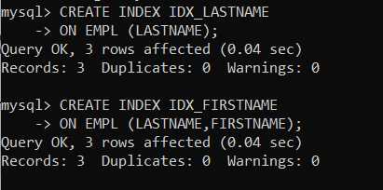
CREATE INDEX STATEMENT
Example:-
DROP INDEX Statement
The DROP INDEX statement is used to delete an index in a table.
ALTER TABLE table_name DROP INDEX index_name;

Slide 97
INSERT STATEMENT
MySQL INSERT statement is used to store or add data in MySQL table within the database. We can perform insertion of records in two ways using a single query in MySQL:
Insert record in a single row
Insert record in multiple rows

Slide 98
INSERT STATEMENT
INSERT RECORD IN A SINGLE ROW
Syntax:
INSERT INTO table_name ( field1, field2,...fieldN )
VALUES( value1, value2,...valueN );
NOTE: Field name is optional. If we want to specify partial values, the field name is mandatory. It also ensures that the column name and values should be the same. Also, the position of columns and corresponding values must be the same.

Slide 99
INSERT STATEMENT
INSERT RECORD IN MULTIPLE ROWS
Syntax:
INSERT INTO table_name VALUES
( value1, value2,...valueN )
( value1, value2,...valueN )
..........
( value1, value2,...valueN );

Slide 100
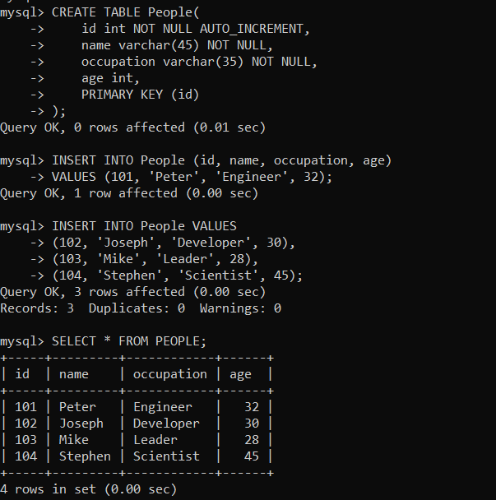
INSERT STATEMENT
Example:-

Slide 101
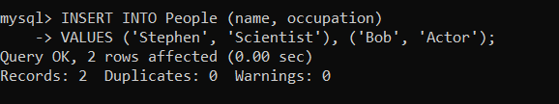
INSERT STATEMENT
If we want to store records without giving all fields, we use the following partial field statements. In such case, it is mandatory to specify field names.

Slide 102
SELECT STATEMENT
The SELECT statement in MySQL is used to fetch data from one or more tables. We can retrieve records of all fields or specified fields that match specified criteria using this statement.
SELECT STATEMENT SYNTAX
SELECT field_name1, field_name 2,... field_nameN
FROM table_name1, table_name2...
[WHERE condition]
[GROUP BY field_name(s)]
[HAVING condition]
[ORDER BY field_name(s)]
[OFFSET M ][LIMIT N];

Slide 103
SELECT STATEMENT
SYNTAX FOR ALL FIELDS:
SELECT * FROM tables [WHERE conditions]
[GROUP BY fieldName(s)]
[HAVING condition]
[ORDER BY fieldName(s)]
[OFFSET M ][LIMIT N];

Slide 104
PARAMETER EXPLANATION
Parameter Name | Descriptions
field_name(s) or * | It is used to specify one or more columns to returns in the result set. The asterisk (*) returns all fields of a table.
table_name(s) | It is the name of tables from which we want to fetch data.
WHERE | It is an optional clause. It specifies the condition that returned the matched records in the result set.
GROUP BY | It is optional. It collects data from multiple records and grouped them by one or more columns.
HAVING | It is optional. It works with the GROUP BY clause and returns only those rows whose condition is TRUE.
ORDER BY | It is optional. It is used for sorting the records in the result set.
OFFSET | It is optional. It specifies to which row returns first. By default, It starts with zero.
LIMIT | It is optional. It is used to limit the number of returned records in the result set.

Slide 105
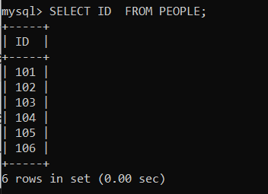
SELECT STATEMENT
If we want to retrieve a single column from the table, we need to execute the below query:

Slide 106
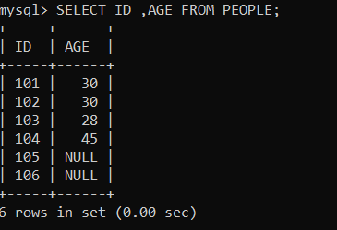
SELECT STATEMENT
If we want to query multiple columns from the table, we need to execute the below query:

Slide 107
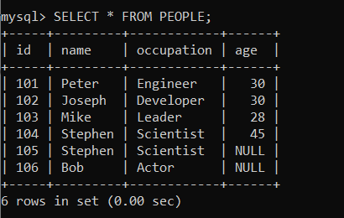
SELECT STATEMENT
If we want to fetch data from all columns of the table, we need to use all column's names with the select statement. Specifying all column names is not convenient to the user, so MySQL uses an asterisk (*) to retrieve all column data as follows:

Slide 108
WHERE CLAUSE
MySQL WHERE Clause is used with SELECT, INSERT, UPDATE and DELETE clause to filter the results. It specifies a specific position where you have to do the operation.
Syntax:
WHERE conditions;
Parameter:
conditions: It specifies the conditions that must be fulfilled for records to be selected.

Slide 109
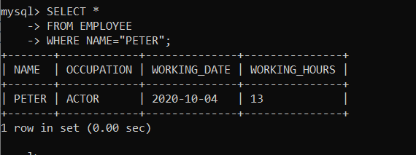
WHERE CLAUSE WITH SINGLE CONDITION
SELECT *
FROM EMPLOYEE
WHERE NAME = ’PETER';

Slide 110
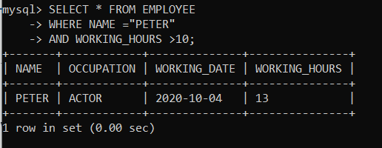
WHERE CLAUSE WITH AND CONDITION
In this example, we are retrieving data from the table "officers" with AND condition.
SELECT *
FROM officers
WHERE NAME = ’PETER'
AND WORKING_HOURS>10;

Slide 111
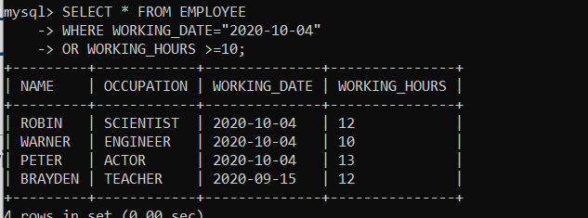
WHERE CLAUSE WITH OR CONDITION
SELECT *
FROM officers
WHERE WORKING_DATE =“2020-10-04”
OR WORKING_HOURS >=10;

Slide 112
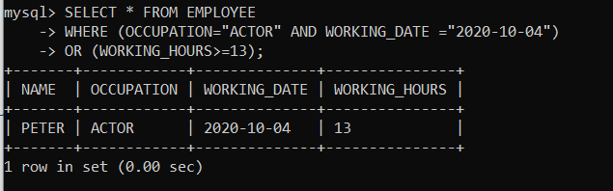
WHERE CLAUSE WITH COMBINATION OF AND & OR CONDITIONS
SELECT *
FROM officers
WHERE (OCCUPATION = ’ACTOR' AND WORKING_DATE = ’2020-10-04')
OR (WORKING_HOURS>= 13);

Slide 113
ORDER BY CLAUSE
The MYSQL ORDER BY Clause is used to sort the records in ascending or descending order.
Syntax:
SELECT expressions
FROM tables
[WHERE conditions]
ORDER BY expression [ ASC | DESC ];

Slide 114
ORDER BY CLAUSE
Parameters
expressions: It specifies the columns that you want to retrieve.
tables: It specifies the tables, from where you want to retrieve records. There must be at least one table listed in the FROM clause.
WHERE conditions: It is optional. It specifies conditions that must be fulfilled for the records to be selected.
ASC: It is optional. It sorts the result set in ascending order by expression (default, if no modifier is provider).
DESC: It is also optional. It sorts the result set in descending order by expression.

Slide 115
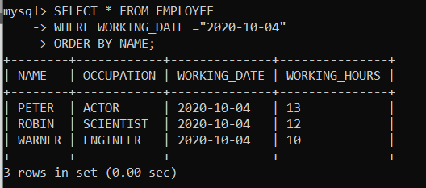
ORDER BY: WITHOUT USING ASC/DESC ATTRIBUTE
If you use MySQL ORDER BY clause without specifying the ASC and DESC modifier then by default you will get the result in ascending order.
SELECT *
FROM officers
WHERE address = 'Lucknow'
ORDER BY officer_name;

Slide 116
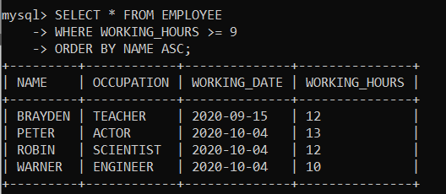
ORDER BY: WITH ASC ATTRIBUTE
Example to retrieve the data in ascending order.
SELECT *
FROM EMPLOYEE
WHERE WORKING_HOURS >=9
ORDER BY NAME ASC;

Slide 117
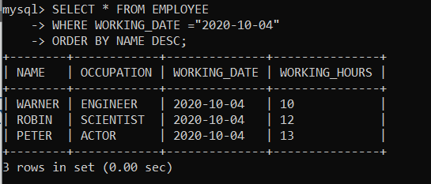
ORDER BY: WITH DESC ATTRIBUTE
SELECT *
FROM EMPLOYEE
WHERE WORKING_DATE= ’2020-10-04'
ORDER BY NAME DESC;

Slide 118
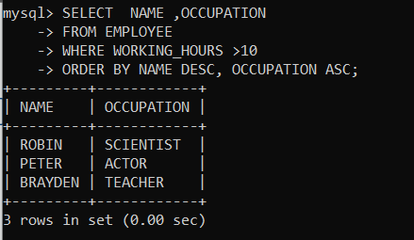
ORDER BY: USING BOTH ASC AND DESC ATTRIBUTES
SELECT NAME,OCCUPATION
FROM EMPLOYEE
WHERE WORKING_HOURS >10
ORDER BY NAME DESC, OCCUPATION ASC;

Slide 119
GROUP BY CLAUSE
The GROUP BY Clause is used to collect data from multiple records and group the result by one or more column. It is generally used in a SELECT statement.
You can also use some aggregate functions like COUNT, SUM, MIN, MAX, AVG etc. on the grouped column.
Syntax:
SELECT expression1, expression2, ... expression_n,
aggregate_function (expression)
FROM tables
[WHERE conditions]
GROUP BY expression1, expression2, ... expression_n;

Slide 120
GROUP BY CLAUSE
Parameters
expression1, expression2, ... expression_n: It specifies the expressions that are not encapsulated within an aggregate function and must be included in the GROUP BY clause.
aggregate_function: It specifies a function such as SUM, COUNT, MIN, MAX, or AVG etc. tables: It specifies the tables, from where you want to retrieve the records. There must be at least one table listed in the FROM clause.
WHERE conditions: It is optional. It specifies the conditions that must be fulfilled for the records to be selected.

Slide 121
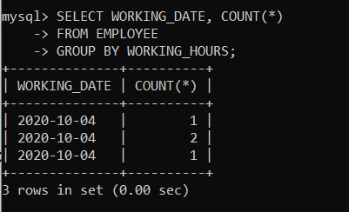
GROUP BY CLAUSE WITH COUNT FUNCTION
let's count repetitive number of WORKING_HOURS in the column WORKING_HOURS.
SELECT WORKING_HOURS, COUNT(*)
FROM EMPLOYEE
GROUP BY WORKING_HOURS;

Slide 122
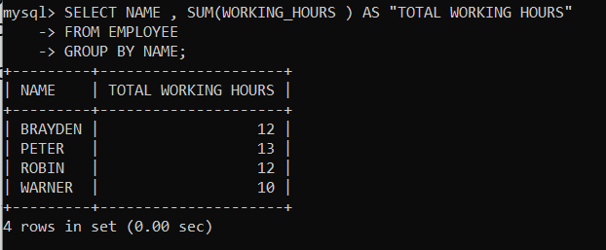
GROUP BY CLAUSE WITH SUM FUNCTION
Now, the following query will GROUP BY the example using the SUM function and return the emp_name and total working hours of each employee.
SELECT emp_name, SUM(working_hours) AS "Total working hours"
FROM employees
GROUP BY emp_name;

Slide 123
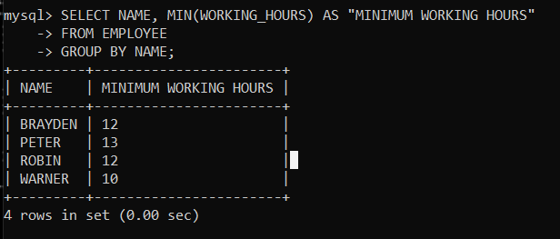
GROUP BY CLAUSE WITH MIN FUNCTION
The following example specifies the minimum working hours of the employees form the table "employees".
Execute the following query:
SELECT emp_name, MIN(working_hours) AS "Minimum working hour"
FROM employees
GROUP BY emp_name;

Slide 124
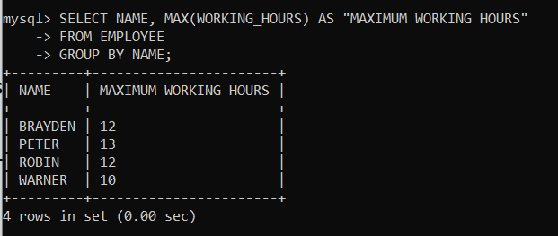
GROUP BY CLAUSE WITH MAX FUNCTION
The following example specifies the maximum working hours of the employees form the table "employees".
SELECT emp_name, MAX (working_hours) AS "Minimum working hour"
FROM employees
GROUP BY emp_name;

Slide 125
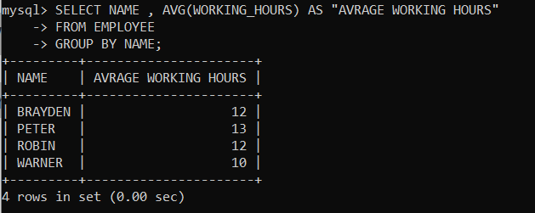
GROUP BY CLAUSE WITH AVG FUNCTION
The following example specifies the average working hours of the employees form the table "employees".
SELECT emp_name, AVG(working_hours) AS "Average working hour"
FROM employees
GROUP BY emp_name;

Slide 126
JOINS
JOINS are used with SELECT statement. It is used to retrieve data from multiple tables. It is performed whenever you need to fetch records from two or more tables.
There are three types of MYSQL joins:
MySQL INNER JOIN (or sometimes called simple join)
MySQL LEFT OUTER JOIN (or sometimes called LEFT JOIN)
MySQL RIGHT OUTER JOIN (or sometimes called RIGHT JOIN)

Slide 127
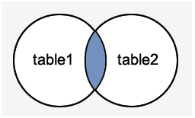
INNER JOIN (SIMPLE JOIN)
The MySQL Inner Join is used to returns only those results from the tables that match the specified condition and hides other rows and columns. MySQL assumes it as a default Join, so it is optional to use the Inner Join keyword with the query.
We can understand it with the following visual representation where Inner Joins returns only the matching results from table1 and table2:

Slide 128
INNER JOIN (SIMPLE JOIN)
Inner Join Syntax:
The Inner Join keyword is used with the SELECT statement and must be written after the FROM clause.
SELECT columns
FROM table1
INNER JOIN table2 ON condition1
INNER JOIN table3 ON condition2 ...;

Slide 129
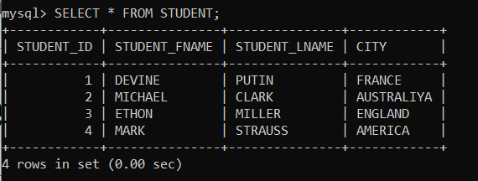

INNER JOIN (SIMPLE JOIN)
Example
Let us first create two tables "students" and "technologies" that contains the following data:

Slide 130

INNER JOIN (SIMPLE JOIN)
To select records from both tables, execute the following query:
SELECT STUDENT.STUDENT_FNAME, STUDENT.STUDENT_LNAME, STUDENT.CITY, TECHNOLOGY.TECHNOLOGY
FROM STUDENT
INNER JOIN TECHNOLOGY
ON STUDENTS.STUDENT_ID = TECHNOLOGY.TECH_ID;

Slide 131

INNER JOIN WITH GROUP BY CLAUSE
The Inner Join can also be used with the GROUP BY clause. The following statement returns student id, technology name, city, and institute name using the Inner Join clause with the GROUP BY clause.
SELECT STUDENTS.STUDENT_ID, TECHNOLOGY.INST_NAME, STUDENTS.CITY, TECHNOLOGY.TECHNOLOGY
FROM STUDENT
INNER JOIN TECHNOLOGY
ON STUDENTS.STUDENT_ID = TECHNOLOGY.TECH_ID GROUP BY INST_NAME;

Slide 132

INNER JOIN WITH WHERE CLAUSE
The WHERE clause enables you to return the filter result. The following example illustrates this clause with Inner Join:
SELECT TECH_ID, INST_NAME, CITY, TECHNOLOGY
FROM STUDENTS
INNER JOIN TECHNOLOGY
USING (STUDENT_ID) WHERE TECHNOLOGY = "JAVA";

Slide 133

LEFT JOIN
The Left Join in MySQL is used to query records from multiple tables. This clause is similar to the Inner Join clause that can be used with a SELECT statement immediately after the FROM keyword. When we use the Left Join clause, it will return all the records from the first (left-side) table, even no matching records found from the second (right side) table. If it will not find any matches record from the right side table, then returns null.
We can understand it with the following visual representation where Left Joins returns all records from the left-hand table and only the matching records from the right side table:

Slide 134
LEFT JOIN
LEFT JOIN Syntax
The following syntax explains the Left Join clause to join the two or more tables:
SELECT columns
FROM table1
LEFT [OUTER] JOIN table2
ON Join_Condition;

Slide 135


LEFT JOIN
LEFT JOIN Example
LEFT JOIN clause for joining two tables
we are going to create two tables "customers" and "orders" that contains the following data:

Slide 136

LEFT JOIN
LEFT JOIN clause for joining two tables

Slide 137

LEFT JOIN WITH GROUP BY CLAUSE
The Left Join can also be used with the GROUP BY clause. The following statement returns customer id, customer name, qualification, price, and date using the Left Join clause with the GROUP BY clause.

Slide 138

LEFT JOIN WITH WHERE CLAUSE
The WHERE clause is used to return the filter result from the table. The following example illustrates this with the Left Join clause:

Slide 139

RIGHT JOIN
The Right Join is used to joins two or more tables and returns all rows from the right-hand table, and only those results from the other table that fulfilled the join condition. If it finds unmatched records from the left side table, it returns Null value. It is similar to the Left Join, except it gives the reverse result of the join tables. It is also known as Right Outer Join. So, Outer is the optional clause used with the Right Join.
We can understand it with the following visual representation where Right Outer Join returns all records from the left-hand table and only the matching records from the other table:

Slide 140
RIGHT JOIN
RIGHT JOIN Syntax
SELECT column_list
FROM Table1
RIGHT [OUTER] JOIN Table2
ON join_condition;

Slide 141
RIGHT JOIN
RIGHT JOIN clause for joining two tables
Here, we are going to create two tables "customers" and "orders" that contains the following data:

Slide 142

RIGHT JOIN
RIGHT JOIN clause for joining two tables

Slide 143

RIGHT JOIN WITH WHERE CLAUSE
MySQL uses the WHERE clause to provide the filter result from the table. The following example illustrates this with the Right Join clause:

Slide 144

CROSS JOIN
CROSS JOIN is used to combine all possibilities of the two or more tables and returns the result that contains every row from all contributing tables. The CROSS JOIN is also known as CARTESIAN JOIN, which provides the Cartesian product of all associated tables. The Cartesian product can be explained as all rows present in the first table multiplied by all rows present in the second table. It is similar to the Inner Join, where the join condition is not available with this clause.
We can understand it with the following visual representation where CROSS JOIN returns all the records from table1 and table2, and each row is the combination of rows of both tables.

Slide 145
CROSS JOIN
CROSS JOIN Syntax
The CROSS JOIN keyword is always used with the SELECT statement and must be written after the FROM clause.
SELECT column-lists
FROM table1
CROSS JOIN table2;

Slide 146

CROSS JOIN
CROSS JOIN clause for joining two tables
Here, we are going to create two tables "customers" and "contacts" that contains the following data:

Slide 147

CROSS JOIN
CROSS JOIN clause for joining two tables

Slide 148
SELF JOIN
A SELF JOIN is a join that is used to join a table with itself.
There is a need to combine data with other data in the same table itself.
SELF JOIN Syntax
SELECT s1.col_name, s2.col_name...
FROM table1 s1, table1 s2
WHERE s1.common_col_name = s2.common_col_name;

Slide 149

SELF JOIN
Example
create a table "student" in a database that contains the following data:

Slide 150

SELF JOIN
Example
we are going to get all the result (student_id and name) from the table where student_id is equal, and course_id is not equal.

Slide 151
UNION OPERATOR
The UNION operator is used to combine the result-set of two or more SELECT statements.
Every SELECT statement within UNION must have the same zz of columns
The columns must also have similar data types
The columns in every SELECT statement must also be in the same order
UNION Syntax
SELECT column_name(s) FROM table1 UNION SELECT column_name(s) FROM table2;

Slide 152
UNION OPERATOR
UNION ALL Syntax
The UNION operator selects only distinct values by default. To allow duplicate values, use UNION ALL:
SELECT column_name(s) FROM table1 UNION ALL SELECT column_name(s) FROM table2;

Slide 153

UNION OPERATOR
UNION Example
The following SQL statement returns the cities (only distinct values) from both the "Customers" and the "Suppliers" table:

Slide 154

UNION OPERATOR
Example
Note: If some customers or suppliers have the same city, each city will only be listed once, because UNION selects only distinct values. Use UNION ALL to also select duplicate values!

Slide 155

UNION OPERATOR
UNION ALL Example
The following SQL statement returns the cities (duplicate values also) from both the "Customers" and the "Suppliers" table:

Slide 156

UNION OPERATOR
UNION With WHERE
The following SQL statement returns the German cities (only distinct values) from both the "Customers" and the "Suppliers" table:

Slide 157

UNION OPERATOR
UNION ALL With WHERE
The following SQL statement returns the German cities (duplicate values also) from both the "Customers" and the "Suppliers" table:

Slide 158

UNION OPERATOR
UNION Example
The following SQL statement lists all customers and suppliers:

Slide 159
AGGREGATE FUNCTIONS
MySQL's aggregate function is used to perform calculations on multiple values and return the result in a single value like the average of all values, the sum of all values, and maximum & minimum value among certain groups of values. We mostly use the aggregate functions with SELECT statements in the data query languages.
Syntax:
The following are the syntax to use aggregate functions in MySQL:
function_name (DISTINCT | ALL expression)

Slide 160
AGGREGATE FUNCTIONS
There are various aggregate functions available in MySQL. Some of the most commonly used aggregate functions are summarised in the below table:
Aggregate Function | Descriptions
count() | It returns the number of rows, including rows with NULL values in a group.
sum() | It returns the total summed values (Non-NULL) in a set.
average() | It returns the average value of an expression.
min() | It returns the minimum (lowest) value in a set.
max() | It returns the maximum (highest) value in a set.
groutp_concat() | It returns a concatenated string.
first() | It returns the first value of an expression.
last() | It returns the last value of an expression.

Slide 161
COUNT() FUNCTION
MySQL count() function returns the total number of values in the expression. This function produces all rows or only some rows of the table based on a specified condition, and its return type is BIGINT. It returns zero if it does not find any matching rows. It can work with both numeric and non-numeric data types.
Suppose we want to get the total number of employees in the employee table, we need to use the count() function as shown in the following query:
mysql> SELECT COUNT(name) FROM employee;

Slide 162

COUNT() FUNCTION
Example

Slide 163

SUM() FUNCTION
The MySQL sum() function returns the total summed (non-NULL) value of an expression. It returns NULL if the result set does not have any rows. It works with numeric data type only.
Suppose we want to calculate the total number of working hours of all employees in the table, we need to use the sum() function as shown in the following query:
mysql> SELECT SUM(working_hours) AS "Total working hours" FROM employee;

Slide 164

AVG() FUNCTION
MySQL AVG() function calculates the average of the values specified in the column. Similar to the SUM() function, it also works with numeric data type only.
Suppose we want to get the average working hours of all employees in the table, we need to use the AVG() function as shown in the following query:
mysql> SELECT AVG(working_hours) AS "Average working hours" FROM employee;

Slide 165

MIN() FUNCTION
MySQL MIN() function returns the minimum (lowest) value of the specified column. It also works with numeric data type only.
Suppose we want to get minimum working hours of an employee available in the table, we need to use the MIN() function as shown in the following query:
mysql> SELECT MIN(working_hours) AS Minimum_working_hours FROM employee;

Slide 166

MAX() FUNCTION
MySQL MAX() function returns the maximum (highest) value of the specified column. It also works with numeric data type only.
Suppose we want to get maximum working hours of an employee available in the table, we need to use the MAX() function as shown in the following query:
mysql> SELECT MAX(working_hours) AS Maximum_working_hours FROM employee;

Slide 167

FIRST() FUNCTION
This function returns the first value of the specified column. To get the first value of the column, we must have to use the LIMIT clause. It is because FIRST() function only supports in MS Access.
Suppose we want to get the first working date of an employee available in the table, we need to use the following query:
mysql> SELECT working_date FROM employee LIMIT 1;

Slide 168

LAST() FUNCTION
This function returns the last value of the specified column. To get the last value of the column, we must have to use the ORDER BY and LIMIT clause. It is because the LAST() function only supports in MS Access.
Suppose we want to get the last working hour of an employee available in the table, we need to use the following query:
mysql> SELECT working_hours FROM employee ORDER BY name DESC LIMIT 1;

Slide 169
SUBQUERY
A subquery in MySQL is a query, which is nested into another SQL query and embedded with SELECT, INSERT, UPDATE or DELETE statement along with the various operators. We can also nest the subquery with another subquery. A subquery is known as the inner query, and the query that contains subquery is known as the outer query. The inner query executed first gives the result to the outer query, and then the main/outer query will be performed. MySQL allows us to use subquery anywhere, but it must be closed within parenthesis.

Slide 170
SUBQUERY
The following are the rules to use subqueries:
Subqueries should always use in parentheses.
If the main query does not have multiple columns for subquery, then a subquery can have only one column in the SELECT command.
We can use various comparison operators with the subquery, such as >, <, =, IN, ANY, SOME, and ALL. A multiple-row operator is very useful when the subquery returns more than one row.
We cannot use the ORDER BY clause in a subquery, although it can be used inside the main query.
***If we use a subquery in a set function, it cannot be immediately enclosed in a set function.

Slide 171
SUBQUERY
The following are the advantages of using subqueries:
The subqueries make the queries in a structured form that allows us to isolate each part of a statement.
The subqueries provide alternative ways to query the data from the table; otherwise, we need to use complex joins and unions.
The subqueries are more readable than complex join or union statements.

Slide 172
SUBQUERY
SUBQUERY SYNTAX
SELECT column_list (s) FROM table_name
WHERE column_name OPERATOR
(SELECT column_list (s) FROM table_name [WHERE])

Slide 173

SUBQUERY
Subquery Example
Suppose we have a table named “customer" that contains the following data:

Slide 174

SUBQUERY
Following is a simple SQL statement that returns the employee detail whose id matches in a subquery:

Slide 175

SUBQUERY WITH COMPARISON OPERATOR
A comparison operator is an operator used to compare values and returns the result, either true or false. The following comparison operators are used in MySQL <, >, =, <>, <=>, etc.
Following is a simple SQL statement that returns the customer detail whose income is more than 20000 with the help of subquery:

Slide 176

SUBQUERY WITH COMPARISON OPERATOR
find employee details with maximum income using a subquery.

Slide 177

SUBQUERY WITH IN OR NOT-IN OPERATOR
If the subquery produces more than one value, we need to use the IN or NOT IN operator with the WHERE clause.
Suppose we have a table named "Student1" and "Student2" that contains the following data:

Slide 178

SUBQUERY WITH IN OR NOT-IN OPERATOR
The following subquery with NOT IN operator returns the student1 detail who does not belong to Los Angeles City from both tables as follows:

Slide 179

SUBQUERY IN THE FROM CLAUSE
If we use a subquery in the FROM clause, MySQL will return the output from a subquery is used as a temporary table. We called this table as a derived table, inline views, or materialized subquery.
The following subquery returns the maximum, minimum, and average number of items in the order table:

Slide 180

CORRELATED SUBQUERIES
A correlated subquery in MySQL is a subquery that depends on the outer query. It uses the data from the outer query or contains a reference to a parent query that also appears in the outer query. MySQL evaluates it once from each row in the outer query.
EXAMPLE
We select an customer name and city whose income is higher than the average income of all employees in each city.

Slide 181
SUBQUERIES WITH EXISTS OR NOT EXISTS
The EXISTS operator is a Boolean operator that returns either true or false result. It is used with a subquery and checks the existence of data in a subquery. If a subquery returns any record at all, this operator returns true. Otherwise, it will return false. The NOT EXISTS operator used for negation that gives true value when the subquery does not return any row. Otherwise, it returns false. Both EXISTS and NOT EXISTS used with correlated subqueries.

Slide 182
SUBQUERIES WITH EXISTS OR NOT EXISTS
Suppose we have a table customer and order that contains the data as follows:

Slide 183

SUBQUERIES WITH EXISTS OR NOT EXISTS
The below SQL statements uses EXISTS operator to find the name, occupation, and Qualification of the customer who has placed at least one order.

Slide 184

SUBQUERIES WITH EXISTS OR NOT EXISTS
This statement uses NOT EXISTS operator that returns the customer details who have not placed an order.

Slide 185
SUBQUERIES WITH ALL, ANY, AND SOME
We can use a subquery which is followed by the keyword ALL, ANY, or SOME after a comparison operator. The following are the syntax to use subqueries with ALL, ANY, or SOME:
operand comparison_operator ANY (subquery)
operand comparison_operator ALL (subquery)
operand comparison_operator SOME (subquery)
The ALL keyword compares values with the value returned by a subquery. Therefore, it returns TRUE if the comparison is TRUE for ALL of the values returned by a subquery. The ANY keyword returns TRUE if the comparison is TRUE for ANY of the values returned by a subquery. The ANY and SOME keywords are the same because they are the alias of each other.

Slide 186

SUBQUERIES WITH ALL, ANY, AND SOME
ANY OPRATOR

Slide 187

SUBQUERIES WITH ALL, ANY, AND SOME
ALL OPRATOR

Slide 188

WHAT IS ETL?

Slide 189
INTRODUCTION TO ETL
ETL is a type of data integration that refers to the three steps (extract, transform, load) used to blend data from multiple sources. It's often used to build a data warehouse . During this process, data is taken (extracted) from a source system, converted (transformed) into a format that can be analyzed, and stored (loaded) into a data warehouse or other system. Extract, load, transform (ELT) is an alternate but related approach designed to push processing down to the database for improved performance.

Slide 190
WHY ETL IS IMPORTANT
When used with an enterprise data warehouse (data at rest), ETL provides deep historical context for the business.
By providing a consolidated view, ETL makes it easier for business users to analyze and report on data relevant to their initiatives.
ETL can improve data professionals’ productivity because it codifies and reuses processes that move data without requiring technical skills to write code or scripts.
ETL has evolved over time to support emerging integration requirements for things like streaming data.
Organizations need both ETL and ELT to bring data together, maintain accuracy and provide the auditing typically required for data warehousing, reporting and analytics.

Slide 191
HOW ETL WORKS
Extract
During data extraction, raw data is copied or exported from source locations to a staging area. Data management teams can extract data from a variety of data sources, which can be structured or unstructured. Those sources include but are not limited to:
SQL or NoSQL servers
CRM and ERP systems
Flat files
Email
Web pages

Slide 192
HOW ETL WORKS
2. Transform
In the staging area, the raw data undergoes data processing. Here, the data is transformed and consolidated for its intended analytical use case. This phase can involve the following tasks:
Filtering, cleansing, de-duplicating, validating, and authenticating the data.
Performing calculations, translations, or summarizations based on the raw data. This can include changing row and column headers for consistency, converting currencies or other units of measurement, editing text strings, and more.
Conducting audits to ensure data quality and compliance
Removing, encrypting, or protecting data governed by industry or governmental regulators
Formatting the data into tables or joined tables to match the schema of the target data warehouse.

Slide 193
HOW ETL WORKS
3. Load
In this last step, the transformed data is moved from the staging area into a target data warehouse. Typically, this involves an initial loading of all data, followed by periodic loading of incremental data changes and, less often, full refreshes to erase and replace data in the warehouse. For most organizations that use ETL, the process is automated, well-defined, continuous and batch-driven. Typically, ETL takes place during off-hours when traffic on the source systems and the data warehouse is at its lowest.

Slide 194

THANK YOU !!!
(USA)
2-Industrial Park Drive, E-Waldorf, MD, 20602,
United States
(USA)
+1-844-889-4054
(Singapore)
3 Temasek Avenue, Singapore 039190
info@careerera.com www.careerera.com
(INDIA)
B-44, Sector-59, Noida Uttar Pradesh 201301
(INDIA)
+91-92-5000-4000

