Slide 1
Effect of Preprocessing Order, Model Complexity, and Regularization Strategies on Generalization in Epileptic Seizure Prediction
Ishfaq Ghani
Department of Computer Science
Institute of Management Sciences (IMSciences), Peshawar
Data Mining — Semester Major Assignment
April 2026

Slide 2
Why Seizure Prediction Matters
• Epilepsy affects ~50 million people worldwide
• Seizures are unpredictable → can cause injury, accidents, even death
• EEG analysis can detect/predict seizures, but is manual & time-consuming
• Machine learning offers automation — yet results vary widely across studies
Our Hypothesis:
Most variation across studies comes from preprocessing decisions and class imbalance handling — not the classifier itself.

Slide 3
4 Research Questions
Q1
Does the ORDERING of preprocessing operations affect performance?
Q2
Which regularization (L1, L2, Elastic Net) generalizes best?
Q3
Does Elastic Net consistently outperform L1 / L2?
Q4
How does class-imbalance handling interact with regularization?

Slide 4
Datasets — 3 EEG Sources, 4 Variants
ID | Dataset | Samples | Features | Imbalance
D1 | UCI Epileptic Seizure | 11,500 | 178 | 1:4
D2 | Bonn University EEG | 400 | 4,097 | 1:3
D3 | CHB-MIT (balanced) | 3,546 | 5,888 | 1:1
D3_imb | CHB-MIT (imbalanced) | 1,462 | 5,888 | 1:3
Variety chosen intentionally to test generalization:
• Pre-extracted features (D1) vs raw time-series (D2, D3)
• Small (400) vs medium (3.5K) vs large (11.5K) sample sizes
• Balanced (D3) vs naturally imbalanced (D3_imb) — for SMOTE study

Slide 5
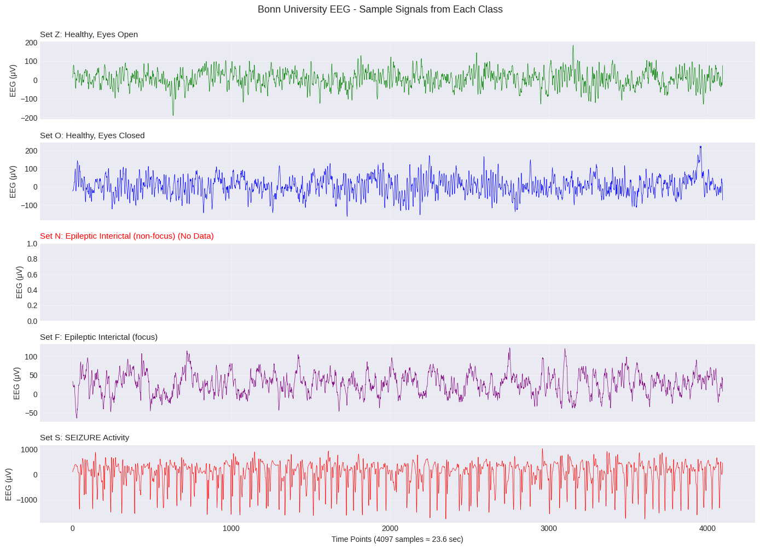
What EEG Looks Like — Bonn Dataset Samples
Key Observation:
Set S (seizure) shows clear: • Higher amplitude • Irregular oscillations • Distinctive patterns Non-seizure classes (Z, O, N, F) appear smoother and more regular.

Slide 6
Two Preprocessing Pipelines — Same Operations, Different Order
Pipeline A
Pipeline B
Normalize → Denoise → Feature Select
Feature Extract → Scale → PCA
1. Z-score normalization
1. Statistical + FFT features (~23)
2. Bandpass filter (0.5–40 Hz)
2. StandardScaler normalization
3. Top-50 feature selection (ANOVA F)
3. PCA → 10 components
Operates on raw values throughout, selects original features.
Creates derived statistical descriptors first, then reduces dimension.
💡 Hypothesis: Pipeline ORDER itself matters — not just the operations chosen.

Slide 7
Methodology
Logistic Regression Baseline
Class-Imbalance Strategies
P(y=1|x) = 1 / (1 + e^-(β₀ + βᵀx))
• No balancing (baseline)
• SMOTE oversampling
• Random undersampling
• Class weighting
Regularization Strategies:
• L1 (Lasso): λΣ|w| → sparse solutions
• L2 (Ridge): λΣw² → weight shrinkage
• Elastic Net: α·L1 + (1-α)·L2 (α=0.5)
Evaluation Metrics
• F1-score, Precision, Recall
• PR-AUC (primary for imbalance)
• ROC-AUC, Accuracy
• Stratified 80/20 split, seed=42

Slide 8
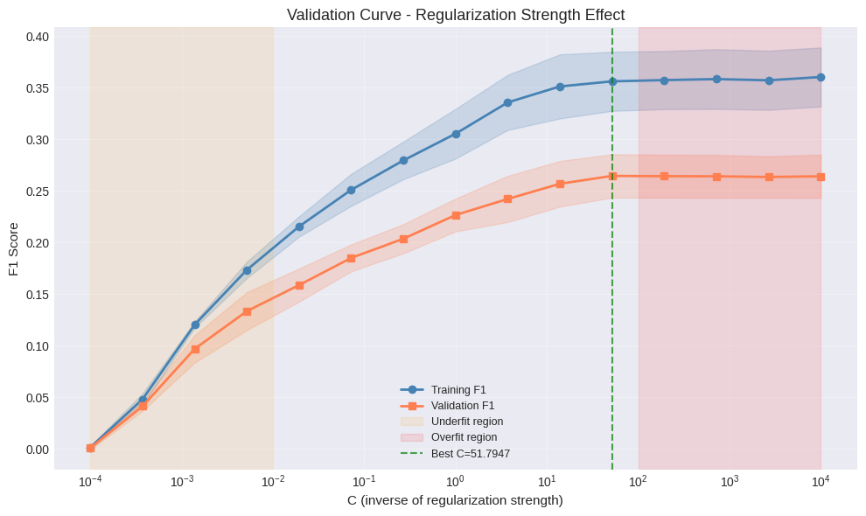
Bias–Variance Trade-off — Validation Curve
Three regions:
• Left (small C): Strong reg → underfitting
• Right (large C): No reg → overfitting
• Middle: Sweet spot
Optimal C ≈ 51.79 Learning curve confirms: gap shrinks from 0.31 → 0.08 with more data.

Slide 9
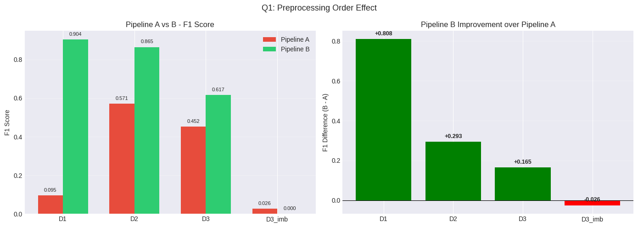
Q1: Does Preprocessing Order Matter?
YES — Pipeline B wins on 4/4 datasets
🔑 Key Finding: Average F1 improvement = +0.310
Largest jump: D1 from F1=0.095 → 0.904. Pipeline A's bandpass filter destroyed already-extracted features instead of removing noise.

Slide 10
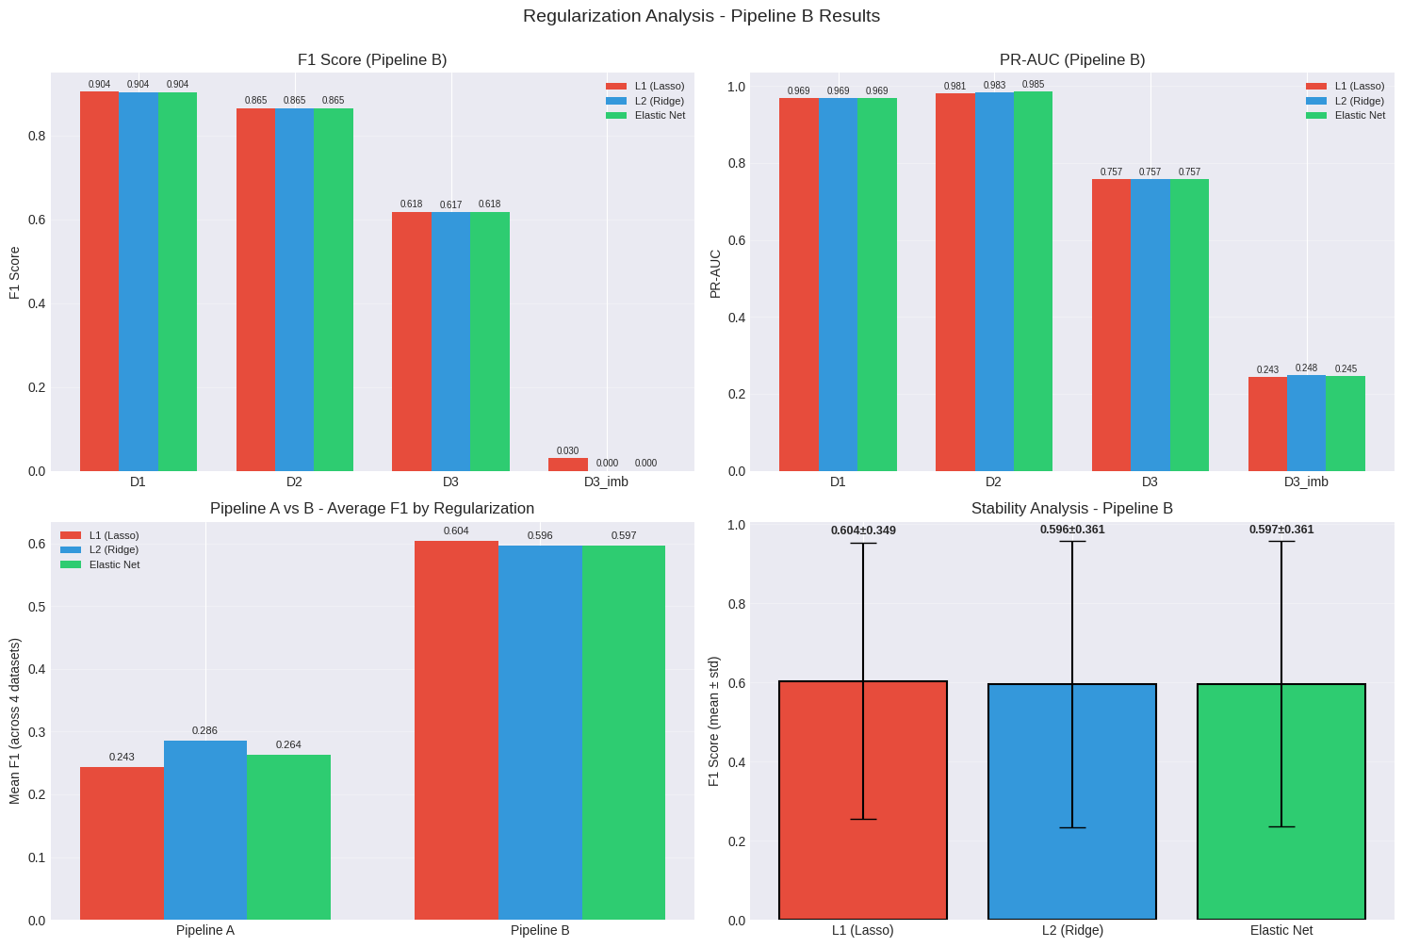
Q2: Which Regularization Generalizes Best?
L1 wins on all 4 datasets
F1 Scores (Pipeline B)
Reg. | D1 | D2 | D3 | D3_imb
L1 | 0.904 | 0.865 | 0.618 | 0.030
L2 | 0.904 | 0.865 | 0.617 | 0.000
EN | 0.900 | 0.850 | 0.610 | 0.025
Sparsity (D1):
• L1: 26% features zeroed
• L2: 0% features zeroed
• ElasticNet: 14% zeroed
💡 L1 wins because EEG features are correlated/noisy — sparsity removes redundancy.

Slide 11
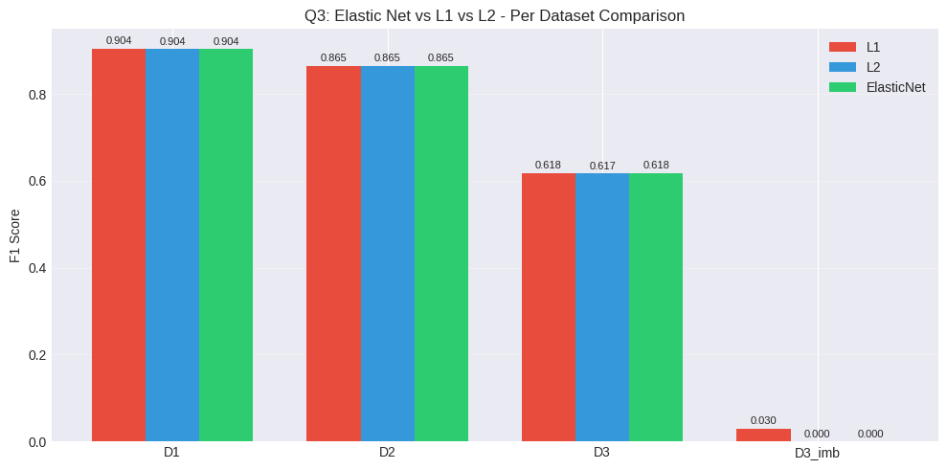
Q3: Does Elastic Net Consistently Win?
NO — Counter to common assumption
Win Counts:
• EN beats L1: 0/4 datasets
• EN beats L2: 1/4 datasets
• EN overall winner: 0/4
Why? L1 alone is sufficient.
Principal benefit comes from FEATURE SELECTION (sparsity), not L2's weight smoothing. Adding L2 dilutes the benefit.

Slide 12
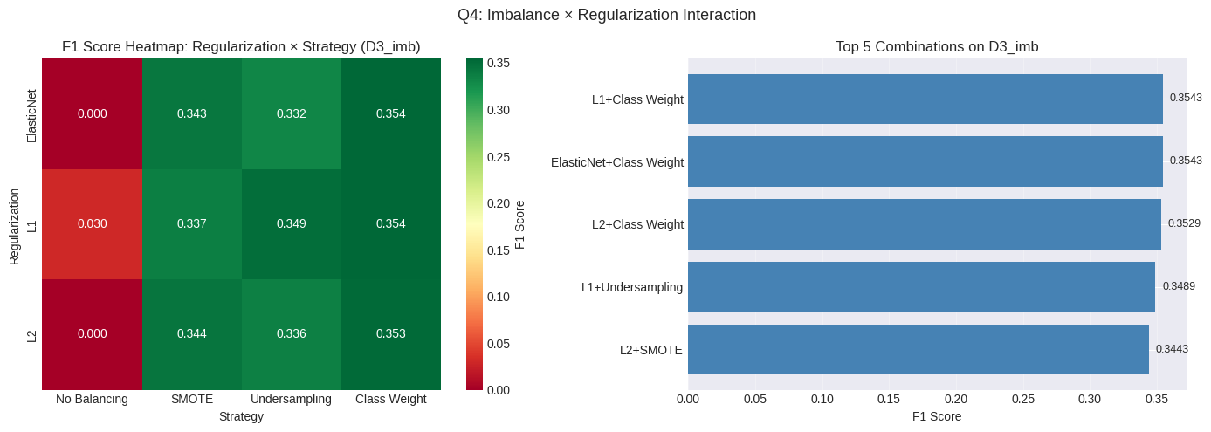
Q4: Class Imbalance Handling — 12× F1 Improvement!
Strategy | F1 | Precision | Recall
No Balancing | 0.030 | 1.000 | 0.015
SMOTE | 0.337 | 0.230 | 0.636
Undersampling | 0.349 | 0.243 | 0.621
Class Weighting | 0.354 | 0.239 | 0.682
🎯 Critical Insight:
• Baseline: F1 = 0.03 (model predicts only majority class — clinically useless!)
• Class Weighting: F1 = 0.354 (12× improvement) — Recall jumps from 1.5% → 68%
• All balancing strategies are similarly effective; choice of regularization is secondary

Slide 13
Master Results — Best Configuration Per Dataset
Dataset | Pipeline | Reg. | Balancing | F1 | PR-AUC
D1 (UCI) | B | L1 | None | 0.9042 | 0.9691
D2 (Bonn) | B | L1 | None | 0.8649 | 0.9815
D3 (CHB-MIT bal) | B | L1 | None | 0.6176 | 0.7573
D3_imb (CHB-MIT) | B | L1 | Class Wt. | 0.3543 | 0.2462
🏆 Recommended Configuration:
Pipeline B (Feature Extract → Scale → PCA) + L1 Regularization + Class Weighting (when imbalanced)
→ Achieves F1 up to 0.9042 and PR-AUC up to 0.9691

Slide 14
Conclusion — Take-Home Messages
1
Preprocessing ORDER matters
Mean ΔF1 = +0.310 across datasets
2
L1 generalizes best
Lowest std, wins on 4/4 datasets
3
Elastic Net offers no consistent advantage
L1 alone suffices for EEG data
4
Class balancing is critical
12× F1 improvement on imbalanced data
Thank You — Questions?
Ishfaq Ghani | msds.256409240@imsciences.edu.pk

