Slide 1







Training for the Future
Tuan Duong
February 21, 2022

Slide 2



OUTLINE
Executive Summary
Introduction
Methodology
Results
Visualization – Charts
Dashboard
Discussion
Findings & Implications
Conclusion
Appendix

Slide 3

EXECUTIVE SUMMARY
IBM is looking to invest money to their employees for future technology training.
This analysis will look at the present and future needs based on a survey.
Languages
Databases
Platforms
Web Frame
Then it will look at the demographics for diversity.
Lastly, a dashboard will be made for some EDA
To conclude, we will talk about the insight.

Slide 4

INTRODUCTION
This project is being presented in a role of a data analyst working for fictitious technology company, IBN.
It was prepared for the IBM Data Analyst Capstone.
This report includes the data analyst methodology, results, and conclusions on their findings.
IBN is looking invest in their employees to train them on future technology.
This presentation will look at the current technology.
Then look at what the future needs are.

Slide 5

METHODOLOGY
Data Collection
Data Wrangling
EDA: Data Visualization
Dashboard
Current Technology
Future Needs
Results

Slide 6
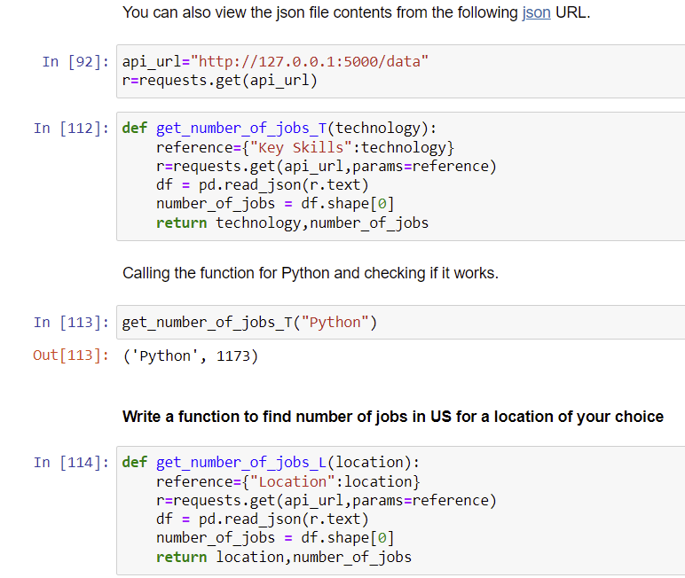
Data Collection
Data was collecting through an API
Data was collected through web scraping
Data was collected through a database

Slide 7
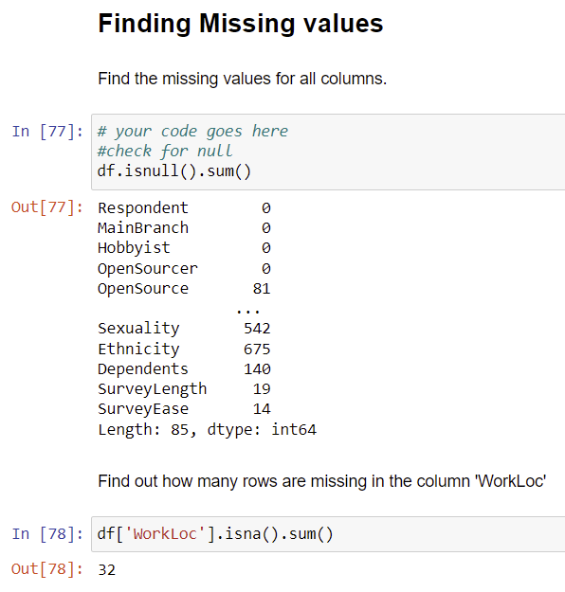
Data Wrangling
Data was cleaned with the following techniques
Look for duplicates
Drop duplicates
Look for Null values
Impute Null values
Look for outliers
Drop outliers
Normalized Data

Slide 8
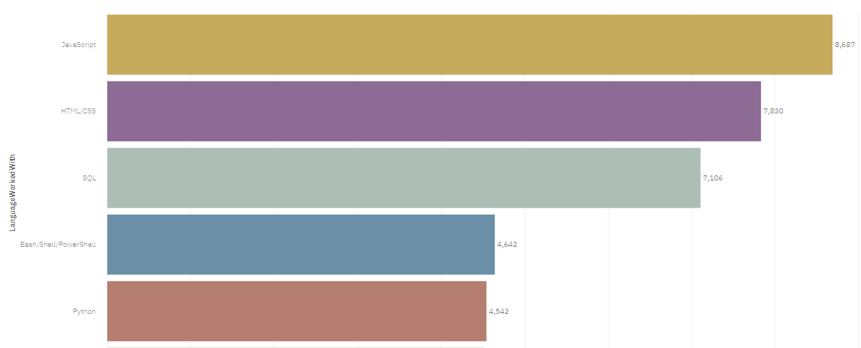
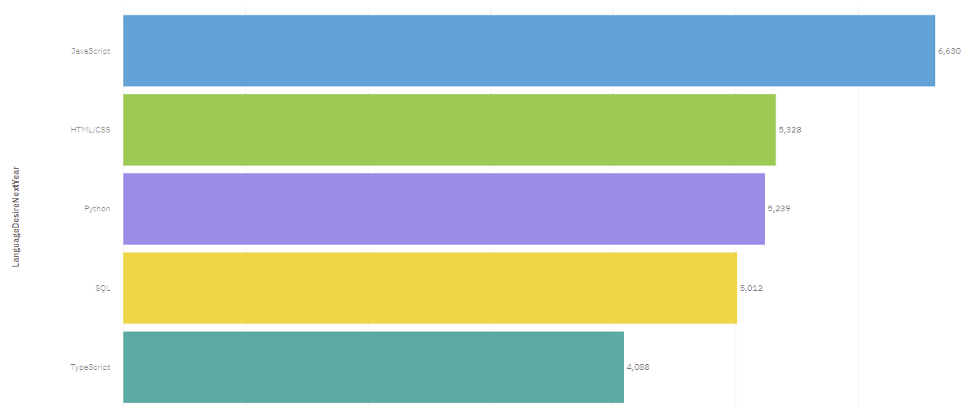
EDA: PROGRAMMING LANGUAGE TRENDS
Current Year
Next Year

Slide 9
PROGRAMMING LANGUAGE TRENDS - FINDINGS & IMPLICATIONS
Findings
Java Script is still most desired.
HTML is second.
Python is upcoming.
Implications
Should still invest in JavaScript
Should still invest in HTML
Look into Python/SQL next year.

Slide 10
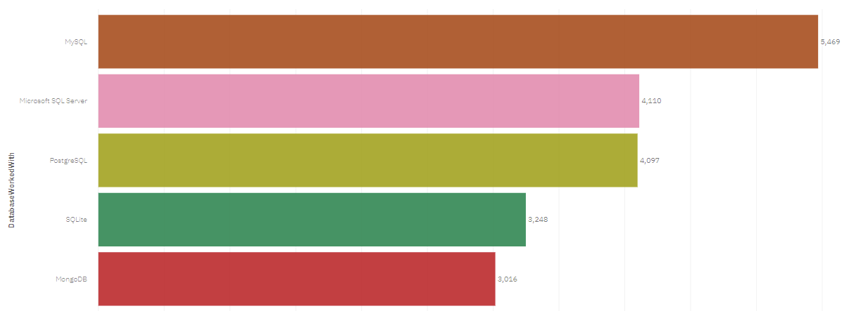
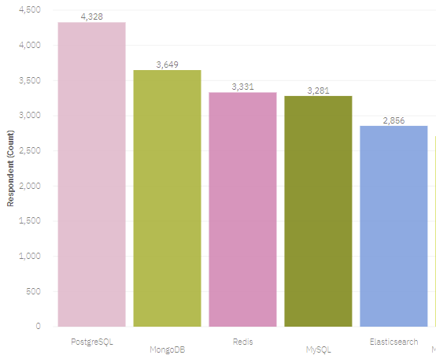
EDA: DATABASE TRENDS
Current Year
Next Year

Slide 11
DATABASE TRENDS - FINDINGS & IMPLICATIONS
Findings
PostgreSQL is most desired
Followed by MongoDB
Followed by Redis
Implications
Should invest in PostgreSQL
Maybe invest in MongoDB
Look for other upcoming databases next year.

Slide 12

DASHBOARD
Link to Dashboard
https://dataplatform.cloud.ibm.com/dashboards/6660ed24-2bfd-4555-b641-9cb236d2730c/view/6333c301339903ff6be9f2e4079078537e662c08b5bb810ad68d7b4907317997a93a1294c82e1908d8400667fabd155a98

Slide 13
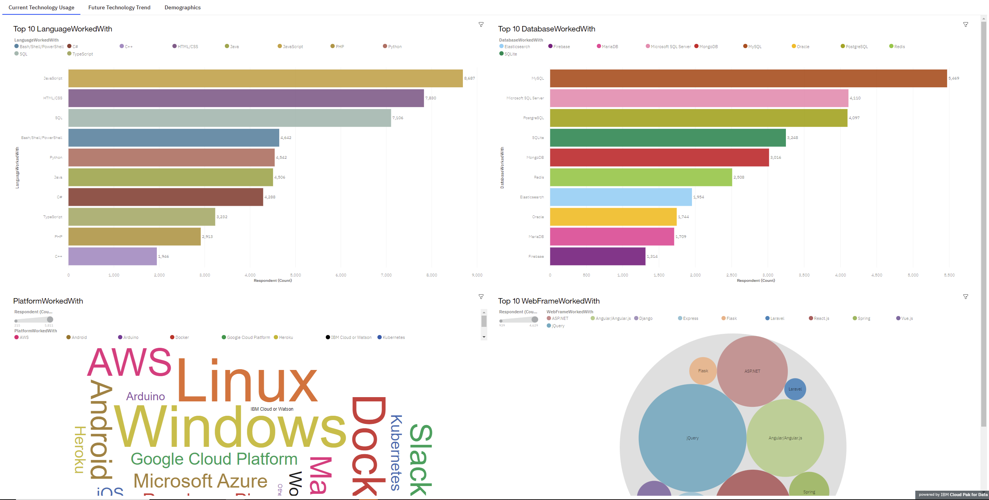
DASHBOARD TAB 1

Slide 14
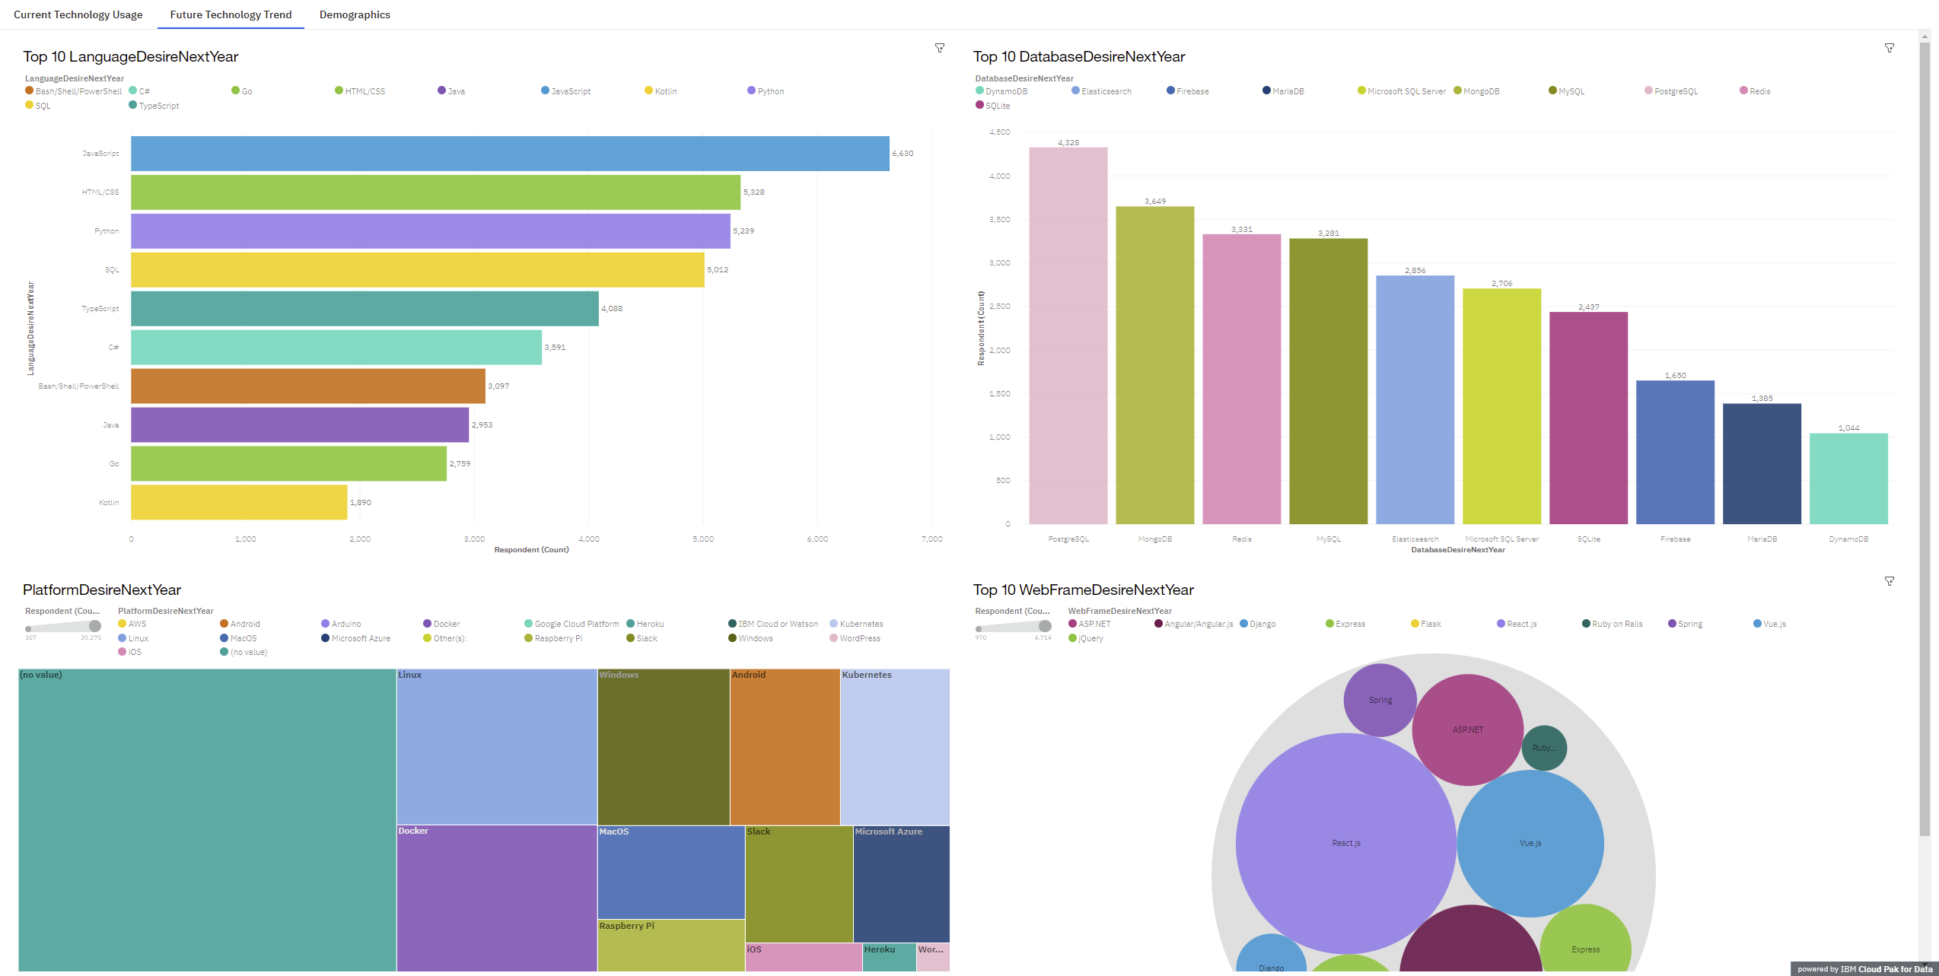
DASHBOARD TAB 2

Slide 15
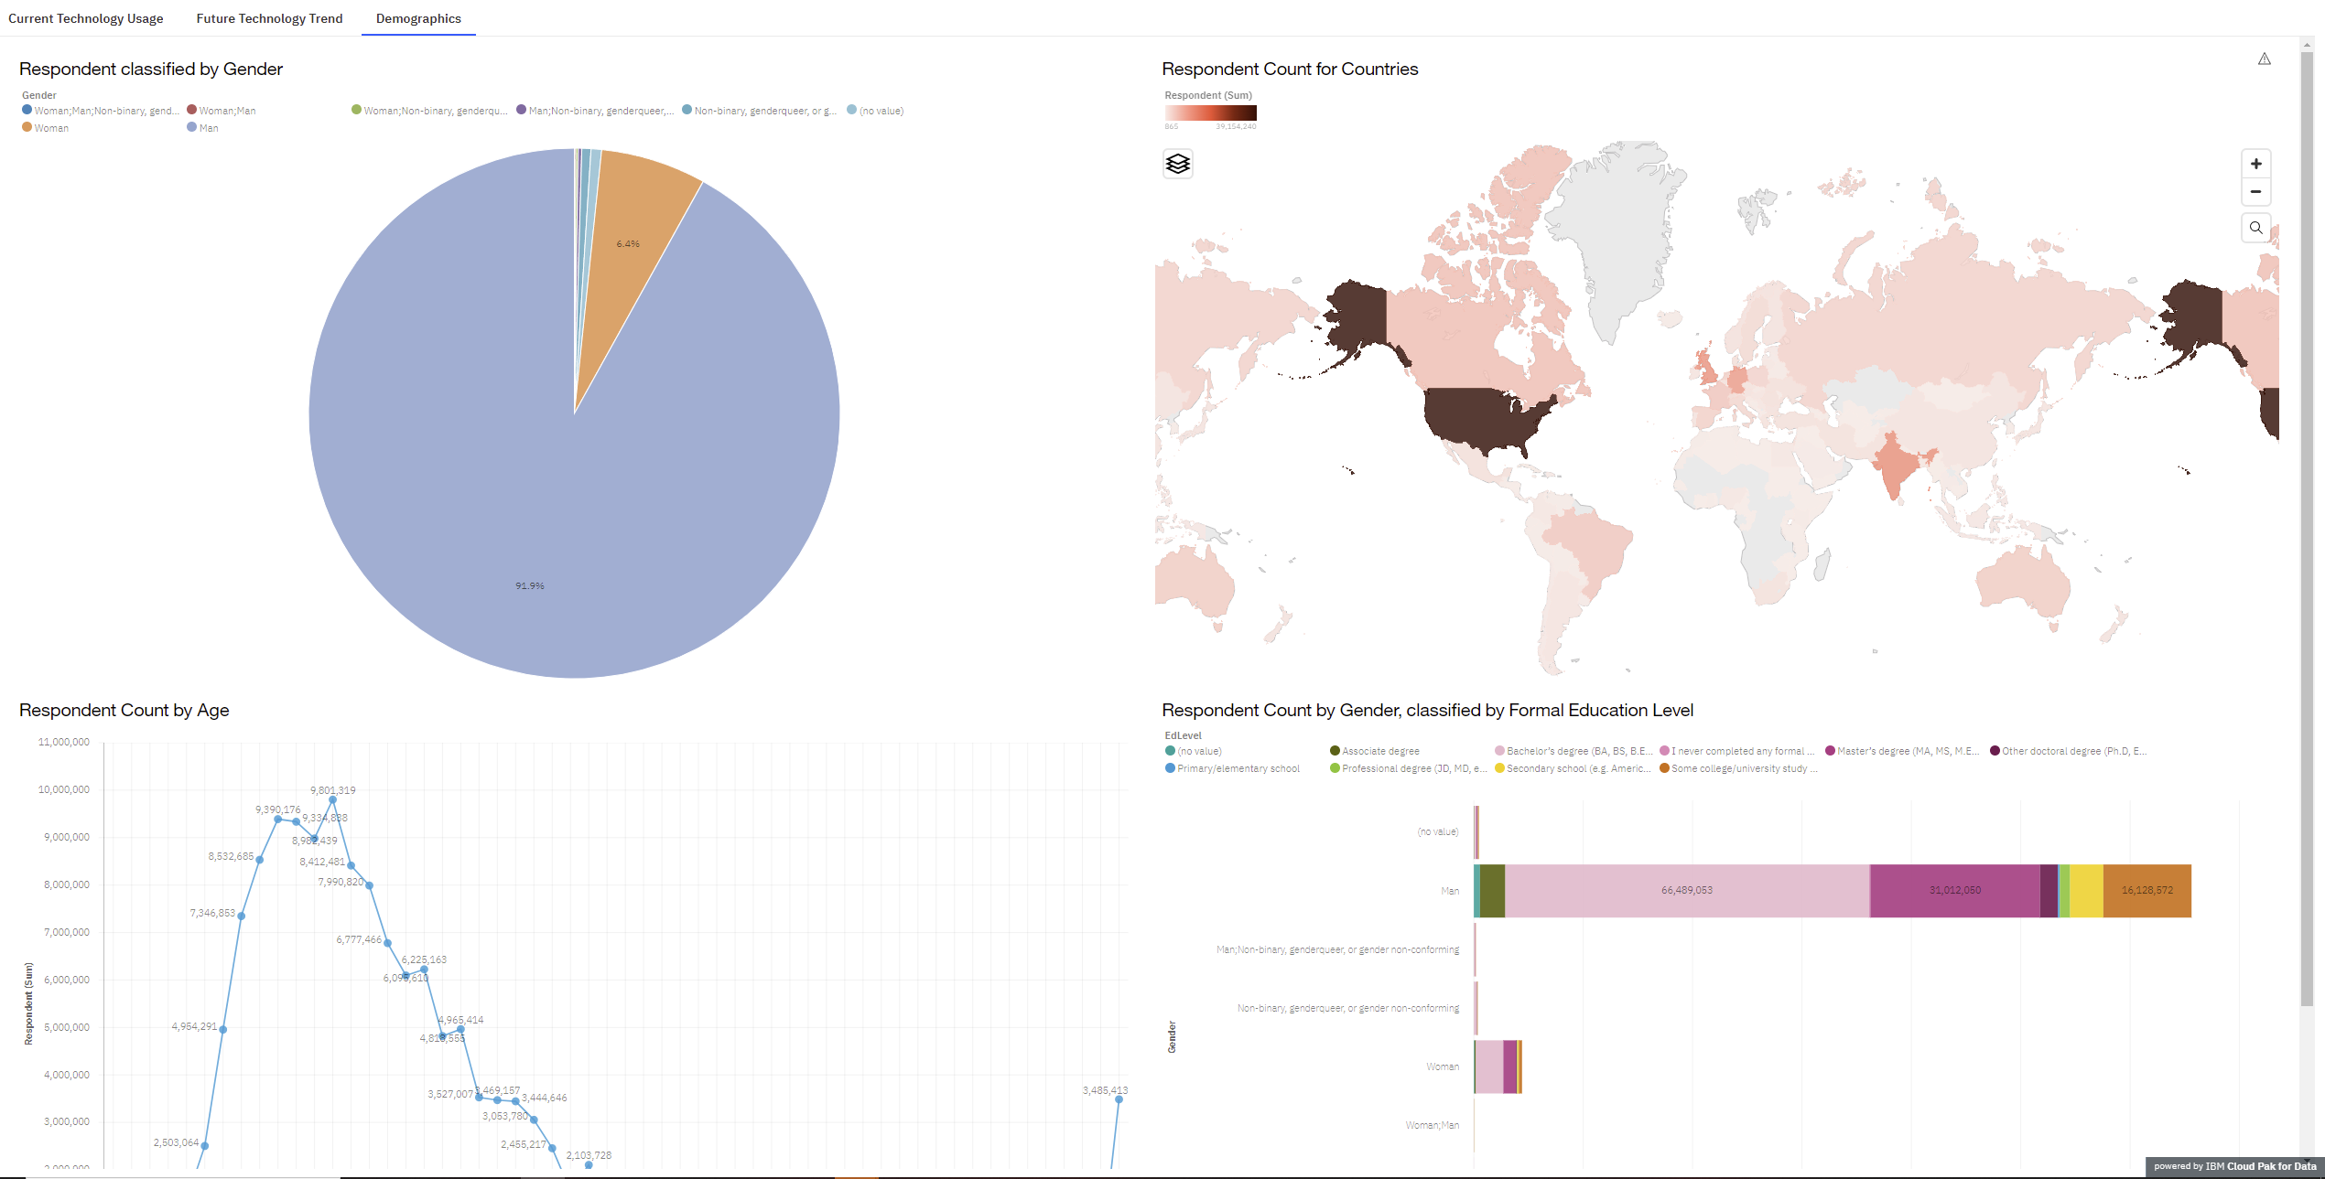
DASHBOARD TAB 3

Slide 16
OVERALL FINDINGS & IMPLICATIONS
Findings
Language developing is at a good spot
Database developing needs to be updated
Diversity may need to be looked at
Implications
No Change in Language
Should invest in new database training with PostgreSQL
Diversifying might help bring in different views

Slide 17
RESULTS
Results show that a shift technology may be trending
Research committee should be formed for technology that should be updated

Slide 18
DISCUSSION
Further research needs to be done for platform and web frame future technologies
One indication is database, web frame network, and platform technology may be changing
Board should discuss where is the best area to update

Slide 19

CONCLUSION
Data Analyst performed data acquisition, wrangling, and validation
Data Analyst went through an EDA through SQL, Data Visualization, and Dashboard making
Data Analyst looked through analysis for insight
Insight was found through a shift of technology needs.

Slide 20

APPENDIX
The project was created by the following applications: Python, Jupyter Notebook, SQLLite, IBM Cognos Microsoft Excel, Microsoft Power Point. These libraries were used in Python: Pandas, Numpy, Matplotlib, Seaborn, Requests, Beautiful Soup, API, and Wget.

Slide 21
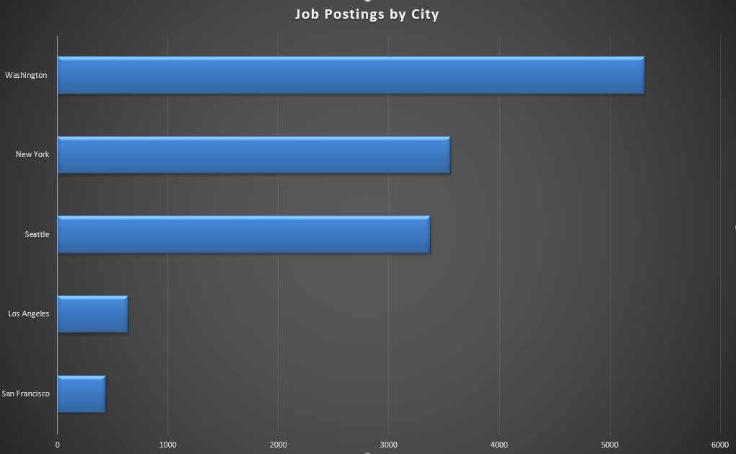
GITHUB JOB POSTINGS

Slide 22
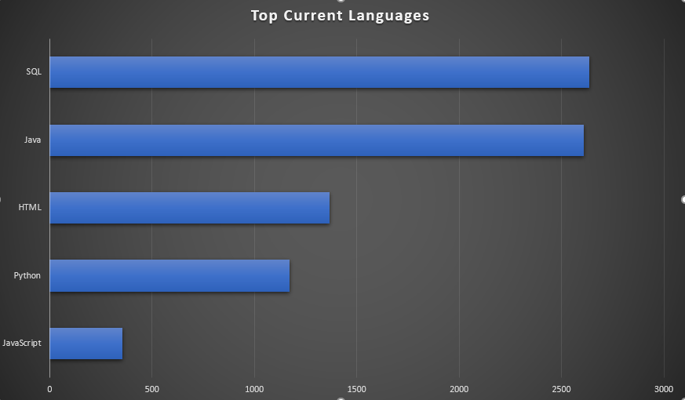
POPULAR LANGUAGES

