Slide 1
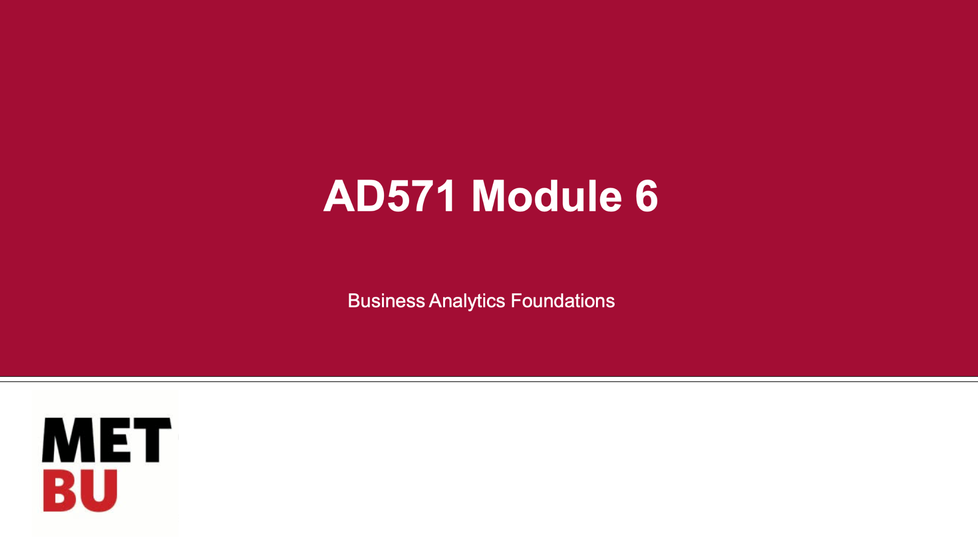
AD571 Final Presentation
Canarsie, NY
Igor Iasevych

Slide 2
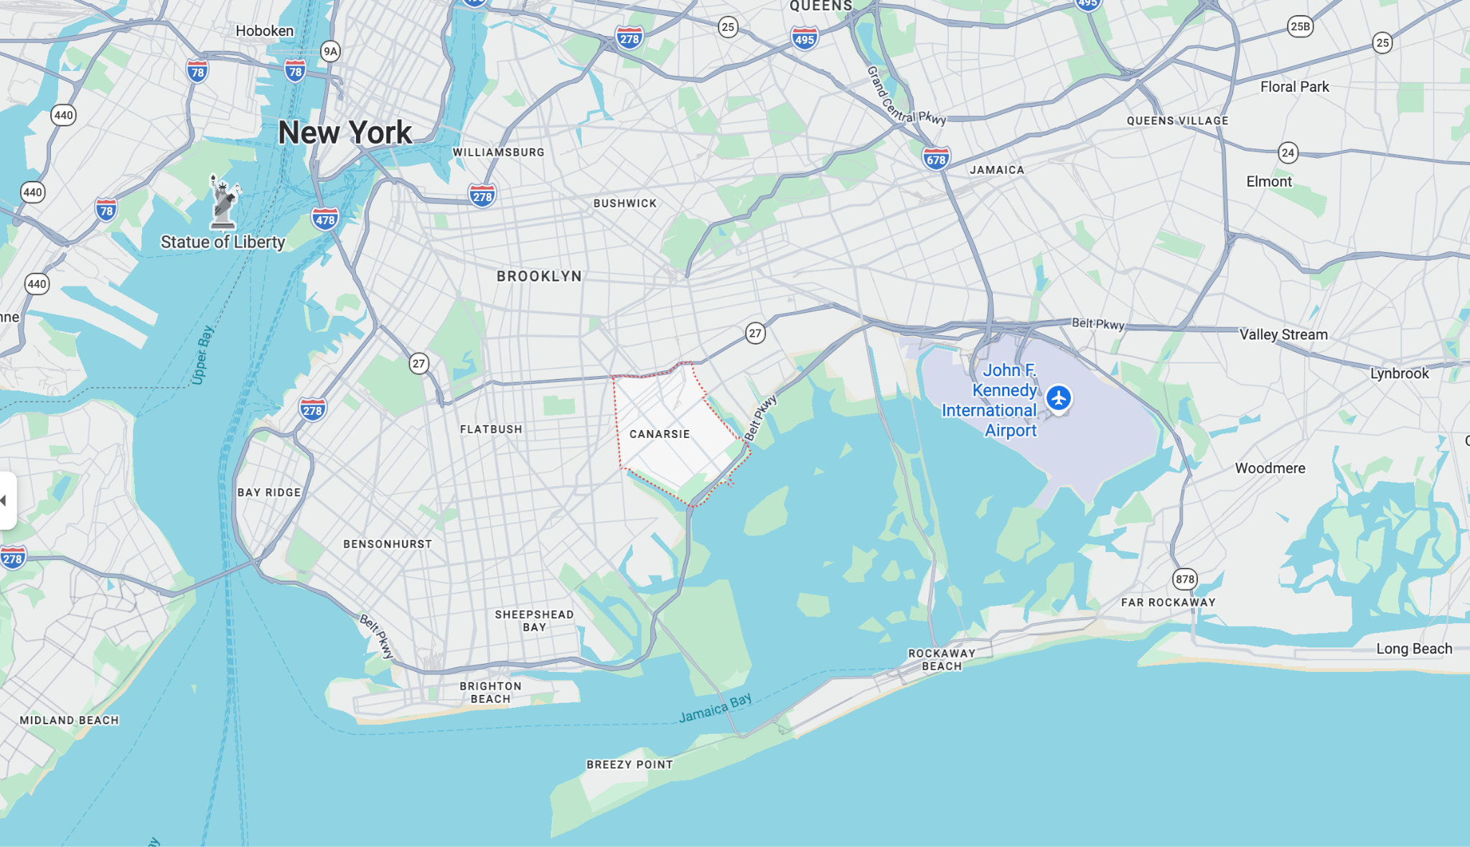
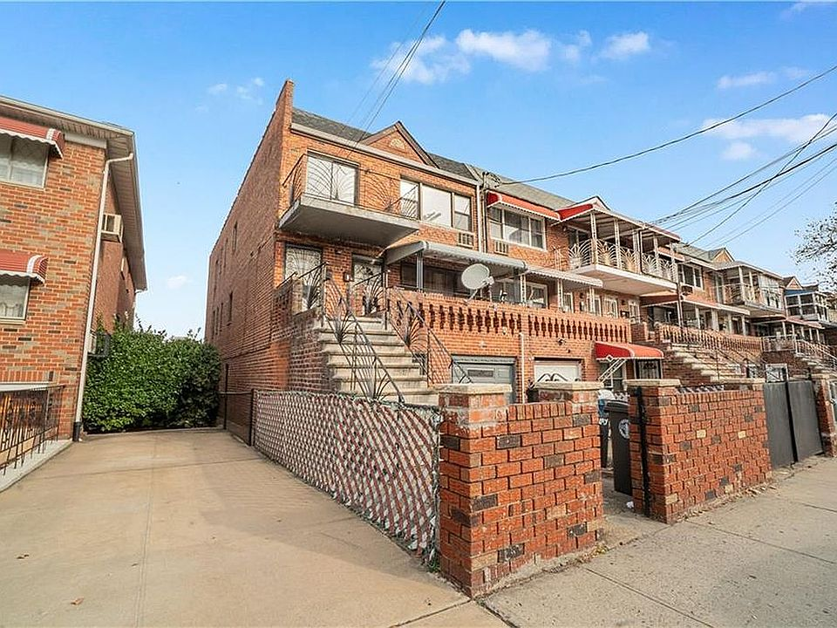
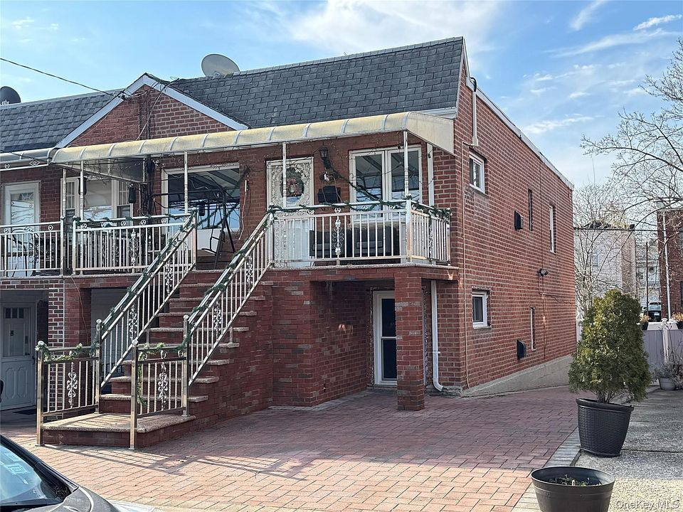
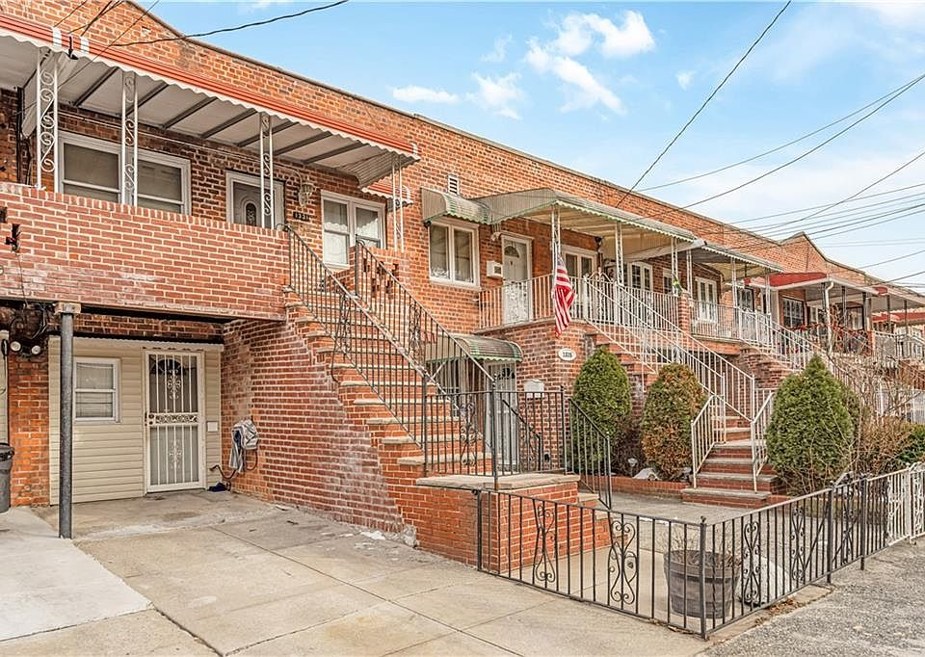
Canarsie, NY

Slide 3
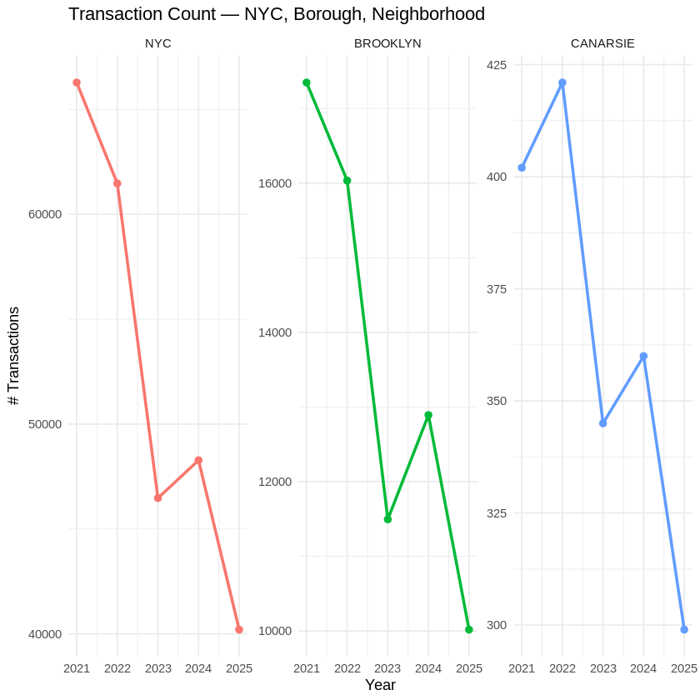
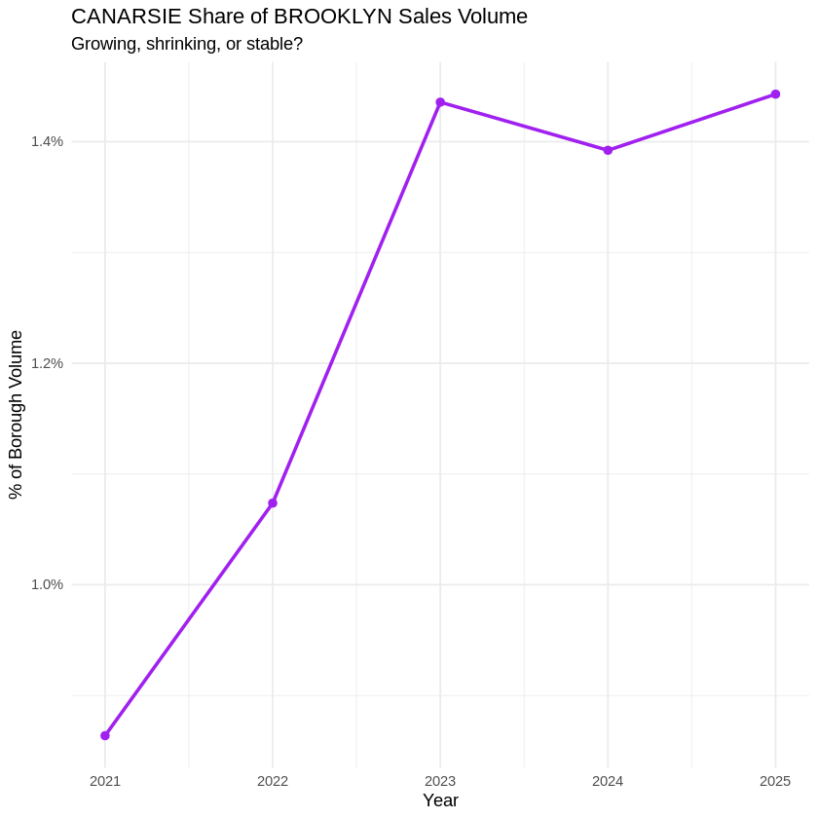
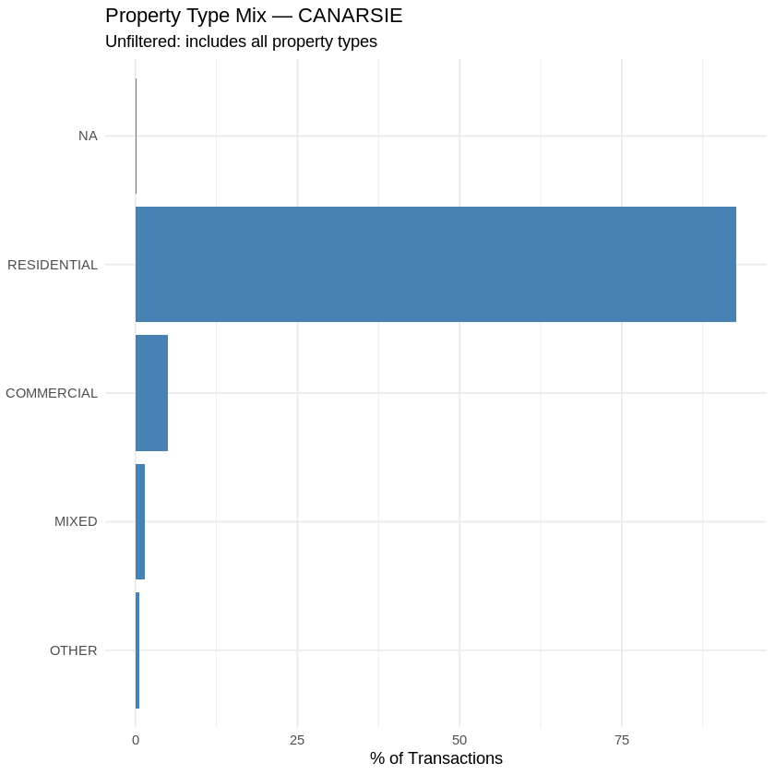
Canarsie is a small but resilient residential neighborhood
While home sales across NYC and Brooklyn nearly dropped by half after the 2021 peak, Canarsie’s numbers stayed relatively steady.
Canarsie is accounts for a small share of Brooklyn's total sales volume, its market footprint grew steadily from ~1% in 2021 to over 1.4% in 2025.
Nearly 92.7% of all market activity driven by home sales. Commercial represents only 5.06%.

Slide 4
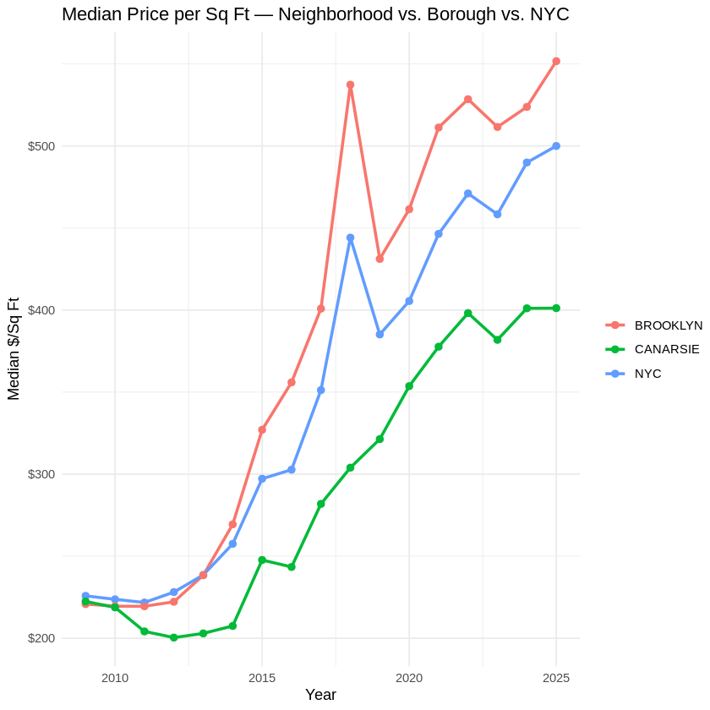
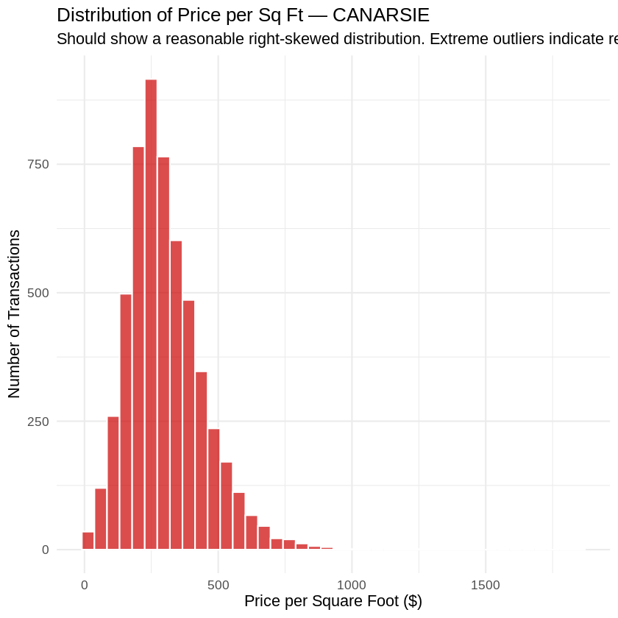
Price is a competitive advantage of Canarsie
Canarsie’s median price per square foot remains significantly lower than Brooklyn and NYC averages.
The neighborhood is a stable, middle-market area with an average price of $279.487 per square foot.
The average home price is $535,838 with 50% of homes selling in the narrow range from (1st Qu.) $380,188 to (3rd Qu.) $675,000.
Q1 | $380,188
Median | $525,000
Mean | $535,838
Q3 | $675,000
!
While sales price and gross square feet are key metrics, their weak correlation (0.326) indicates that other structural and neighborhood factors play an equally vital role in determining value.

Slide 5
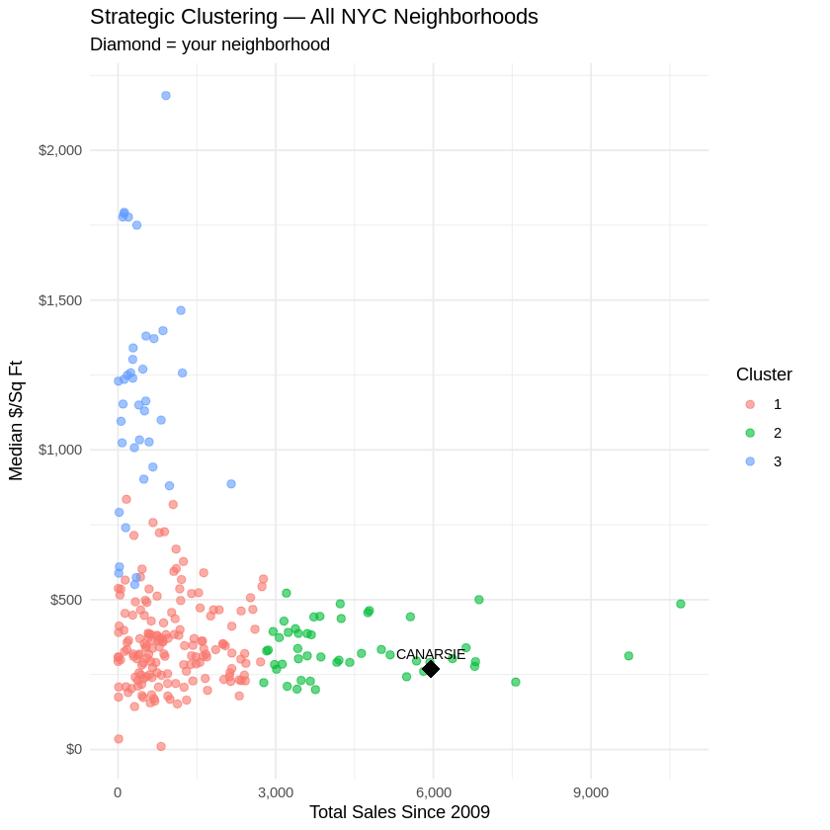
Canarsie belongs to Mid-Market cluster of NYC
1.Budget Basics: Represents reliable, multi-family residential areas with prices slightly higher Mid-Market and consistent sales volume.
2.Mid-Market: Cluster includes Canarsie, is the most liquid part of the market, featuring the highest transaction counts.
3.Luxury: Exclusive, low-volume neighborhoods where the price per square foot is nearly four times higher than the other clusters ($1,190 vs ~$340).
 | Average Price | Average Sales Number | Average Price per Sq Ft
1.Budget Basics | $805,073 | 1,004 | $355
2. Mid-Market | $643,079 | 4,564 | $337
3.Luxury | $3,672,112 | 439 | $1,190

Slide 6
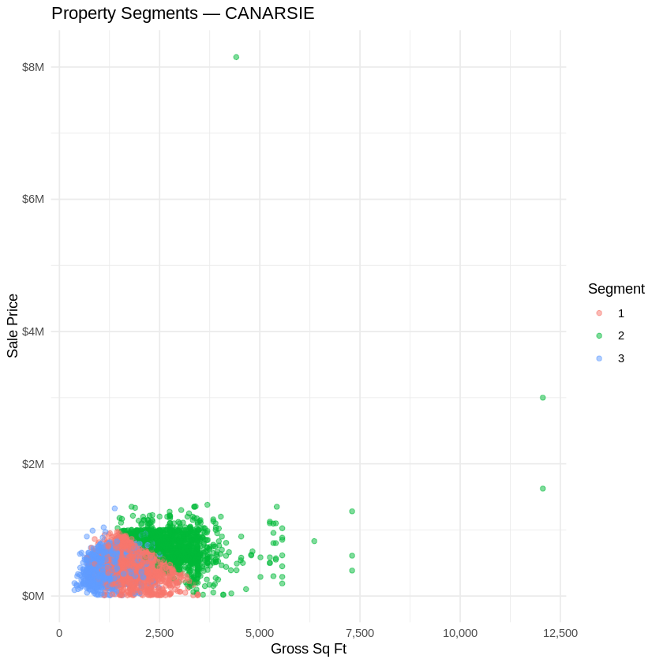
Around ½ of all sales in Canarsie are within one segment
1.Standard: Representing 48.3% of the neighborhood, these are the typical two-family homes (median 1,764 sq ft).
2.Premium: Representing 25.9% of the neighborhood. The larger multi-unit properties (median 2,760 sq ft). They have the highest prices $744k.
3.Entry: Representing 25.8% of the neighborhood. Consisting of single-family starter homes (median 1,201 sq ft), this segment offers the lowest price point ($415k) and is ideal for first-time homebuyers.
Segment | Sales Number | Share/ Distribution | Average Price | Average Sq Ft | Average Units
1. Standard | $2,695 | 48.30% | $478,091 | 1,764 | 2
2. Premium | $1,448 | 25.90% | $744,740 | 2,760 | 2
3.Entry | $1,437 | 25.80% | $415,000 | 1,201 | 1
!
To maximize revenue while minimizing market entry risk a new brokerage should strategically focus on Standard (Segment 1), which represents nearly half 48.3% of the local market share, targeting the largest possible pool of potential listings.
Furthermore, with a median price of $478k, these homes are far more
affordable and liquid than those in the Premium segment ($744k), making
them highly attractive to a broad base of buyers and sellers alike.

Slide 7
Building class is the main price driver, vs Age or #units
Drivers | Estimate ($)
SALE YEAR | $16.0
YEAR BUILT | -$0.6
RESIDENTIAL UNITS | -$14.4
BLDG CLASS: ONE FAMILY ATTACHED | -$0.7
BLDG CLASS: TWO FAMILY BRICK | -$38.8
BLDG CLASS: TWO FAMILY FRAME | -$40.6
BLDG CLASS: MISCELLANEOUS TWO FAMILY | -$61.5
BLDG CLASS: THREE FAMILIES | -$98.7
BLDG CLASS: Other | $17.4
Sale Year (Time): The market is appreciating. Every year, properties gain about +$16.04 per sq ft. If you wait one year to sell your house, the overall market inflation gives you an extra $16.04 per square foot.
Year Built: Newer is not better in Canarsie. For every year newer a building is, its value decreases by -$0.65 per sq ft, indicating a premium on older construction (likely due to stronger brick construction, larger lots, or historic charm).
Number of Units: Density penalizes square-foot value. Each extra residential unit drops the price by -$14.37 per sq ft.
Building Class: Property type matters heavily. For example, "THREE FAMILIES" buildings sell for -$98.68 less per square foot compared to the baseline, while the "Other" category commands a +$17.35 premium.
!
Roughly 95% of our pricing estimates will fall within ±$228/sqft of the actual price – this is extremely high compared to Canarsie's media price of ~$400/sqft (in 2025).
This massive deviation proves that Canarsie is an "opaque" market driven by unmeasured factors like interior renovations and specific block appeal.
A brokerage entering Canarsie will have a massive competitive advantage by using on-the-ground local experts to inspect properties, and accurately identify true mispriced gems.
Notes:
Act 2 — What drives price (45 sec)
A3 regression.
What property characteristics predict sale price in this neighborhood?
This matters for the brokerage because it tells agents where to focus — which listings are worth pursuing, what differentiates high-value properties, and whether price is predictable or noisy.

Slide 8
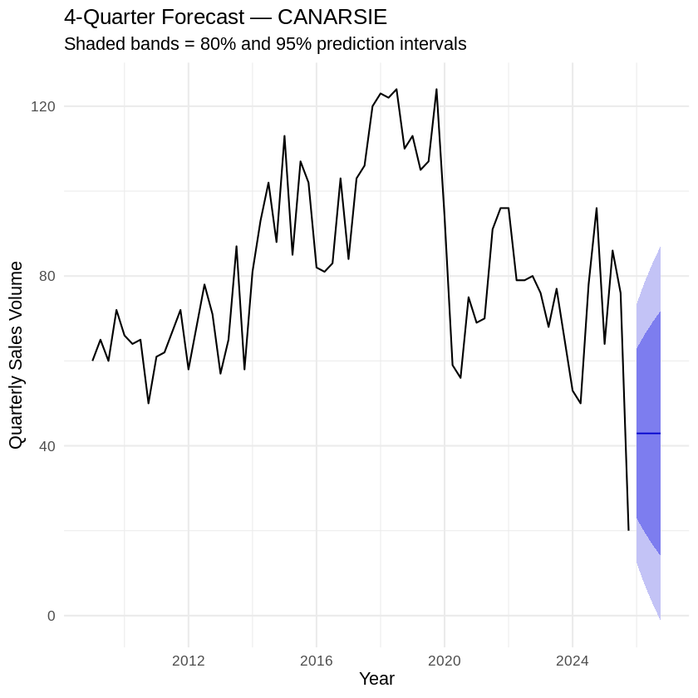
Future volumes are unpredictable, massive uncertainty range
2009–2013: A relatively flat period, hovering between 50 and 75 sales per quarter, reflecting the slow recovery following the 2008 housing crash.
2014–2019: A strong, sustained upward trend, peaking at an all-time high of 124 sales in Q4 2018 and Q4 2019.
2020–2025: Sales volumes back down to historical lows by the end of 2025.
Quarter | Sales | Lower 95% | Upper 95%
Q1 | 43 | 12 | 73
Q2 | 43 | 7 | 79
Q3 | 43 | 3 | 83
Q4 | 43 | -1 | 87
!
A business cannot rely on a stable, guaranteed volume of transactions to generate consistent revenue.
Notes:
Act 3 — Where the market is going (45 sec) A4 forecast. Is the market growing, declining, or flat? What does the confidence interval look like — wide or narrow?

Slide 9
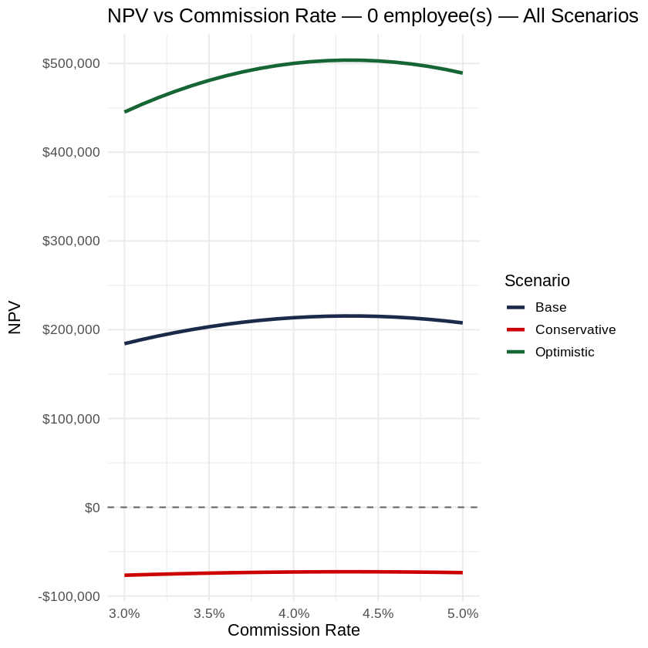
We should open the Canarsie office
The optimal configuration for the base case is a commission rate of 4.3% with 0 employees. 6.6% market penetration rate.
First-Quarter Monitoring and Pivot if 43 residential transactions per quarter turned to 12 deals, it confirms the market is tracking along the negative NPV curve. Hitting this Q1 trigger should result in an immediate operational freeze or market exit before subsequent fixed overhead costs are incurred.
 | Commission | Employees | Penetration | NPV
Base case | 4.3% | 0 | 6.6% | $215,512
Conservative (low CI) | 4.3% | 0 | 6.6% | -$72,649
Optimistic (high CI) | 4.3% | 0 | 6.6% | $503,713
!
The core trade-off is balancing margin (profit per deal) against volume (market share). Moving to a lower commission rate sacrifices too much profit margin per transaction, while pushing to a higher rate triggers a steep drop in market penetration that completely wipes out the pricing premium.
Notes:
Act 4 — The decision (90 sec) A5. Should we open? What's the optimal configuration? What is the NPV under base and conservative forecasts?

Slide 10
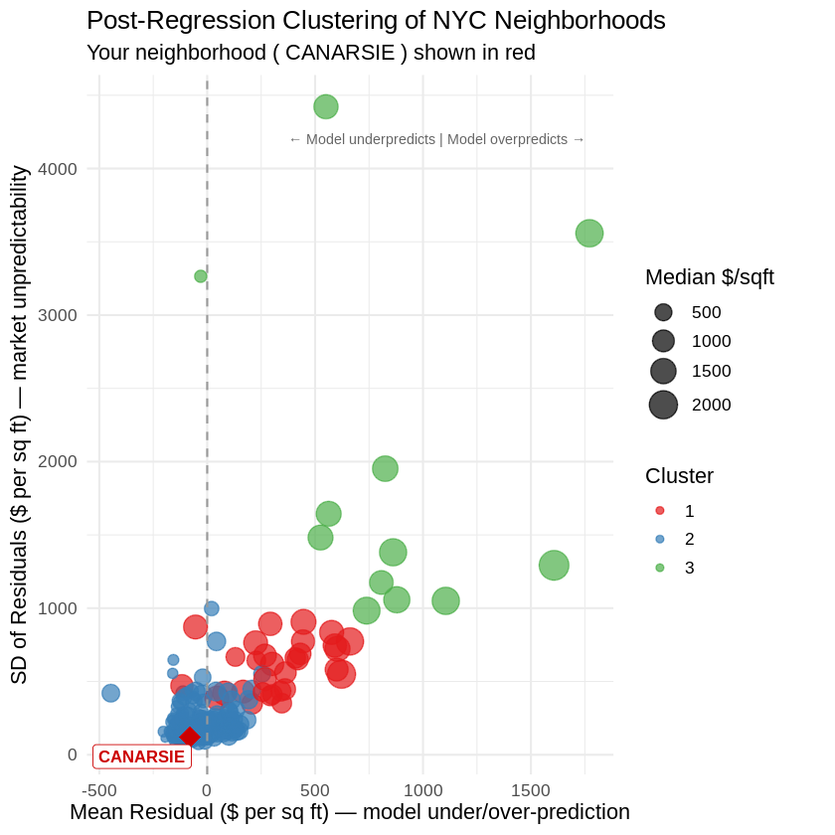
Target: volume-driven business with superior customer service
Compared to the rest of NYC, Canarsie is incredibly stable. (expl. luxury neighborhoods have deviations of $1,000 to $3,000+ per sq ft!)
Canarsie is one of NYC's most stable and transparent markets. A brokerage entering this area faces low risk and a low barrier to entry.
Success here does not require unlocking hidden pricing secrets; it requires building a volume-driven business that wins on superior customer service and operational efficiency.
Notes:
Act 5 — The recommendation (30 sec) One clear sentence: open or don't open, at what commission rate and staffing level, and what's the single biggest risk that would change the answer.

Slide 11
Thank you!
https://colab.research.google.com/drive/1uVIPuNPJ8M9zbvCk8l8nBezipttdWl1G?usp=sharing

