Slide 1
Classifier evaluation
IIT CS481 Spring

Slide 2
Text classification
Pre-processing
  Lower case
  tokenization
  punctuation removal
  stop words removal
  Stemming
  lemmatization
  POS tagging
  Generating word cloud
Feature engineering
  CountVectorizer
  TfidfVectorizer
LogisticRegression classifier
Train test split
Interpretation
Evaluate classifier performance
Parameter tuning

Slide 3

Evaluation
Evaluation matrix:
  Confusion matrix
  Precision
  Recall
  F1
  Accuracy
  ROC AUC
  Precision recall curve
Parameter tuning
Kfold cross validation
Grid search
Notes:
Train a classifier on training data
Apply the classifier on testing data to predict the labels for test data
Truth label VS predicted label
Apply evaluation matrix to measure the quality of predictions

Slide 4
Confusion matrix
 | Actual pos | Actual neg
Predicted pos | tp (correctly predicted as pos) | fp (falsely predicted as pos)
Predicted neg | fn (falsely predicted as neg) | tn (correctly predicted as neg)
FN: a person that actually got COVID but tested negative;
FP: a person that don’t get COVID but tested positive;
Notes:
A confusion matrix summarizes the number of predictions made by a model for each class, and the classes to which those predictions actually belong.
E.g., here is a confusion matrix for a binary classifier, each cell has a specific name and records specific information.
FP and FN are the types of prediction errors made by a model.
COVID as example
%%%
https://machinelearningmastery.com/fbeta-measure-for-machine-learning/

Slide 5
Confusion matrix
 | Actual pos | Actual neg
Predicted pos | tp (correctly predicted as pos) | fp (falsely predicted as pos)
Predicted neg | fn (falsely predicted as neg) | tn (correctly predicted as neg)
 | Actual pos | Actual neg
Predicted pos | tp = 3 | fp = 1
Predicted neg | fn = 2 | tn = 2
Notes:
Think COVID testing as a classification problem and we have a pre-trained classifier.
We apply this classifier to make predictions.
If there are 8 people tested for COVID, 0 as neg, 1 as pos.
Fill the confusion matrix for this result.
2 people get covid but tested neg;
1 people not get covid but tested pos;
How do we evaluate the performance of this classifier?

Slide 6
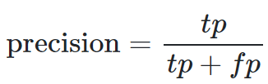
 | Actual pos | Actual neg
Predicted pos | tp (correctly predicted as pos) | fp (falsely predicted as pos)
Predicted neg | fn (falsely predicted as neg) | tn (correctly predicted as neg)
Among all the samples predicted as pos, what’s the fraction of tp samples?
The ability of the classifier to accurately predict pos samples
Minimize false positives increases precision
 | Actual pos | Actual neg
Predicted pos | tp = 3 | fp = 1
Predicted neg | fn = 2 | tn = 2
3/(3+1)
Notes:
Precision calculates the percentage of correct positive predictions.
It is defined as the ratio of correctly predicted positive examples divided by the tp+fp, which is the total number of positive examples that were predicted.
So it basically ask the question….
Precision measures …
minimize false positives increases precision, nothing to do with fn.
The result is a value between 0.0 for no precision and 1.0 for full or perfect precision.
E.g.,

Slide 7

 | Actual pos | Actual neg
Predicted pos | tp (correctly predicted as pos) | fp (falsely predicted as pos)
Predicted neg | fn (falsely predicted as neg) | tn (correctly predicted as neg)
Among all the actual pos samples, what’s the fraction of tp samples?
The ability of the classifier to find all positive samples
minimize false negatives increases recall
 | Actual pos | Actual neg
Predicted pos | tp = 3 | fp = 1
Predicted neg | fn = 2 | tn = 2
3/(3+2)
Notes:
Recall calculates the percentage of correct predictions for the positive class out of all actual positive samples.
0.0 for no recall
1.0 for perfect recall

Slide 8
Precision VS recall
Pos
How accurately could we predict for correct positive samples?
Minimize FP increases precision
How many correct positive samples do we find among all the positive samples?
Minimize FN increases recall
F-measure
Notes:
Precision and recall measure the two types of errors that could be made for the positive class;
- F-Measure provides a way to combine both precision and recall into a single measure that captures both properties
%%%
High precision, low recall (accurately find pos samples, but only limited number of pos samples)
Low precision, high recall (inaccurately find many pos samples)
Want a classifier to accurately find an many pos samples as possible
Balance between precision and recall

Slide 9
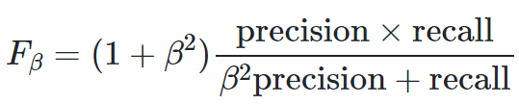
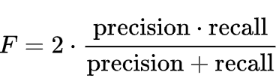
F-beta score: the weighted mean of precision and recall (0~1)
F1: beta = 1
 | Actual pos | Actual neg
Predicted pos | tp = 3 | fp = 1
Predicted neg | fn = 2 | tn = 2
Precision = 3 / (3+1)
Recall = 3/(3+2)
F1 = 2*(3/4*3/5)/(3/4+3/5)
Notes:
General definition of F-beta score is like this: a weighted mean of precision and recall
Coef beta to control the weight of precision and recall
Beta = 1, F1 score
The intuition is that both precision and recall are taking into account
and a good precision and good recall together result in a good F-measure
If all predicted as neg, then TP=0, the precision=0, recall=0, F1 score is 0.
If all predicted as pos, then the fn=0, recall = 1, precision=0.5 in a balanced dataset
E.g.

Slide 10

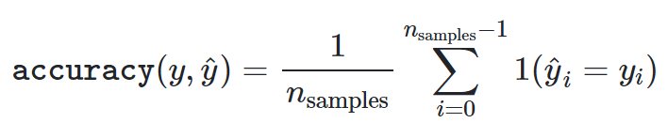
accuracy
 | Actual pos | Actual neg
Predicted pos | tp (correctly predicted as pos) | fp (falsely predicted as pos)
Predicted neg | fn (falsely predicted as neg) | tn (correctly predicted as neg)
The fraction of the correct predictions:
Notes:
Not only care about the positive class, but also the correct prediction of the negative class

Slide 11
Summary
Precision and recall provide two ways to summarize the errors made for the positive class (FP, FN).
F-measure provides a single score that summarizes the precision and recall.
Accuracy summarizes the correct predictions for both positive and negative classes.

Slide 12
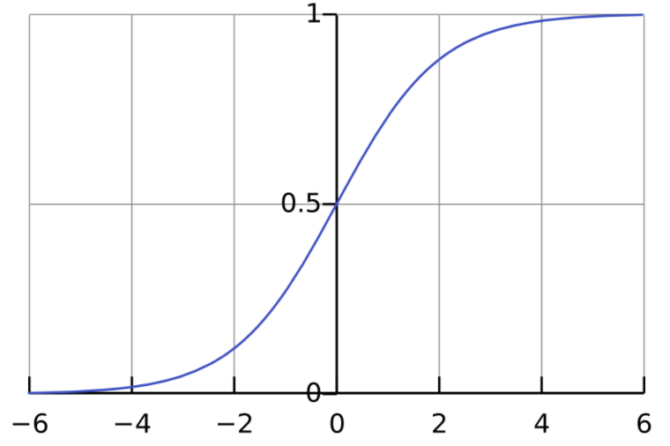
Interpret probability with different thresholds
Probability of a sample belonging to each class:
  Prob>=0.5 → pos
  Prob<0.5 → neg
Interpret probability using other thresholds:
  Prob>=0.4 → pos
  Prob<0.4 → neg
  Want less false neg errors (COVID)
  Prob>=0.6 → pos
  Prob<0.6 → neg
  Want less false pos errors (crime conviction)
ROC curve
Precision-recall curve
Notes:
predict probabilities of an observation belonging to each class
Use a default threshold 0.5 to predict class label
Interpret the probability using different thresholds other than 0.5
allow the model to make a trade-off between
false positives errors: predict an event when there was no event
false negatives errors: predict no event when in fact there was an event
FN errors: COVID test
FP errors: crime conviction, pregnancy test, don’t want to falsely predicted as crime or pregnant might cause severe result.
The two tools that help us interpret classification performance under different thresholds are: ROC Curves, Precision-Recall Curves

Slide 13
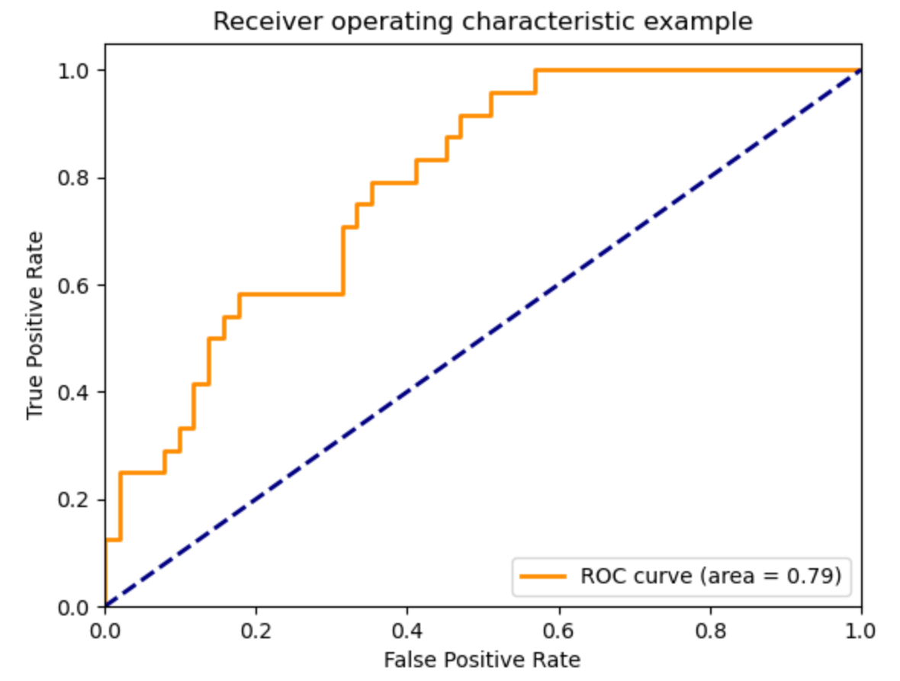
ROC curve
Correctly predicted as pos
Falsely predicted as pos
Notes:
ROC curve is….
As this example shows, it is a plot of the FP rate (x-axis) VS the TP rate (y-axis) for different thresholds (0.0 ~ 1.0)
%%%
Put another way, it plots the false alarm rate versus the hit rate.
The ROC curve is a useful tool for a few reasons:
The curves of different models can be compared directly in general or for different thresholds.
The area under the curve (AUC) can be used as a summary of the model skill.
The shape of the curve contains a lot of information, including what we might care about most for a problem, the expected false positive rate, and the false negative rate.
To make this clear:
Smaller values on the x-axis of the plot indicate lower false positives and higher true negatives.
Larger values on the y-axis of the plot indicate higher true positives and lower false negatives.
If you are confused, remember, when we predict a binary outcome, it is either a correct prediction (true positive) or not (false positive). There is a tension between these options, the same with true negative and false negative

Slide 14
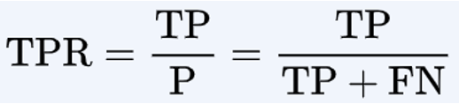

ROC curve
 | Actual pos | Actual neg
Predicted pos | tp | fp
Predicted neg | fn | tn
Notes:
TPR: is calculated as the number of TP divided by the actual pos samples (TP+FN).
Recall: describes how good the model is at predicting the positive class when the actual outcome is positive.
FPR: is calculated as the number of FP divided by the actual neg samples (FP+TN)
how often a positive class is predicted when the actual outcome is negative
%%%
https://towardsdatascience.com/demystifying-roc-curves-df809474529a

Slide 15



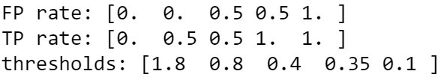
ROC curve
truth | threshold | TPR | FPR
 | >=1.8 | 0/2 | 0/2
1 | >=0.8 | 1/2 | 0/2
0 | >=0.4 | 1/2 | 1/2
1 | >=0.35 | 2/2 | 2/2
0 | >=0.1 | 2/2 | 2/2
Notes:
As we mentioned that the ROC curve allows us to interpret model performance with different probability thresholds
Before plotting the roc curve, we’ll need to calculate the TPR and FPR at different thresholds;
E.g., given a list of true labels and the predicted probabilities
We sort the predict probabilities in descending order, and the truth labels should correspond to the probabilities
We take each probability as a threshold and calculate the TPR and FPR
The results from scikit learn
%%%
https://scikit-learn.org/stable/modules/generated/sklearn.metrics.roc_curve.html

Slide 16
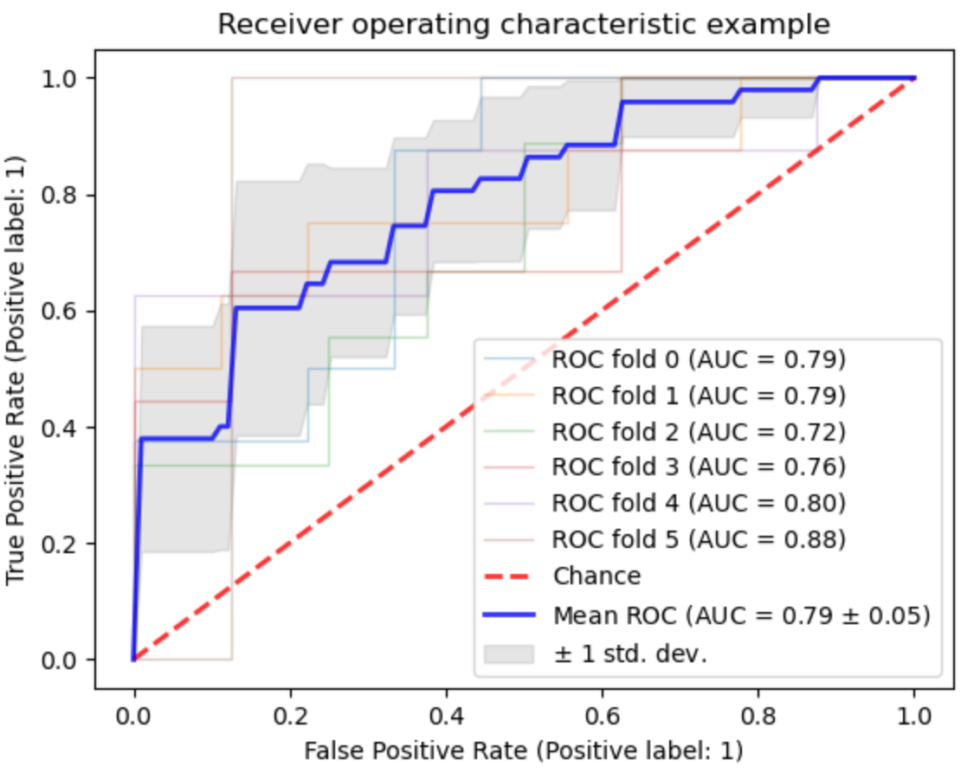
ROC AUC(Area Under the Curve)
an aggregate measure of model performance across all possible classification thresholds
Correctly predicted as pos
Falsely predicted as pos
Notes:
We then predict the ROC curve
Correctly predicted as pos VS falsely predicted as pos
If a model makes random predictions for a balanced test set, 50% to correctly predict a sample as pos, and 50% , denoted by a diagonal here;
If a model performs good, it should have higher TPR than FPR, the shape of the curve tells this information
Choose the most appropriate threshold for determine a class label
The area under the curve (AUC) can be used as a summary of the model skill.
It is an aggregate measure of model performance across all possible classification thresholds
ROC AUC for the diagonal is 0.5
Compare different models based on the curves
- Model performance in general or model performance for different thresholds.
%%%
https://towardsdatascience.com/understanding-auc-roc-curve-68b2303cc9c5
https://machinelearningmastery.com/roc-curves-and-precision-recall-curves-for-classification-in-python/
https://towardsdatascience.com/demystifying-roc-curves-df809474529a

Slide 17
Model Evaluation
 | Actual pos | Actual neg
Predicted pos | tp | fp
Predicted neg | fn | tn
Notes:
By now, we have talked about several different ways to evaluate the classifier performance;
Precision, recall, f1 to evaluate classifier performance for predicting pos samples with a specific threshold
summarizes model performance for a specific probability threshold (e.g. 0.5)
ROC curve, roc auc score to compare model performance with a variety of different thresholds
Precision is defined as …, it describes how good a model is at predicting the pos samples;
Recall is defined as …, it describes the ability of the model correctly identify pos samples;
precision and recall are useful in cases where there is an imbalance in the observations between the two classes, especially when we only have a few positive samples;
The precision and recall we talked about in previous slides are typically calculated based on a specific probability threshold (0.5).
In the case that we want to check the precision and recall for different thresholds, we will need a precsion-recall curve

Slide 18
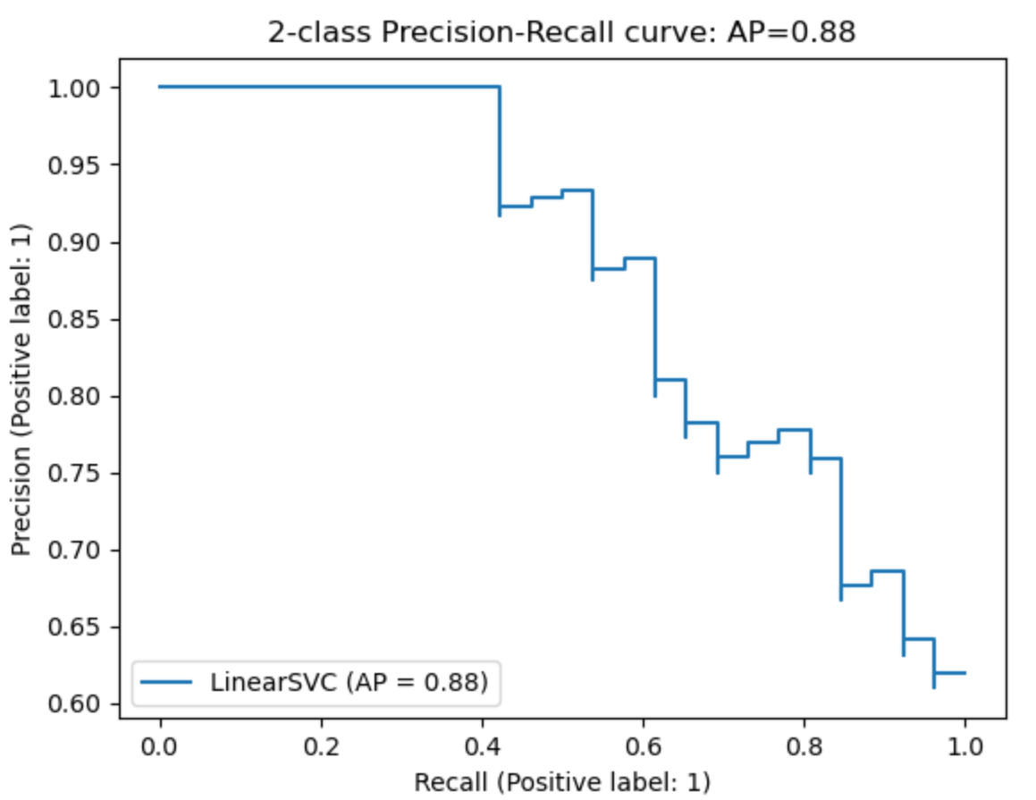
Precision_recall_curve
Perfect model towards (1,1)
Notes:
A precision-recall curve is much like the ROC curve, it shows the precision (y-axis) and recall (x-axis) for different thresholds
A model with perfect performance is depicted as a point at (1,1)
Want to make the curve as close to (1, 1) as possible
you will notice that at no point are we using the True Negatives
This is particularly useful for the situations where we have an imbalanced dataset and the number of negatives is much larger than pos
https://machinelearningmastery.com/roc-curves-and-precision-recall-curves-for-classification-in-python/
https://www.analyticsvidhya.com/blog/2020/09/precision-recall-machine-learning/

Slide 19

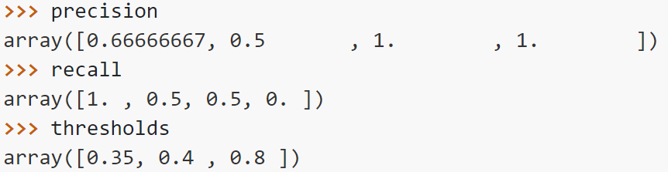
Precision_recall_curve
 |  | Precision | Recall
1 | >=0.8 | 1/1 | 1/2
0 | >=0.4 | 1/2 | 1/2
1 | >=0.35 | 2/3 | 2/2
0 | 0.1 | 2/4 | 2/2
Notes:
The way of calculating precision recall scores for different thresholds is similar to that in calculating roc curve

Slide 20
ROC vs Precision-Recall Curves
Summarizes model performance using different probability thresholds
ROC curves should be used when there are roughly equal numbers of observations for each class
Precision-Recall curves should be used when there is a moderate to large class imbalance (when we are interested in the pos class and there’s only a few pos samples)

Slide 21
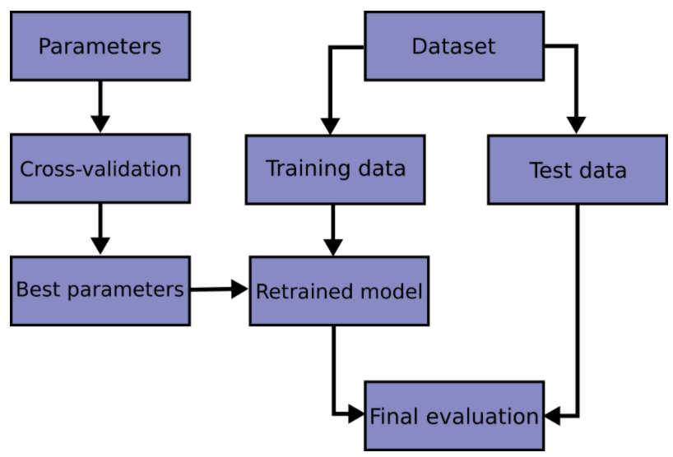
Parameter tuning
Notes:
In the previous classes, we talked about splitting data into training and testing.
If a model get perfect performance on the training data but fail to predict unseen data
Then this model is overfitting
To avoid overfitting, we usually hold part of the data as test data
Then during the training processing, we do parameter tuning to find the best set of parameters
We do this with the grid search technique
After we find the best parameters, we do final evaluation on the test set

Slide 22
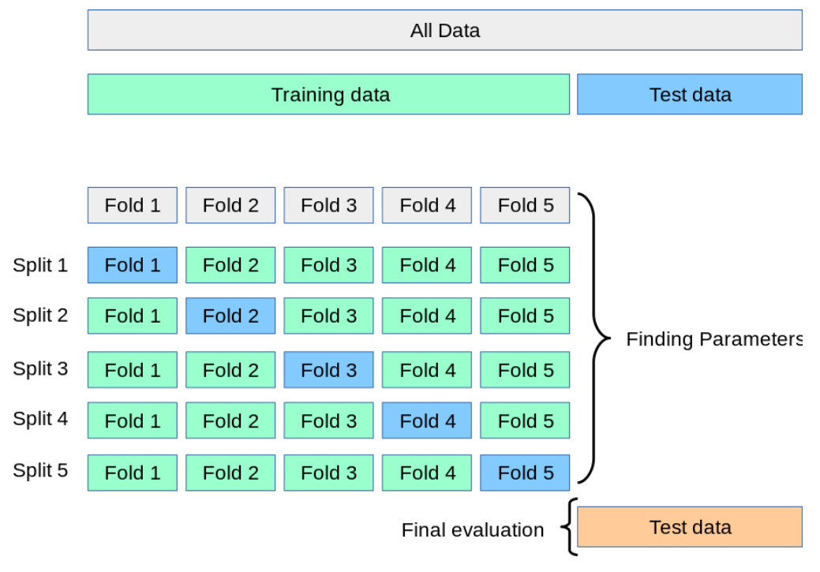
K-fold cross validation
Notes:
When searching for the best parameters, we also need a held-out dataset to evaluate model performance.
So we take another part of the training data as validation set
training proceeds on the training set
and then evaluation is done on the validation set
We use this evaluation to determine if we selected the best model parameters
A basic approach to do this is k-fold CV
We split the training set into k subsets
A model is first trained using k−1 folds as training data;
And then validate on the remaining fold to test the current model performance.
The final performance is reported as the average of the values in the loop.

Slide 25
Roc_auc score
The area under the ROC Curve is also known as AUC.
AUC provides an aggregate measure of performance of a model across all possible classification thresholds
shows the performance of one classification model at all classification thresholds
The aim was to analyze the predictive power of the predictor in ensuring the detection of as many true positives as possible while minimizing false positives
Covid test
A false positive in this case occurs when the person tests positive, but does not actually have the disease. A false negative, on the other hand, occurs when the person tests negative, suggesting they are healthy, when they actually do have the disease
Receiver Operating Characteristic
Y-axis: true positive rate (TPR)
sensitivity, recall, hit rate, or true positive rate (TPR)
X-axis: false positive rate (FPR)
fall-out or false positive rate (FPR)
at various threshold settings
Notes:
The curves of different models can be compared directly in general or for different thresholds.
To make this clear:
Smaller values on the x-axis of the plot indicate lower false positives and higher true negatives.
Larger values on the y-axis of the plot indicate higher true positives and lower false negatives.
If you are confused, remember, when we predict a binary outcome, it is either a correct prediction (true positive) or not (false positive). There is a tension between these options, the same with true negative and false negative
connection between clinical sensitivity and specificity for every possible cut-off for a test or a combination of tests

Slide 26
ROC curves and precision recall curves
interpret the prediction of probabilities for binary classification problems.
predict the probabilities for each class
calibrate the threshold for how to interpret the predicted probabilities
a default might be to use a threshold of 0.5, meaning that a probability in [0.0, 0.49] is a negative outcome (0) and a probability in [0.5, 1.0] is a positive outcome (1)
ROC Curves summarize the trade-off between the true positive rate and false positive rate for a predictive model using different probability thresholds.
Precision-Recall curves summarize the trade-off between the true positive rate and the positive predictive value for a predictive model using different probability thresholds.
ROC curves are appropriate when the observations are balanced between each class, whereas precision-recall curves are appropriate for imbalanced datasets
COVID-19 as an example for true pos rate and false pos rate
Notes:
probabilities may be interpreted using different thresholds that allow the operator of the model to trade-off concerns in the errors made by the model, such as the number of false positives compared to the number of false negatives. This is required when using models where the cost of one error outweighs the cost of other types of errors
help in the interpretation of probabilistic forecast for binary (two-class) classification predictive modeling problems are ROC Curves and Precision-Recall curves.

Slide 27
False Positive. Predict an event when there was no event.
False Negative. Predict no event when in fact there was an event.
By predicting probabilities and calibrating a threshold, a balance of these two concerns can be chosen by the operator of the model
in a smog prediction system, we may be far more concerned with having low false negatives than low false positives. A false negative would mean not warning about a smog day when in fact it is a high smog day, leading to health issues in the public that are unable to take precautions. A false positive means the public would take precautionary measures when they didn’t need to

Slide 28
Classification_report
builds a text report showing the main classification metrics

Slide 29
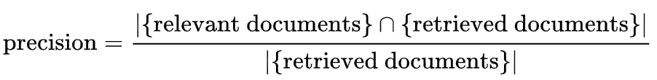
is the ability of the classifier not to label as positive a sample that is negative
precision is the fraction of retrieved documents that are relevant to the query
the fraction of relevant instances among the retrieved instances, while recall (also known as sensitivity) is the fraction of relevant instances that were retrieved. Both precision and recall are therefore based on relevance.

