Slide 1
ATMOSPHERIC MANAGEMENT SYSTEM
SOFTWARE ENGINEERING

Slide 2
MADE BY:-
Lakshya Bhardwaj IIT2020097
Tarun Harishchandra Pal IIT2020098
Kunal Prajapati IIT2020099
Mohit Kumar Mina IIT2020100

Slide 3
REQUIREMENT
Intellij IDEA need to be installed in the system
Java need to be installed in the system
Good Knowledge about the java
RAM – 4gb Ssd or Hdd- more than 128gb Processor-intel i5

Slide 4
PURPOSE
The system should be able to monitor the level of hazardous gasses present in the environment (via means of random number generation).
In an alarming situation, the system must be able to generate an alarm (also add an auto-generated message and mail system).

Slide 5
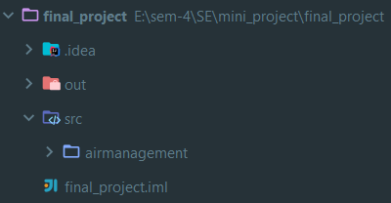
HOW TO USE THE PROGRAM
Step-01: Un-zip the folder.
Step-02: Open the mini_project.
Step-03: Open the final_project in the Intellij IDEA.
Step-04: Click the “src” folder and open it.

Slide 6
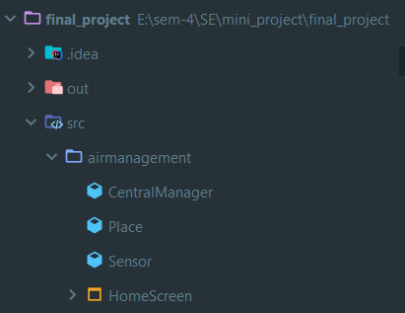
Step-05: Now Click “airmanagement” folder.

Slide 7
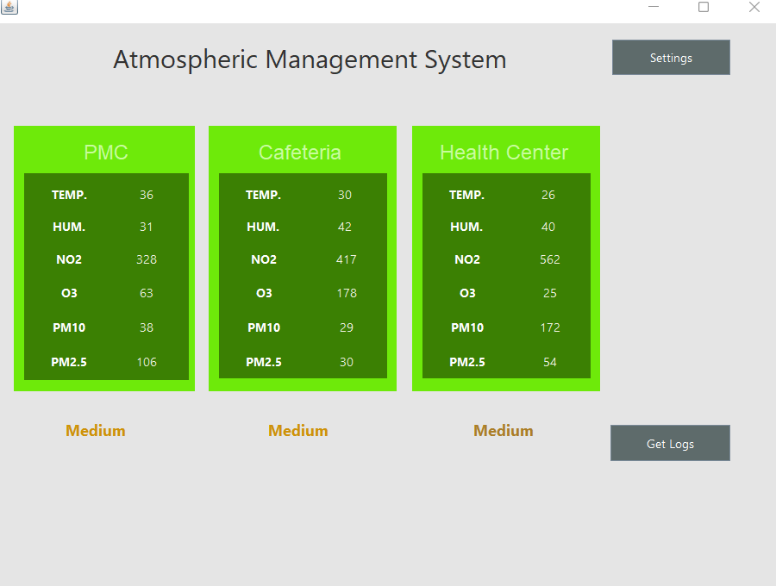
Step-06: Now click the “HomeScreen” and then click “HomeScreen.java” file.
Step-07: Run the “HomeScreen.java” file. This will start the program.

Slide 8
DEMO VIDEO
https://drive.google.com/file/d/1u-Q2HCi4kW8TGK44TKoeHv572I7E1wG2/view?usp=sharing

Slide 9
THANK YOU

